Slide 1
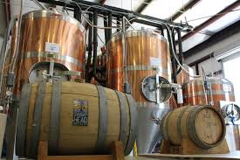
Anheuser-BusCh Market analysis
Holmes and Schwan

Slide 2

Brewer and beer style forecast
Our mission is to analyze Anheuser-Busch’s competition
OPTIMAL opportunities in the craft beer market

Slide 3
Agenda
What and how did we produce this market analysis?
What is your competition?
What kind of beer are they producing?
What issue did we find in your data?
What style and where are your competitors producing beers?
What states does the ABV and IBU matter?
What ABV metrics are available?
What is the relationship between the ABV and IBU values?
What conclusion have we come to?
What can be done in future market analysis with the right data?

Slide 4

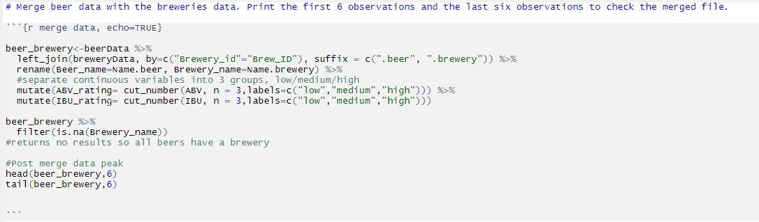
Market statistics tools
R Language used by the majority of data scientist
Notes:
Notes notes

Slide 5
States With the Most Breweries
State | Number_of_breweries
CO | 47
CA | 39
MI | 32
OR | 29
TX | 28

Slide 6
States With the Least Breweries
State | Number_of_breweries
NV | 2
DC | 1
ND | 1
SD | 1
WV | 1

Slide 7
First Breweries Combined Beer
Beer_name | Beer_ID | ABV | IBU | Brewery_id | Style | Ounces | Brewery_name | City | State | ABV_rating | IBU_rating
Pub Beer | 1436 | 0.050 | NA | 409 | American Pale Lager | 12 | 10 Barrel Brewing Company | Bend | OR | low | NA
Devil's Cup | 2265 | 0.066 | NA | 178 | American Pale Ale (APA) | 12 | 18th Street Brewery | Gary | IN | high | NA
Rise of the Phoenix | 2264 | 0.071 | NA | 178 | American IPA | 12 | 18th Street Brewery | Gary | IN | high | NA
Sinister | 2263 | 0.090 | NA | 178 | American Double / Imperial IPA | 12 | 18th Street Brewery | Gary | IN | high | NA
Sex and Candy | 2262 | 0.075 | NA | 178 | American IPA | 12 | 18th Street Brewery | Gary | IN | high | NA
Black Exodus | 2261 | 0.077 | NA | 178 | Oatmeal Stout | 12 | 18th Street Brewery | Gary | IN | high | NA

Slide 8
Last Breweries Combined Beer
Beer_name | Beer_ID | ABV | IBU | Brewery_id | Style | Ounces | Brewery_name | City | State | ABV_rating | IBU_rating
Rocky Mountain Oyster Stout | 1035 | 0.075 | NA | 425 | American Stout | 12 | Wynkoop Brewing Company | Denver | CO | high | NA
Belgorado | 928 | 0.067 | 45 | 425 | Belgian IPA | 12 | Wynkoop Brewing Company | Denver | CO | high | medium
Rail Yard Ale | 807 | 0.052 | NA | 425 | American Amber / Red Ale | 12 | Wynkoop Brewing Company | Denver | CO | low | NA
B3K Black Lager | 620 | 0.055 | NA | 425 | Schwarzbier | 12 | Wynkoop Brewing Company | Denver | CO | medium | NA
Silverback Pale Ale | 145 | 0.055 | 40 | 425 | American Pale Ale (APA) | 12 | Wynkoop Brewing Company | Denver | CO | medium | medium
Rail Yard Ale (2009) | 84 | 0.052 | NA | 425 | American Amber / Red Ale | 12 | Wynkoop Brewing Company | Denver | CO | low | NA

Slide 9
What Data Was Missing?
ABV > 2.57% IBU > 41.7% Style > 0.21%

Slide 10
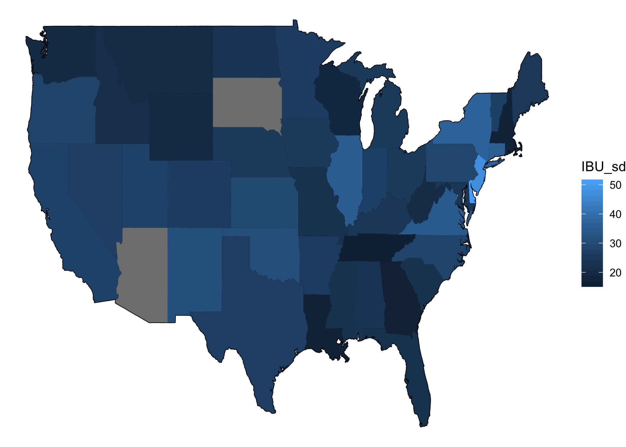
States IBU Standard Deviation

Slide 11
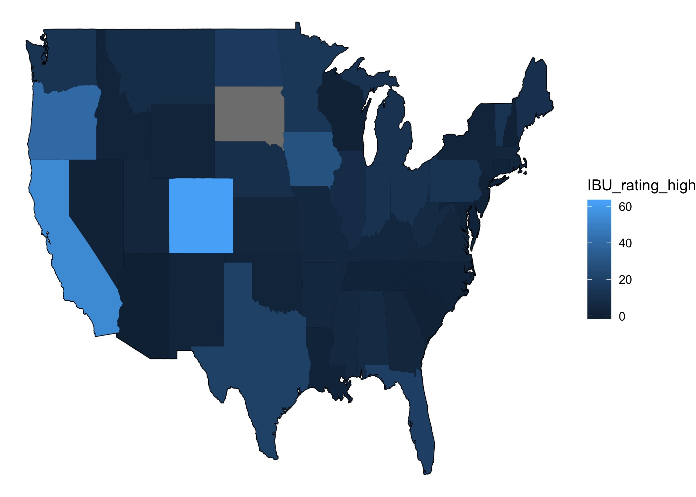
States IBU High

Slide 12
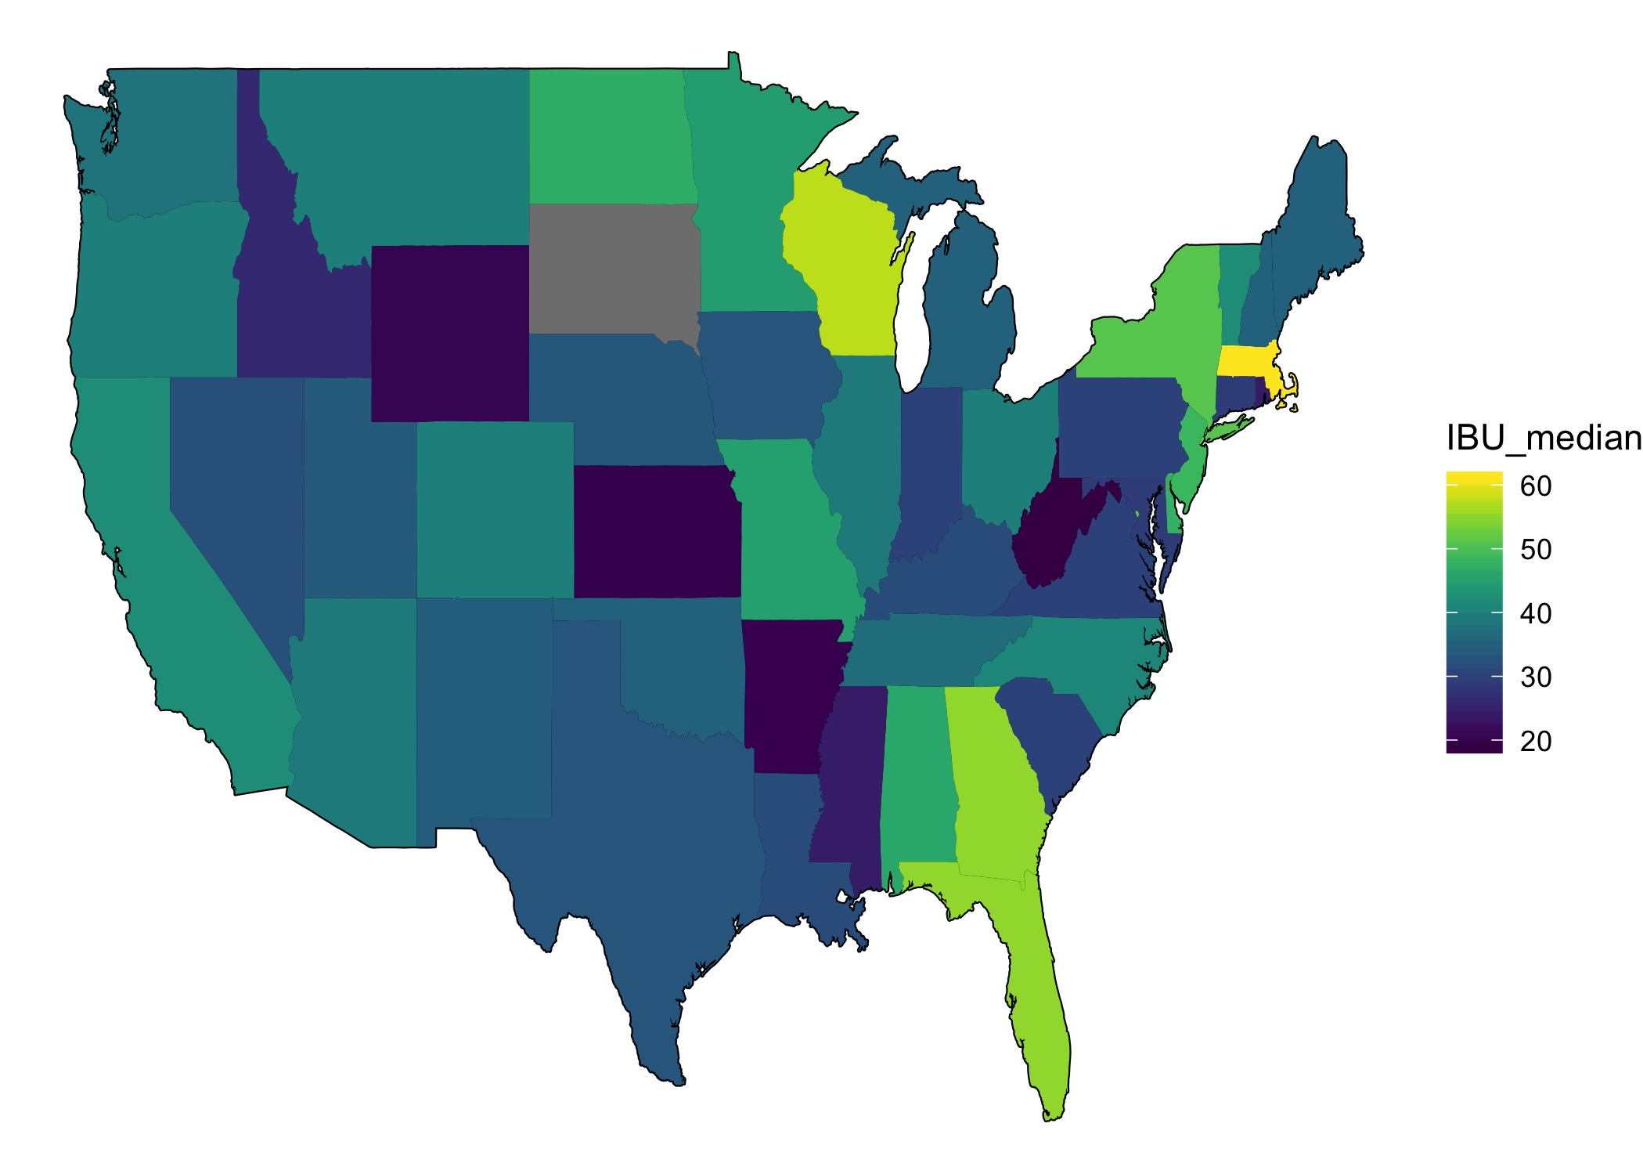
States IBU Ratings

Slide 13
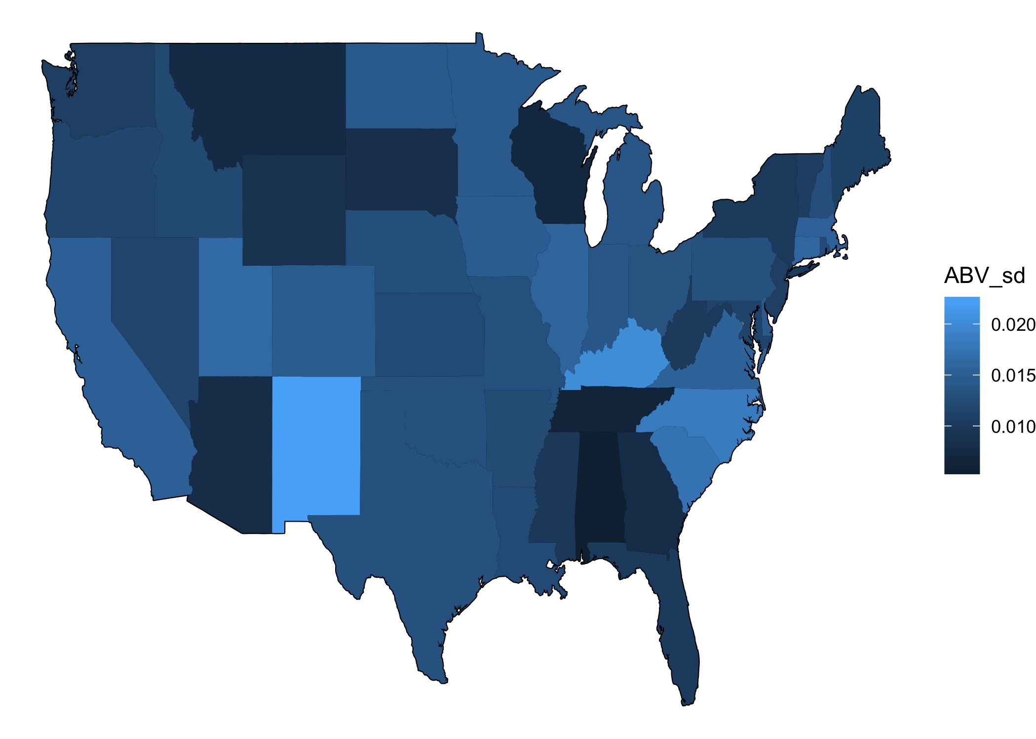
States ABV Standard Deviation

Slide 14
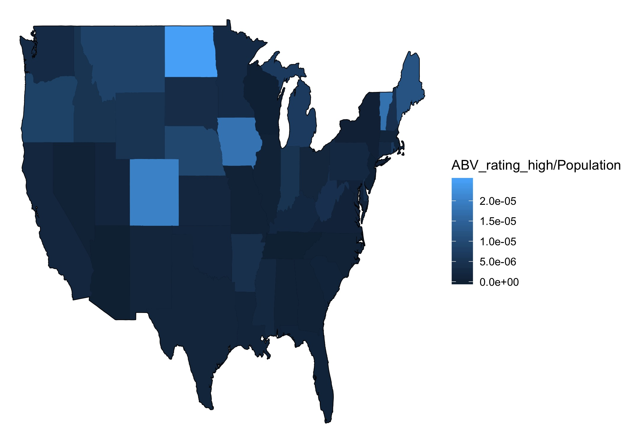
States ABV High

Slide 15
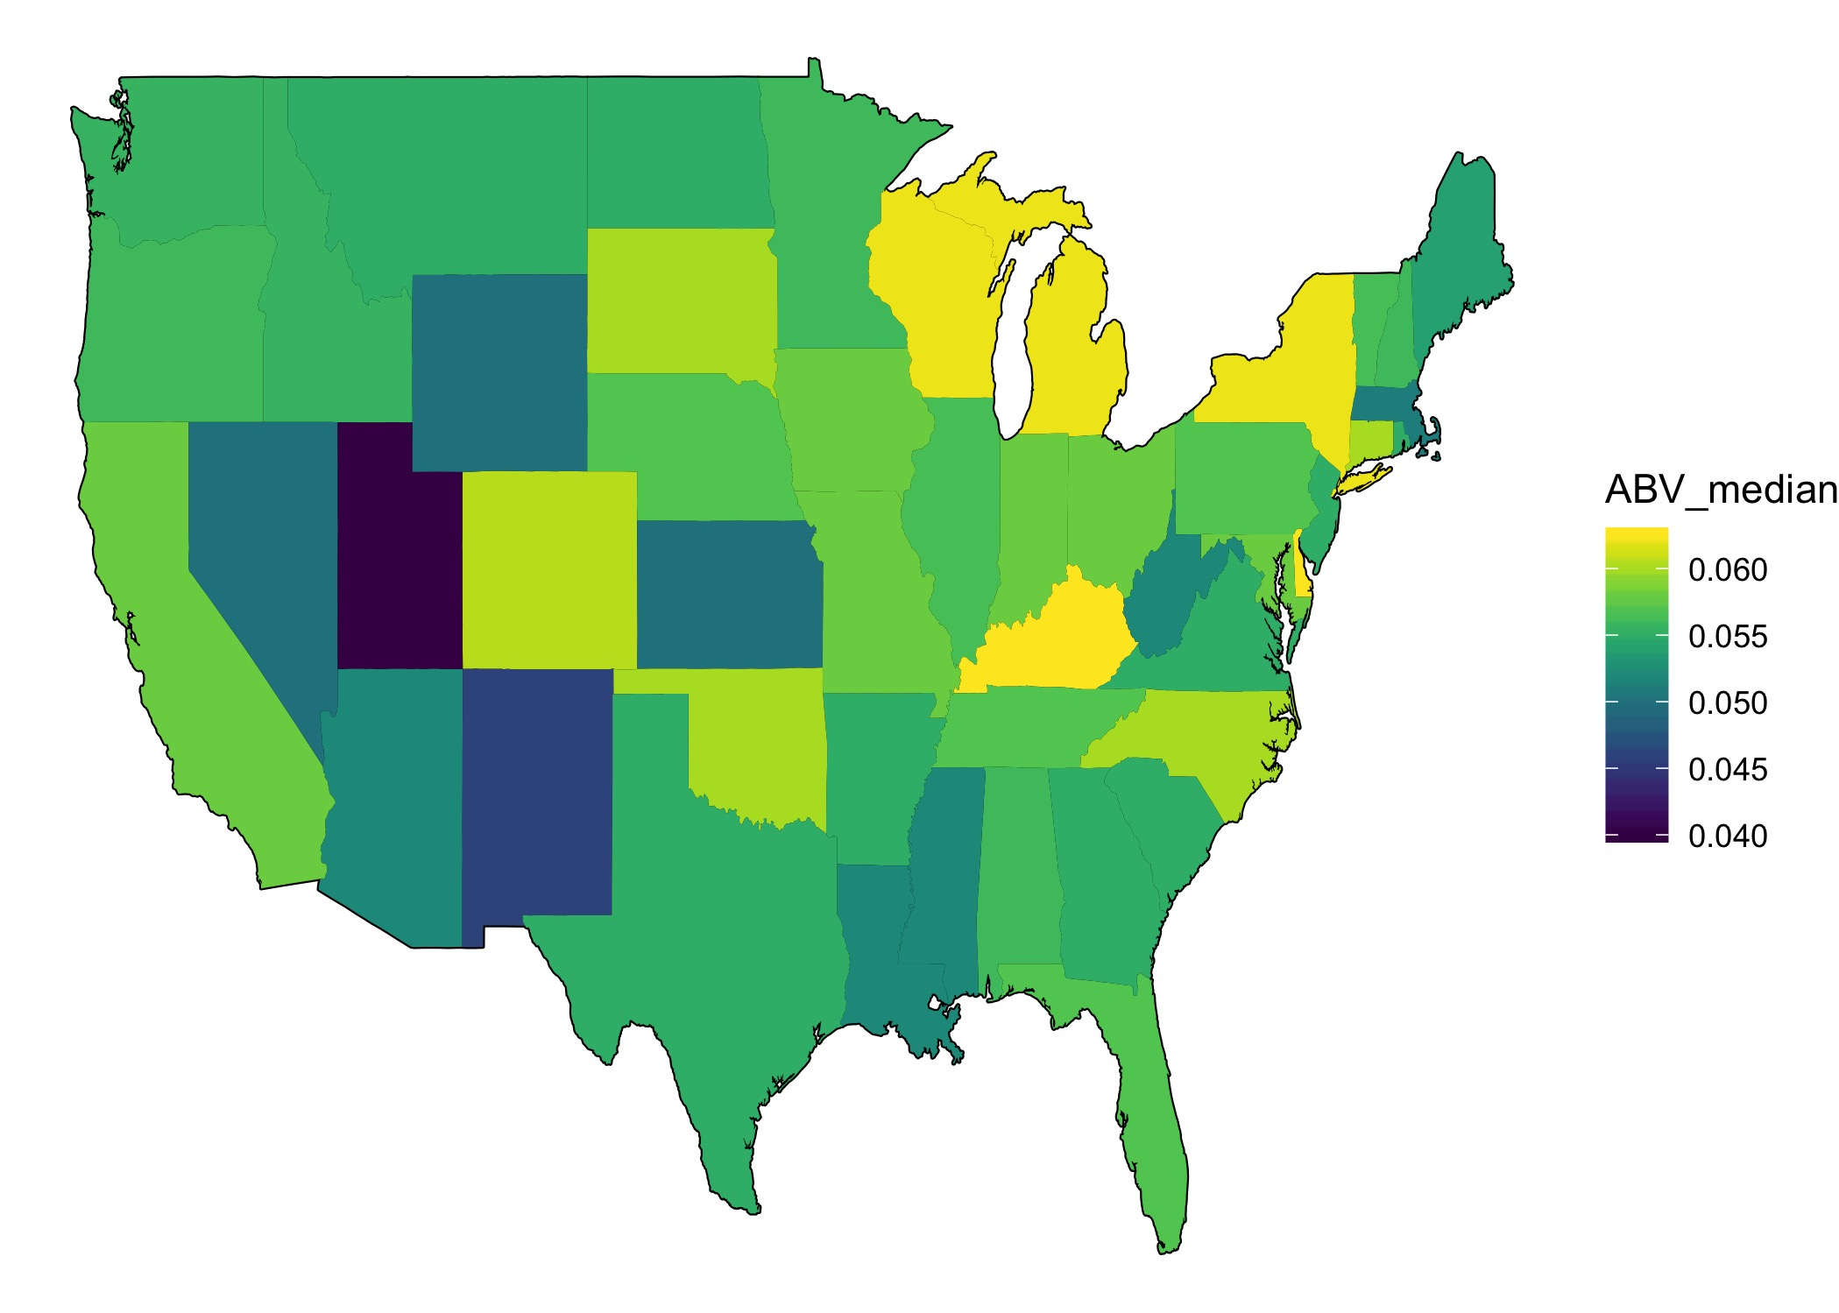
States ABV Ratings

Slide 16
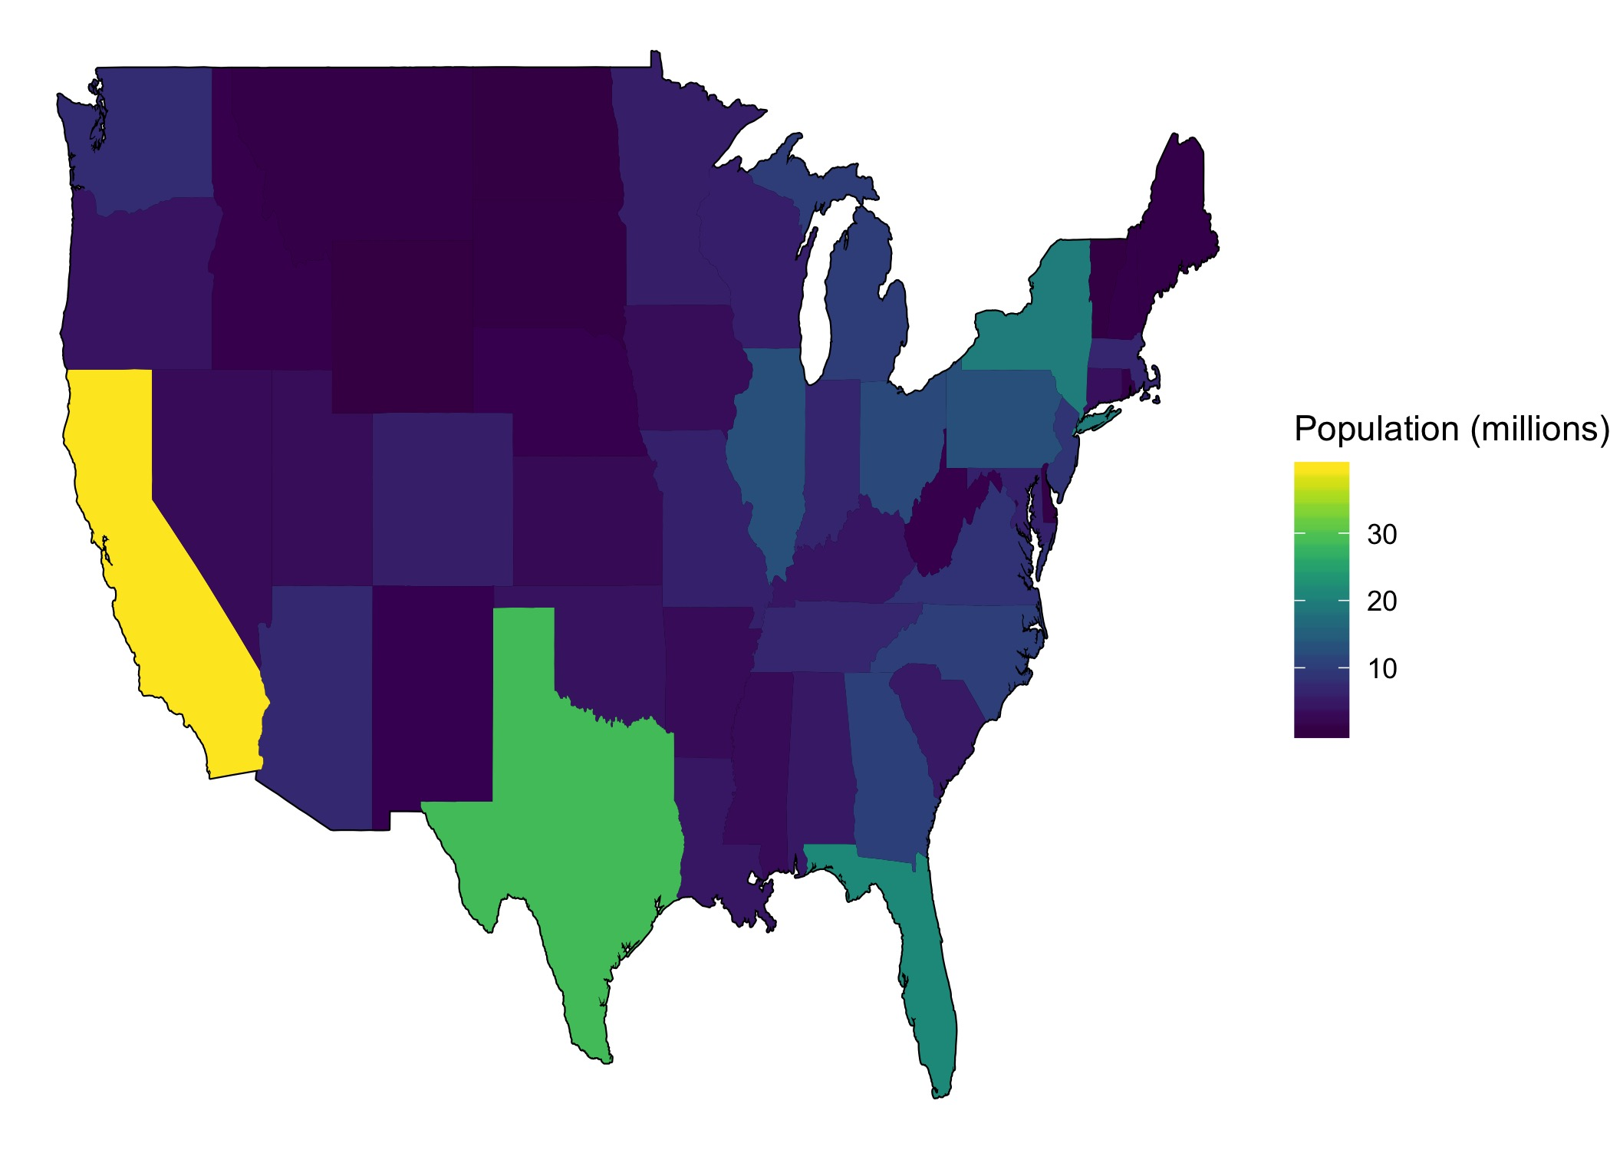
States Brewers Ratings

Slide 17
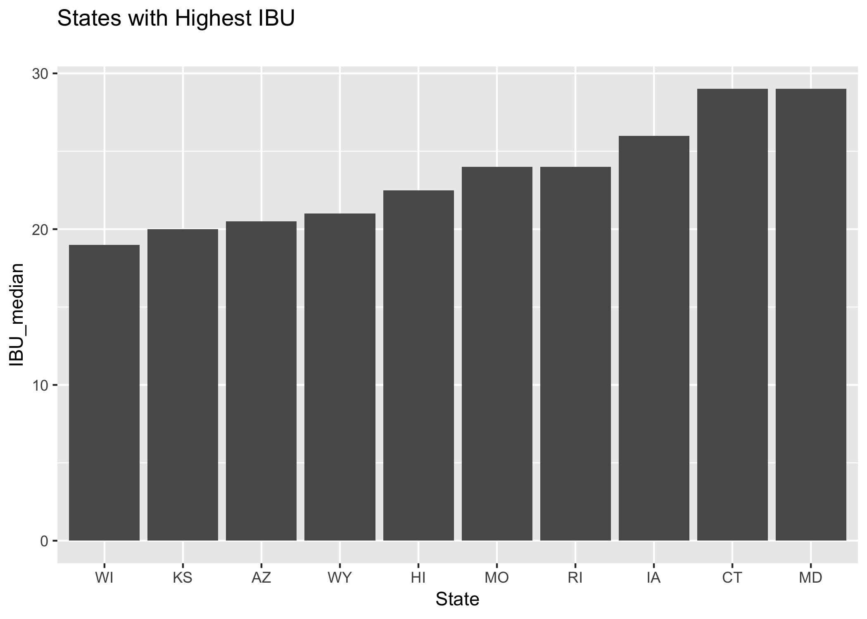
States with High Median ABV and IBU

Slide 18
Highest ABV & IBU by State
State with the most ABV beers is CO
State with the most IBU beers is CO

Slide 19
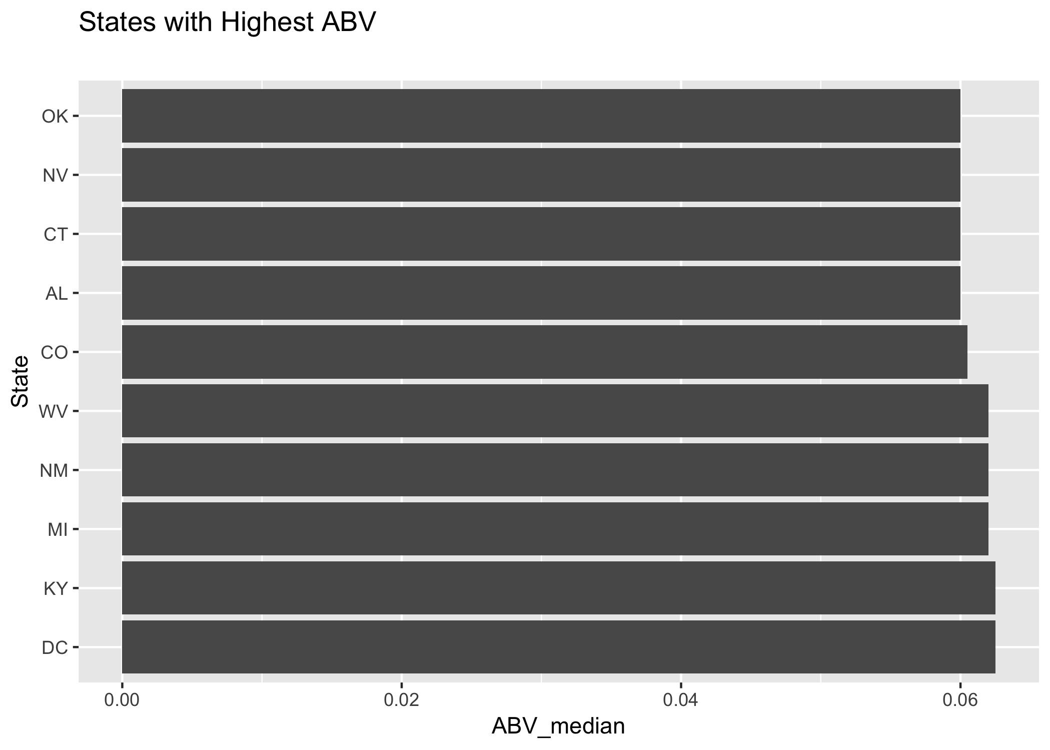
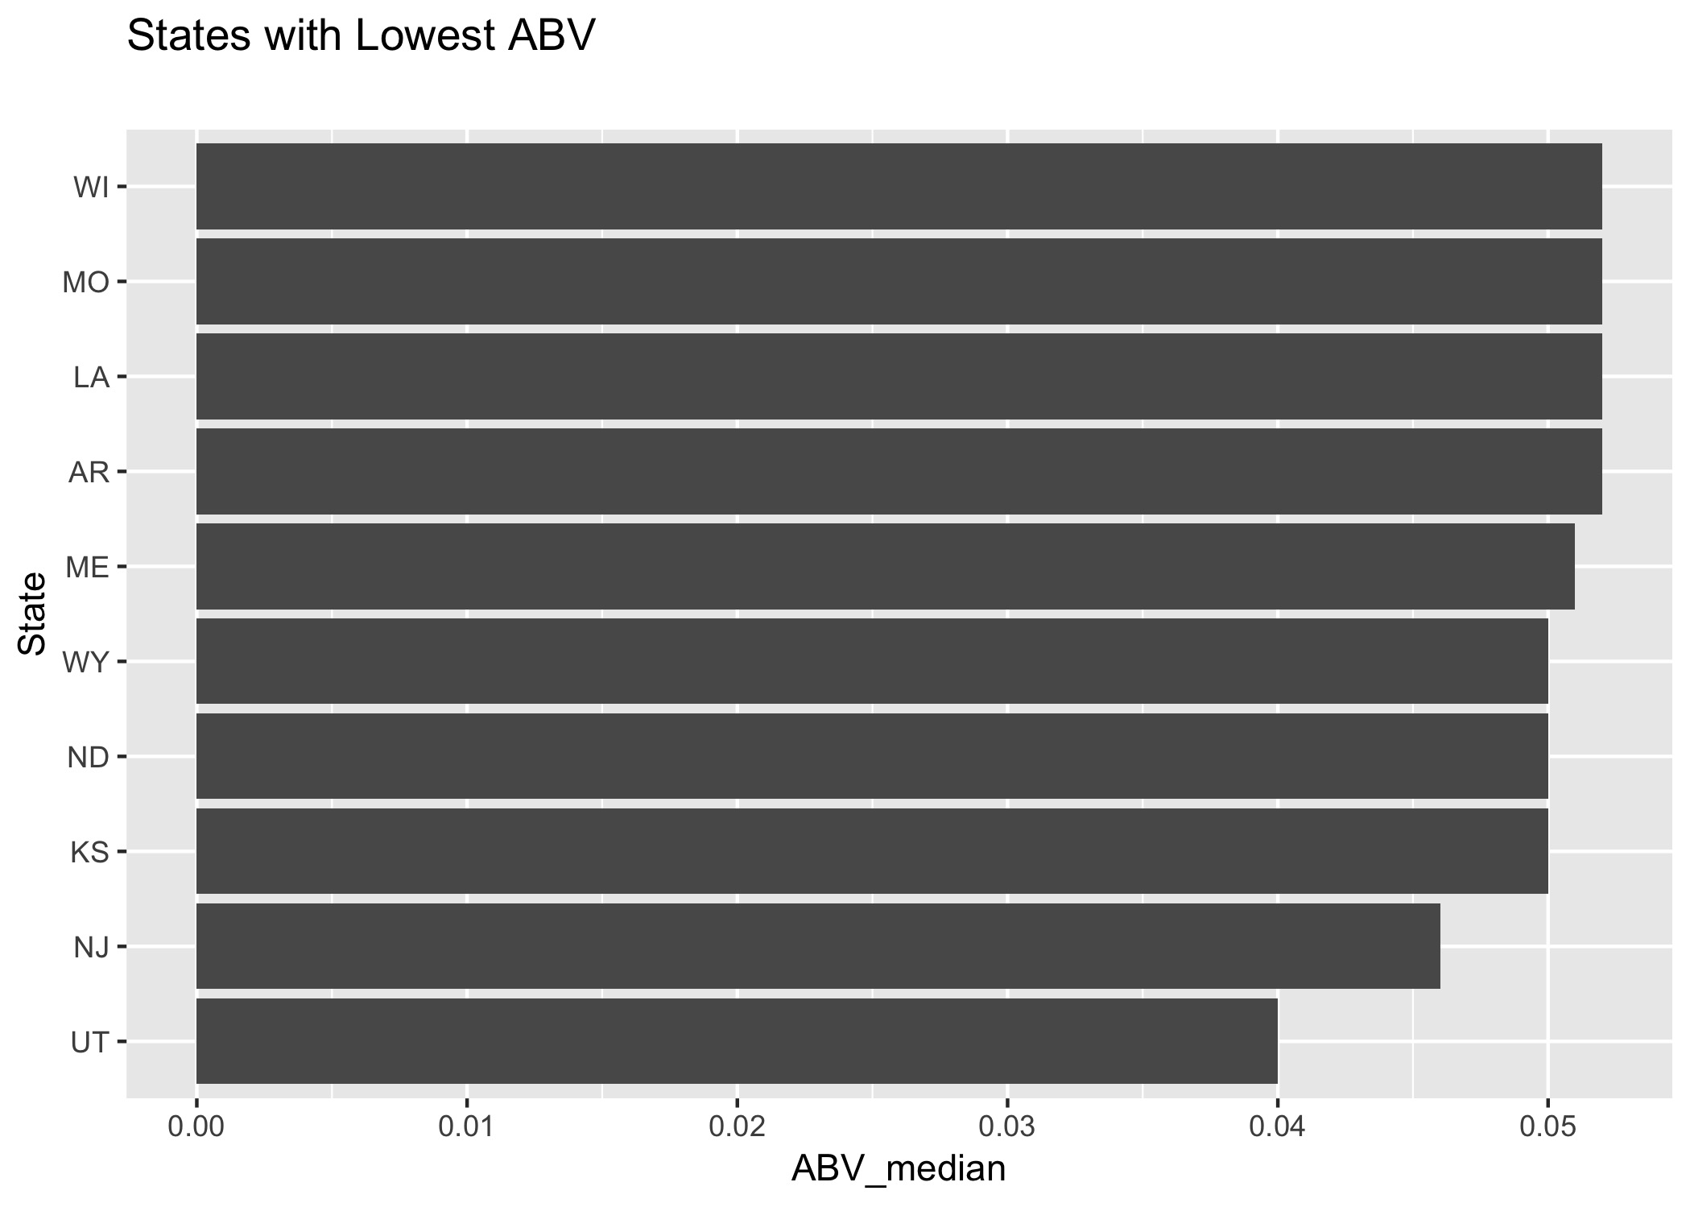
Summary ABV Top and Bottom by States

Slide 20
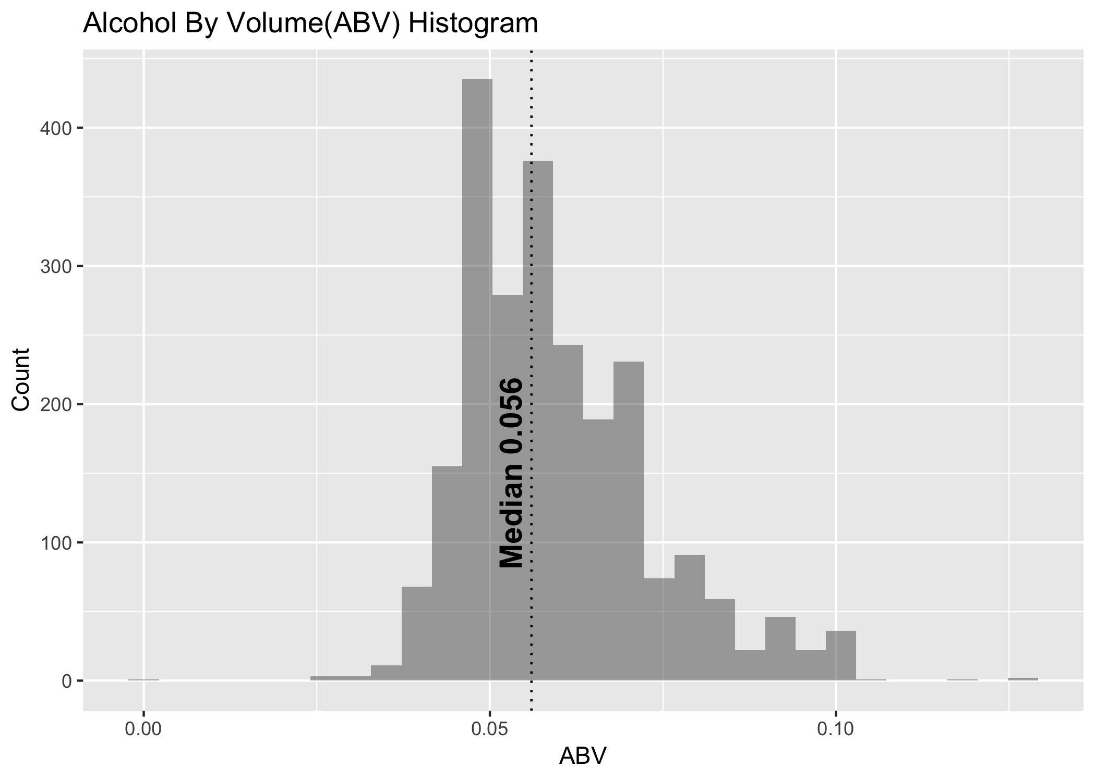
Alcohol by Volume

Slide 21
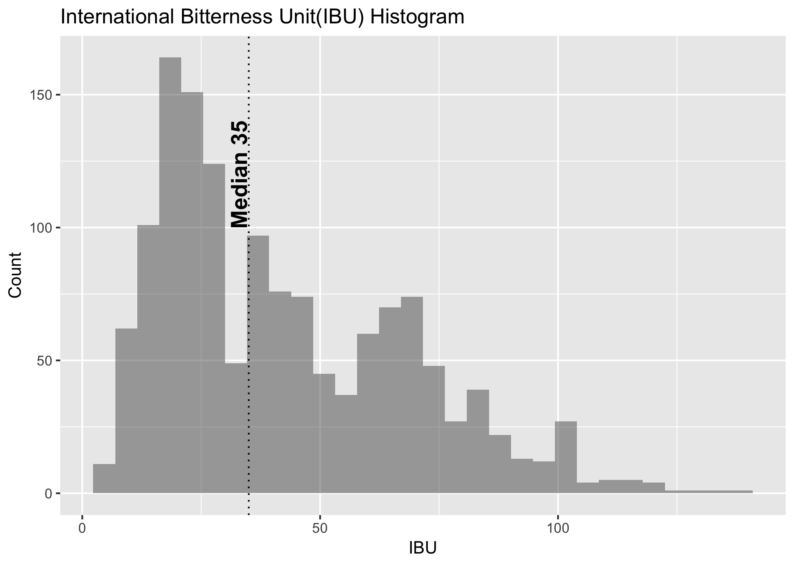
Bitterness by Volume

Slide 22
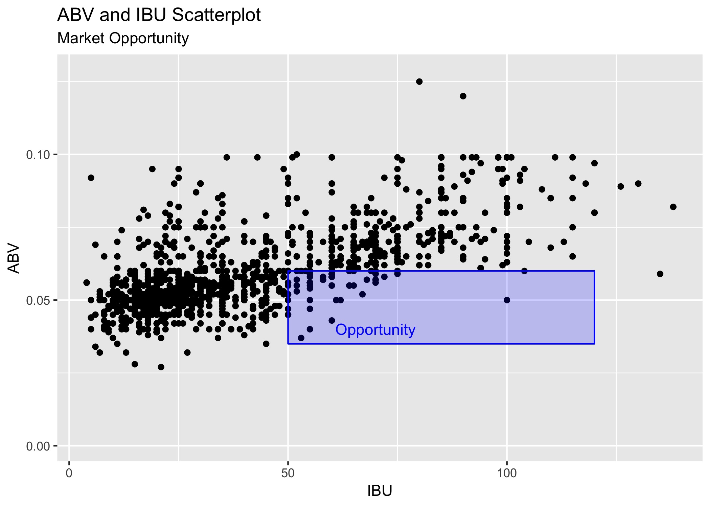
Relationship Between ABV and IBU

Slide 23
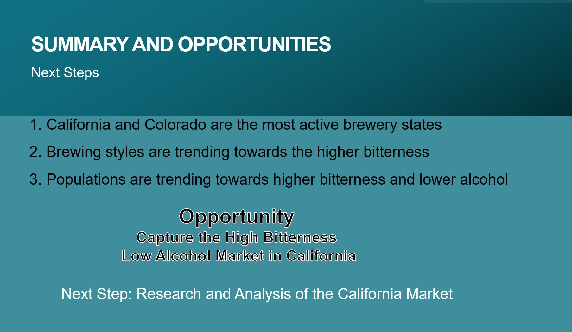
Summary and Opportunities

Slide 24
