Slide 1
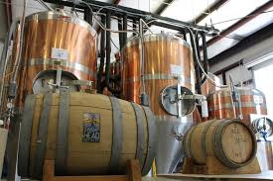
Anheuser-BusCh Market analysis
Blake and Schwan

Slide 2

Brewer and beer style forecast
Our mission is to analyze Anheuser-Busch’s competition
OPTIMAL opportunities in the craft beer market

Slide 3
Agenda
What and how did we produce this market analysis?
What is your competition?
What kind of beer are they producing?
What issue did we find in your data?
What style and where are your competitors producing beers?
What states does the ABV and IBU matter?
What ABV metrics are available?
What is the relationship between the ABV and IBU values?
What conclusion have we come to?
What can be done in future market analysis with the right data?

Slide 4

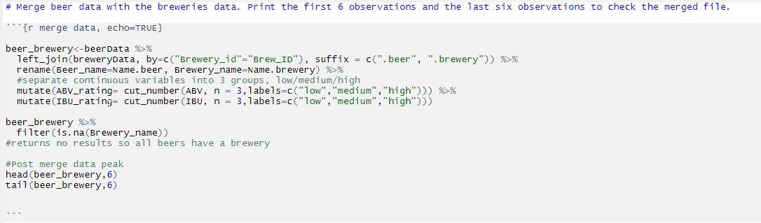
Market statistics tools
R Language used by the majority of data scientist
Notes:
Notes notes

Slide 5
Summary and opportunities
Next Steps
California and Colorado are the most active brewery states
Brewing styles are trending towards the higher bitterness
Populations are trending towards higher bitterness and lower alcohol
Opportunity
Capture the High Bitterness
Low Alcohol Market in California
Next Step: Research and Analysis of the California Market

Slide 6
Research project repository Blake holmes & Mel schwan
https://github.com/bjholmes23/msds6306-case-study-1.git

