Slide 1

Group 3: Boston Crime Data 2015-2018
Capt Brandon Hufstetler
1st Lt Garrett Alarcon
2d Lt Jinan Andrews
2d Lt Anson Cheng
2d Lt Nick Forrest
2d Lt Nestor Hernandez

Slide 2
Overview
Objectives
Data Overview
Data Prep
Exploratory Data Analysis
C 5.0 Decision Tree
Keras Neural Network
Summary

Slide 3
Objectives
This report seeks to answer the following research questions:
Where do crimes most commonly occur in the city of Boston?
What type of crimes most commonly occur in each of the 12 districts of Boston?
Is there a pattern the rate of crime that occurs throughout the day?
What is the best way to allocate Boston Police Department manpower to utilize officers more efficiently and effectively?

Slide 4
Data Overview
Boston Crime Database obtained from:
https://www.kaggle.com/ankkur13/boston-crime-data
Used Predictor Variables:
DISTRICT Factor
MONTH Factor
DAY_OF_WEEK Factor
HOUR Factor
LATITUDE Numeric
LONGITUDE Numeric
Response Variable:
OFFENSE_CODE Factor
*Unused variables were redundant or unnecessary for this analysis

Slide 5
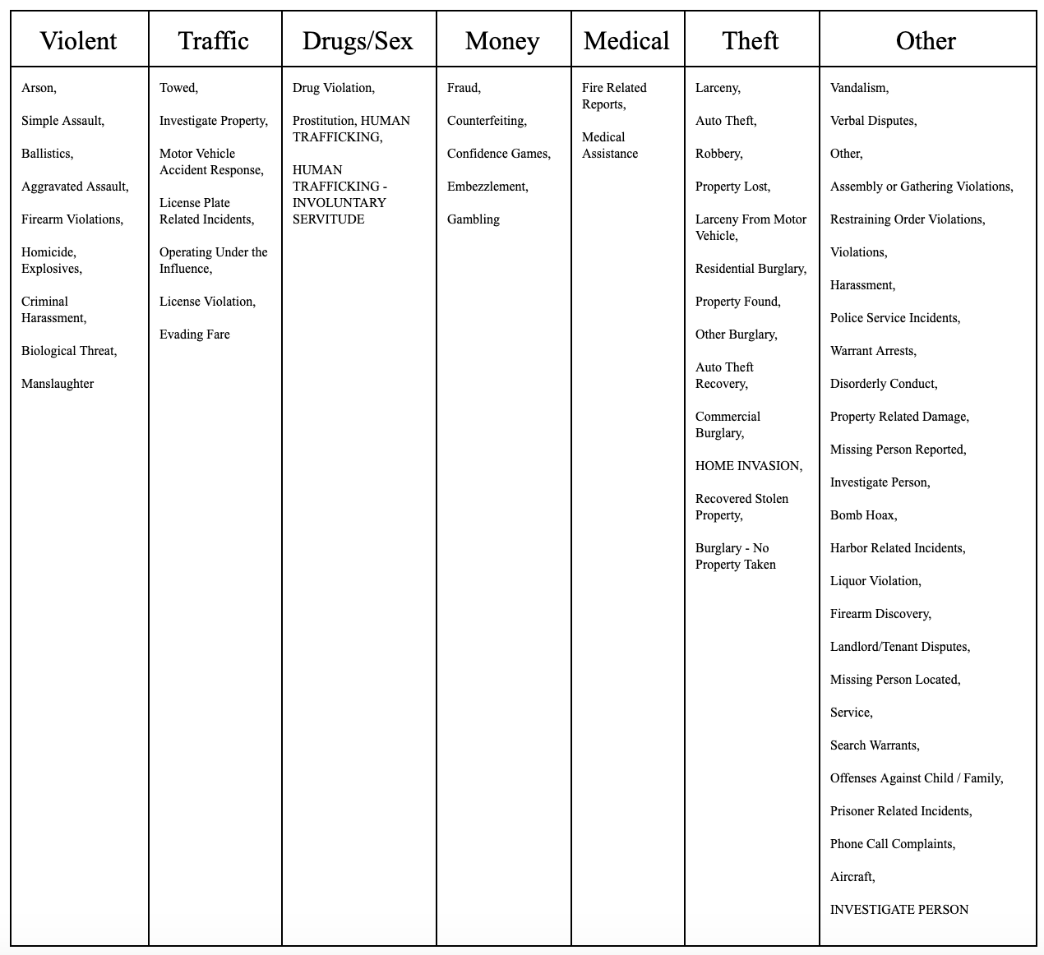
Data Prep
Offense Codes were sorted into seven categories:

Slide 6

Data Prep
DAY_OF_WEEK ordered from Monday to Sunday
This step was not required for MONTH or HOUR because those variables are input as numeric factors.

Slide 7
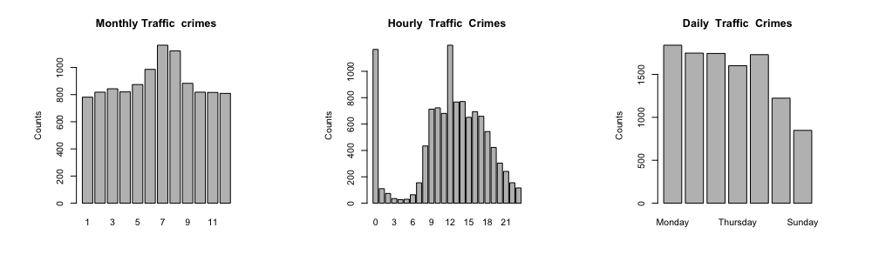
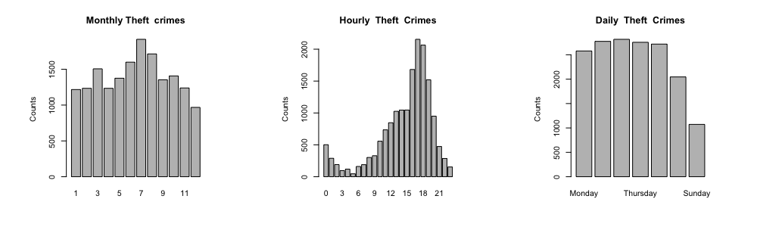
Exploratory Data Analysis
Strong Hourly Trends – Traffic, Theft

Slide 8
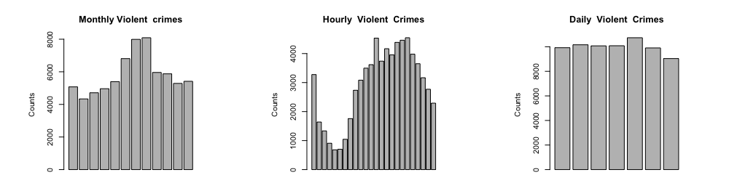
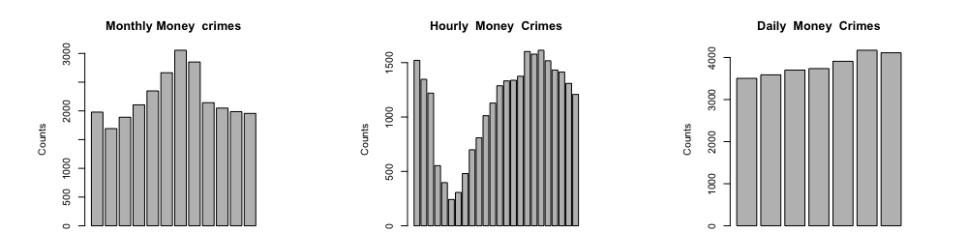
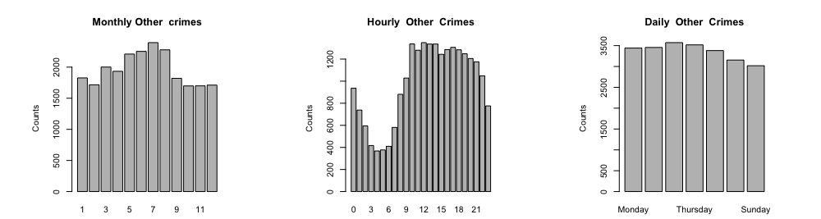
Exploratory Data Analysis
Moderate Hourly Trends – Violent, Money, Other

Slide 9
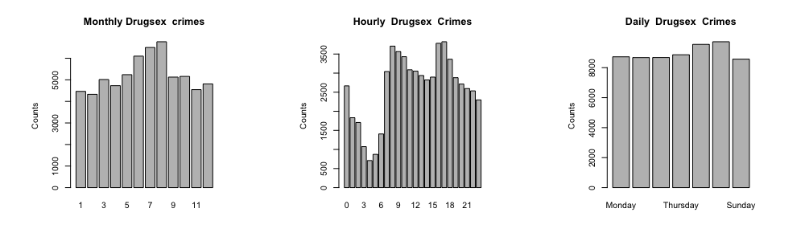
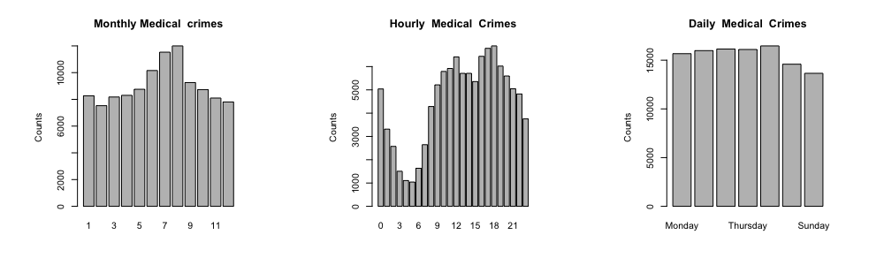
Exploratory Data Analysis
Bi-Modal Hourly Trends – Drugs/Sex, Medical

Slide 10
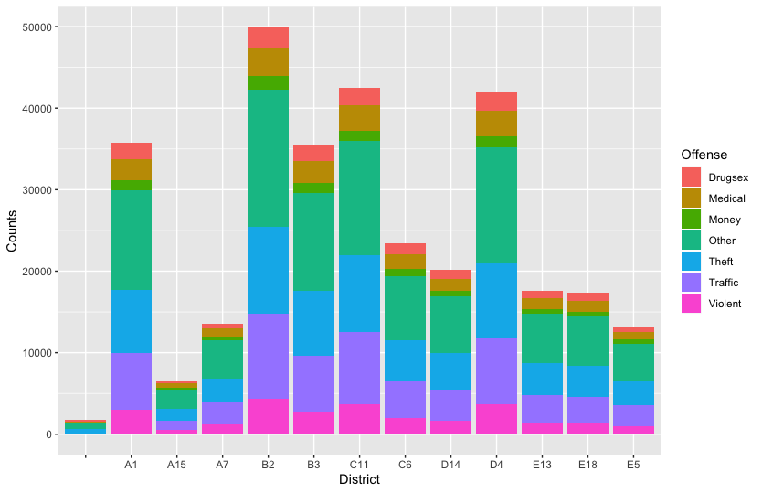
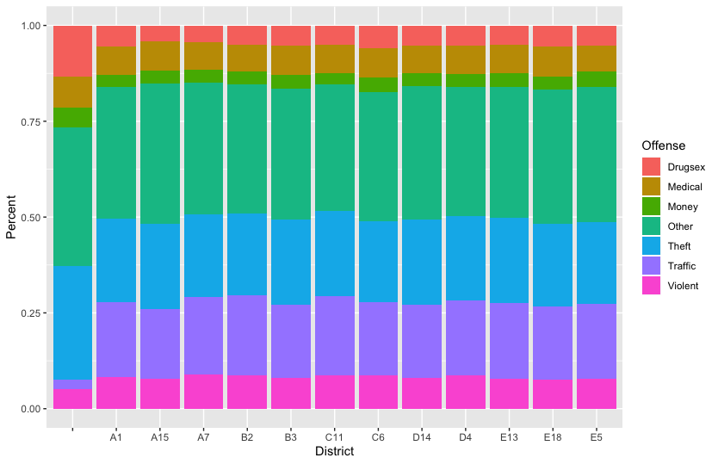
Exploratory Data Analysis
District Crime Breakdowns

Slide 11
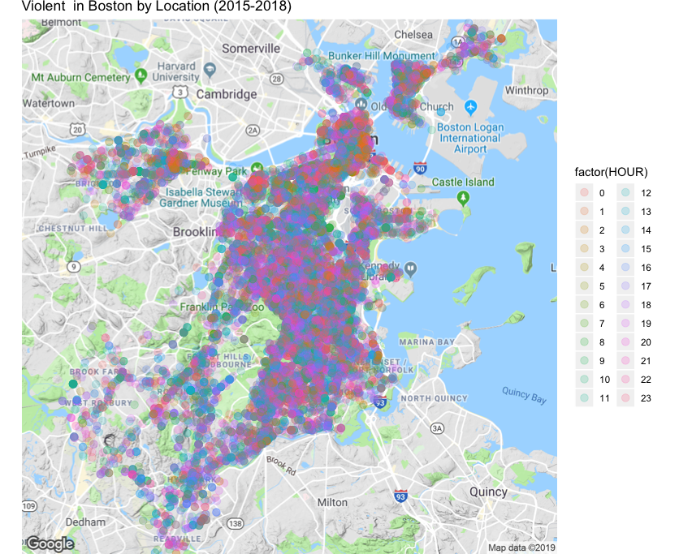
Exploratory Data Analysis
Violent Crime Heat Map

Slide 12
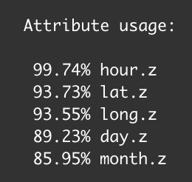
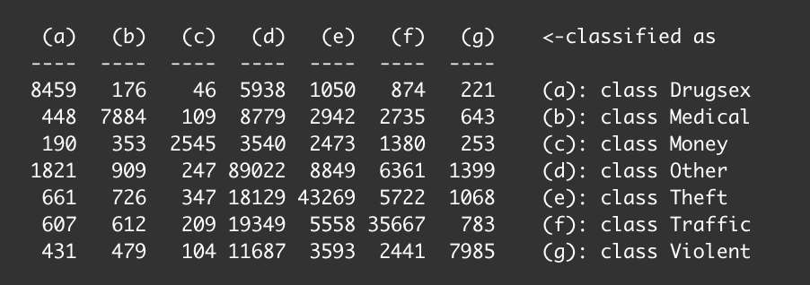
C 5.0 Decision Tree
Attribute Usage:
Confusion Matrix:
Accuracy: 61%

Slide 13
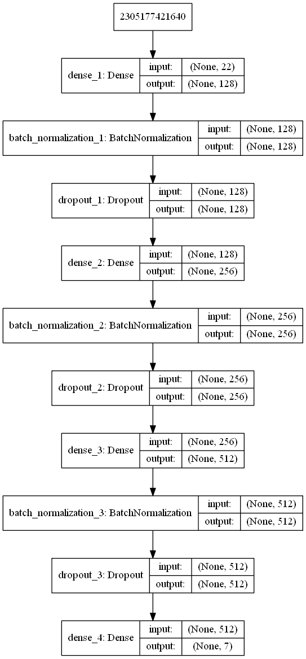
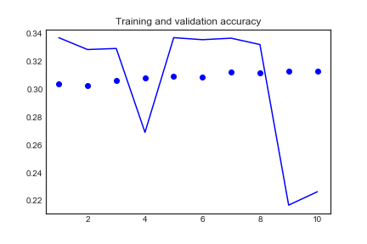
Keras Neural Network

Slide 14
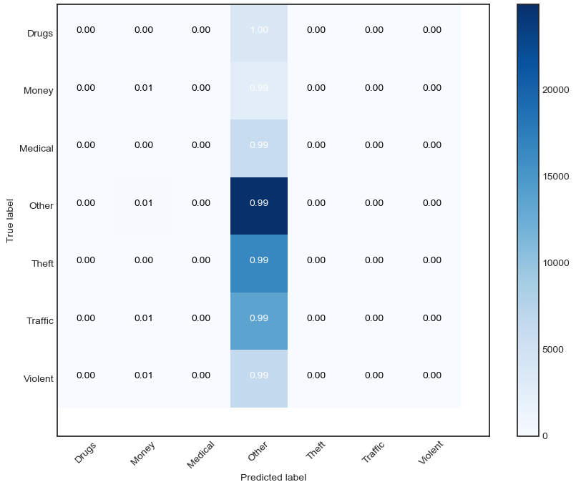
Keras Neural Network
Confusion Matrix:
Accuracy: 31%

Slide 15
Summary
Exploratory Data Analysis provided useful insights into temporal and geographic trends in the data.
When given time and location:
C 5.0 model predicts expected crime with 61% accuracy
Neural Network predicts crime with 31% accuracy
All districts experience similar ratio of crime types, but manpower needs vary greatly.
This analysis could help with manpower allocation and expectation management.

Slide 16
Questions?

