Slide 1

Group 3: Boston Crime Data 2015-2018
Capt Brandon Hufstetler
1st Lt Garrett Alarcon
2d Lt Jinan Andrews
2d Lt Anson Cheng
2d Lt Nick Forrest
2d Lt Nestor Hernandez
Notes:
Nestor

Slide 2
Overview
Objectives
Data Overview
Data Prep
Exploratory Data Analysis
C 5.0 Decision Tree
Keras Neural Network
Summary
Notes:
Nestor

Slide 3
Objectives
This report seeks to answer the following research questions:
Where do crimes most commonly occur in the city of Boston?
What type of crimes most commonly occur in each of the 12 districts of Boston?
Is there a pattern for the rate of crime that occurs throughout the day?
What is the best way to allocate Boston Police Department manpower to utilize officers more efficiently and effectively?
Notes:
Nestor

Slide 4
Data Overview
Boston Crime Database obtained from:
https://www.kaggle.com/ankkur13/boston-crime-data
Used Predictor Variables:
DISTRICT Factor
MONTH Factor
DAY_OF_WEEK Factor
HOUR Factor
LATITUDE Numeric
LONGITUDE Numeric
Response Variable:
OFFENSE_CODE Factor
*Unused variables were redundant or unnecessary for this analysis
Notes:
Anson

Slide 5
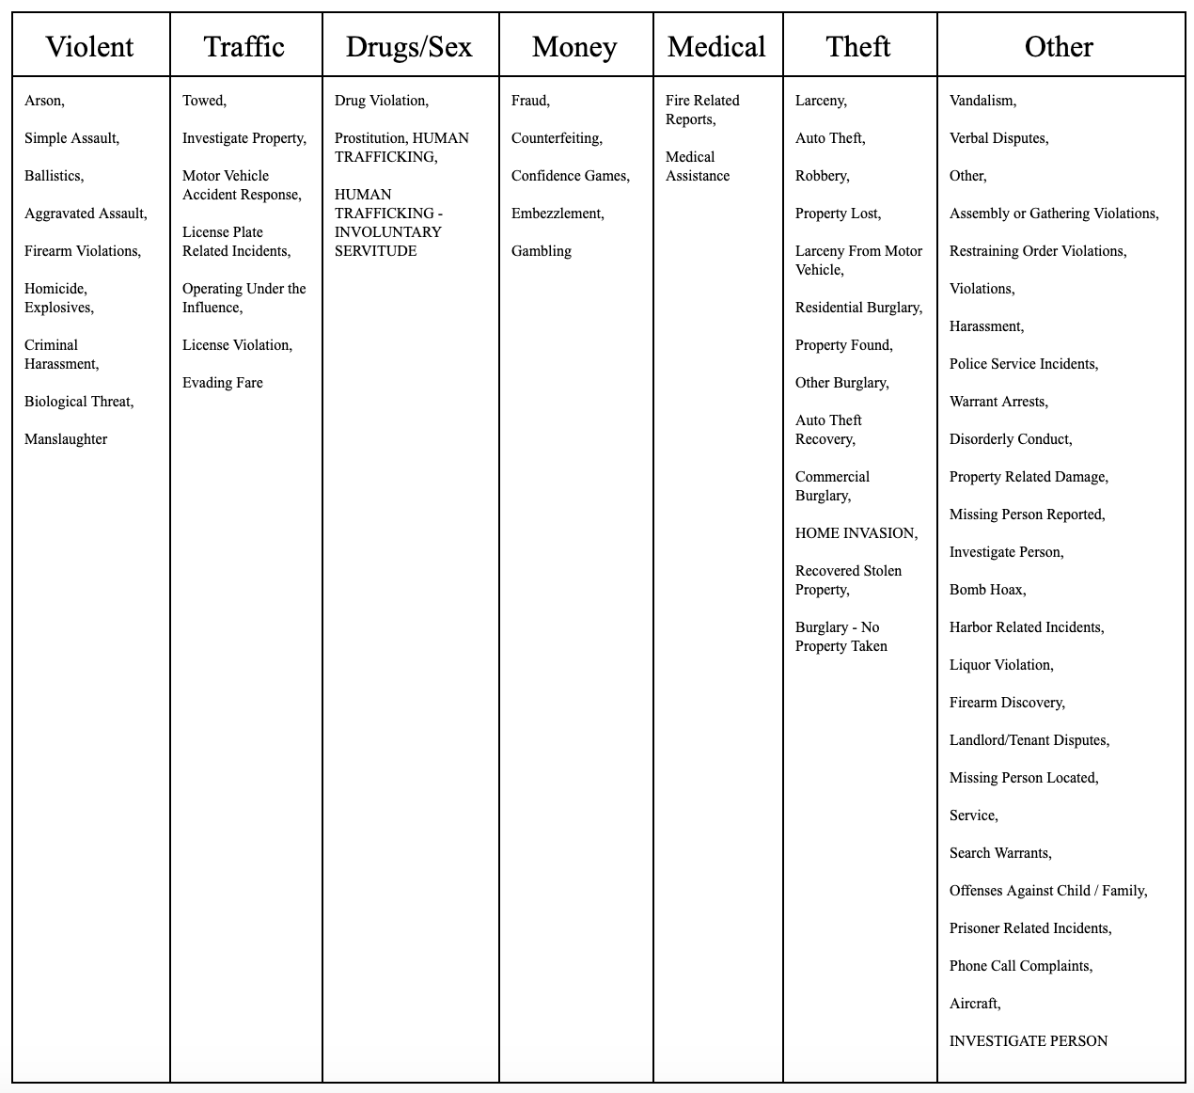
Data Prep
Offense Codes were sorted into seven categories:
Notes:
Anson

Slide 6

Data Prep
DAY_OF_WEEK ordered from Monday to Sunday
This step was not required for MONTH or HOUR because those variables are input as numeric factors.
Notes:
Anson

Slide 7
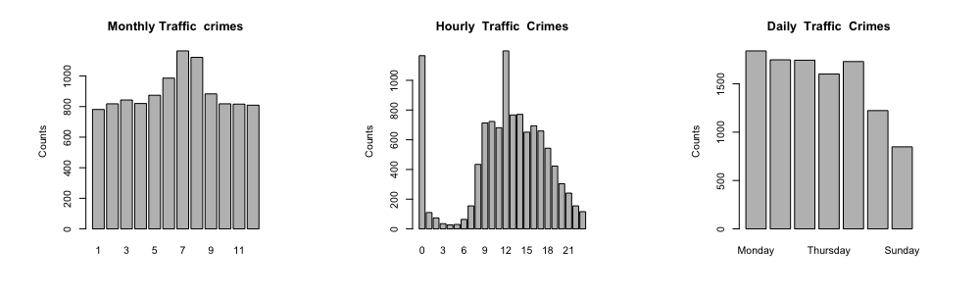
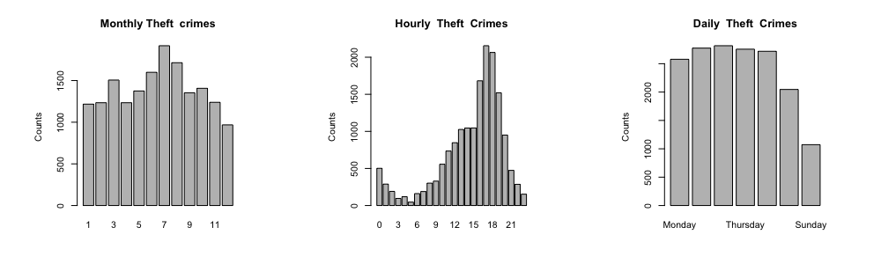
Exploratory Data Analysis
Strong Hourly Trends – Traffic, Theft
Notes:
Examined monthly, hourly, and daily trends for the 7 categories (traffic, theft, violent, money, other, drug/sex, medical)

Slide 8
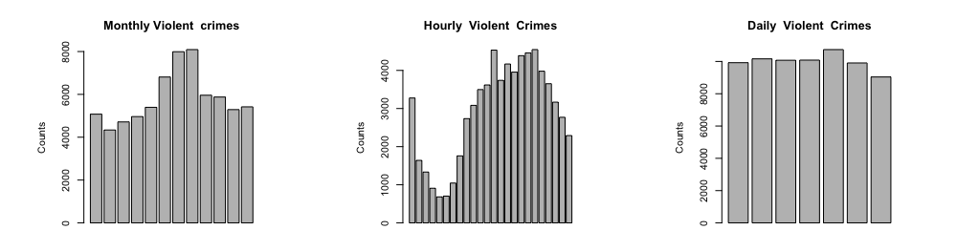
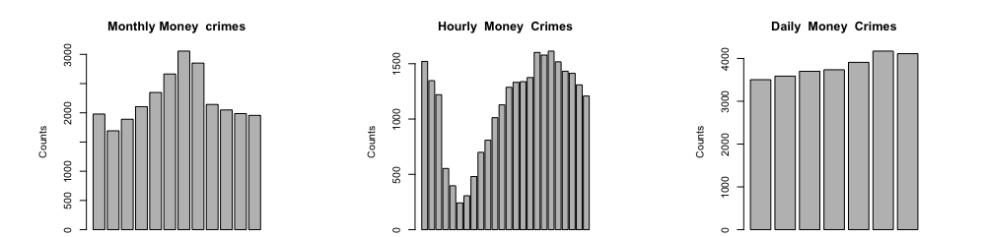
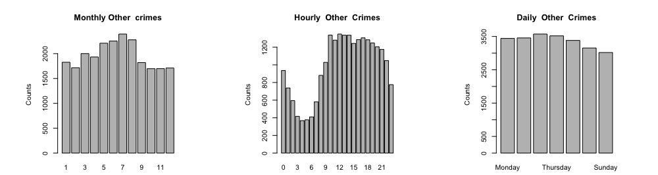
Exploratory Data Analysis
Moderate Hourly Trends – Violent, Money, Other
Notes:
Jinan

Slide 9
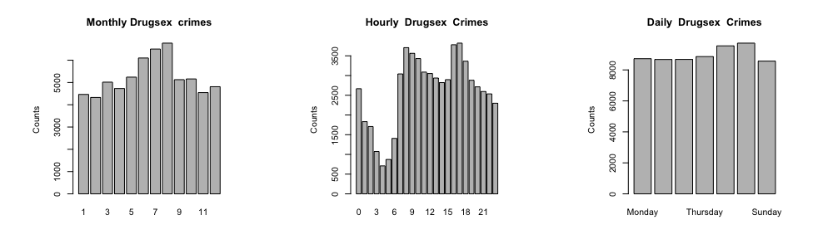
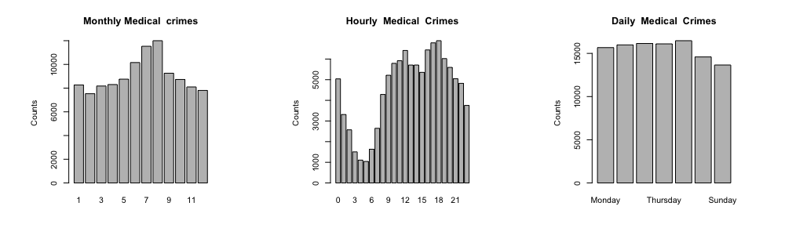
Exploratory Data Analysis
Bi-Modal Hourly Trends – Drugs/Sex, Medical
Notes:
Monthly: occurrences rose during summer months and dropped off around September
Hourly: crime occurrence dipped around 3 am and then occurrences increased as the working day began
Weekly: Generally uniform

Slide 10
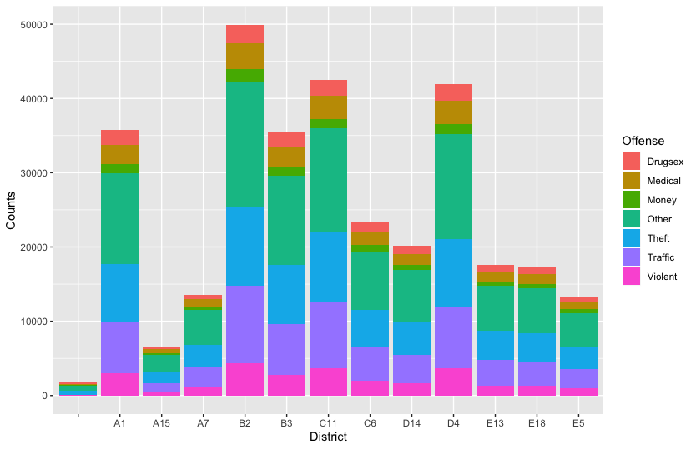
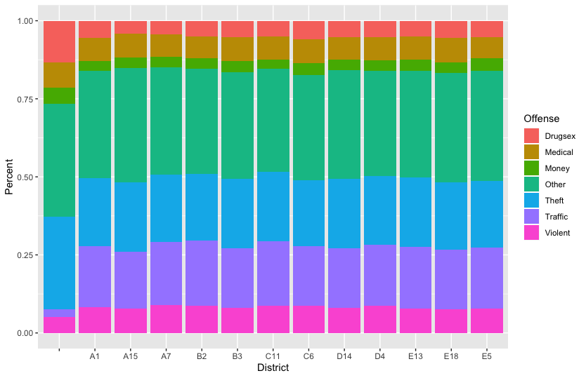
Exploratory Data Analysis
District Crime Breakdowns
Notes:
Each district was looked at individually and compared to each other
Normalized district comparison:
First column is non-reported districts

Slide 11
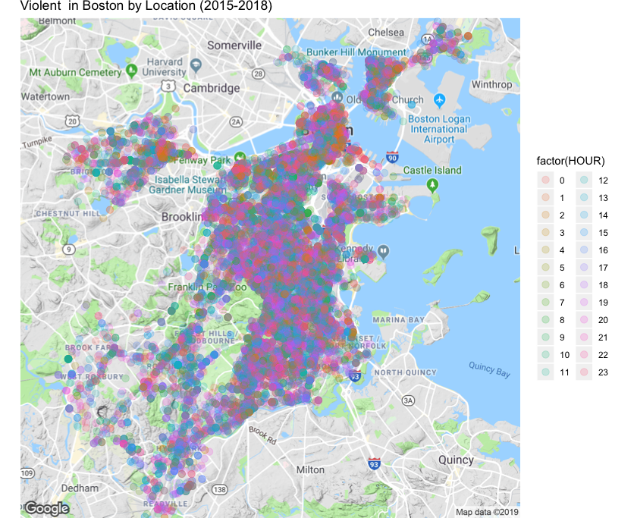
Exploratory Data Analysis
Violent Crime Heat Map
Notes:
Jinan

Slide 12
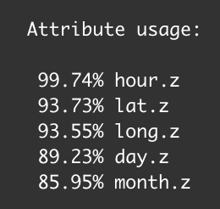
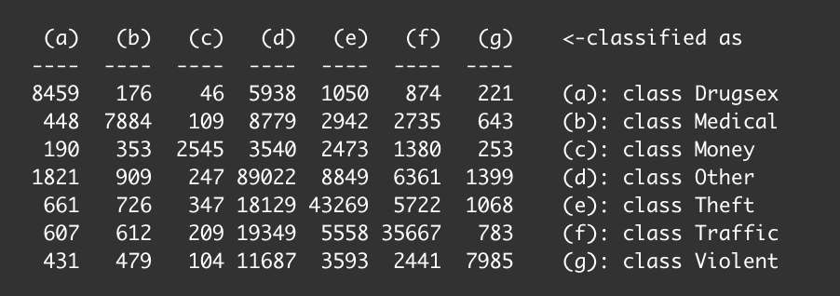
C 5.0 Decision Tree
Attribute Usage:
Confusion Matrix:
Accuracy: 61%
Notes:
Huf

Slide 13
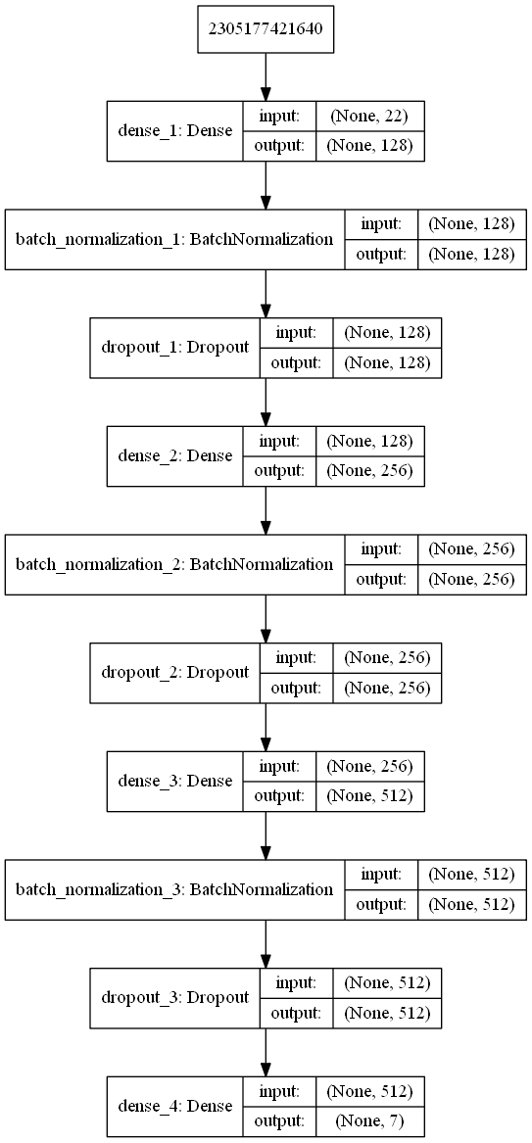
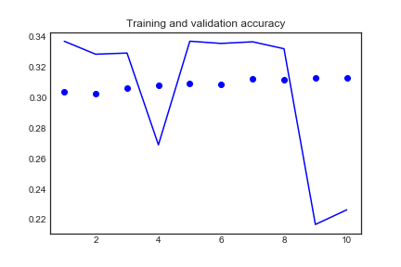
Keras Neural Network
Notes:
Nick/Garrett

Slide 14
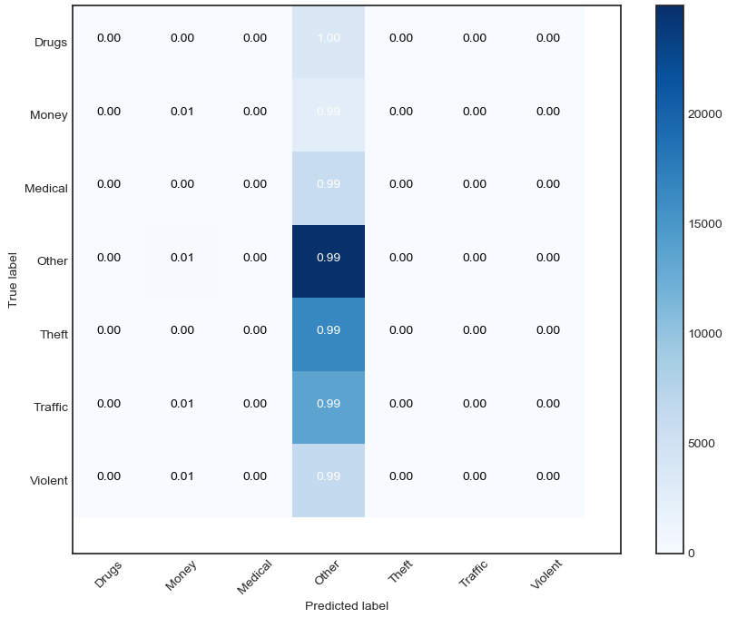
Keras Neural Network
Confusion Matrix:
Accuracy: 31%
Notes:
Garrett

Slide 15
Summary
Exploratory Data Analysis provided useful insights into temporal and geographic trends in the data.
When given time and location:
C 5.0 model predicts expected crime with 61% accuracy
Neural Network predicts crime with 31% accuracy
All districts experience similar ratio of crime types, but manpower needs vary greatly.
This analysis could help with manpower allocation and expectation management.
Notes:
Nick

Slide 16
Research Questions
Where do crimes most commonly occur in the city of Boston?
Dispersed throughout Boston
Location of crimes is a function of crime type and time.
Given a specific type of crime, it is possible to some extent to predict where and when it is expected to occur.
What type of crimes most commonly occur in each of the 12 districts of Boston?
Each district appears to experience the same distribution of crime.
Difference between each district is in the rate at which crime occurs. Some districts experience significantly more crime than others.
Is there a pattern for the rate of crime that occurs throughout the day?
Crime occurrence dipped around 3 am and then occurrences increased as the working day began
What is the best way to allocate Boston Police Department manpower to utilize officers more efficiently and effectively?
Using a predictive model like the C5.0, it may be possible for a decision maker to determine the appropriate training, allocation and scheduling of officers in Boston
Notes:
Nick

Slide 17
Questions?

