Slide 1


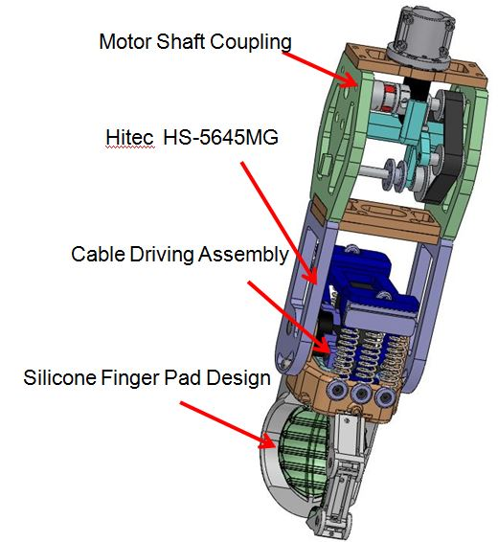
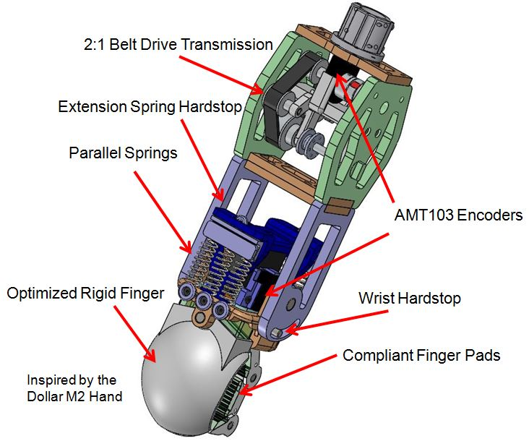
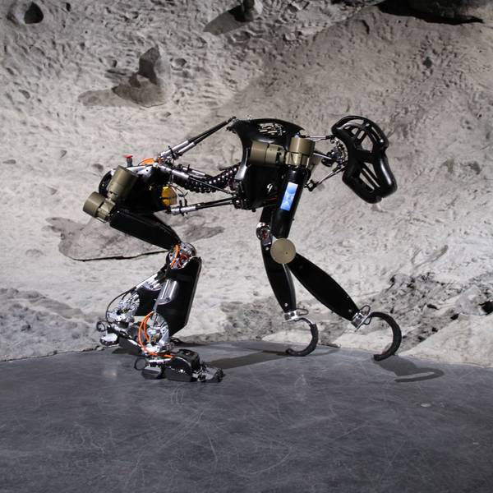
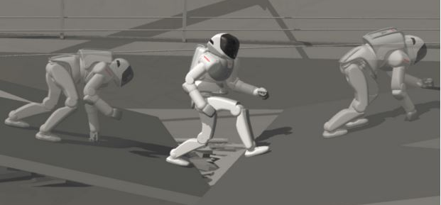
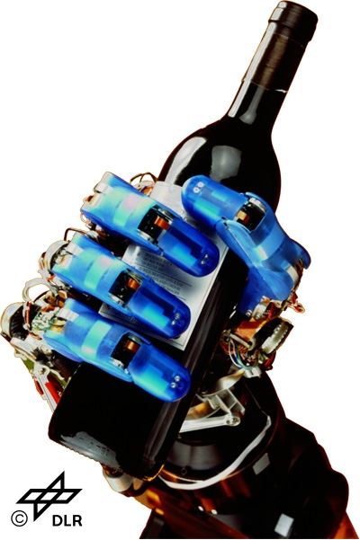
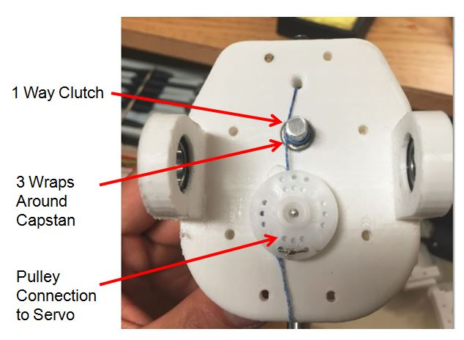
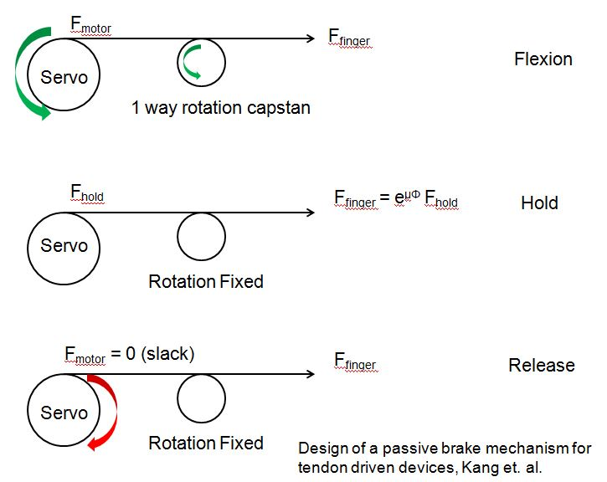
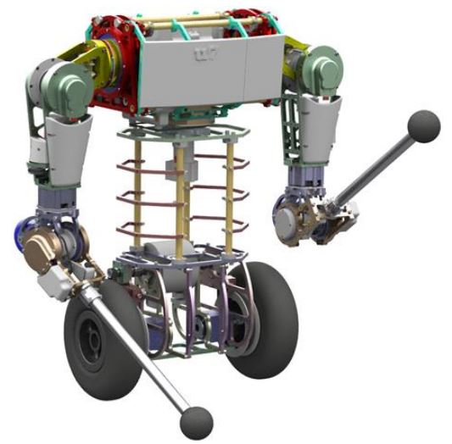
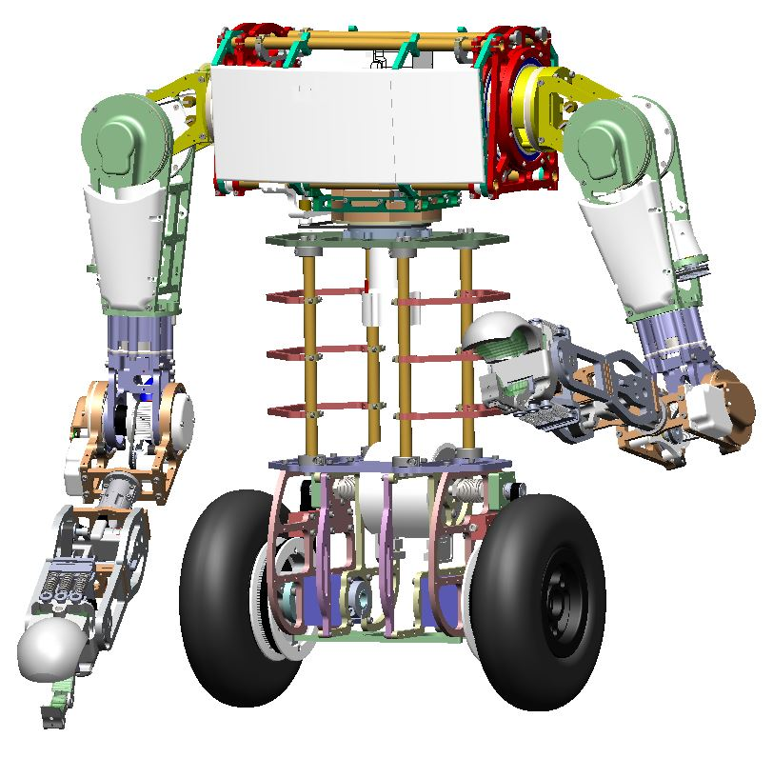
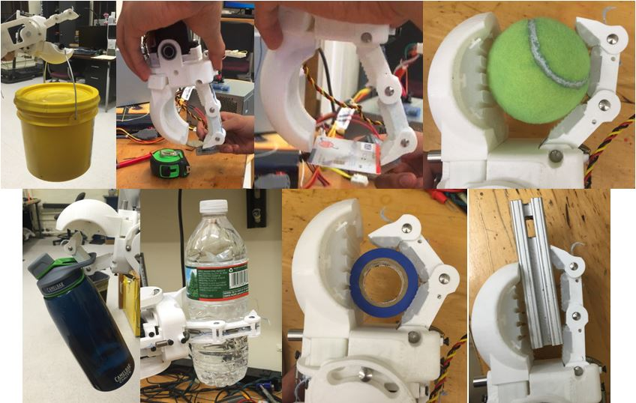
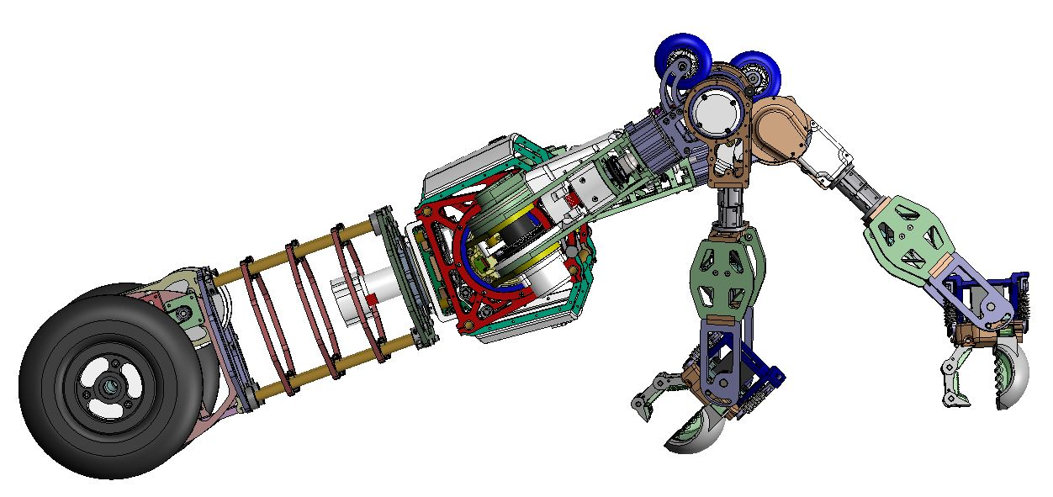
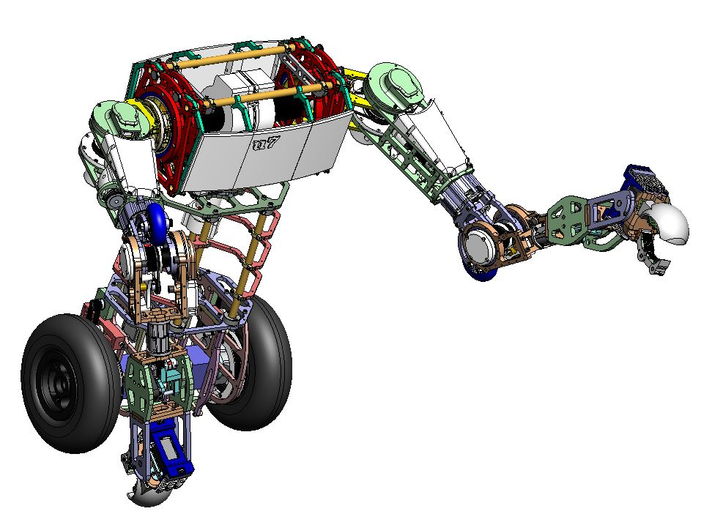
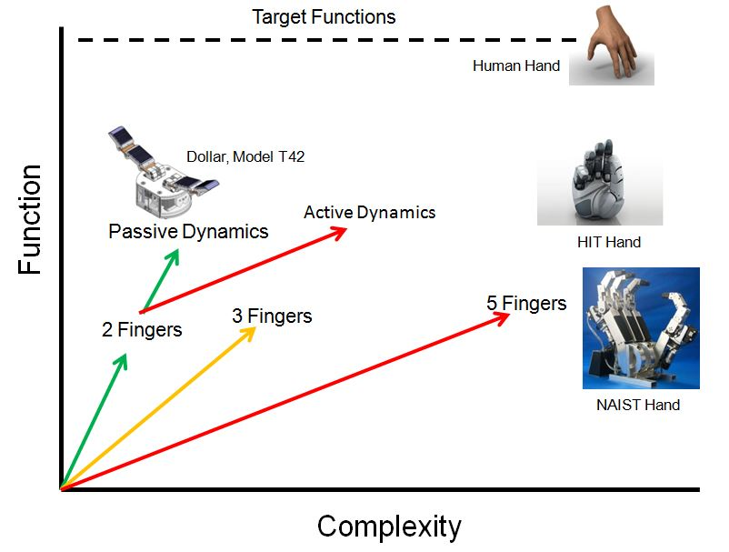
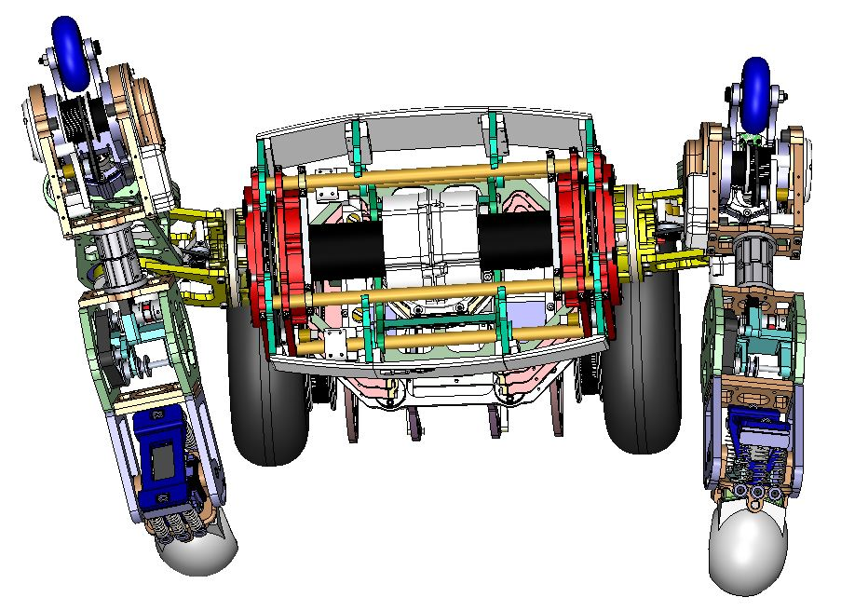

 | Undergraduate Research Conference A Robotic Manipulator for Grasping and Locomotion
_______________________________________________
Brian Jin, Prof. Frank C. Sup IV
Motivation
Robotic manipulation and locomotion are typically approached as separate problems.
Hybrid function hand-foot manipulator can reduce the energy costs associated with performing both tasks
Applications for bipedal robots that can switch to quadrupedal motion when advantageous
Goal is to develop and assess robotic hand morphology for both locomotion and grasping.
Results
Prototype Components
Left: C shape finger for Charlie, the Robotic Ape, Center: Concept for HONDA ASIMO switching from bipedal to quadrupedal motion , Right: DLR4 Hand Grasp
Cable Driving Assembly
Clutch Mechanism Operation
Objective
Specifications derived from uBot-7 requirements, a service robot for the disabled at the Laboratory of Perceptual Robotics
Demonstrate combined grasping and locomotion potential
Grasping
Left: uBot-7 with current end effectors, Right: uBot-7 with current prototype
Method
Minimize weight and size by maximizing function to complexity ratio
FEA for optimization and simulation of hyperelastic material for compliant finger pads
Hybrid deposition manufacturing for seamless connection between finger pads and fingers
Dissolvable molds give additional control over finger pad compliance
Grasps from top left, prehensile, pinch (quarter), pinch (card), sphere, hook, cylinder (bottle), cylinder (underactuated grasp), pinch (long object)
Comparison of Different Robotic Hand Morphology
Locomotion
Concept applications of manipulator for locomotion. From top left: quadrupedal walking, three point ground contact with one hand free for grasping, transition from prone to upright position
Future Work
Implement prototype onto uBot-7 to validate the design’s capacity to perform different types of locomotion
Incorporate tactile sensing in the finger pads to determine contact between the finger and object
Design a controller for the series elastic wrist for precise position control
Improve functions of the wrist by adding a rotational degree of freedom
Department of Mechanical & Industrial Engineering

