Slide 1
Spring Microservice Project Architecture

Slide 2
Contents
Spring Cloud Architecture
Detailed Architecture
What is Microservice
What is Spring Cloud

Slide 3
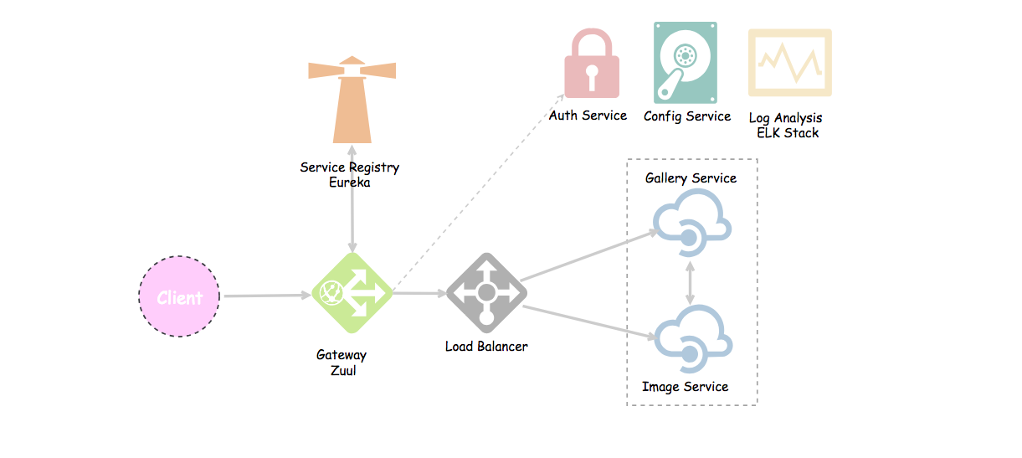
Spring Cloud Architecture
Spring Cloud provides solutions to cloud enable your microservices. It leverages and builds on top of some of the Cloud solutions open sourced by Netflix (Netflix OSS).

Slide 4
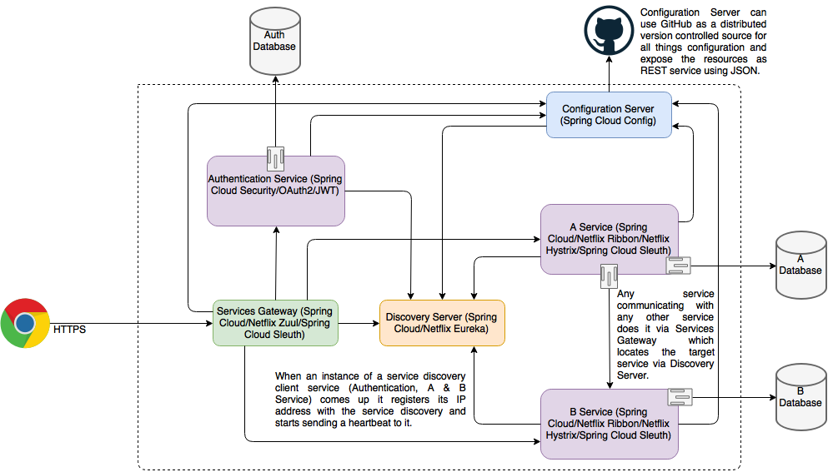
User Mgmt Service
DETAILED MICROSERVICE ARCHITECTURE

Slide 5
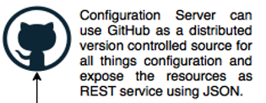
All Microservices
Config Server
DB
Authorization Service
(Spring Cloud Security/OAuth2/JWT)
Rest API
User Service
People Service
DB
JWT
Rest API
Access Token
JWT
DB
JWT
Rest API
Project Service
Client
Access Token
Gateway Service
(Netflix Zuul/Spring Cloud Gateway)
Access Token
Discovery Eureka Server
(Netflix Eureka)
JWT
DB
JWT
Rest API
Account Service
JWT
JWT
Darshan Service
DB
JWT
Rest API
Data Service
DB
Rest API
JWT
Messaging Service
DB
Rest API
Microservice Architecture in Dev Environment

Slide 6
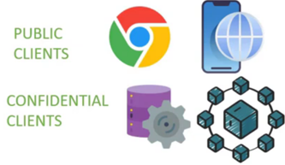


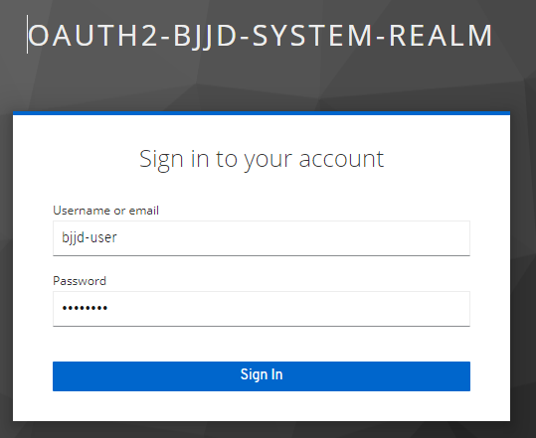
Microservices as Resource server containing the REST API as protected resources
Config Server
All Microservices
DB
Rest API
User Service
JWT
People Service
DB
Rest API
JWT
Project Service
DB
Access the service using client application by providing their credentials
Rest API
1
JWT
POST /login
JWT Access Token
Client Application
(can be Spring MVC)
Spring Cloud Gateway App Service
Discovery Eureka Server
(Netflix Eureka)
DB
4
JWT
Rest API
Account Service
Access + Id Token
8
RESOURCE SERVER
5
JWT
DB
USER OR RESOURCE OWNER
Rest API
Darshan Service
3
2
Token Response
(Access Token + Id Token)
7
Token Request
(client + user details to authenticate and authorize)
Verify Access Token
JWT
Data Service
DB
Rest API
JWT
DB
Rest API
Messaging Service
Keycloak is Identity and Access Management Server, which is a OAuth2 and OpenID Connect(OIDC) protocol complaint
AUTHORIZATION SERVER
Microservice Architecture in Dev Environment with Keycloak

Slide 7
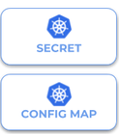

DB
Authorization Service
(Spring Cloud Security/OAuth2/JWT)
Rest API
User Service
People Service
DB
JWT
Rest API
Access Token
JWT
DB
JWT
Rest API
Project Service
Client
Access Token
Gateway Service
(Spring Cloud Gateway/Ingress)
Access Token
Discovery Eureka Server
(Netflix Eureka)
JWT
DB
JWT
Rest API
Account Service
JWT
JWT
Darshan Service
DB
JWT
Rest API
Data Service
DB
Rest API
JWT
Messaging Service
DB
Rest API
Microservice Architecture in Production Environment

Slide 8
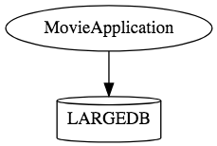
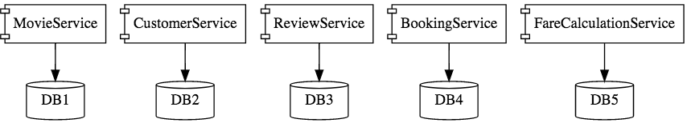
Spring Microservice
A microservice is an engineering approach focused on decomposing applications into single-function modules with well-defined interfaces which are independently deployed and operated by small teams who own the entire lifecycle of the service.
Microservices in a nutshell allows us to break our large system into number of independent collaborating components.
This is how a monolith would look like. One application for everything.
This is how the same application would look like when developed using Microservices Architecture.
Microservice Architectures involve a number of small, well designed, components interacting with messages.

Slide 9
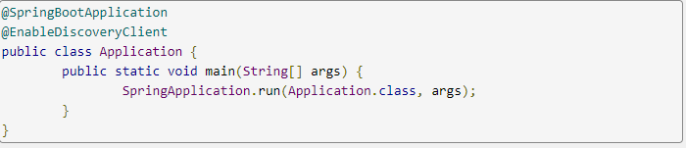
Spring Cloud
Spring Cloud is a framework for building robust cloud applications. It facilitates the development of applications by providing solutions to many of the common problems faced when building distributed system.
Spring Cloud- which builds on top of Spring Boot*, provides a set of tools to quickly build cloud-based microservices. Spring Cloud provides tools for developers to quickly build some of the common patterns in distributed systems.
Spring Cloud takes a very declarative approach, and often you get a lot of features with just a classpath change and/or an annotation.
Example application that is a discovery client:
*Spring Boot is an efficient framework for creating a Spring-based application. Anyone with basic Java programming skills can quickly create and run a Spring Boot microservice.

Slide 10
Spring Cloud Tools
Spring Cloud provides the following tools:
Configuration Management: Spring Config Server (with GIT repository)
Service Registration and Discovery -Eureka Server (Netflix)
Gateway to client applications - Zuul Gateway (Netflix)
Authentication Service -Spring Cloud Security, JWT, Outh2 -
Rest Client - FeignClient and RestTemplate
Load Balancer - Using Ribbon Approach
Circuit Breaker Pattern - Hystrix
Distributed log tracing - Zipkin and Sleuth
Managing, Searching, and Visualizing Logs - ELK (Elasticsearch, Logstash, Kibana)
*Spring Boot is an efficient framework for creating a Spring-based application. Anyone with basic Java programming skills can quickly create and run a Spring Boot microservice.

Slide 11
Service Registration and Discovery - Eureka Server (owned by Netflix)
Eureka Server or service will register every microservice and then the client microservice will look up the Eureka server to get a dependent microservice to get the job done without knowing the IP address of dependent microservice.
Eureka Server is owned by Netflix and in this, Spring Cloud offers a declarative way to register and invoke services by Java annotation.
It’s duty to give names to each microservice. Why?
No need to hardcode the IP addresses of microservices.
What if services use dynamic IP addresses; when autoscaling.
Every service register itself with Eureka, and pings Eureka server to notify that it’s alive. If Eureka server didn’t receive any notification from a service. This service is unregistered from the Eureka server automatically.

Slide 12
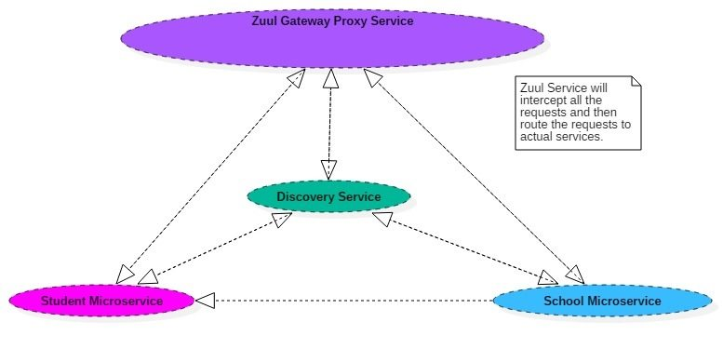
Gateway to client applications - Zuul Gateway (Netflix)
A gateway is a single-entry point into the system, used to handle requests by routing them to the corresponding microservice. It can also be used for authentication, monitoring, and more.
Why it is required: And as we spin more instances of services, each with a different port numbers, So, now the question is: How can we call the services from the browser and distribute the requests among their instances running at different ports?
Well, a common solution is to use a Gateway.
What’s Zuul?
It’s a proxy, gateway, an intermediate layer between the users and your services.
Eureka server solved the problem of giving names to services instead of hardcoding their IP addresses.
But, still, we may have more than one service (instances) running on different ports. So, Zuul …
Maps between a prefix path, say/gallery/** and a service gallery-service. It uses Eureka server to route the requested service.
It’s worth mentioning that Zuul acts as a Eureka client. So, we give it a name, port, and link to Eureka server (same as we did with image service).
It loads balances (using Ribbon) between instances of a service running on different ports.
What else? We can filter requests, add authentication, etc.
NOTE: When calling any microservice from the browser, we can’t call it by its name as we do when we call one microservice from another microservice — This is used internally between services.
Where Zuul fits in microservices ecosystem?
A common problem, when building microservices, is to provide a unique gateway to the client applications of your system. And to solve this problem, Netflix (a major adopter of microservices) created and open-sourced its Zuul proxy server and later Spring under Pivotal has adapted this in its spring cloud stack and enabled us to use zuul easily and effectively with just few simple steps.

Slide 13
Authentication Service – Spring Cloud Security, OAuth2, JWT
Authentication Service is used for validating user credentials, and issuing tokens.
The authentication flow is simple as:
The user sends a request to get a token passing his credentials.
The server validates the credentials and sends back a token.
With every request, the user has to provide the token, and server will validate that token.
Validating the token in Authentication service for every request: Gateway Service has to call the auth service to validate user credentials and the issued token before allowing the requests to go to any service.
Authentication Service Tools
Spring Cloud Security
OAuth2
JWT
Authentication service can call any user-mgmt-service to validate the user credentials with the DB or any other source.

Slide 14
Rest Client – Rest Template and Fiegn Client
The calls from one microservice (Rest Client) to the other microservices can be done using:
RestTemplate. An object that’s capable of sending requests to REST API services.
FeignClient (acts like a proxy), and provides another approach to RestTemplate.
Both, load balance requests across the services.
What Is a Feign Client?
Netflix provides Feign as an abstraction over REST-based calls, by which microservices can communicate with each other, but developers don't have to bother about REST internal details.
Feign is a declarative web service client. It makes writing web service clients easier. To use Feign create an interface and annotate it. It has pluggable annotation support including Feign annotations and JAX-RS annotations. Feign also supports pluggable encoders and decoders. Spring Cloud integrates Ribbon and Eureka to provide a load balanced http client when using Feign.
Why We Use Feign Client
For example, EmployeeDashBoard service has to communicate with EmployeeService, we programmatically construct the URL of the dependent microservice, then called the service using RestTemplate, so we need to be aware of the RestTemplate API to communicate with other microservices, which is certainly not part of our business logic.
The question is, why should a developer have to know the details of a REST API? Microservice developers only concentrate on business logic, so Spring addresses this issues and comes with Feign Client, which works on the declarative principle. We have to create an interface/contract, then Spring creates the original implementation on the fly, so a REST-based service call is abstracted from developers. Not only that — if you want to customize the call, like encoding your request or decoding the response in a Custom Object, you can do it with Feign in a declarative way. Feign, as a client, is an important tool for microservice developers to communicate with other microservices via Rest API.

Slide 15
Client side Load Balancer – Netflix Ribbon
Client Side Load Balancer : What if more than one instance of a microservice running on different ports. So, we need to balance the requests among all the instances of a service. When using ‘Ribbon’ approach (default), requests will be distributed equally among them.
Why Client Side Load Balancer
1. Traditional server side load balancing
Server side load balancing is involved in monolithic applications where we have limited number of application instances behind the load balancer. We deploy our war/ear files into multiple server instances which are basically a pool of server having the same application deployed and we put a load balancer in front of it.
Load balancer has a public IP and DNS. The client makes a request using that public IP/DNS. Load balancer decides to which internal application server request will be forwarded to. It mainly use round robin or sticky session algorithm. We call it server side load balancing.
Problems in microservices architecture
Mostly server side load balancing is a manual effort and we need to add/remove instances manually to the load balancer to work. So ideally we are loosing the today’s on demand scalability to auto-discover and configure when any new instances will be spinned of.
Another problem is to have a fail-over policy to provide the client a seamless experience. Finally we need a separate server to host the load balancer instance which has the impact on cost and maintenance.
2. Client side load balancing
To overcome the problems of traditional load balancing, client side load balancing came into picture. They reside in the application as inbuilt component and bundled along with the application, so we don’t have to deploy them in separate servers.
Now let’s visualize the big picture. In microservice architecture, we will have to develop many microservices and each microservice may have multiple instances in the ecosystem. To overcome this complexity we have already one popular solution to use service discovery pattern. In spring boot applications, we have couple of options in the service discovery space such as eureka, consoul, zookeeper etc.
Now if one microservice wants to communicate with another microservice, it generally looks up the service registry using discovery client and Eureka server returns all the instances of that target microservice to the caller service. Then it is the responsibility of the caller service to choose which instance to send request.
Here the client side load balancing comes into picture and automatically handles the complexities around this situation and delegates to proper instance in load balanced fashion. Note that we can specify the load balancing algorithm to use.
3. Netflix ribbon – Client side load balancer
Netflix ribbon from Spring Cloud family provides such facility to set up client side load balancing along with the service registry component. Spring boot has very nice way of configuring ribbon client side load balancer with minimal effort. It provides the following features
a. Load balancing b. Fault tolerance
c. Multiple protocol (HTTP, TCP, UDP) support in an asynchronous and reactive model d. Caching and batching

Slide 16
1.Service Registration and Discovery - Eureka Server (owned by Netflix)
Eureka Server or service will register every microservice and then the client microservice will look up the Eureka server to get a dependent microservice to get the job done without knowing the IP address of dependent microservice.
Eureka Server is owned by Netflix and in this, Spring Cloud offers a declarative way to register and invoke services by Java annotation.
It’s duty to give names to each microservice. Why?
No need to hardcode the IP addresses of microservices.
What if services use dynamic IP addresses; when autoscaling.
Every service register itself with Eureka, and pings Eureka server to notify that it’s alive. If Eureka server didn’t receive any notification from a service. This service is unregistered from the Eureka server automatically.

