Slide 1
The Admissions Funnel
Fulfilling NAU’s Strategic Mission
Ben Jefferies
Notes:
Intro: 1. Who you are 2. what you study (focused on public sector/ed data – no RCT, mostly observational/quasi-exp designs and econometric) 3. why you love data, have used in other roles 4.

Slide 2
Analysis Purpose
Objective: uncover patterns and insights in student enrollment and retention during a fall admissions cycle.
Framework: data and trends are assessed through the lens of NAU’s Elevating Excellence strategic roadmap.
Primary Research Questions:
Is the NAU student body reflective of the goals in the strategic roadmap?
Are there any recruitment tools that drive admits/enrolls/retention?
Is NAU successful in equitably expanding Statewide/Online programming?

Slide 3
Methodology
Data Review – Reviewed data and dictionary
Data Cleaning and Exploration – R, Excel
Example: .xlsx file date errors in ‘Accept Date’ field
Example: null values in ‘Offered Aid Amount’ converted to 0
Example: derived variables for GPA bands, admit to accept time elapsed
Descriptive Statistics – R, PowerBI
Segmentation by key demographics highlighted in Elevating Excellence
Visualizations – R, PowerBI
Modeling - R
Notes:
Dataset description: nearly 40,000 rows, each representing an admitted student. Tracks each students action:

Slide 4

The Admissions Funnel
Current Context
Enrollment Cliff
Negative Perceptions of Higher Ed.
NAU Enrollment Declines
Notes:
Retention after first year is roughly 14% of the admitted students. 73% retention after the first year is also comparable with NAU’s average.

Slide 5
Ethnicity and the Funnel
Ipeds Ethnicity | Admitted (%) | Accepted (%) | Enrolled (%) | Retained (%)
American Indian/Alaska Native | 554 (1.6%) | 198 (2.4%) | 155 (2.3%) | 97 (2%)
Asian | 1521 (4.4%) | 178 (2.1%) | 146 (2.1%) | 119 (2.8%)
Black/African American | 1858 (5.4%) | 343 (4.1%) | 244 (3.6%) | 138 (2.8%)
Hispanic/Latino | 12372 (35.7%) | 2304 (27.5%) | 1718 (25.4%) | 1164 (23.7%)
Native Hawaiian/Oth Pac Island | 192 (0.6%) | 34 (0.4%) | 24 (0.3%) | 14 (0.3%)
Not Specified | 475 (1.4%) | 84 (1%) | 69 (1%) | 45 (.9%)
Two or More | 2304 (6.6%) | 567 (6.8%) | 460 (6.8%) | 335 (6.8%)
White | 15352 (44.3%) | 4671 (55.8%) | 3945 (58.3%) | 2998 (61%)
Each column shows the total students of each ethnicity and the percentage of all students at that stage.
White students, and those identifying as Two or More increased their percentage of the total student population from the admitted stage to the retained stage.
Notes:
NAU Strategic Goal: have a student body that is representative of AZ, demographically.
Next slide: focus in on two specific ethnic groups of importance to NAU where we could use more intentional efforts.

Slide 6
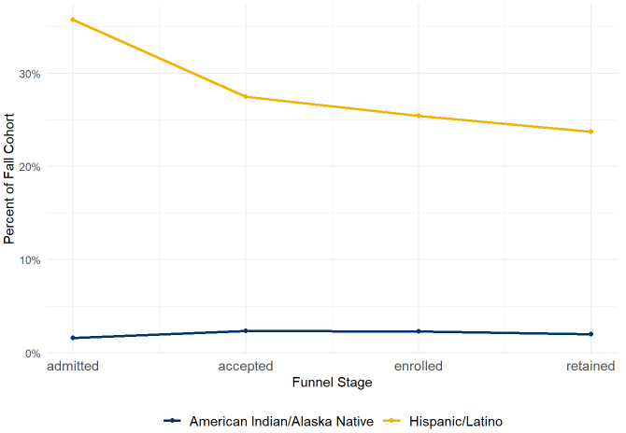
Trends in the Hispanic and Indigenous Funnel
NAU’s strategic roadmap calls for the student body to reflect AZ’s (‘23) state demographics
Hispanics: 31%
Indigenous: 3.4%
Split Recommendations
Promote acceptance and enrollment with Hispanic students
Recruit more heavily for indigenous students
Notes:
The trends are roughly comparable for both male and female students of Hispanic and Indigenous backgrounds. Big Rec: targeted support for at-risk groups
Also, Data only takes us so far, we might need more intensive surveys and focus groups to identify why students aren’t accepting/enrolling.

Slide 7
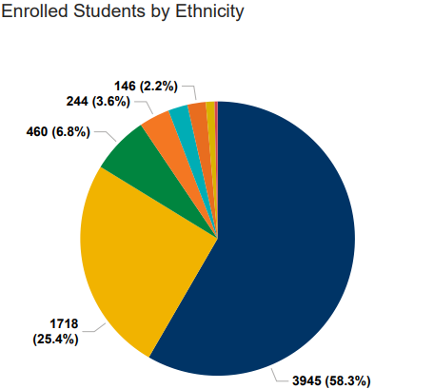
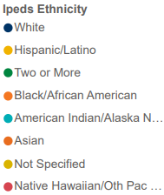
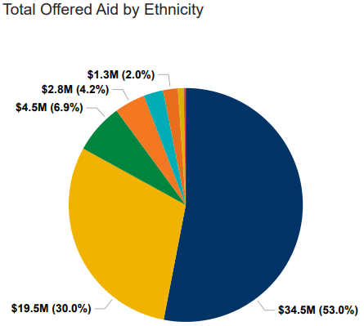
Financial Aid Distribution
Key tool in promoting diversity in the student body
Percent of students receiving aid: 78%
Average Financial Aid package: $10,955
Distribution of Aid by ethnicity is roughly proportional to enrolled student counts.

Slide 8
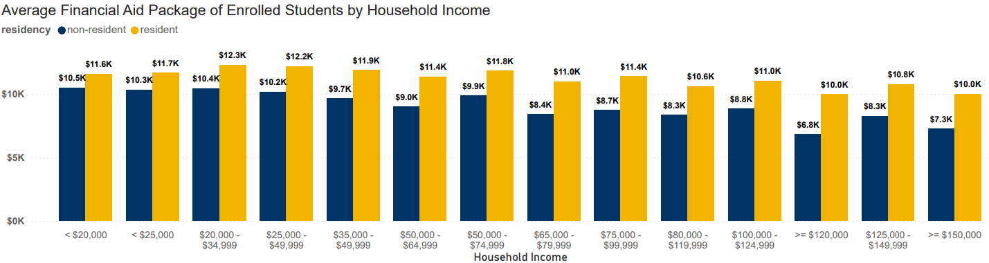
Financial Aid Distribution
Financial Aid packages are higher for students with lower income
Financial Aid packages are largest for residents

Slide 9
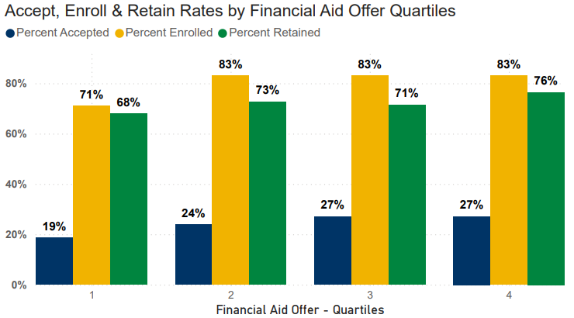
Does Financial Aid Drive Enrollment?
Increased Financial Aid does increase likelihood of a student accepting their offer
$5000 in aid increases the probability of accepting by 5%
No statistical difference between ethnic groups
Logistic Regression Model – all coefficients significant (p < 0.01)
Average time between admission and acceptance: 99 days.
Quartiles
$0 $6405
$6406 $9349
$9350 $12295
$12296 $23810
Does increasing Financial Aid decrease time to acceptance?
Each $1000 in aid is associated with 3 additional days between admission and acceptance
Linear model with significant coefficients (p < 0.01)
Notes:
I wanted to come to a rigorous statistically accurate estimate of the exact effect that financial aid spending has on the admissions funnel.
Explain Quartiles (25% increments).
Looking at the graph, appears there is a slight correlation in accept/enroll when students move from the bottom quartile to the second quartile.
Sometimes, graphs are deceiving.

Slide 10
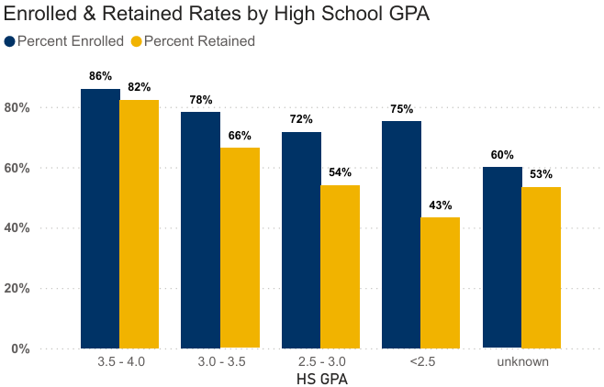
What does Drive Enrollment?
High School GPA
Slightly negative impact on acceptance rate
A 1 point increase in HS GPA = an 10% increase in likelihood of enrolling AND a 29% increase in the probability the student retains (p > 0.01)
Controlling for financial aid
Recommendation:
Increase rigorous programs
Increase attractiveness to high performing students
Notes:
Recommendation:
Advertise rigorous programs
Increase research and other extra opportunities for undergrads
Promote those opportunities (undergrad research symposium)

Slide 11
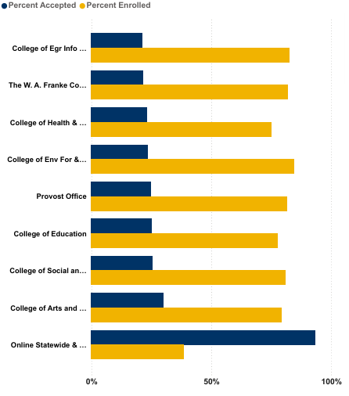
Online & Statewide
Online Education is another critical component of the Elevating Excellence strategic roadmap
Incentives and student behavior are the reverse of in-person programs
Recommendation:
Incentives for students to enroll
Identify factors making students likely to enroll in online/statewide programs
Notes:
Why does it make sense to branch out into online/statewide: equity to meet students where they are at, but also expand our reach to non-traditional student, broaden the pool of potential students

Slide 12
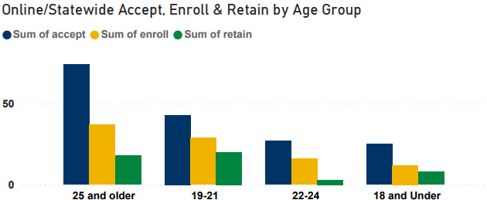
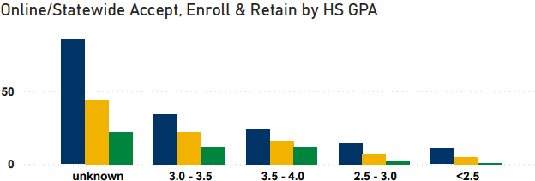
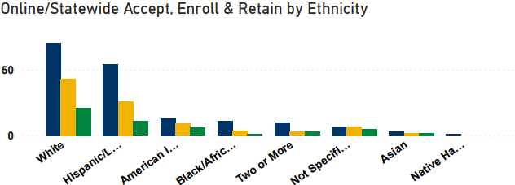
Online & Statewide Students
Only 94 students in this cohort enrolled in Online/Statewide
Tend to be older, part time, non-traditional
Recommendations:
Non-traditional programs mean non-traditional start – evaluate programs on a year-round basis
Increase flexibility of programs

Slide 13
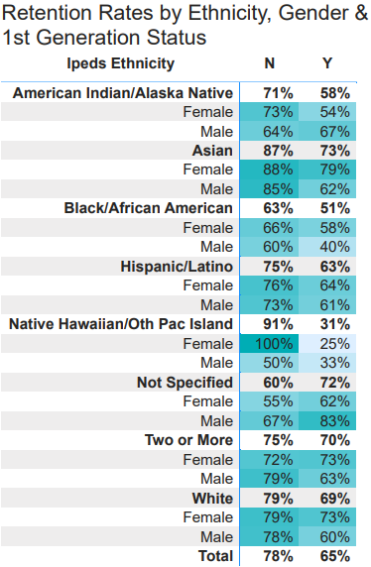
Greatest Risk of Non-Retention
First Generation
Males
Native Hawaiian/Pacific Islander
Black/African American
Females
Not Specified
Indigenous
Black/African American
Recommendations
Inclusive, Intentional programming
Targeted, early outreach
Notes:
Ultimately, in an era of shrinking numbers of graduating HS students, we need to be focusing efforts on retention.

Slide 14
Further Analysis
Student Action Data
Web Analytics
Integrated Data Systems
LMS and 3rd Party Vendors
Granular data with student address to more accurately calculate and predict overall revenues (WUE vs. non-resident)
Gender impacts on student enrollment and retention
First Generation impacts on student enrollment and retention

Slide 15
Conclusion and Recommendations
Split methods for Hispanic and Indigenous students
Financial Aid used sparingly as a strategic tool
GPA
Increase connections with high GPA students and their teachers.
Need to build the perception that NAU is rigorous, exciting environment for prospective students who were successful in high school
Online Programs
Research further to identify Incentives for enrollment
Increase Flexibility
Shift to Retention
Identify most at-risk groups for targeted, early interventions
Promote use of activity/granular data to identify early warning signs.

Slide 16
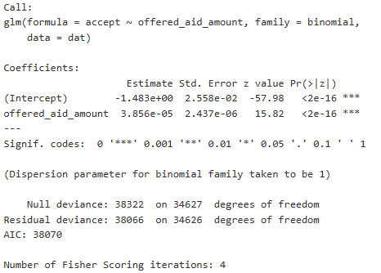
Appendix: Logit acceptance

Slide 17
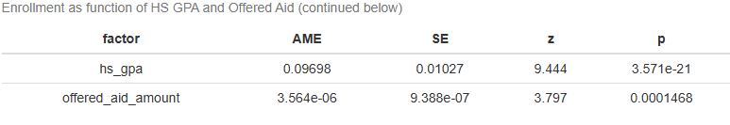
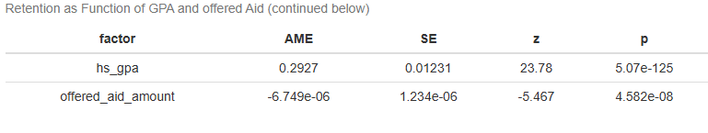
Appendix: Logit Enroll & Retain ~ GPA + Aid

Slide 18
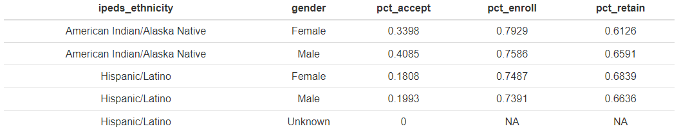
Appendix: Hispanic/Indigenous Funnel

Slide 19
3. Analytical Approach
Describe the techniques you used to explore the data:
Descriptive Statistics: Summarized key metrics (e.g., retention rate, average GPA, distribution of financial aid).
Segmentation: Broke down retention by categories such as:
Residency status (in-state vs. out-of-state)
First-generation status
Academic performance
Financial aid received
Visualization: Used charts (bar graphs, heatmaps, scatter plots) to highlight trends and relationships.
Predictive Modeling (if applicable):
Logistic regression or decision trees to identify factors most associated with retention.
Feature importance to guide recommendations.
4. Insights & Interpretation
Share what you discovered:
Which groups had higher/lower retention?
Were there any surprising trends (e.g., aid type vs. retention)?
Did any variables strongly correlate with retention outcomes?
5. Recommendations
Offer actionable suggestions based on your findings:
Targeted support for at-risk groups.
Data-driven outreach strategies.
Suggestions for further data collection or analysis (e.g., qualitative surveys, longitudinal tracking).
6. Tools Used
Mention the software/tools you used:
Excel, Power BI, Tableau, R, Python (e.g., pandas, seaborn, scikit-learn)
Why you chose them (e.g., ease of visualization, statistical modeling capabilities)

