Slide 1
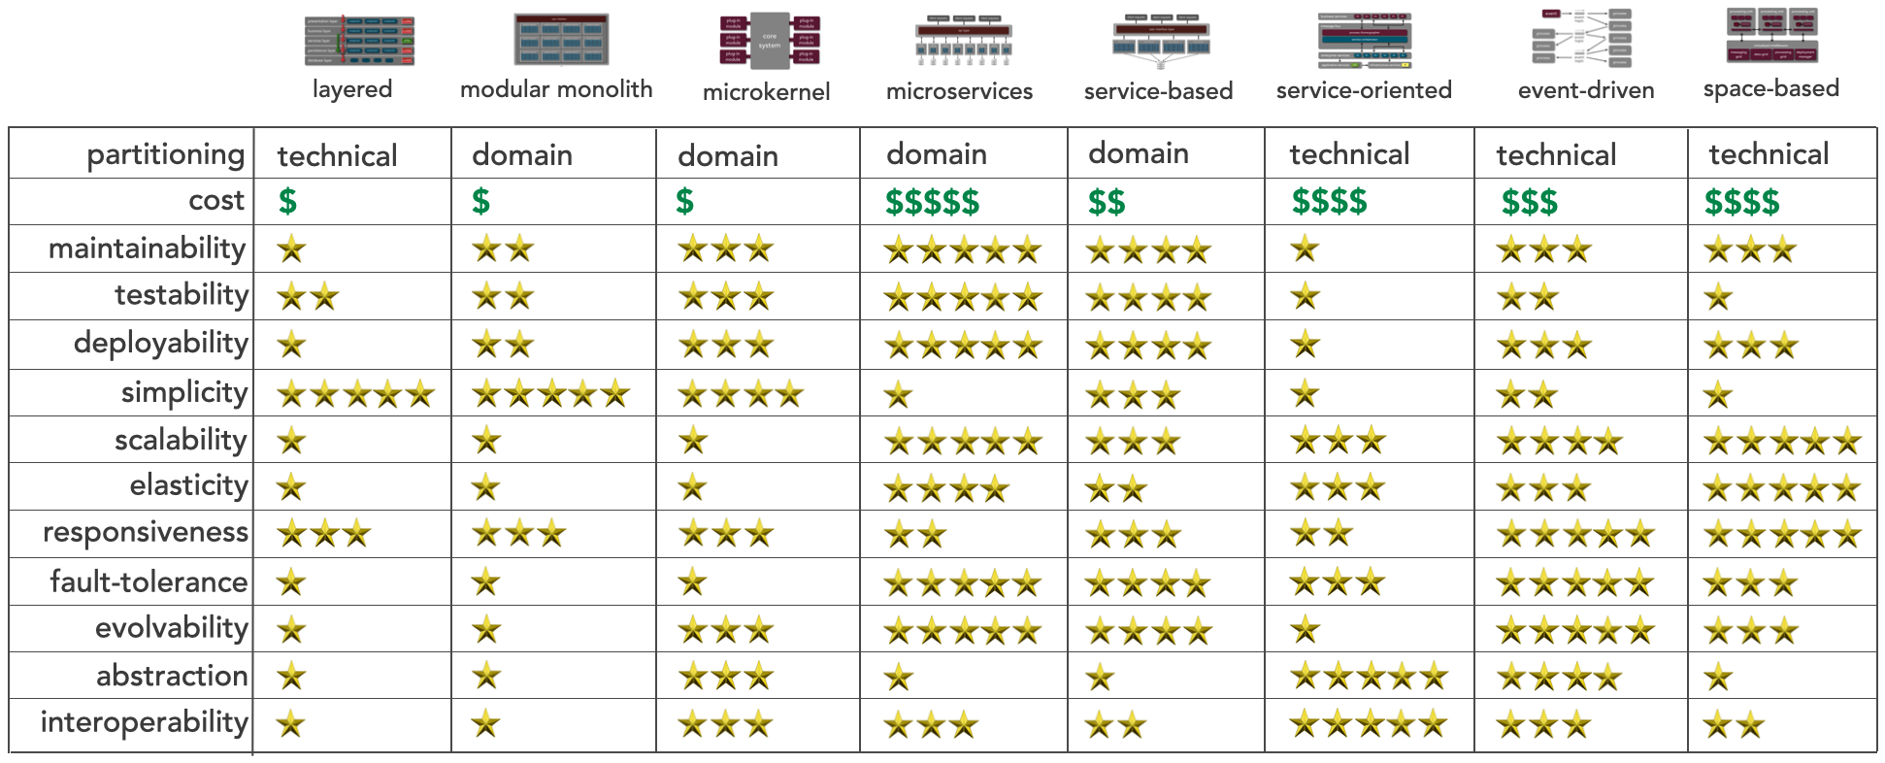
Architecture Styles Worksheet
System/Project:
Architect/Team:
Date:
Selected Architecture(s):
V2.0 Created by Mark Richards, DeveloperToArchitect.com

