Slide 1
Github: The understanding
Brock Kamrath

Slide 2
Introduction
Welcome to Version Control week!

Slide 3


Slide 4
In our lectures and excercises on version control with GitHub, we will largely utilize + Happy Git and GitHub for the useR by Jennifer Bryan @ happygitwithr.com + Introduction to Github by Lise Montefiore for REEU P4 program

Slide 5
Today’s Schedule
Article discussion
Work through Chapter 18: Test drive R Markdown
Discussion on Workflow (markdown files instead of .docx files) and general questions
Present and discuss excerise to be due the following Tuesday 2/9/21

Slide 6
Discussion Questions
1. What have you found to be the most challenging aspect of GitHub and Version Control?

Slide 7
Discussion Questions
What have you found to be the most challenging aspect of GitHub and Version Control?
2. What are your biggest concerns about using GitHub and RMarkdown for homework and future collaboration?

Slide 8
Git/GitHub and RStudio is suited to R Markdown file for reports
If you are anything like me, when you write a report you immediately open MS Word.
However, version control with GitHub and RStudio is suited for using R and RMarkdown files
Here is the official R Markdown documentation Here is the R Markdown cheatsheet

Slide 9
What else you do in R Markdown
Presentations
Handouts
Interactive reports
Books
Blogs
Websites
Correctly-formatted journal articles
With formulas
$$\sum_{i=0}^{n}{i^{2}}=\frac{(n^{2}+n)(2n+1)}{6}$$

Slide 10
Go through a example using CH: 18
In your myrepo repository, We will
Author an R Markdown document
Render it to a markdown file
Commit and push to GitHub

Slide 11
Workflows - RMarkdown
Create a new R markdown file
Edit the output format
if using GitHub to host file, then set output: github_document or add a keep_md: true
By making foo.Rmd available, others can see and run your actual code.
By sharing foo.md and/or foo.html, others can casually browse your end product and decide if they even want to bother
Work on the report/document/presentation
Add code in chunks. Refine it. Add new chunks. Go crazy!
Keep running the code “manually” to make sure it works.
Save, then knit
Commit the files to GitHub (with a comment)
Push to your GitHub repository
View in GitHub

Slide 12
Workflows - Fork and Clone
You know how to clone, commit, push, and pull from a repo you created in GitHub
But how do you clone and edit someone else’s repository when collaborating
Fork and Clone!

Slide 13
Workflows - Fork and Clone
In GitHub, navigate to the repo of interest
Click Fork (in the upper right hand corner)
This creates a repo in your GitHub account
Clone the forked repo (aka your copy of the repo) into your GitHub remote to your local computer
We have done this before

Slide 14
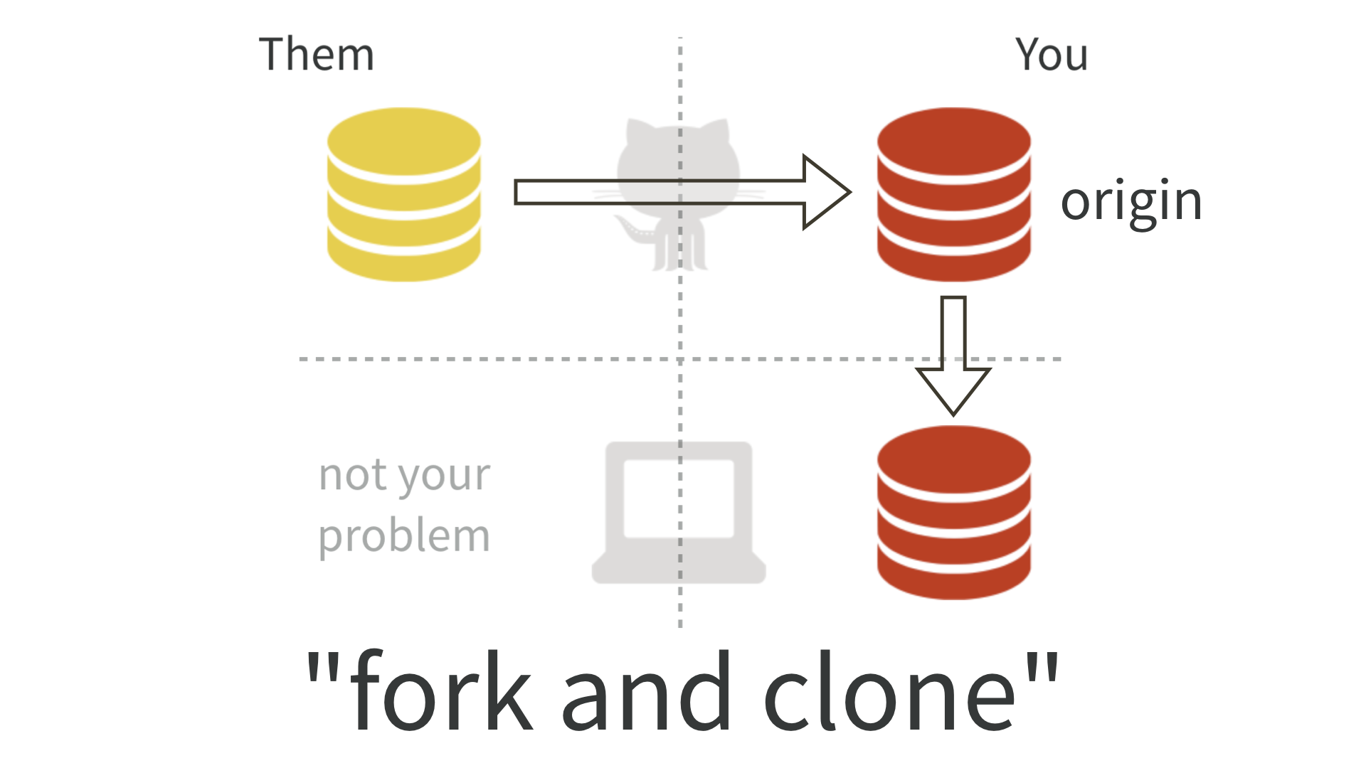

Slide 15
Workflows - fork and clone
Now you can engage with the new repo
If you want the owner of the original repo to add your work, submit a pull request
pull request - you are requesting that they pull in your work
BUT
Dont mess with the master!
Work in a new branch!
Do not make commits to the master of a repo that you forked
The owner of the repo will be happier to recieve a pull request from a non-master branch

Slide 16
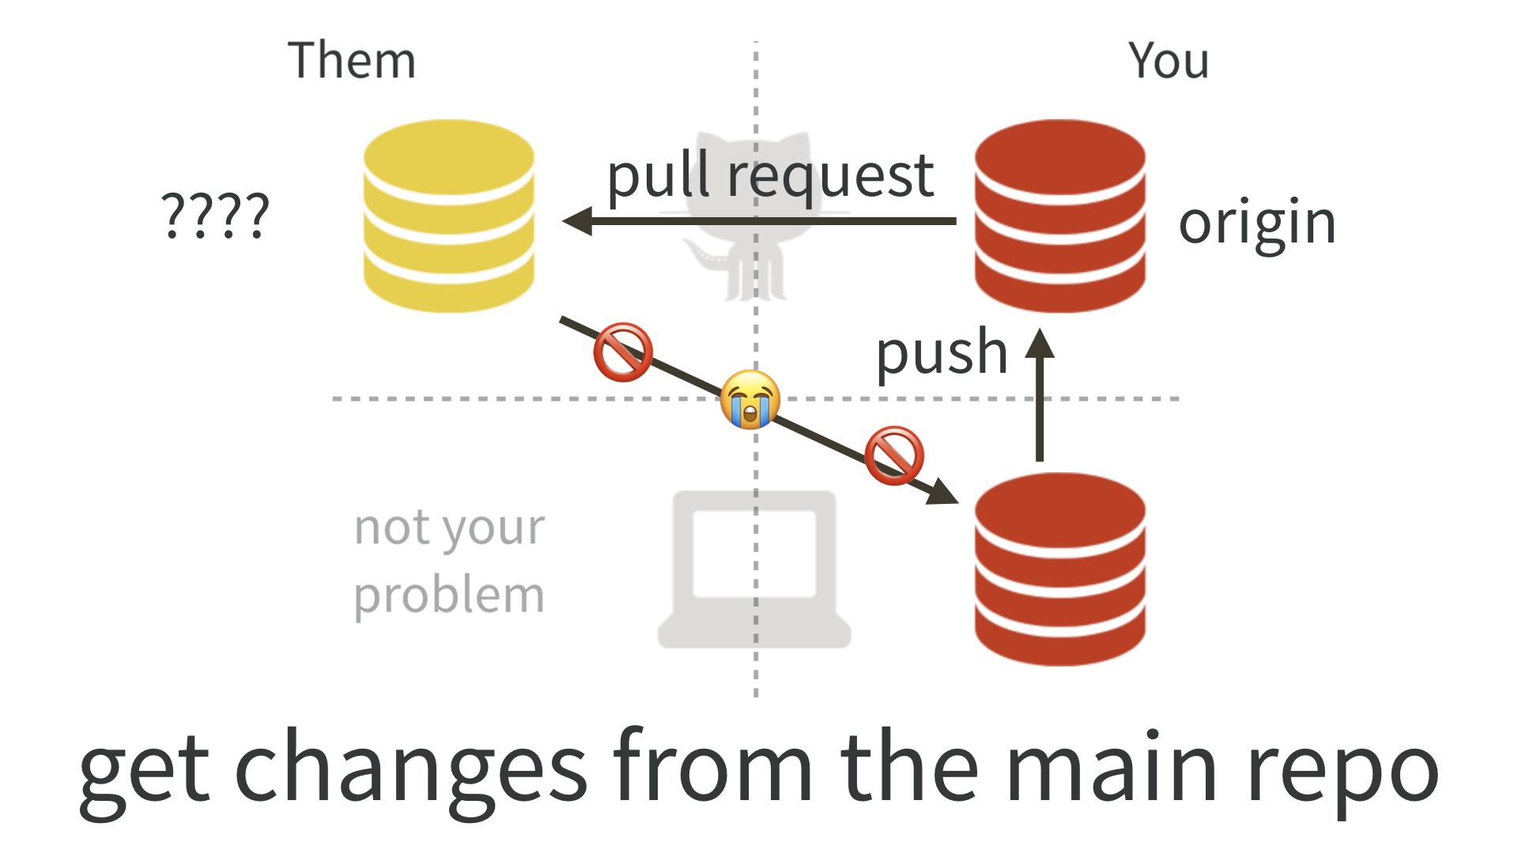
You are now here

Slide 17
Workflows - fork and clone
In order to keep your copied repo up-to-date, you need to get the upstream changes
This will need to be done in the terminal
First, list your remotes
Let’s inspect the current remotes for your local repo. In the shell (Appendix @ref(shell)):
git remote -v
We need to add the upstream remote

Slide 18
Workflows - upstream remote
Let us add OWNER/REPO as the upstream remote.
On GitHub, make sure you are signed in and navigate to the original repo, OWNER/REPO. It is easy to get to from your fork, YOU/REPO, via “forked from” links near the top.
Use the big green “Clone or download” button to get the URL for OWNER/REPO on your clipboard. Be intentional about whether you copy the HTTPS or SSH URL.
Now, click on “New Branch” in the Git pane.

Slide 19
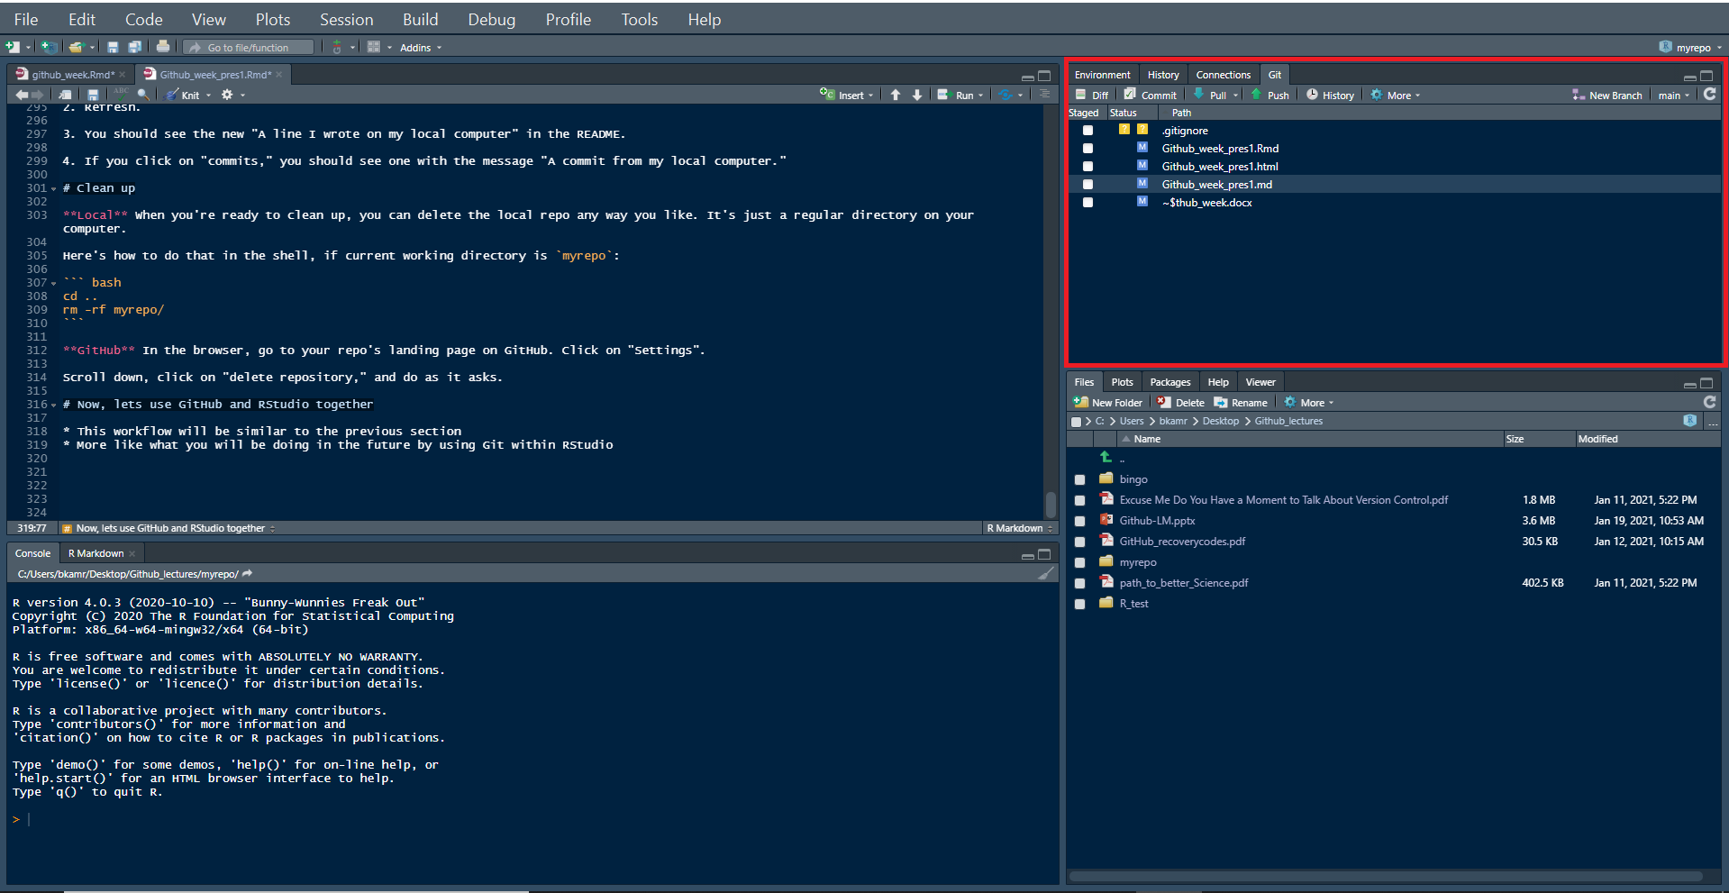

Slide 20
Click “Add Remote”
Enter upstream as the remote name
paste the URL for OWNER/REPO that you got from GitHub.
Click “Add”.
Decline the opportunity to add a new branch by clicking “Cancel”.
The nickname upstream can technically be whatever you want, however, there is a strong tradition of using upstream

Slide 21
Workflows - verify upstream remote
Let’s inspect the current remotes for your local repo AGAIN. In the shell:
git remote -v
Now you should see something like
origin https://github.com/YOU/REPO.git (fetch) origin https://github.com/YOU/REPO.git (push) upstream https://github.com/OWNER/REPO.git (fetch) upstream https://github.com/OWNER/REPO.git (push)
Notice the second remote, named upstream, corresponding to the original repo on GitHub. We have gotten to this:

Slide 22
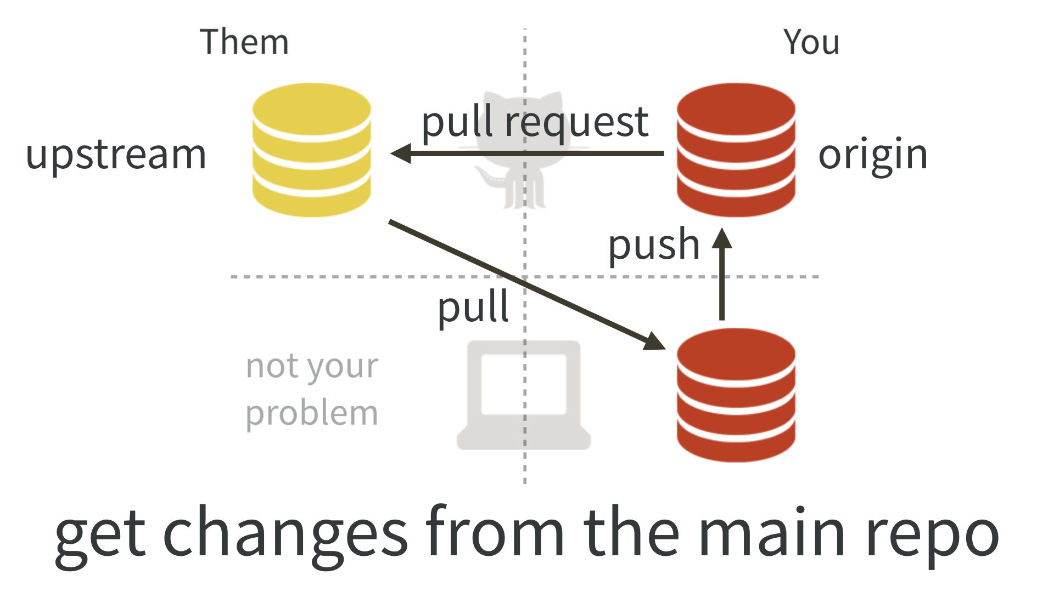

Slide 23
Pull changes from upstream
Now we can pull the changes that we don’t have from OWNER/REPO into our local copy.
git pull upstream master --ff-only
This says: “pull the changes from the remote known as upstream into the master branch of my local repo”.
We are being explicit about the remote and the branch in this case, because the upstream/master is not the default tracking branch for local master.
I highly recommend using the --ff-only flag

Slide 24
Those are the basics in Git, GitHub, and RStudio
Now lets get to work on an exercise!

Slide 25
Class exercise

