Slide 1
Meeting with NCWQR

Slide 2
Methods + analysis
Three step analysis of trends
What were the overall trends from 2009-2021
What have recent year trends differed from previous trends in response to more intensive nutrient management regulations? (2009-2015 vs. 2015-2021)
Where have these changes come from?
Flow conditions trends
split on low and high using the 60th percentile
Seasonal trends
Split into winter (Dec – Feb), spring (Mar – Jul), and offseason (Aug – Nov)
*Potentially consider including March in the Winter months
*At this point, make sure to keep separate (can think about further)
*average concentration on flows greater than 90/95%
Count events and constrain within timeframe.*
*consider discussing 2019 effects*

Slide 3
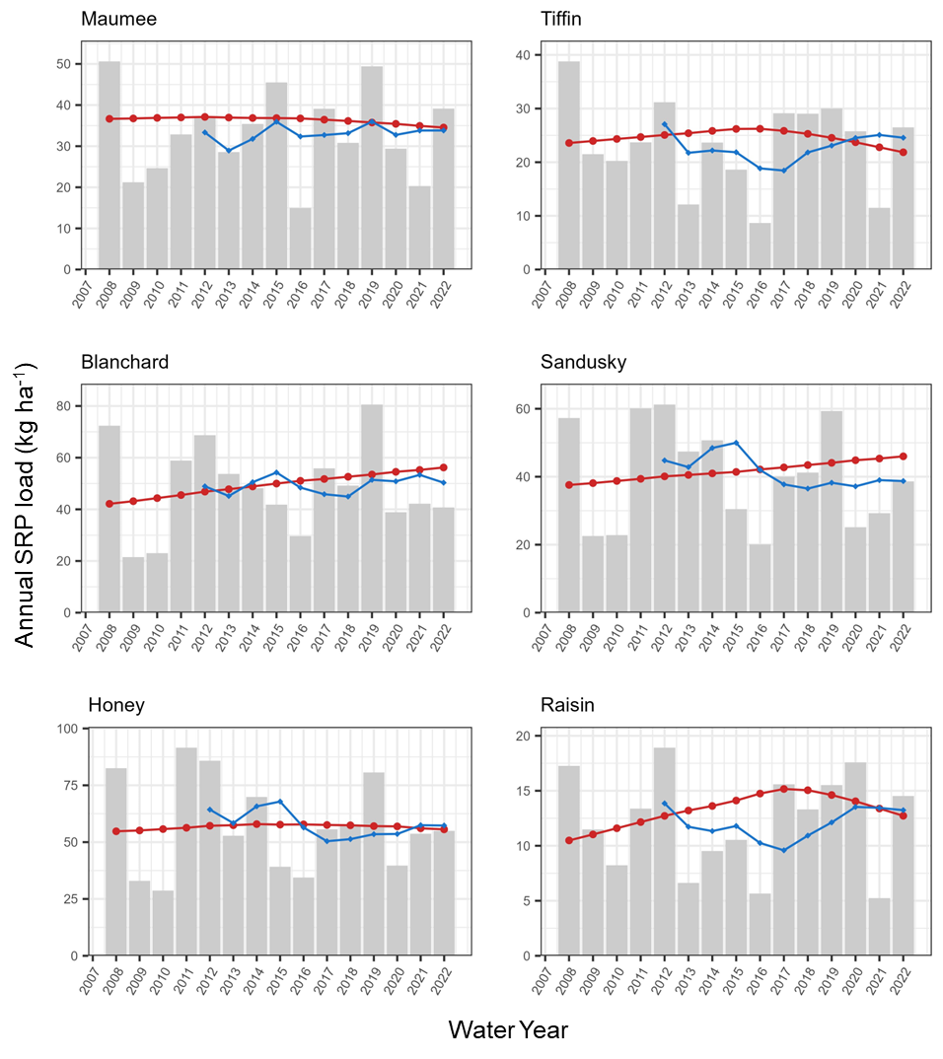
Annual Fluxes in SRP
-5%
-5%
28%
19%
2%
21%

Slide 4
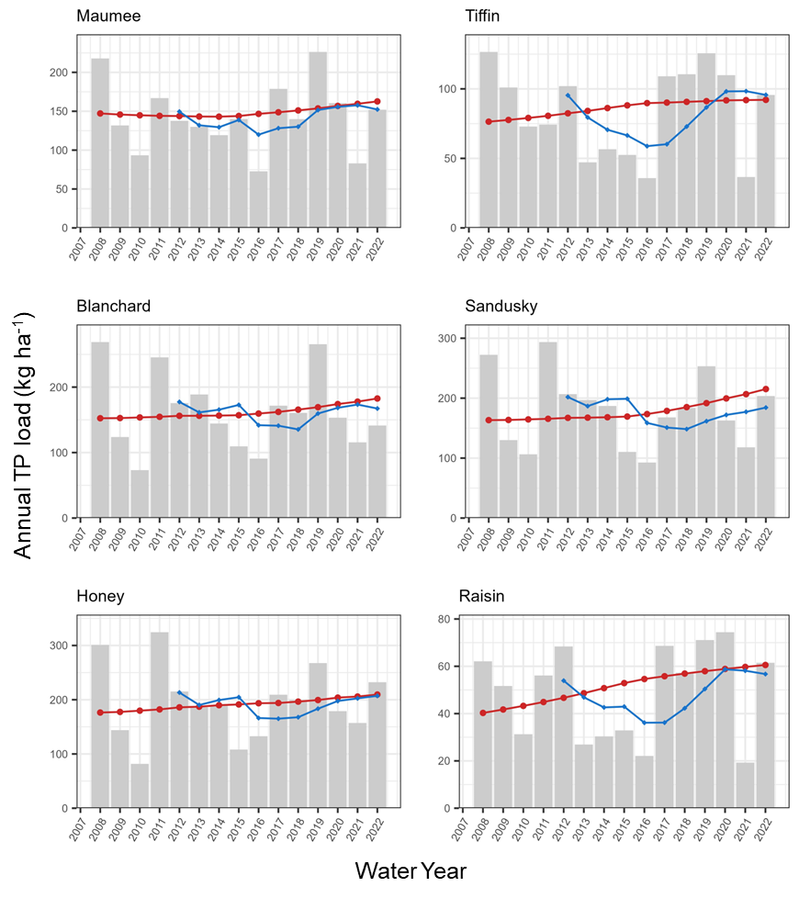
Annual Fluxes in TP
10%
18%
16%
26%
16%
43%

Slide 5
Have these improvements occurred recently?
In light of the WLEB nutrient regulations implemented in 2015

Slide 6
SRP (%/yr) has been improving
Site | FN concentration |  | FN flux
 | 2009-2015 | 2015-2021 | 2009-2015 | 2015-2021
MAU | 0.8 | -0.8 | 0.04 | -0.86
TIF | 1.7 | -2.4 | 1.60 | -2.2
BLA | 12 | 3.2 | 2.60 | 1.8
SAN | 1.2 | 3.2 | 1.40 | 1.6
HON | -0.7 | -0.8 | 0.78 | -0.47
RAI | 7.2 | 2.0 | 4.70 | -0.86
Average | 3.7 | 0.7 | 1.9 | -0.2

Slide 7
TP (%/yr) changes have been variable
Site | FN concentration |  | FN flux
 | 2009-2015 | 2015-2021 | 2009-2015 | 2015-2021
MAU | -0.3 | 1.2 | -0.2 | 1.8
TIF | 1.7 | -0.6 | 2.3 | 0.7
BLA | 5.1 | 2.7 | 0.5 | 2.2
SAN | -0.3 | 3.8 | 0.6 | 3.7
HON | 0.6 | 1.3 | 1.3 | 1.3
RAI | 3.8 | 1.5 | 4.5 | 2.2
Average | 1.8 | 1.7 | 1.5 | 2.0

Slide 8
Where have changes been occuring?
Flow conditions
Seasonal conditions

Slide 9
SRP – Changes were consistent across conditions
Site | FN concentration |  | FN flux
 | Low | High | Low | High
MAU | -0.6 | 0.5 | -0.4 | -0.4
TIF | -0.5 | -0.4 | -1.3 | -0.3
BLA* | 12 | 3.6 | 8.4 | 1.6
SAN | 2.1 | 2.4 | 1.0 | 1.6
HON | -1.8 | 0.0 | -1.3 | 0.2
RAI* | 7.5 | 3.4 | 3.8 | 1.5
Average | 3.1 | 1.6 | 1.7 | 0.7

Slide 10
TP - high flow changes were typically greater although all were positive
Site | FN concentration |  | FN flux
 | Low | High | Low | High
MAU | 0.1 | 0.8 | 0.3 | 0.8
TIF | 0.0 | 0.9 | 0.3 | 1.7
BLA* | 6.7 | 2.1 | 4.2 | 1.2
SAN | 0.6 | 2.4 | 1.1 | 2.3
HON | 0.1 | 1.4 | 0.5 | 1.4
RAI | 2.5 | 3.1 | 2.3 | 3.8
Average | 3.1 | 1.6 | 1.7 | 0.7

Slide 11
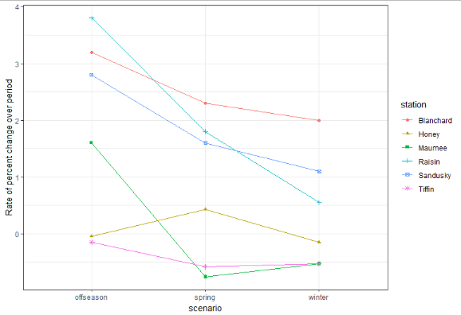
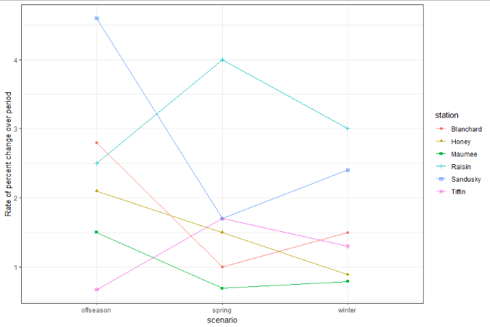
SRP fluxes
TP fluxes
Notes:
Still need to investigate changes in season from pre vs. post

