Slide 1
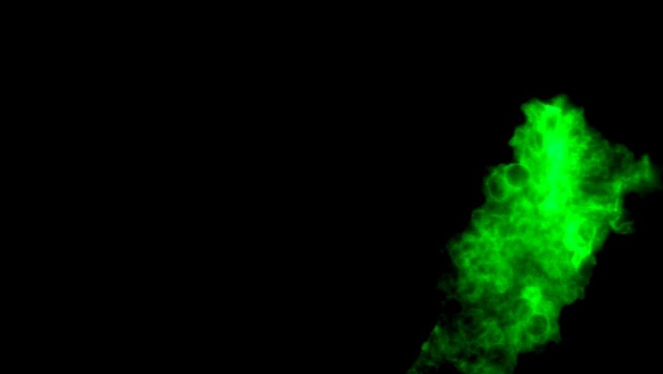
Measures of Disease in Clinical Epidemiology
Brendan J. Kelly, MD, MS
Infectious Diseases, Epidemiology & Microbiology University of Pennsylvania
19 November 2025
image: Federica Viazzi "Microscopy image of P. jirovecii"

Slide 2
Disclosures
No conflicts of interest.

Slide 3
Learning Objectives
Measures of disease occurrence: use population data to describe health and disease.
Key concepts -- explain the meaning of:
data types and terminology prevalence
incidence (warning: multiple types)
relative risk (RR) odds ratio (OR)
Implementation: prevalence, incidence, RR, and OR from study data (2x2 tables!).

Slide 4
Why Do I Care? ...
Why use these tools (prevalence, incidence, RR, OR)?
inform differential diagnoses & counsel patients (your job)
design public health interventions & direct new diagnostics/therapies (society!) understand distributions and determinants of diseases (science!)

Slide 5
... What Do I Need to Know for the Test?
Why use these tools (prevalence, incidence, RR, OR)?
inform differential diagnoses & counsel patients (y our job)
design public health interventions & direct new diagnostics/therapies (society!) understand distributions and determinants of diseases (science!)
How to use these tools:
precise definitions (e.g., RR vs OR, cumulative incidence vs incidence density) a bit of arithmetic

Slide 6
Data Types & Distributions

Slide 7
Data Types & Distributions
Case from 1981

Slide 8
Data Types & Distributions
Case from 1981
Prevalence

Slide 9
Data Types & Distributions
Case from 1981
Prevalence
Incidence

Slide 10
Data Types & Distributions
Case from 1981
Prevalence
Incidence
Inference from Exposures & Outcomes

Slide 11
Data Types & Distributions
Case from 1981
Prevalence
Inference from Exposures & Outcomes
Relative Risk &
Odds Ratios
Incidence

Slide 12
Data Types & Distributions
Case from 1981
Prevalence
Inference from Exposures & Outcomes
Relative Risk &
Odds Ratios
Incidence

Slide 13
Data Types
Dichotomous: binary 0 / 1, true / false
the focus of most methods in this course (e.g., pneumonia, MI)
Continuous: real values, infinite scale
discussed in diagnostics lecture (e.g., age, height)
Nominal: discrete data
categories without intrinsic order (e.g., state)
Ordinal: discrete data
categories with intrinsic order (e.g., age category)

Slide 14
How to Characterize Continuous Data
Pair a measure of central tendency with a measure of dispersion:
mean and SD (both affected by outliers) median and IQR
In doing so, account for uncertainty in measures.

Slide 15
Characterize Continuous Data: Central Tendency
Mean ( μ):
1
N
μ = ∑ xi N
i=1
Median: middle value, when values ordered / ranked
Mode: most frequently occurring value
(you do NOT need to memorize these formulas)

Slide 16
Characterize Continuous Data: Variation/Spread
Standard deviation (SD or σ):
 1
σ = ⎷
N
∗ ∑(x_{i} − μ)²
i=1
N
Interquartile range (IQR) depends on ranking the values:
the first quartile is the "middle" value of the first half of the ordered set
the third quartile is the "middle" value of the second half of the ordered set IQR is the range of values between first and third quartiles
(you do NOT need to memorize these formulas)

Slide 17
Describing Continuous Data
"Normally distributed": data well characterized by mean and standard deviation (SD).
“Non-parametric” data have a mean and standard deviation, but these parameters do NOT characterize the data well...

Slide 18
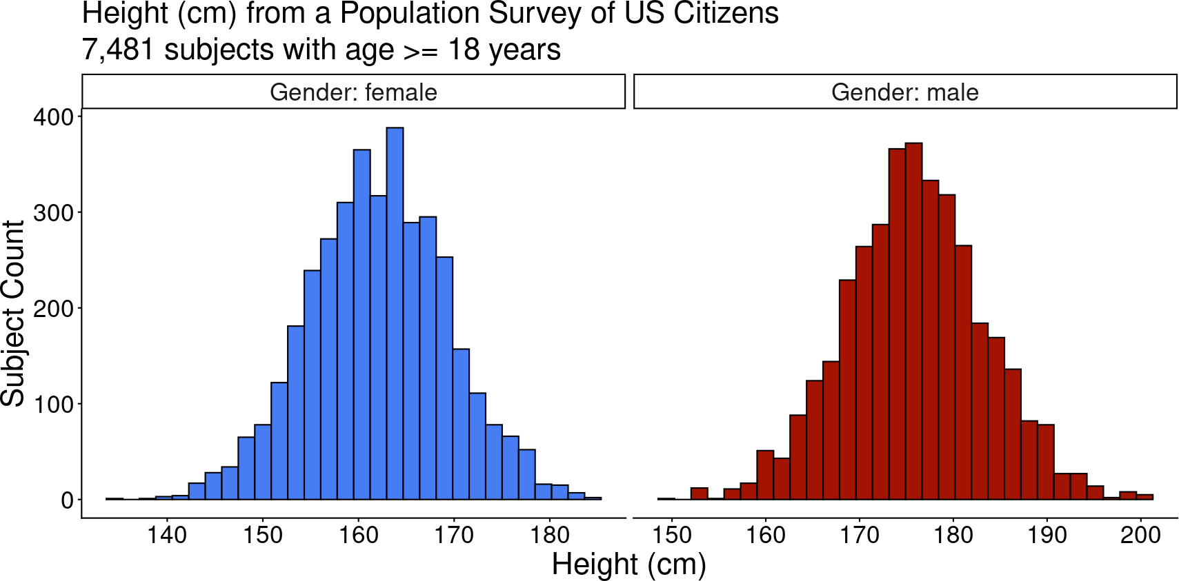
"Normally Distributed" Continuous Data
CDC National Health and Nutrition Examination Survey (NHANES)

Slide 19
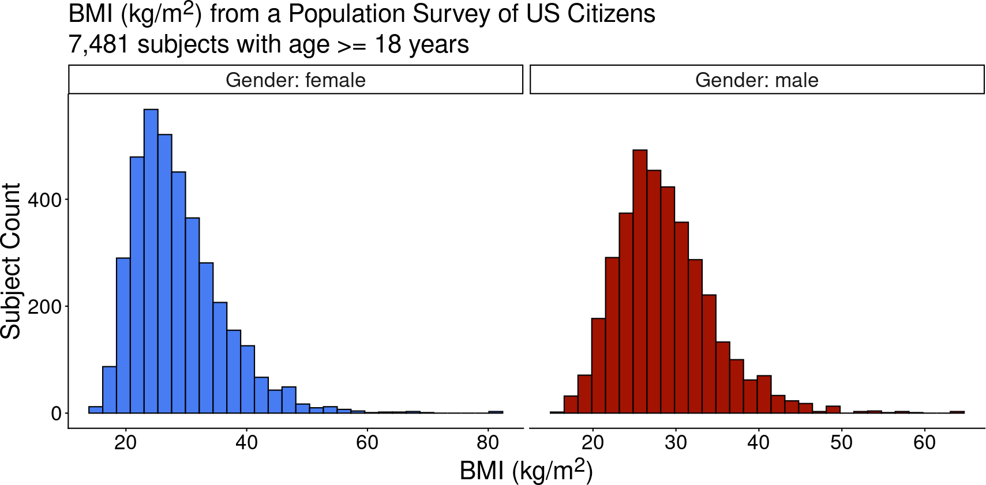
"Non-Parametric" Continuous Data: Skewed
CDC National Health and Nutrition Examination Survey (NHANES)

Slide 20
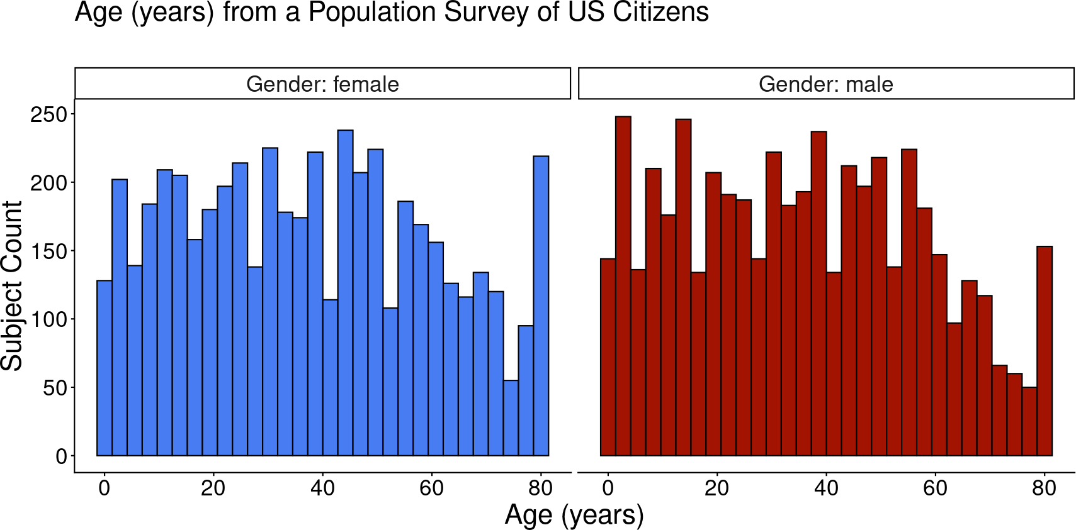
"Non-Parametric" Continuous Data: Uniform
CDC National Health and Nutrition Examination Survey (NHANES)

Slide 21
Describing Continuous Data
"Normally distributed": data well characterized by mean and standard deviation (SD).
“Non-parametric” data have a mean and standard deviation, but these parameters do NOT characterize the data well:
skewed data: distribution not symmetric around a central value
uniform data: distributed with equal probability of each value
For "non-parametric" data, we prefer to use median and interquartile range (IQR) to describe the distribution of a continuous variable because these are less affected by extreme values.
You can always calculate mean and SD from continuous data. But these parameters might not represent the data well.

Slide 22
Dichotomizing Continuous Data
Using a threshold to transform continuous data into dichotomous data means
losing
information about uncertainty.
This is on top of the fundamental uncertainty we face with any epidemiologic measure: does the measured population represent the population of interest?
See the diagnosis lecture: for example, threshold of oxygen saturation (or β-D glucan) to diagnose Pneumocystis pneumonia (PCP) means trade-off between sensitivity and specificity.

Slide 23
Dichotomania
As we discuss prevalence, incidence, RR, and OR, we focus on dichotomous exposures and outcomes.
Remember -- with dichotomous data: information about uncertainty is lost misclassification is a risk
But we're doing it anyway 😀 ... why?
Medicine focuses on dichotomous diagnostic and treatment decisions.
Altman & Royston BMJ 2006

Slide 24
What About Regression?
As we discuss prevalence, incidence, RR, and OR, we focus on dichotomous exposures and outcomes.
Regression methods account for different data types: linear models: continuous outcomes
generalized linear models: dichotomous, nominal, ordinal, etc outcomes can incorporate different exposure data types & multiple exposures
Regression methods are beyond the scope of this course.
Altman & Royston BMJ 2006

Slide 25
Data Types & Distributions
Case from 1981
Prevalence
Incidence
Inference from Exposures & Outcomes
Relative Risk &
Odds Ratios

Slide 26
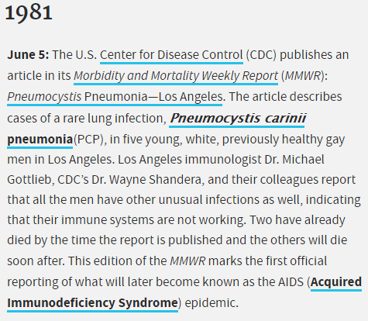
HIV Pandemic: MMWR June 5, 1981

Slide 27
HIV Pandemic: MMWR June 5, 1981
All the above observations suggest the possibility of a
cellular-immune
dysfunction related to a common exposure that predisposes individuals to
opportunistic infections such as pneumocystosis and candidiasis
. Although the
role of CMV infection in the pathogenesis of pneumocystosis remains unknown, the possibility of P. carinii infection must be carefully considered in a differential diagnosis for previously healthy homosexual males with dyspnea and pneumonia.
— Gottlieb MS et al MMWR 1981

Slide 28

HIV Pandemic: Stigma & Discrimination
Socially vulnerable groups often at higher infection risk:
HIV, COVID-19
how we name infectious diseases has exacerbated stigma
bad epidemiology exacerbates stigma
Prejudice is used to gain political power: homophobia in the 1980s
anti-Asian racism in the 2020s
Radiolab "The Ashes on the Lawn"

Slide 29
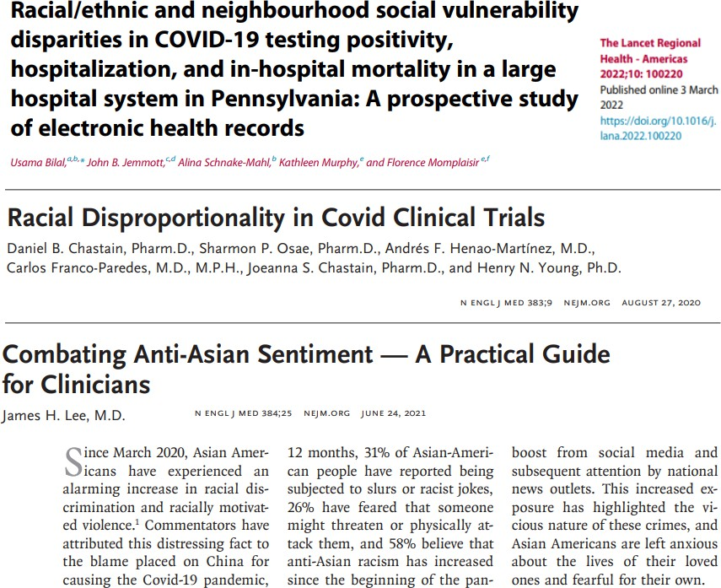
COVID-19 Pandemic: Stigma & Discrimination
As we proceed in course, think about causal versus proxy variables. For example:
Race is not a proxy for biology.
Race exerts large effects on health: structural racism & direct / interpersonal racism
High-risk work, access to care, and social networks are some ways social determinants and racism impact health.
Bilal U et al Lancet Reg Health Am 2022;
Chastain DB et al NEJM 2020; Lee JH NEJM 2021

Slide 30
Case from 1981... Pneumocystis pneumonia?
36-year-old man presents with a 4-month history of fever, dyspnea, and cough.
What is his diagnosis? Does he have Pneumocystis pneumonia (PCP)?
As you collect data (history, vital signs, physical exam, laboratory test values, radiology results), you are making inferences about the diagnosis based on associations between your findings and disease states.

Slide 31
Case from 1981... Pneumocystis pneumonia?
Differential diagnosis must be grounded in understanding:
distributions of disease: we'll learn about prevalence & incidence
determinants of disease: we'll learn 2x2 tables to relate exposures and outcomes
PCP is a fungal pneumonia caused by Pneumocystis jirovecii (formerly Pneumocystis carinii), which causes dyspnea, hypoxemia, and nonproductive cough, and eventually cystic lung changes.
In 1981, Pneumocystis was known to be a low prevalence disease. New data would show an increasing incidence.

Slide 32
Case from 1981... Pneumocystis pneumonia?
Does our patient have Pneumocystis pneumonia (PCP)?
How is the distribution of Pneumocystis pneumonia changing? What are the determinants of Pneumocystis pneumonia?
Note: questions depend on dichotomous definition of disease (yes/no Pneumocystis)

Slide 33
Measuring Disease Occurrence
Data Types & Distributions
Case from 1981
Inference from Exposures & Outcomes
Relative Risk &
Odds Ratios
Incidence

Slide 34
Data Types & Distributions
Case from 1981
Prevalence
Inference from Exposures & Outcomes
Relative Risk &
Odds Ratios
Incidence

Slide 35
Prevalence
How common is Pneumocystis pneumonia (PCP)?
Prevalence:
number with the disease / number in specified population
point prevalence: at a specific point in time
period prevalence: during a given period (e.g., 12-month prevalence) a proportion (unitless, ranges from 0-1)
numerator includes all people who have the disease, both new and ongoing cases represents a cross-sectional “snapshot” of the population

Slide 36
Prevalence of Pneumocystis pneumonia
In 1967, CDC became the sole supplier of pentamidine in the United States and began collecting data on cases of PCP:
period prevalence published in 1974*: 579 cases (194 confirmed) over 3 years what’s the denominator?
what’s the prevalence?
Point prevalence of Pneumocystis would be vanishingly small given limited duration of disease.
From 1967-1974, even the period prevalence was very small.
[*] Walzer PD et al Annals Int Med 1974

Slide 37
Point Prevalence versus Period Prevalence
To understand the difference between point and period prevalence, let's imagine a cohort of people living with HIV/AIDS at risk for Pneumocystis:
50 high-risk subjects enrolled at the start of a two-year observation period cases of PCP each receive 3 weeks of antibiotic treatment (red on plot) incomplete follow-up (grey on plot)
some subjects started on Pneumocystis prophylaxis (blue on plot)

Slide 38
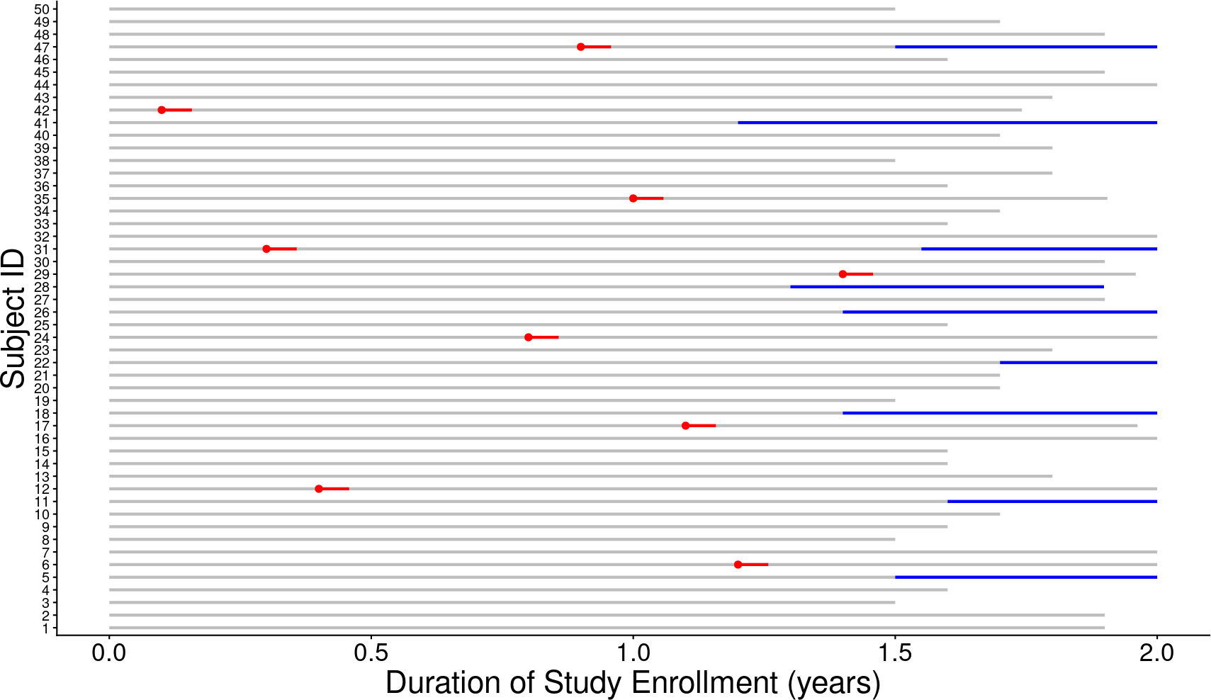
Cohort at Risk for Pneumocystis

Slide 39
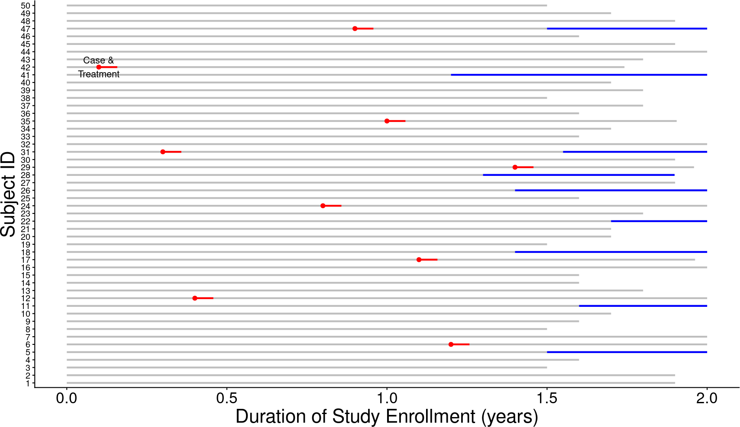
Cohort at Risk for Pneumocystis

Slide 40
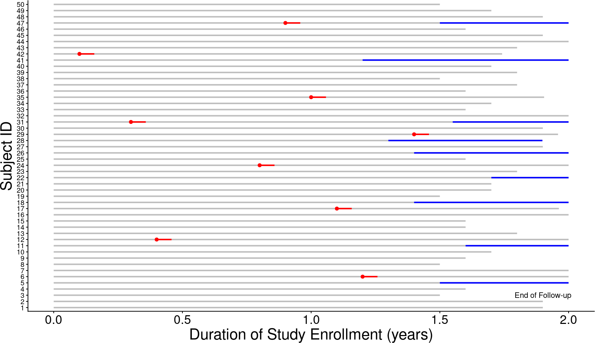
Cohort at Risk for Pneumocystis

Slide 41
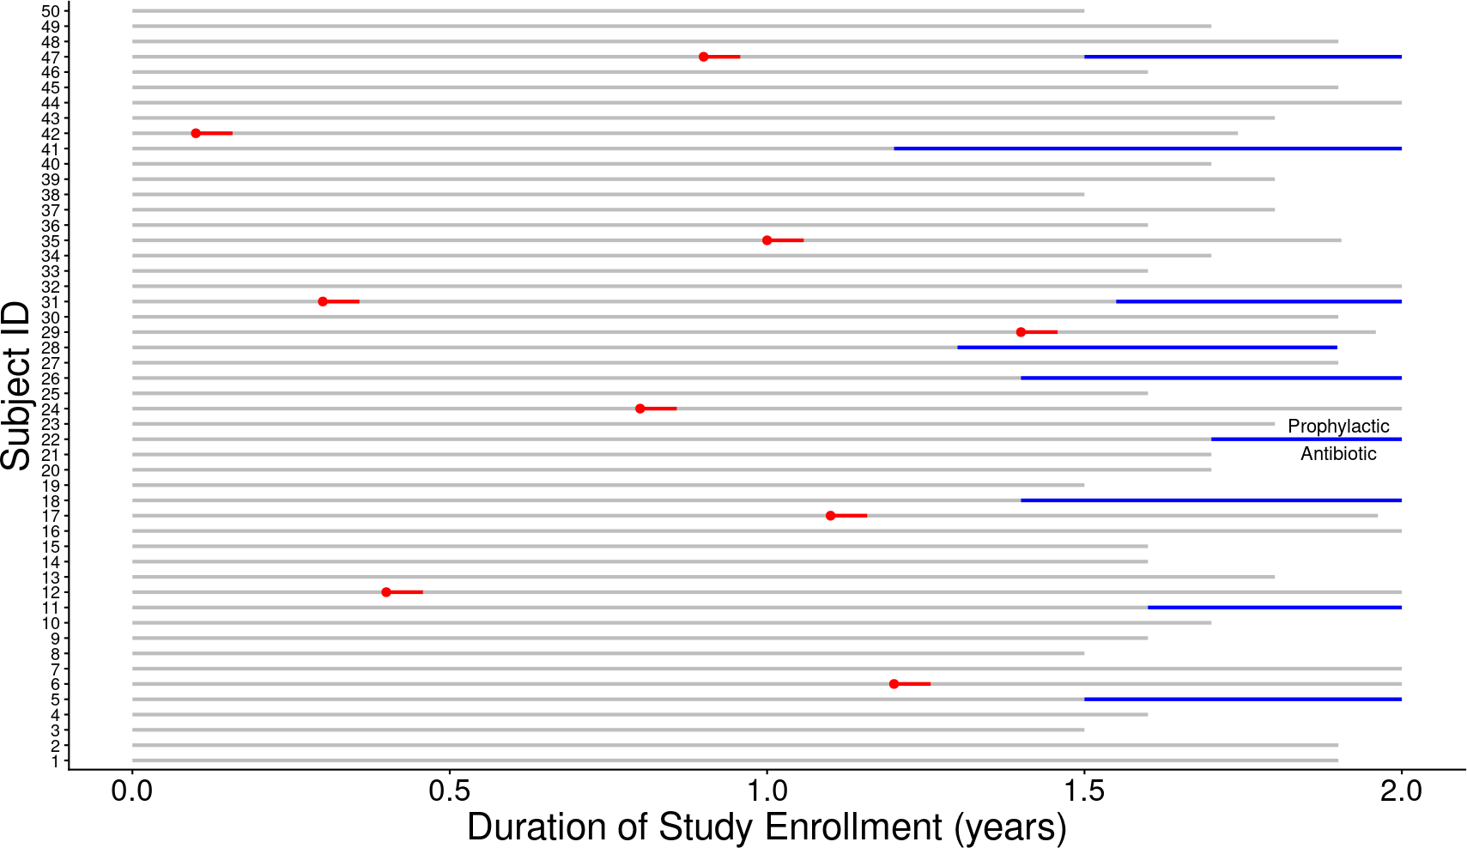
Cohort at Risk for Pneumocystis

Slide 42
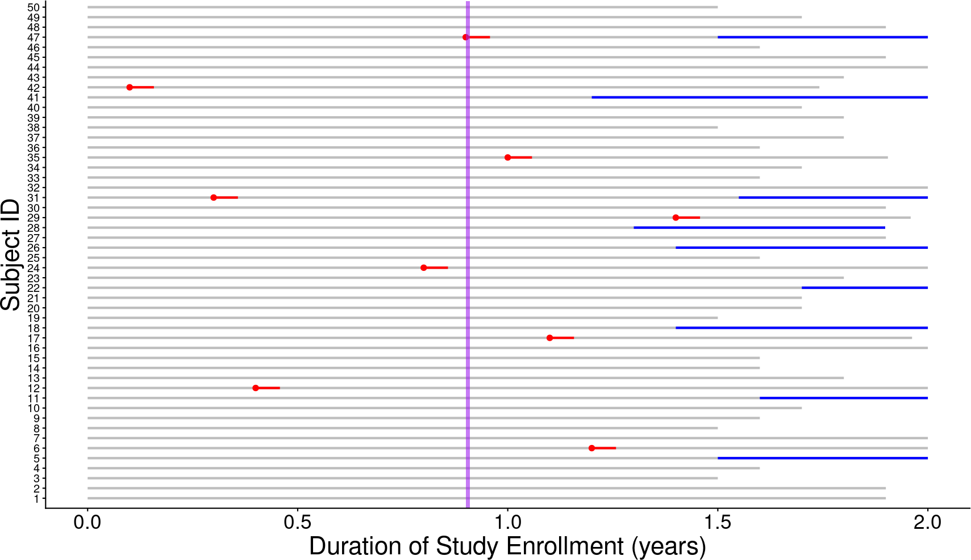
Cohort at Risk: Point Prevalence

Slide 43
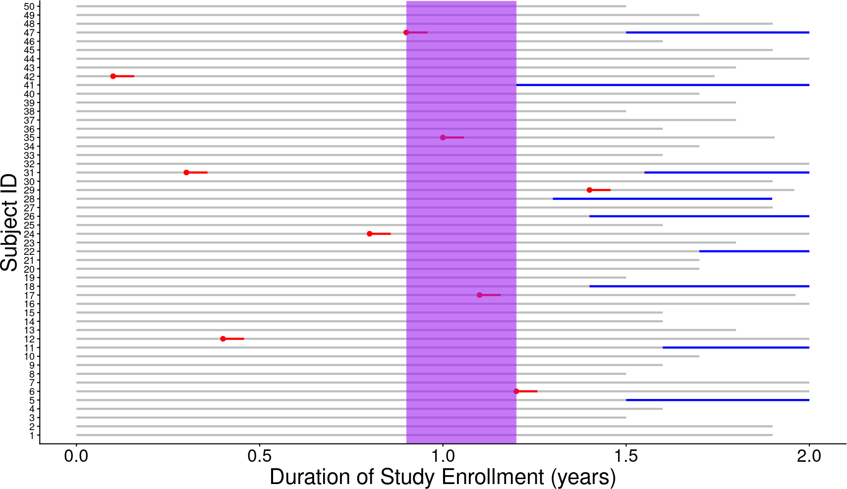
Cohort at Risk: Period Prevalence

Slide 44
Prevalence
Prevalence is NOT the same as risk.
Prevalence numerator includes all people who have the disease, both new and ongoing cases, so represents a cross-sectional “snapshot” of the population.
Prevalence does NOT estimate the risk of developing the disease because
prevalence
does NOT fully account for time
(are the measured cases old cases or new cases?).
Prevalence can provide a useful snapshot of the burden of disease.

Slide 45
Reflection Question
How can an infection have high prevalence if it occurs infrequently?
the infection is rapidly fatal
the infection rapidly resolves
a few children get the infection every year, but the infection persists for the rest of their lives
the infection results in lifelong protective immunity

Slide 46
Data Types & Distributions
Case from 1981
Prevalence
Measuring Disease Occurrence
Inference from Exposures & Outcomes
Relative Risk &
Odds Ratios

Slide 47
Data Types & Distributions
Case from 1981
Prevalence
Incidence
Inference from Exposures & Outcomes
Relative Risk &
Odds Ratios

Slide 48
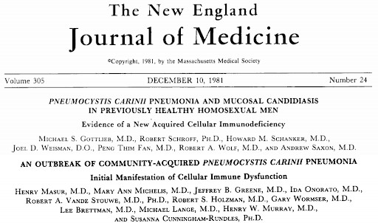
Case from 1981... Pneumocystis pneumonia?
new Pneumocystis cases (NYC¹): 13 cases over 21 months
new Pneumocystis cases (LA²): 5 cases over 7 months
concurrent opportunistic infections:
CMV
Candida
Kaposi's sarcoma
[1,2] Masur H et al NEJM 1981; Gottlieb MS et al NEJM 1981

Slide 49
Incidence
Pneumocystis pneumonia (PCP) is occurring more frequently...
Incidence: occurrence of new cases over a given period of time.
cumulative incidence:
new cases
cumulative incidence =
persons at risk
at start time interval
incidence density: (more precise)
new cases
incidence density =
person time at risk

Slide 50
Cumulative Incidence
Cumulative incidence:
must specify population consisting of at-risk individuals must specify a time period of observation
numerator = all new cases during a specified time period
denominator = all individuals at risk in the specified population at the start of the specified time period (does NOT account for deaths due to other causes)
ranges from 0 to 1 (a.k.a., “incidence proportion”)
like prevalence, is a proportion and therefore has no units (but only makes sense if you specify the time period of observation, e.g., % per year)

Slide 51
Incidence Density
Incidence density:
in a specified population consisting of at risk individuals over a specified period of observation, more precisely quantifies the person-time at risk
numerator = all new cases during a specified time period
denominator = the sum, over all individuals in the population, of time at risk until the event of interest, death, loss to follow-up, the end of the study, or when they are no longer at risk for whatever reason
not a proportion; range depends on the units of person-time (0 to infinity)
accounts for death from other causes!

Slide 52
Incidence: Which Denominator?
To understand the difference between cumulative incidence and incidence density, let's return to our imagined study of people living with HIV/AIDS at risk for Pneumocystis:
50 high-risk subjects enrolled at the start of a two-year observation period cases of PCP each receive 3 weeks of antibiotic treatment (red on plot) incomplete follow-up (grey on plot)
some subjects started on Pneumocystis prophylaxis (blue on plot)

Slide 53
Cohort at Risk for Pneumocystis

Slide 54
Cohort at Risk for Pneumocystis

Slide 55
Cohort at Risk for Pneumocystis

Slide 56
Cohort at Risk for Pneumocystis

Slide 57
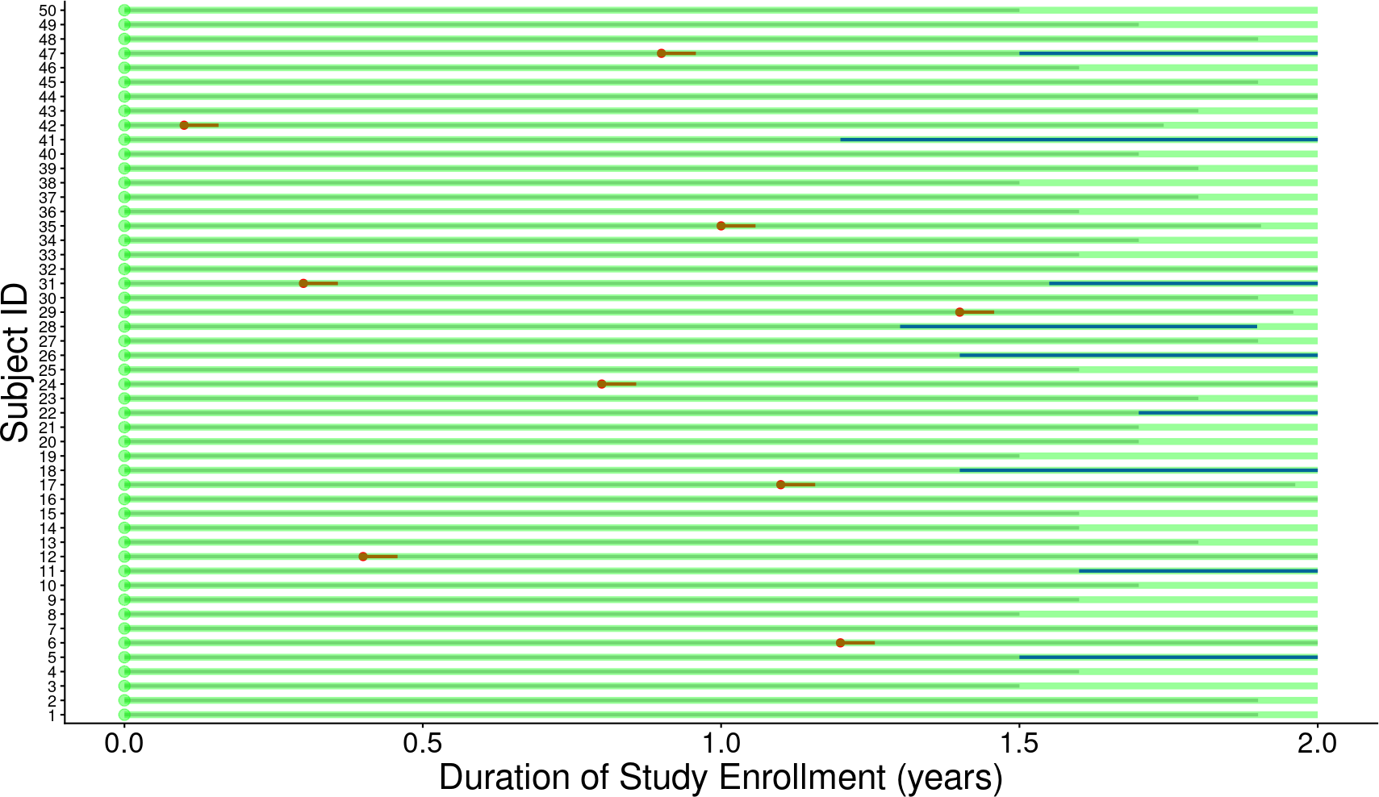
Cohort at Risk: Cumulative Incidence (at risk at start)

Slide 58
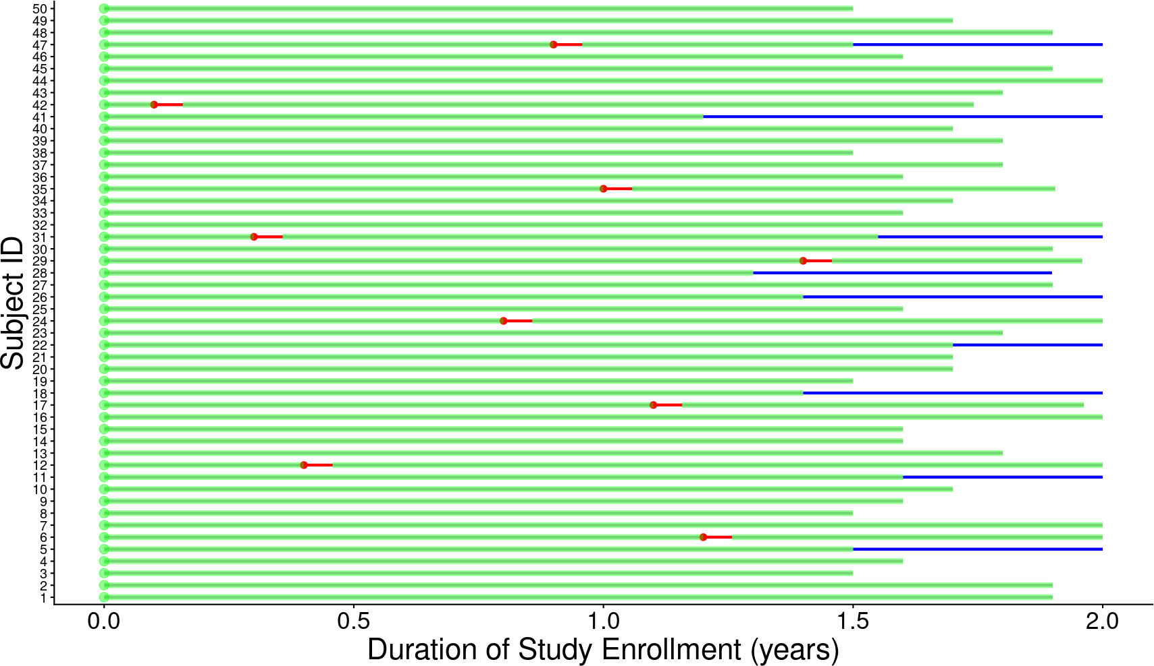
Cohort at Risk: Incidence Density (person-time at risk)

Slide 59
Incidence: Which Denominator?
Cumulative incidence of Pneumocystis versus incidence density:
if the end of the grey line is death / loss to follow-up, how does incidence density compare to annual cumulative incidence?
if you don’t count time on prophylaxis or treatment antibiotics as “time at risk”, how does the incidence density compare to the annual cumulative incidence?

Slide 60
Notes on Population at Risk
In a population, individuals are at risk of disease if they:
do not have the disease at baseline
are capable of developing the disease (e.g., have the organ of interest; have not been successfully immunized against the disease; haven’t developed lifelong immunity)
The difference between cumulative incidence and incidence density is that the latter attempts a more precise quantification of population at risk -- it’s harder to evaluate, but more informative if you can.

Slide 61
Notes on Person-Time
To improve precision of risk estimate (incidence density), we measure:
population at risk of outcome
actual time at risk (during which outcome could occur)
Person-time:
denominator for incidence density
the product of population at risk and time at risk (e.g., patient-months)

Slide 62
Beware the Phrase “Incidence Rate”!
“Incidence rate” is used to mean two different things:
number new cases / number persons at risk @ start (short) time interval (e.g., “annual incidence rate” to mean cumulative incidence over one year)
number new cases / person-time at risk (i.e., incidence density, the precise rate)

Slide 63
Reflection Question
Your patient with HIV is considering starting prophylactic antibiotics for PCP. You have PCP prevalence, cumulative incidence, and incidence density data available. Which data provide the most precise information on the patient’s risk of PCP off of prophylaxis?
prevalence
cumulative incidence
incidence density

Slide 64

Can You Tell Prevalence from Incidence?
Incidence
Prevalence
Population Size
Death or Recovery

Slide 65
Can You Tell Prevalence from Incidence?
HIV in Rakai, Uganda 1994-2003*:
intensive “ABC” intervention (Abstinence, Be faithful, Condoms) prevalence declined...
incidence remained constant at 1.5% per year! what happened?
[*] Wawer M et al CROI 2005; Roehr B BMJ 2005

Slide 66
Data Types & Distributions
Case from 1981
Prevalence
Incidence
What determines risk?
Relative Risk &
Odds Ratios

Slide 67
Data Types & Distributions
Case from 1981
Prevalence
Incidence
Inference from Exposures & Outcomes
Relative Risk &
Odds Ratios

Slide 68
Basics of Study Types
We want to understand the
relationship between risk factors (exposures) and disease
(outcomes). Move beyond risk in whole population -- what's risk conditional on particular risk factors?
To calculate incidence need to know how many are in a population:
randomized trials: pick the population, randomize, control the treatment, and measure the outcome
cohort studies: pick the population, divide into preselected exposure (treatment or risk factor) groups, and measure the outcome
But do NOT know this in case control studies: pick the cases and control groups, then measure rates of exposure (do NOT know size of population at risk).

Slide 69
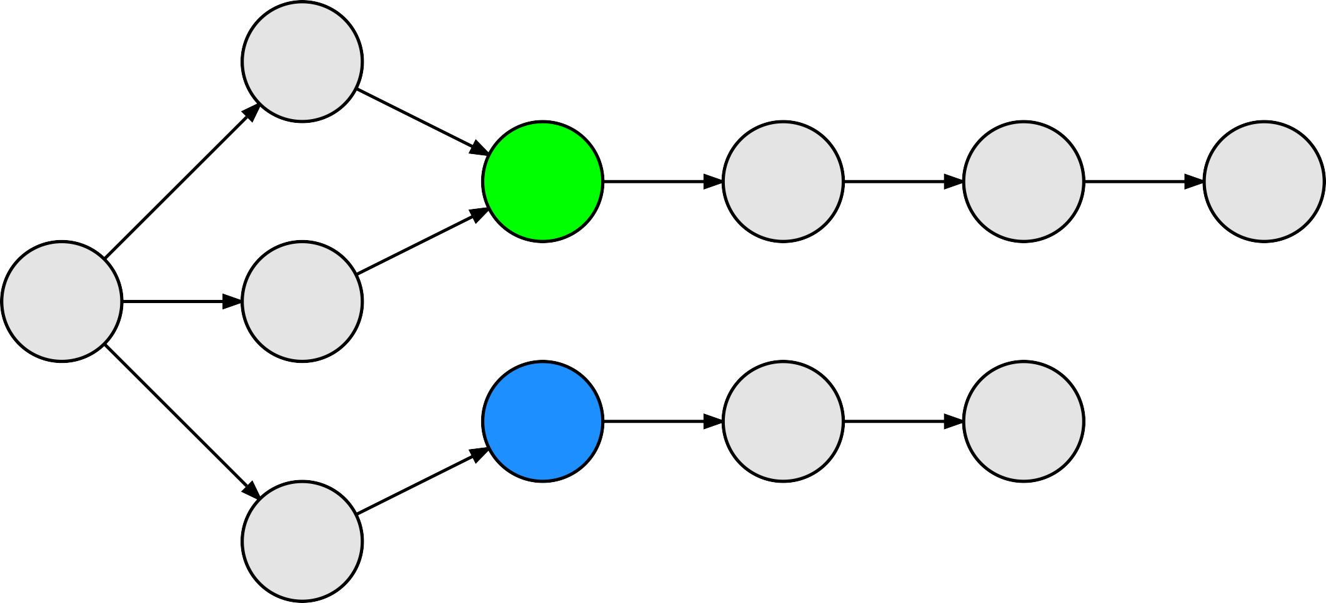
Randomized Controlled Trial
Denominator Known
Measure Outcome Incidence
Relative Risk
AR RD NNT
Study Design
Cohort
Denominator NOT Known
Measure Exposure Odds
Odds Ratio
Case-Control

Slide 70
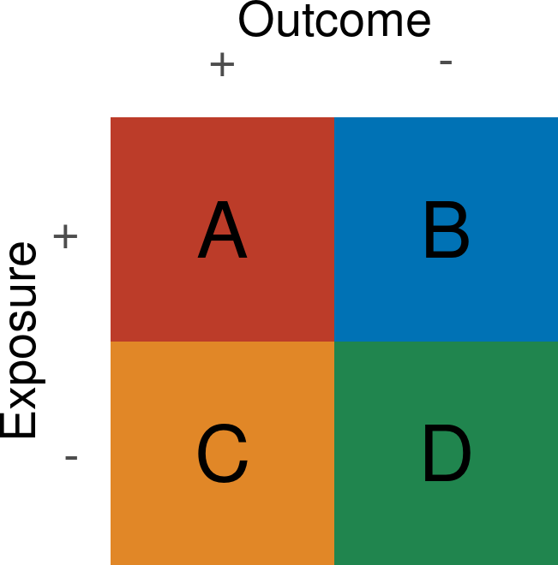
2x2 Table
Dichotomous exposures and outcomes.
Examine relationships between exposures and outcomes.
Goal: inference about larger world.

Slide 71
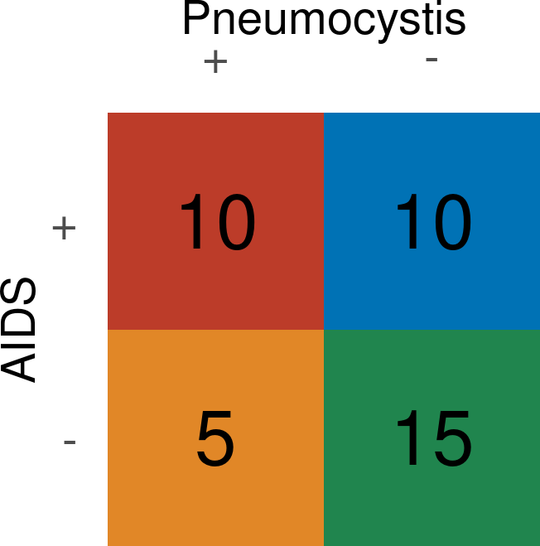
2x2 Table
Dichotomous exposures and outcomes.
Examine relationships between exposures and outcomes.
Goal: inference about larger world.

Slide 72
2x2 Table: PICO
Relationship to your evidence-based medicine (EBM) course:
PICO: population, intervention, control, outcome
intervention/control are exposure groups; outcome is dichotomous for 2x2 table data
Goal: inference about larger world.

Slide 73
2x2 Table
Dichotomous exposures and outcomes.
Examine relationships between exposures and outcomes.
Goal: inference about larger world.
Is study RCT/cohort or case-control?
Can always calculate a relative risk (RR) from 2x2 table but only appropriate for RCT/cohort
Can always calculate an odds ratio (OR) from 2x2 table but only appropriate for case-control study
(can do better with RR if RCT/cohort)

Slide 74
Data Types & Distributions
Case from 1981
Prevalence
Incidence
Inference from Exposures & Outcomes
Aggregate vs Conditional Risk

Slide 75
Data Types & Distributions
Case from 1981
Prevalence
Incidence
Inference from Exposures & Outcomes
Relative Risk &
Odds Ratios

Slide 76
2x2 Table: Calculate Relative Risk for Cohort/Trial
Relative Risk (RR): risk (incidence) exposed
/ risk (incidence) unexposed:
A
RR =
(A+B)
C (C+D)
Risk difference (RD): risk (incidence) exposed - risk (incidence) unexposed:
A C
RD =
−
(A + B) (C + D)

Slide 77
PCP ~ AIDS: Relative Risk (RR)
Imagine a cohort study examining incidence (risk) for Pneumocystis among patients with or without an Acquired Immunodeficiency Syndrome (AIDS):
Relative Risk (RR):
10
(10+10)
0.5
RR =
= = 2
0.25
5 (5+15)
Risk difference (RD):
10
5
RD =
−
= 0.25
(10 + 10)
(5 + 15)

Slide 78
2x2 Table: Calculate NNT for Cohort/Trial
Risk difference (RD): risk (incidence) exposed - risk (incidence) unexposed:
A C
RD =
−
(A + B) (C + D)
Number needed to treat (NNT): given RD between exposures, how many exposure switches needed to change one outcome:
1 1
NNT =
=
RD
A ₋ C
(A+B) (C+D)

Slide 79
PCP ~ AIDS: Number Needed to Treat
Cohort study examining incidence (risk) for Pneumocystis among patients with or without AIDS:
Risk difference (RD):
10 5
RD =
− = 0.25
(10 + 10) (5 + 15)
Number needed to treat (NNT): given RD between exposures, how many exposure switches needed to change one outcome:
1 1 1
NNT = = RD
10 ₋ 5
= = 4
0.25
(10+10) (5+15)

Slide 80
AR vs RD vs NNT
absolute risk (AR): risk of developing disease over a period of time (incidence!)
if 1 in 10 chance of developing skin cancer in your lifetime, AR = 10%
risk difference (RD): difference in risk between treatment/exposure and control 3 in 10 cured with treatment vs 2 in 10 with control, RD = 3/10 – 2/10 = 10%
number needed to treat (NNT): number treated for one person to benefit
NNT = 1/RD
from RD numbers above, NNT = 1/RD = 1/0.1 = 10 (treat 10 people to cure 1 more)

Slide 81
2x2 Table: Calculate Odds Ratio for Case-Control Study
Denominators are deceptive in case-control study because determined by investigator.
Impossible to measure true risk/incidence. Instead, measure exposure odds in cases & controls.
Odds Ratio (OR): odds exposure in cases / odds exposure in controls:
A
A ∗ D
OR = ^{C} =
B D
B ∗ C

Slide 82
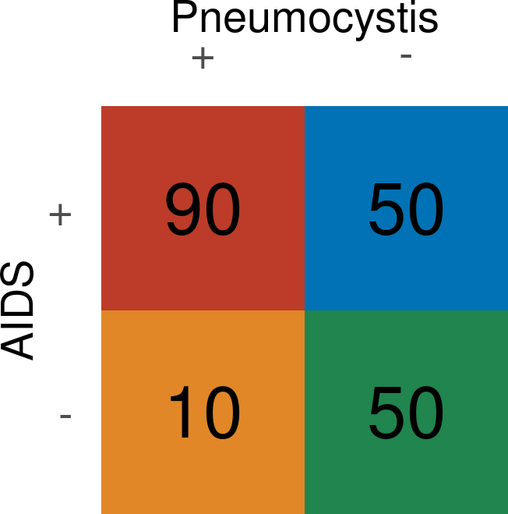
PCP Cases vs Controls: Odds Ratio (OR)
Imagine a different study: 100 Pneumocystis cases and 100 controls; measure whether 'AIDS' (exposure) differs between groups chosen by investigator.
Odds Ratio (OR): odds exposure in cases / odds exposure in controls:
90
90 ∗ 50
OR = ¹⁰ =
= 9
50 50
50 ∗ 10

Slide 83
Utility of Odds Ratio (OR) & Case-Control Study Design
Because ratio of cases and controls determined by investigator, not valid to calculate incidence of outcome (AR or RR, RD, NNT), but if outcome incidence is low, then A + B ~ B & C + D ~ D:
A (A+B)
A B
A ∗ D
A C
RR =
∼
=
=
= OR
C (C+D)
C D
B ∗ C
B D
OR approximates RR if outcome occurs
infrequently (<15%).
Though OR is
fundamentally different from RR, we use it
as an approximation of RR
. If outcome is
more common, OR & RR differ increasingly.

Slide 84
Data Types & Distributions
Case from 1981
Prevalence
Incidence
Inference from Exposures & Outcomes
Relative Risk &
Odds Ratios

Slide 85
Measures of Disease in Clinical Epidemiology
Distribution of data determines how we describe them: mean + SD vs median + IQR.
Prevalence is determined by incidence and survival time. Incidence density best accounts for time at risk for disease.
Relative risk (RR) is the ratio of incidence in exposed over incidence in unexposed. Odds ratio (OR) is the ratio of exposure odds in cases over exposure odds in controls.
OR approximates RR when outcome is rare. NNT can be a clinically useful number.

Slide 86
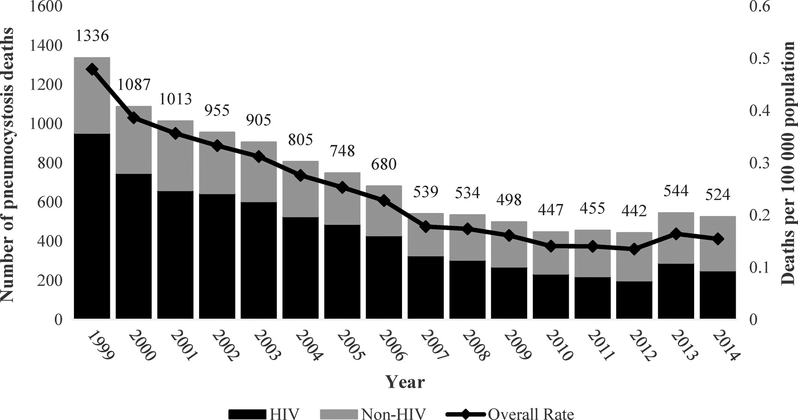
Wickramasekaran et al Mycoses 2017

Slide 87
Questions?
image: Federica Viazzi "Microscopy image of P. jirovecii"

