Slide 1
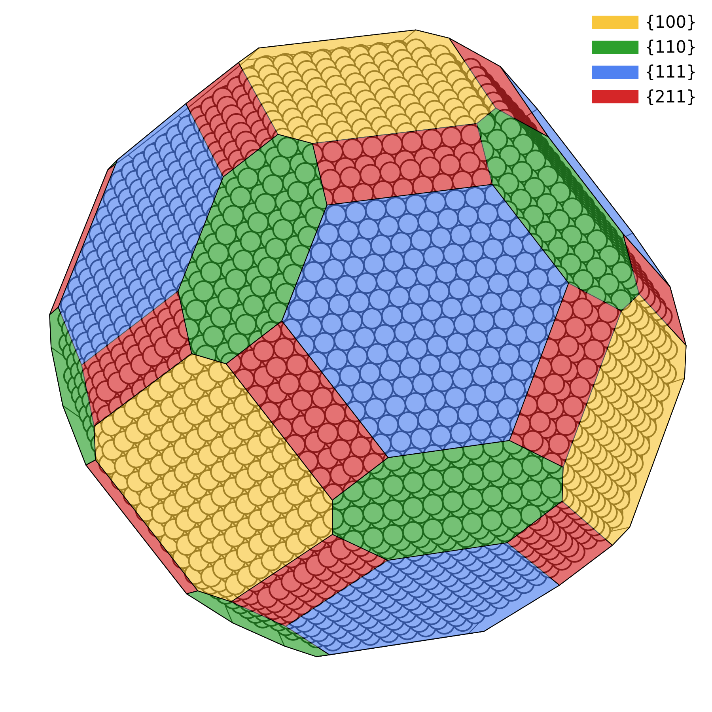
Example of a particle.

Slide 2
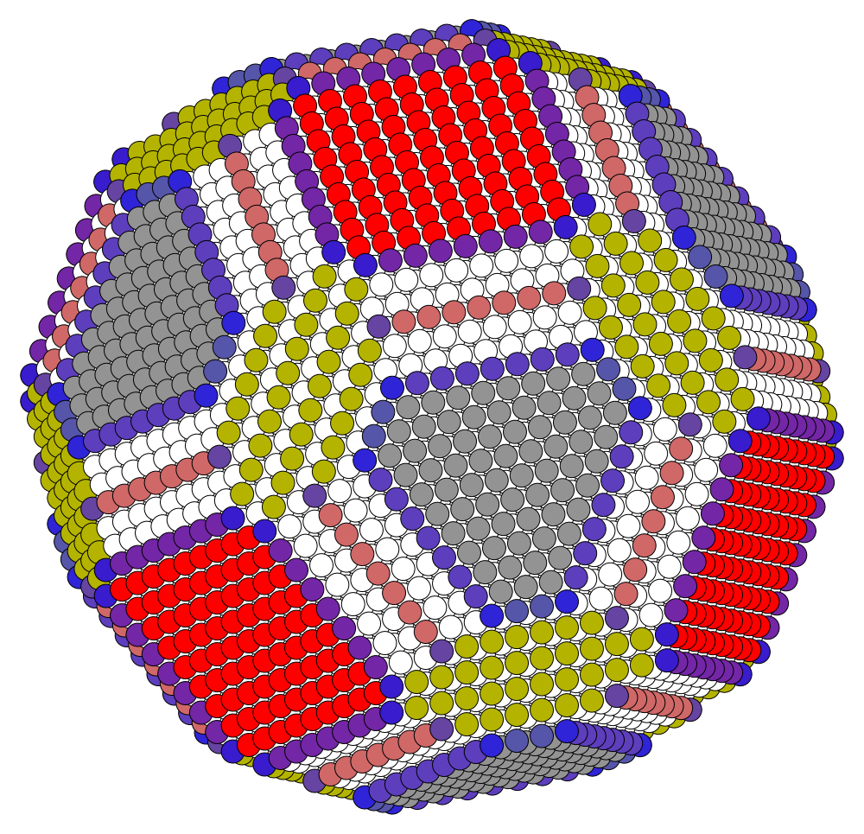
Identification of facets and interfaces.
(100)
(211)-(100)
(211)
(111)-(211)
(111)
(111)-(110)
(110)

Slide 3
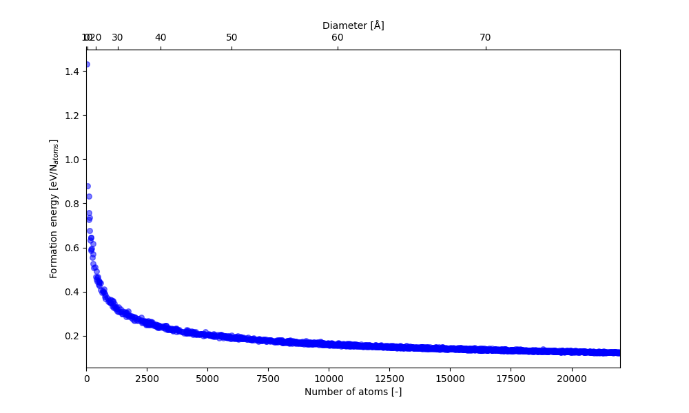
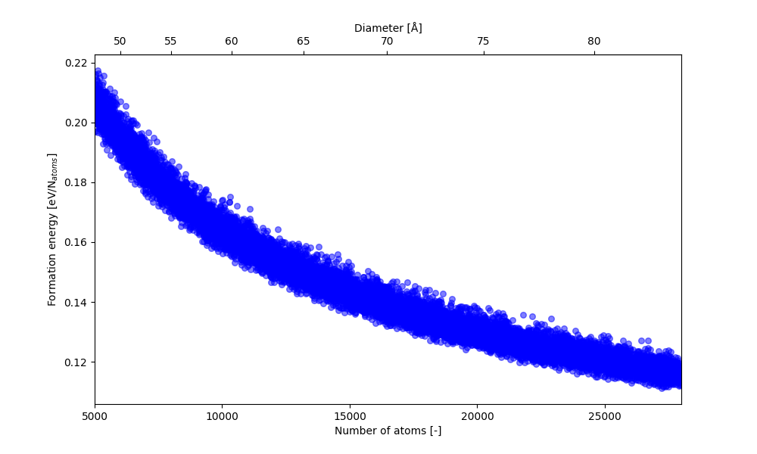
Ensemble of nanoparticles.

Slide 4
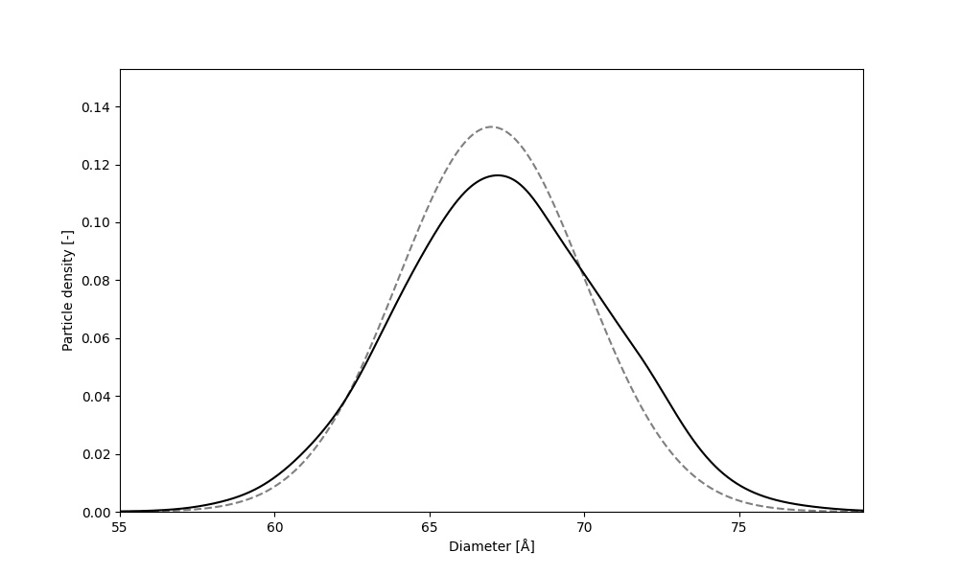
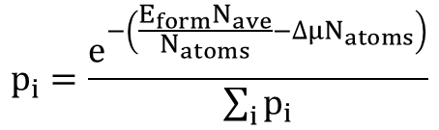
Particle size distribution.
$N_{ave}$ and $∆μ$ are optimized to get a distribution of particles close to the target normal distribution. The density is calculated with Gaussian KDE.
$$p_{i}=\frac{e^{−\left(\frac{{E_{form}N}_{ave}}{N_{atoms}}−∆μN_{atoms}\right)}}{\sum_{i}{p_{i}}}$$

Slide 5
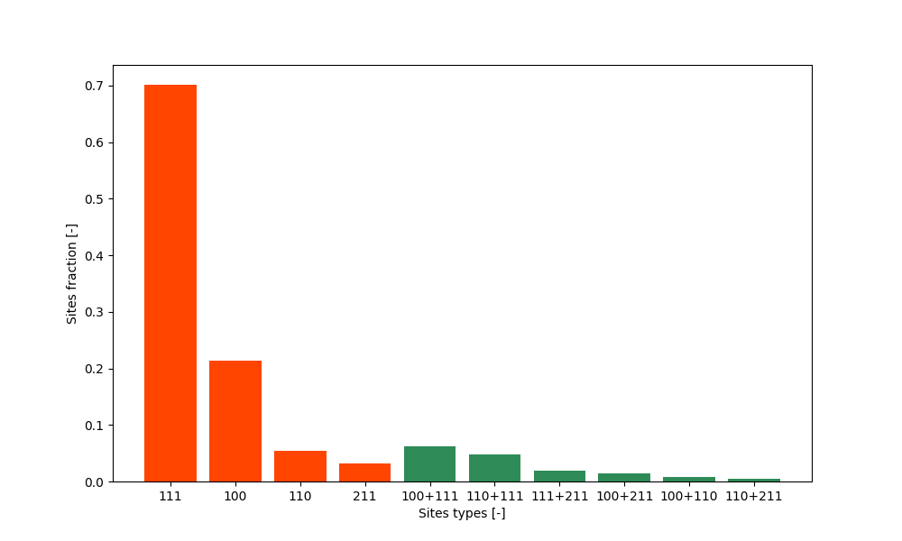
Sites fractions.
Sites fractions are obtained normalizing the sites concentrations by the number of facet sites.
Facet sites
Interface stes

Slide 6
Sites fractions.
111 | 100 | 110 | 211 | 100+111 | 110+111 | 111+211 | 100+211 | 100+110 | 110+211
0.7015 | 0.2127 | 0.0542 | 0.0314 | 0.0619 | 0.0486 | 0.0184 | 0.0145 | 0.0085 | 0.0051

