Slide 1
Biggus: Making “biggish” dense data easy to use
Bill Little

Slide 2

Scientist

Slide 3
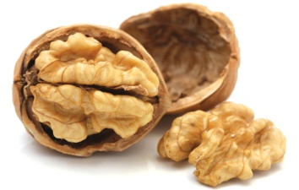


Provides N-dimensional virtual arrays of arbitrary size.
Defines a simple adapter interface for data source containment.
Concatenate or tile virtual arrays to increase their extent.
Stack virtual arrays to increase their dimensionality.
Performs lazy operations,
  indexing and slicing to subset a virtual array.
  element-wise arithmetic operators.
  statistical aggregation operators.
Requires an explicit request to realize a concrete result.
Out-of-core streaming to a data target.
Biggus in a nutshell ...

Slide 4

Implements a generalised N-dimensional gridded data model known as a Cube.
github.com/SciTools
scitools.org.uk
Deferred loading, virtual array and lazy evaluation capability provided by Biggus.
Iris
Post processing analysis and visualization tool.

Slide 5
Examples ...

Slide 6
Containing the data source ...
Wrapping a NumPy array ...
import numpy as np
np_arr = np.empty((1024, 2048), dtype=np.float64)
np_bar = biggus.NumpyArrayAdapter(np_arr)
print np_bar
<NumpyArrayAdapter shape=(1024, 2048) dtype=dtype('float64')>

Slide 7
Containing the data source ...
Wrapping a HDF5 dataset ...
import h5py
h5_dataset = h5py.File(‘data.h5’)[‘dataset’]
h5_bar = biggus.NumpyArrayAdapter(h5_dataset)
print h5_bar
<NumpyArrayAdapter shape=(1024, 2048) dtype=dtype('float64')>

Slide 8
Containing the data source ...
Wrapping a NetCDF variable ...
import netCDF4 as nc
nc_var = nc.Dataset(‘data.nc’).variables[‘variable’]
nc_bar = biggus.OrthoArrayAdapter(nc_var)
print nc_bar
<OrthoArrayAdapter shape=(1024, 2048) dtype=dtype('float64')>
print nc_bar[::2, -256:]
<OrthoArrayAdapter shape=(512, 256) dtype=dtype('float64')>

Slide 9
Biggus array adapter interface ...
borrows from the NumPy API.
provides an Array abstract base class.
requires,
  dtype property
  shape property
  __getitem__ magic method
is data source agnostic.

Slide 10
Going big with Biggus ...
bar = biggus.LinearMosaic([np_bar, h5_bar, nc_bar], axis=0)
print bar
48 MB
<LinearMosaic shape=(3072, 2048) dtype=dtype(‘float64')>
big_bar = biggus.ArrayStack(np.array([bar] * 1024))
print big_bar
48 GB
<ArrayStack shape=(1024, 3072, 2048) dtype=dtype(‘float64')>
bigger_bar = biggus.LinearMosaic([big_bar] * 1024), axis=2)
print bigger_bar
48 TB
<LinearMosaic shape=(1024, 3072, 2097152) dtype=dtype('float64')>

Slide 11
Biggus lazy operators ...
Element-wise arithmetic operators
Statistical aggregation operators
add
subtract
count
max
mean
min
std
sum
var

Slide 12
Lazy arithmetic ...
ab_bar = biggus.add(a, b)
print ab_bar
<_Elementwise shape=(1024, 2048, 4192) dtype=dtype('float32')>
result = ab_bar.ndarray()
print type(result), result.shape
32 GB
<type 'numpy.ndarray'> (1024, 2048, 4192)
But what’s happening under the hood ?

Slide 13
Lazy arithmetic ...
Biggus constructs an expression evaluation graph to achieve out-of-core processing.
Producer
Node
Producer
Node
a
b
chunk_{a}
chunk_{b}
add
Q
Q
Consumer
Node
chunk_{(a+b)}
a+b
Q
In-memory
Result Node

Slide 14
Lazy statistical aggregation ...
mean_bar = biggus.mean(ab_bar, axis=0)
print mean_bar
<_Aggregation shape=(2048, 4192) dtype=dtype('float32')>
sum_bar = biggus.sum(ab_bar, axis=0)
print sum_bar
<_Aggregation shape=(2048, 4192) dtype=dtype('float32')>
biggus.ndarrays([mean_bar, sum_bar])
Attempt to evaluate in parallel

Slide 15
Lazy statistical aggregation ...
Producer
Node
Producer
Node
a
b
chunk_{a}
chunk_{b}
add
Q
Q
Q
Q
Consumer
Node
chunk_{(a+b)}
Q
Q
Consumer
Node
Q
Q
Consumer
Node
mean
sum
chunk_{(a+b)}
chunk_{∑(a+b)}
Q
Q
Q
Q
In-memory
Result Node
(a+b)
∑(a+b)
In-memory
Result Node

Slide 16

Extend lazy operator coverage.
Explore JIT optimisations.
Arithmetic operator broadcasting and type-promotion.
Lazy rolling window capability.
Easy to plug-in custom lazy operators.
Mighty oaks from little acorns grow ...

Slide 17
Questions ...
https://github.com/bjlittle/ams2015

Slide 18
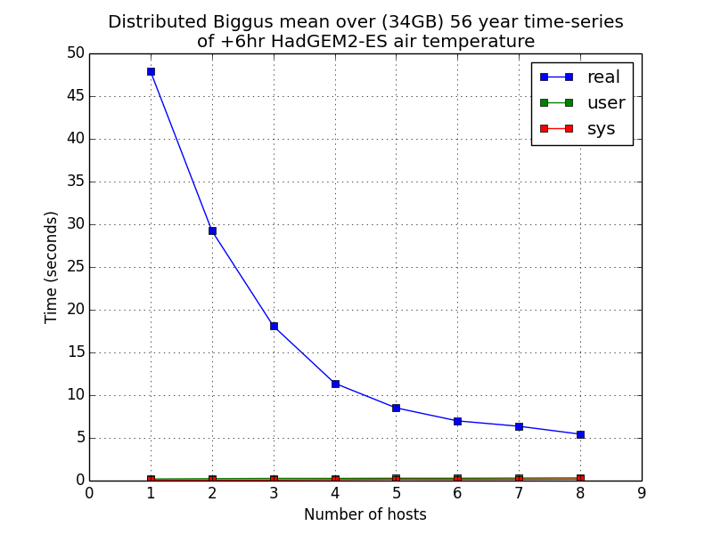
Widespread laziness is productive ...

