Slide 1






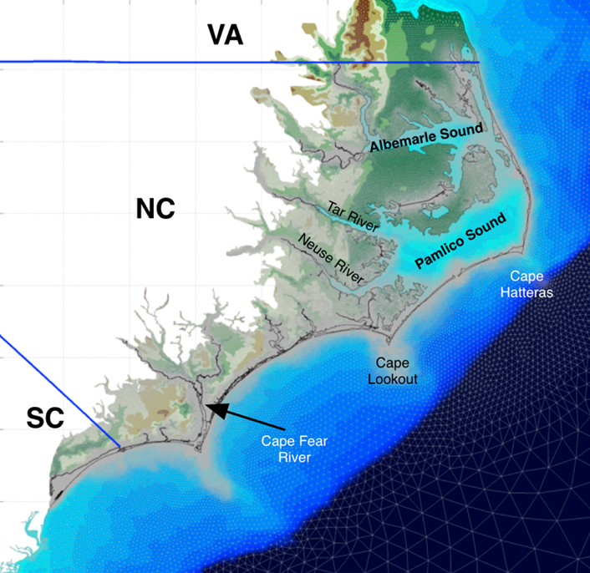

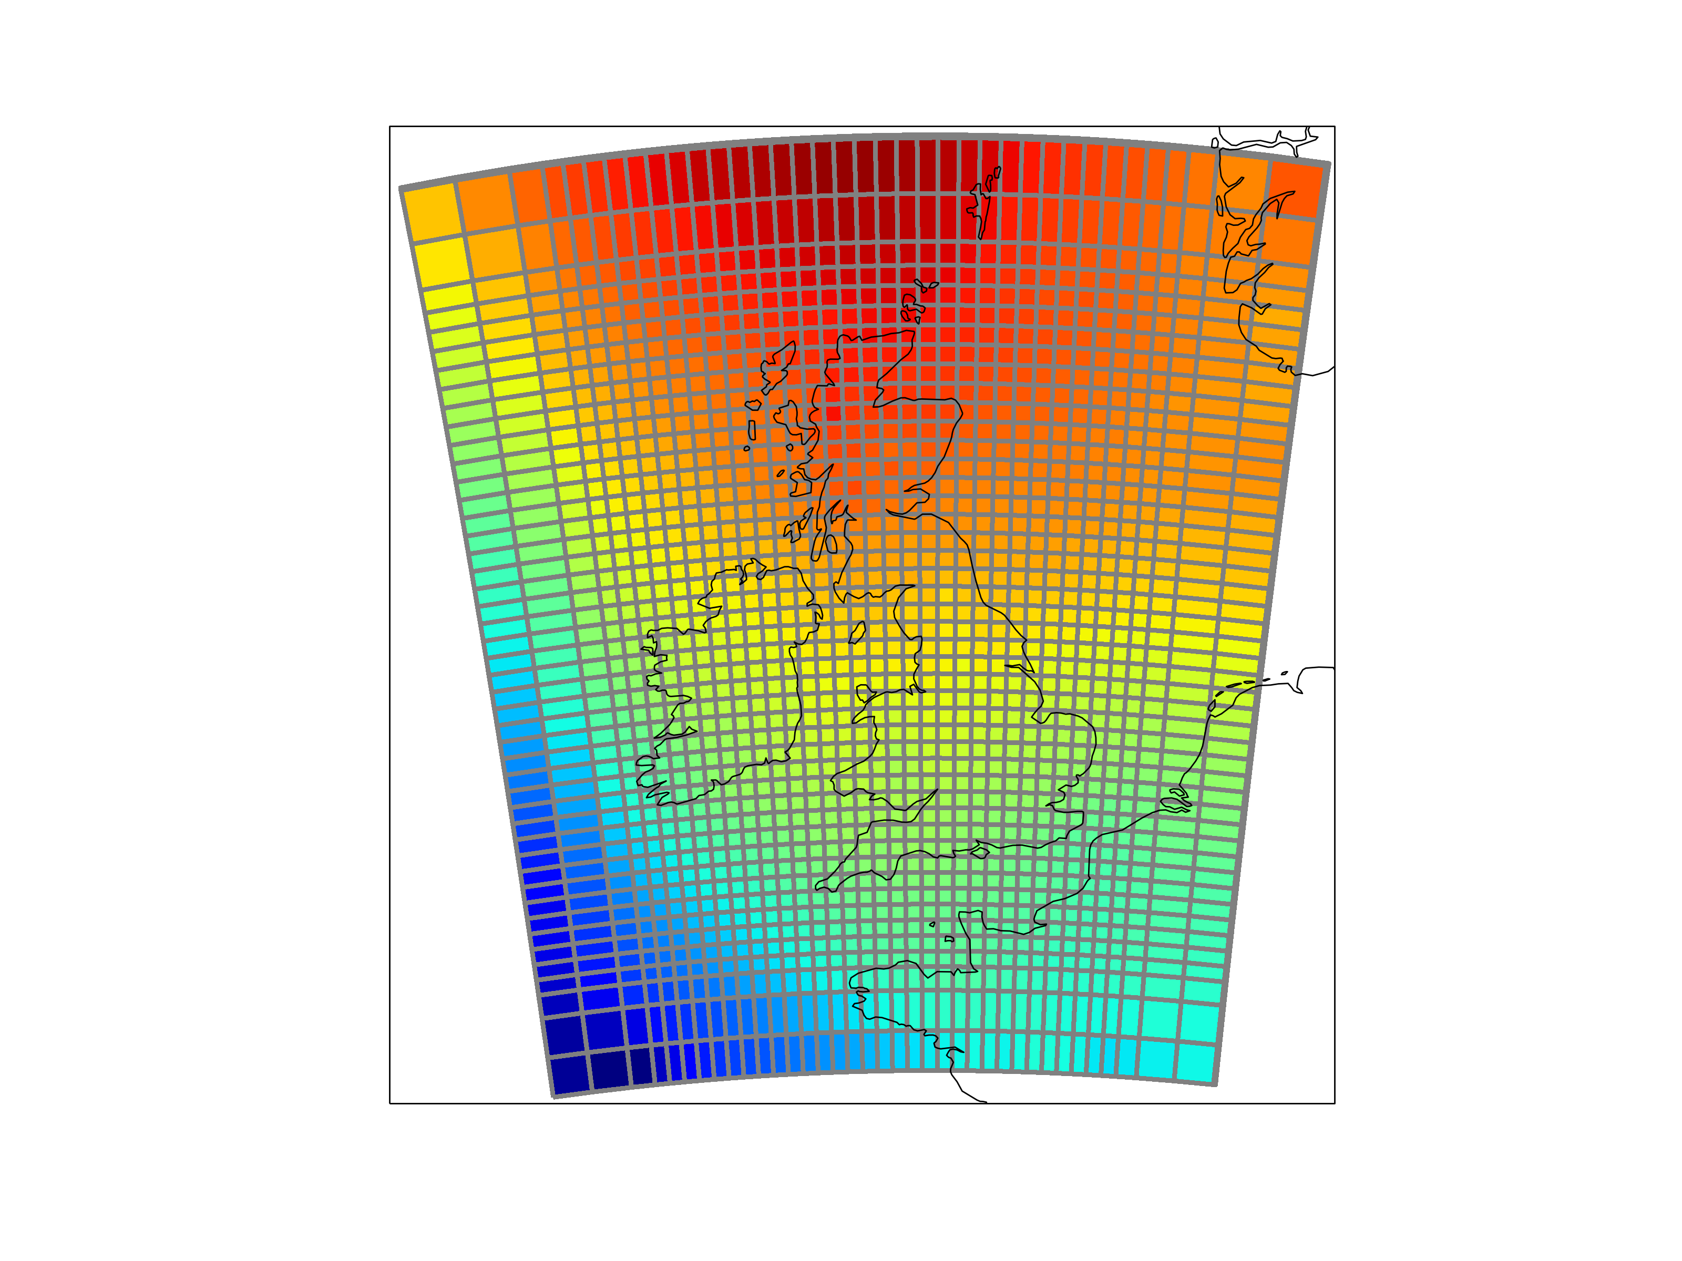



Iris & pyugrid: Consistent access to structured and unstructured grids
Bill Little - Analysis, Visualisation and Data Team, UK Met Office.
Chris Calloway - Renaissance Computing Institute, University of North Carolina at Chapel Hill.
Abstract
With non-uniform grids becoming
increasingly common in ocean and
atmosphere models there is a growing need
for tools which can deal with these non-uniform grids, both in isolation and in conjunction with uniform grids. To meet this challenge, the development communities for the Iris and pyugrid Python libraries are collaborating on the addition of non-uniform grid handling within Iris. The approach taken is to provide a single, grid-independent
API to enable common operations such as
regional extraction, interpolation,
re-gridding, statistical analysis,
and visualisation.
Iris shares an open DAP connection to a UGRID convention compliant NetCDF resource with pyugrid. Pyugrid supplies Iris with ugrid methods so that Iris can manipulate the data on the ugrid.
Collaboration and result of recent sprint ...
http://goo.gl/2KEoFW
A SciPy 2014 sprint between the Met Office, RENCI, NOAA, and USGS started the collaboraion by decorating an Iris cube with a pyugrid instance. A second November 2014 sprint at the Met Office with RENCI shared the DAP connetion between an Iris cube and a pygrid instance.
http://goo.gl/dBQll7
http://goo.gl/BJglOs
The UGRID conventions are a proposed set of extensions to the CF conventions.
PyUgrid is a Python API to create and access data in datasets conforming to the UGRID conventions.
Would you benefit from a unified grid API?
How do you represent and manipulate your data?
The UGRID conventions specify schema elements and attributes required to manage data on unstructured grids..
Iris allows you to easily manipulate your gridded data. Common operations include interpolation, regridding, constraining, aggregation, concatenation, merging and plotting.
Future work will extend Iris to perform the same analysis and visualization functions on unstructured grids as on structured grids: a unified grid API.
Do you
UGRID?
The UGRID conventions describe mesh networks. The topolgy of a mesh network allows data to associate with nodes, edges, and/or faces.
Iris is
strategically important to the Met Office. It underpins the future capability of how our scientists will analyse and visualise their data.
Iris isolates analysis and visualisation capability from file format specifics.
Iris implements a generalised
N-dimensional gridded data model know as a Cube.
http://goo.gl/UJoVHP
http://goo.gl/GbLNx9
The Iris data model is aligned with the CF Metadata Conventions.
Iris delivers data interoperability by translating between disparate file formats via the common representation of an
Iris Cube.
CF Metadata Conventions
The Climate and Forecast (CF) Metadata Conventions define an encoding standard for representing spatial and temporal metadata in the NetCDF file format.
Collaborate with the growing Iris user and developer community on Google Groups.
Phenomenon metadata and data payload are encapsulated within an Iris Cube.
Met Office FitzRoy Road, Exeter, Devon, EX1 3PB United Kingdom
Email: bill.little@metoffice.gov.uk
RENCI/UNC-CH 100 Europa Drive, Suite 540, Chapel Hill, NC 27517
Email: cbc@unc.edu
© Crown copyright 07/0XXX Met Office and the Met Office logo are registered trademarks

