Slide 1
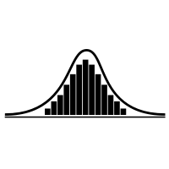
























Encoding
Decoding
Input data
(reversed)
Autoregressive Generative Model
Compressed data
$$x_{n}$$
$$x_{n−1}$$
$$…$$
$$x_{2}$$
$$x_{1}$$
$$B_{1}$$
$$B_{2}$$
$$…$$
$$B_{m−1}$$
$$B_{m}$$
$$P(x)$$
Original data
$$…$$
ANS Decoder
$$x_{1}$$
$$x_{2}$$
$$…$$
$$x_{n−1}$$
$$x_{n}$$
ANS Encoder
$$P(x_{i})$$
$$x_{1..i}$$
Autoregressive Generative Model
$$B_{m}$$
$$B_{m−1}$$
$$…$$
$$B_{2}$$
$$B_{1}$$
Compressed data

Slide 2


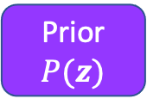






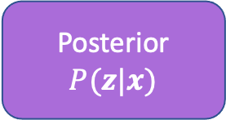



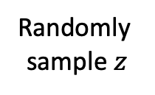



Randomly sample $z$
Posterior$P(z|x)$
$$z$$
Latent Variable Model
Input data
$$x_{1}$$
$$x_{2}$$
$$…$$
$$x_{n−1}$$
$$x_{n}$$
$$P(x)$$
$$…$$
Prior $P(z)$
ANS Encoder
ANS Encoder
$$B_{1}$$
$$B_{2}$$
$$…$$
$$B_{m−1}$$
$$B_{m}$$
$$B_{z}$$
Compressed data
Compressed latent sample

Slide 3




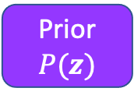










Compressed latent sample
Compressed data
$$B_{z}$$
$$B_{m}$$
$$B_{m−1}$$
$$…$$
$$B_{2}$$
$$B_{1}$$
Prior $P(z)$
ANS Decoder
$$z$$
Latent Variable Model
$$P(x)$$
ANS Decoder
$$…$$
$$x_{1}$$
$$x_{2}$$
$$…$$
$$x_{n−1}$$
$$x_{n}$$
Original data

Slide 4


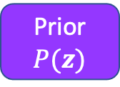








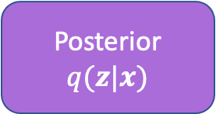





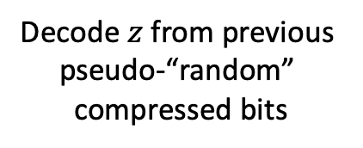




Decode $z$ from previous pseudo-“random” compressed bits
ANS Decoder
Posterior$q(z|x)$
$$z$$
Latent Variable Model
Input data
$$x_{1}$$
$$x_{2}$$
$$…$$
$$x_{n−1}$$
$$x_{n}$$
$$P(x)$$
$$…$$
Prior $P(z)$
Get “bits-back”
from previously compressed data
ANS Encoder
ANS Encoder
$$…$$
$$A_{m−1}$$
$$A_{m}$$
$$A_{1}$$
$$A_{2}$$
$$B_{1}$$
$$B_{2}$$
$$…$$
$$B_{m−1}$$
$$B_{m}$$
$$B_{z}$$
Previous bits in compressed data stream
Compressed data
Compressed latent sample

Slide 5



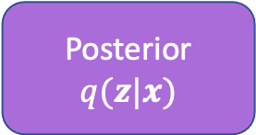


Previous bits in compressed data stream
Compressed latent sample
Compressed data
$$B_{z}$$
$$B_{m}$$
$$B_{m−1}$$
$$…$$
$$B_{2}$$
$$B_{1}$$
$$A_{2}$$
$$A_{1}$$
Prior $P(z)$
$$A_{m}$$
$$A_{m−1}$$
$$…$$
Put “bits-back”
Into compressed
data stream
ANS Decoder
ANS Encoder
$$z$$
Posterior$q(z|x)$
Latent Variable Model
$$P(x)$$
ANS Decoder
$$…$$
$$x_{1}$$
$$x_{2}$$
$$…$$
$$x_{n−1}$$
$$x_{n}$$
Original Data

Slide 6

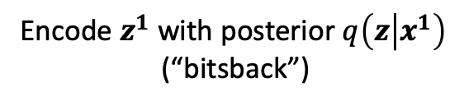



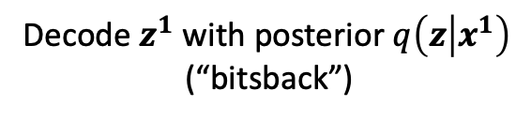


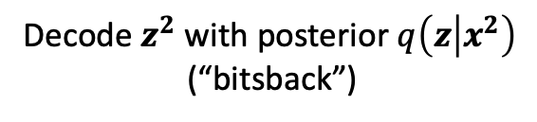
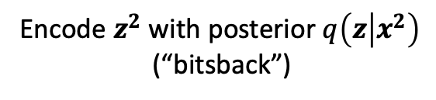


Encoding
Decoding
Existing bitstream
Bitstream
v
Decode $z^{1}$ with posterior $q\left(z | x^{1}\right)$
(“bitsback”)
Decode $z^{2}$ with prior P$(z)$
Encode $x^{1}$ with model P$(x|z^{1})$
Decode $x^{2}$ with model P$(x|z^{2})$
Encode $z^{1}$ with prior P$(z)$
Encode $z^{2}$ with posterior $q\left(z | x^{2}\right)$
(“bitsback”)
Decode $z^{2}$ with posterior $q\left(z | x^{2}\right)$
(“bitsback”)
v
Decode $z^{1}$ with prior P$(z)$
Encode $x^{2}$ with model P$(x|z^{2})$
v
Decode $z^{1}$ with model P$(x|z^{1})$
Encode $z^{2}$ with prior P$(z)$
Encode $z^{1}$ with posterior $q\left(z | x^{1}\right)$
(“bitsback”)

