Slide 1
The Vehicle Routing Problem with Time Windows (VRPTW)
Authors: Eric McAlpine, Marc Sensenich, and Aaron Weckerly
Slippery Rock University of Pennsylvania

Slide 2
Agenda
Overview/Abstract
Detailed Problem Explanation
Heuristics Implemented
Quality Assurance
Example Output
Results Comparison
Relationship to Operating Systems
Caveats/Minefields
Questions and answers

Slide 3
Overview/Abstract
The Vehicle Routing Problem (VRP) is a well-known scheduling problem which seeks to service a number of customers with a fleet of vehicles. The VRP is typically seen as a multiple objective problem; traditionally the objectives include minimizing the total route distance, duration, and vehicles utilized. An extension of the VRP is the Vehicle Routing Problem with Time Window Constraints (VRPTW). In the VRPTW, the objectives from the VRP are included on top of seeking to service all customers on the route within a set arrival and departure time. In our project we implement heuristics presented by Marcus Solomon in his paper “Algorithms for the Vehicle Routing and Scheduling Problem with Time Windows Constraints” in the Zeus framework which provides a mean to run Vehicle Routing Problems.We compare our implementation results against those found by Solomon and the best known results found for the VRPTW.

Slide 4
Detailed Explanation
VRPTW is a multiple objective problem
The objectives from the base VRP
Minimization of waiting time
Meeting the customer’s set deadlines
This extension of the VRP now accounts for both the temporal and spatial aspects of vehicle movement
Conditions for feasibility now must account for arrival after time window
Three types of data sets
Clustered, random, and random clusters

Slide 5
Heuristics
Clarke and Wright Savings
Savings with Time Windows
Time Oriented Nearest Neighbor
Insertion
I
II
II
Sweep Heuristic

Slide 6
Clarke and Wright Savings
One of the best known heuristics despite its shortcomings
Initially a feasible solution consists of N routes between the depot and customers
At any iteration two routes are able to be merged into a single route, by doing so this will generate a savings
s_{ij} = c_{i0} + c_{0j} - c_{ij}
This route is based on the greedy principle and contains no way to undo unsatisfactory route merges

Slide 7
Savings with Time Windows
This is an extension of the Clarke and Wright Savings heuristic which takes in account for time windows
At each iteration the heuristic must take in account the time window constraints
This heuristic may find it profitable to join customers close in distance but far away in time
These links introduce extended periods of waiting time
This causes high opportunity cost since this vehicle could be servicing other customers during this time

Slide 8
Time Oriented Nearest Neighbor
This heuristic starts each route by finding the unrouted customer “closest” to the depot and at every subsequent iteration finds the closest to the last inserted customer
Closest is defined in terms of geographical and temporal closeness of the customers
This accounts for distance (d), time difference between completion of service (T), and urgency (u)
c_{ij} = δ₁d_{ij} + δ₂T_{ij} + δ₂v_{ij}
The customer that has been selected for insertion is then inserted at the end of an emerging route

Slide 9
Insertion Heuristics
This is a class of sequential, tour-building heuristics that initializes every route using various criteria
The unrouted customer with the furthest distance and with the earliest deadline
After initialization these methods utilize two criteria, c₁(i, u, j) & c₂(i, u, j), at every iteration to insert a new customer u into a partial route
These heuristics can be seen as a generalization of the time-oriented nearest-neighbor heuristic
The difference is that we allow for these customers to be inserted into a route and not at the end

Slide 10
Insertion I
This insertion heuristic tries to maximize the benefit derived from servicing a customer on the current route than on a direct route
The best insertion position is one that that minimizes a measure of the extra distance and time required to service a customer
Criteria
c_{1.1}(i, u, j) = d_{iu} + d_{uj} - μd_{ij}, μ ≥ 0
c_{1.2}(i, u, j) = b_{ju} - b_{j}
c₁ = ɑ₁c_{1.1}(i, u, j) + ɑ₂c_{1.2}(i, u, j), ɑ₁ + ɑ₂ = 1
c₂(i, u, j) = λd_{0u} - c2(i, u, j), λ ≥ 0

Slide 11
Insertion II
This insertion heuristic tries select a customer whose insertion costs minimize a measure total route distance and time
Criteria
c₁ as defined in Insertion I
c₂(i, u, j) = β1R_{d}(u) + β2R_{t}(u), β1+β2 = 1, β1 ≥ 0, β2 > 0
Where R_{d}(u) and R_{t}(u) are the total route distance and time if u were to be inserted into the route

Slide 12
Insertion III
This insertion heuristic modifies the temporal aspect of the heuristic to account for the urgency of servicing a customer
Criteria
c_{1.1} and c_{1.2} as defined in Insertion I
c_{1.3}(i, u, j) = l_{u} - b_{u}
c1 = ɑ₁c_{1.1}(i, u, j) + ɑ₂c_{1.2}(i, u, j) + ɑ₁c_{1.3}(i, u, j), ɑ₁ + ɑ₂ + ɑ₃ = 1, ɑ₁ ≥ 0, ɑ₂ ≥ 0, ɑ₃ ≥ 0
c₂ = c₁(i, u, j)

Slide 13
Quality Assurance
Quality Assurance process
read results
read in original shipments and depots
rerun the calculations, verify results
QA checkpoints
customer serviced once, only once
max travel time per truck
max demand on trucks
early/late time
wait time

Slide 14
Example Output
Two flavors of result output
Short results
Long results
Comparison Output
Log of all runs
Solomon benchmark
Best Known

Slide 15
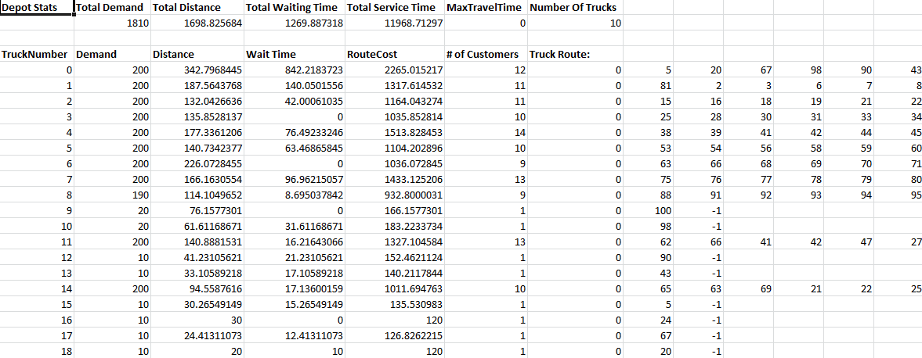
Example Output cont.
Short Results

Slide 16
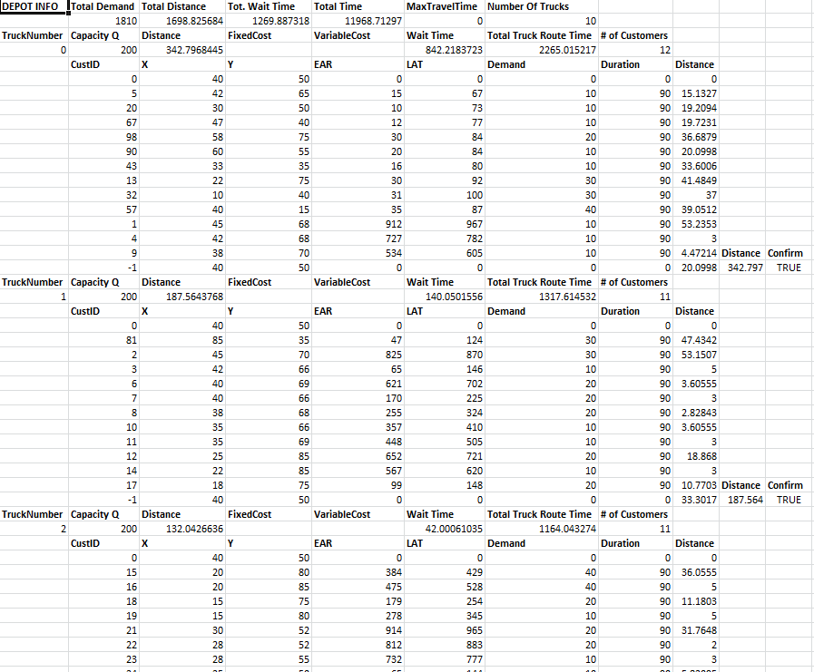
Example Output cont.
long Results go here

Slide 17
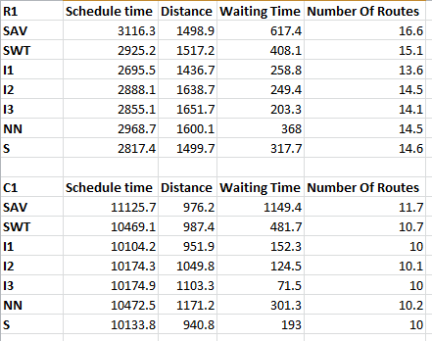
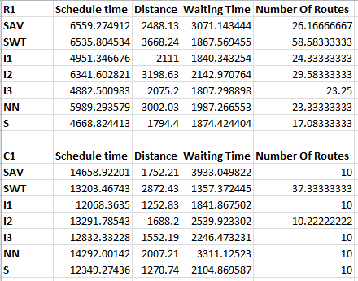
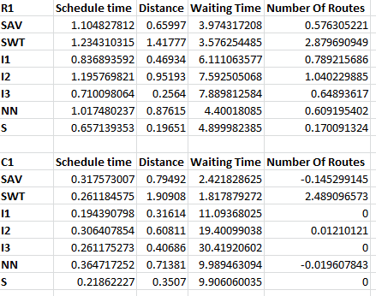
Results Comparison
Comparison
Solomon (Avg) Results
Group 4 (Avg) Results

Slide 18
Relation to Operating Systems
Vehicle Routing is similar to CPU scheduling
Time Windows related to Real-Time Operating System
Both contain a variety of algorithms, which vary in efficiency based on situation.

Slide 19
Caveats/Minefields
Savings not implemented as according to Solomon’s paper.
A thorough understanding of the following is necessary
Zeus framework
The Vehicle Routing Problem with Time Windows
Object-Oriented Programming

Slide 20
Thank you for your time
Questions?

