Slide 1
FastIO Midpoint Presentation Benjamin Braun & Nate Chizgi

Slide 2
Introduction
Fast-IO Design Goal
Provide a simple off the shelf streaming interface to and from an icestick FPGA.
Icestick is unique in that it contains a fully open-source back-end to program the device. However, there is no off-the-shelf method of streaming data to/from the device without detailed understanding of the device.
Our goal is to enable someone with little to no background to pick up an Icestick device from the store and, using our streaming interface, program a simple piece of art rendered on the FPGA and displayed on their computer in real time

Slide 3
Streaming Protocol
Design Decisions - Modified UART
For demonstration purposes, implementing overclocked UART RX/TX
UART support is built in to Icestick device without any device level modifications –
Other (parallel/faster) protocols available through device level soldering
Able to achieve 0.715 MBps with overclocked UART (12MHz baud)
Good for 640x480 2 FPS 8-bit / pixel
Other future enhancements discussed in ‘future work’ to improve throughput

Slide 4
Streaming Interface
Fast-IO API
IOSpec(<type>, paramList)
Support various simple streaming types with user defined transforms/callbacks
Types
DisplayInOut(x_res, y_res, fps, fd…)
DisplayOut(x_res, y_res, fps, fd)
Printf(numPort)
ReadLines(userCB, numPort, fd)
WriteLines(userCB, fd)

Slide 5
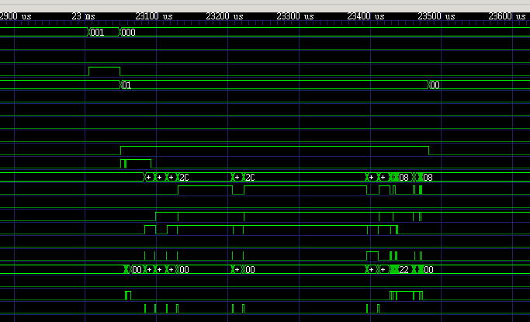

Streaming Examples
Simplified support for common use cases
Display Rendered Stream (Time-varying gradient video)
Output pixel brightness = f(x,y,time) = x+baud(t)
Display = DisplayOut(x_res=640, y_res=480, fps=60, playback)
userCirc = userRenderGradient(display.x, display.y, baud)
Output time-stamped debug trace to bin file (waveform viewer)
Output concat(data, timestamp) from several (5) usr defined modules
userCB = counter(timestamp_res, baud)
Write = writeLines(userCB, numPort, binary)
UserModA(dbgOut=Write.port[0]) … UserModZ(dbgOut=Write.port[N])
Output print statements from several User modules
Printf = printf(numPort)
UserModA(dbgOut=printf.port[0]) … UserModZ(dbgOut=printf.port[N])

Slide 6
Challenges Faced
Flexibility vs Complexity Tradeoff
Simple API reduces flexibility from user
e.g. displayInOut is non-descriptive – complexity is moved to the user modules (buffering, line depth, dynamic control flow, etc)
CPU dropped packets
No notification from CPU when CPU drops packets (FPGA pumps data too fast e.g.)
Implemented reverse path ACK which comes after buffer_depth/2 packets drained by CPU -> allows automatic stall on FPGA side to avoid dropped packets

