Slide 1
Fast I/O Library for Icestick
Midpoint Presentation
Benjamin Braun & Nate Chizgi
Notes:
1

Slide 2
Goals
Implement a library in magma for icestick FPGA ↔ CPU I/O…
Currently, communicating between the CPU and a running icestick is hard!
… that makes common communication patterns easy:
Visual Data: graphics rendered on FPGA displayed on CPU screen in real-time
Debugging / Log Data: printf() “statements” in magma show in CPU terminal
Stream Data: file on CPU read to FPGA program, output written back to file.
Disclosure: we hope to have a demo for one, possibly two, of these patterns
Notes:
2

Slide 3
Challenges
Few choices for an I/O primitive to unmodified Icestick
UART is the only primitive that doesn’t require hardware mod
… but it’s slow and unreliable
Complex semantics of different communication patterns
What should the library look like?
Notes:
3

Slide 4
I/O Primitive
UART is slow
Demo UART runs at 115,200 baud
~7 KBps
Visual data cap: 64x64 1 FPS @ 8-bits/pixel
We found the FTDI chip will support up to 12,000,000 baud
Results in 0.715 MBps streaming FPGA→CPU
Visual data cap: 640x480 2 FPS @ 8-bits/pixel
Notes:
4

Slide 5
I/O Primitive
UART is unreliable
Problem: FPGA→CPU data dropped if buffers on FTDI chip overflow
As far as we know, they are silently dropped without notifying CPU
Solution: Add backpressure mechanism
Require CPU to signal “ACK” of received data to FPGA
FPGA will wait to send more data unless earlier data was ACKed
Effectively limits the amount of in-flight data FPGA→CPU at any time
Notes:
5

Slide 6
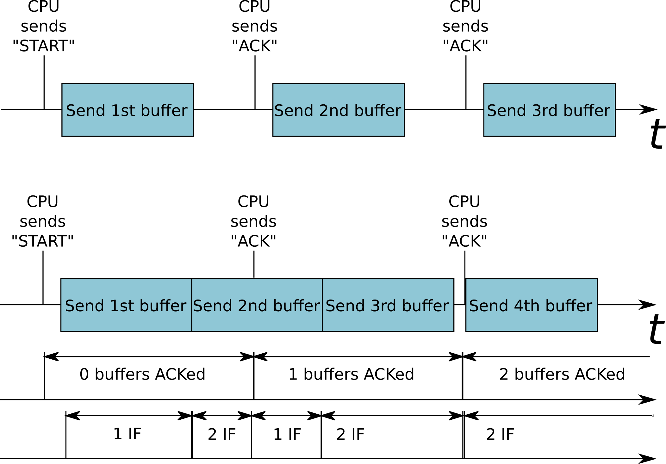
I/O Primitive
Reliable UART
Reliable UART
(fast version)
IF= # in-flight
Notes:
6

Slide 7
Implementing Communication Patterns
Magma code
requiring visual display
Compiles to...
FPGA layout
Generated binary
(with GUI)
Fast-IO circuitry
Communication
Notes:
7

Slide 8
Implementing Communication Patterns
Magma code
with “printfs”
Compiles to...
FPGA layout
Generated binary
(outputs to stdout)
Fast-IO circuitry
Communication
Notes:
8

Slide 9
Magma code
using Fast-IO library
Compiles to... (magma)
Verilog
+
“.iospec” file (produced as side-effect)
Compiles to... (icestorm)
Compiles to... (our own “iocc” script)
Compiles to... (our own “iocc” script)
FPGA layout
C++ program
C++ program
Compiles to... (gcc)
Generated Binary
Notes:
9

Slide 10
Icestick Fast-IO Library API
//”Hello world” for procedural graphics using Icestick Fast-IO
magma.main()
conn = ifio_connection(UART) //use UART (only option for now)
display = ifio_simpledisplay(conn, 640, 480, 60) //width, height, framerate
def my_procedural_graphics():
return AnonCircuit(
in16 X,
in16 Y,
in32 frameCount,
//dynamic black-and-white diagonal gradient
Out32 out = X + Y + FrameCount
)
gfx = my_procedural_graphics()
gfx(display.X,display.Y,display.FrameCount)
wire(gfx.out, display.pixelOut)
magma.compile()
Notes:
10

Slide 11
Icestick Fast-IO Library API
ifio_connection(...)
Define connection properties. Pass result as argument to below:
ifio_simpledisplay(width,height,framerate,details)
make a width x height display @ framerate, other args in “details”
ifio_display()
“Advanced” version of simpledisplay (details omitted)
ifio_printf(formaSame as simpledisplay except t_string,arg_description)
Prints data to CPU stdout on any clock cycle where “enable” line is 1
ifio_stream_process(“file_in.txt”,”file_out.txt”)
Exposes data from “file_in.txt” to FPGA whenever FPGA sets “ready”
Exposes FPGA output to “file_out.txt” whenever FPGA sets “valid”
+ more communication patterns?
Notes:
11

Slide 12
Challenges Addressed
Few choices for an I/O primitive to unmodified Icestick
Fast reliable UART
Library abstracts away I/O primitive
Complex semantics of different communication patterns
Library API is specialized for a set of common patterns
Easy to use, at the expense of some flexibility
Notes:
12

Slide 13
Thank you!

Slide 14
Backup Slides

Slide 15
Icestick Fast-IO Library API
Fast-IO API
IOSpec(<type>, paramList)
Support various simple streaming types with user defined transforms/callbacks
Types
DisplayInOut(x_res, y_res, fps, fd…)
DisplayOut(x_res, y_res, fps, fd)
Printf(numPort)
ReadLines(userCB, numPort, fd)
WriteLines(userCB, fd)
Notes:
15

Slide 16
Streaming Protocol
Design Decisions - Modified UART
For demonstration purposes, implementing overclocked UART RX/TX
UART support is built in to Icestick device without any device level modifications –
Other (parallel/faster) protocols available through device level soldering
Able to achieve 0.715 MBps with overclocked UART (12MHz baud)
Good for 640x480 2 FPS 8-bit / pixel
Other future enhancements discussed in ‘future work’ to improve throughput
Notes:
16

Slide 17
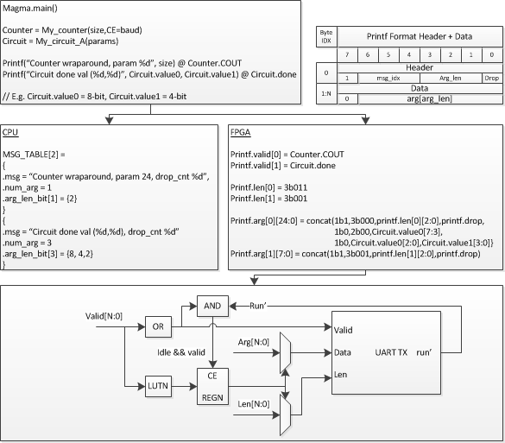
Printf flow chart
Example compilation flow
CPU side program
Hold bulk of message
Flatten pre-processed args
Arg count & bitwidth
FPGA side program
Control header
msg idx (tie w/CPU)
Length
Drop ind. (conflict)
Argument body
Concatenated body
Print at some event
Notes:
17

Slide 18
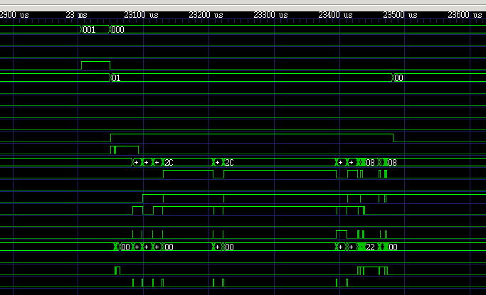

Streaming Examples
Simplified support for common use cases
Display Rendered Stream (Time-varying gradient video)
Output pixel brightness = f(x,y,time) = x+baud(t)
Display = DisplayOut(x_res=640, y_res=480, fps=60, playback)
userCirc = userRenderGradient(display.x, display.y, baud)
Output time-stamped debug trace to bin file (waveform viewer)
Output concat(data, timestamp) from several (5) usr defined modules
userCB = counter(timestamp_res, baud)
Write = writeLines(userCB, numPort, binary)
UserModA(dbgOut=Write.port[0]) … UserModZ(dbgOut=Write.port[N])
Output print statements from several User modules
Printf = printf(numPort)
UserModA(dbgOut=printf.port[0]) … UserModZ(dbgOut=printf.port[N])
Notes:
18

