Slide 1
Fast I/O Library for Icestick
Midpoint Presentation
Benjamin Braun & Nate Chizgi
Notes:
<number>

Slide 2
Goals
Implement a library in magma for icestick FPGA ↔ CPU I/O
Currently, communicating between the CPU and a running icestick is hard!
… that makes common communication patterns easy:
Visual Data: graphics rendered on FPGA displayed on CPU screen in real-time
Debugging / Log Data: printf() “statements” in magma show in CPU terminal
Stream Data: file on CPU read to FPGA program, output written back to file.
Disclosure: we hope to have a demo for one, possibly two, of these patterns
Notes:
<number>

Slide 3
Challenges
Few choices for an I/O primitive to unmodified Icestick
UART is the only primitive that doesn’t require hardware mod
… but it’s slow and unreliable
Complex semantics of different communication patterns
What should the library look like?
Notes:
<number>

Slide 4
I/O Primitive
UART is slow
Demo UART runs at 115,200 baud
~7 KBps
Visual data cap: 64x64 1 FPS @ 8-bits/pixel
We found the FTDI chip will support up to 12,000,000 baud
Results in 0.715 MBps streaming FPGA→CPU
Visual data cap: 640x480 2 FPS @ 8-bits/pixel
Notes:
<number>

Slide 5
I/O Primitive
UART is unreliable
Problem: FPGA→CPU data dropped if buffers on FTDI chip overflow
As far as we know, they are silently dropped without notifying CPU
Solution: Require CPU to signal “ACK” of received data to FPGA
FPGA will wait to send more data unless earlier data was ACKed
Effectively limits the amount of in-flight data FPGA→CPU at any time
Notes:
<number>

Slide 6
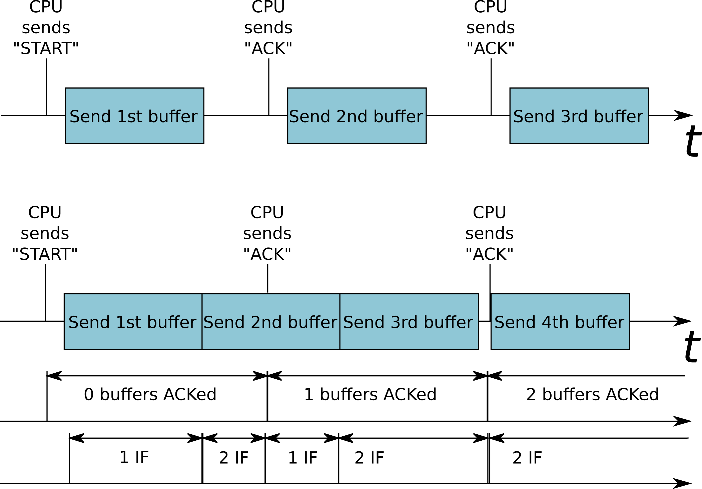
I/O Primitive
Reliable UART
Reliable UART
(fast version)
IF= # in-flight
Notes:
<number>

Slide 7
Icestick Fast-IO Library API
Fast-IO API
IOSpec(<type>, paramList)
Support various simple streaming types with user defined transforms/callbacks
Types
DisplayInOut(x_res, y_res, fps, fd…)
DisplayOut(x_res, y_res, fps, fd)
Printf(numPort)
ReadLines(userCB, numPort, fd)
WriteLines(userCB, fd)
Notes:
<number>

Slide 8
Streaming Protocol
Design Decisions - Modified UART
For demonstration purposes, implementing overclocked UART RX/TX
UART support is built in to Icestick device without any device level modifications –
Other (parallel/faster) protocols available through device level soldering
Able to achieve 0.715 MBps with overclocked UART (12MHz baud)
Good for 640x480 2 FPS 8-bit / pixel
Other future enhancements discussed in ‘future work’ to improve throughput
Notes:
<number>

Slide 9
Implementing Communication Patterns
Magma code
requiring visual display
Compiles to...
FPGA layout
Generated binary
(with GUI)
Fast-IO circuitry
Communication
Notes:
<number>

Slide 10
Implementing Communication Patterns
Magma code
with “printfs”
Compiles to...
FPGA layout
Generated binary
(outputs to stdout)
Fast-IO circuitry
Communication
Notes:
<number>

Slide 11
Magma code
using Fast-IO library
Compiles to... (magma)
Verilog
+
“.iospec” file (produced as side-effect)
Compiles to... (icestorm)
Compiles to... (our own “iocc” script)
Compiles to... (our own “iocc” script)
FPGA layout
C++ program
C++ program
Compiles to... (gcc)
Generated Binary
Notes:
<number>

Slide 12
Icestick Fast-IO Library API
//”Hello world” for procedural graphics using Icestick Fast-IO
magma.main()
conn = ifio_connection(UART) //use UART (only option for now)
display = ifio_simpledisplay(conn, 640, 480, 60) //width, height, framerate
def my_procedural_graphics():
return AnonCircuit(
in16 X,
in16 Y,
in32 frameCount,
//dynamic black-and-white diagonal gradient
Out32 out = X + Y + FrameCount
)
gfx = my_procedural_graphics()
gfx(display.X,display.Y,display.FrameCount)
wire(gfx.out, display.pixelOut)
magma.compile()
Notes:
<number>

Slide 13
Icestick Fast-IO Library API
ifio_connection(...)
Define connection properties. Pass result as argument to below:
ifio_simpledisplay(width,height,framerate,details)
make a width x height display @ framerate, other args in “details”
ifio_display()
“Advanced” version of simpledisplay (details omitted)
ifio_printf(formaSame as simpledisplay except t_string,arg_description)
Prints data to CPU stdout on any clock cycle where “enable” line is 1
ifio_stream_process(“file_in.txt”,”file_out.txt”)
Exposes data from “file_in.txt” to FPGA whenever FPGA sets “ready”
Exposes FPGA output to “file_out.txt” whenever FPGA sets “valid”
+ more communication patterns?
Notes:
<number>

Slide 14
Challenges Addressed
Few choices for an I/O primitive to unmodified Icestick
Fast reliable UART
Library abstracts away I/O primitive
Complex semantics of different communication patterns
Library API is specialized for a set of common patterns
Easy to use, at the expense of some flexibility
Notes:
<number>

Slide 16
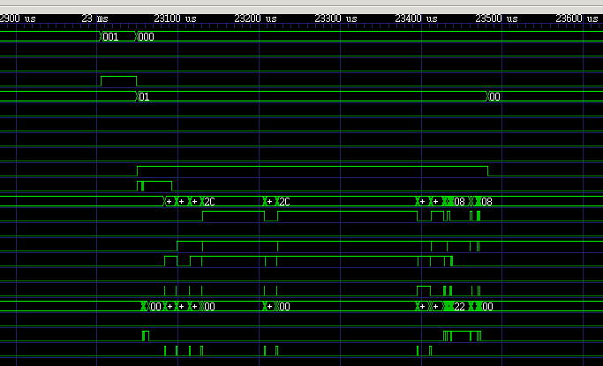

Streaming Examples
Simplified support for common use cases
Display Rendered Stream (Time-varying gradient video)
Output pixel brightness = f(x,y,time) = x+baud(t)
Display = DisplayOut(x_res=640, y_res=480, fps=60, playback)
userCirc = userRenderGradient(display.x, display.y, baud)
Output time-stamped debug trace to bin file (waveform viewer)
Output concat(data, timestamp) from several (5) usr defined modules
userCB = counter(timestamp_res, baud)
Write = writeLines(userCB, numPort, binary)
UserModA(dbgOut=Write.port[0]) … UserModZ(dbgOut=Write.port[N])
Output print statements from several User modules
Printf = printf(numPort)
UserModA(dbgOut=printf.port[0]) … UserModZ(dbgOut=printf.port[N])
Notes:
<number>

