Slide 1
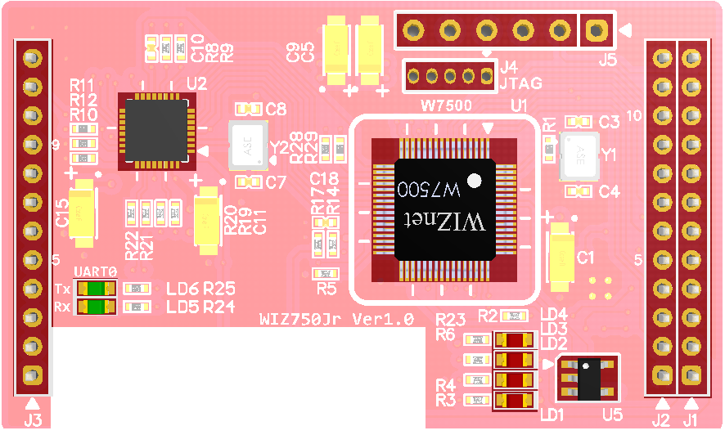
Expansion ISP port
JTAG
2
PHY
1x12
Network Trans Line
1x12
Data Trans Line
1
Main MCU
W7500
3
EEPROM
4
Indicate LED
5
Power LED
1x12
Expansion GPIO / App Boot / ISP Port

Slide 2
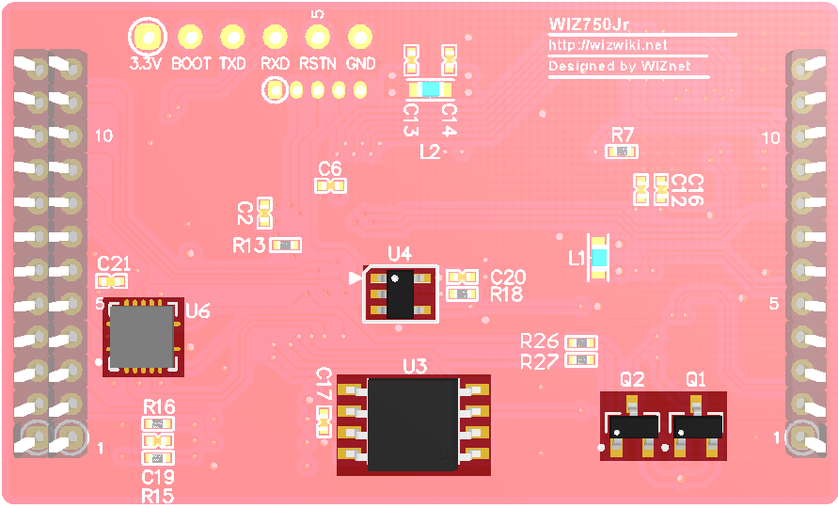
Qurdruple
3-state Buffer
6
7
Not Gate
PNP Transistor
9
Data Flash
8

Slide 3
Expansion ISP port
JTAG
PHY
1x12
Network Trans Line
1x12
Data Trans Line
Main MCU
W7500
EEPROM
UART TX/RX LED
Indicate LED
Power LED
1x12
Expansion GPIO / App Boot / ISP Port

Slide 4
Qurdruple
3-state Buffer
Not Gate
PNP Transistor
Data Flash

Slide 5
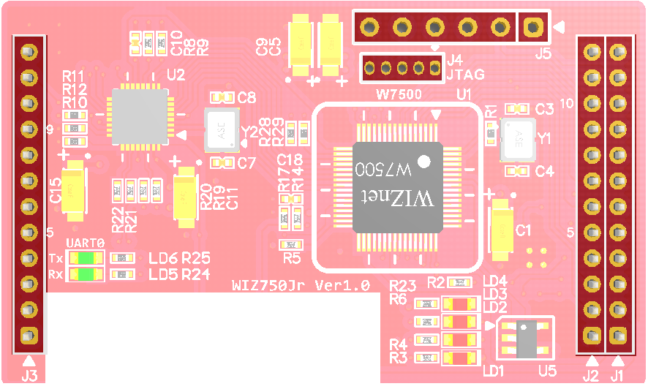
GND
ISP
JTAG
VCC_3.3V
/RESET
PA_04
SWDIO
U_RXD2
PC_11
PA_03
SWCLK
U_TXD2
PC_10
/RESET
BOOT
GND
VCC_3.3V
Network
Line
(10/100M) Ethernet
VCC_3.3V
STATUS
PA_07
Data
Line
PB_05
COL
GND
PHY_AD3
U_DSR
PA_09
NC
U_CTS
PA_11
PHY_AD0
U_RXD
PA_14
GND
GND
MDI_TP
U_DTR
PA_10
MDI_TN
U_RTS
PA_12
GND
U_TXD
PA_13
MDI_RP
GND
MDI_RN
/RESET
NC
VCC_3.3V
EX_GPIOA
EX_GPIOB
EX_GPIOD
APP_BOOT
EX_GPIOC
GND
U_RXD2
STAT_LED1
BOOT
U_TXD2
STAT_LED0
GND
PA_08
PC_15
PC_13
PC_12
PC_14
PC_11
PC_09
PC_10
PC_08
Optional Line
(Debug, Expansion GPIO, Status LED)

Slide 6
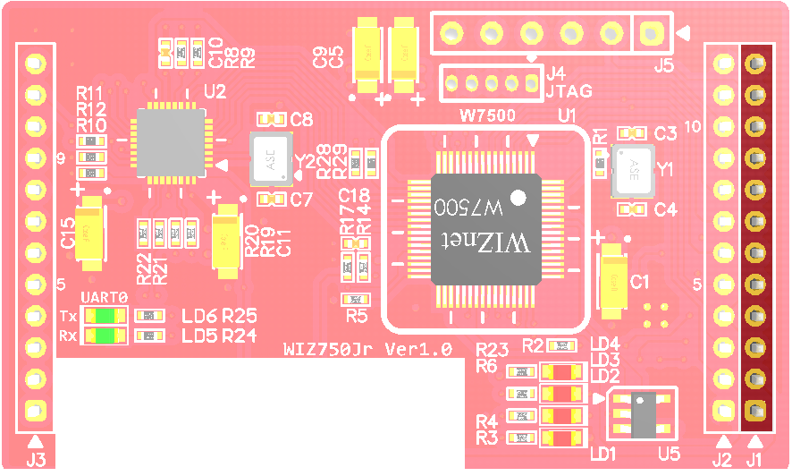
STATUS
GND
U_DSR
U_CTS
U_RXD
GND
U_DTR
U_RTS
U_TXD
GND
/RESET
VCC_3.3V

Slide 7
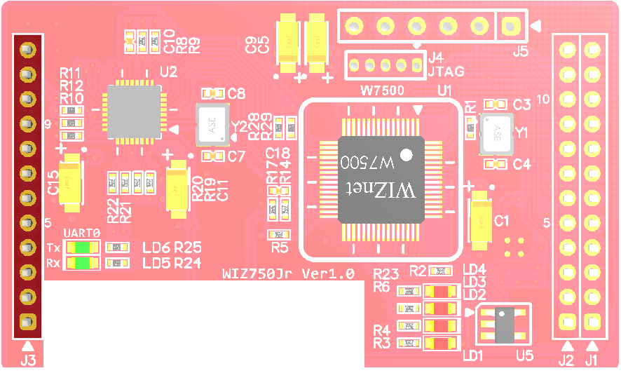
VCC_3.3V
COL
PHY_AD3
NC
PHY_AD0
GND
MDI_TP
MDI_TN
GND
MDI_RP
MDI_RN
NC

Slide 8
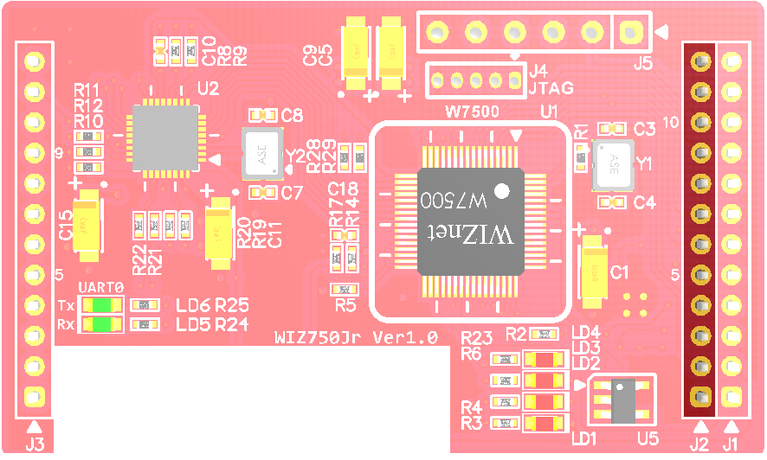
EX_GPIOA
EX_GPIOB
EX_GPIOD
APP_BOOT
EX_GPIOC
GND
U_RXD2
STAT_LED1
BOOT
U_TXD2
STAT_LED0
GND

Slide 9
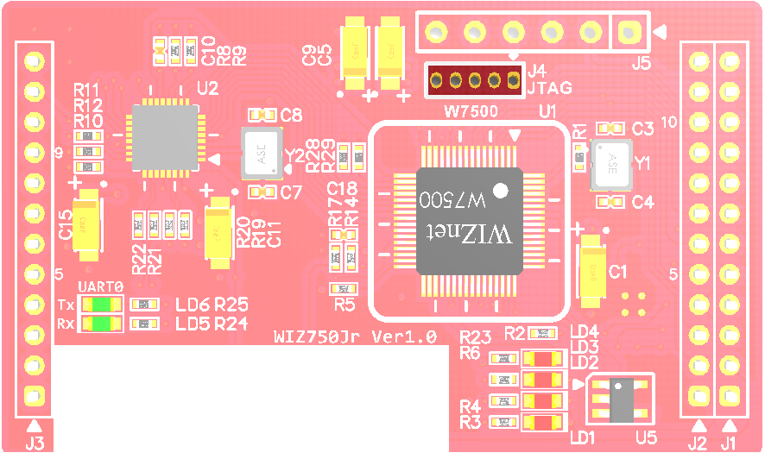
JTAG
GND
/RESET
PA_03
SWCLK
PA_04
SWDIO
VCC_3.3V

Slide 10
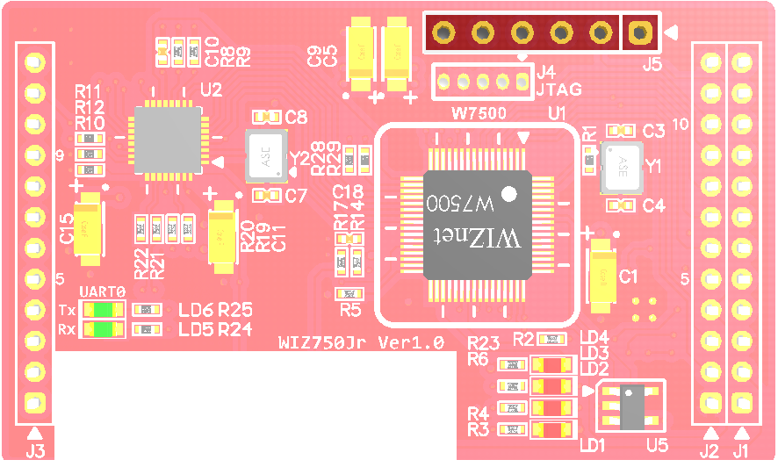
GND
ISP
/RESET
U_RXD2
PC_11
U_TXD2
PC_10
BOOT
VCC_3.3V

Slide 11
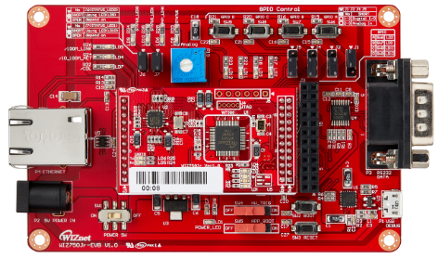
Indicate LED
(10/100_LED(ACT/LINK))
(COL LED) etc
Expansion GPIO
RS-232
Connector
(D-SUB9)
RJ-45
Connector
Power
Adapter
Micro USB B type
Debug/ISP Port
Power Switch
Mode Switch
Normal/Config
App Boot
Switch
Boot Switch
Reset Switch

