Slide 1
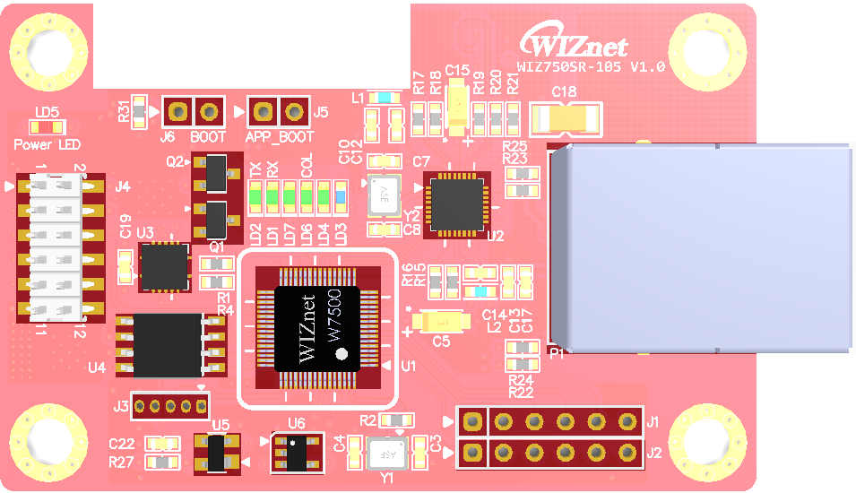
7
6
5
2x6
Data Trans Line
Boot
App Boot
RJ-45
Ethernet Connector
3
PNP Transistor
4
2
PHY
8
Main MCU
W7500
Quadruple
3-state Buffer
1
Data Flash
13
9
Expansion GPIO port
JTAG
EEPROM
Expansion ISP port
14
10
12
Reset IC
11

Slide 2
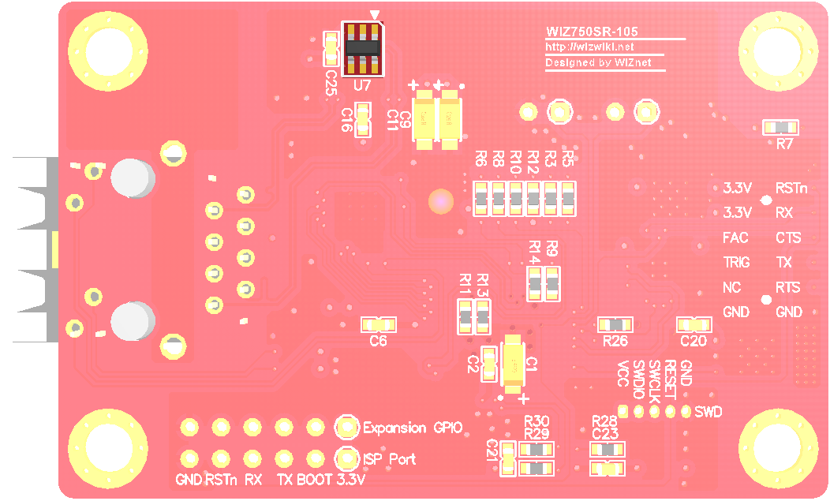
Ethernet line
ESD Protect
15

Slide 3
2x6
Data Trans Line
Boot
App Boot
RJ-45
Ethernet Connector
PNP Transistor
PHY
Quadruple
3-state Buffer
Main MCU
W7500
Data Flash
Expansion GPIO port
JTAG
EEPROM
Expansion ISP port
Reset IC

Slide 4
Ethernet line
ESD Protect

Slide 5
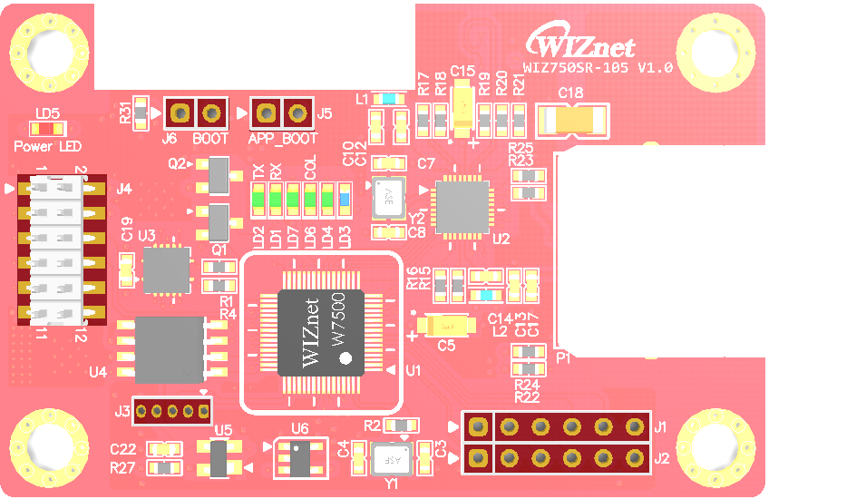
BOOT
Boot
VCC_3.3V
APP BOOT
PA_08
GND
Data
Line
/RESET
VCC_3.3V
Data
Line
PA_14
U_RXD
VCC_3.3V
PA_11
U_CTS
FAC nRST
PA_06
PA_13
U_TXD
HW_TRIG
PA_09
PA_12
U_RTS
NC
VCC_3.3V
Expansion
GPIO
GND
GND
GPIO_D
PC_12
GPIO_C
PC_13
GPIO_B
PC_14
GPIO_A
PC_15
GND
JTAG
GND
/RESET
PA_03
SWCLK
GND
ISP
PA_04
SWDIO
/RESET
VCC_3.3V
U_RXD2
PC_11
U_TXD2
PC_10
BOOT
VCC_3.3V

Slide 6
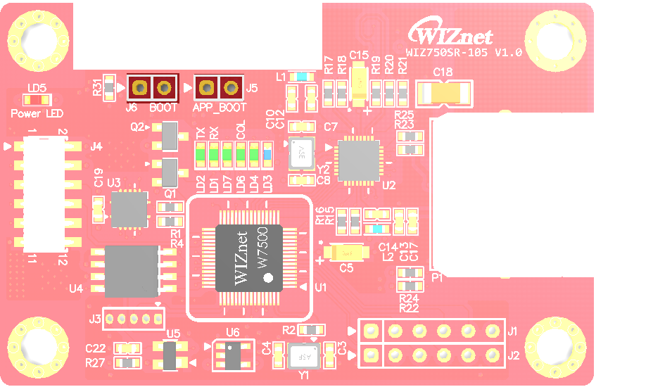
BOOT
Boot
VCC_3.3V
APP BOOT
PA_08
GND

Slide 7
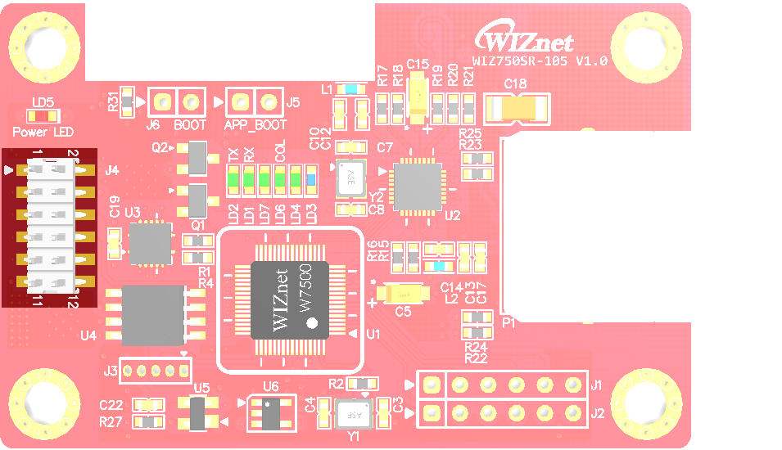
Data
Line
/RESET
VCC_3.3V
Data
Line
PA_14
U_RXD
VCC_3.3V
PA_11
U_CTS
FAC nRST
PA_06
PA_13
U_TXD
HW_TRIG
PA_09
PA_12
U_RTS
NC
GND
GND

Slide 8
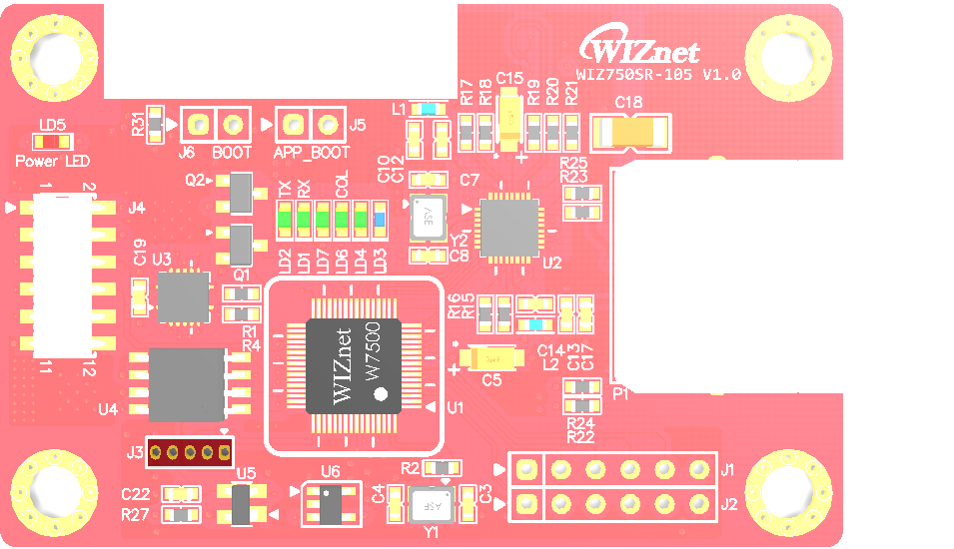
JTAG
GND
/RESET
PA_03
SWCLK
PA_04
SWDIO
VCC_3.3V

Slide 9
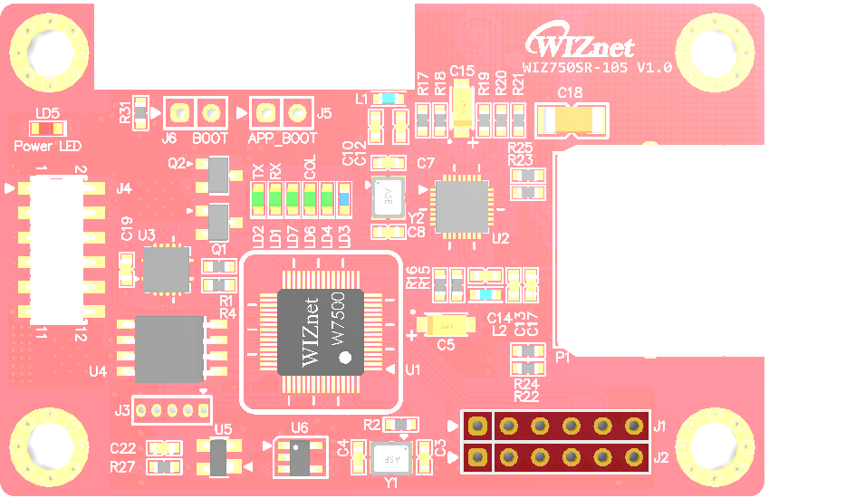
VCC_3.3V
Expansion
GPIO
GPIO_D
PC_12
GPIO_C
PC_13
GPIO_B
PC_14
GPIO_A
PC_15
GND
GND
ISP
/RESET
U_RXD2
PC_11
U_TXD2
PC_10
BOOT
VCC_3.3V

