Slide 1
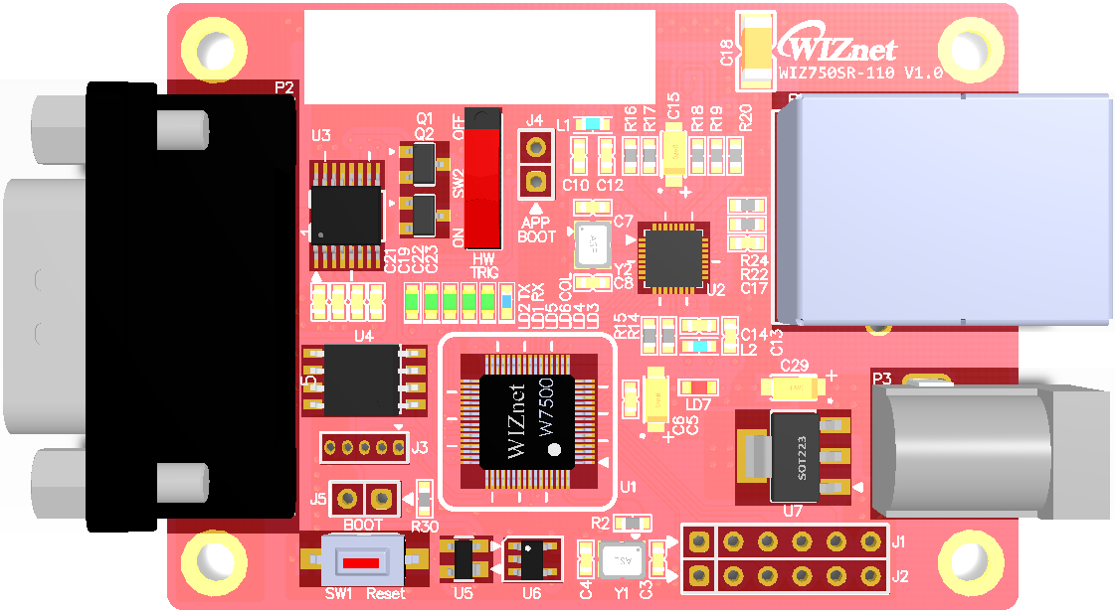
8
7
4
RJ-45
Ethernet Connector
D-SUB9 Connector
RS-232C Transceiver
PNP Transistor
3
App Boot
5
HW_TRIG
Slide SW
6
Data Flash
Main MCU
W7500
17
5v to 3.3v LDO
9
1
2
PHY
18
5V DC-JACK
10
16
JTAG
Expansion GPIO port
EEPROM
14
Expansion ISP port
15
Boot
11
Reset
Push SW
Reset IC
12
13

Slide 2
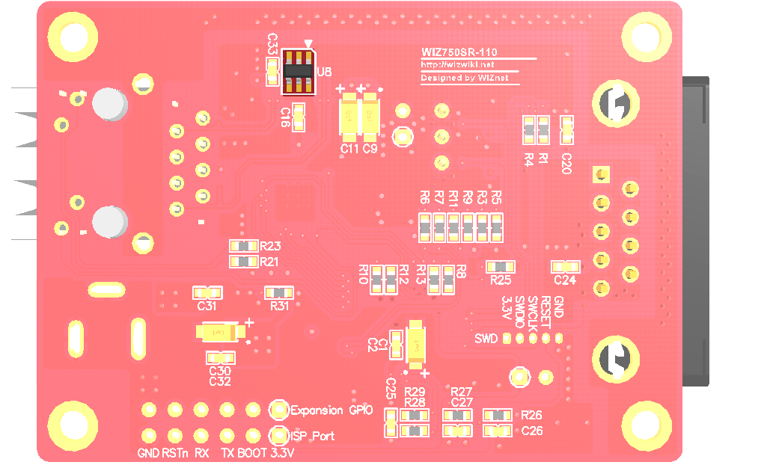
Ethernet line
ESD Protect
19

Slide 3
D-SUB9 Connector
RS-232C Transceiver
PNP Transistor
RJ-45
Ethernet Connector
App Boot
HW_TRIG
Slide SW
Data Flash
Main MCU
W7500
5v to 3.3v LDO
PHY
5V DC-JACK
JTAG
Expansion GPIO port
EEPROM
Expansion ISP port
Boot
Reset
Push SW
Reset IC

Slide 4
Ethernet line
ESD Protect

Slide 5
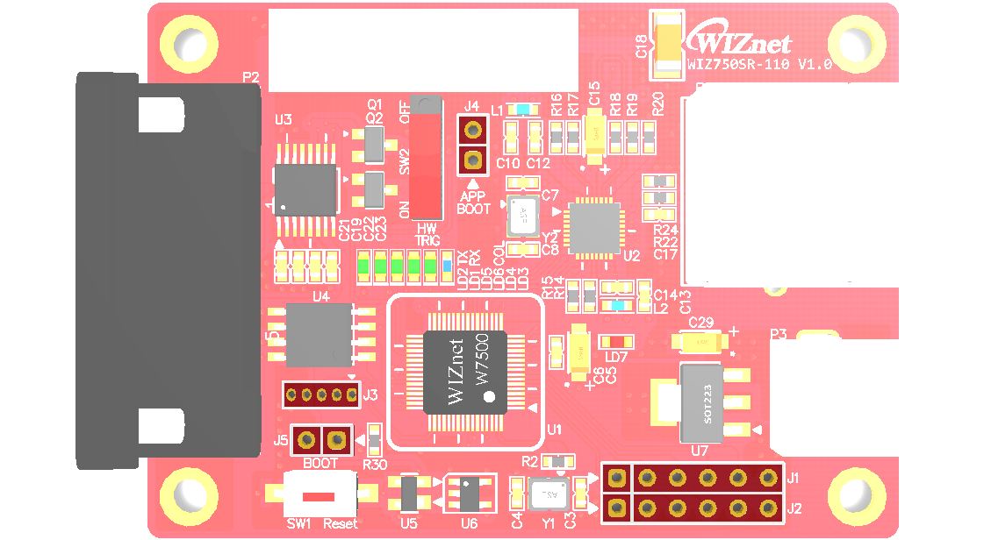
GND
Boot
APP BOOT
JTAG
VCC_3.3V
PA_04
SWDIO
PA_03
SWCLK
/RESET
VCC_3.3V
Expansion
GPIO
GND
GPIO_D
PC_12
GPIO_C
PC_13
GPIO_B
PC_14
GPIO_A
PC_15
GND
VCC_3.3V
BOOT
GND
ISP
/RESET
Boot
U_RXD2
PC_11
U_TXD2
PC_10
BOOT
VCC_3.3V

Slide 6
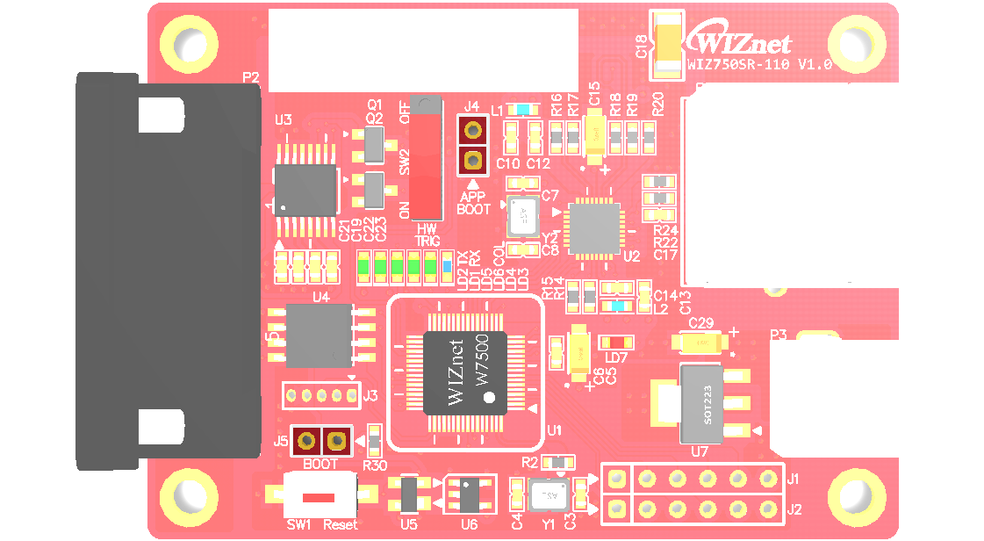
GND
Boot
APP BOOT
VCC_3.3V
BOOT
Boot

Slide 7
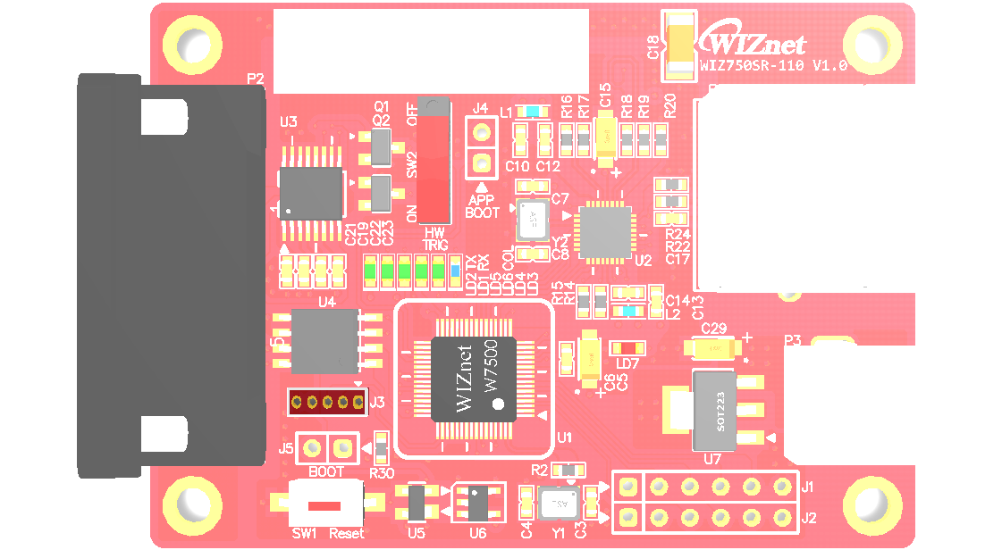
JTAG
VCC_3.3V
PA_04
SWDIO
PA_03
SWCLK
/RESET
GND

Slide 8
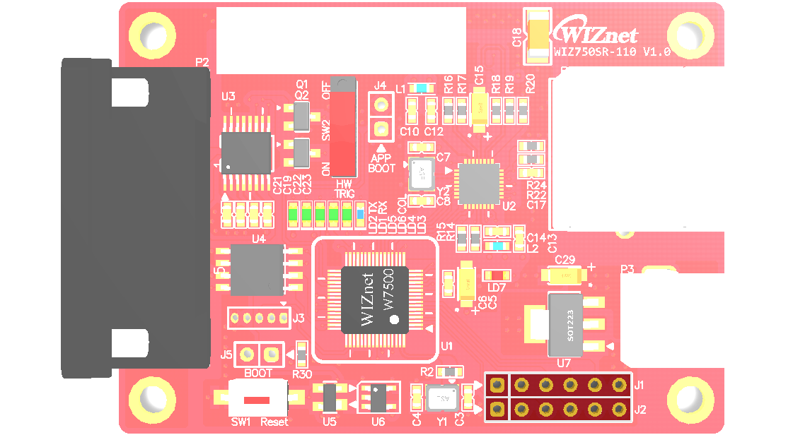
VCC_3.3V
Expansion
GPIO
GPIO_D
PC_12
GPIO_C
PC_13
GPIO_B
PC_14
GPIO_A
PC_15
GND
GND
ISP
/RESET
U_RXD2
PC_11
U_TXD2
PC_10
BOOT
VCC_3.3V

Slide 9
