Slide 1
{PYTHON}
A little girl goes into a pet show and asks for a wabbit. The shop keeper looks down at her, smiles and says:
"Would you like a lovely fluffy little white rabbit, or a cutesy wootesly little brown rabbit?"
"Actually", says the little girl, "I don't think my python would notice."
—Nick Leaton, Wed, 04 Dec 1996

Slide 2
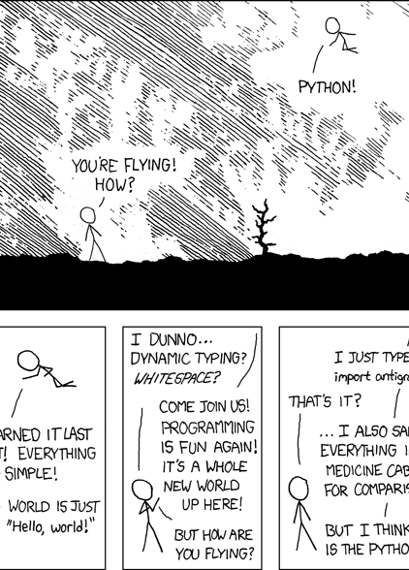
{how to use python}:
Interactive Interface:
%python
>>>5+4*(25-9)/2
37
^D to exit Interactive Interface
Running Python Programs:
%python filename.py
Hashbang:
#!/usr/bin/env python
YOU CAN IMPORT ANYTHING
(even cats)

Slide 3
{operator precedence} (a = 10, b= 20, d = 60(0011 1100), e = 13(0000 1101))
operator | description
** | Exponentiation (raise to the power)
~ + - | Ccomplement, unary plus and minus (method names for the last two are +@ and -@)
* / % // | Multiply, divide, modulo and floor division
+ - | Addition and subtraction
>> << | Right and left bitwise shift
& | Bitwise 'AND'
^ | | Bitwise exclusive `OR' and regular `OR'
<= < > >= | Comparison operators
<> == != | Equality operators
= %= /= //= -= += *= **= | Assignment operators
is is not | Identity operators
in not in | Membership operators
not or and | Logical operators

Slide 4
{all the operators!} (a = 10 b= 20)
operator | name | description/example
+ | addition | a+b=30
- | subtraction | subtracts right hand from left hand operator
* | multiplication | a*b=200
/ | division | a/b == a divided by b = .5
% | modulus | a%b == remainder of a/b = 0
** | exponent | a**b == a^{b} = 100000000000000000000
// | floor division | floor(a/b) = 0 or 9//2 = 4
== | boolean equal | (a == b) is not true.
!= | boolean not equal | (a != b) is true.
<> | if values are not equal then condition becomes true. | (a <> b) is true. This is similar to != operator.
> | greater than | (a > b) is not true.
< | less than | (a < b) is true.
>= | greater than or equal | (a >= b) is not true.
<= | less than or equal | (a <= b) is true.

Slide 5
{well, maybe not all of them} (a = 10, b= 20, d = 60(0011 1100), e = 13(0000 1101))
operator | name | description/example
= | assignment | c = a + b will assigne value of a + b into c
+= | additive assignment | c += a is equivalent to c = c + a
-= | subtractive assignment | c -= a is equivalent to c = c - a
*= | multiplicative assignment | c *= a is equivalent to c = c * a
/= | divisori assignment | c /= a is equivalent to c = c / a
%= | modulus assignment | c %= a is equivalent to c = c % a
**= | exponential assignment | c **= a is equivalent to c = c ** a
//= | floor divisori assignment | c //= a is equivalent to c = c // a
& | Binary AND Operator | (a & b) will give 12 which is 0000 1100
| | Binary OR Operator | (a | b) will give 61 which is 0011 1101
^ | Binary XOR Operator | (a ^ b) will give 49 which is 0011 0001
~ | Binary Ones Complement | (~a ) will give -60 which is 1100 0011
<< | Binary Left Shift Operator | a << 2 will give 240 which is 1111 0000
>> | Binary Right Shift Operator | a >> 2 will give 15 which is 0000 1111

Slide 6
{…hmm. still more} (a = 10, b= 20, d = 60(0011 1100), e = 13(0000 1101))
operator | name | description/example
and | logical AND operator | (a and b) is true.
or | logical OR Operator | (a or b) is true.
not | logical NOT operator | not(a and b) is false.
in | Evaluates to true if it finds a variable in the specified sequence and false otherwise. | x in y, here in results in a 1 if x is a member of sequence y.
not in | Evaluates to true if it does not finds a variable in the specified sequence and false otherwise. | x not in y, here not in results in a 1 if x is not a member of sequence y.
is | Evaluates to true if the variables on either side of the operator point to the same object and false otherwise. | x is y, here is results in 1 if id(x) equals id(y).
is not | Evaluates to false if the variables on either side of the operator point to the same object and true otherwise. | x is not y, here is not results in 1 if id(x) is not equal to id(y).

Slide 7
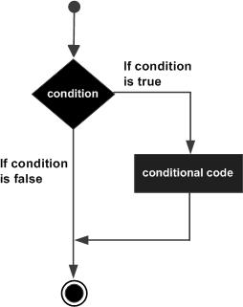
{if}
#!/usr/bin/python
var1 = 100
if var1:
print "1 - Got a true expression value"
print var1
var2 = 0
if var2:
print "2 - Got a true expression value"
print var2
print "Good bye!"

Slide 8
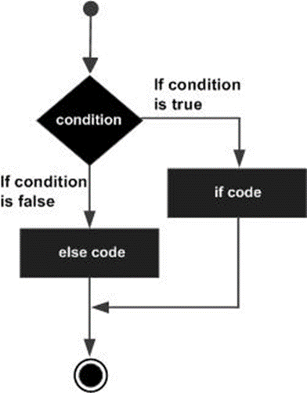
{if…elif…else}
#!/usr/bin/python
var = 100
if var == 200:
print "1 - Got a true expression value"
print var
elif var == 150:
print "2 - Got a true expression value"
print var2
elif var == 100:
print "3 - Got a true expression value"
print var
else:
print "4 - Got a false expression value"
print var
print "Good bye!"

Slide 9
{nested if}
#!/usr/bin/python
var = 100
if var < 200:
print "Expression value is less than 200"
if var == 150:
print "Which is 150"
elif var == 100:
print "Which is 100"
elif var == 50:
print "Which is 50"
elif var < 50:
print "Expression value is less than 50"
else:
print "Could not find true expression"
print "Good bye!"

Slide 10
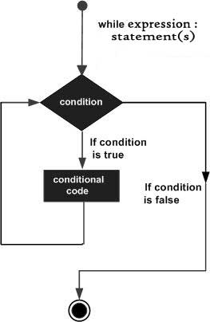
{while…}
//CODE:
#!/usr/bin/python
count = 0
while (count < 9):
print 'The count is:', count
count = count + 1
print "Good bye!"
//RESULT:
The count is: 0
The count is: 1
The count is: 2
The count is: 3
The count is: 4
The count is: 5
The count is: 6
The count is: 7
The count is: 8
Good bye!

Slide 11
{…while}
//CODE:
#!/usr/bin/python
count = 0
while count < 5:
print count, " is less than 5"
count = count + 1
else:
print count, " is greater than 5"
//RESULT:
0 is less than 5
1 is less than 5
2 is less than 5
3 is less than 5
4 is less than 5
5 is greater than 5

Slide 12
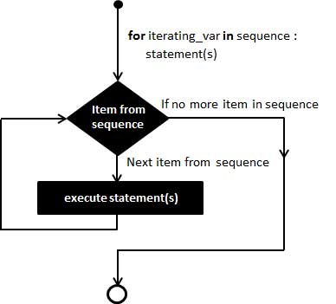
{for…}
//CODE:
#!/usr/bin/python
for letter in 'Python': # First Example
print 'Current Letter :', letter
fruits = ['banana', 'apple', 'mango']
for fruit in fruits: # Second Example
print 'Current fruit :', fruit
print "Good bye!"
//RESULT:
Current Letter : P
Current Letter : y
Current Letter : t
Current Letter : h
Current Letter : o
Current Letter : n
Current fruit : banana
Current fruit : apple
Current fruit : mango
Good bye!

Slide 13

{…for…}
//CODE:
#!/usr/bin/python
fruits = ['banana', 'apple', 'mango']
for index in range(len(fruits)):
print 'Current fruit :', fruits[index]
print "Good bye!"
//RESULT:
Current fruit : banana
Current fruit : apple
Current fruit : mango
Good bye!

Slide 14
{else with loops}
//CODE:
#!/usr/bin/python
for num in range(10,20): #to iterate between 10 to 20
for i in range(2,num): #to iterate on the factors of the number
if num%i == 0: #to determine the first factor
j=num/i #to calculate the second factor
print '%d equals %d * %d' % (num,i,j)
break #to move to the next number, the #first FOR
else: # else part of the loop
print num, 'is a prime number'
//RESULT:
10 equals 2 * 5
11 is a prime number
12 equals 2 * 6
13 is a prime number
14 equals 2 * 7
15 equals 3 * 5
16 equals 2 * 8
17 is a prime number
18 equals 2 * 9
19 is a prime number

Slide 15
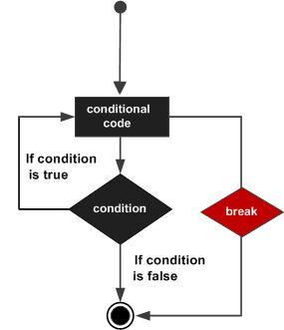
{break}
//CODE:
#!/usr/bin/python
for letter in 'Python': # First Example
if letter == 'h':
break
print 'Current Letter :', letter
var = 10 # Second Example
while var > 0:
print 'Current variable value :', var
var = var -1
if var == 5:
break
print "Good bye!"
//RESULT:
Current Letter : P
Current Letter : y
Current Letter : t
Current variable value : 10
Current variable value : 9
Current variable value : 8
Current variable value : 7
Current variable value : 6
Good bye!

Slide 16
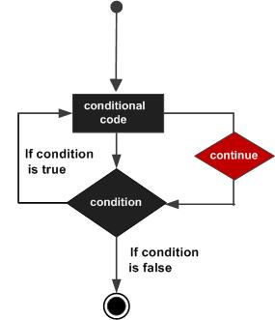
{continue}
//CODE:
#!/usr/bin/python
for letter in 'Python': # First Example
if letter == 'h':
continue
print 'Current Letter :', letter
var = 10 # Second Example
while var > 0:
var = var -1
if var == 5:
continue
print 'Current variable value :', var
print "Good bye!"
//RESULT:
Current Letter : P
Current Letter : y
Current Letter : t
Current Letter : o
Current Letter : n
Current variable value : 9
Current variable value : 8
Current variable value : 7
Current variable value : 6
Current variable value : 4
Current variable value : 3
Current variable value : 2
Current variable value : 1
Current variable value : 0
Good bye!

Slide 17

{pass}
//CODE:
#!/usr/bin/python
for letter in 'Python':
if letter == 'h':
pass
print 'This is pass block'
print 'Current Letter :', letter
print "Good bye!"
//RESULT:
Current Letter : P
Current Letter : y
Current Letter : t
This is pass block
Current Letter : h
Current Letter : o
Current Letter : n
Good bye!

Slide 18
{numbers}
int | long | float | complex
10 | 51924361L | 0.0 | 3.14j
100 | -0x19323L | 15.20 | 45.j
-786 | 0122L | -21.9 | 9.322e-36j
080 | 0xDEFABCECBDAECBFBAEl | 32.3+e18 | .876j
-0490 | 535633629843L | -90. | -.6545+0J
-0x260 | -052318172735L | -32.54e100 | 3e+26J
0x69 | -4721885298529L | 70.2-E12 | 4.53e-7j
number objects are created when you assign a value to them
for example:
var1 = 1
var2 = 10
To delete the reference to a number object, use del
del var1[,var2[,var3[…,varN]]]
del var
del var_a, var_b
function | description
int(x) | convert x to a plain integer
long(x) | convert x to a long integer
float(x) | convert x to a floating-point number
complex(x) | convert x to a complex number with a real part x and imaginary part zero
complex(x,y) | convert x and y to a complex number with a real part x and imaginary part y

Slide 19
{strings}
//CODE:
#!/usr/bin/python
var1 = 'Hello World!'
var2 = "Python Programming"
print "var1[0]: ", var1[0]
print "var2[1:5]: ", var2[1:5]
//RESULT:
var1[0]: H
var2[1:5]: ytho
string objects are created when you assign a value to them
for example:
var1 = ‘Hello World’
var2 = ‘Python Programming’
//CODE
#!/usr/bin/python
var1 = 'Hello World!'
print "Updated String :- ", var1[:6] + 'Python'
//RESULT:
Updated String :- Hello Python

Slide 20
{lists}
//creating lists:
list1 = ['physics', 'chemistry', 1997, 2000];
list2 = [1, 2, 3, 4, 5 ];
list3 = ["a", "b", "c", "d"];
//updating lists:
//CODE:
print "Value available at index 2 : "
print list[2];
list[2] = 2001;
print "New value available at index 2 : "
print list[2];
//RESULTS:
Value available at index 2 :
1997
New value available at index 2 :
2001
//accessing values in lists
//CODE:
#!/usr/bin/python
list1 = ['physics', 'chemistry', 1997, 2000];
list2 = [1, 2, 3, 4, 5, 6, 7 ];
print "list1[0]: ", list1[0]
print "list2[1:5]: ", list2[1:5]
//RESULT:
list1[0]: physics
list2[1:5]: [2, 3, 4, 5]
//delete list elements
//CODE:
list1 = ['physics', 'chemistry', 1997, 2000];
print list1;
del list1[2];
print "After deleting value at index 2 : "
print list1;
//RESULTS:
['physics', 'chemistry', 1997, 2000]
After deleting value at index 2 :
['physics', 'chemistry', 2000]

Slide 21
{tuples}
tuples are just like lists, however, tuples can’t be changed
syntactically, tuples use parenthesis where lists use square brackets
//operating on tuples:
//CODE:
#!/usr/bin/python
tup1 = (12, 34.56);
tup2 = ('abc', 'xyz');
# Following action is not valid for tuples
# tup1[0] = 100;
# So let's create a new tuple as follows
tup3 = tup1 + tup2;
print tup3;
//declaration
tup1 = ('physics', 'chemistry', 1997, 2000);
tup2 = (1, 2, 3, 4, 5 );
tup3 = "a", "b", "c", "d";
tup4 = ();
tup5 = (50,);
basic list and tuple operations
Python Expression | Results | Description
len((1, 2, 3)) | 3 | Length
(1, 2, 3) + (4, 5, 6) | (1, 2, 3, 4, 5, 6) | Concatenation
['Hi!'] * 4 | ('Hi!', 'Hi!', 'Hi!', 'Hi!') | Repetition
3 in (1, 2, 3) | True | Membership
for x in (1, 2, 3): print x, | 1 2 3 | Iteration

