Slide 1
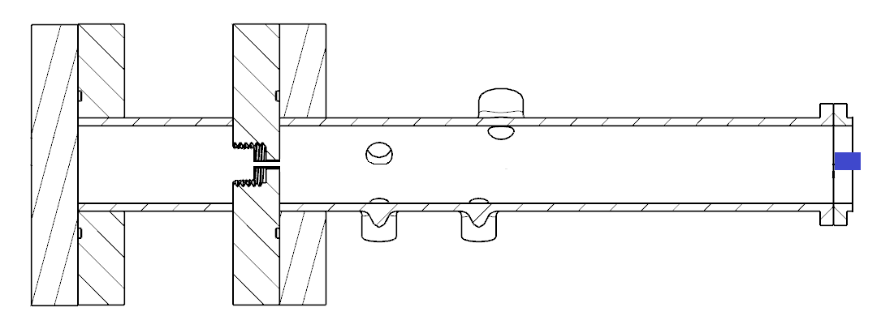
Air outlet (G1/4”)
Specialist high pressure clamp
Plugged G1/4”
Water inlet (1/2”)

