Slide 1
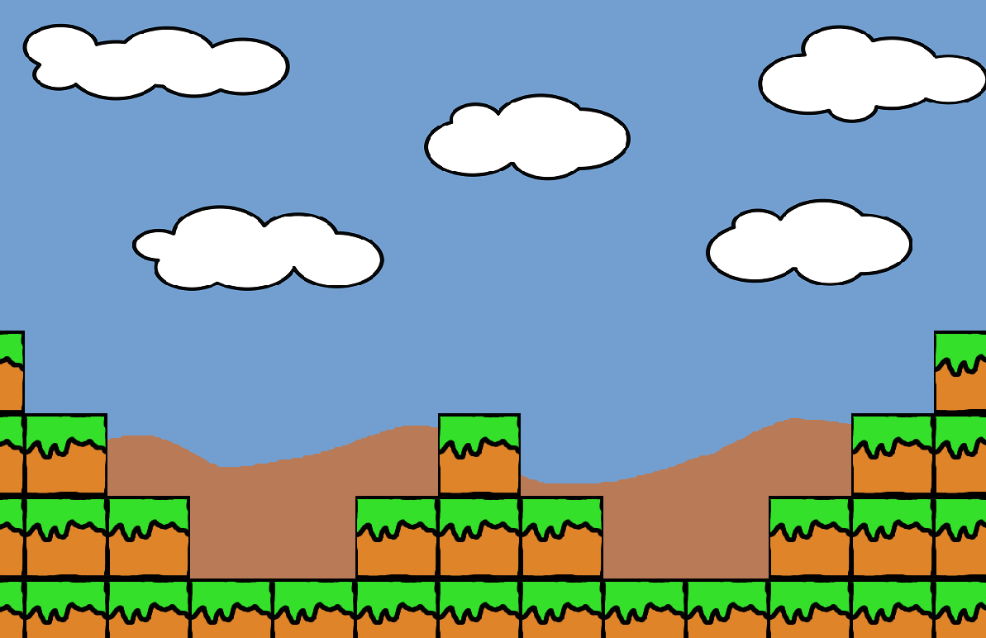

Jump N‘ Run
seproject 42:
Tobias Ofterdinger
Björn Eschle

Slide 2




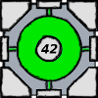


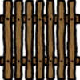
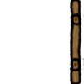
Spielobjekte
TYP_AIR = 0
TYP_GRAS = 1
TYP_ENEMY = 2
TYP_WATER = 3
TYP_COIN = 4
TYP_GOAL = 5
TYP_CRATE = 6
TYP_BUTTON = 7
TYP_GATE = 8

Slide 3
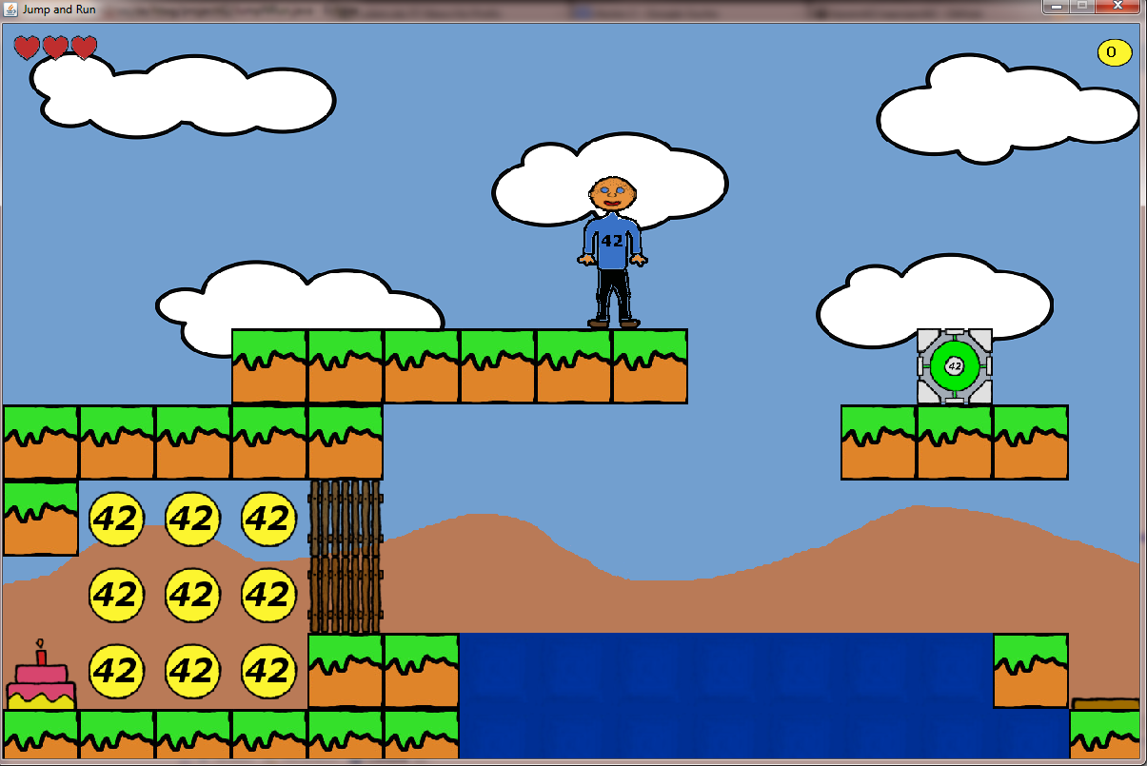
1,5,0,1,1,0,0,0,0
1,4,4,4,1,0,0,0,0
1,4,4,4,1,0,0,0,0
1,4,4,4,1,1,0,0,0
1,1,8,8,1,1,0,0,0
1,1,0,0,0,1,0,0,0
3,3,0,0,0,1,0,0,0
3,3,0,0,0,1,0,0,0
3,3,0,0,0,1,0,0,0
3,3,0,0,0,0,0,0,0
3,3,0,0,0,0,0,0,0
3,3,0,0,1,0,0,0,0
3,3,0,0,1,6,0,0,0
3,1,0,0,1,0,0,0,0
1,7,0,0,0,0,0,0,0
Karten Aufbau
→
→
→
→
→
→
→
→
→
→
→
→
→
→
→
0 | 0 | 0 | 0 | 0 | 0 | 0 | 0 | 0 | 0 | 0 | 0 | 0 | 0 | 0
0 | 0 | 0 | 0 | 0 | 0 | 0 | 0 | 0 | 0 | 0 | 0 | 0 | 0 | 0
0 | 0 | 0 | 0 | 0 | 0 | 0 | 0 | 0 | 0 | 0 | 0 | 0 | 0 | 0
0 | 0 | 0 | 1 | 1 | 1 | 1 | 1 | 1 | 0 | 0 | 0 | 6 | 0 | 0
1 | 1 | 1 | 1 | 1 | 0 | 0 | 0 | 0 | 0 | 0 | 1 | 1 | 1 | 0
1 | 4 | 4 | 4 | 8 | 0 | 0 | 0 | 0 | 0 | 0 | 0 | 0 | 0 | 0
0 | 4 | 4 | 4 | 8 | 0 | 0 | 0 | 0 | 0 | 0 | 0 | 0 | 0 | 0
5 | 4 | 4 | 4 | 1 | 1 | 3 | 3 | 3 | 3 | 3 | 3 | 3 | 1 | 7
1 | 1 | 1 | 1 | 1 | 1 | 3 | 3 | 3 | 3 | 3 | 3 | 3 | 3 | 1

Slide 4
Karten Aufbau
1,5,0,1,1,0,0,0,0
1,4,4,4,1,0,0,0,0
1,4,4,4,1,0,0,0,0
1,4,4,4,1,1,0,0,0
1,1,8,8,1,1,0,0,0
1,1,0,0,0,1,0,0,0
3,3,0,0,0,1,0,0,0
3,3,0,0,0,1,0,0,0
3,3,0,0,0,1,0,0,0
3,3,0,0,0,0,0,0,0
3,3,0,0,0,0,0,0,0
3,3,0,0,1,0,0,0,0
3,3,0,0,1,6,0,0,0
3,1,0,0,1,0,0,0,0
1,7,0,0,0,0,0,0,0
0 | 0 | 0 | 0 | 0 | 0 | 0 | 0 | 0 | 0 | 0 | 0 | 0 | 0 | 0
0 | 0 | 0 | 0 | 0 | 0 | 0 | 0 | 0 | 0 | 0 | 0 | 0 | 0 | 0
0 | 0 | 0 | 0 | 0 | 0 | 0 | 0 | 0 | 0 | 0 | 0 | 0 | 0 | 0
0 | 0 | 0 | 1 | 1 | 1 | 1 | 1 | 1 | 0 | 0 | 0 | 6 | 0 | 0
1 | 1 | 1 | 1 | 1 | 0 | 0 | 0 | 0 | 0 | 0 | 1 | 1 | 1 | 0
1 | 4 | 4 | 4 | 8 | 0 | 0 | 0 | 0 | 0 | 0 | 0 | 0 | 0 | 0
0 | 4 | 4 | 4 | 8 | 0 | 0 | 0 | 0 | 0 | 0 | 0 | 0 | 0 | 0
5 | 4 | 4 | 4 | 1 | 1 | 3 | 3 | 3 | 3 | 3 | 3 | 3 | 1 | 7
1 | 1 | 1 | 1 | 1 | 1 | 3 | 3 | 3 | 3 | 3 | 3 | 3 | 3 | 1

Slide 5
Karten Aufbau
1,5,0,1,1,0,0,0,0
1,4,4,4,1,0,0,0,0
1,4,4,4,1,0,0,0,0
1,4,4,4,1,1,0,0,0
1,1,8,8,1,1,0,0,0
1,1,0,0,0,1,0,0,0
3,3,0,0,0,1,0,0,0
3,3,0,0,0,1,0,0,0
3,3,0,0,0,1,0,0,0
3,3,0,0,0,0,0,0,0
3,3,0,0,0,0,0,0,0
3,3,0,0,1,0,0,0,0
3,3,0,0,1,6,0,0,0
3,1,0,0,1,0,0,0,0
1,7,0,0,0,0,0,0,0
0 | 0 | 0 | 0 | 0 | 0 | 0 | 0 | 0 | 0 | 0 | 0 | 0 | 0 | 0
0 | 0 | 0 | 0 | 0 | 0 | 0 | 0 | 0 | 0 | 0 | 0 | 0 | 0 | 0
0 | 0 | 0 | 0 | 0 | 0 | 0 | 0 | 0 | 0 | 0 | 0 | 0 | 0 | 0
0 | 0 | 0 | 1 | 1 | 1 | 1 | 1 | 1 | 0 | 0 | 0 | 6 | 0 | 0
1 | 1 | 1 | 1 | 1 | 0 | 0 | 0 | 0 | 0 | 0 | 1 | 1 | 1 | 0
1 | 4 | 4 | 4 | 8 | 0 | 0 | 0 | 0 | 0 | 0 | 0 | 0 | 0 | 0
0 | 4 | 4 | 4 | 8 | 0 | 0 | 0 | 0 | 0 | 0 | 0 | 0 | 0 | 0
5 | 4 | 4 | 4 | 1 | 1 | 3 | 3 | 3 | 3 | 3 | 3 | 3 | 1 | 7
1 | 1 | 1 | 1 | 1 | 1 | 3 | 3 | 3 | 3 | 3 | 3 | 3 | 3 | 1

Slide 6
Karten Aufbau
1,5,0,1,1,0,0,0,0
1,4,4,4,1,0,0,0,0
1,4,4,4,1,0,0,0,0
1,4,4,4,1,1,0,0,0
1,1,8,8,1,1,0,0,0
1,1,0,0,0,1,0,0,0
3,3,0,0,0,1,0,0,0
3,3,0,0,0,1,0,0,0
3,3,0,0,0,1,0,0,0
3,3,0,0,0,0,0,0,0
3,3,0,0,0,0,0,0,0
3,3,0,0,1,0,0,0,0
3,3,0,0,1,6,0,0,0
3,1,0,0,1,0,0,0,0
1,7,0,0,0,0,0,0,0
0 | 0 | 0 | 0 | 0 | 0 | 0 | 0 | 0 | 0 | 0 | 0 | 0 | 0 | 0
0 | 0 | 0 | 0 | 0 | 0 | 0 | 0 | 0 | 0 | 0 | 0 | 0 | 0 | 0
0 | 0 | 0 | 0 | 0 | 0 | 0 | 0 | 0 | 0 | 0 | 0 | 0 | 0 | 0
0 | 0 | 0 | 1 | 1 | 1 | 1 | 1 | 1 | 0 | 0 | 0 | 6 | 0 | 0
1 | 1 | 1 | 1 | 1 | 0 | 0 | 0 | 0 | 0 | 0 | 1 | 1 | 1 | 0
1 | 4 | 4 | 4 | 8 | 0 | 0 | 0 | 0 | 0 | 0 | 0 | 0 | 0 | 0
0 | 4 | 4 | 4 | 8 | 0 | 0 | 0 | 0 | 0 | 0 | 0 | 0 | 0 | 0
5 | 4 | 4 | 4 | 1 | 1 | 3 | 3 | 3 | 3 | 3 | 3 | 3 | 1 | 7
1 | 1 | 1 | 1 | 1 | 1 | 3 | 3 | 3 | 3 | 3 | 3 | 3 | 3 | 1

Slide 7
Karten Aufbau
1,5,0,1,1,0,0,0,0
1,4,4,4,1,0,0,0,0
1,4,4,4,1,0,0,0,0
1,4,4,4,1,1,0,0,0
1,1,8,8,1,1,0,0,0
1,1,0,0,0,1,0,0,0
3,3,0,0,0,1,0,0,0
3,3,0,0,0,1,0,0,0
3,3,0,0,0,1,0,0,0
3,3,0,0,0,0,0,0,0
3,3,0,0,0,0,0,0,0
3,3,0,0,1,0,0,0,0
3,3,0,0,1,6,0,0,0
3,1,0,0,1,0,0,0,0
1,7,0,0,0,0,0,0,0
Level.lvl
0 | 0 | 0 | 0 | 0 | 0 | 0 | 0 | 0 | 0 | 0 | 0 | 0 | 0 | 0
0 | 0 | 0 | 0 | 0 | 0 | 0 | 0 | 0 | 0 | 0 | 0 | 0 | 0 | 0
0 | 0 | 0 | 0 | 0 | 0 | 0 | 0 | 0 | 0 | 0 | 0 | 0 | 0 | 0
0 | 0 | 0 | 1 | 1 | 1 | 1 | 1 | 1 | 0 | 0 | 0 | 6 | 0 | 0
1 | 1 | 1 | 1 | 1 | 0 | 0 | 0 | 0 | 0 | 0 | 1 | 1 | 1 | 0
1 | 4 | 4 | 4 | 8 | 0 | 0 | 0 | 0 | 0 | 0 | 0 | 0 | 0 | 0
0 | 4 | 4 | 4 | 8 | 0 | 0 | 0 | 0 | 0 | 0 | 0 | 0 | 0 | 0
5 | 4 | 4 | 4 | 1 | 1 | 3 | 3 | 3 | 3 | 3 | 3 | 3 | 1 | 7
1 | 1 | 1 | 1 | 1 | 1 | 3 | 3 | 3 | 3 | 3 | 3 | 3 | 3 | 1

Slide 8
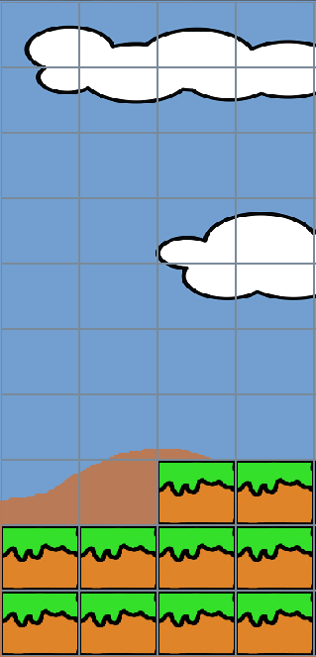
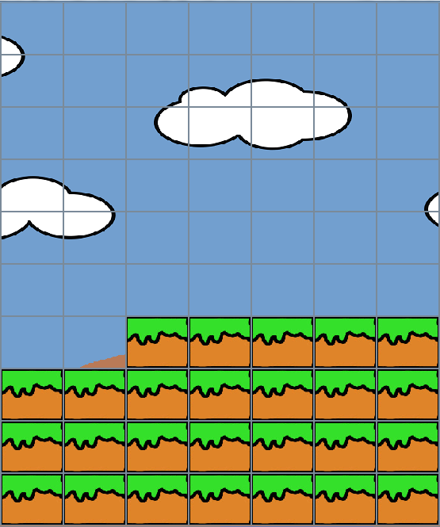
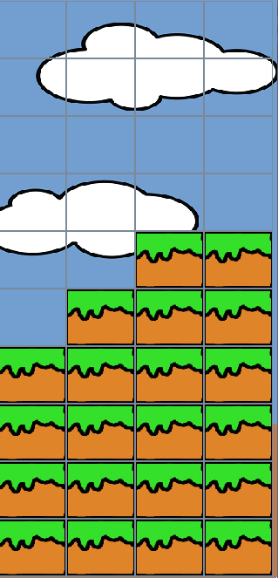

Dynamisches Nachladen
Sichtbarer Bereich

Slide 9


Kollisionsabfrage
0,0
X
100,100
300,200
Y

Slide 10
Schwierigkeiten
Kollisionsabfrage
Gravity isMovable?
Left isMovable?
Move down
Move left
Lösung
Schutz des kritischen Bereichs
durch Mutex

Slide 11
Schwierigkeiten
Performance
Große Karten
Koordinaten aller Blöcke berechnen
Dynamisches Nachladen
Gegner/Schalter/Tore
Algorithmen aller Gegner/Schalter/Tore berechnen
Nur aktiv wenn in sichtbarem Bereich
Weitere:
Maven !

