Slide 1


DWH2 Final Project
- Johnson Michal, Kryeziu Leona, Wagner Björn -
https://github.com/bjoern555/dwh2-text-to-sql

Slide 2
Dataset Choice & Rationale
Questions drawn from data/dev.json (Spider/BIRD-style benchmark on the Football DB)
Test Set: 18 Questions (Easy 3 / Medium 6 / Hard 5 / Extra 4)
Difficulty | Count | Question IDs
Easy 🟢 | 3 | 779, 268, 297
Medium 🟠 | 6 | 89, 506, 708, 569, 861, 605
Hard 🔴 | 5 | 94, 155, 259, 426, 534
Extra-Hard 🟣 | 4 | 120, 284, 551, 591
Total | 18 | 9 🟢🟠 | 9 🔴🟣 => 50/50
Why FootballDB?
Easy to spot-check predicted SQL against intuition
Query results can be validated intuitively
No need to study the database schema in depth

Slide 3
System Architecture / Setup
LLM
Local Ollama with llama3.2:1b or qwen2.5-coder:14b
Configurable via .env (OLLAMA_MODEL)
Database
PostgreSQL, Schema exp_v3, hosted on ZHAW-Server
Connection via LangChain
Approach
LangGraph-based multi-step reasoning
Evaluation Metric
Execution Accuracy: Predicted result == Gold result
(exact match)

Slide 4
Query Examples - Three Sample Cases
"Where was the world cup in 2018?"
Gold: SELECT venue FROM world_cup WHERE year = 2018
Pred: SELECT T1.venue FROM world_cup T1 INNER JOIN stadium T2 ON T1.venue = T2.city WHERE ...
Gold result: [('Russia',)] Pred result: empty
Issue: Unnecessary join on stadium table
"Show all national teams who have won more than 2 world cups"
Gold: ... JOIN national_team T2 ... WHERE winner = 'true' GROUP BY teamname HAVING COUNT(year) > 2
Pred: ... INNER JOIN world_cup_result T2 ... WHERE winner = 'TRUE' GROUP BY teamname HAVING ...
Both results: [Argentina, Italy, Brazil, Germany]
Note: Different formulation, identical result
"Which players played for Switzerland in 2014? Return the names of the players"
Gold: ... JOIN player_fact ... JOIN national_team ... WHERE teamname = 'Switzerland' AND year = 2014
Pred: ... JOIN player_club_team T2 ... WHERE T2.club_id = 'Q2701659' AND T1.country = 'Switzerland' ...
Gold result: 23 players · Pred result: SQL error
Issue: Hallucinated column player.country
Notes:
with Input, Generated SQL, and Result

Slide 5
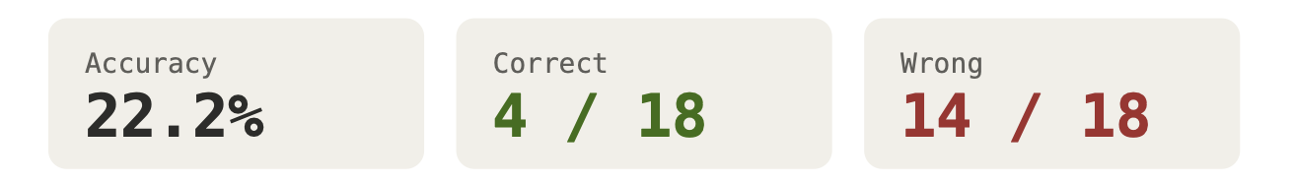
Execution Accuracy Results
First baseline run. Weak overall, but a starting point we improve on later
Accuracy: 22.2 % with the llama3.2:1b model
The model handles trivial lookups but collapses on anything requiring joins or multi-step reasoning (0/4 on extra-hard)

Slide 6
Analysis of Errors / Model Limitations
The llama3.2:1b model fails almost entirely at the schema level, wrong joins and hallucinated columns
This indicates that we need a TABLE_GUIDE
This tells us that llama3.2:1b is too weak and thus we need a better model that doesn’t hallucinate
In-context learning / few-shot examples did help

Slide 7
Optional Techniques Implemented
Execution Accuracy
The biggest win was adding the TABLE_GUIDE to the LLM
In combination with a stronger model, this resulted in an accuracy of 72.2%
Adding few-shot examples helped but introduced the risk of overfitting on the training set
At the end we achieved a success rate of 94.4%, the single remaining error was just one extra column in the SELECT

Slide 8
Conclusion
We managed to adjust our model to reach a success rate of 94% with a start of 22%
The strongest impact was from describing the tables to the model and adjusting the model from llama to qwen
Simple LangGraph-based multi-step reasoning is only working with additional enhancements
Today is a good day to get 20/20 points ;) thanks for reviewing

Slide 9
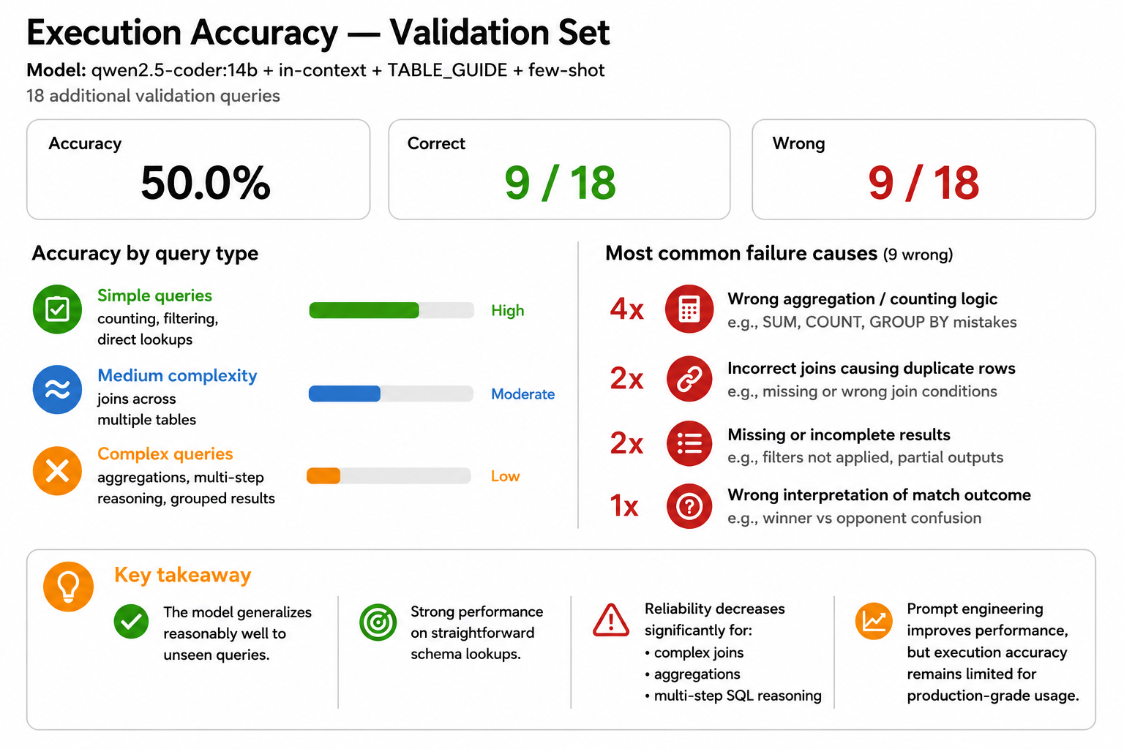
Future Work - Generalization on a New Data Set
We created a new data set for testing if our model overfits or generalizes
Results improved, as expected -> from 22.2% to 50% accuracy
But they did not reach the success rate of our original dataset (94.4%)
It solved >70% of easy questions but none of the hardest ones
Conclusion: the system does not generalize perfectly, it is partly overfitting to our dataset
The held-out set has more aggregation queries (SUM/COUNT/GROUP BY), which were under-represented in our few-shot examples (explaining the 4× aggregation errors)

