Slide 1
Hello QRadar & Python World!
Bjoern found magic on 2019-03-06 13:36:11

Slide 2
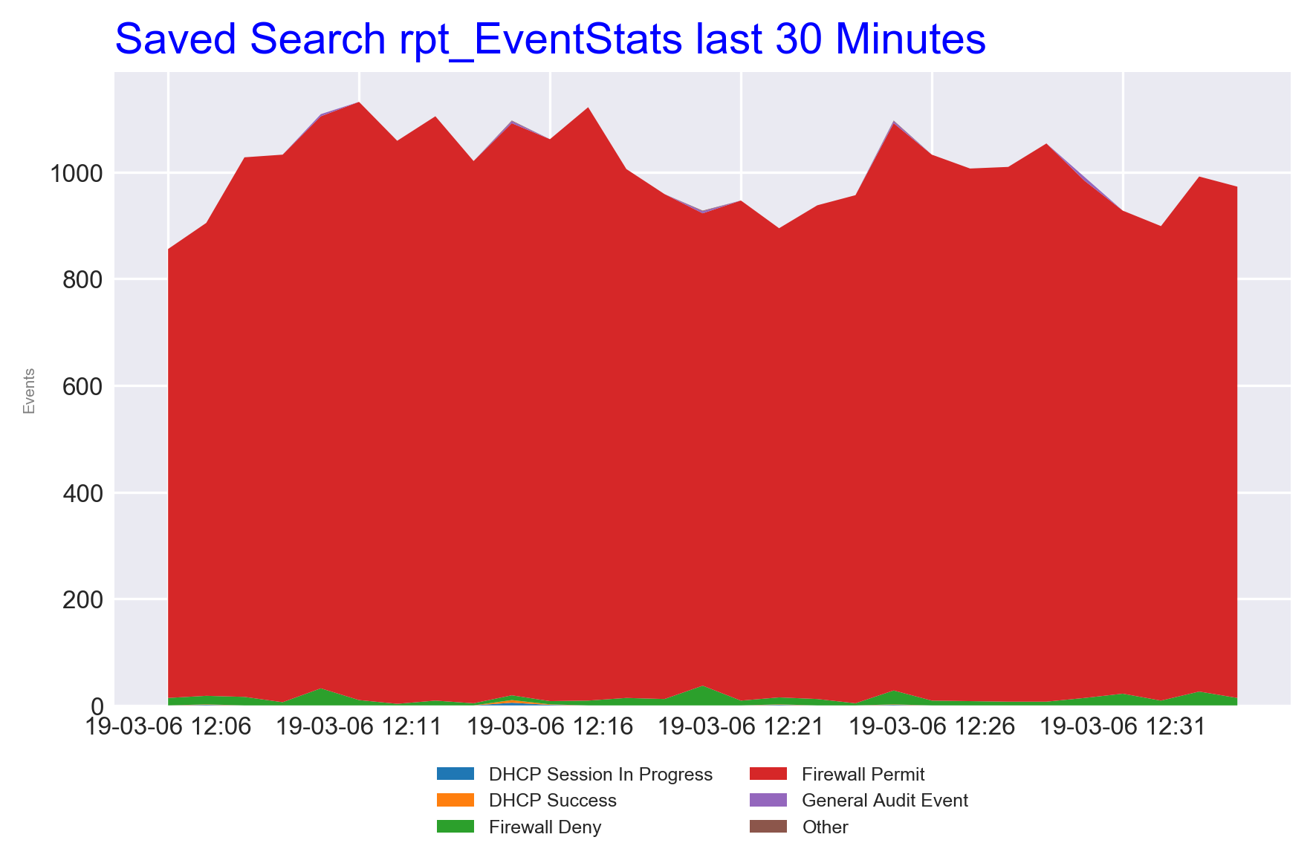
This is the Image Slide

