Slide 1
Crazy Eight Game: Visualization
Babatunde John Olanipekun, (PhD)

Slide 2
Introduction: About the data
Contains the full games and respective actions of the players or the state of the games as the games progresses.
Each game was stored as a separate and 10,000 game records/files were received as individual files .

Slide 3
Introduction: Question of Interest
Generate insights from the data in a visual format

Slide 4
Approach
Data snooping: Look at the raw data structure to check consistency among all data files.
The data structure is reasonably consistent and Seed value is unique (the only unique item) to each game.
Merge the data set. Assign respective seed value to game action and game progress to distinguish games apart.
Create dashboards to explore any trends in players actions, cards names, win statistics etc.
Tableau is tool for visualization. Attempt was made to use the Union function to merge the data files, but Tableau crashed several times due to the size of the resulting file.
The files were successfully merged in pandas/python but several operations used for data munging were particularly slow due to the size of the file and memory size of the laptop.
To assign the Seed, a new column was created and the corresponding seeds copied over.
The wrangled data was written to local computer for onward transfer to Tableau.
Tableau was used to create the dashboard.

Slide 5
Approach: Tools
Data Wrangling:
Jupyter Notebook, Pandas, Numpy, Python seaborn
Visualization:
Tableau desktop

Slide 6
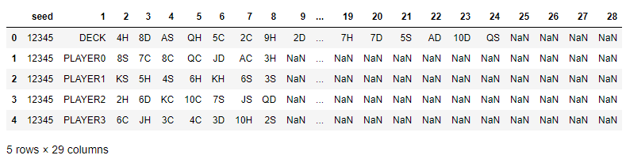
Data cleaning
Below is ‘head’ of final clean data. The Nas are necessary due to unequal row number. They were handled efficiently in Tableau environment.

Slide 7

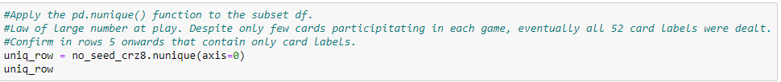
Introduction: Question of Interest
Below is ‘head’ of final clean data. The Nas are necessary due to unequal row number. They were handled efficiently in Tableau environment.

Slide 8

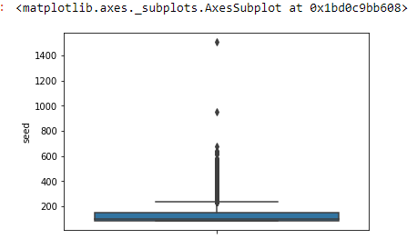
EDA: Jupyter notebook
Number of items (i.e. Actions of the player and the state of the game) is proportions to duration of the game. This boxplot shows the distribution of game duration.
Apart from the outlier that has up to 1400 items. Most games last a duration depicted by less that 200 lines.

Slide 9
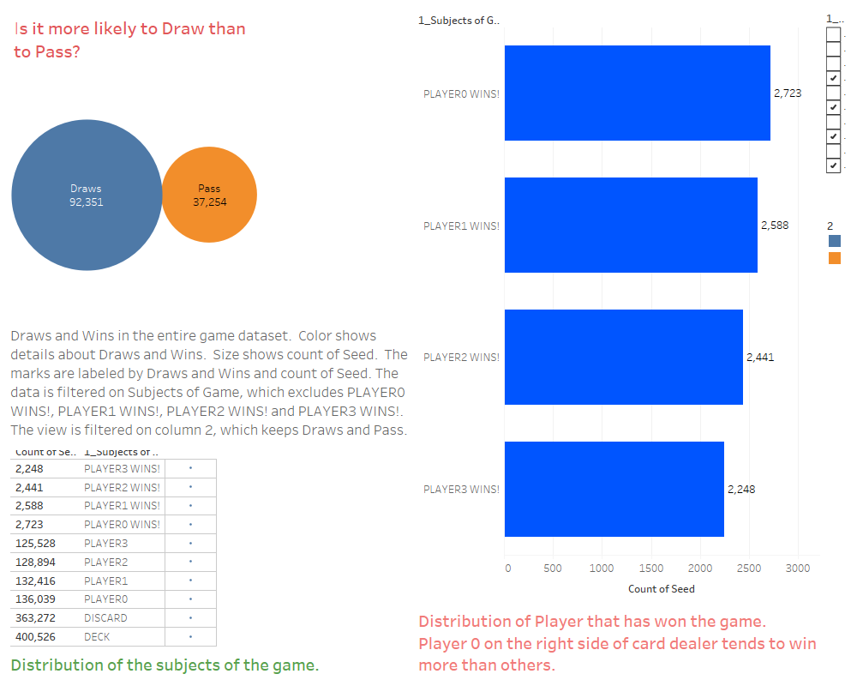
Dashboard created in Tableau

Slide 10
Lessons learnt
This project is primarily a visualization task, so I underestimated the extent of munging/wrangling that I needed to do with the dataset.
As a result, I believed I would be able to complete everything in a Tableau environment. I planned to use Tableau Union to merge all the data file and Tableau Prep for data wrangling/munging.
Despite several attempts, the file size caused Tableau to crash on my laptop while attempting to ‘Unionize’ the data files.
I was able to merge and wrangle these files in the Jupyter notebook with pandas/python functions.

Slide 11
Further exploration
There is room for further analyses of this dataset.
The label of the most common card played first in the game.
Using the game rule for awarding points to each one can calculate the points for each player
Further trends could be viewed in such dataset.
How many times does card ‘8’ (carries the highest point) gets played in a game?

Slide 12
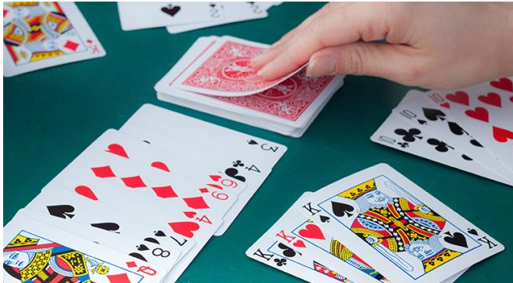

Thank you
THANK YOU VERY MUCH!

