Slide 1

Notes:
This deck follows the GSVFD First Responder EMS Instructor Guide. Teach every skill exactly as the Wise County protocols are written. The instructor guide lists a few protocol items the lead instructor should confirm with the Wise County EMS medical director; that conversation happens before the course, not in front of trainees.

Slide 2
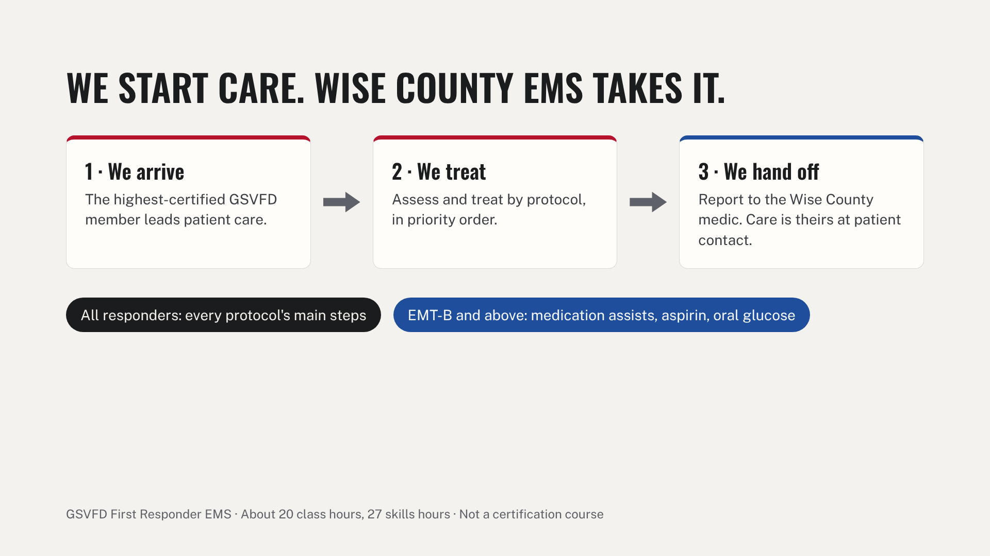
Notes:
Explain that this course trains members on the county's first responder protocols and department skills. It does not replace a Texas DSHS-approved ECA, EMR or EMT certification course. Blue marks anything limited to EMT-B and above throughout the deck. Each module ends at the matching Phase E sign-offs in the taskbook.

Slide 3
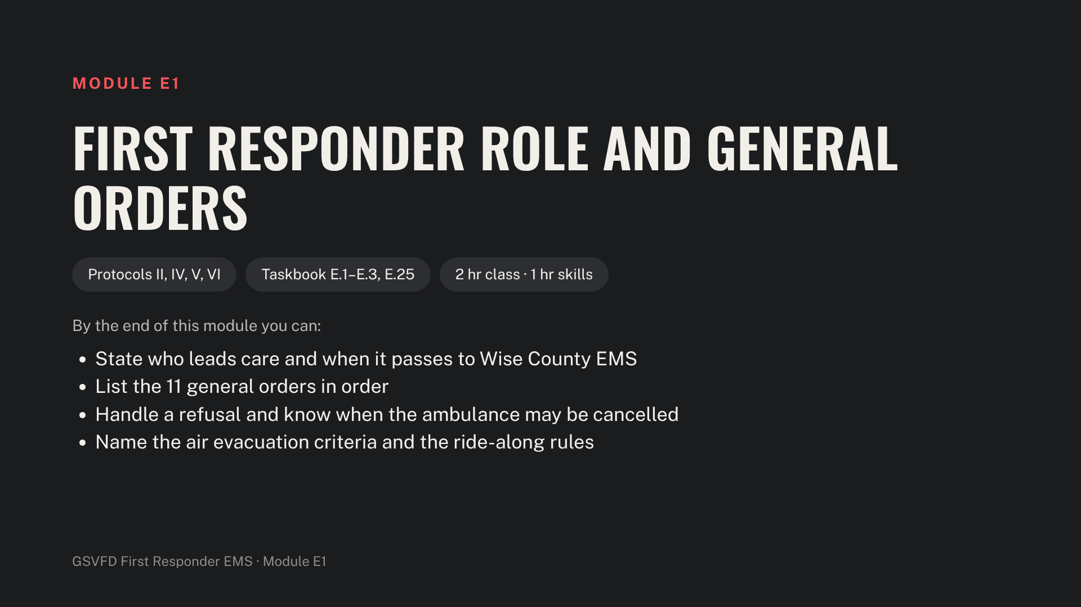
Notes:
Have blank First Responder report and refusal forms on hand. Confirm with Wise County EMS how GSVFD should request air evacuation before teaching that part.

Slide 4
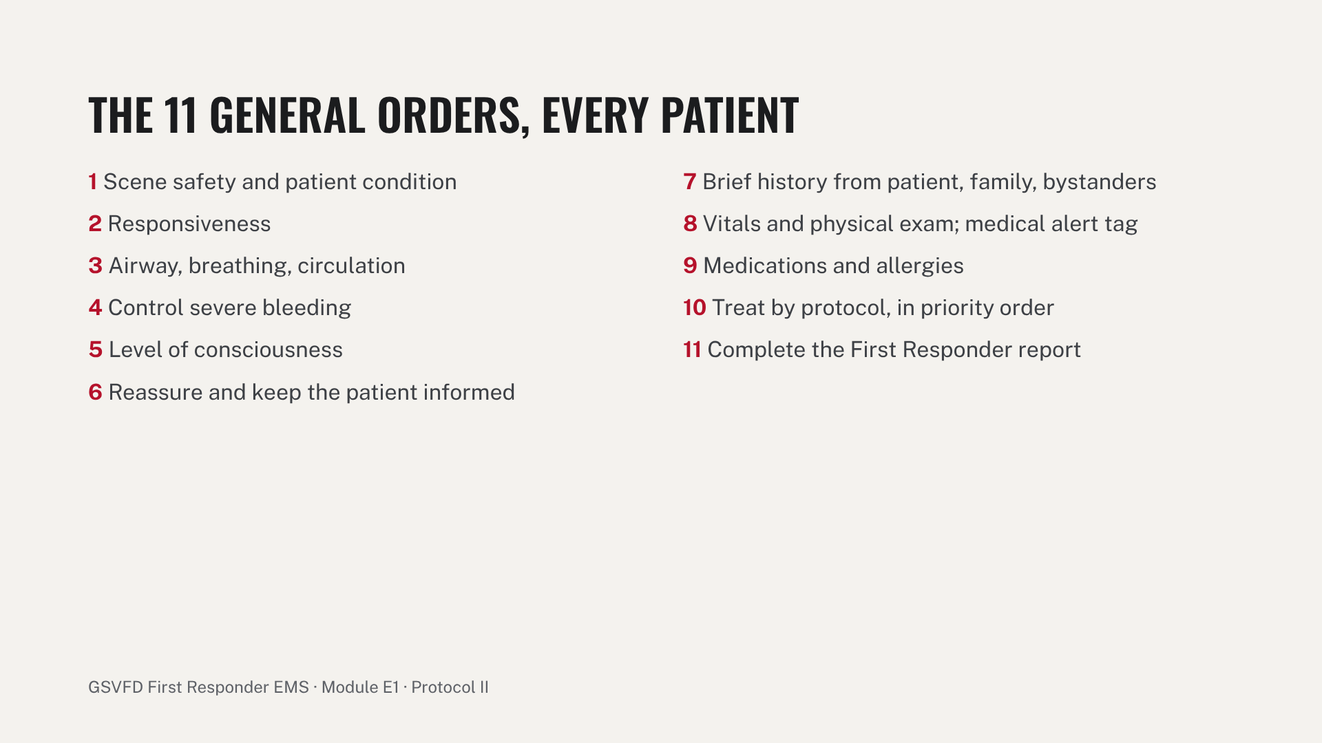
Notes:
Read down the left column, then the right. Have trainees recite the 11 orders in order before the module ends. Stress that steps 1 through 4 come before anything else, and that life threats are fixed as soon as they are found.

Slide 5
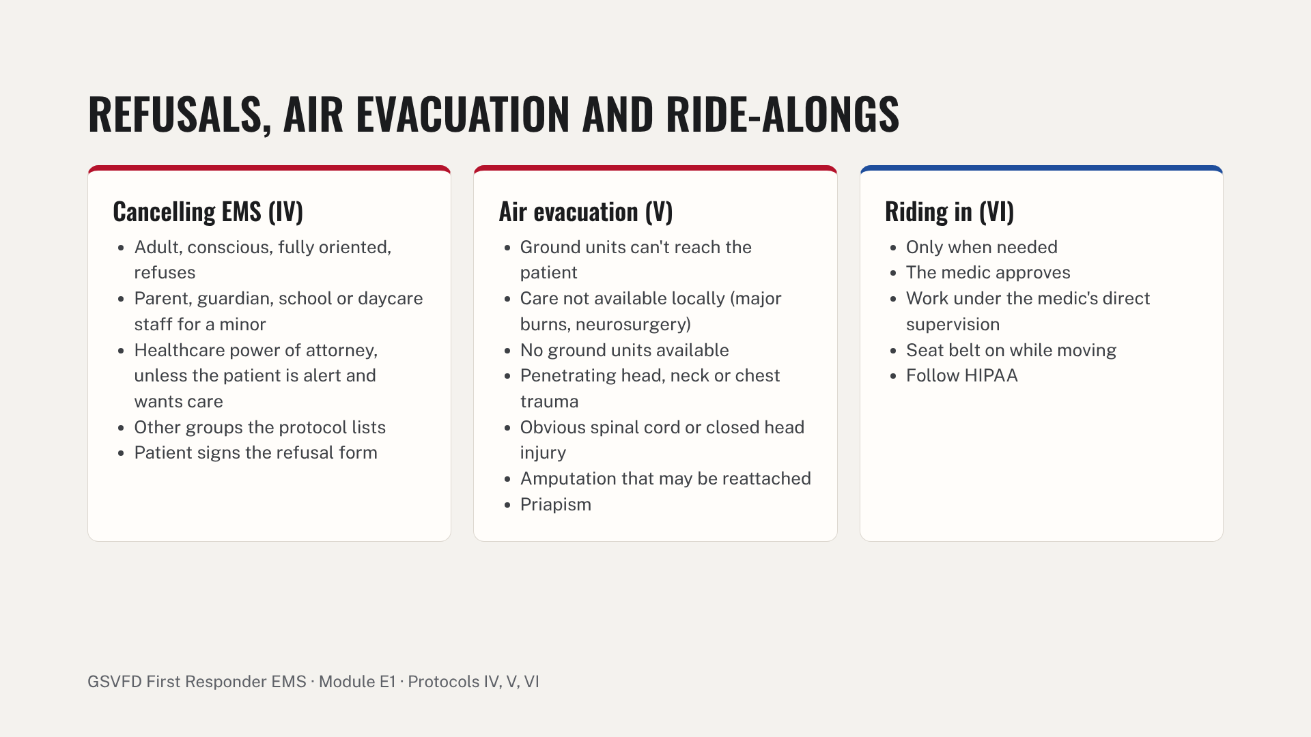
Notes:
For refusals, the patient must be conscious and fully oriented. If they aren't, the ambulance keeps coming. Skills stations: a 30-second handoff to an "arriving medic," and a refusal role-play ending with a completed form. Common errors: rambling handoffs that leave out treatments, cancelling EMS for a patient who isn't fully oriented, and incomplete refusal forms.

Slide 6
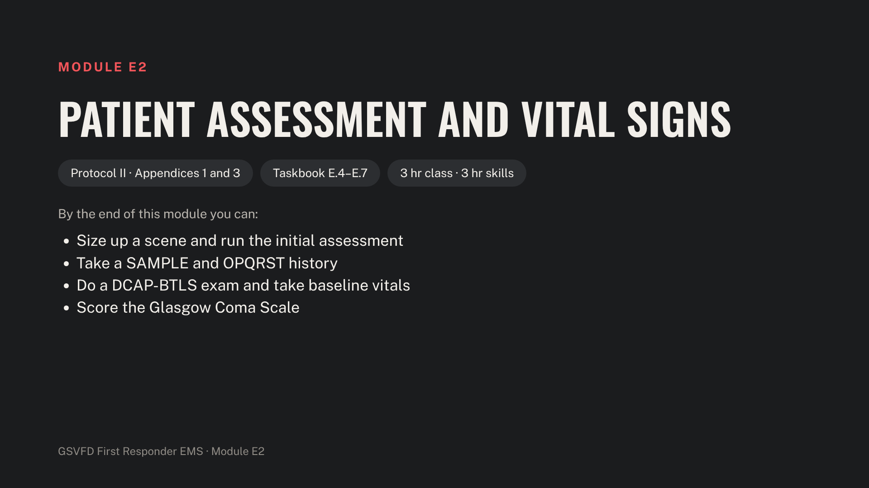
Notes:
Stage BP cuffs, stethoscopes, pulse oximeters, penlights and moulage. Most of this module is hands-on; keep the lecture short.

Slide 7
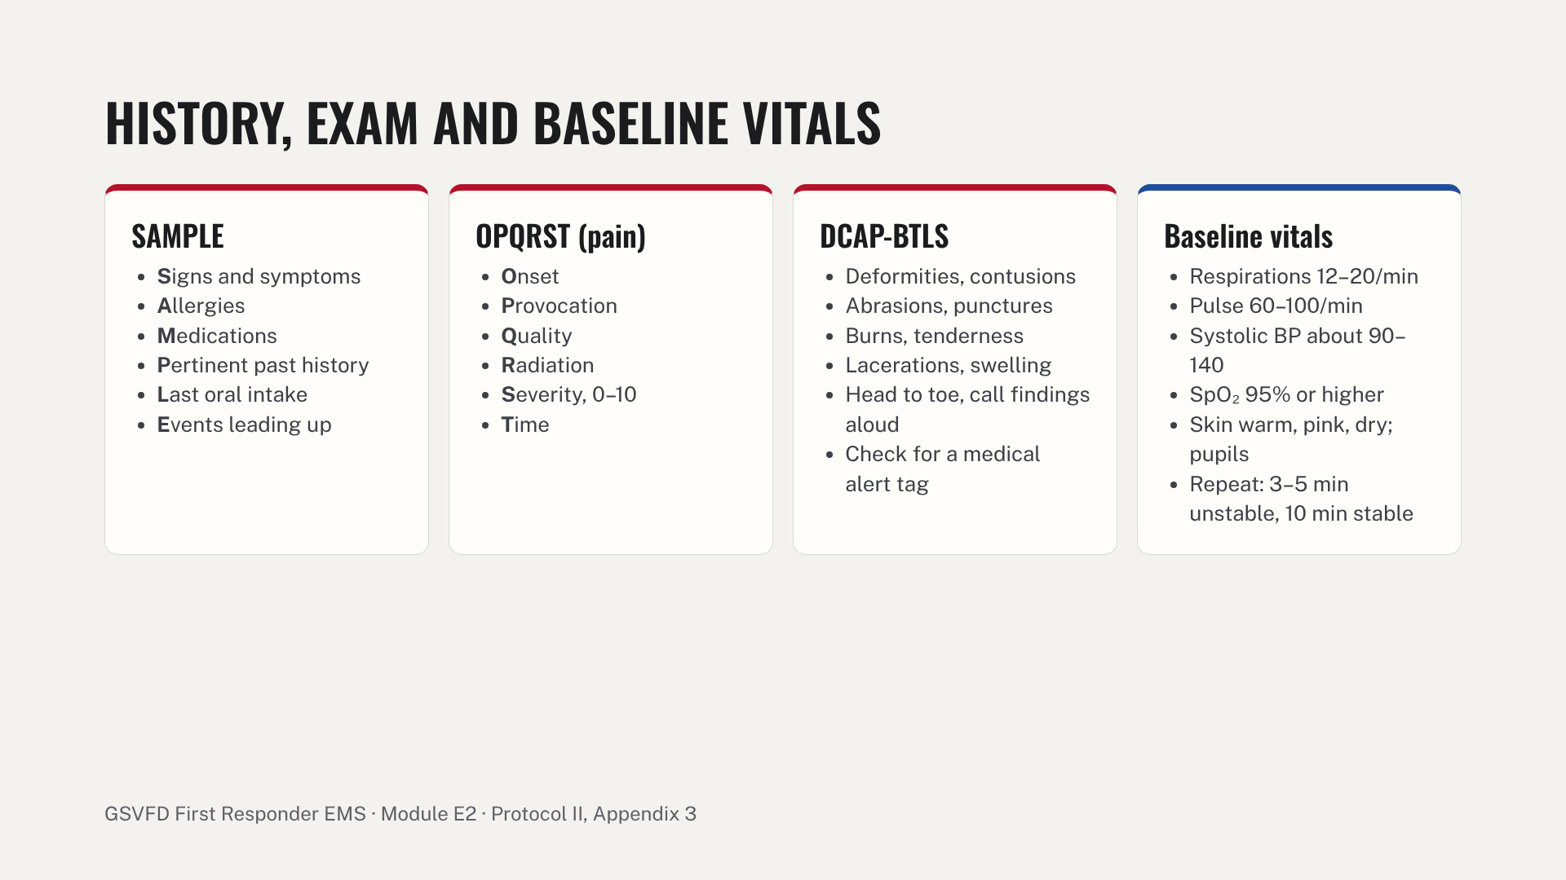
Notes:
Normal ranges are typical resting adult values for teaching; children differ by age, so teach those from the department's EMS textbook. Always repeat vitals at the interval the treatment protocol states. In OPQRST, ask open questions and don't lead the patient: 'Describe the pain,' not 'Is it crushing?'

Slide 8
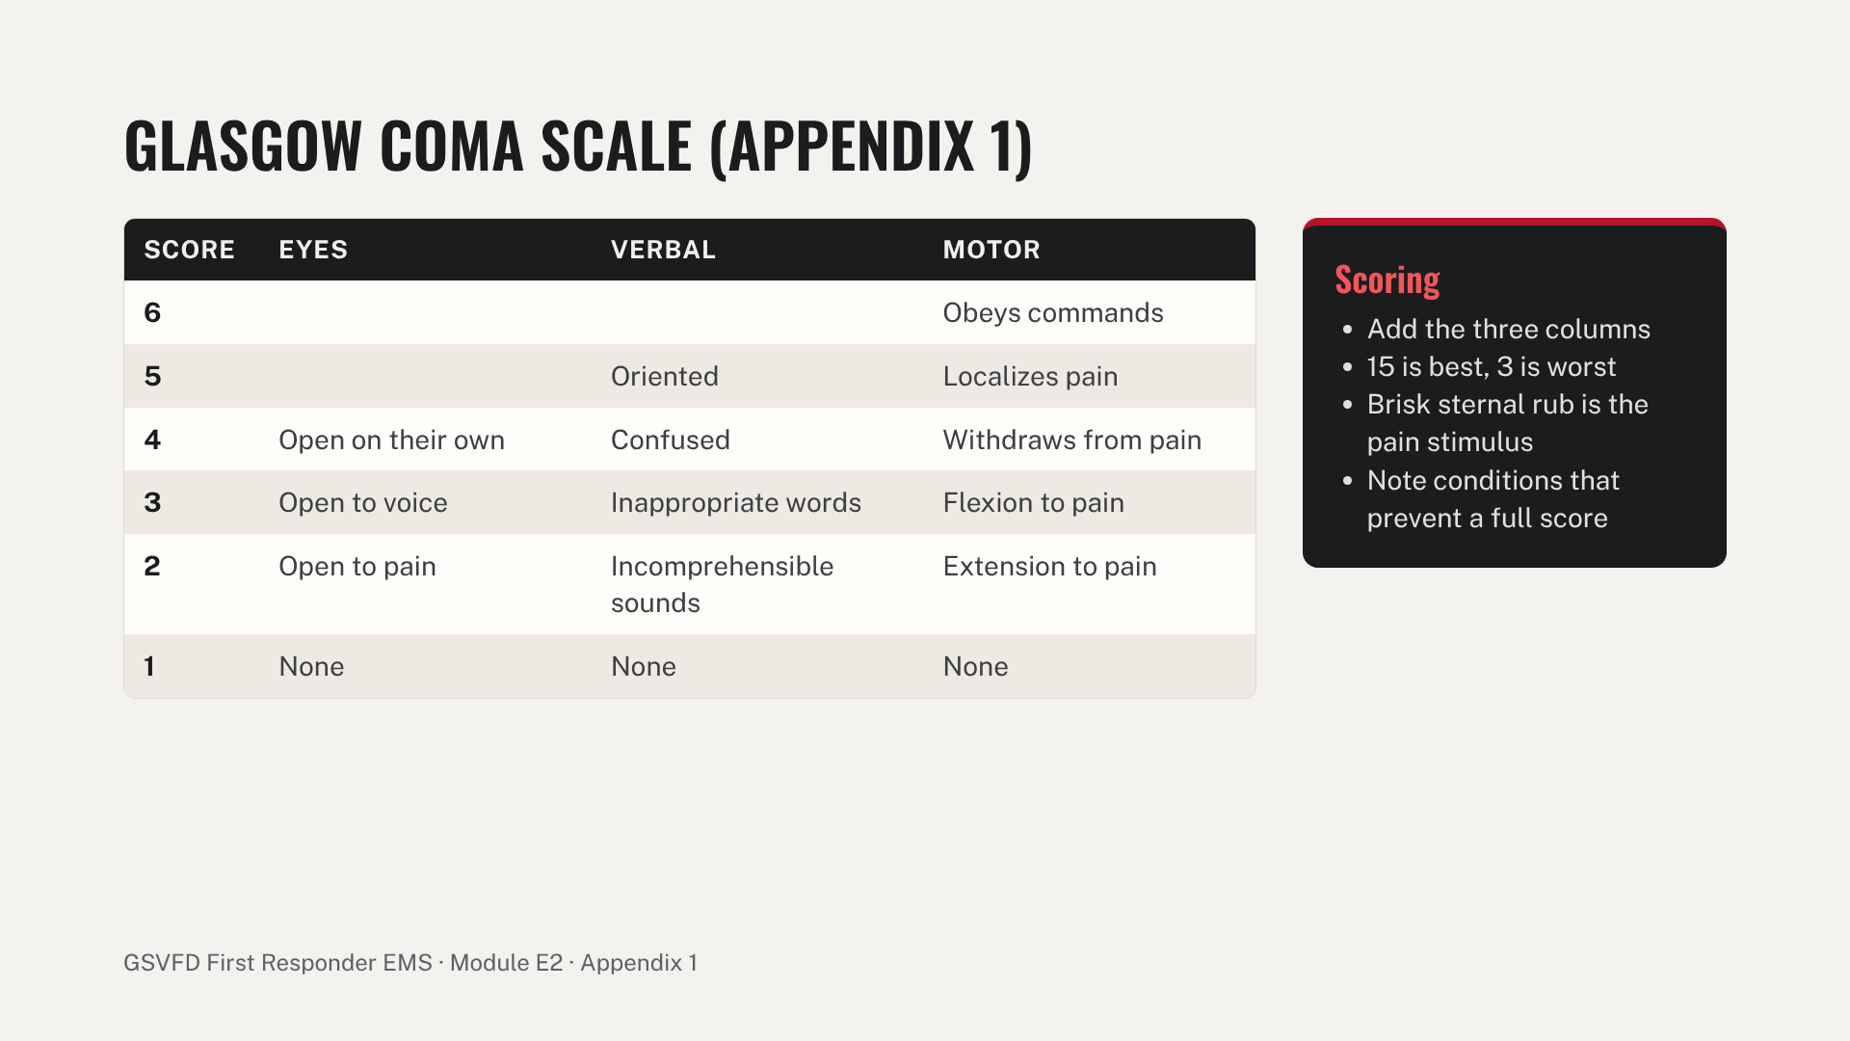
Notes:
Practice: score five role-played patients. Example: eyes open to voice (3), confused (4), localizes pain (5) gives GCS 12. Report the three parts as well as the total to the medic, for example 'E3 V4 M5, 12'.

Slide 9
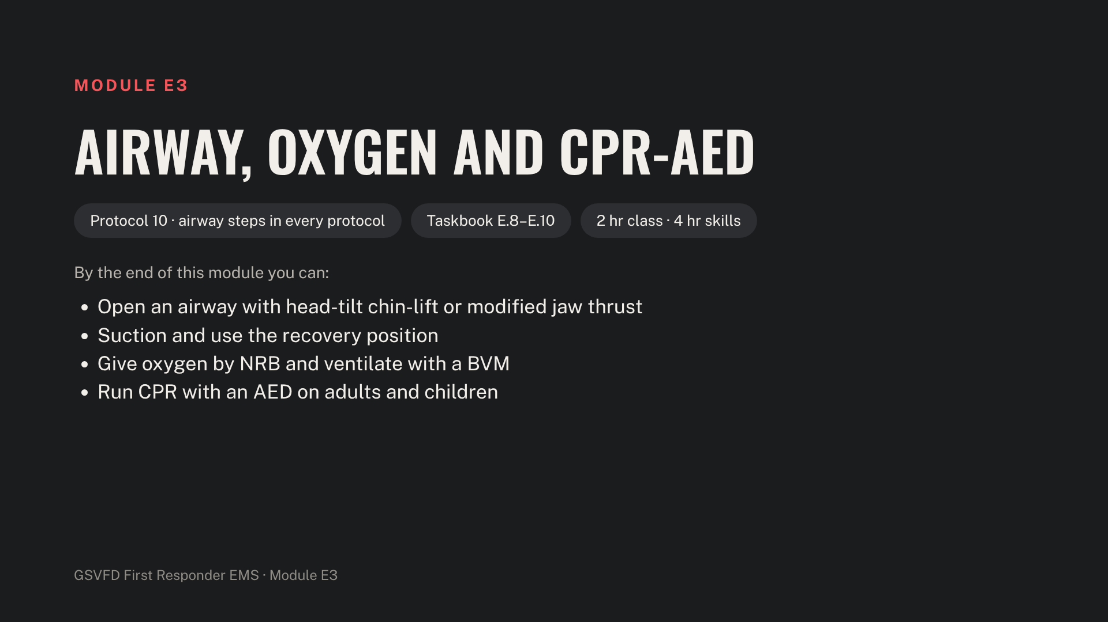
Notes:
Set up adult, child and infant manikins, the AED trainer with adult and pediatric pads, BVMs, an oxygen cylinder with regulator, NRB masks and portable suction. Teach compression depth, rate and ratios from the department's current CPR course so they match each member's CPR card.

Slide 10
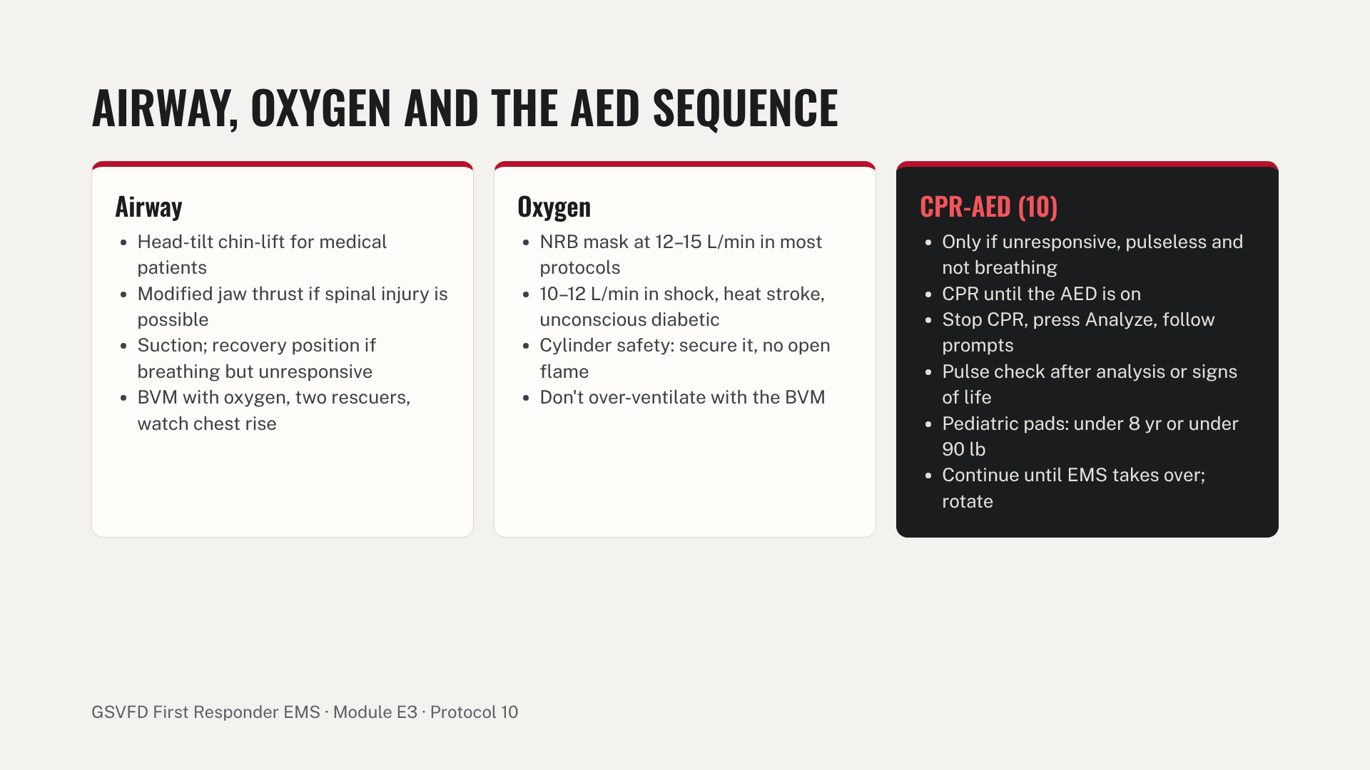
Notes:
Never start CPR on a patient who is conscious, has a pulse or is breathing (protocol 10 contraindications). Skills: airway station, oxygen and BVM station, then adult two-rescuer CPR through two AED analysis cycles and a child with pediatric pads. Watch for long pauses in compressions and adult pads on a small child.

Slide 11
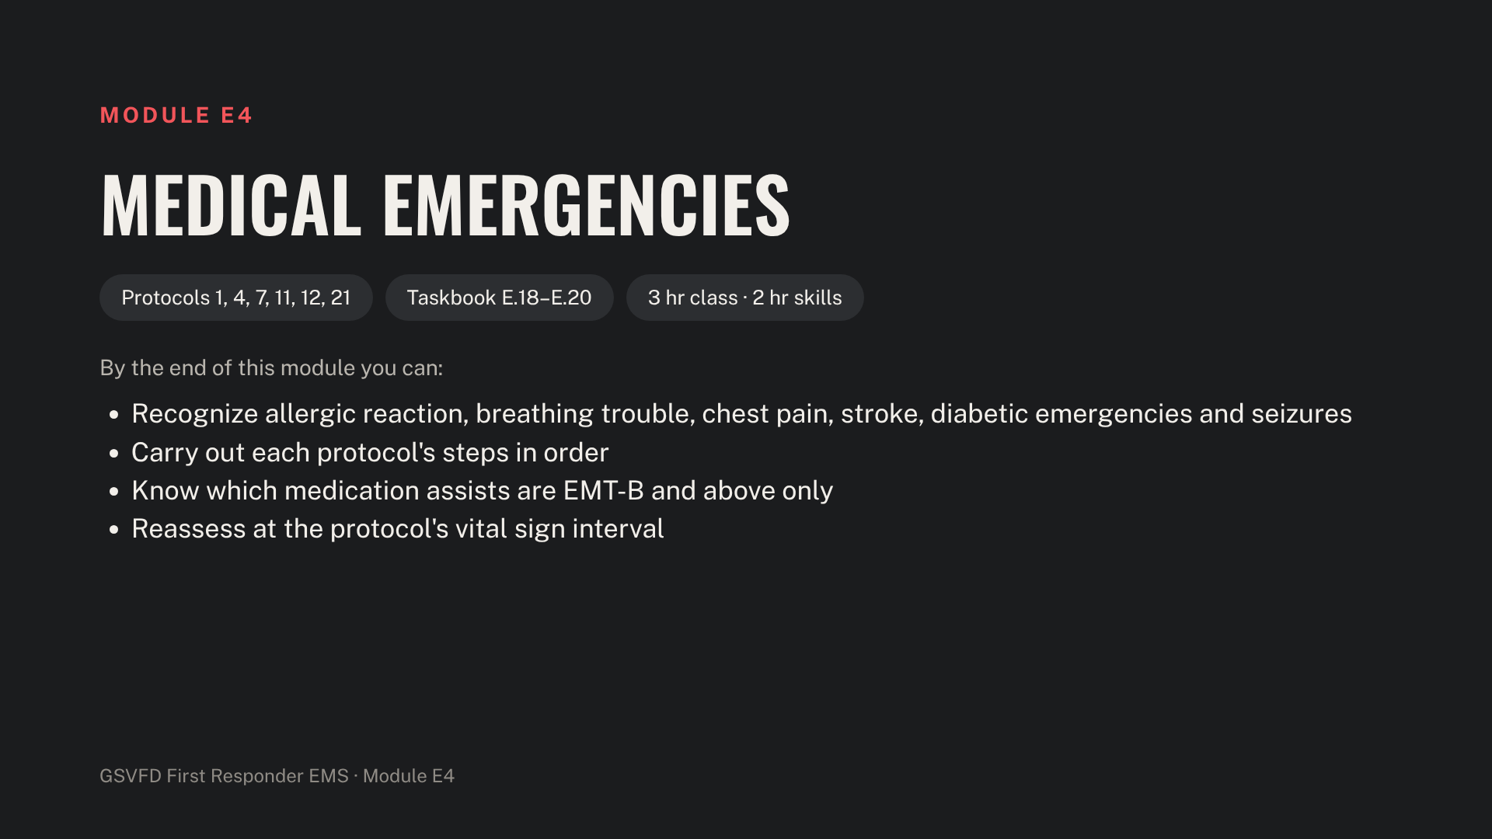
Notes:
Have the trainer epinephrine auto-injector and inhaler, an empty nitroglycerin bottle, aspirin and oral glucose training packages, orange juice and sugar packets on hand. Blue on the next slide marks EMT-B and above.

Slide 12
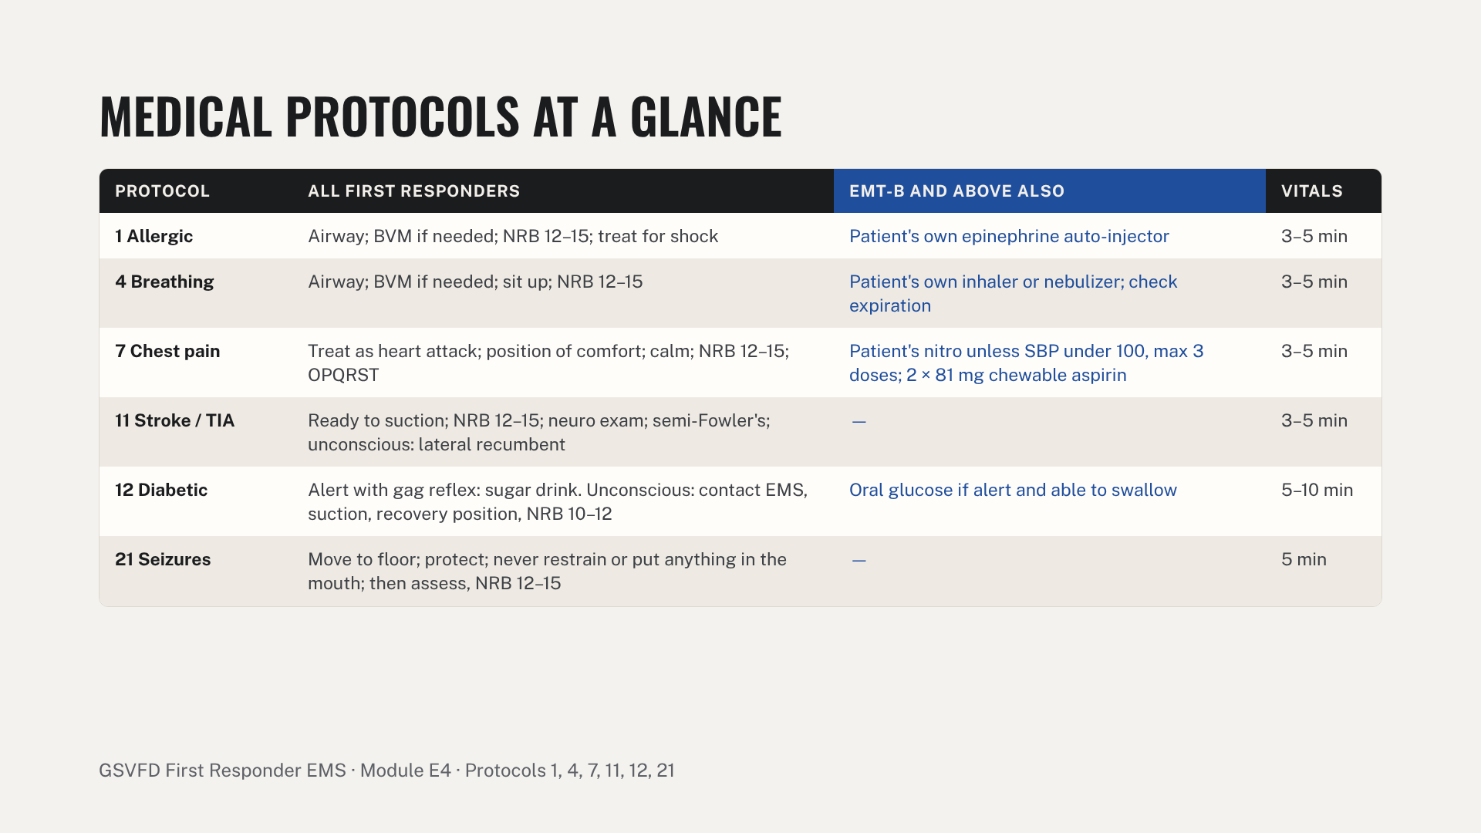
Notes:
15–20% of heart attack patients have no pain or atypical pain, so treat every chest pain as a heart attack. For stroke, note when the patient was last known well. Nothing by mouth unless the patient is alert with a gag reflex. Common errors: nitro without a blood pressure check, sugar to a patient who can't protect the airway, restraining a seizing patient.

Slide 13
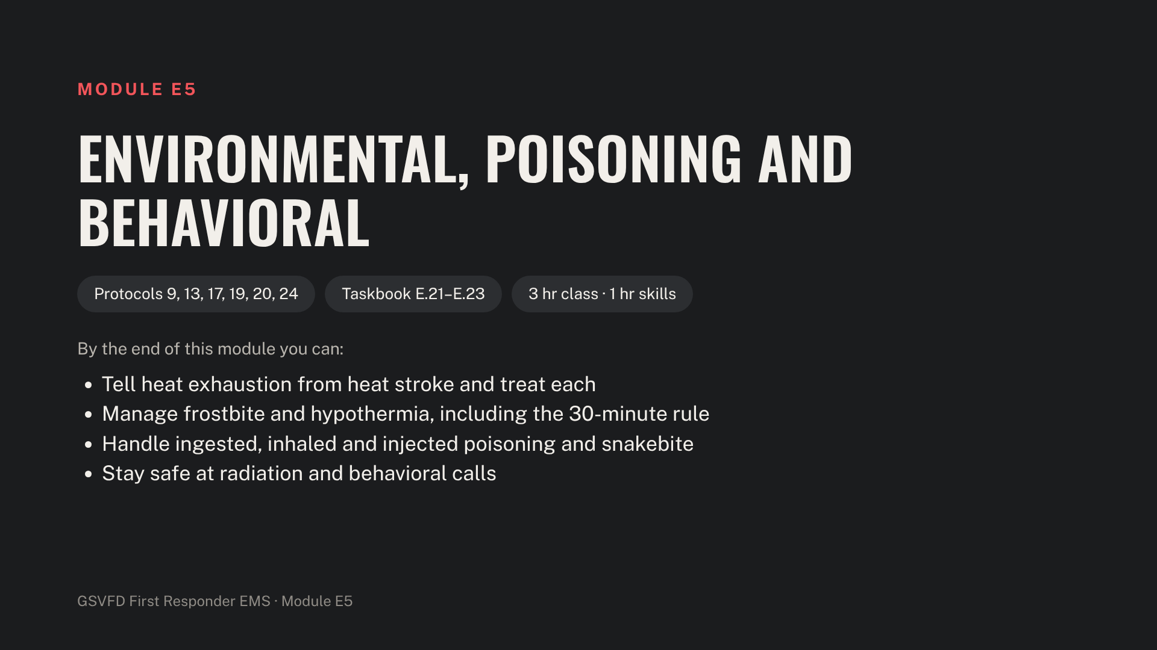
Notes:
Have cold packs, sheets and a spray bottle, blankets, hot packs, splint materials and a mock poison container. Add the Poison Center number, 1-800-222-1222, to apparatus cards.

Slide 14
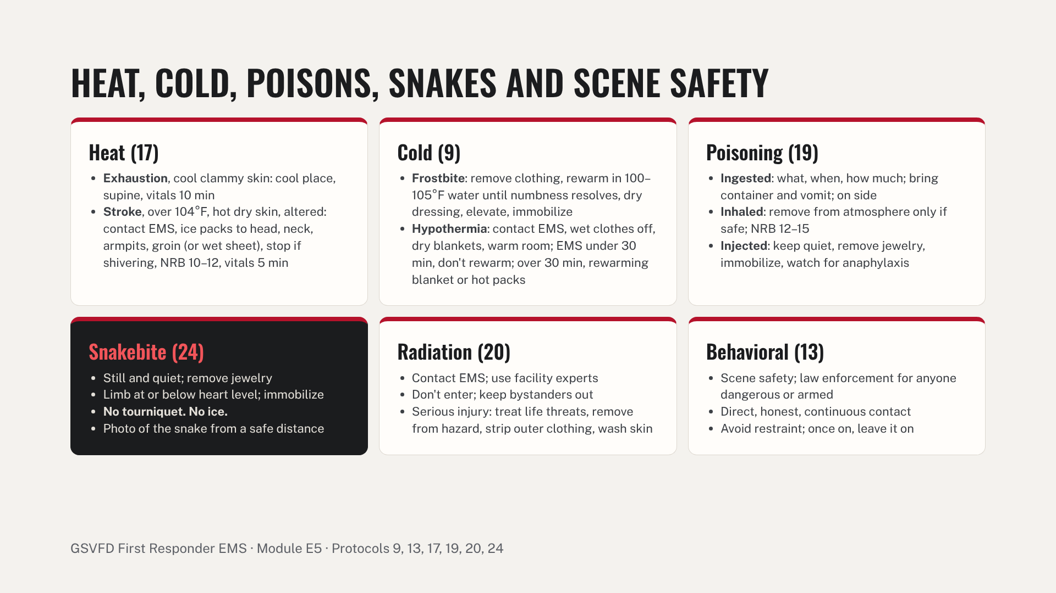
Notes:
Heat stroke is a life threat: cool first. Handle severe hypothermia gently, since rough movement can trigger cardiac arrest. Never pick up a snake, even a dead one. Behavioral health calls can be hard on responders; mention the member assistance program.

Slide 15
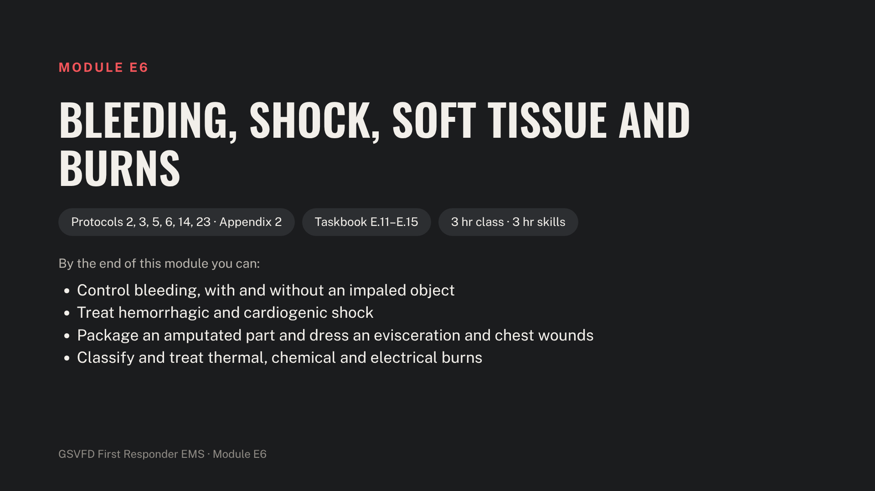
Notes:
Have a bleeding-control trainer, tourniquets and BP cuffs, trauma and occlusive dressings, saline, bags and a cooler, bulky pads and cravats, burn sheets and the Rule of Nines chart.

Slide 16
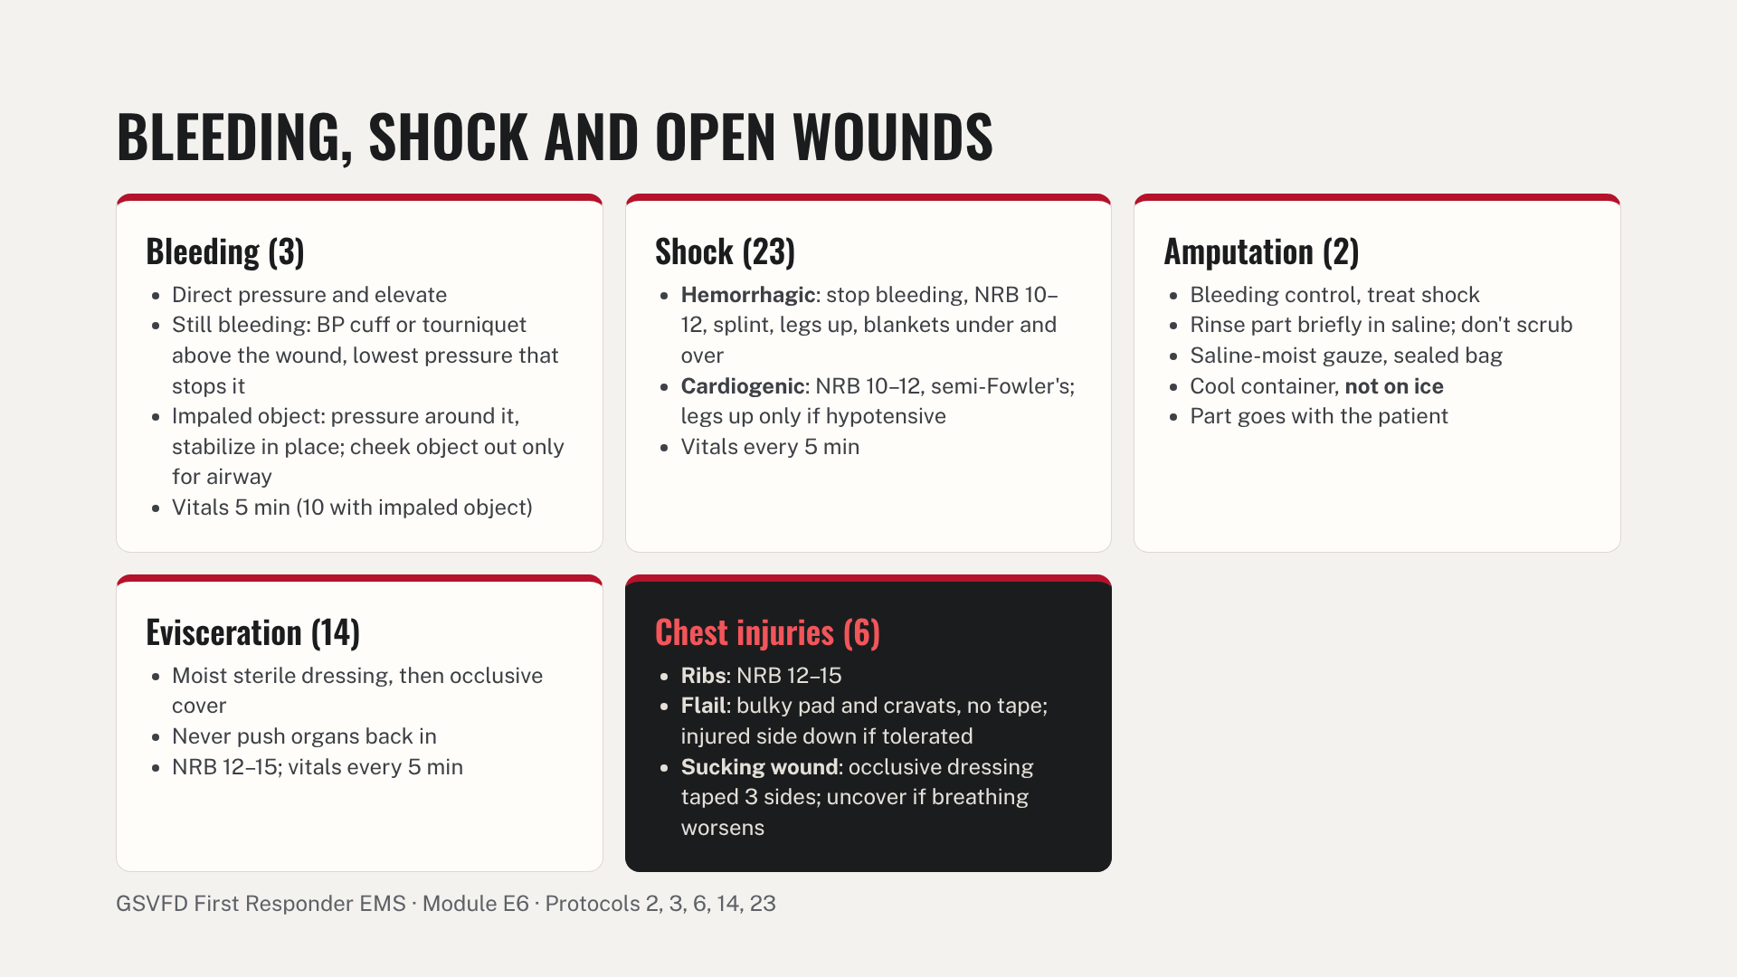
Notes:
Escalate fast on major bleeding: if direct pressure isn't working, go to the cuff or tourniquet. Reattachment is possible up to 24 hours but best within a few, so speed matters without missing other injuries. Amputation that may be reattached is an air evacuation criterion.

Slide 17
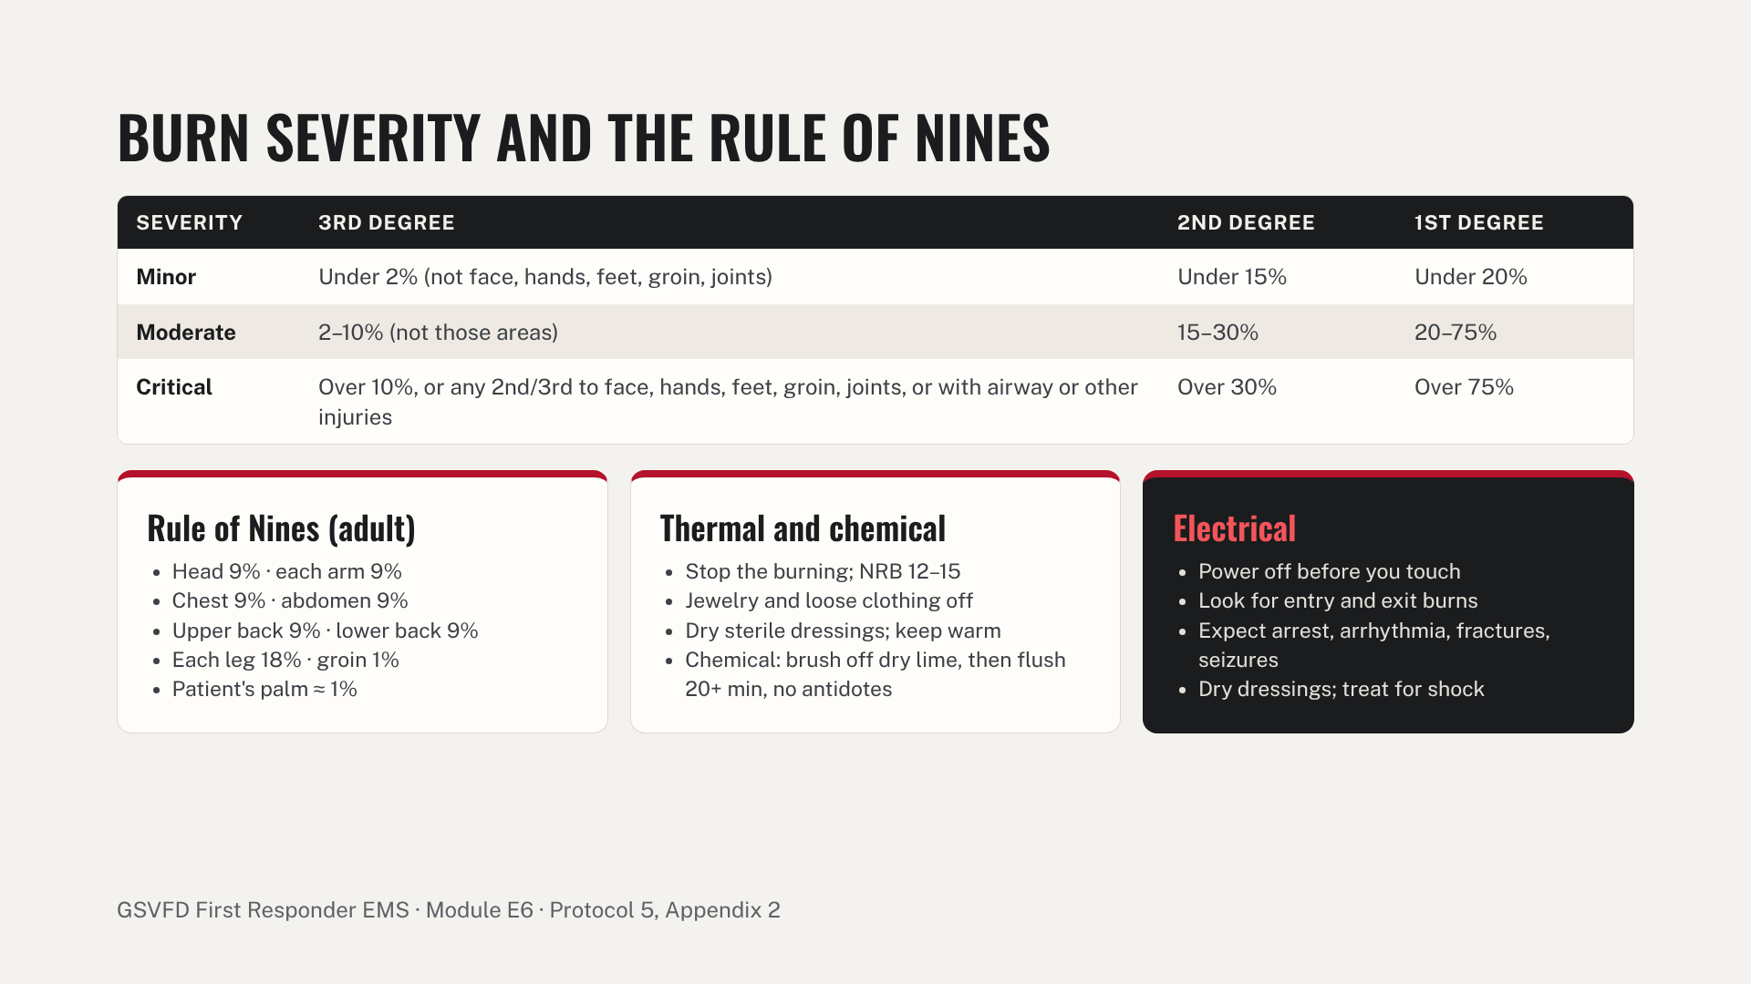
Notes:
Degree: 1st is red and swollen; 2nd is red, mottled and blistered with intense pain; 3rd is charred or dry white and may be painless in the center. Report degree, percentage and severity to the responding EMS unit. Major burns are an air evacuation criterion. Don't cool large burns until the patient is hypothermic.

Slide 18
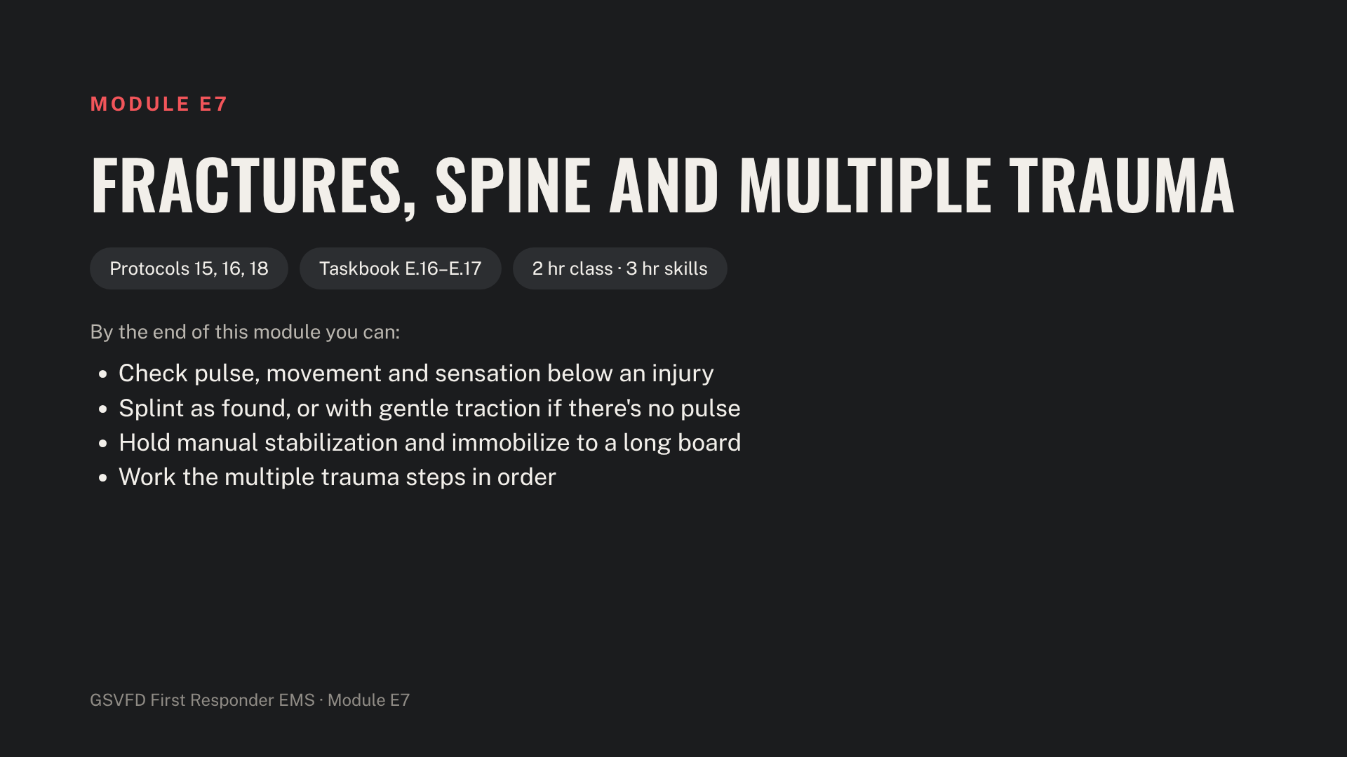
Notes:
Have rigid, SAM and vacuum splints, slings and swathes, cervical collars, a long spine board with straps and head blocks, suction and a BVM.

Slide 19
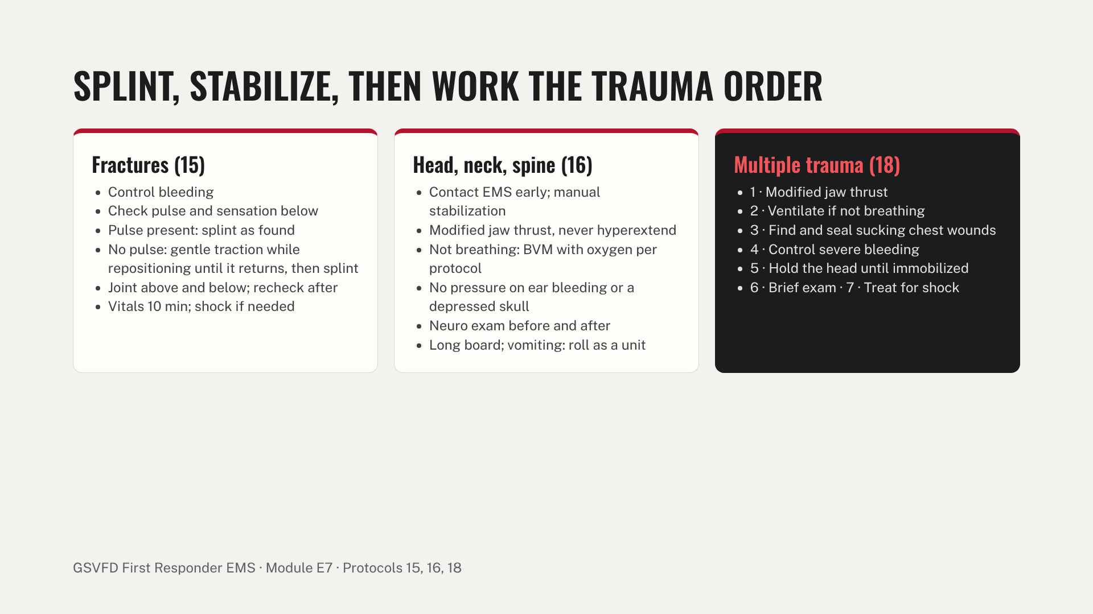
Notes:
Neuro exam: level of consciousness, posture, sensation, movement and pupils. Obvious spinal cord or closed head injury, and penetrating trauma to the head, neck or chest, are air evacuation criteria. Common errors: letting go of the head too early, no neuro check, no distal recheck after splinting, head-tilt on a trauma patient.

Slide 20
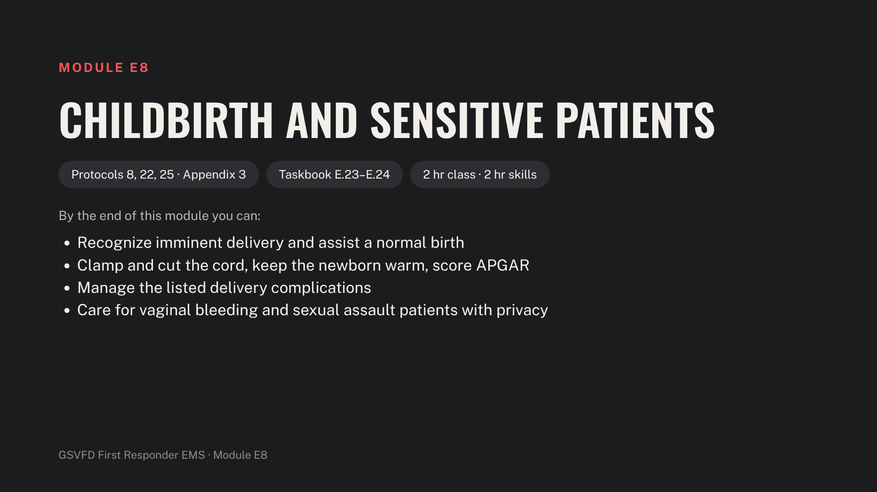
Notes:
Have the OB delivery manikin and a full OB kit: clamps, sterile scissors, bulb syringe, towels, infant blanket and a basin or bag. These calls can be hard on crews and patients; keep discussion respectful.

Slide 21
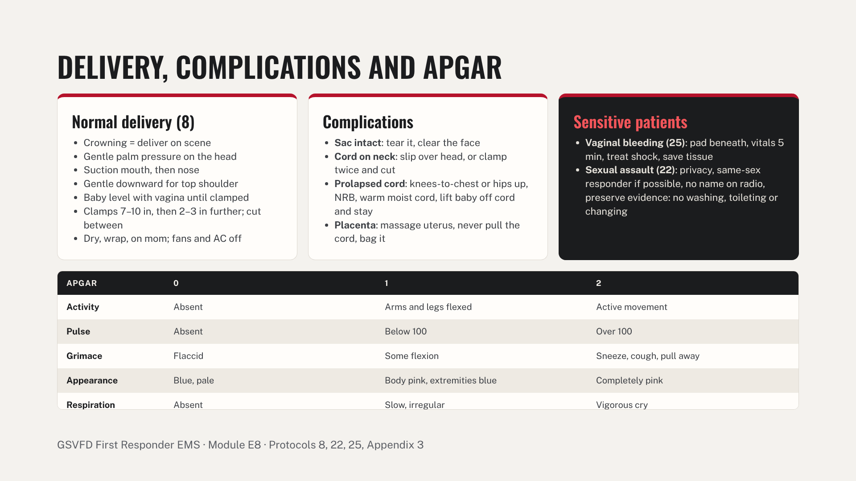
Notes:
Score APGAR at 1 and 5 minutes: 7–10 excellent, 4–6 moderately depressed, 0–3 severely depressed. Check the mother for seizures or fainting; vitals every 10 minutes. Common errors: pulling on the cord, letting the newborn get cold, and forgetting the second APGAR.

Slide 22
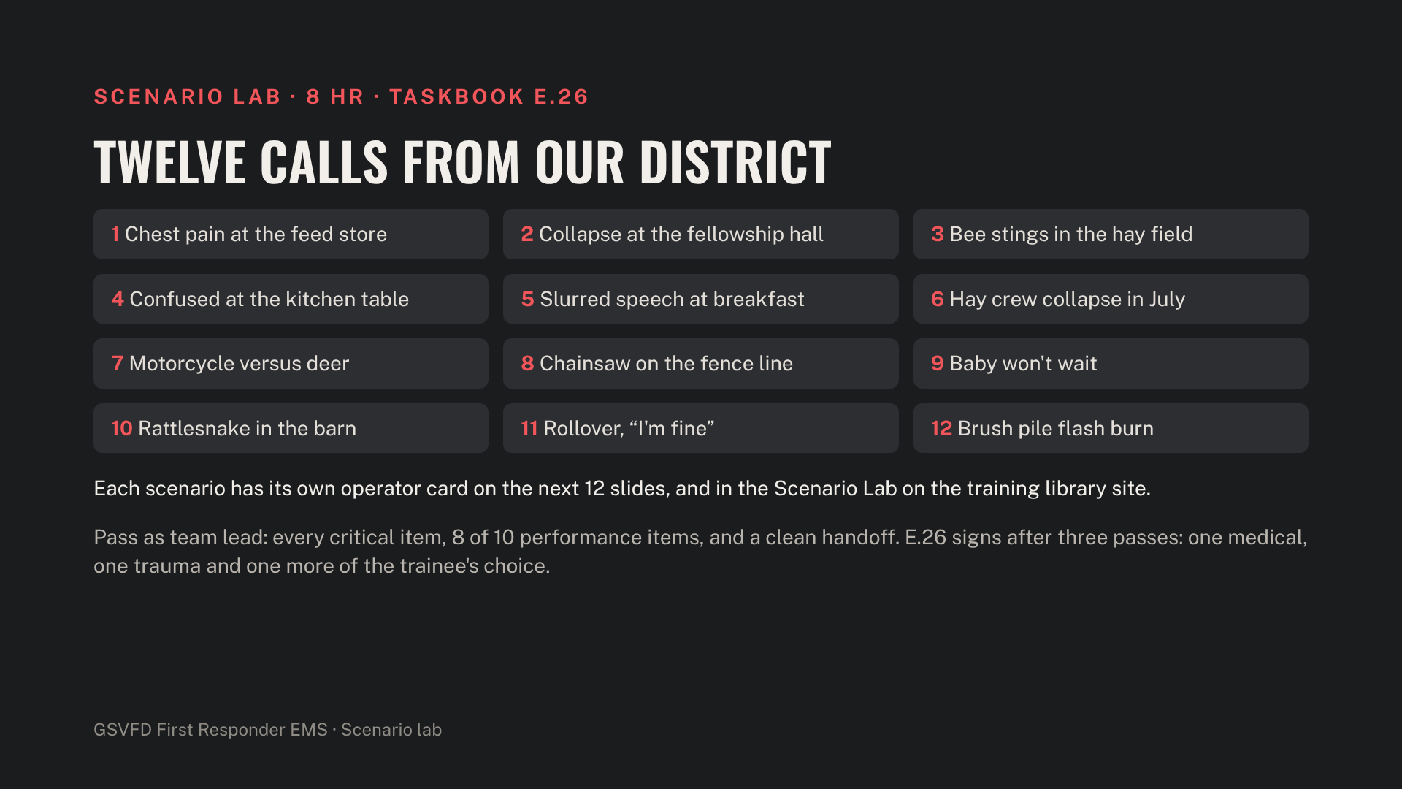
Notes:
Scenarios 1–6 are medical; 7–12 are trauma, childbirth, refusal and burns. The full card for each scenario follows this slide, in order. The evaluation sheet is in the instructor guide. Rotate trainees through team lead, and run a short debrief after every scenario: what went well, what to change.

Slide 23
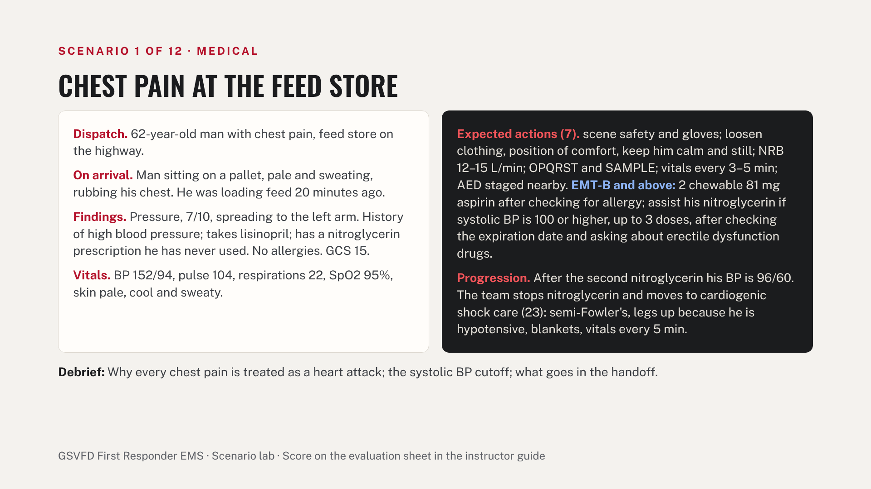
Notes:
Operator card. Read the dispatch aloud, then give findings and vitals only when the team checks for them. About 10 minutes plus a 5-minute debrief. The left side is what the patient and scene show; the right side is what the team should do and how the patient changes. Pass: every critical item and at least 8 of the 10 performance items.

Slide 24
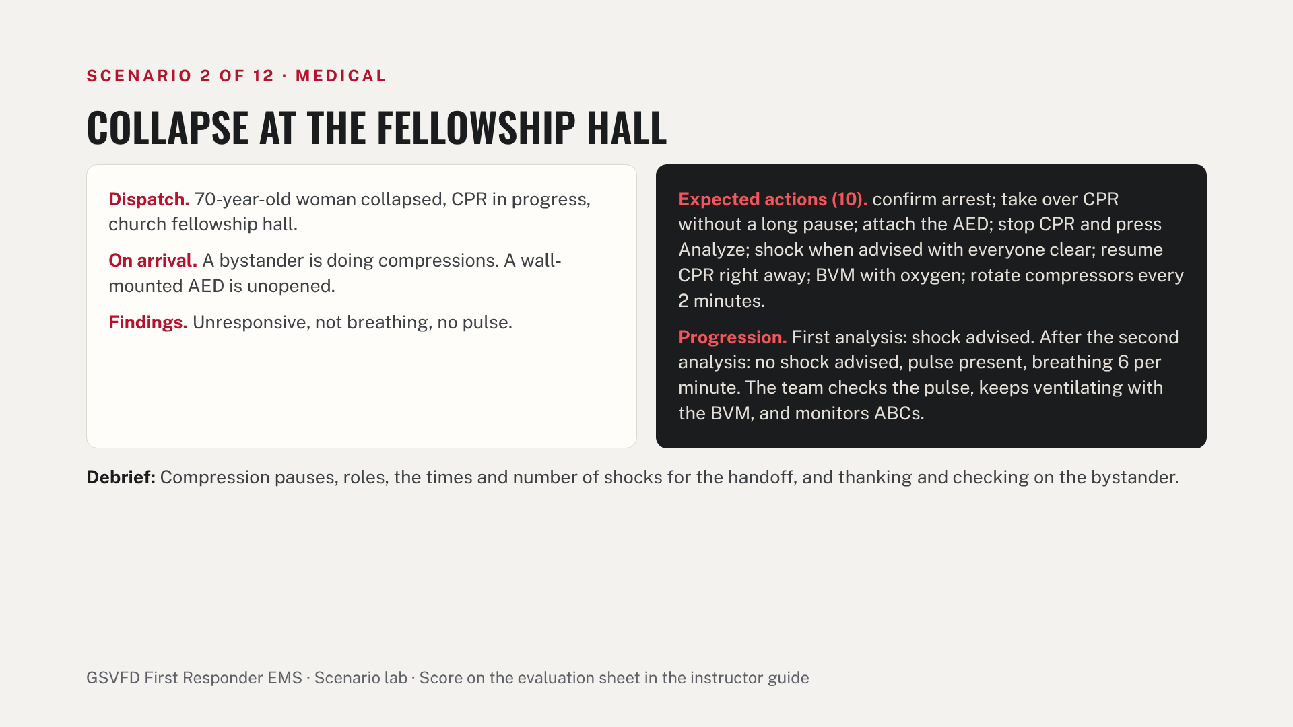
Notes:
Operator card. Read the dispatch aloud, then give findings and vitals only when the team checks for them. About 10 minutes plus a 5-minute debrief. The left side is what the patient and scene show; the right side is what the team should do and how the patient changes. Pass: every critical item and at least 8 of the 10 performance items.

Slide 25
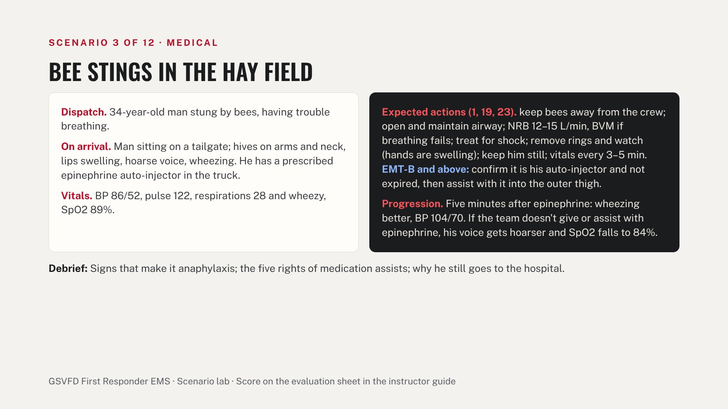
Notes:
Operator card. Read the dispatch aloud, then give findings and vitals only when the team checks for them. About 10 minutes plus a 5-minute debrief. The left side is what the patient and scene show; the right side is what the team should do and how the patient changes. Pass: every critical item and at least 8 of the 10 performance items.

Slide 26
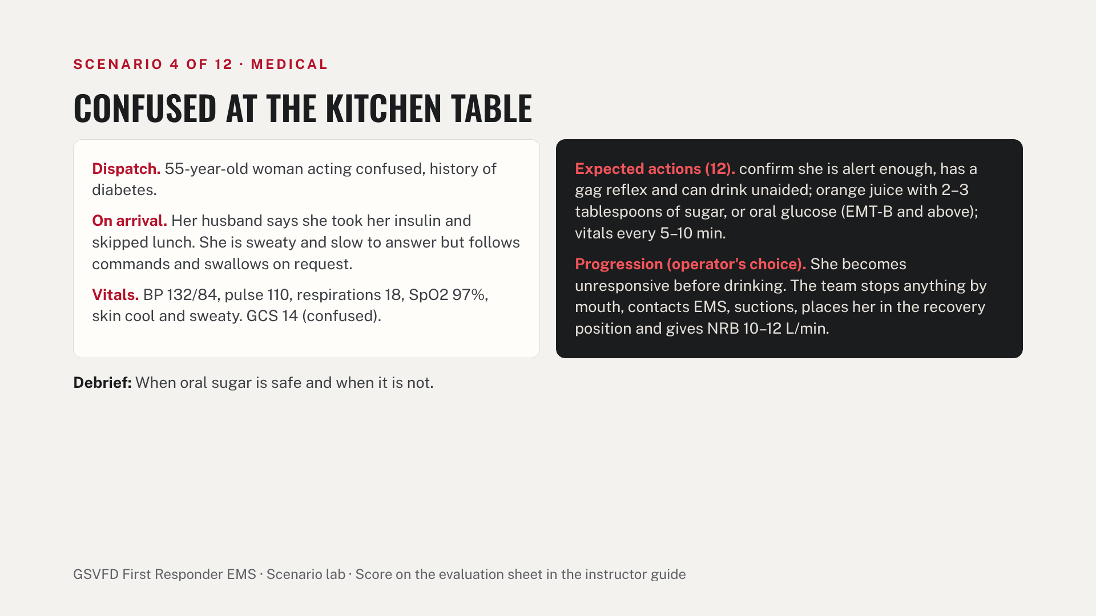
Notes:
Operator card. Read the dispatch aloud, then give findings and vitals only when the team checks for them. About 10 minutes plus a 5-minute debrief. The left side is what the patient and scene show; the right side is what the team should do and how the patient changes. Pass: every critical item and at least 8 of the 10 performance items.

Slide 27
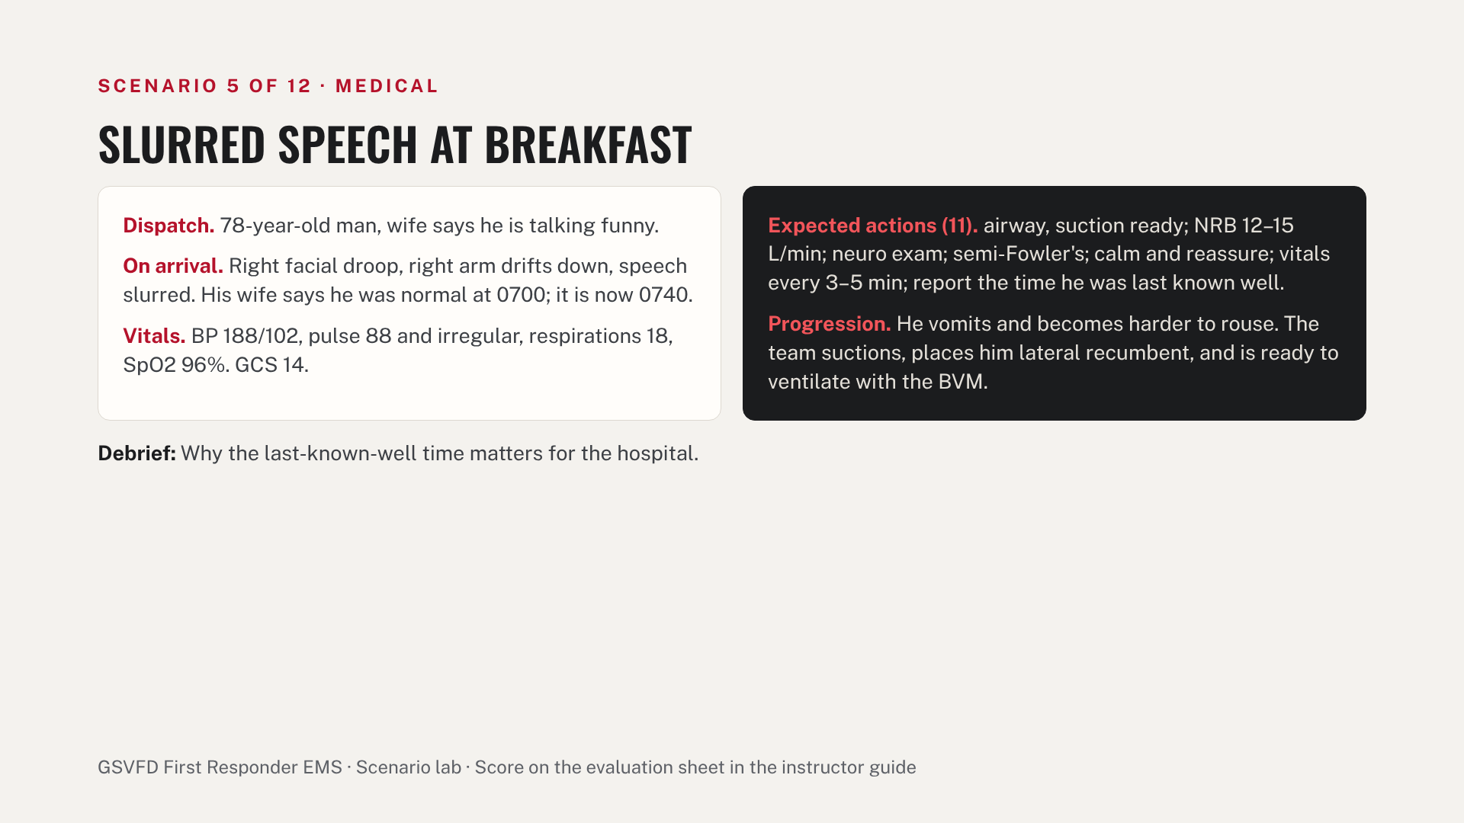
Notes:
Operator card. Read the dispatch aloud, then give findings and vitals only when the team checks for them. About 10 minutes plus a 5-minute debrief. The left side is what the patient and scene show; the right side is what the team should do and how the patient changes. Pass: every critical item and at least 8 of the 10 performance items.

Slide 28
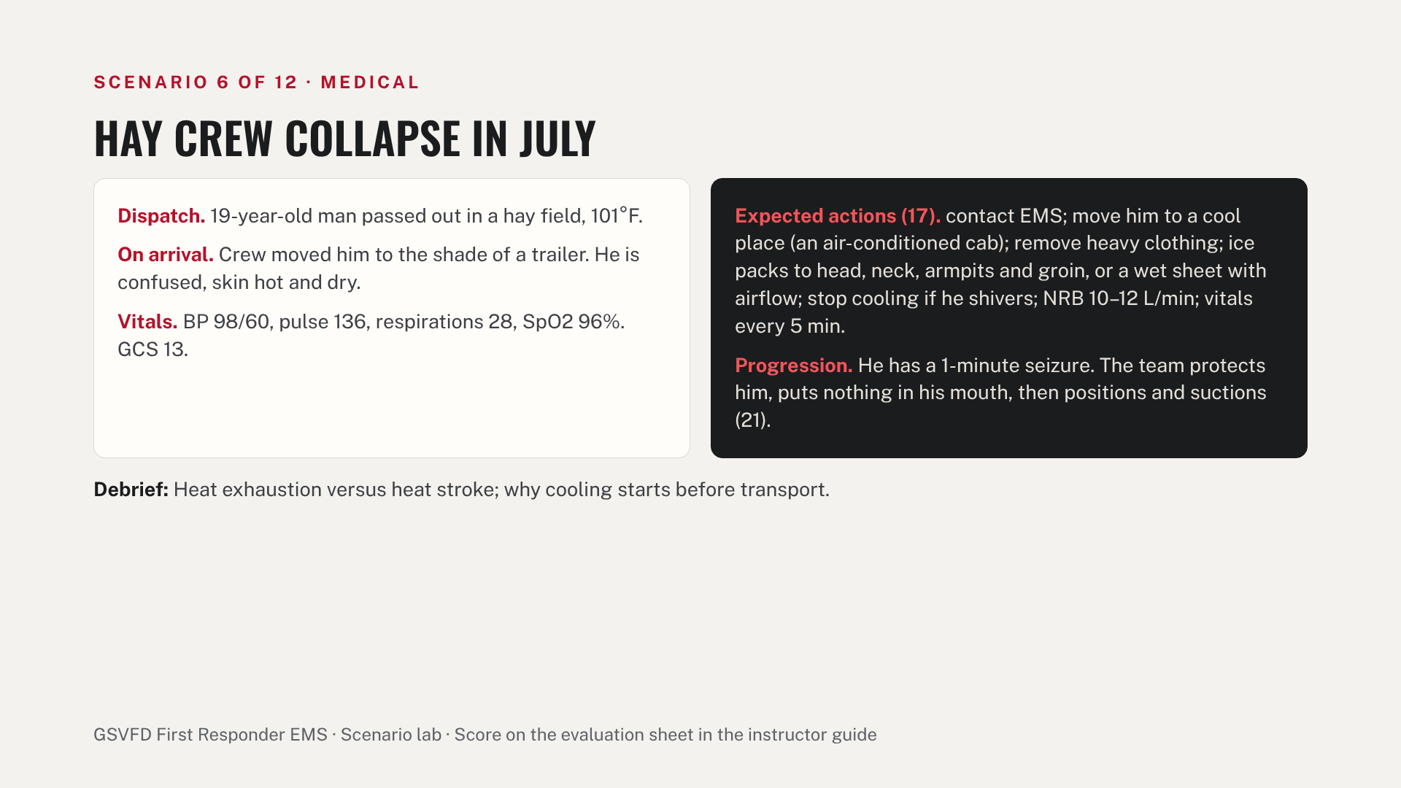
Notes:
Operator card. Read the dispatch aloud, then give findings and vitals only when the team checks for them. About 10 minutes plus a 5-minute debrief. The left side is what the patient and scene show; the right side is what the team should do and how the patient changes. Pass: every critical item and at least 8 of the 10 performance items.

Slide 29
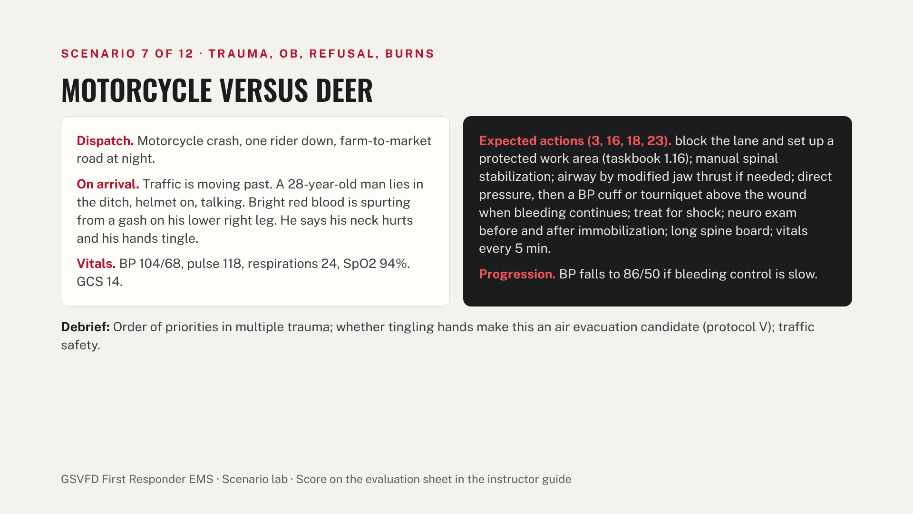
Notes:
Operator card. Read the dispatch aloud, then give findings and vitals only when the team checks for them. About 10 minutes plus a 5-minute debrief. The left side is what the patient and scene show; the right side is what the team should do and how the patient changes. Pass: every critical item and at least 8 of the 10 performance items.

Slide 30
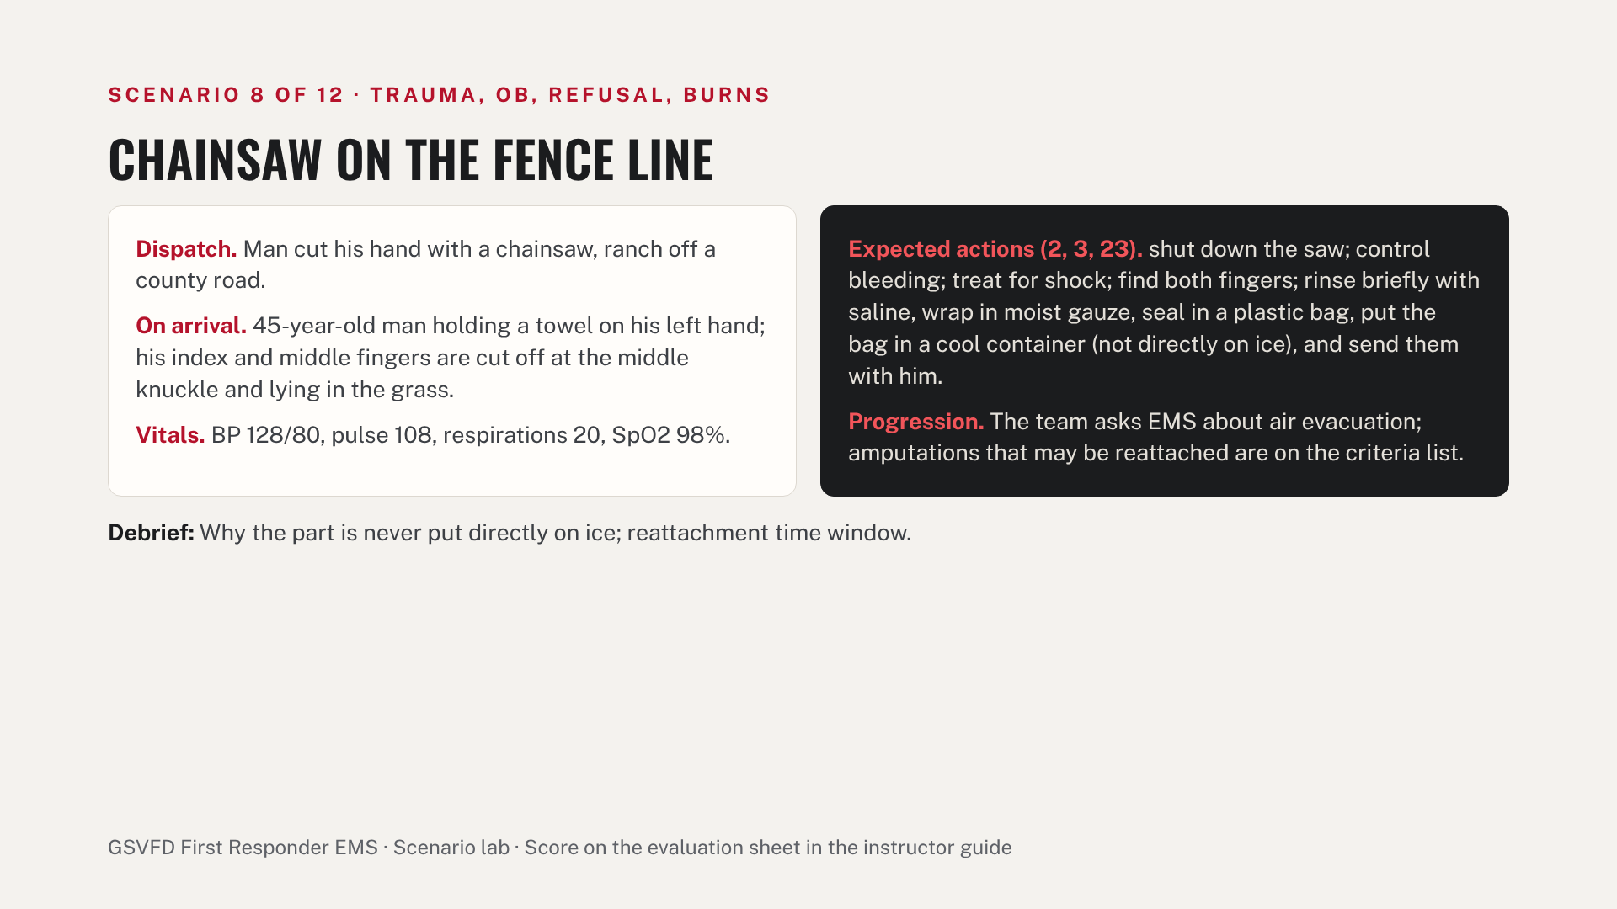
Notes:
Operator card. Read the dispatch aloud, then give findings and vitals only when the team checks for them. About 10 minutes plus a 5-minute debrief. The left side is what the patient and scene show; the right side is what the team should do and how the patient changes. Pass: every critical item and at least 8 of the 10 performance items.

Slide 31
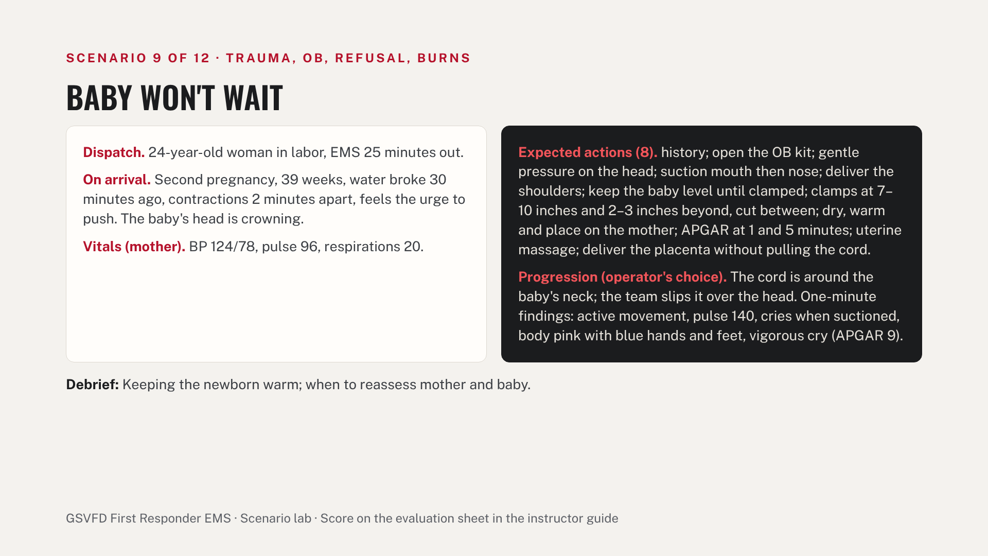
Notes:
Operator card. Read the dispatch aloud, then give findings and vitals only when the team checks for them. About 10 minutes plus a 5-minute debrief. The left side is what the patient and scene show; the right side is what the team should do and how the patient changes. Pass: every critical item and at least 8 of the 10 performance items.

Slide 32
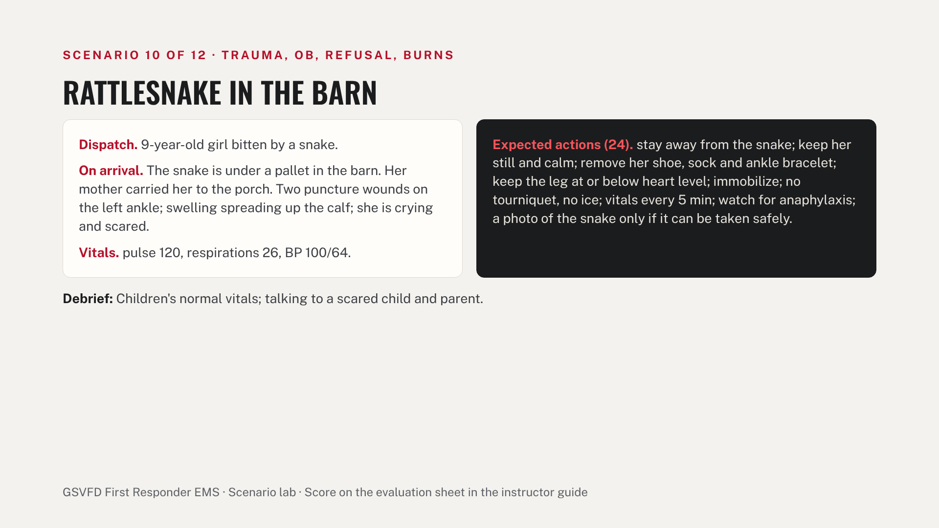
Notes:
Operator card. Read the dispatch aloud, then give findings and vitals only when the team checks for them. About 10 minutes plus a 5-minute debrief. The left side is what the patient and scene show; the right side is what the team should do and how the patient changes. Pass: every critical item and at least 8 of the 10 performance items.

Slide 33
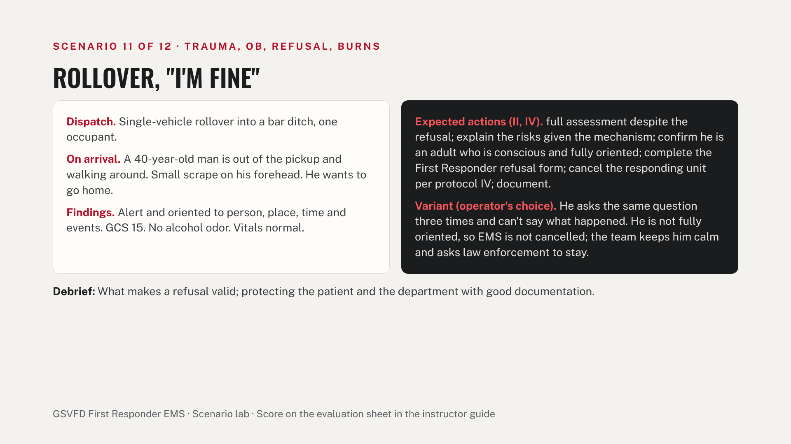
Notes:
Operator card. Read the dispatch aloud, then give findings and vitals only when the team checks for them. About 10 minutes plus a 5-minute debrief. The left side is what the patient and scene show; the right side is what the team should do and how the patient changes. Pass: every critical item and at least 8 of the 10 performance items.

Slide 34
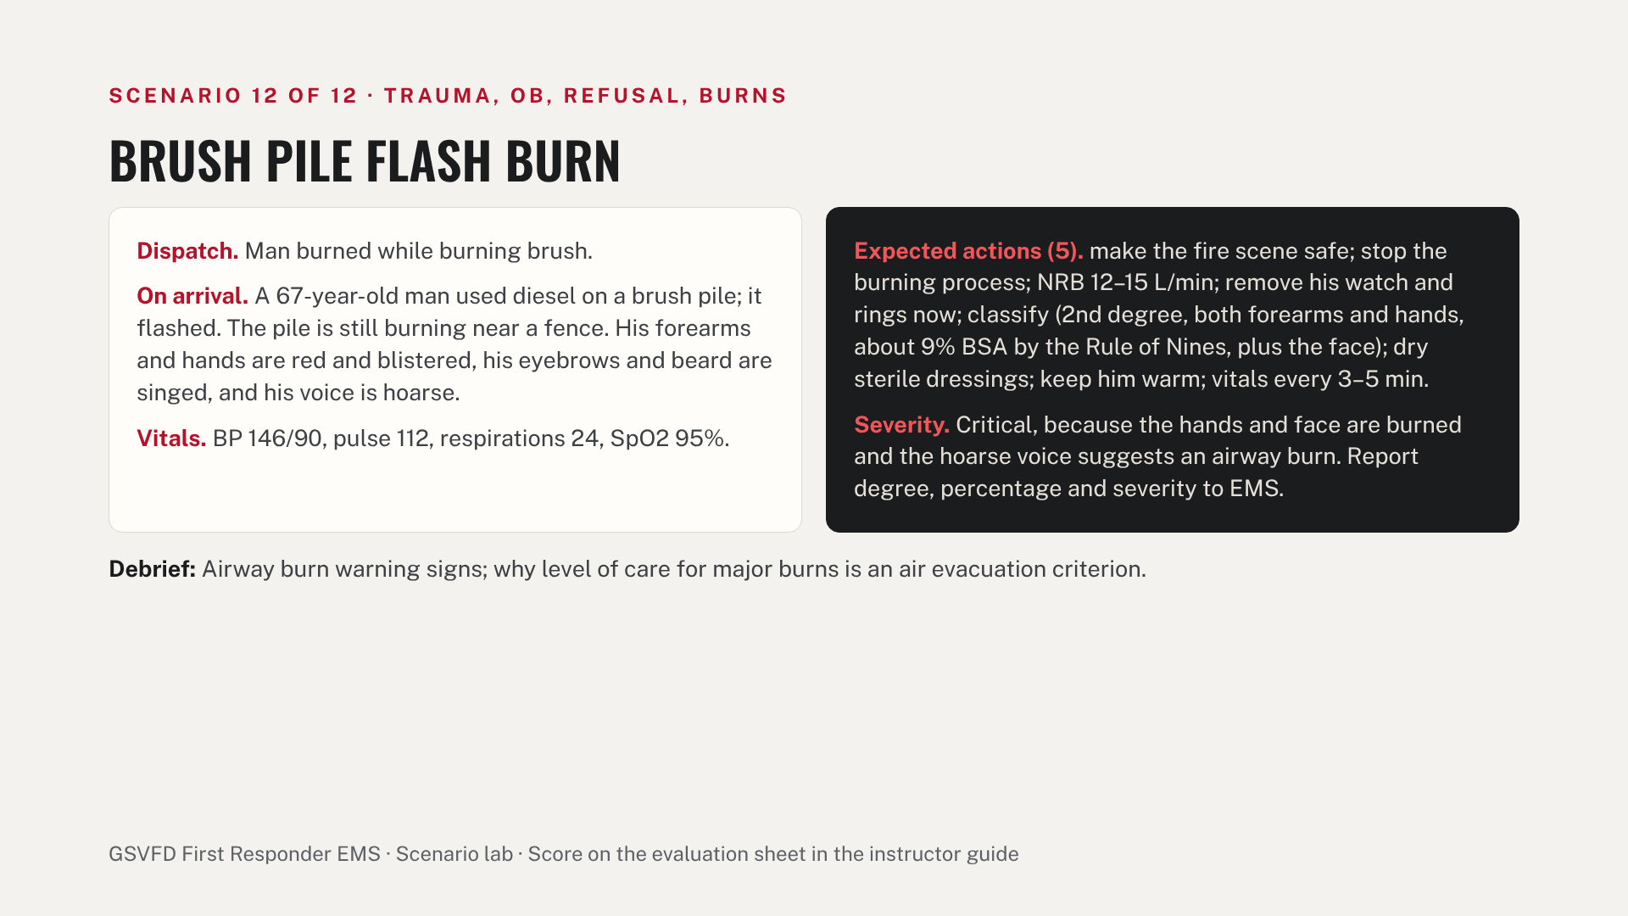
Notes:
Operator card. Read the dispatch aloud, then give findings and vitals only when the team checks for them. About 10 minutes plus a 5-minute debrief. The left side is what the patient and scene show; the right side is what the team should do and how the patient changes. Pass: every critical item and at least 8 of the 10 performance items.

Slide 35
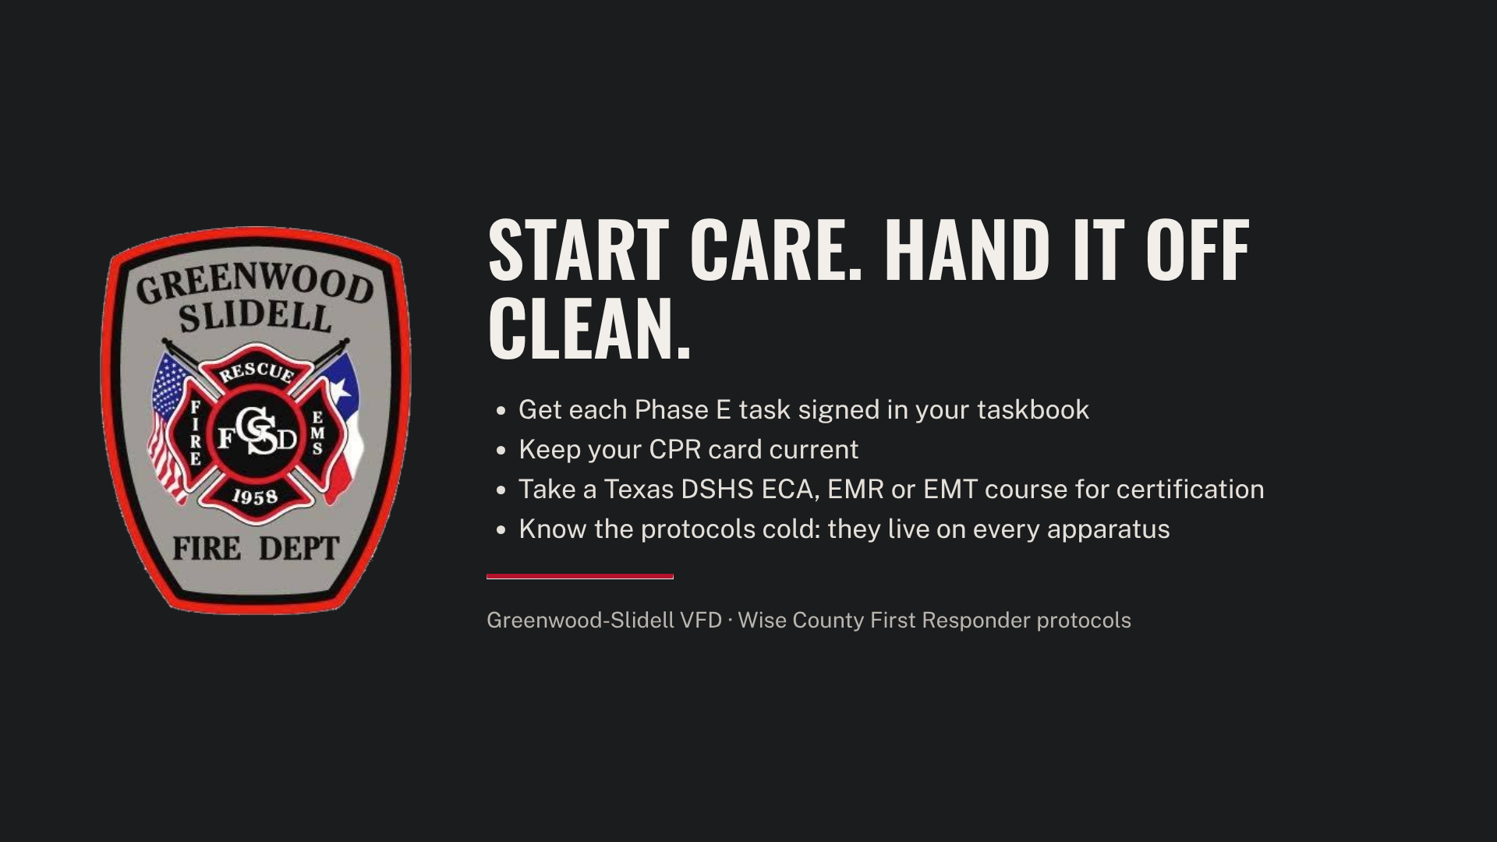
Notes:
Close by pointing trainees to the taskbook Phase E pages and the training library, where the protocols and the instructor guide live. Remind them this course does not certify them; it prepares them to work under the county's first responder protocols.

