Slide 1

Notes:
Welcome the class. This deck follows the GSVFD Firefighter I & II Instructor Guide, one section per module. Each module opens with its objectives and the taskbook tasks it prepares trainees for, then the key teaching points. Lectures stay under 50 minutes before a break or a move to the drill ground.

Slide 2
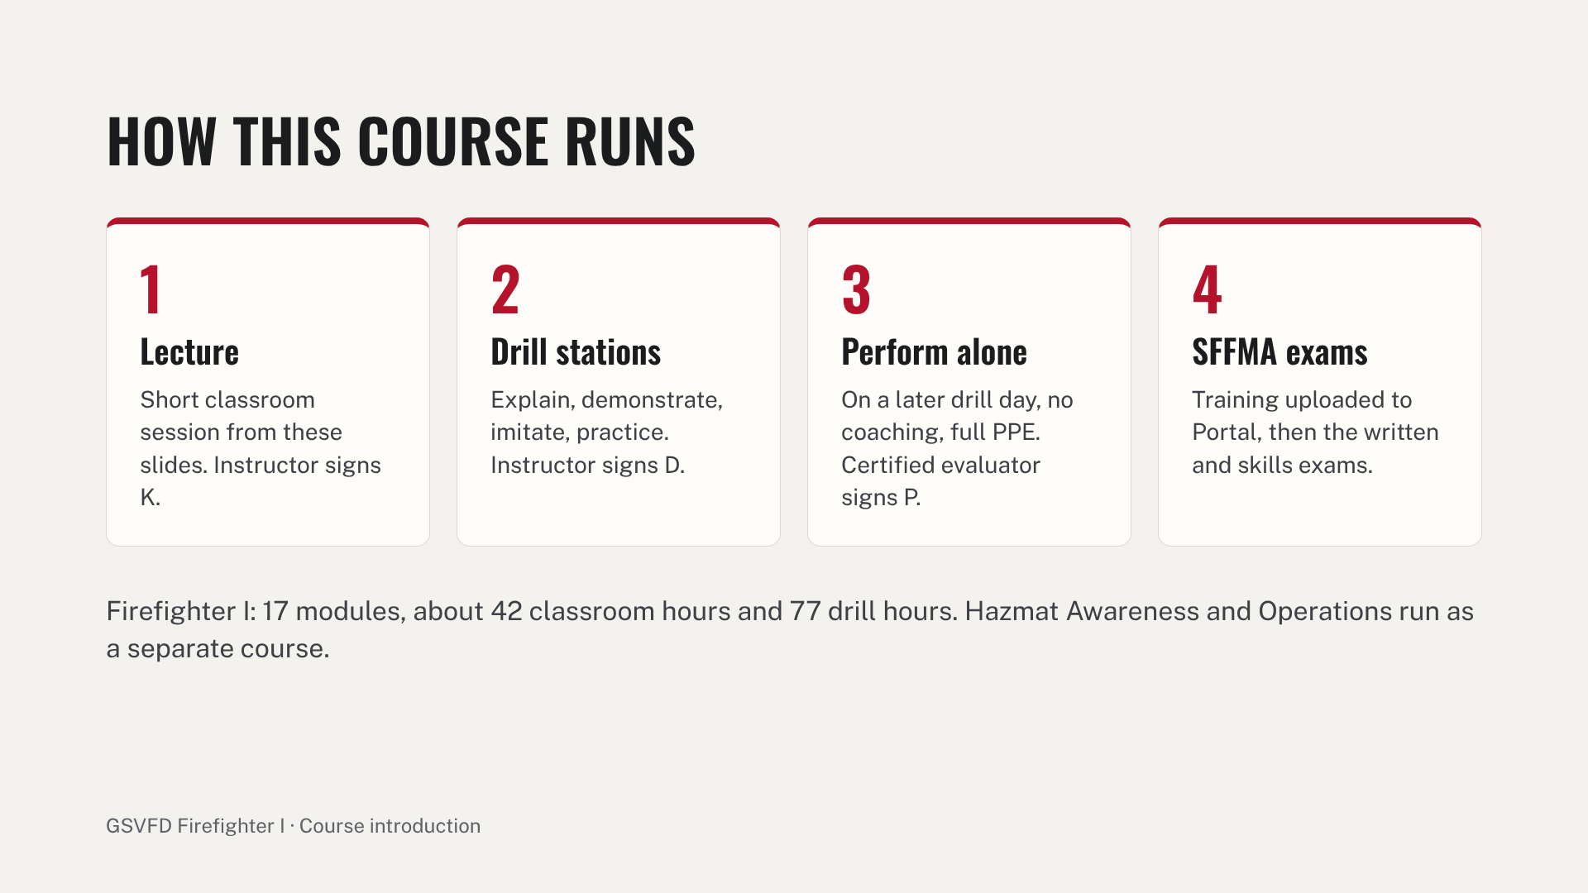
Notes:
Walk through the four steps. Stress that a P sign-off is never given the same day as the D sign-off, and that the taskbook is the department's record while SFFMA runs the actual certification exams. Point trainees to the SFFMA crosswalk at the back of the taskbook so they know which skill sheets they will be tested on.

Slide 3
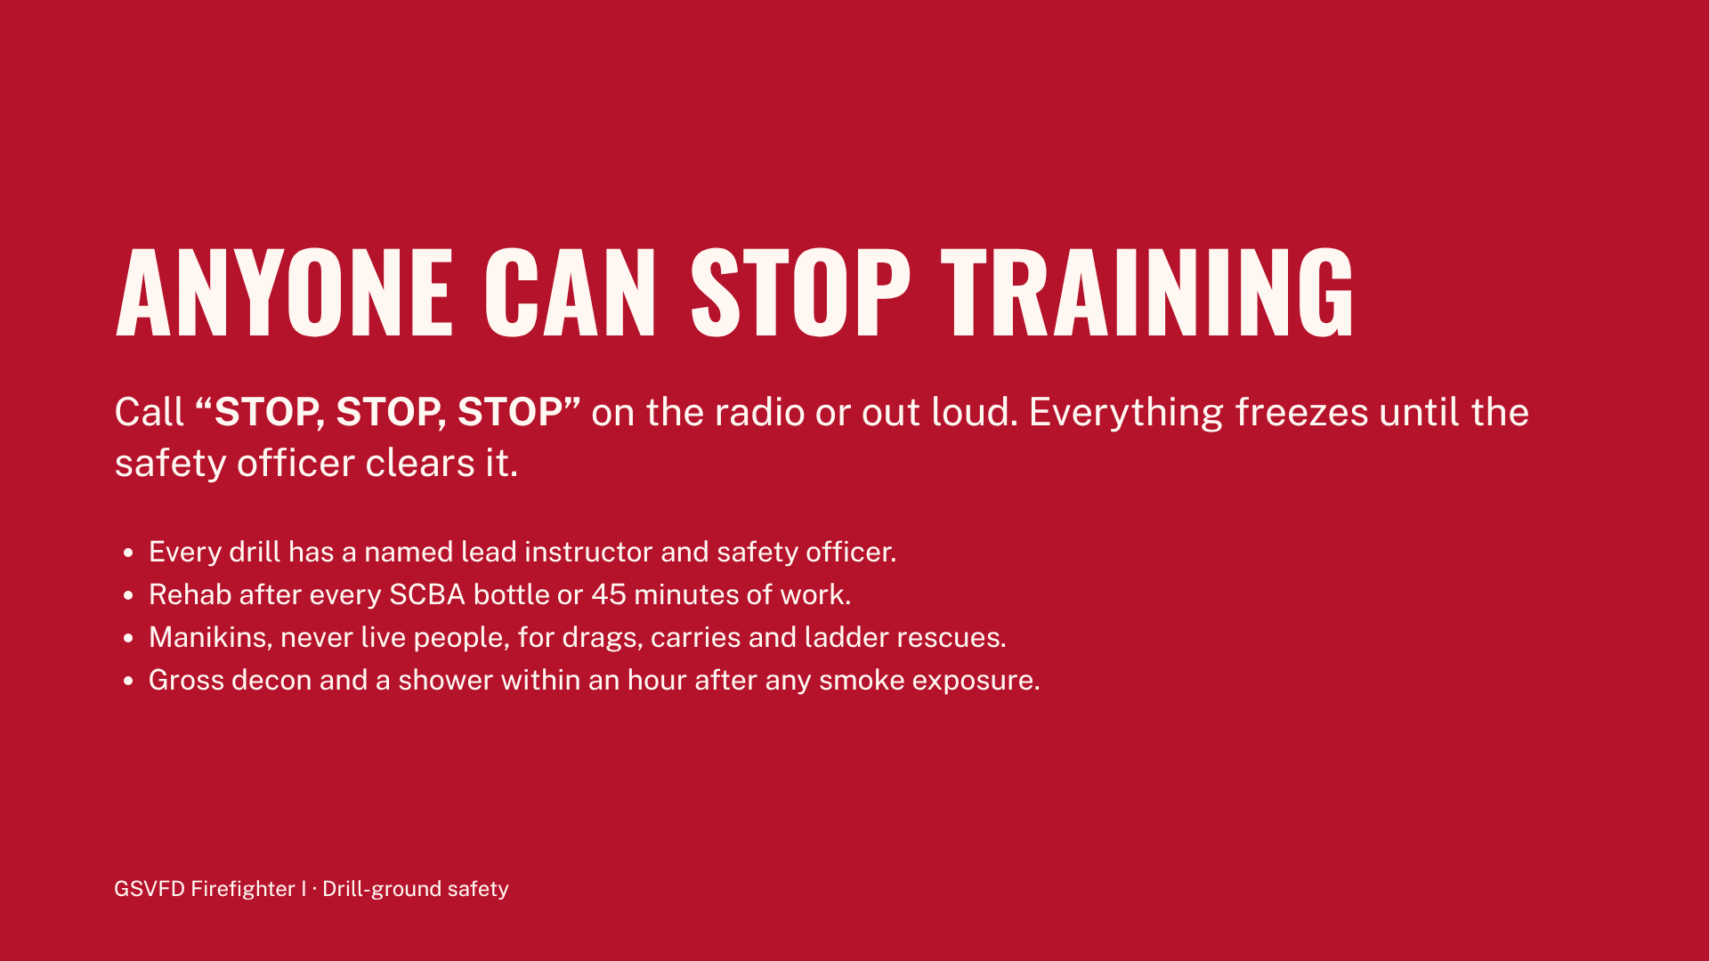
Notes:
Read this slide at the start of every drill, not only the first one. Name today's safety officer and point out the rehab location. Remind trainees that calling a safety stop is never wrong and never held against them. Report every injury or near miss that day on the department form.

Slide 4
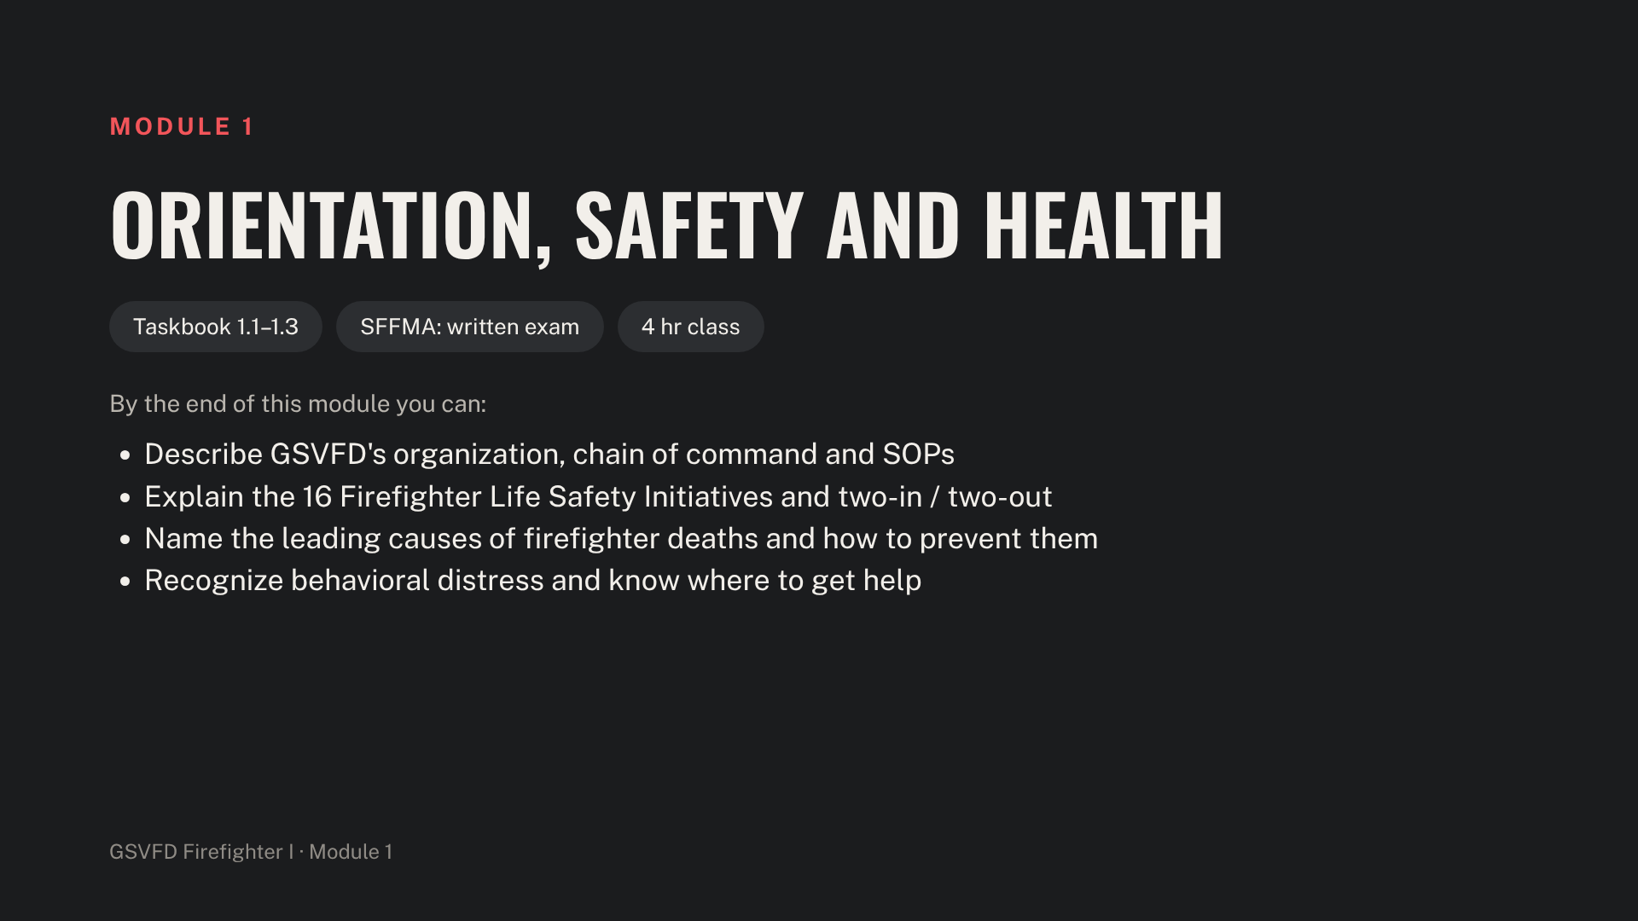
Notes:
Have the Chief or a senior officer open this module. Cover department history, the district, mutual-aid partners and dispatch before moving to safety. Hand out SOPs and have trainees sign the acknowledgment (Phase 0, item 0.2).

Slide 5
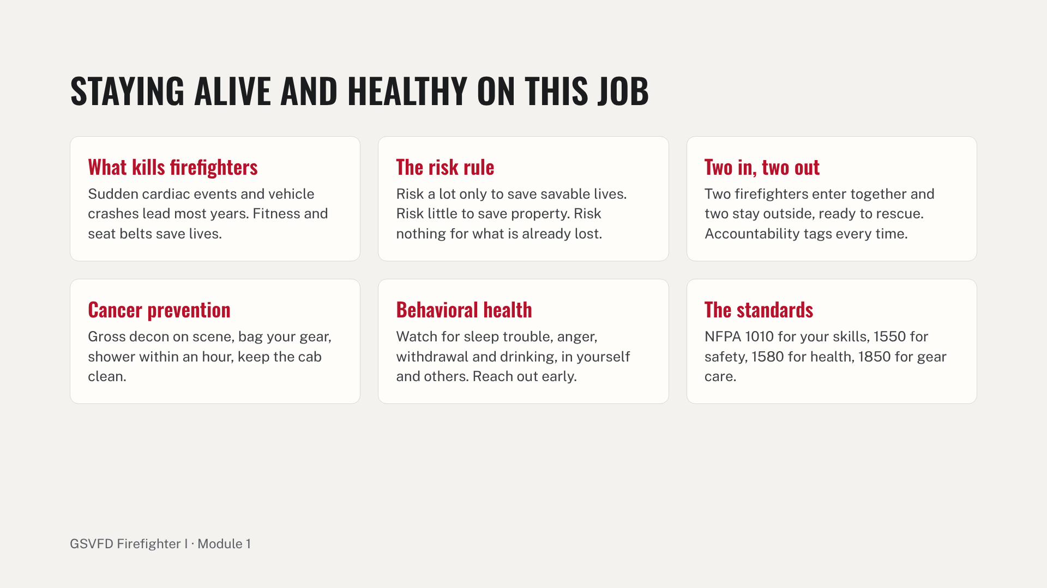
Notes:
Go through the 16 Firefighter Life Safety Initiatives as a handout; this slide covers the ones trainees act on every call. Give every trainee the member assistance program contact in writing. Close with a 10-question quiz; 70% passes, then sign K for taskbook items 1.1 through 1.3.

Slide 6
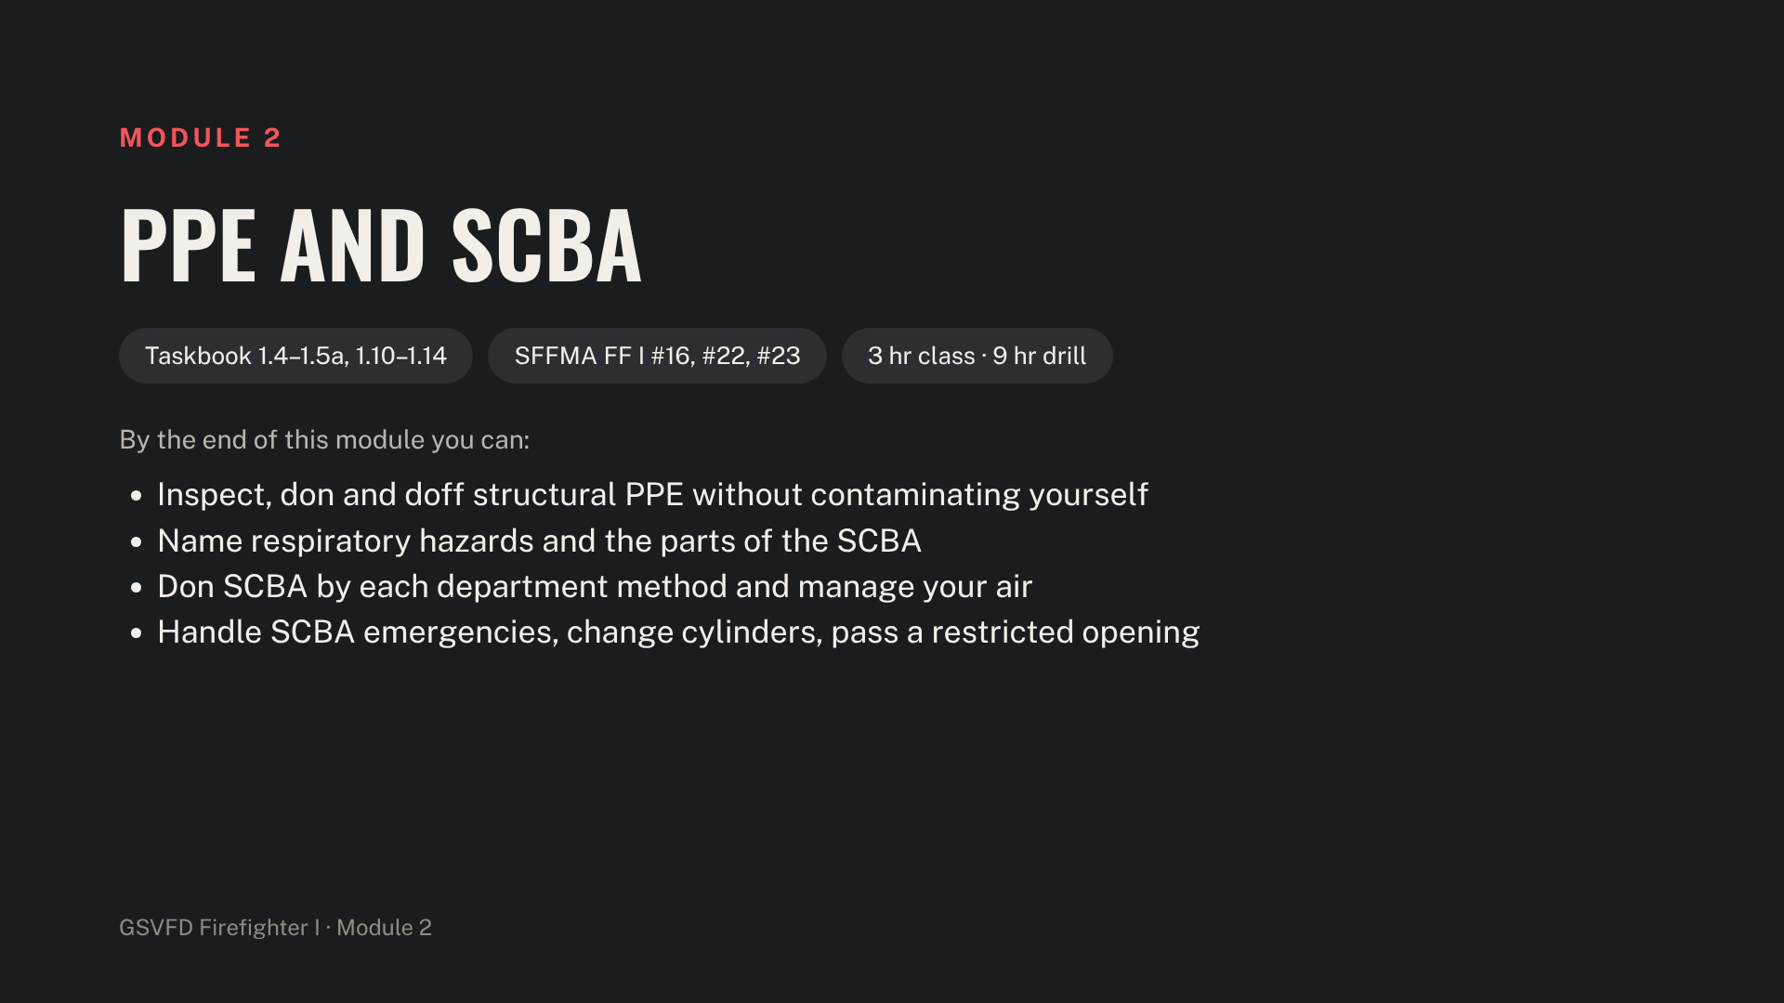
Notes:
Confirm every trainee's fit test (Phase 0, item 0.13) is on file before anyone wears SCBA. Have a full PPE set and SCBA staged for each trainee at the front of the room so you can point to parts during the lecture.

Slide 7
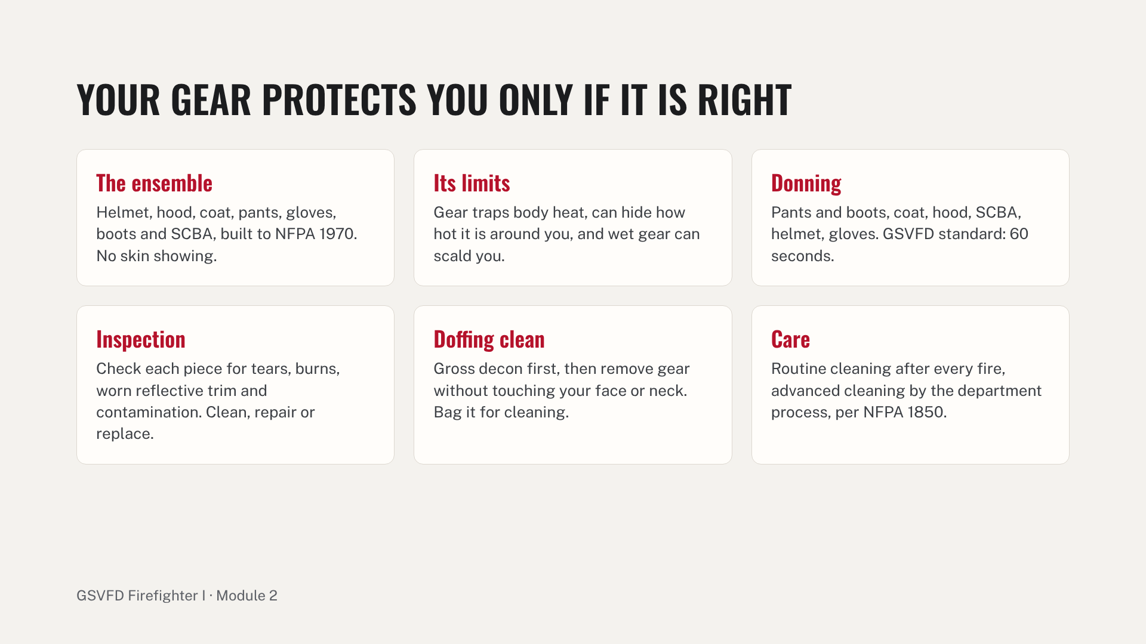
Notes:
Demonstrate a full don at working speed, then slowly while naming each step. Point out the most common fail points: the hood not covering the facepiece edge, exposed wrists and neck, and the collar not up. Station A practice is donning to 60 seconds and a full PPE inspection with the checklist (taskbook 1.5a, SFFMA FF I #22).

Slide 8
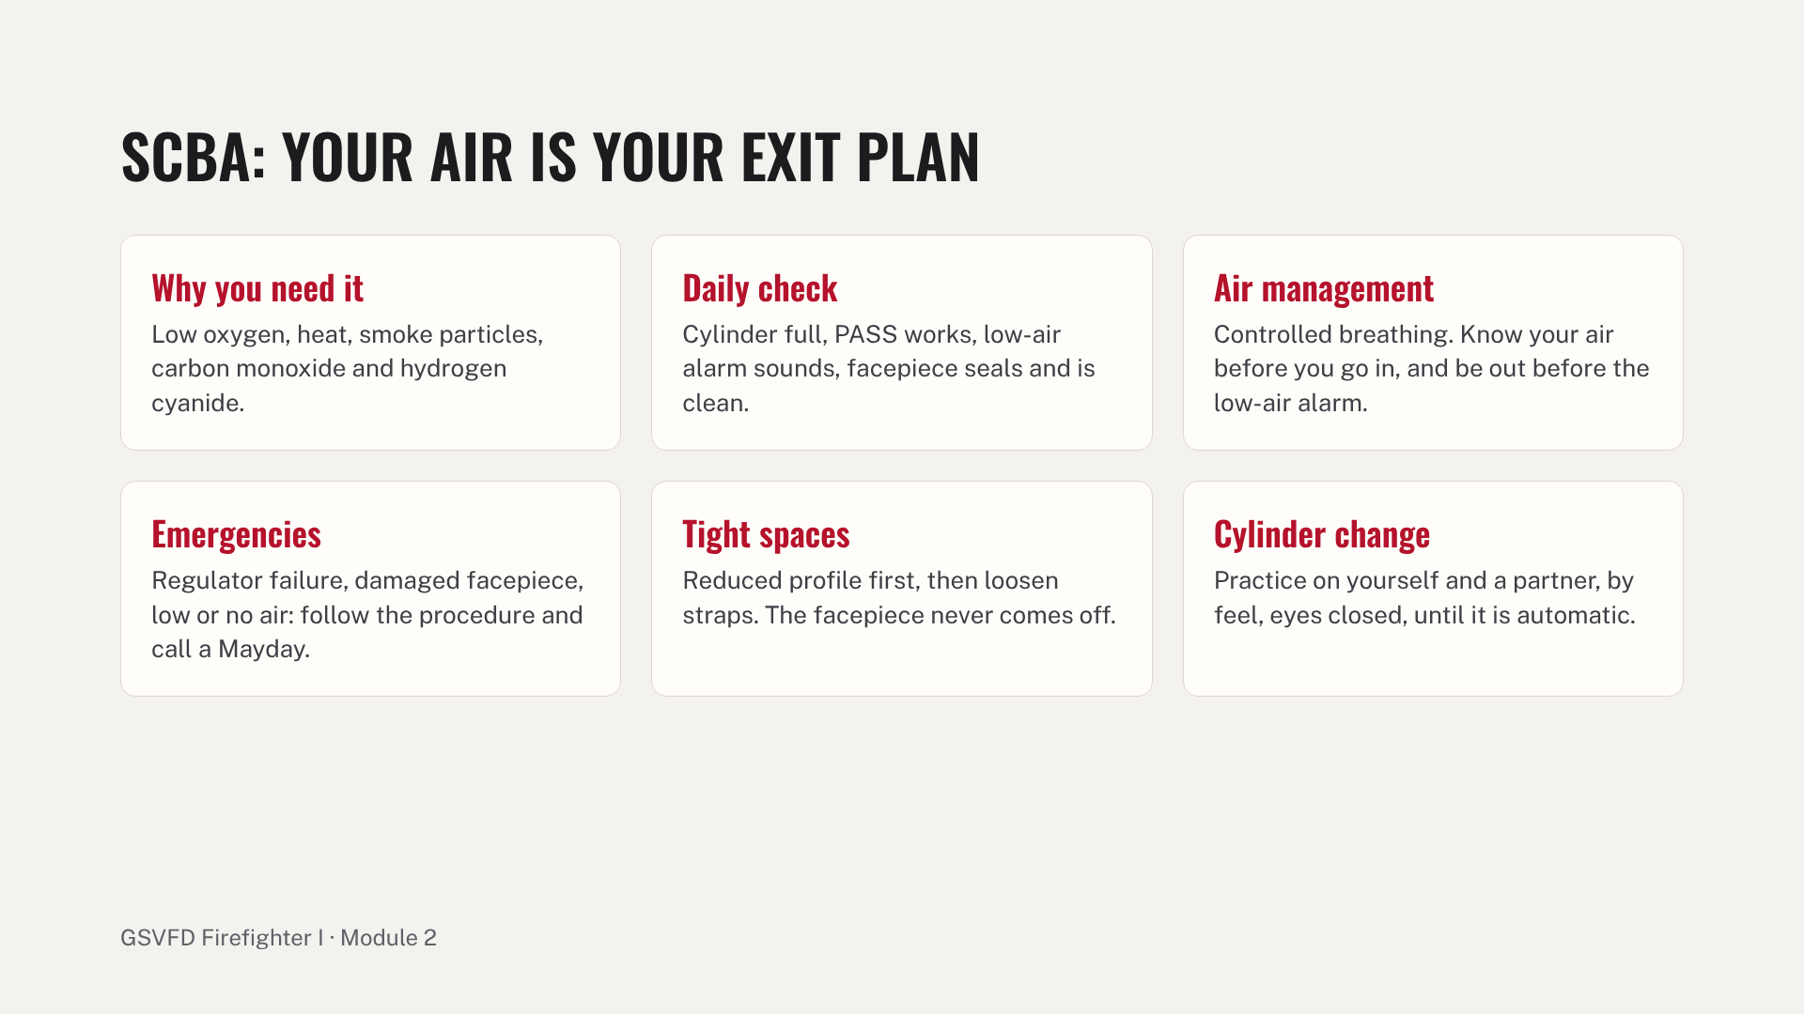
Notes:
Walk through each part on a real SCBA: backplate and harness, cylinder, regulator, facepiece, PASS and low-air alarm. Demonstrate each donning method the department uses (over the head, coat style, seat-mounted). Drill stations B to E follow: donning to 60 seconds, cylinder changes, the blackout confidence course and restricted passage, and emergency procedures called as a Mayday. Automatic fail at the P sign-off: PASS not armed, cylinder not checked full, reaching for the facepiece in the restricted passage.

Slide 9
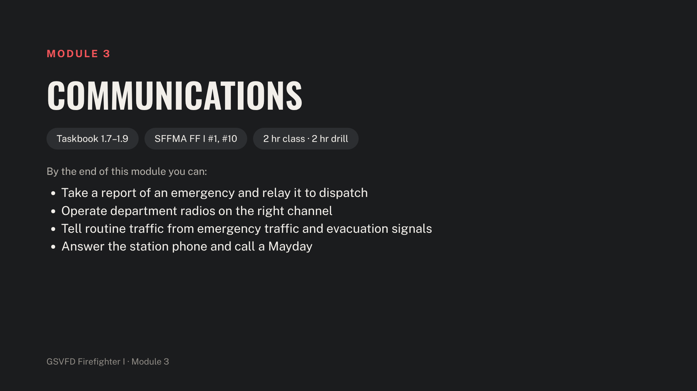
Notes:
Before class, fill in the GSVFD channel plan and the dispatch center's name on the next slide's notes. Have radios on a training channel ready for the drill stations.

Slide 10
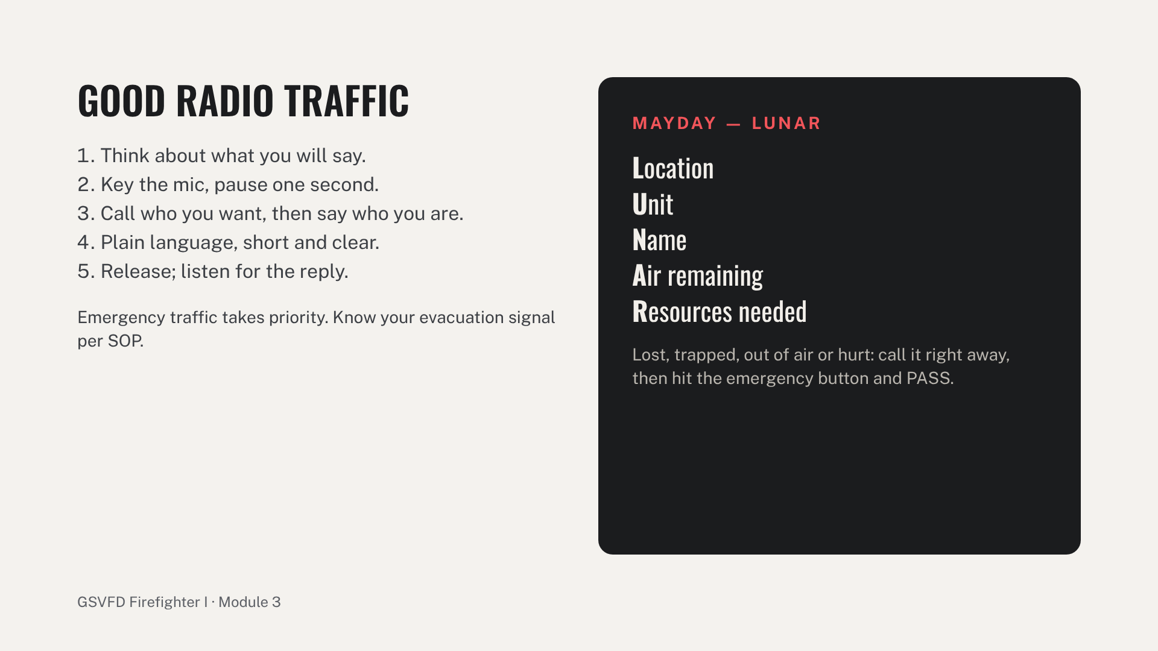
Notes:
Cover how a call reaches GSVFD and what dispatch needs: address, nature, callback number, hazards, number of patients. Add the station-phone message procedure (taskbook 1.8a), which SFFMA can still test. Drill stations: report and relay, radio traffic across the drill ground, and a Mayday in a blackout facepiece within 30 seconds. Common errors: talking as you key and cutting off the first word, the wrong channel, long transmissions, and hesitating to call the Mayday.

Slide 11
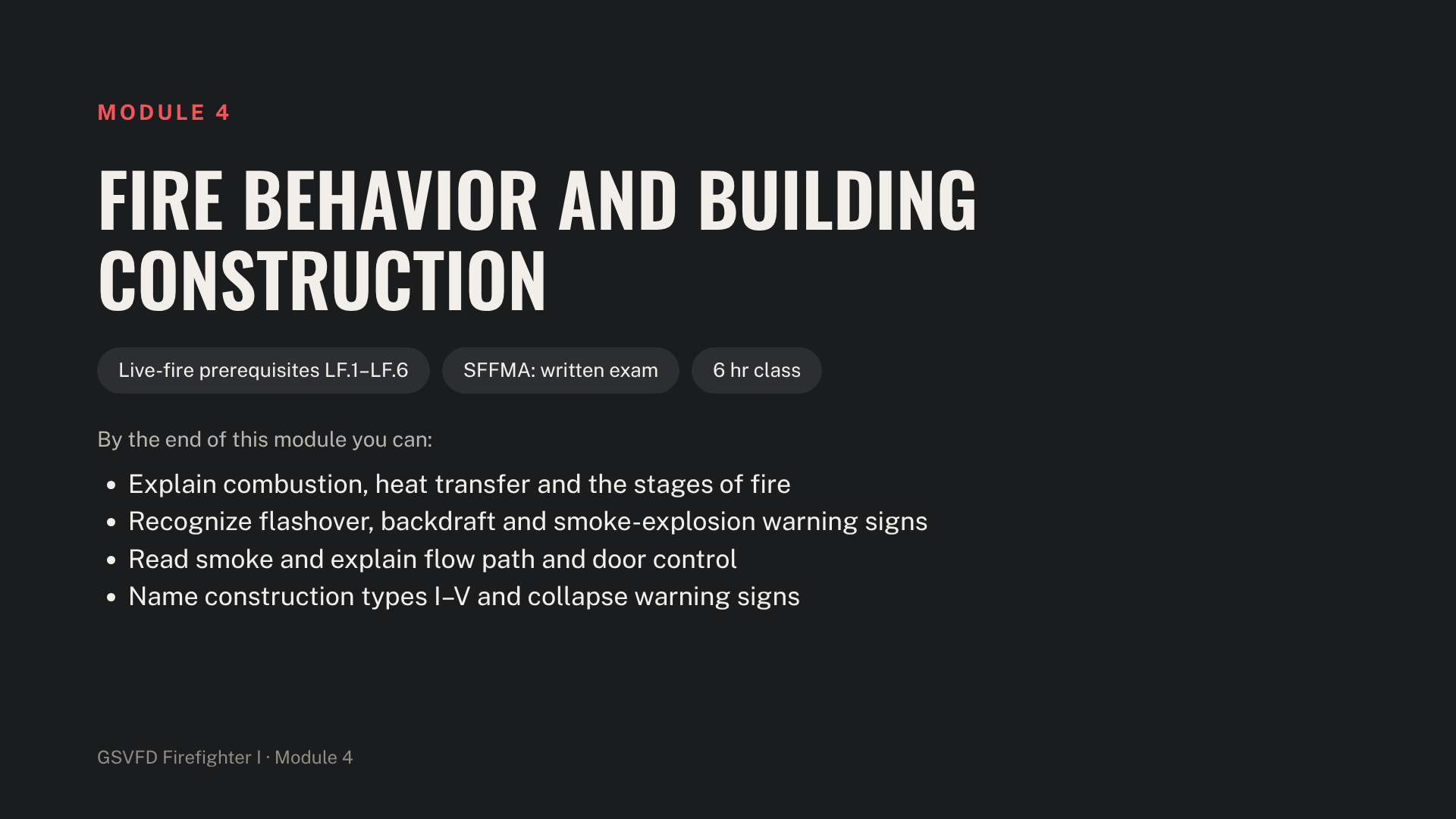
Notes:
This module must be complete, with LF.3 to LF.6 signed, before any trainee joins a live-fire evolution. Use UL Fire Safety Research Institute videos for flow path and modern-fuel fire growth. End with a 25-question test; 70% passes.

Slide 12
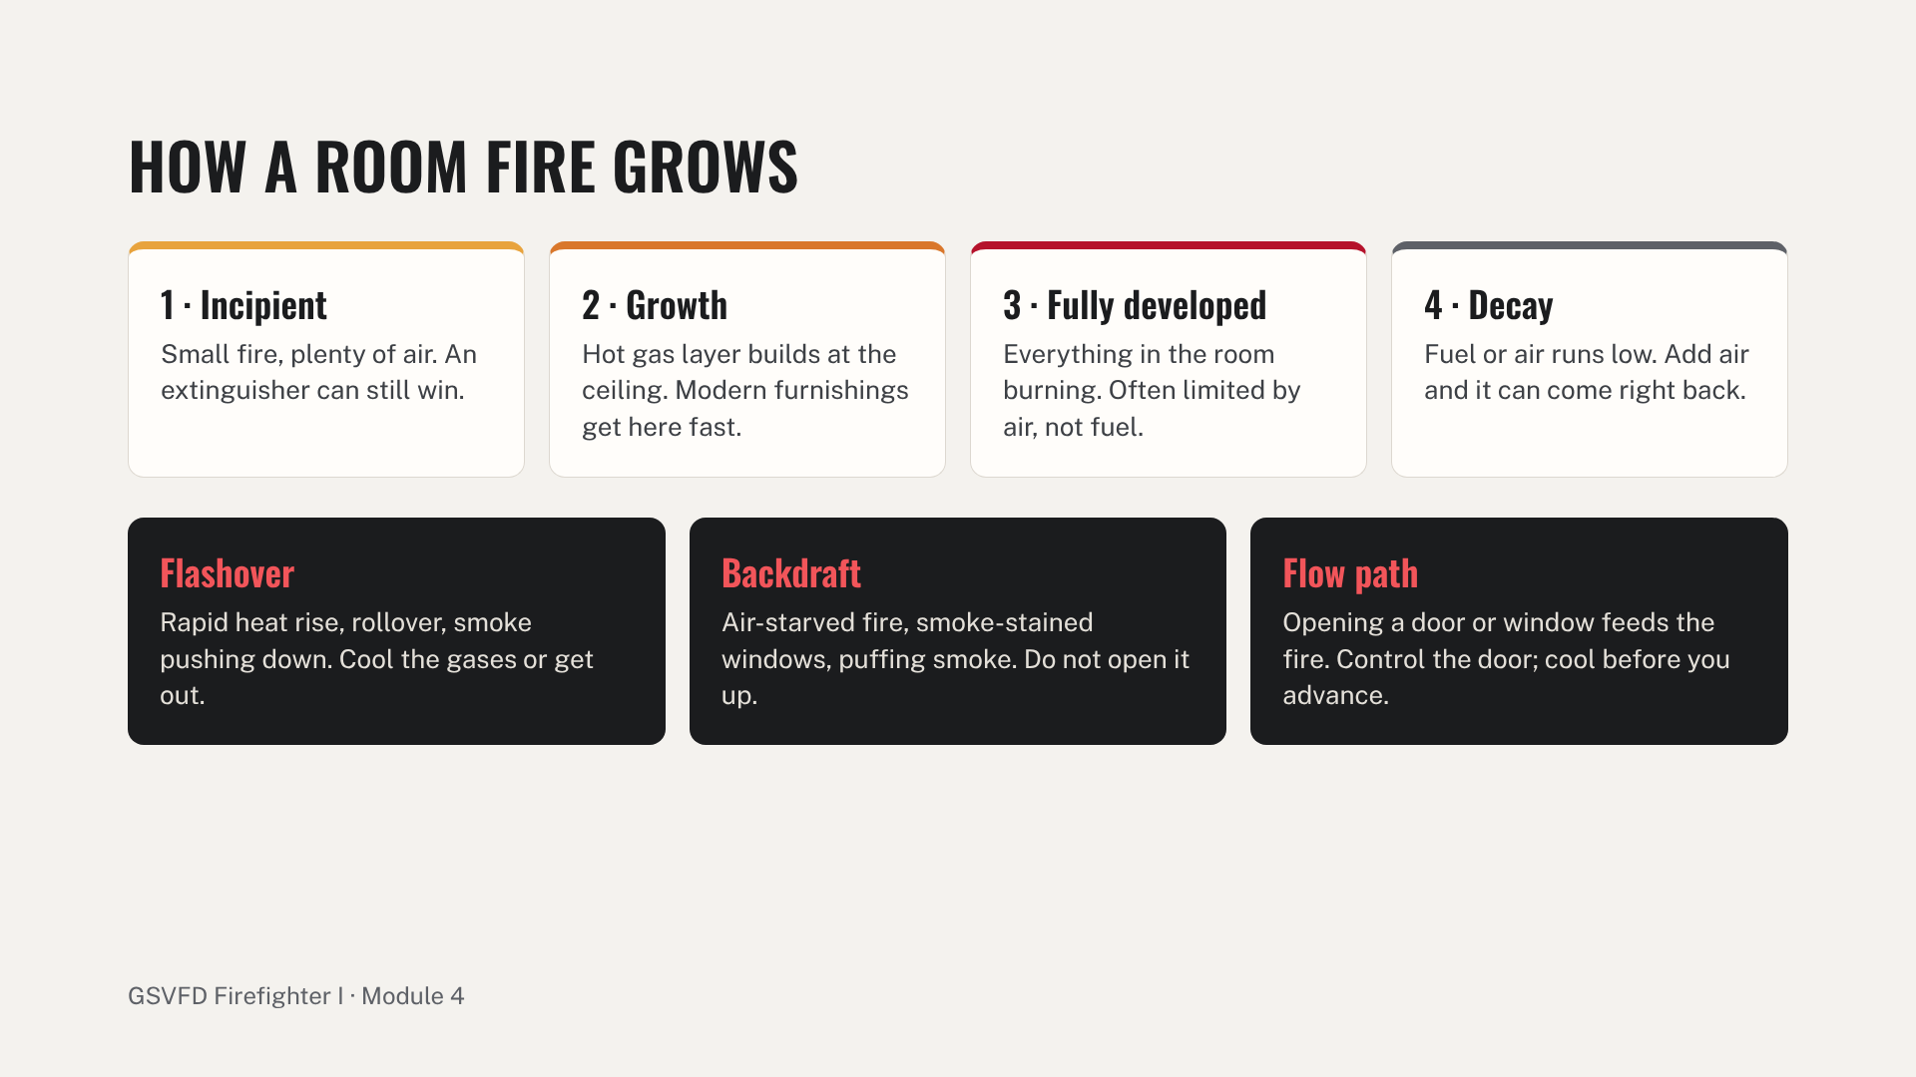
Notes:
Start with combustion: fuel, heat, oxygen and the chemical chain reaction, and the three ways heat moves (conduction, convection, radiation). Then walk the four stages. Explain fuel-limited versus ventilation-limited fire: most fires the crew arrives at are starved of air, so ventilation and door openings speed them up. Teach smoke reading by volume, velocity, density and color. Close with door control and cooling hot gases, and direct, indirect and combination attack.

Slide 13
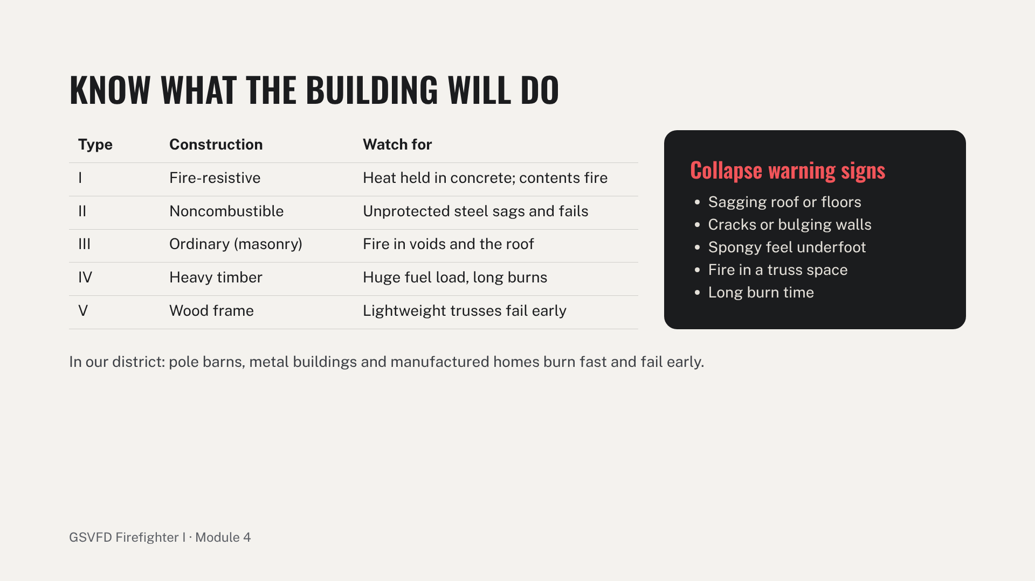
Notes:
Bring samples if you have them: a truss with gusset plates, an engineered I-joist. Explain that lightweight construction can fail in minutes once fire reaches it. Tie each construction type to buildings trainees will see in the district. Sign LF.3 to LF.6 (knowledge) after the written test.

Slide 14
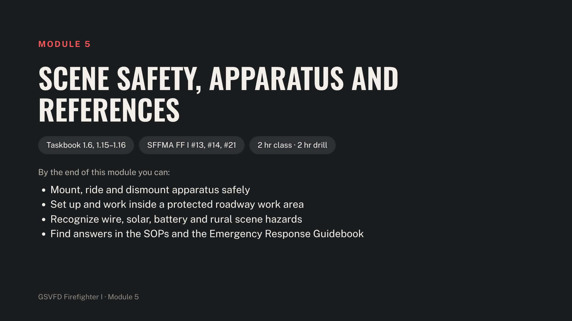
Notes:
Stage an engine, cones, high-visibility vests and the current ERG. Name the district's specific hazards in this module: gas well pads, pipelines and the major roads trainees will work on.

Slide 15
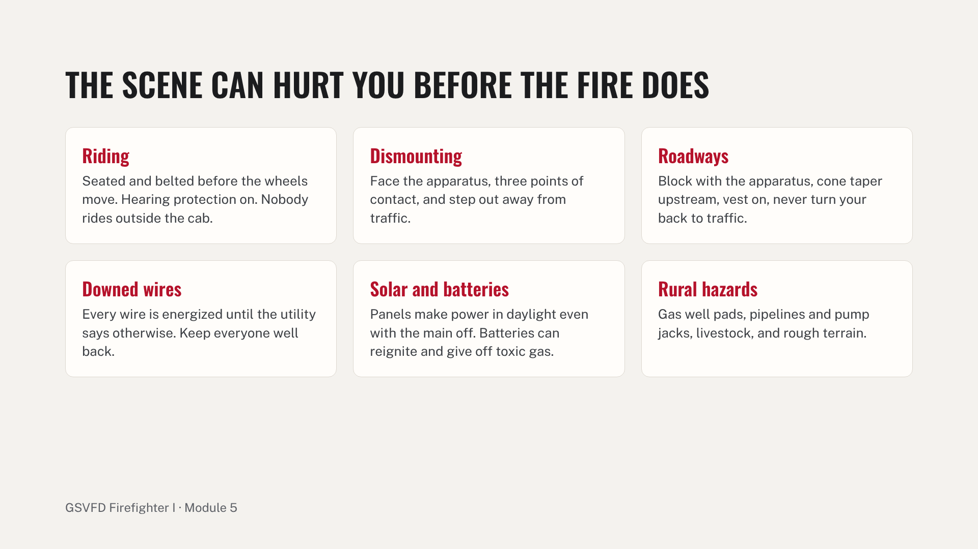
Notes:
Drill stations: mount, belt in and dismount on the curb side; block a lane with the engine and set a cone taper, with trainees working only inside it; and a reference race to find a UN number in the ERG and a policy in the SOPs. Common errors: unbuckling before the apparatus stops, stepping out on the traffic side, and working outside the taper.

Slide 16
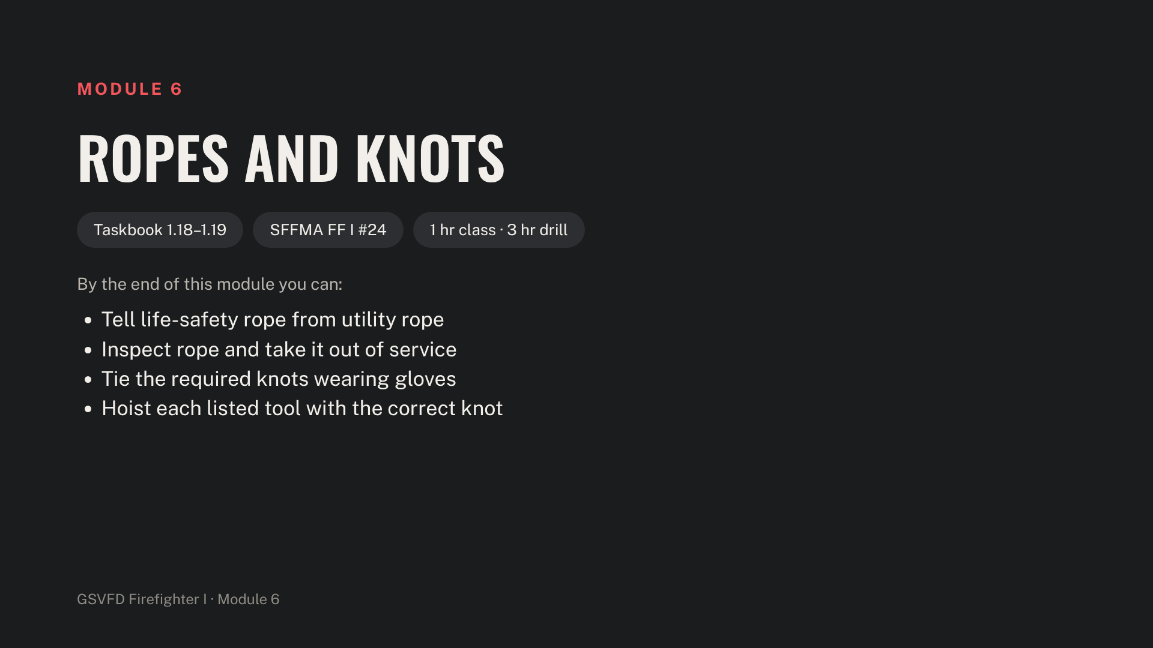
Notes:
Stage utility rope, the rope log, and the tools to hoist: axe, pike pole, short ladder, dry and charged hoseline, and a fan. Pick a hoisting point such as the tower or a second-floor balcony.

Slide 17
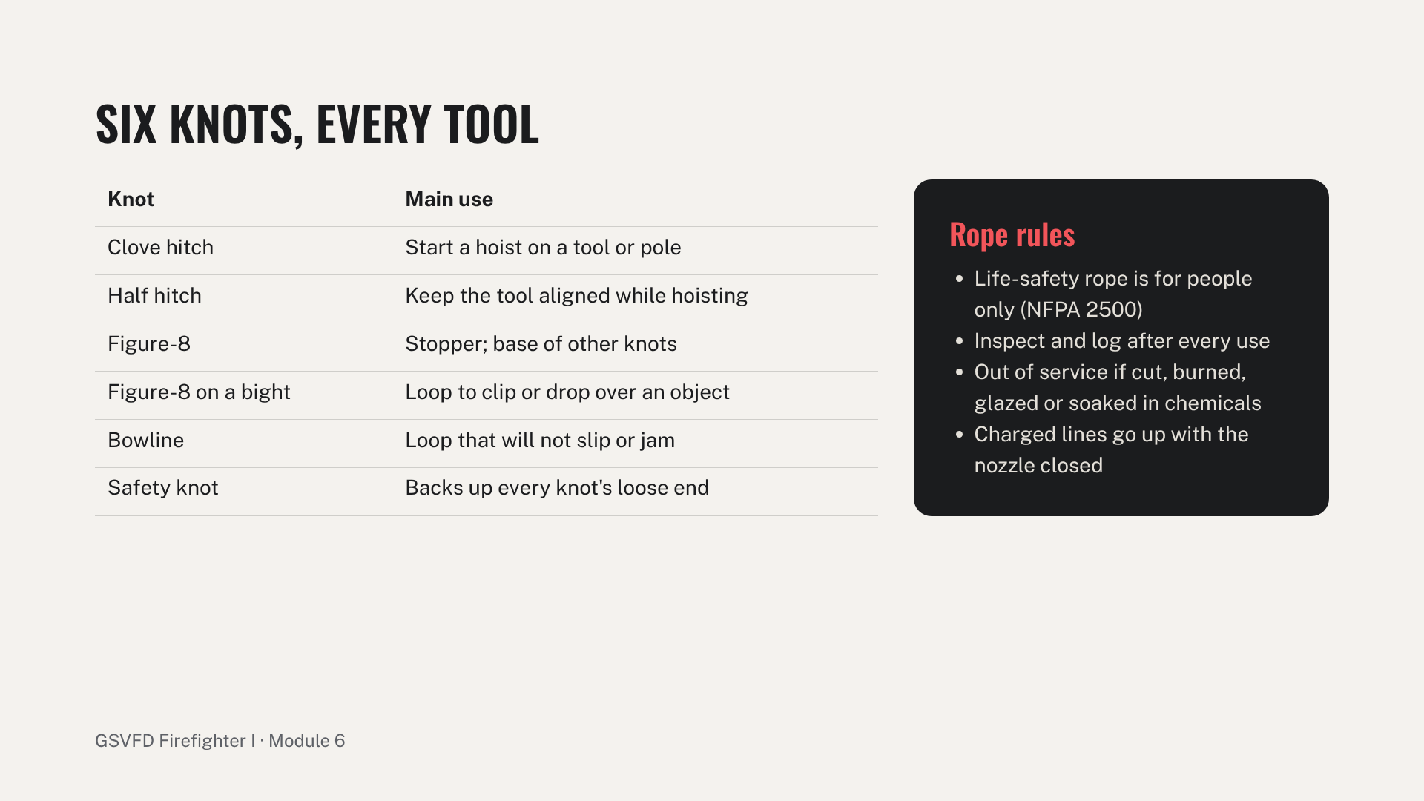
Notes:
Station A is a knot board: every knot gloved, then eyes closed. Station B is hoisting each tool from the hoisting point with a tag line: axe and pike pole with a clove hitch and half hitches, a ladder with a bowline or figure-8 on a bight, dry and charged hose, and a fan. Call "rope" before lowering. Common errors: no safety knot, the hitch on the wrong end of the tool, and a charged line hoisted with the nozzle open.

Slide 18
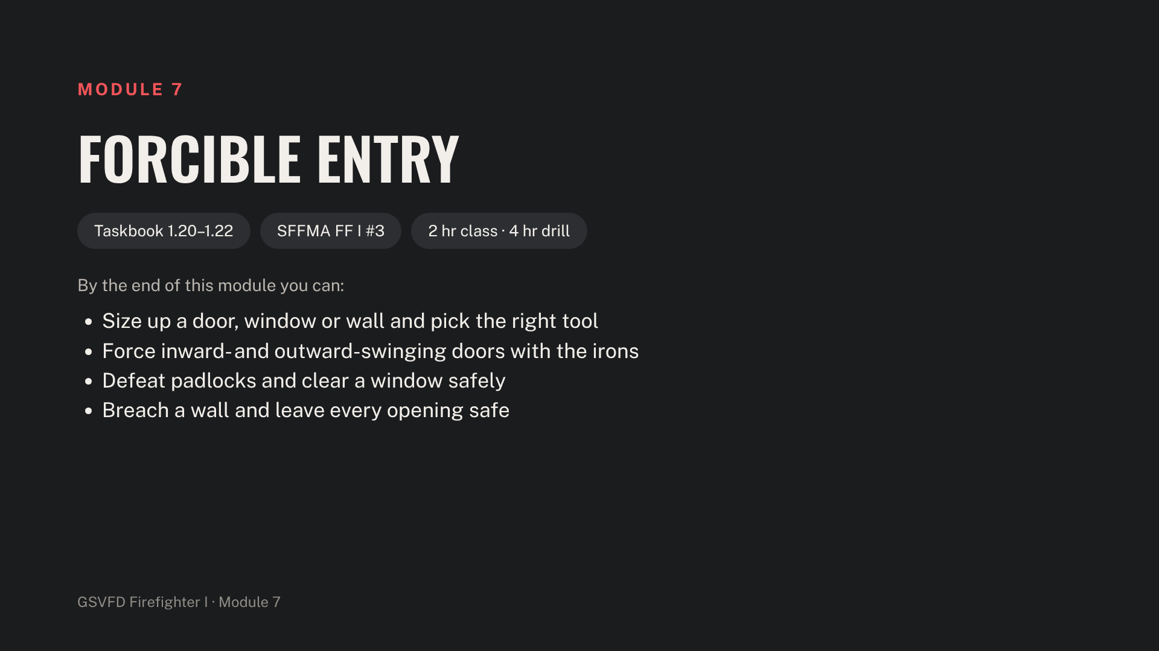
Notes:
Stage the irons (flat-head axe and Halligan), a through-the-lock kit, bolt cutters, a rotary saw, the forcible-entry door prop, padlocks, a window prop and a breach wall. Eye protection for everyone at the props.

Slide 19
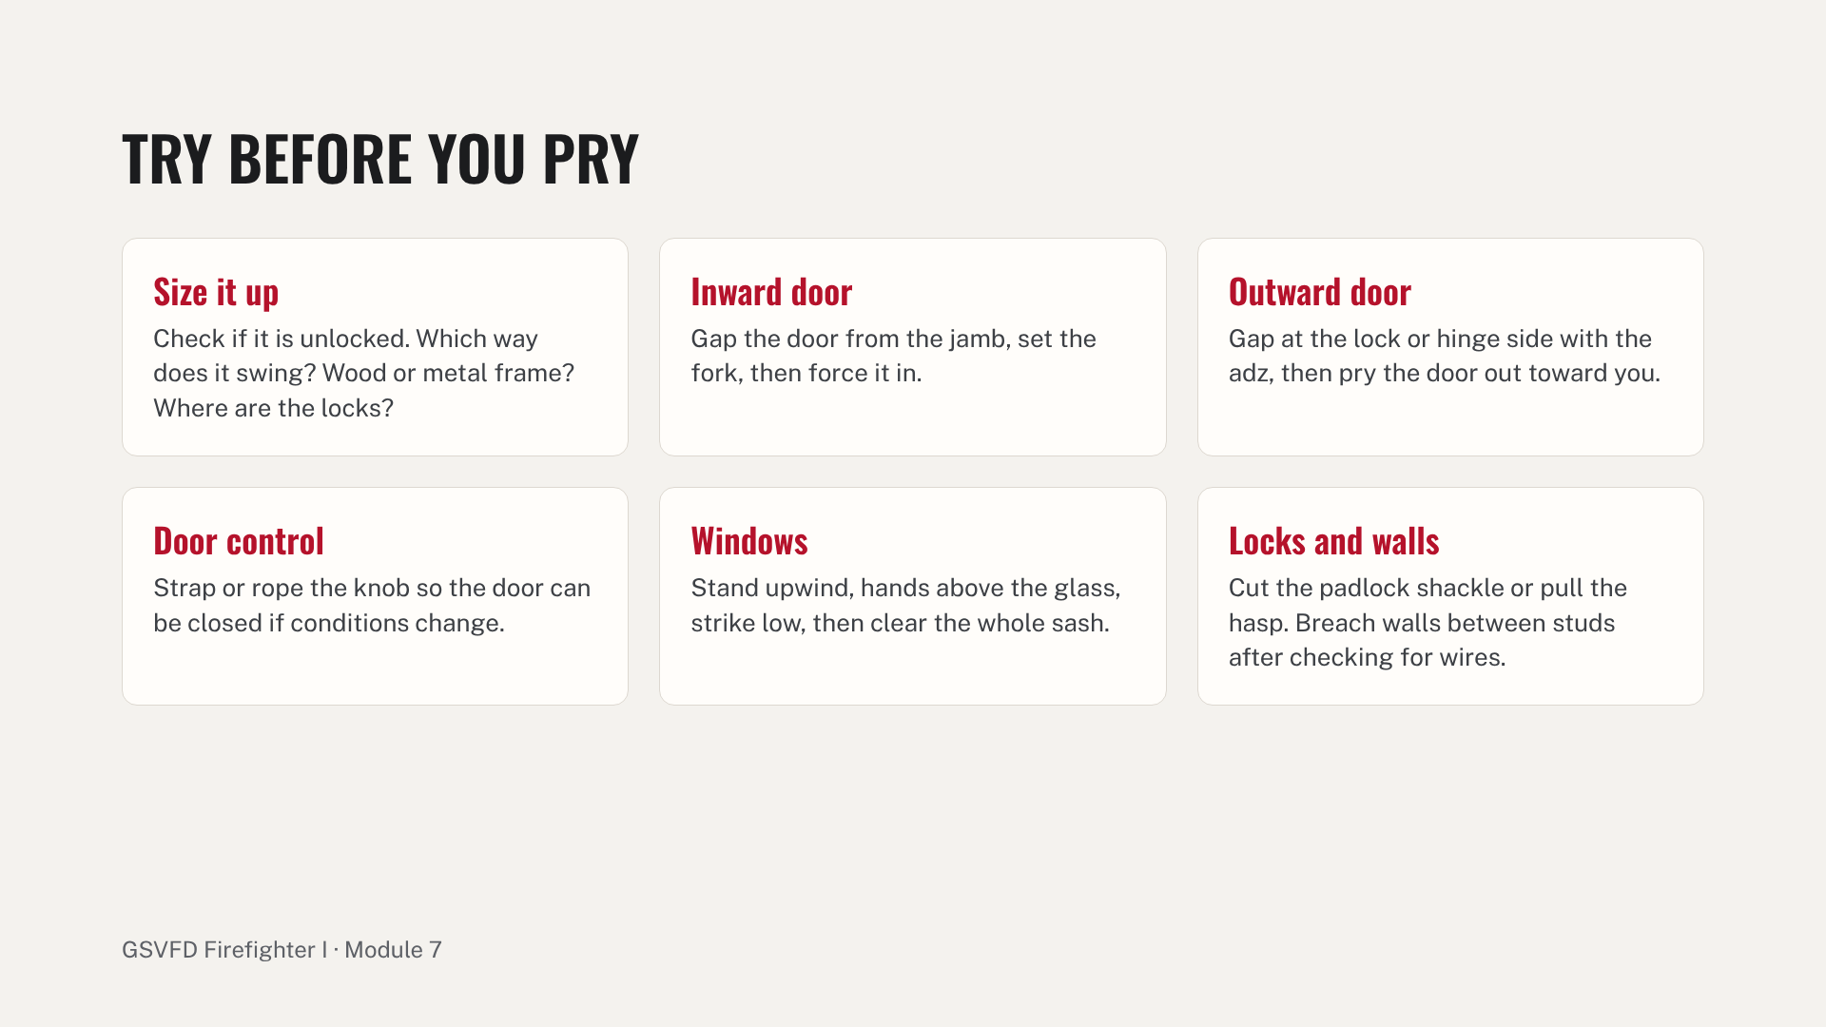
Notes:
Cover the tool families (striking, prying, cutting, pushing and pulling) and saw safety: eye and hearing protection, a fire watch, and spark control. Drill stations: door prop with the irons as a two-person team, padlocks and through-the-lock, and clearing a window and breaching a stud wall. Common errors: no door control, swinging tools without checking the swing area, and glass left in the frame.

Slide 20
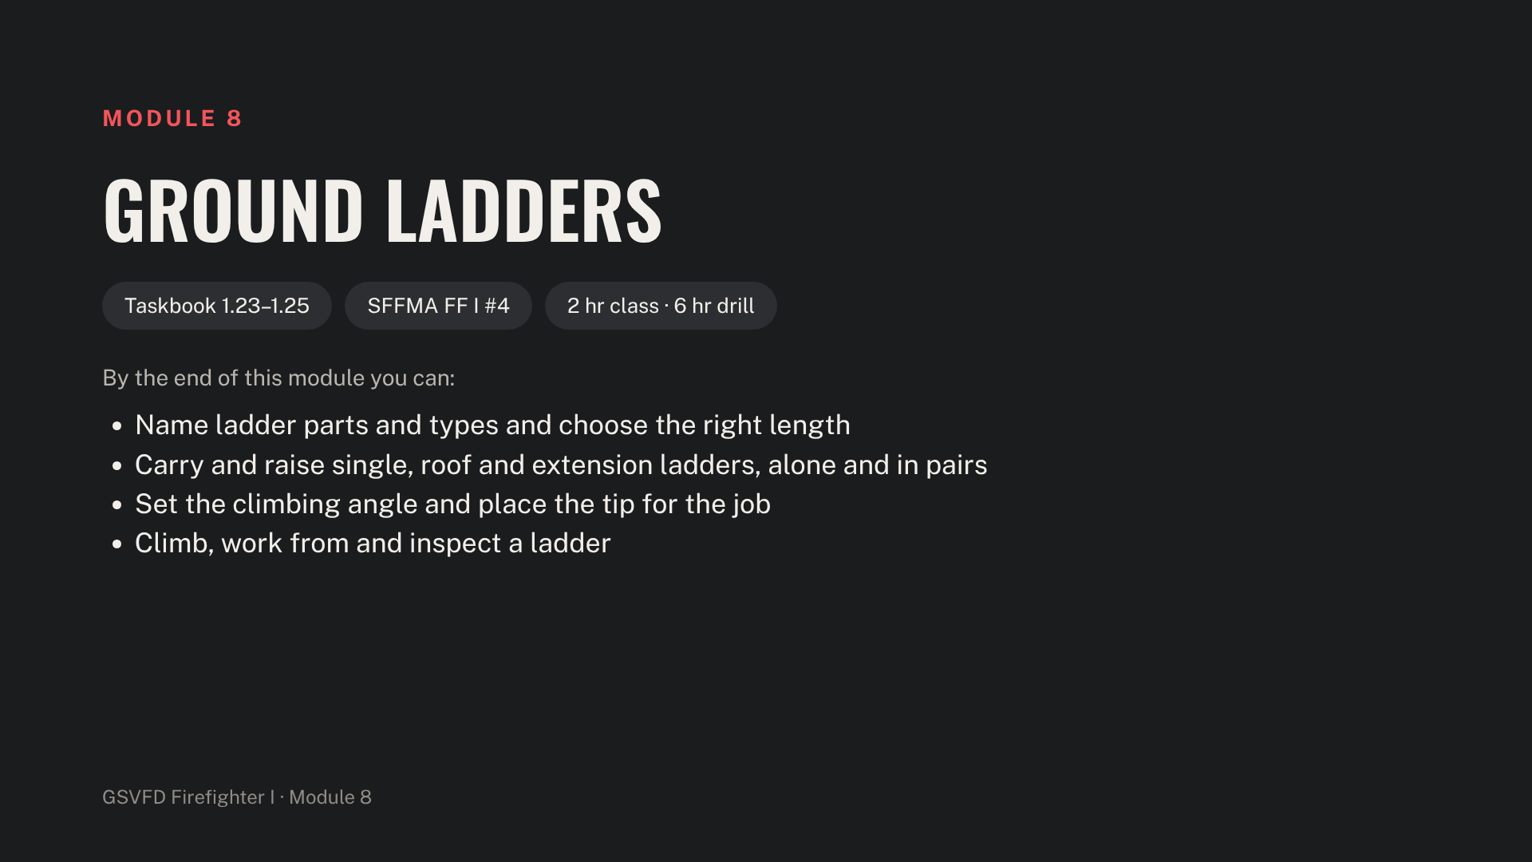
Notes:
Stage every ladder carried on GSVFD apparatus beside a two-story training wall. Foot every ladder during training, and run the first raises without SCBA before adding it.

Slide 21
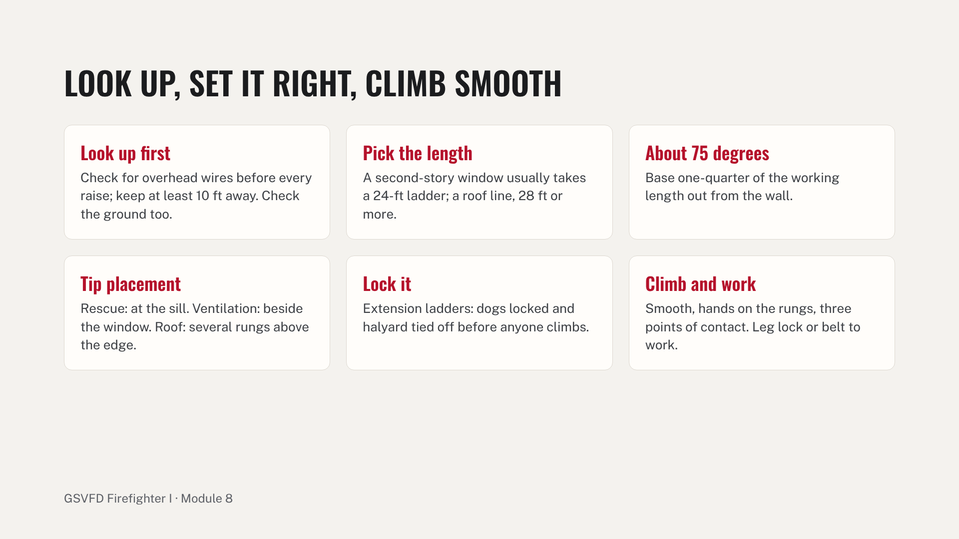
Notes:
Walk the parts on a real extension ladder: beams, rungs, butt, tip, fly and bed sections, halyard, dogs and the heat sensor label. Drill stations: carries and raises for each ladder by each method to window and roof positions, then climb, leg lock, pass a tool, and step onto a roof and back. Inspect and clean after use. Common errors: not checking overhead, dogs not locked, the halyard not tied off, and the tip against glass or gutter.

Slide 22
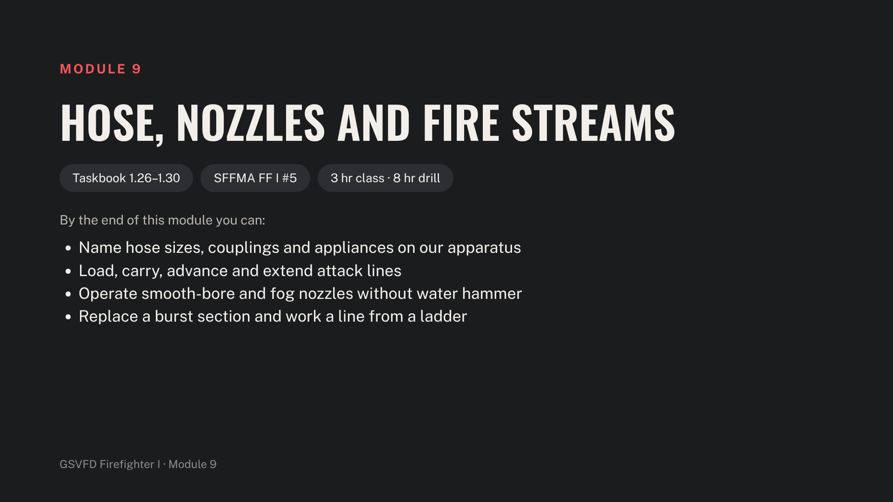
Notes:
Stage an engine with charged attack lines, spare sections, a wye, double-male and double-female adapters, reducers, hose straps and clamps, plus stairs and a ladder for advances.

Slide 23
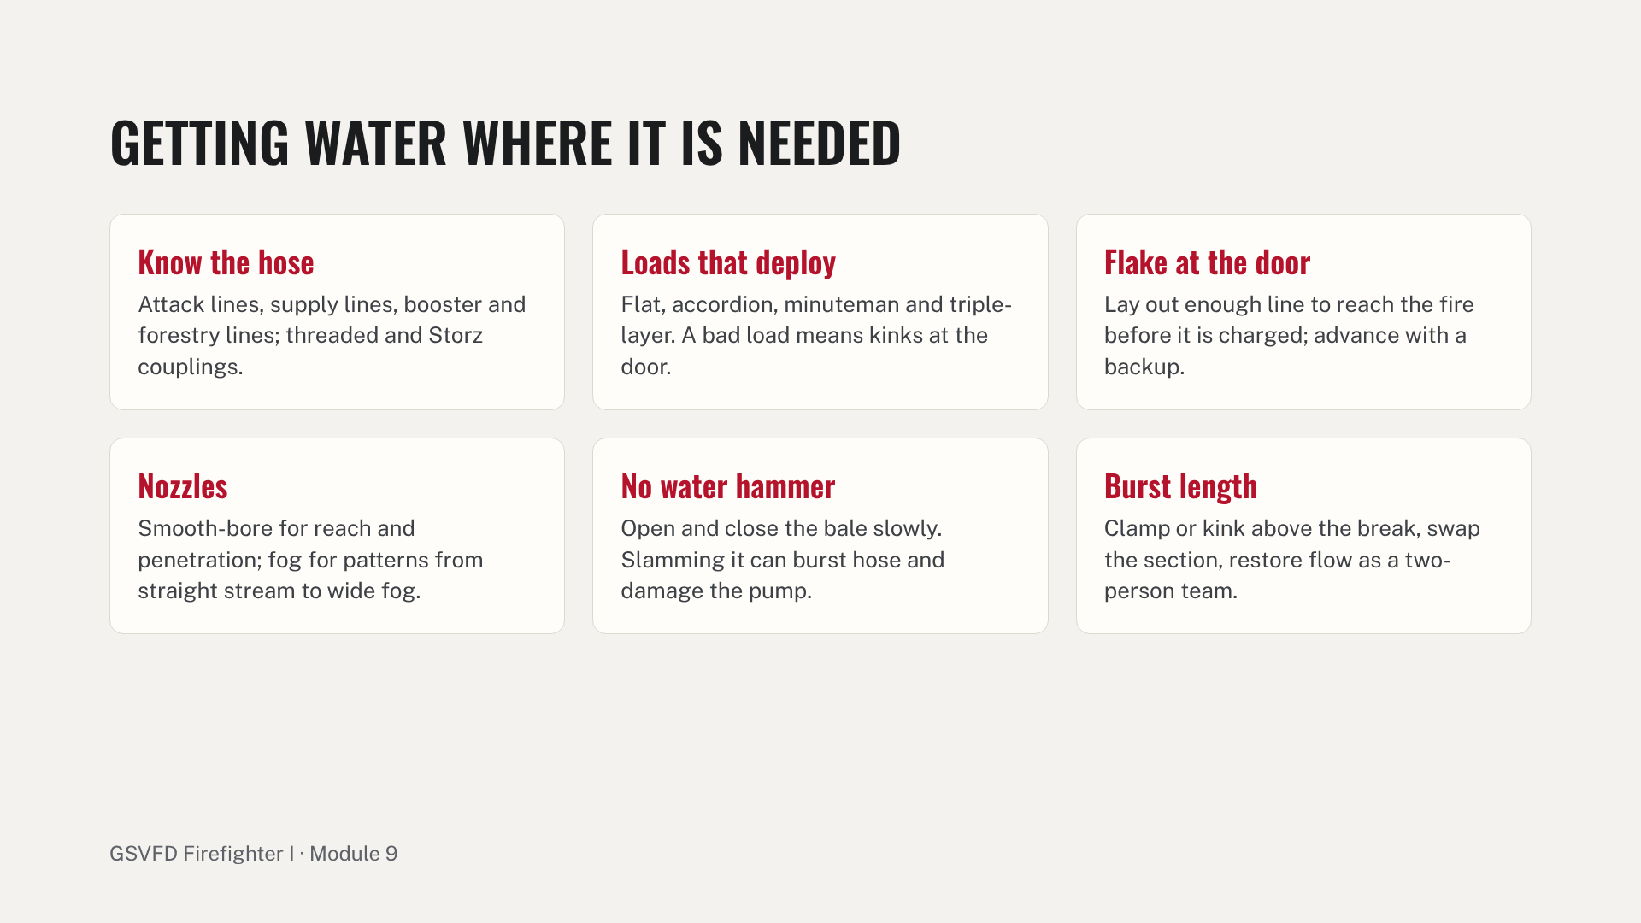
Notes:
Explain nozzle reaction and body position, and why the backup firefighter matters. Drill stations: reload each preconnect; advance a charged line up and down stairs, over a ladder and around corners; nozzle patterns and slow shutdown; burst-section replacement on the clock; and securing a charged line to a ground ladder with a hose strap. Common errors: slamming the bale, kinks left at the door, and advancing without a backup.

Slide 24
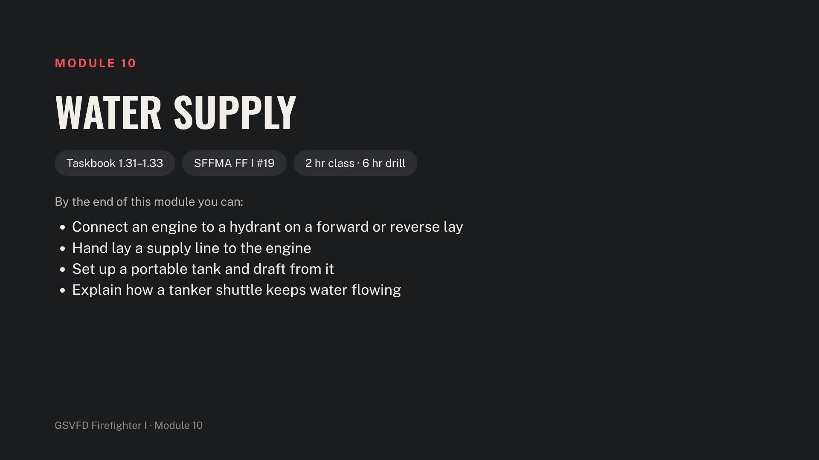
Notes:
Rural water supply decides most GSVFD structure fires, so give this module full drill time. Get the water supplier's permission before flowing any hydrant for training. Stage the engine, tanker, drop tank, hard suction with strainer, jet siphon or transfer equipment, and hydrant tools.

Slide 25
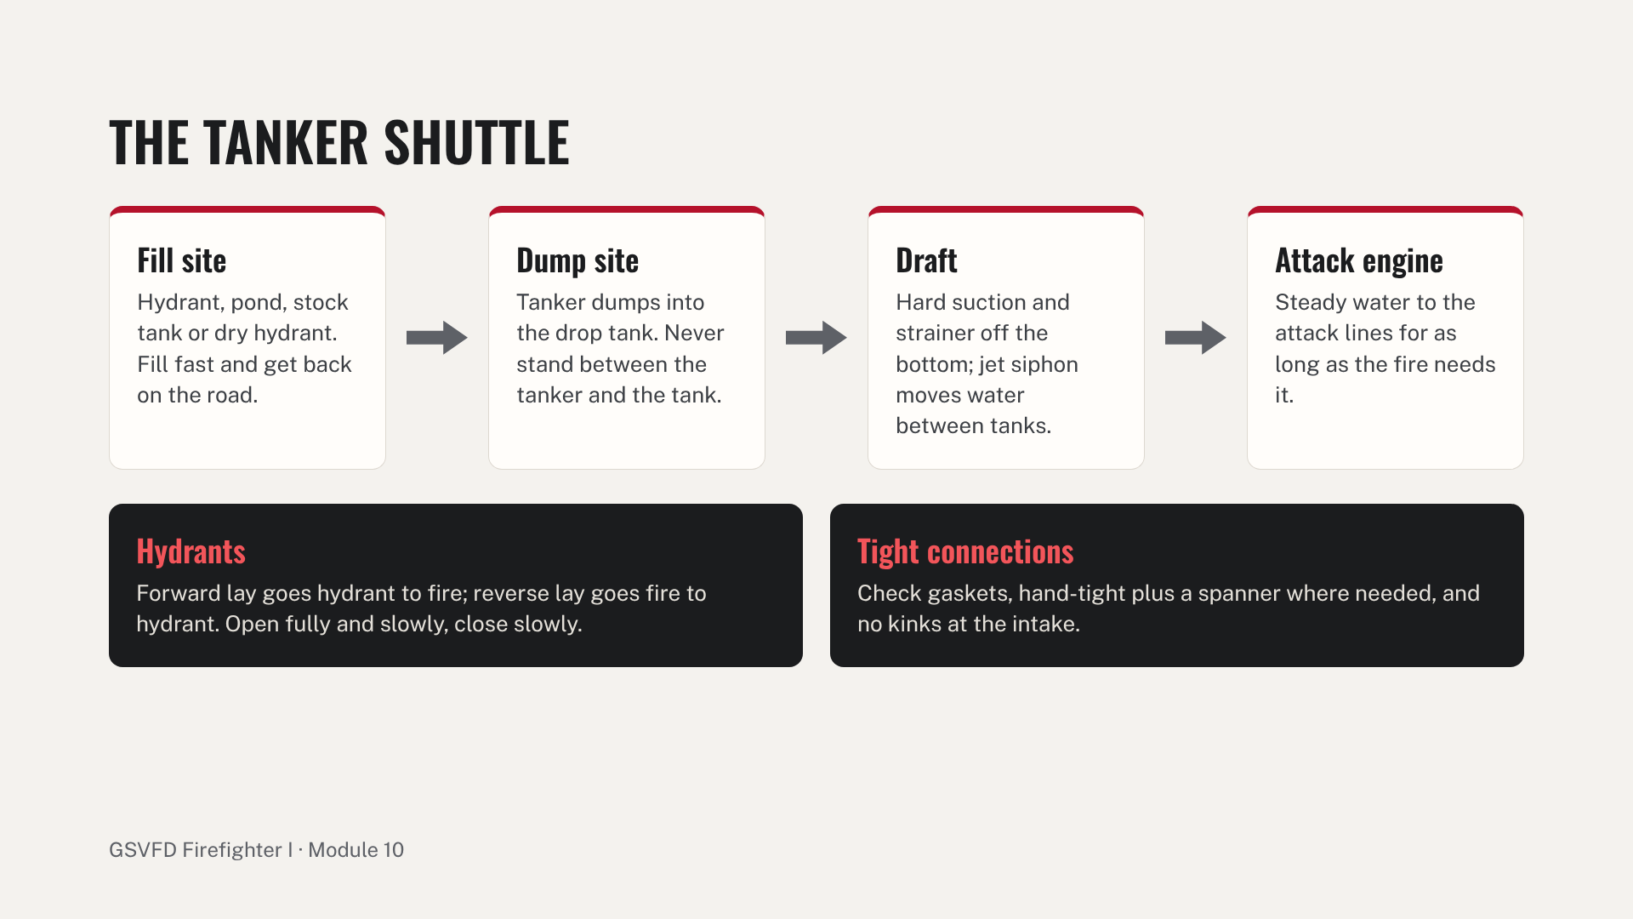
Notes:
Walk the shuttle left to right. Then cover hydrant operation and static sources: ponds, stock tanks, dry hydrants and the basics of drafting. Drill stations: forward and reverse lay to a hydrant; hand lay a short supply line; and a full dump site with drop tank, tanker dump, hard suction and strainer, and transfer between tanks. Run a full tanker-shuttle drill with a mutual-aid tanker at least once a year. Common errors: opening the hydrant too fast, kinks at the intake, the strainer on the tank bottom, and standing in the tanker's path.

Slide 26
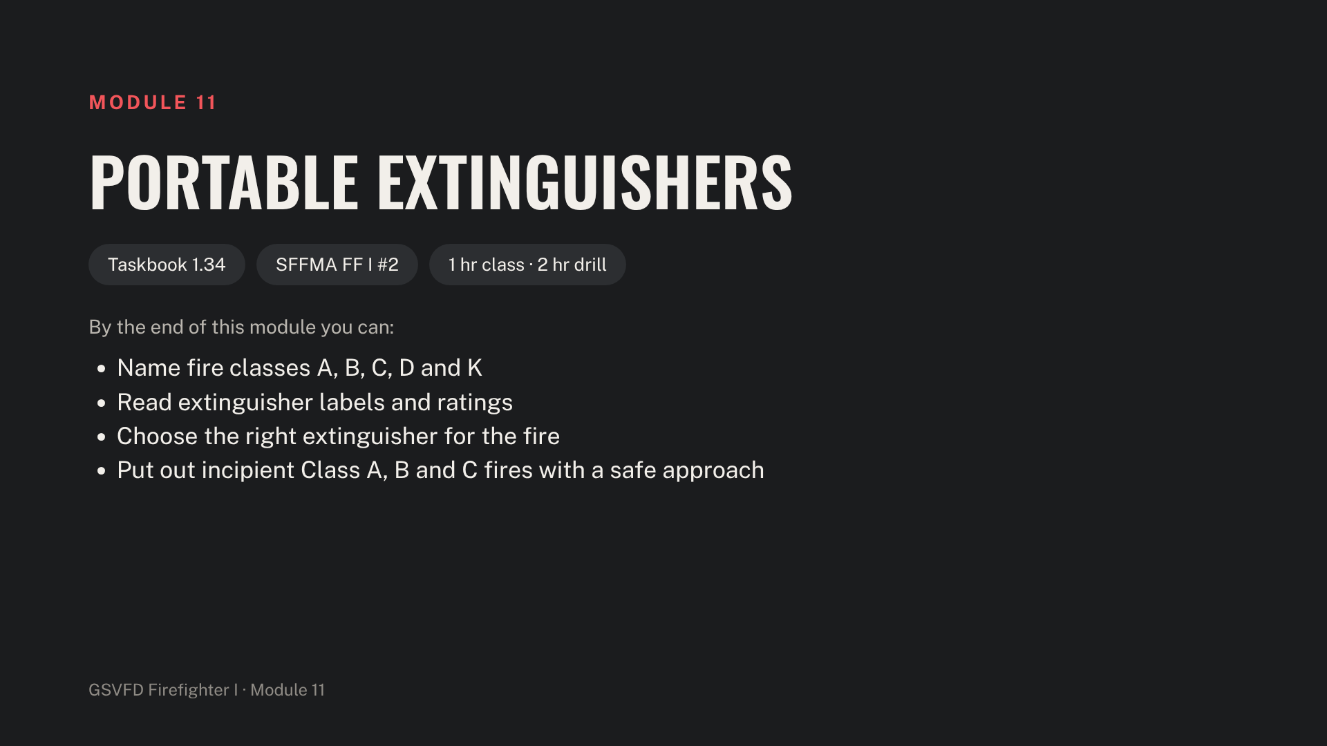
Notes:
Stage pressurized water, ABC dry chemical and CO2 extinguishers, a Class A fuel pan, a Class B pan of at least 9 square feet or a listed simulator, and a simulated energized Class C item.

Slide 27
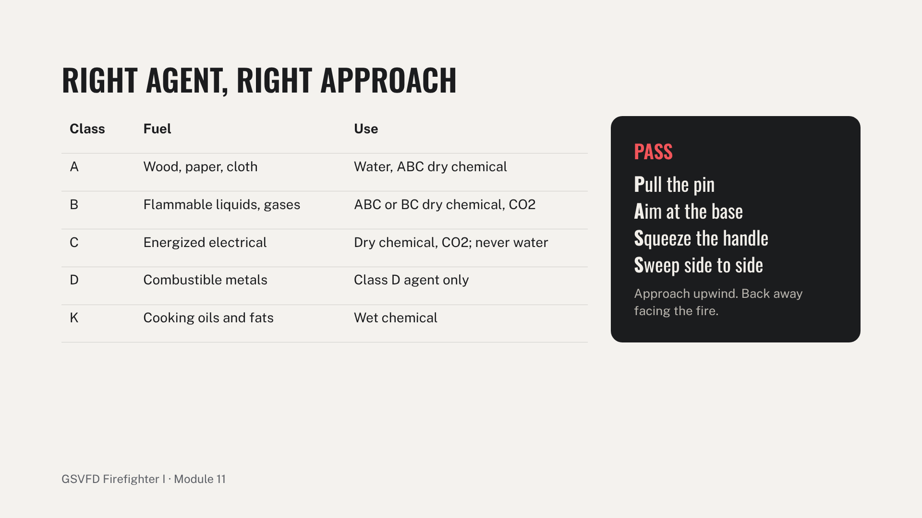
Notes:
Point out the limits of portable extinguishers: short discharge time, short reach and the risk of reflash. Cover the monthly inspection: gauge, pin and seal, hose and tag. Drill: one extinguishment per class, rotating extinguisher types. Common errors: aiming at the flames instead of the base, turning your back on the fire, and water on a Class C fire.

Slide 28
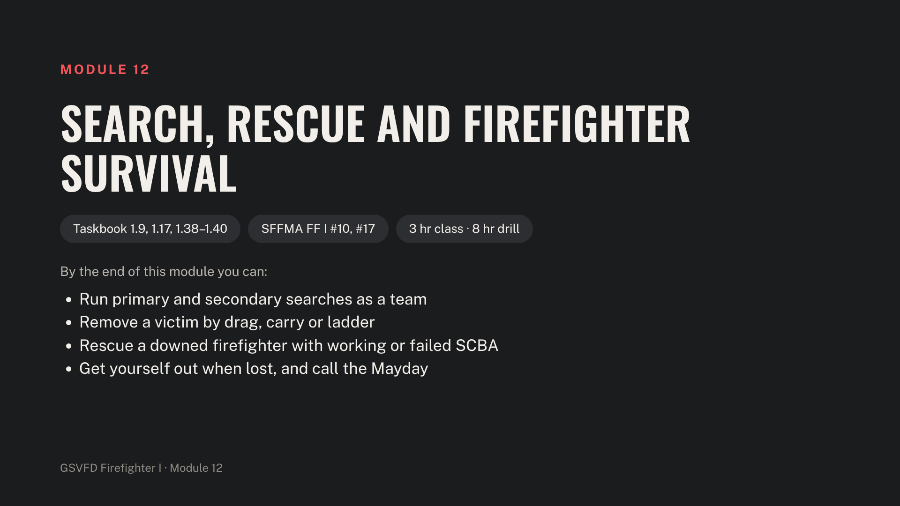
Notes:
Stage a search maze or darkened building, adult and firefighter manikins, a hoseline with couplings, blackout facepieces, ladders, and a drag rescue device or SCBA-strap drag method. Manikins only, never live people.

Slide 29
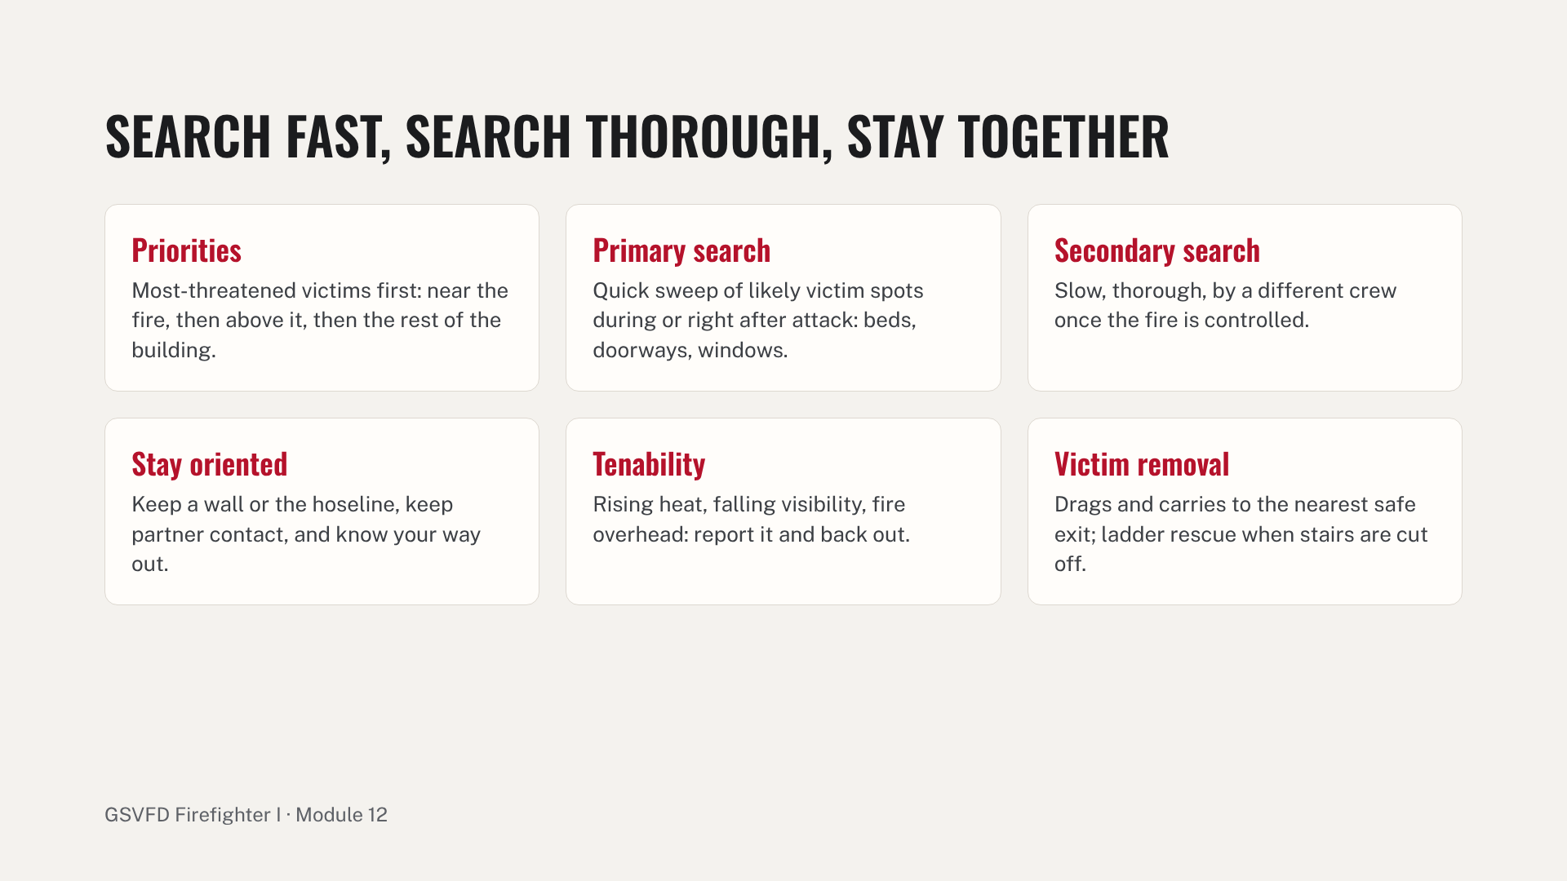
Notes:
Demonstrate an oriented search and a wall search in the darkened building. Station A is a two-person primary search with a manikin; station B is victim removal by drag, two-person carry and ladder rescue. Common errors: losing partner contact, skipping rooms, and standing upright in heat.

Slide 30
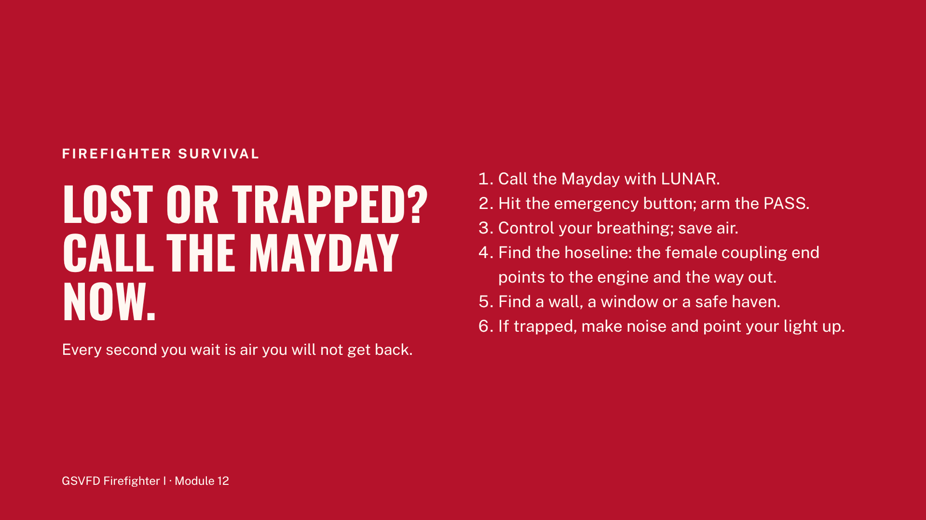
Notes:
Cover rescuing a downed firefighter: converting the SCBA harness into a drag, keeping a failed SCBA's facepiece on, and getting RIT air if the department carries it. Station C: drag a downed firefighter with working SCBA, then with failed SCBA. Station D: a trainee lost on a hoseline in a blackout facepiece reads the couplings, calls the Mayday and exits. Explain that the rapid intervention crew is coming, but the first job is to call for it.

Slide 31
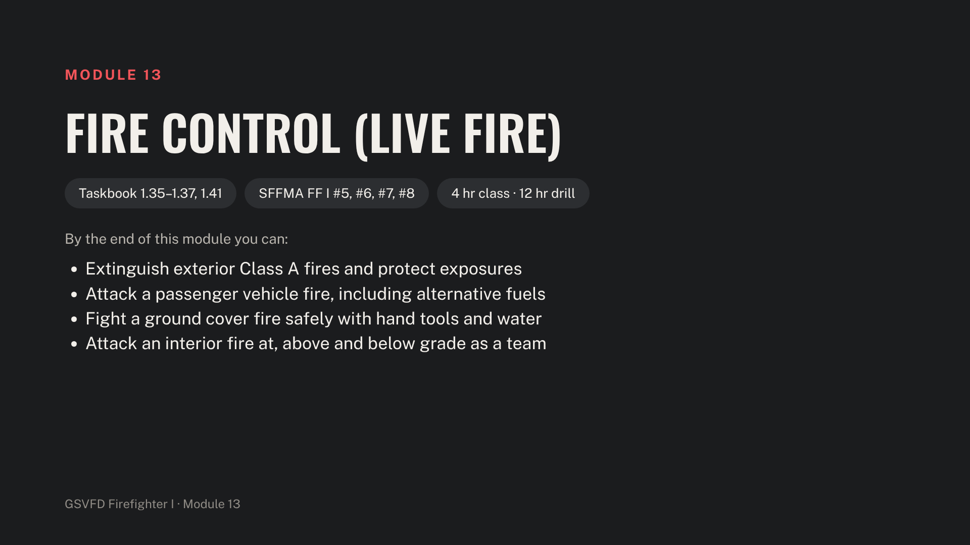
Notes:
No trainee joins a burn until LF.1 to LF.6 are signed in their taskbook. All live-fire evolutions are run to NFPA 1400: instructor-in-charge, safety officer and ignition officer filled by different people, one instructor per five trainees, separate water sources for attack and backup lines, BLS ambulance and a rapid intervention crew on scene. SFFMA requires live fire for skills #5 and #6.

Slide 32
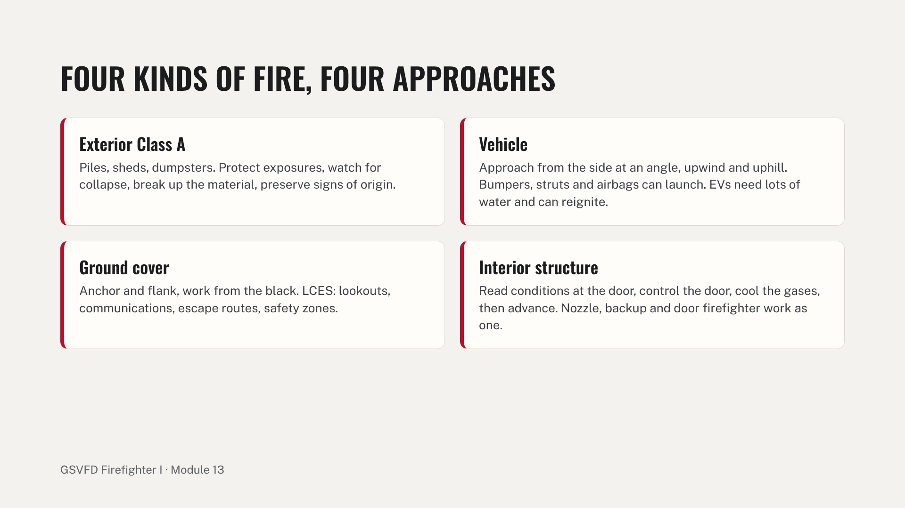
Notes:
Cover direct, indirect and combination attack, and how attack changes for fires above grade (stairs and ladders) and below grade (basements: heat and collapse). Show how to find hidden fire in walls and floors. Burn-day stations, all to NFPA 1400: exterior container, vehicle fire, a simulated ground cover fire with hand tools and a brush truck line, and interior attack at grade with a burst-section replacement, above grade up a ladder or stairs, and below grade down an interior stair. Record every evolution in the taskbook's live-fire log. Common errors: opening the nozzle on smoke without reading conditions, losing door control, standing upright in heat, and leaving vehicle compartments unopened.

Slide 33
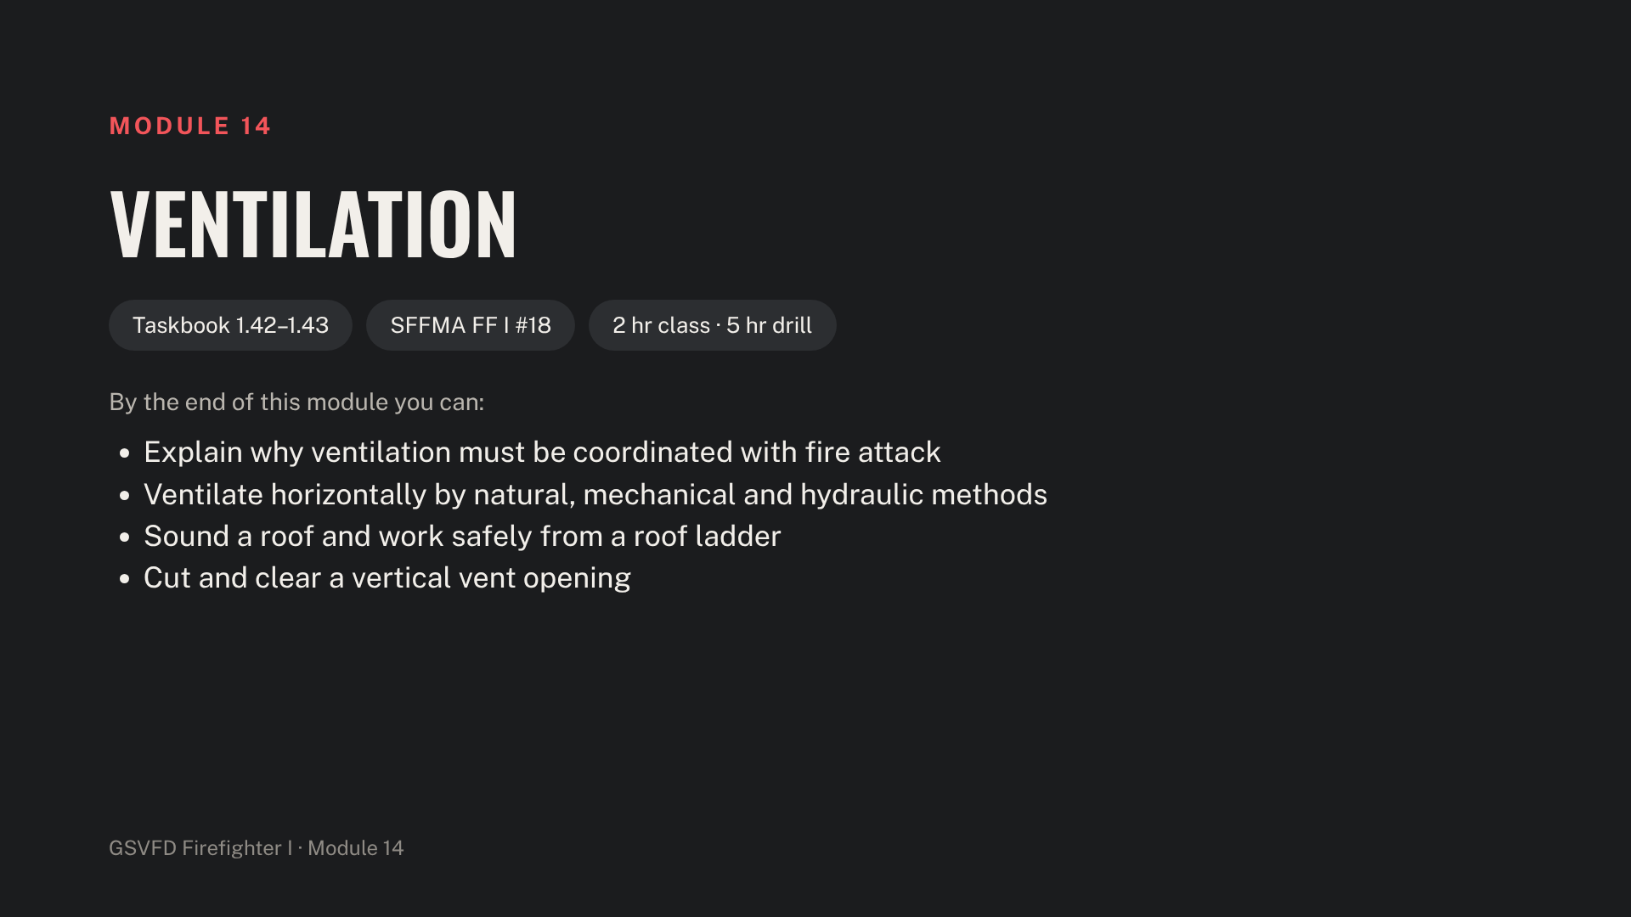
Notes:
Stage a positive-pressure fan, a smoke building or smoke machine, a roof prop, roof and extension ladders, axe, pike pole, saw and a fog nozzle line. Saw operators wear eye, hearing and full PPE with a spotter beside them.

Slide 34
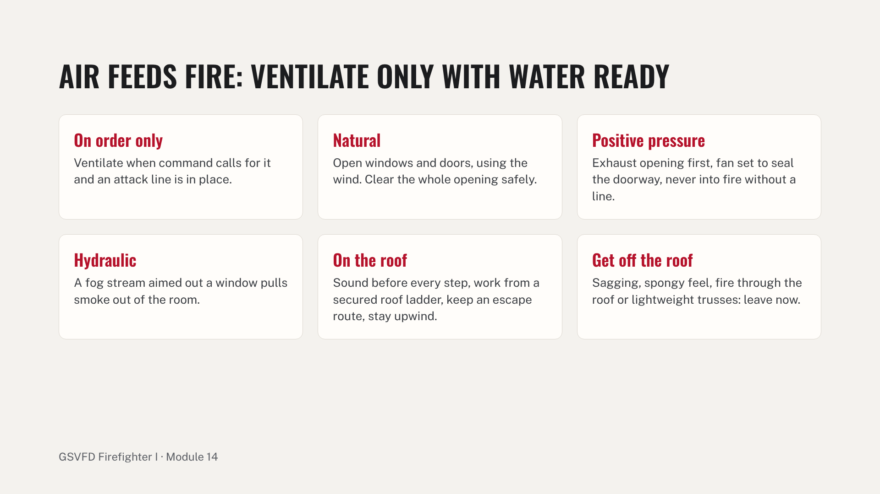
Notes:
Cover the roof types common in the district, including metal roofs, plus louvering and trench cuts at awareness level. Drill stations: clear a window and run a positive-pressure fan on the smoke building; hydraulic ventilation with a fog stream; and on the roof prop, raise and secure ladders, hoist tools, sound, cut and clear an opening. Common errors: venting before the line is ready, a fan with no exhaust opening, and walking the roof without sounding it.

Slide 35

Notes:
Stage an overhaul prop or burned room, pike poles, axes, salvage covers, plastic sheeting, sprinkler wedges and stoppers, and a sprinkler riser or valve prop.

Slide 36
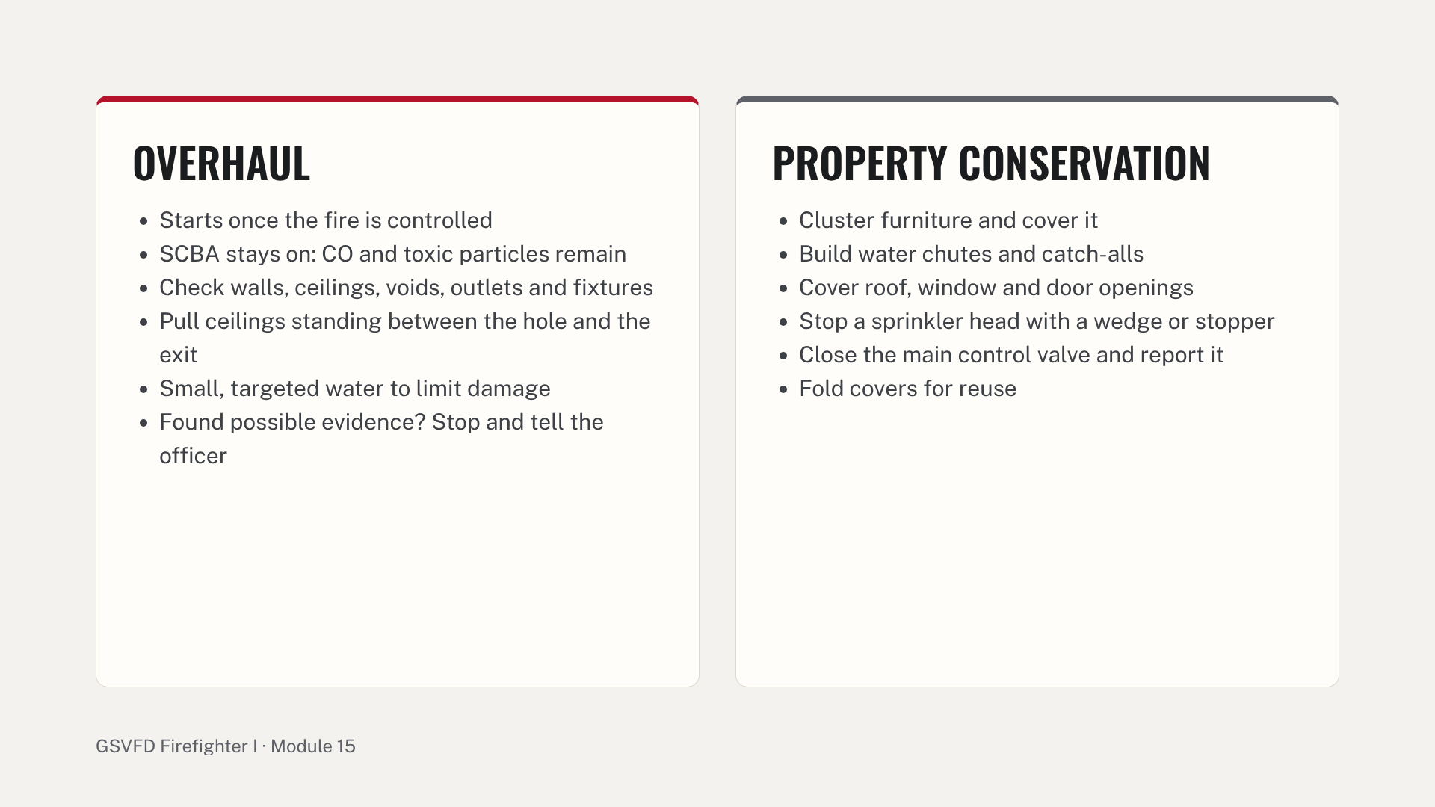
Notes:
Explain why property conservation matters to the people we serve: it is often what they remember about the department. Drill stations: open a wall and ceiling on the prop and check for hidden fire; cluster and cover furniture, build a water chute and a catch-all, fold covers; stop a flowing head and operate the main control valve. Common errors: taking SCBA off during overhaul, throwing debris out before the origin is checked, and leaving the sprinkler valve closed without reporting it.

Slide 37
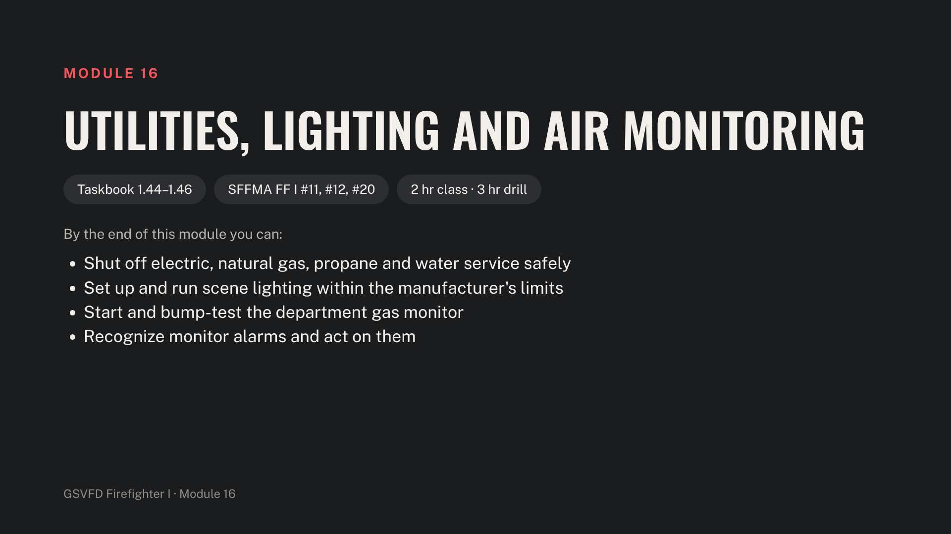
Notes:
Before class, add the department monitor's make, sensors and alarm set points to the next slide's notes. Stage the utility prop, a propane tank valve or prop, generator, lights, cords, GFCI devices, the monitor and bump-test gas.

Slide 38
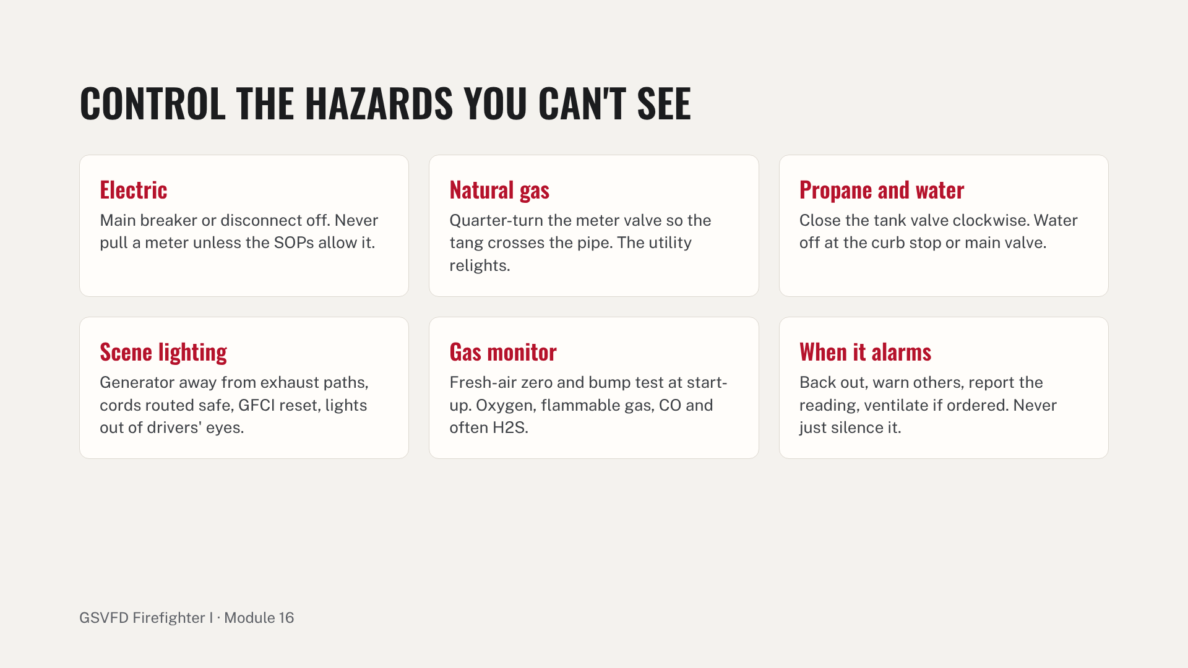
Notes:
Propane is common in district homes and barns: cover leaking and heated tanks. Insert the department monitor's make, sensors and alarm set points here before teaching. Drill stations: shut off each utility on the prop and report; light a mock scene at night; and start, bump-test and use the monitor on scenario readings. Common errors: turning the gas valve the wrong way, overloading the generator, and silencing an alarm without acting on it.

Slide 39
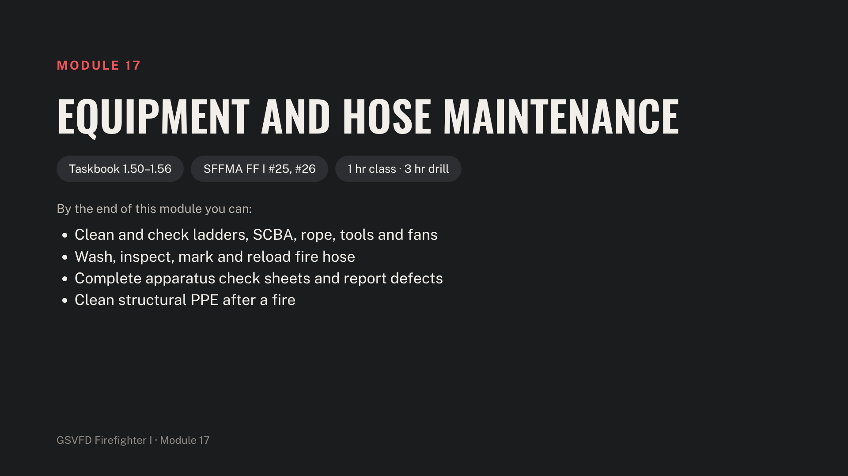
Notes:
Use every real call as practice for taskbook items 1.55 and 1.56: the truck check and post-fire PPE cleaning. Stage cleaning supplies, SCBA check sheets, ladder and rope logs, a hose washer or brushes, spare gaskets and truck check sheets.

Slide 40
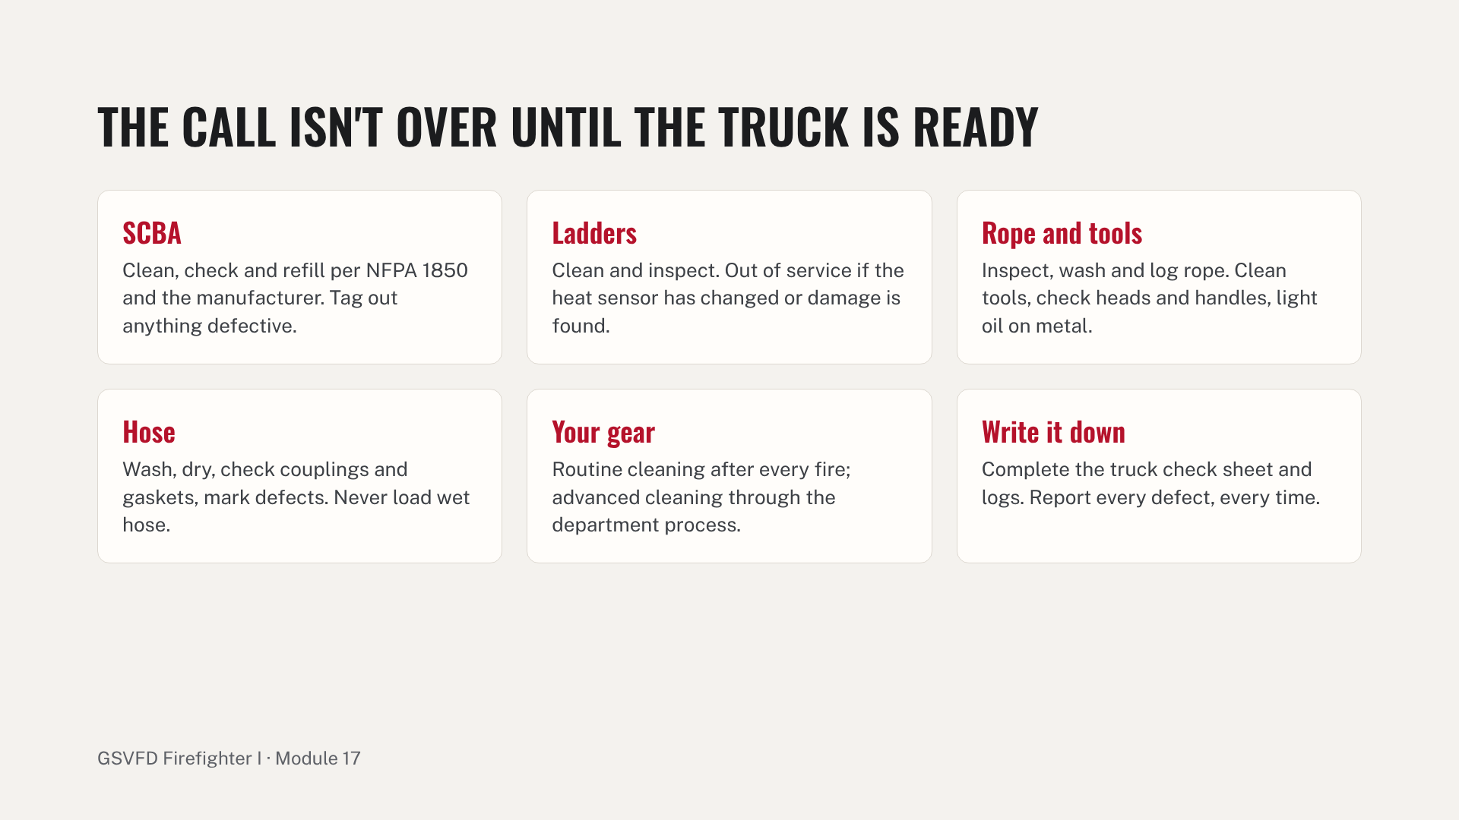
Notes:
Drill: a post-drill or post-call reset where each trainee restores one apparatus to service under supervision. Common errors: loading wet hose, missed records, and putting equipment back in service with an unreported defect.

Slide 41
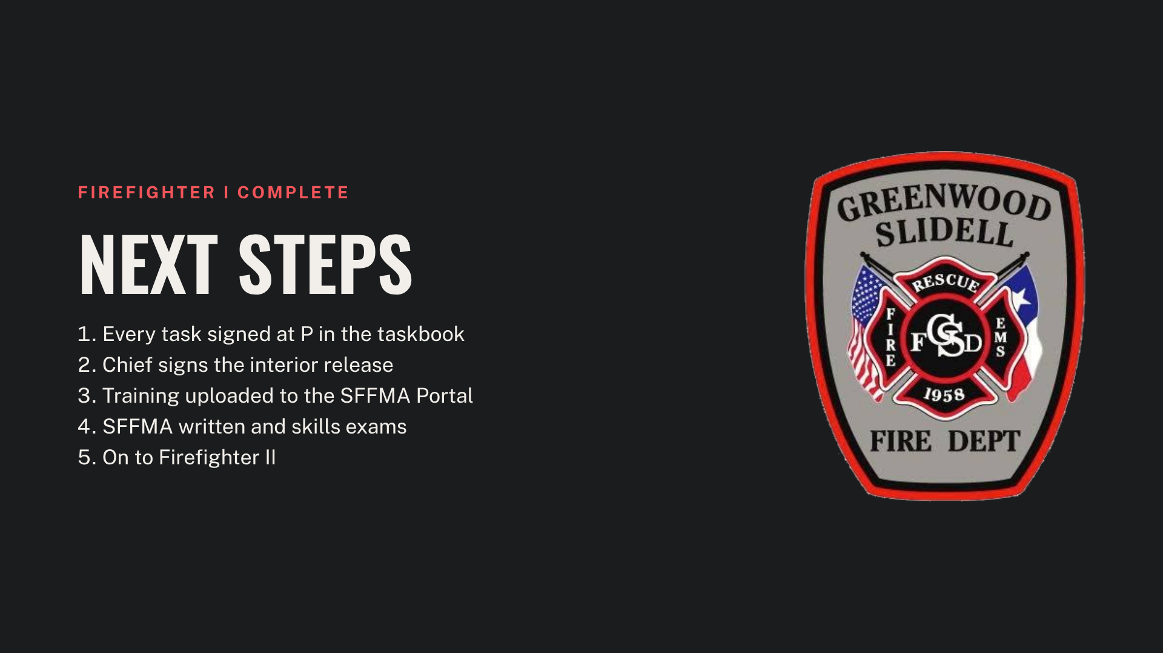
Notes:
Close out the Firefighter I course by reviewing the path to certification. The training officer reconciles every trainee's taskbook with the drill rosters before uploading records to the SFFMA Portal. Schedule a mock SFFMA skills day with an evaluator the trainees do not train with before the real exam.

