Slide 1
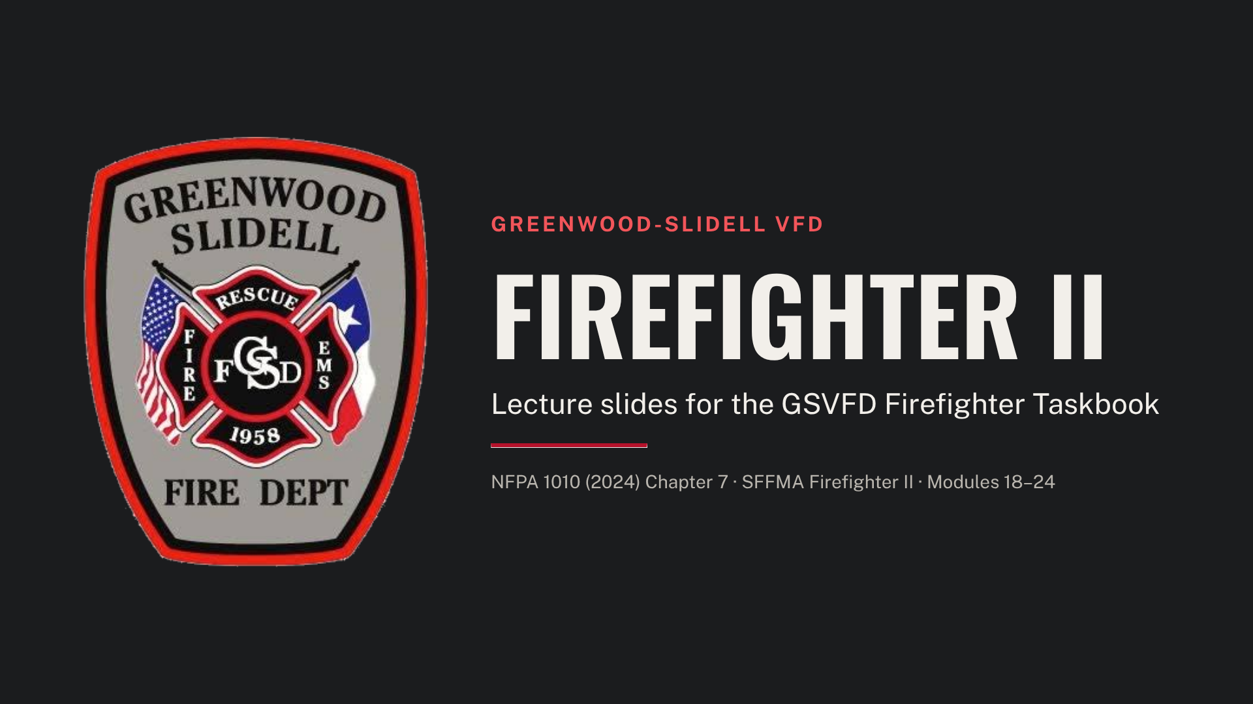
Notes:
Firefighter II starts only after the Chief signs the Phase 1 release. This deck follows the GSVFD Firefighter I & II Instructor Guide, one section per module, with P sign-offs given by members certified at Firefighter II or higher.

Slide 2
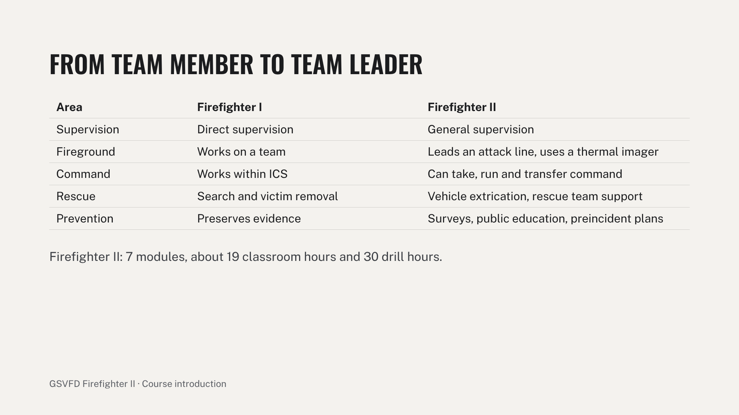
Notes:
Frame Firefighter II as the step from doing tasks to coordinating them. Remind trainees that the same rules apply: K, D and P sign-offs, P on a different day from D, and the SFFMA Firefighter II written and skills exams at the end. Thermal imaging (7.3.3) is new in NFPA 1010 and is not yet on the SFFMA skill sheets, but GSVFD trains and signs it off anyway.

Slide 3
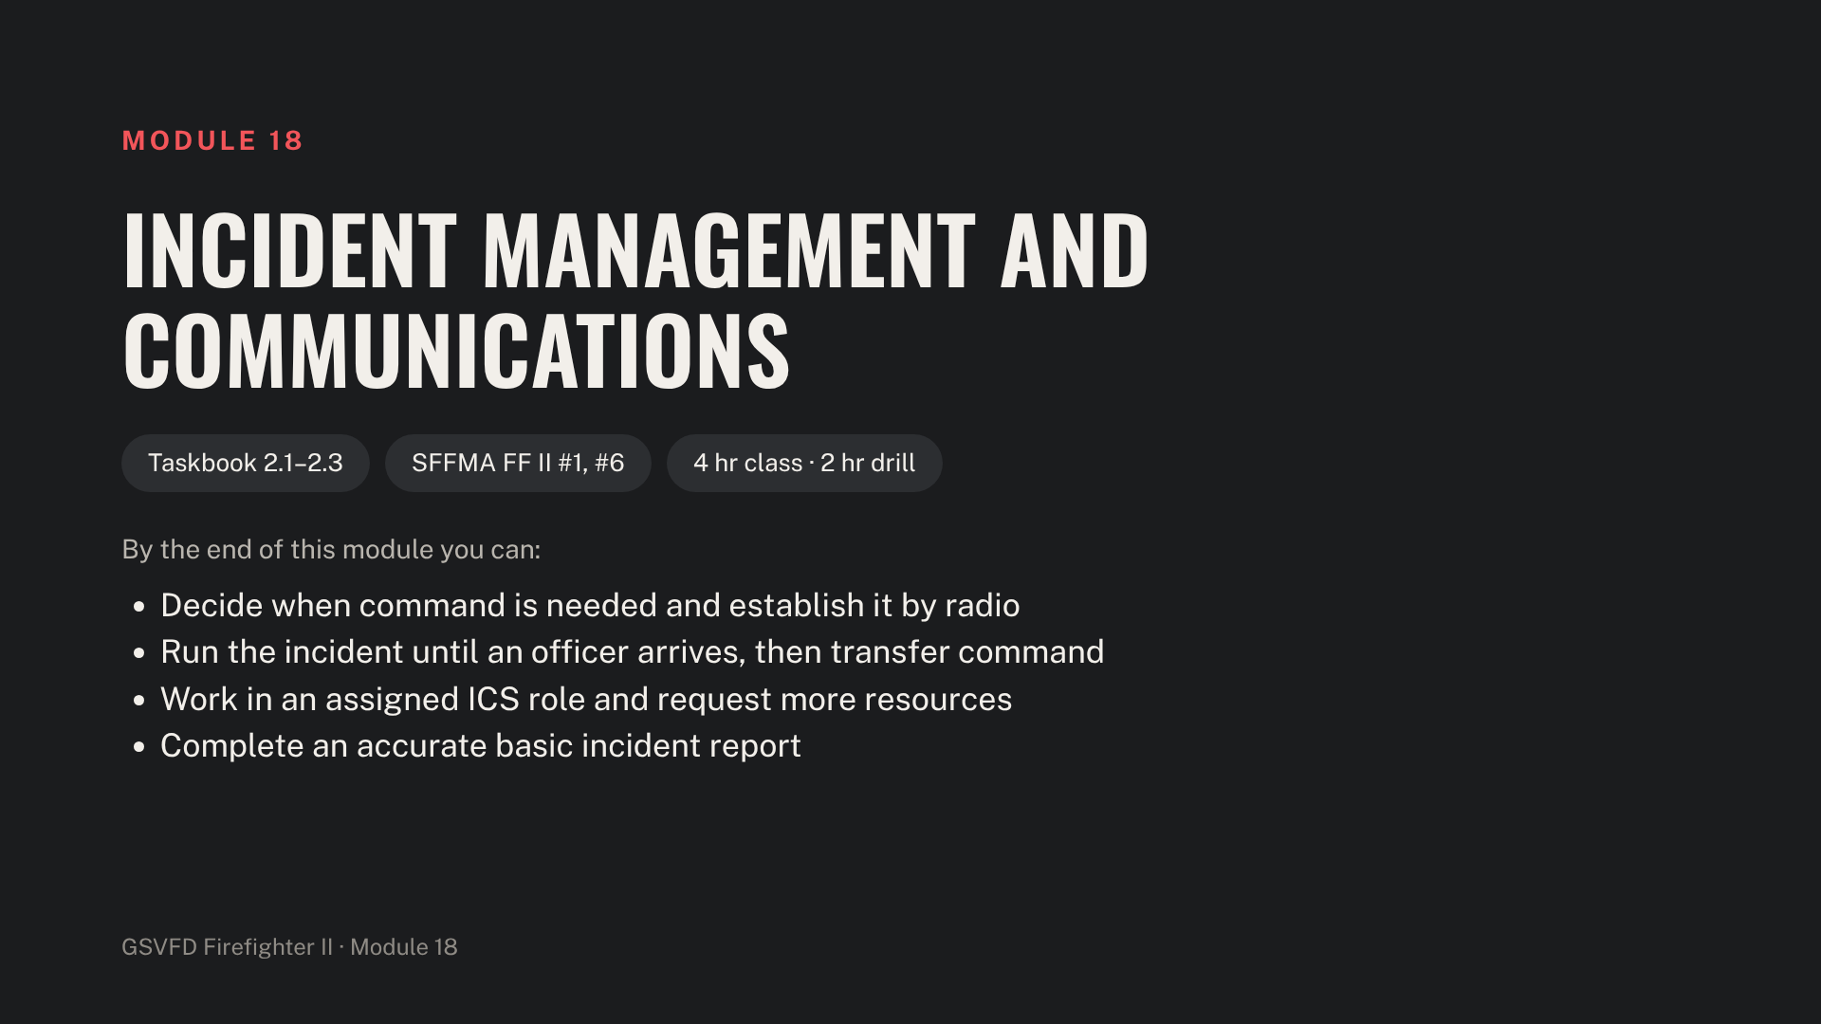
Notes:
Check that ICS-100 and ICS-200 certificates are on file for every trainee. Stage a tabletop or magnetic command board, radios, scenario cards and access to the department's incident report system.

Slide 4
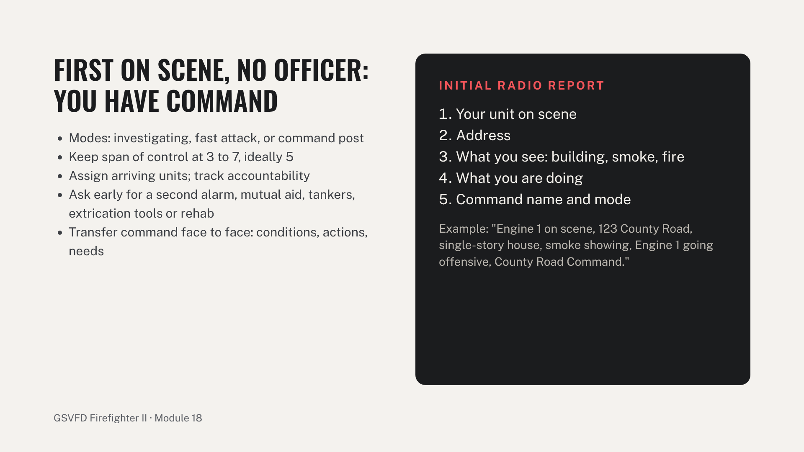
Notes:
Review NIMS and ICS: command, operations, planning, logistics and finance. Cover incident reports: why accuracy matters, required content, codes and proofreading in the department's reporting system. Drill stations: arrive first at a tabletop structure fire, give the initial report, assign arriving units and transfer command; request mutual aid at a large grass fire and extrication tools at a crash by radio; and complete an incident report from a scenario. Common errors: no command name, vague resource requests, and not transferring command when an officer arrives. Adjust the sample report to GSVFD unit names.

Slide 5
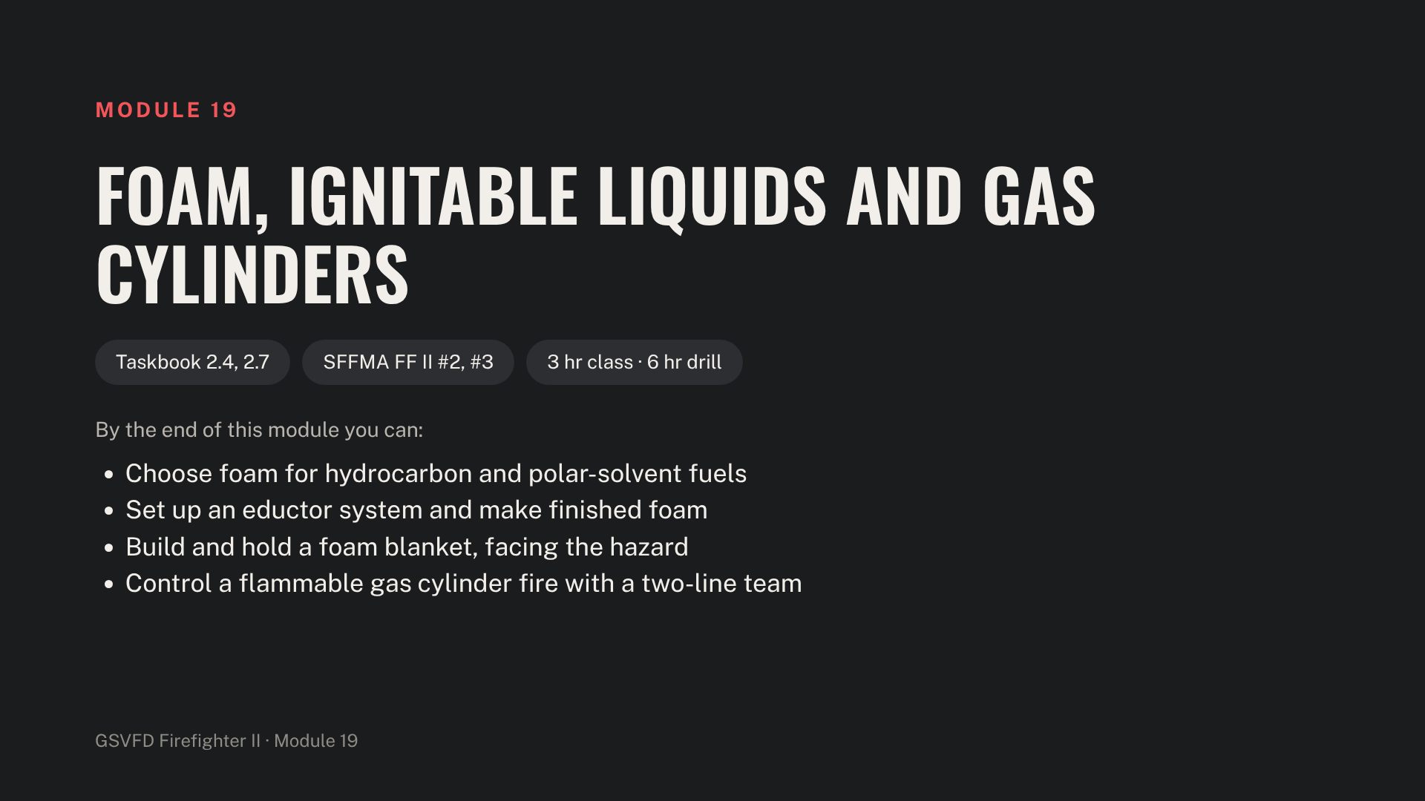
Notes:
Stage the engine, inline eductor and matched nozzle, Class A and Class B or training foam, a burn pan or gas-fired prop, a propane cylinder prop and two attack lines. SFFMA FF II #2 must be live fire or a gas-fired prop. Use training foam where possible and contain the runoff.

Slide 6
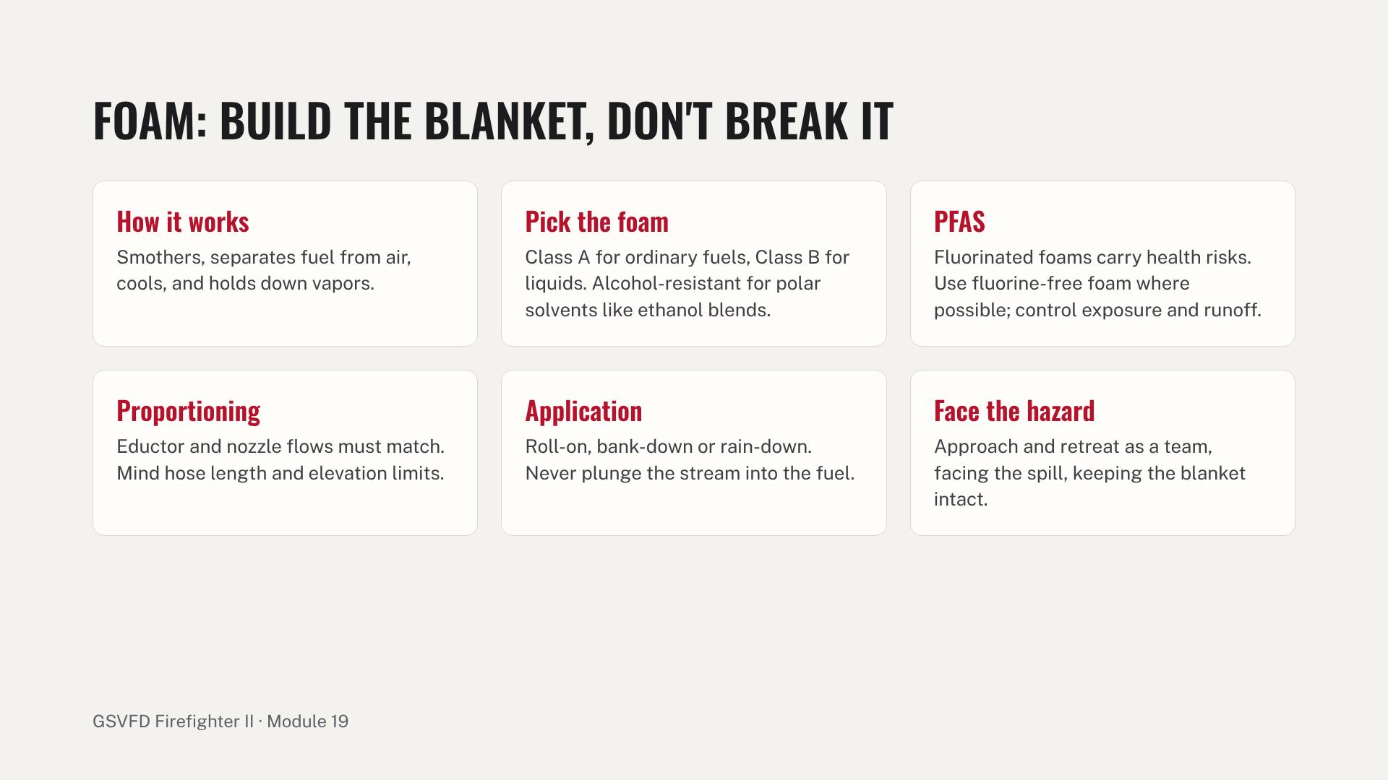
Notes:
Explain common causes of poor foam: mismatched eductor and nozzle, too much hose or elevation, a dirty eductor, and the wrong concentrate percentage. Drill stations: assemble eductor, hose and nozzle and produce finished foam; then extinguish a pan or prop fire with foam and retreat as a team. Common errors: mismatched eductor and nozzle, plunging foam into the pan, and turning backs on the hazard.

Slide 7
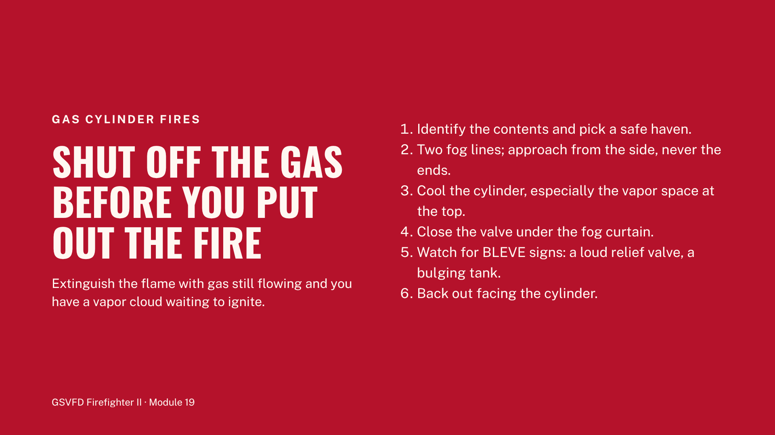
Notes:
Rural propane tanks are common across the district, from barbecue cylinders to large home and farm tanks. Cover how heat raises pressure in a closed cylinder, how the relief valve works, and what to do if the fire goes out early. Drill station C: a two-line approach on the cylinder prop, closing the valve under the fog curtain, cooling and backing out. The most dangerous error is extinguishing the fire before the fuel is shut off.

Slide 8
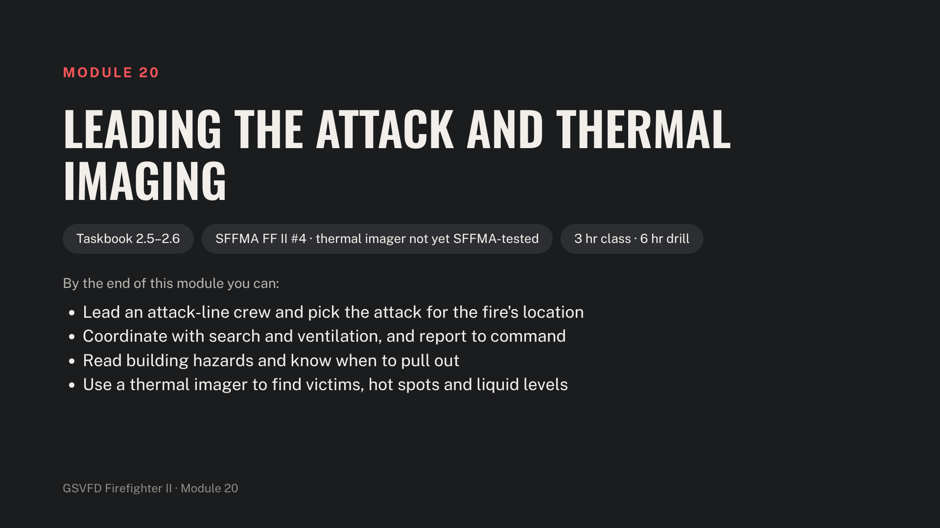
Notes:
Stage a burn building or acquired structure, two attack lines, the department's thermal imagers, and sealed containers partly filled with water for level checks. Thermal imager training is covered by NFPA 1400 (formerly 1408).

Slide 9
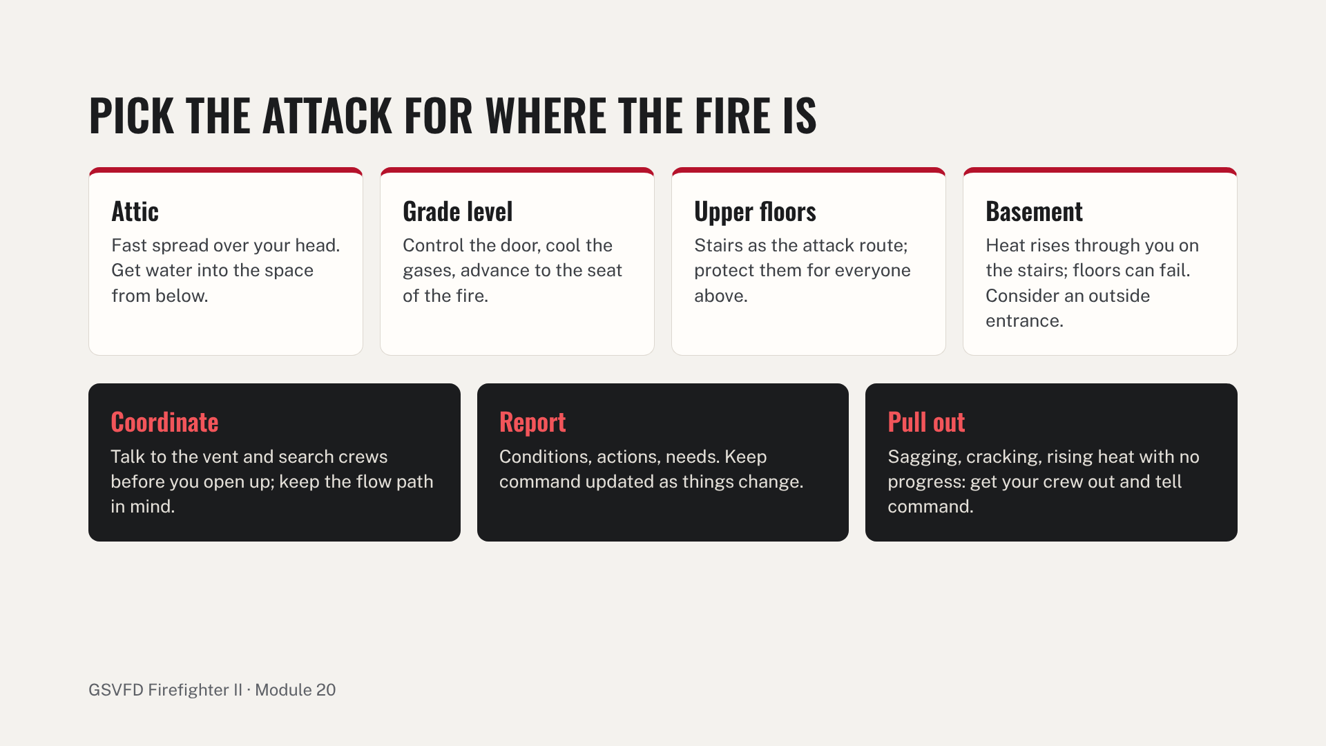
Notes:
Cover how fire affects building materials: wood chars and loses strength, unprotected steel stretches and fails, masonry and concrete spall, gypsum and plaster on lath fall, glass breaks. Drill station A: the trainee leads a two-person crew through a live or simulated attack and reports to command. Common errors: advancing without checking conditions, and no report to command.

Slide 10
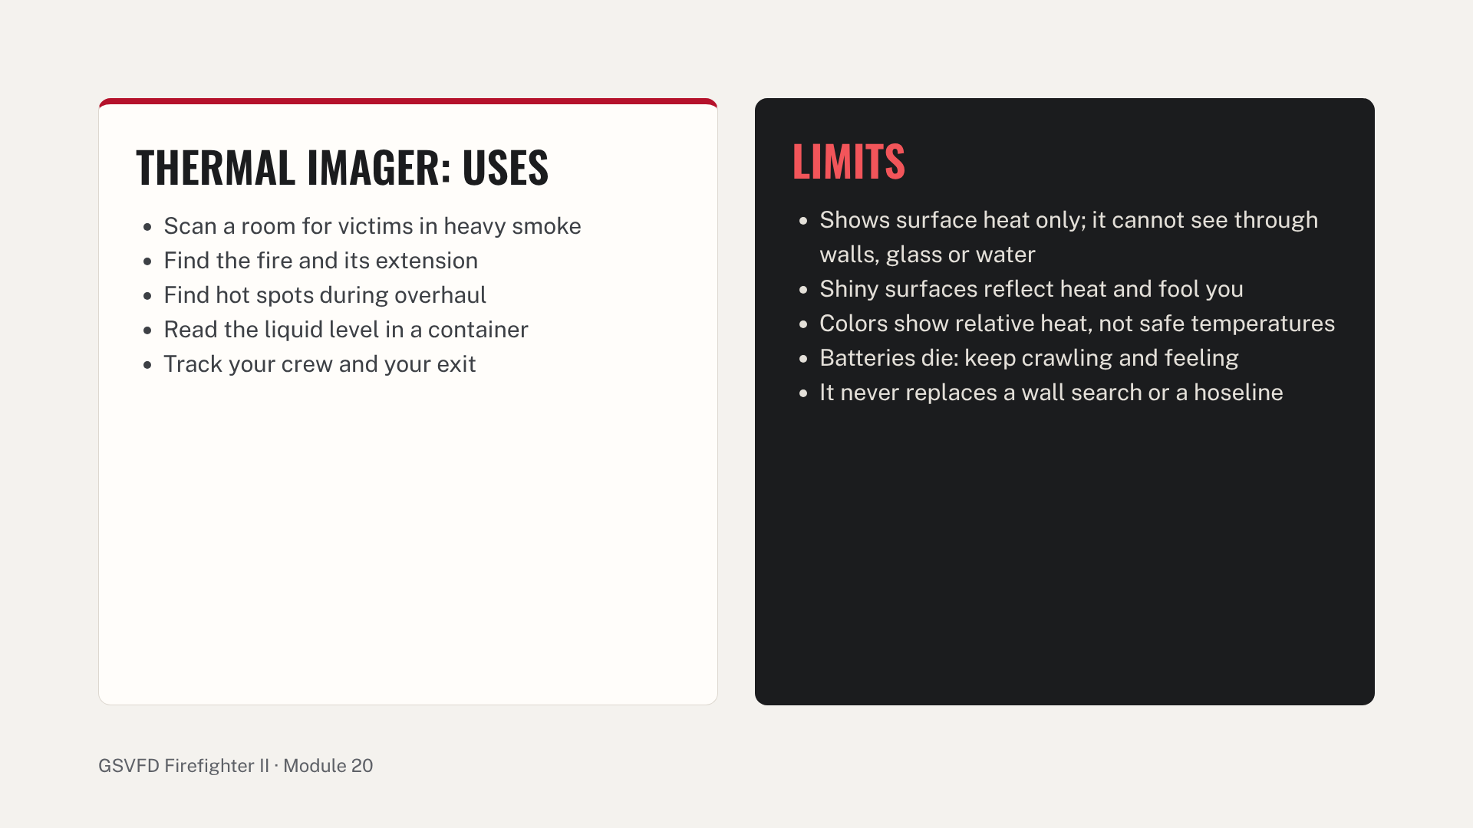
Notes:
Taskbook 2.6 and NFPA 1010 7.3.3 are new in the 2024 edition. Teach the department imager's display modes and color palette. Drill station B: find a hidden manikin, a hot spot behind a wall, and the liquid line in a sealed container. Common error: a crew that stands up and walks because the imager "shows it's clear."

Slide 11
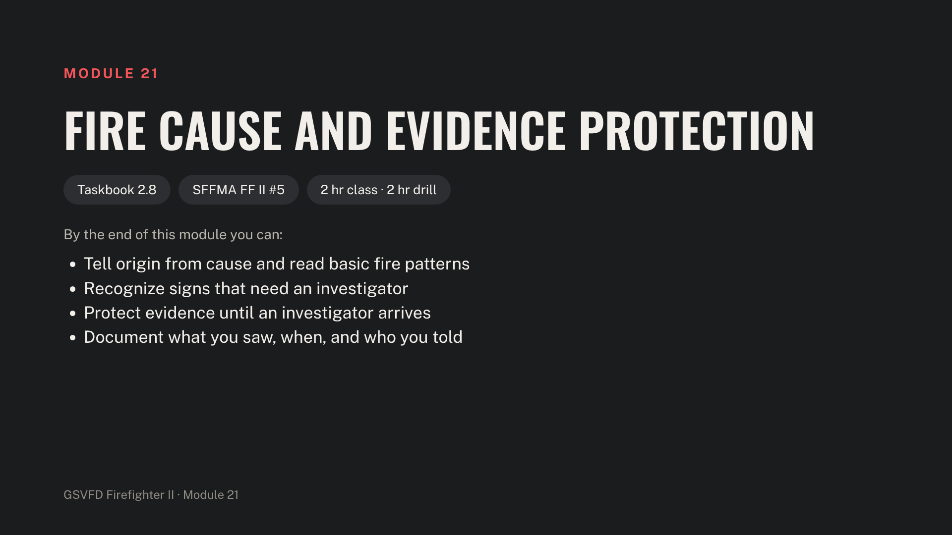
Notes:
Stage a burned room or a staged origin scenario, flashlights, scene tape, salvage covers, evidence markers and a notebook. Name the investigating agencies for the district before class.

Slide 12
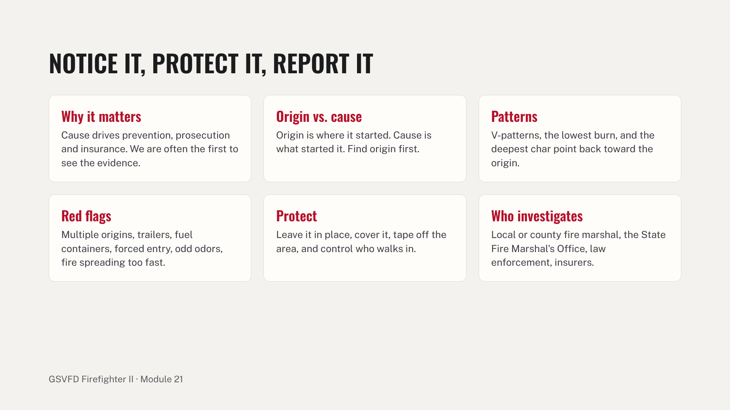
Notes:
Cover what firefighters notice on arrival: people and vehicles leaving, doors and windows open or forced, smoke color, and unusual odors. Stress writing it down: what you saw, when, and who you told. Drill: trainees find and protect evidence in a staged room, then brief the "investigator." Common errors: moving or shoveling debris before the origin is checked, and not noting who entered the scene.

Slide 13
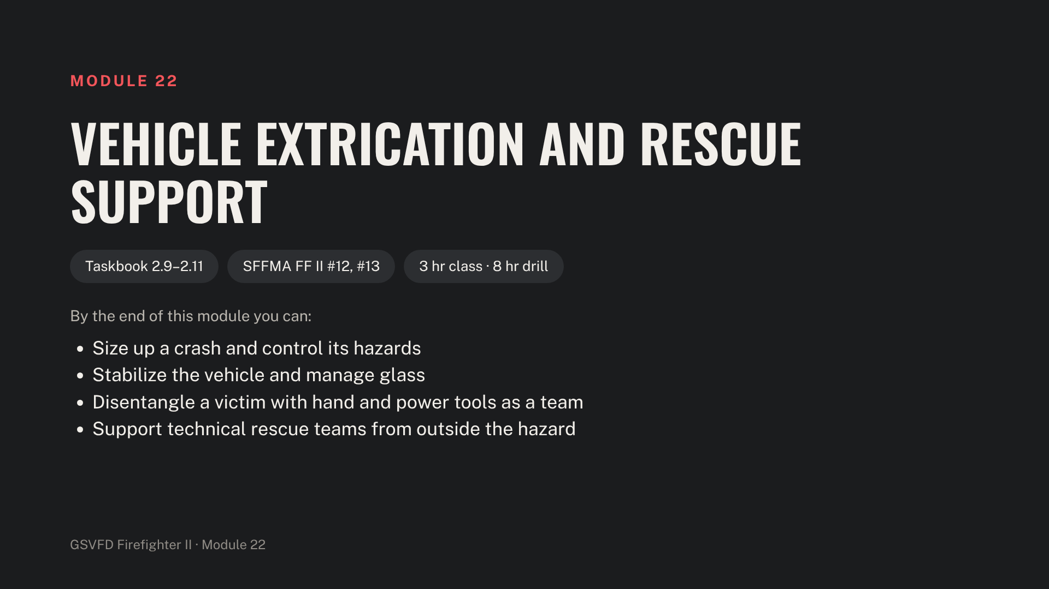
Notes:
Stage junk vehicles, step chocks and box cribbing, struts, the spreader, cutter and ram, a glass saw and center punch, hard and soft protection, and a manikin. Full PPE and eye protection at every station.

Slide 14
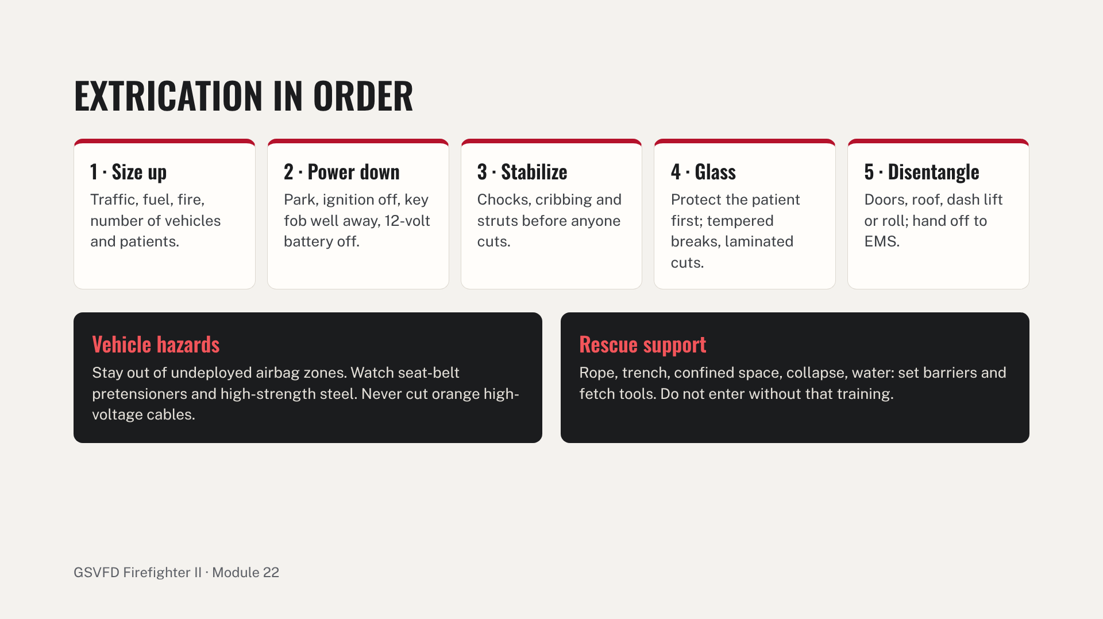
Notes:
Tool safety: pinch points, tool reaction, and never putting your body between the tool and the vehicle. Floodwater rescues are common in the region; rescuers do not enter moving water without swiftwater training and equipment. Drill stations: stabilize a vehicle upright and one on its side; remove side and rear glass and pop a door; full roof removal and a dash lift with a manikin inside; and set up a barrier and retrieve tools during a mock trench or water rescue. Common errors: cutting before stabilization, standing in an airbag zone, and no patient protection during glass work.

Slide 15
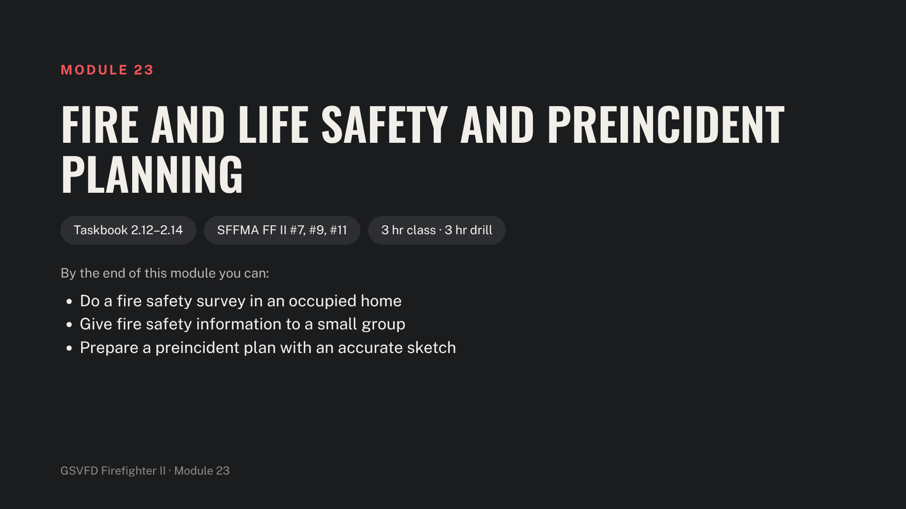
Notes:
Stage home safety survey forms, smoke alarm handouts, prepared presentation materials, preincident plan forms, graph paper or a tablet, and line up a district building to survey.

Slide 16
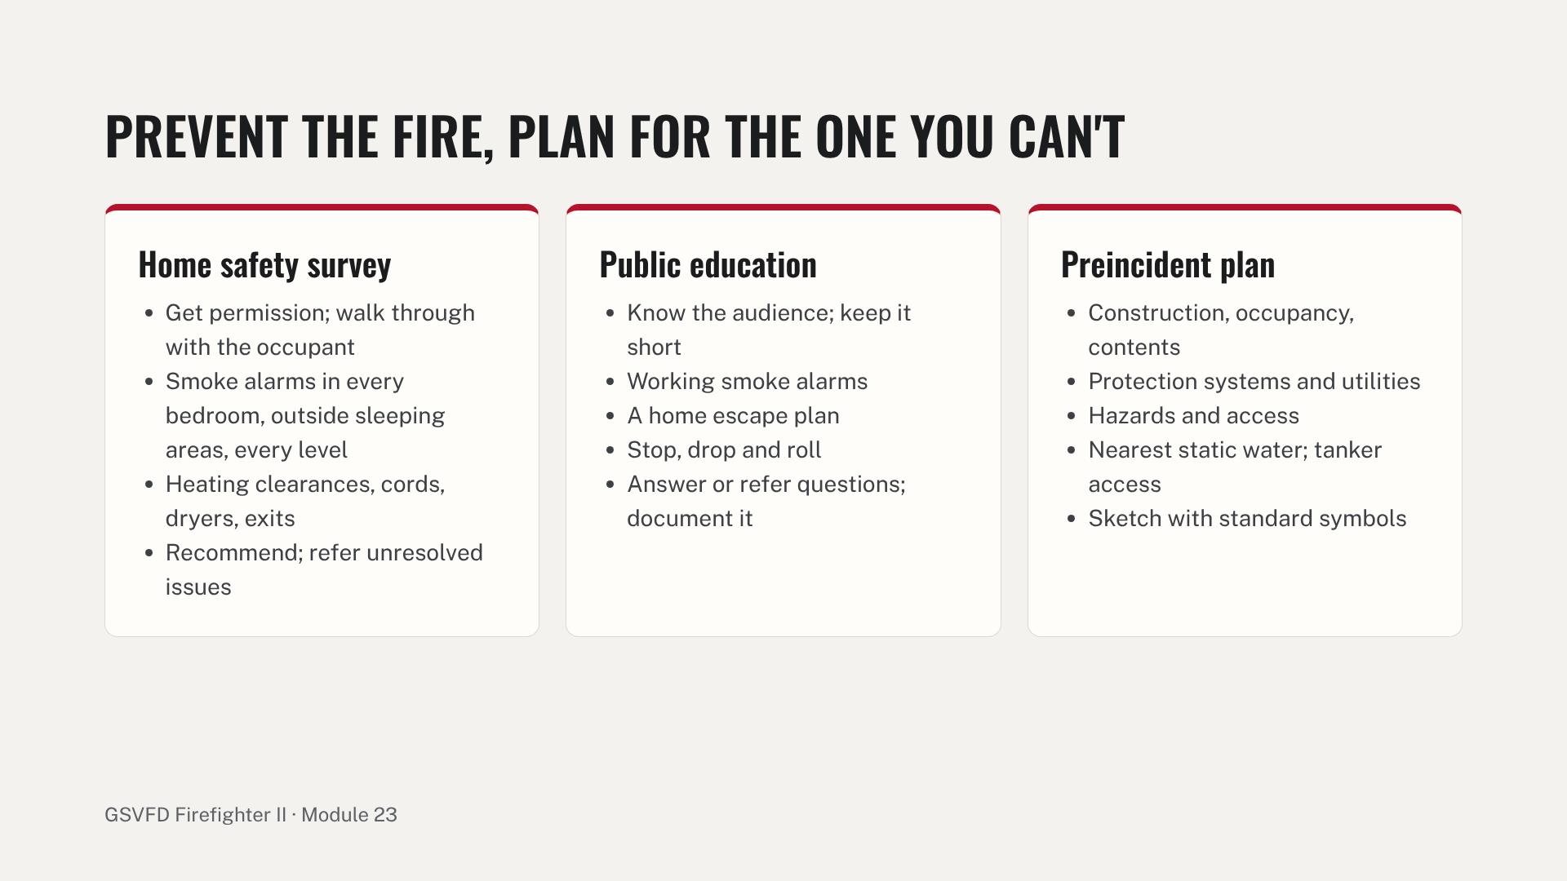
Notes:
Prevention is the best way to cut fire deaths, and a survey is a chance to be welcomed into homes in the district. Coach trainees to recommend without lecturing. Drill stations: survey a member's or volunteer's home with at least two staged hazards; give a 10-minute talk to classmates acting as station visitors; and survey and sketch a commercial or agricultural building. Common errors: incomplete forms, missed hazards, and sketches without water supply, utilities or access marked.

Slide 17
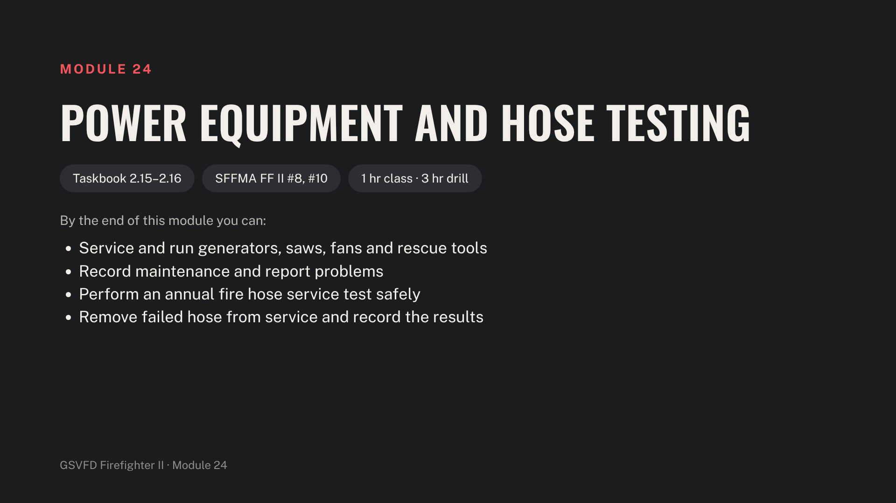
Notes:
Before the drill, look up the department's hose test pressures and hold times in the current standard (NFPA 1930, formerly NFPA 1962) and put them on the next slide's notes. Stage the generator, saws, fan, extrication power unit, fuel and oil, manuals and the maintenance log, plus a hose testing machine or an engine with a hose test gate valve, test lengths, a marker, a timer and record sheets.

Slide 18
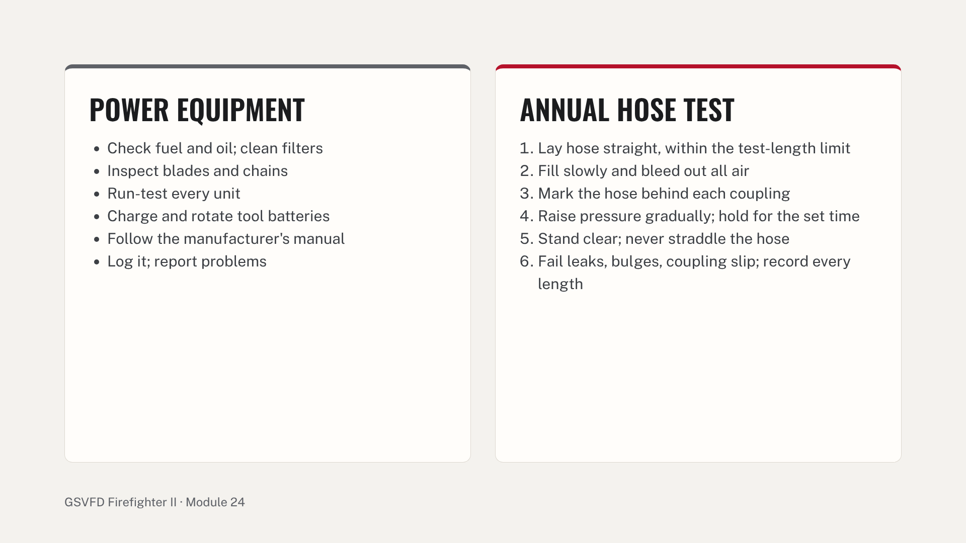
Notes:
Hose testing follows NFPA 1930 (formerly NFPA 1962). Use a hose test gate valve rather than pump pressure alone, and use the stenciled service test pressure for each length. Drill stations: service and run each power unit and fill in the log; test several lengths of attack and supply hose and complete the record. Common errors: air left in the hose, standing in line with couplings, raising pressure too fast, and missing records.

Slide 19
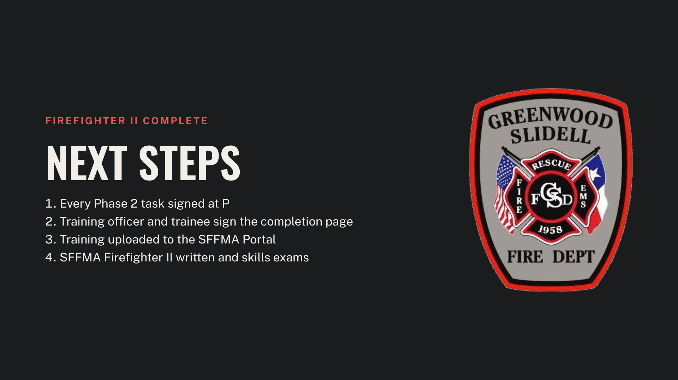
Notes:
Close the course by reviewing the path to certification. SFFMA written exam scores are valid for two years, so every requirement, including the skills exam, must be finished within that window. Hold a mock skills day with an evaluator the trainees do not train with.

