Slide 1
HR Attrition Analysis
What features affect attrition the most?
Brandi Jones
DAT-430-T6751
Leverage Data For Org Results
August 9, 2022

Slide 2
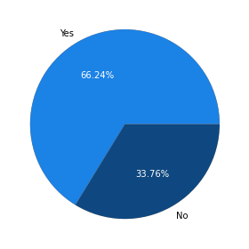
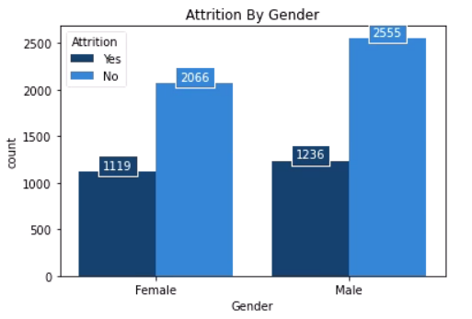
Attrition Totals
2,355 total Attritions, which is 33.8%
4,621 total Non-Attritions, which is 66.2%
No
Yes
1,119 Attrition by Female
1,236 Attrition by Male
Notes:
The question that the HR department has tasked me with is “What metrics are causing high attrition rates in our company?” The first step in my analysis was to determine the total number of attritions in our dataset. I’ve found that out of a total of 2,355 total attritions, 1,119 were by female employees and 1,236 were by male employees.

Slide 3
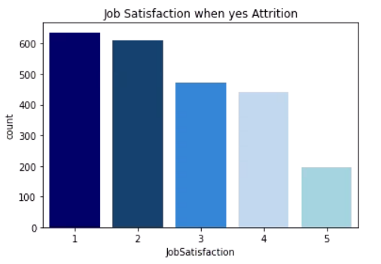
Important Features Related to Attrition
Job Satisfaction 1 and 2 have the highest levels of Attrition
Job Satisfaction 4 and 5 have the lowest levels of Attrition
Notes:
The next step I took was to determine the top features that affected attrition. The first feature I want to touch on is Job Satisfaction. Employees who had a Job Satisfaction level of 1 and 2 showed higher attrition rates than employees with a Job Satisfaction level of 4 and 5.

Slide 4
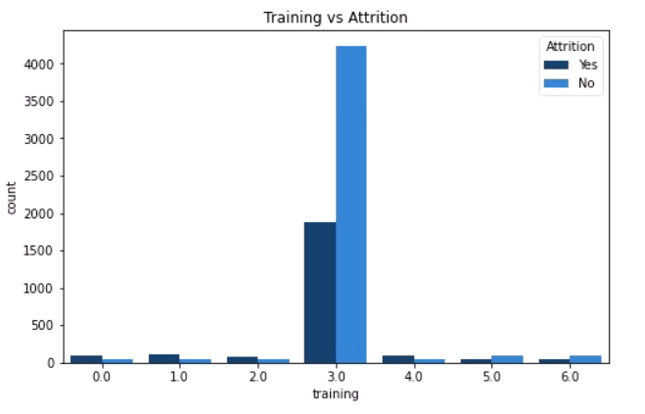
Important Features Related to Attrition
Training levels of 0, 1, and 2 show more Attrition.
Training levels of 3, 5, and 6 show less Attrition.
Notes:
Another feature that showed importance was training. Lower levels of training, to include 0, 1, and 2, show a higher rate of attrition than non-attrition. Training levels of 3, 5, and 6 show a lower rate of attrition.

Slide 5
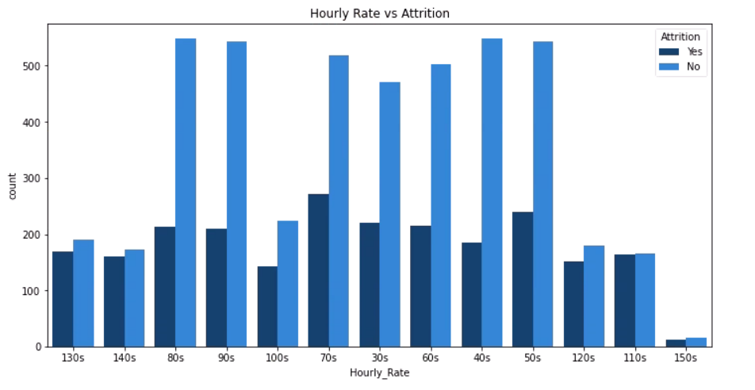
Important Features Related to Attrition
Hourly Rate shows a large difference in Attrition between the rates of 30s and 100s.
Attrition seems to level off at Hourly Rates above 100s.
Notes:
Another important factor related to attrition is Hourly Rate. My analysis shows that employees with an hourly rate between 30 and 110 show higher attrition rates than those with a higher rate. Attrition begins to level off for employees that make above 110.

Slide 6
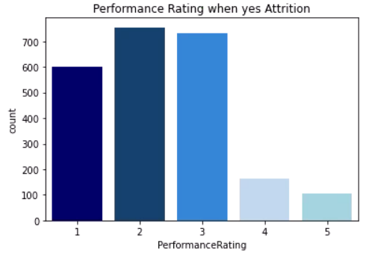
Important Features Related to Attrition
Performance Ratings of 1, 2, and 3 show the highest Attrition.
Performance Ratings of 4 and 5 show the lowest Attrition
Notes:
Performance Rating is another key factor in attrition rates. Employees with Performance Ratings of 1, 2, and 3 show the highest rates of attrition, while employees with a higher performance rating of 4 and 5 shows much less attrition.

Slide 7
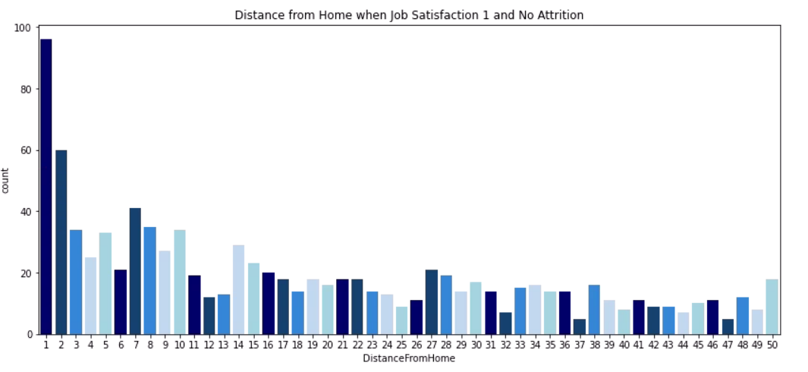
Employees that live closer to work show less Attrition, even when their Job Satisfaction is 1.
Notes:
This bar chart shows the level of non-attrition based on the employee’s distance from home. This chart only shows the attrition rate for employees with a Job Satisfaction level of 1. My analysis shows that the closer an employee lives to the office, the less likely they are to leave regardless of their job satisfaction. The attrition rate increases as the distance from home increases.

Slide 8
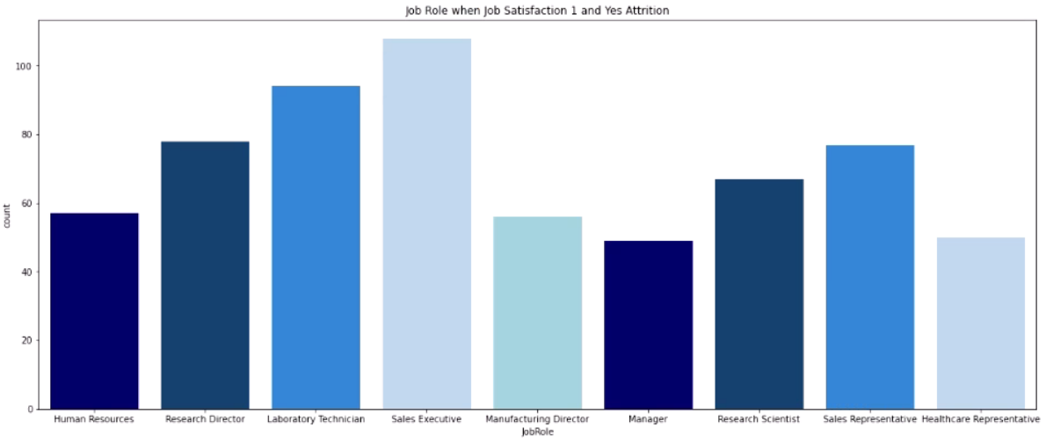
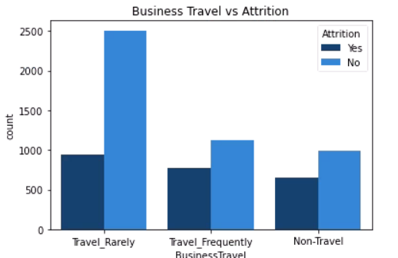
Sales Executive is the department with the highest Attrition when Job Satisfaction is 1.
Employees that Travel Rarely show significantly less Attrition than those that Travel Frequently or not at all.
Notes:
Another point I would like to make is that when Job Satisfaction is level 1, the Job Role with the highest attrition rate is Sales Executive. I have also analyzed Business Travel. I have determined that employees who travel rarely show significantly less attrition than those that travel frequently or not at all.

Slide 9
“Logistic regression estimates the probability of an event occurring based on a given dataset of independent variables” (IBM, 2022)
Model #1
Model #2
Job Satisfaction
Training
Performance Rating
Job Satisfaction
Training
Hourly Rate
Notes:
The first statistical model that I performed was a Logistic Regression. A Logistic Regression allows you to compare different factors to the one factor you are trying to predict. I ran many different models, but the two I found to be most significant included Job Satisfaction, Training, and Performance Rating against Attrition, and then Job Satisfaction, Training, and Hourly Rate against Attrition.

Slide 10
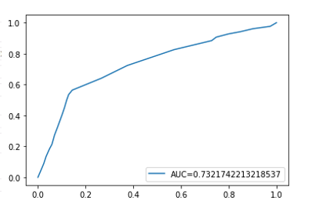
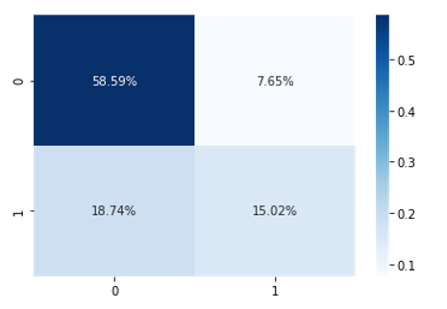
Model #1
The AUC for our first model is 0.73, which means there is a 73% chance that the model will correctly distinguish our results.
The first model presents us with 58.9% of our results being True Positives, which is how many cases our model has correctly predicted.
Notes:
The first Logistic Regression model I want to discuss is Job Satisfaction, Training, and Performance Rating against Attrition. After running this model, I have determined that this model accurately predicts attrition based on the ROC/AUC curve and the confusion matrix. The ROC/AUC allows us to know how well our model has worked. This particular model shows a 73% chance that our model will correctly distinguish our results. The confusion matrix shows us that 58.9% of cases have been correctly predicted to be true positives and 15.02% of our cases have been correctly predicted to be true negatives.

Slide 11
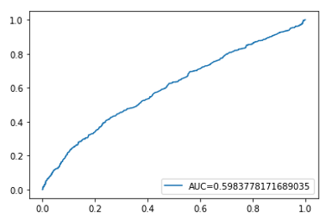
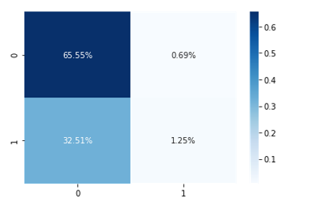
Model #2
The AUC for our first model is 0.59, which means there is a 59% chance that the model will correctly distinguish our results.
Our second model presents us with 65.55% of our results being True Positives, which is how many cases our model has correctly predicted. However, our False Negatives are much higher in this model.
This shows that Hourly Rate is less influential than Performance Rating
Notes:
Our second Logistic Regression model which uses Hourly Rate instead of Job Performance gives us a slightly lower chance of correctly predicting attrition. This model gives us 59% for our ROC/AUC curve. The confusion matrix shows us that while this model has correctly predicted 65.55% of our cases with True Positives, our False Positives are much higher at 32.51%. This teaches us that Hourly Rate is slightly less influential than Performance Rating when predicting attrition.

Slide 12
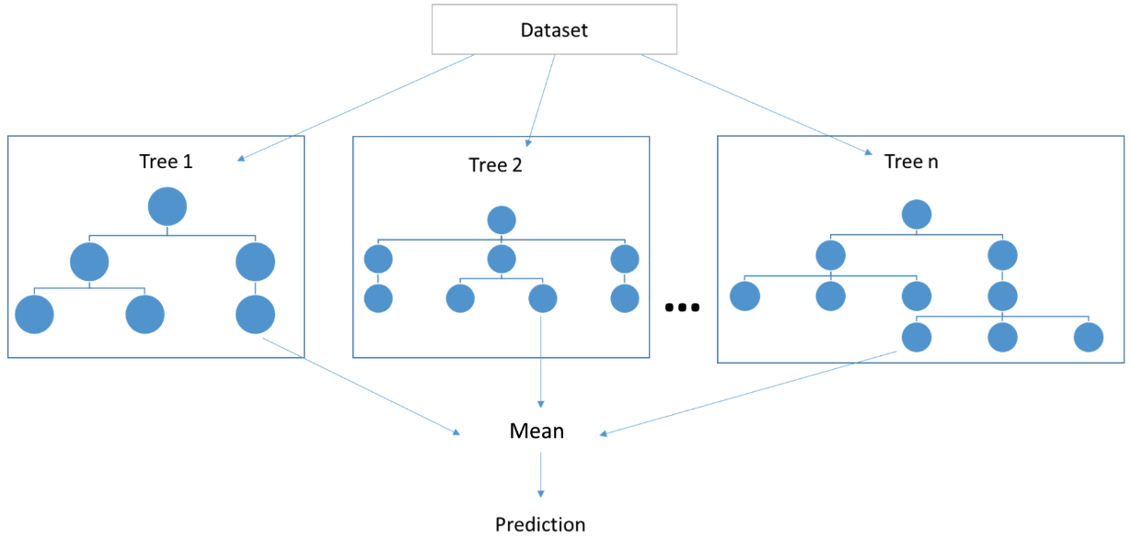
“A Decision Tree is like a flowchart that draws a clear pathway to a decision or outcome; it starts at a single point and then branches off into two or more directions, with each branch of the decision tree offering different possible outcomes” (Meltzer, 2021). A Random Forest is a collection of Decision Trees used to upscale the predictions.
The Random Forest Model used in this analysis will compare each feature to Attrition to make predictions.
ODSC, 2019
Notes:
Decision Trees are a type of flow chart that can be used to make decisions. Random Forest models take many different decision trees to make predictions for your dependent variable, which in our case is Attrition. The random forest model that I ran took many different factors and compared each one to Attrition to determine which ones were the most influential.

Slide 13
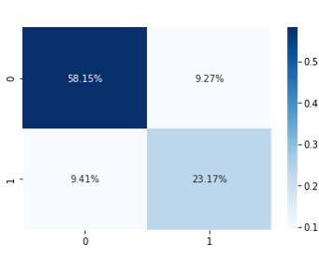
Random Forest
Our Random Forest model had an accuracy of 81%. It successfully predicted 58.15% of its predictions to be True Positives. False Positives are only 9.27%, so this model has worked well at predicting Attrition.
Notes:
After creating our model, I checked the accuracy using a confusion matrix. This model shows an 81% accuracy. It correctly predicted 58.15% of our cases to be true positives and only 9.41% to be false positives.

Slide 14
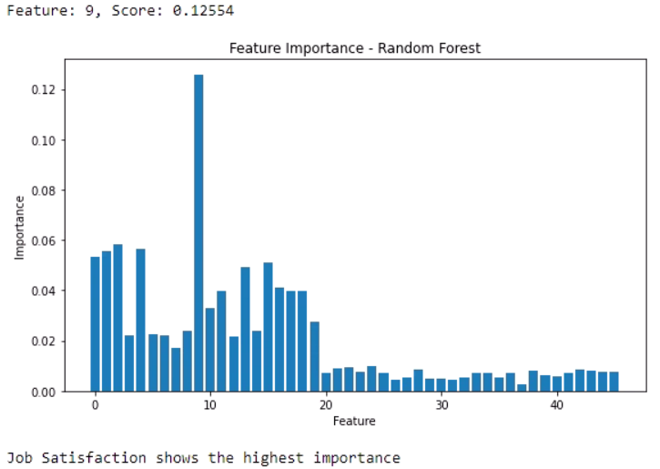
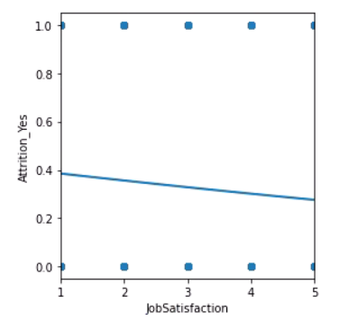
A feature importance chart shows us that Job Satisfaction is the most influential feature in our Random Forest.
A plot of our logistic regression model shows us that as Job Satisfaction increases, Attrition decreases.
Notes:
After running our model, I created a bar chart to show what the most important features are related to attrition. By a landslide, our Random Forest model has shown Job Satisfaction to be the most influential feature in predicting attrition. Using this information, I returned to my logistic regression model. By comparing Job Satisfaction with attrition, you can see that as Job Satisfaction increases, Attrition decreases.

Slide 15
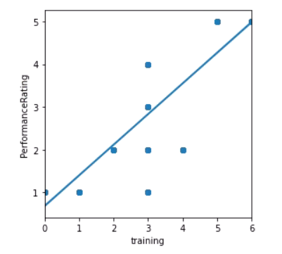
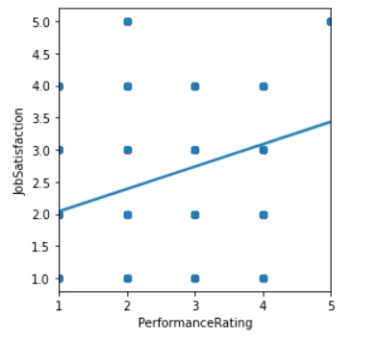
Our model shows us that as training increases, Performance Rating increases.
Our model also shows us that as Performance Rating increases, Job Satisfaction increases.
Notes:
The next thing I wanted to compare was training levels. You can see in the first graph that there is a strong trend line between training and Performance Rating. It is now obvious that as training increases, so does Performance Rating. In our next graph, it can also be seen that as Performance Rating increases, Job Satisfaction increases. We can use this analysis to determine that increased training can lead to increased Performance Rating. Increased Performance Rating can lead to increased Job Satisfaction which will lower the attrition rate.

Slide 16
References
IBM. (2022). What is logistic regression? IBM. Retrieved from https://www.ibm.com/topics/logistic-regression
Meltzer, R. (2021, July 15). What is Random Forest? CareerFoundry. Retrieved from https://careerfoundry.com/en/blog/data-analytics/what-is-random-forest/
ODSC. (2019, February 28). Principles of predictive analytics and the path to time-series predictions. Medium. Retrieved from https://odsc.medium.com/principles-of-predictive-analytics-and-the-path-to-time-series-predictions-a61fb547efa6

