Slide 1
Project three
Brandi Jones
DAT-475-T1310
Applied Data Analysis
October 13, 2022

Slide 2

Organizational Goals
20% reduction in the defects generated during the welding process in the three double production lines of the Manual Finish area
20% increase in the capacity of the three double production lines where electronic boards are processed, without increasing the percentage of defects.
Notes:
A manufacturing company in Tijuana that specializes in building electronic boards has come to realize that their number of manufacturing defects have increased, especially in their welding process and in the component Thru-Holes. After learning that fixing these defects post-production has become cost prohibitive, they are looking to prevent these defects before the product hits the production line. The goal of the company is to have “a 20% reduction in the defects generated during the welding process in the three double production lines of the Manual Finish area” (SNHU, 2022) and to also show “a 20% increase in the capacity of the three double production lines where electronic boards are processed, without increasing the percentage of defects” (SNHU, 2022).

Slide 3
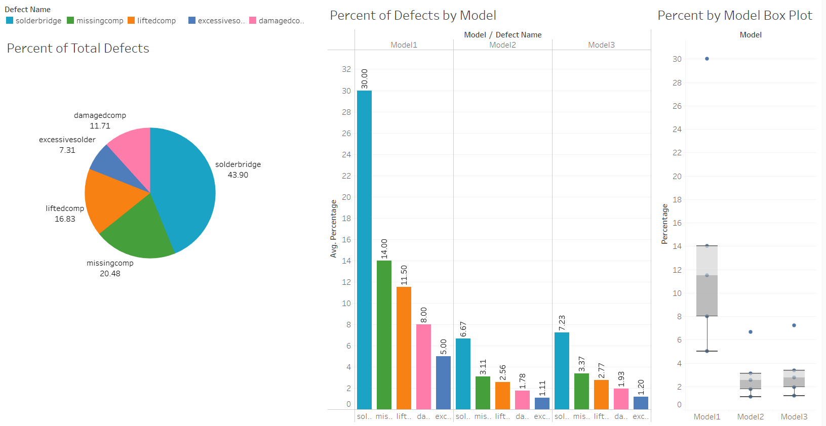
Tableau Dashboard 1
3
Notes:
An overview of the first dashboard created on Tableau gives you an idea of the Defect that is most prominent throughout the entire facility, along with the percentage of defects per model. A box plot shows the spread of our data, and you can easily spot each models minimum, maximum, and mean percentage of defects, along with any outliers.

Slide 4
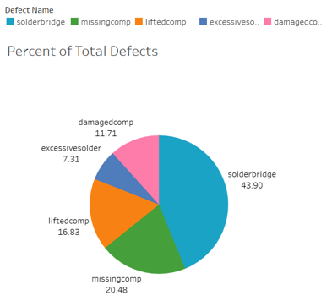
Most frequent defect throughout the entire facility:
solderbridge at 43.90%
Notes:
Looking closer at the first dashboard, we have a pie chart that shows the percent of total defects by name for the entire facility. You can easily spot that solderbridge has the largest slice, at 43.90%. This is followed by missingcomp at 20.48%, liftedcomp at 16.83%, damagedcomp at 11.71%, and then finally excessivesolder at 7.31%. This pie chart gives a great overview of what the most and the least frequent defect is throughout the facility.

Slide 5
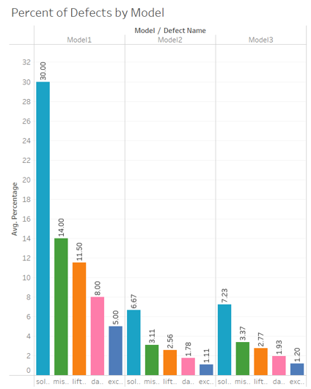
Most Frequent Defect in Model 1:
solderbridge
Most Frequent Defect in Model 2:
solderbridge
Most Frequent Defect in Model 3:
solderbridge
Notes:
The second chart in our dashboard is a bar chart. In this bar chart, you can view the percent of each defect categorized by model number. Each model is sorted in descending order to clearly show which defect is the most prominent, and the bar for each defect is the same color throughout each of the three models to lessen any confusion. It is easy to spot here that solderbridge is the most frequent defect for each model, and excessivesolder is the least frequent. This bar chart is interactive, meaning you can hover over each bar to see the full details, including the defect name, the model number, and the percent at a quick glance.

Slide 6
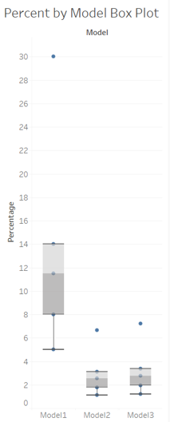
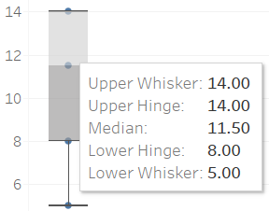
Notes:
“A box plot is a graph showing five values: the minimum, maximum, median, and first & third quartiles of a data set” (Jonathan, 2021). This box plot shows each of the three models and their respective values. As shown in the example to the right, this graph is also interactive, meaning you can hover over the box plot to quickly view the values of that particular model. Model 1 has an upper whisker of 14 which means the maximum value (minus any outliers) is 14. The lower whisker, or minimum, is 5. To find the range of the data you simply subtract the minimum value from the maximum value, which is 9 in this case.

Slide 7
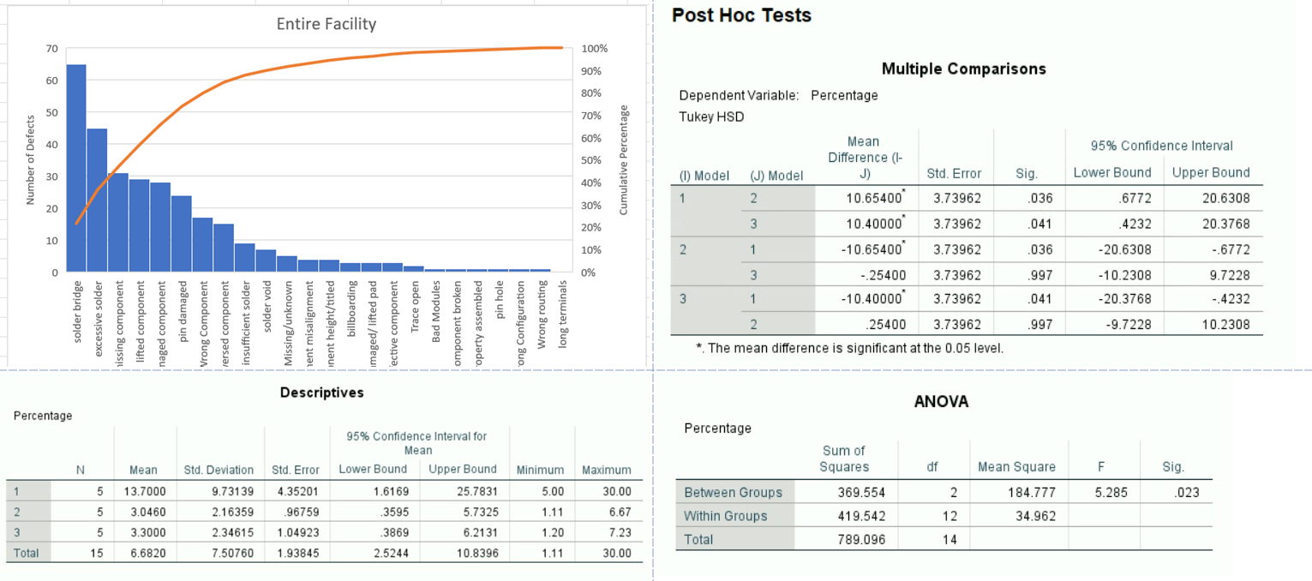
Tableau Dashboard 2
Notes:
The second dashboard created shows the statistical analysis portion of our dataset. The first figure shown is a pareto chart that measures the number of defects by defect name. The second figure gives us the descriptives of our dataset before running our ANOVA. The post hoc test shows us multiple comparisons to determine the individual significance between each model. Finally, the ANOVA test allows us to determine if the model shows a significant difference in the mean of the three models so we can either reject or fail to reject the null hypothesis.

Slide 8
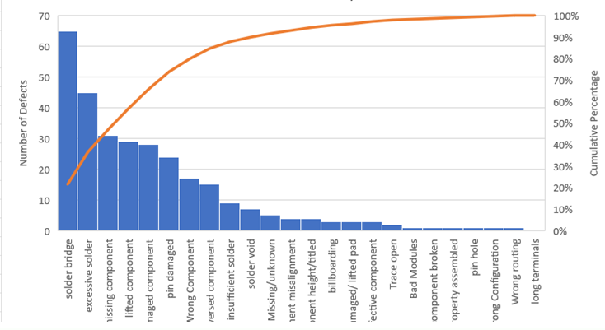
Notes:
Taking a closer look at our second Tableau dashboard, we can view the pareto chart that I created. This pareto chart includes the entire facility, so all the models are in the chart. We can again see that solder bridge is the defect that occurs most frequently. Since one of our organizational goals is a 20% reduction in the defects generated during the welding process in the three double production lines of the Manual Finish area, we would look at the bars that fall at or above the 20% mark to determine where to place our focus. In this case, using the entire facility, those defects include Solder Bridge, Excessive Solder, Missing Component, Lifted Component, Damaged Component, Pin Damaged, Wrong Component, and Reversed Component.

Slide 9
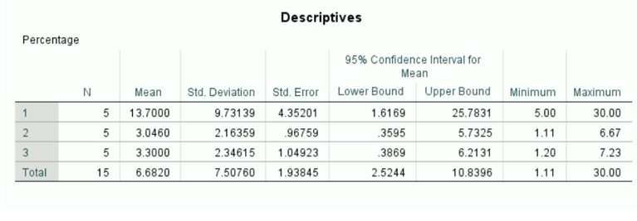
Notes:
The next item in our dashboard includes the descriptives of our dataset before performing our ANOVA test. As seen in this chart, there are 15 total observations. You can easily spot the mean, minimum, and maximum of each model. From this table you can determine that model 1 has a mean of 13.70, model 2 has a mean of 3.046, and model 3 has a mean of 3.30. The mean of the entire facility is 6.682, with a minimum value of 1.11 and a maximum value of 30.

Slide 10
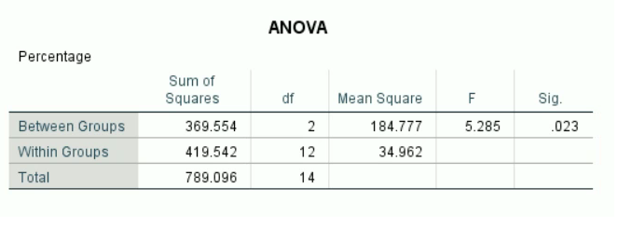
Null Hypothesis: There is no significant difference between the three means
Alternative Hypothesis: There is at least one difference between the three means
Notes:
“A one-way ANOVA is used for three or more groups of data, to gain information about the relationship between the dependent and independent variables” (Kenton, 2022). After running the ANOVA, we can see that the Total Sum of Squares is equal to 789.096. The Sum of Squares Between Groups is 369.554 and the Sum of Squares Within Groups is 419.542. The F-Statistic is 5.285 and the significance (p-value) is .023. Since the p-value is less than the alpha of 0.05, we can determine that this test shows a significant difference, and we would reject the null hypothesis. This leads us to accept the alternative hypothesis, that there is at least one difference between the three means. We can use this test to determine that at least one model has a higher percentage of defects than the other models and this is where we may need to focus our efforts.

Slide 11
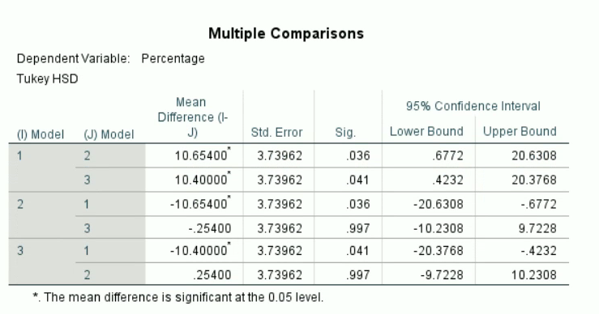
Notes:
“The aim of a post-hoc analysis is to find patterns after the study has been completed, and to find results that weren’t the primary objective. Tukey’s test determines if your sample consists of groups that differ from each other. Every mean is compared with the mean of all other groups using the “Honest Significant Difference,” which represents how far apart the groups are” (Zaveri, 2022). Running this Post Hoc test allows us to compare the mean of each individual model against another individual model to check for significance. After running the Post Hoc test, I can determine that there is a significant difference between Model 1 vs Model 2 and Model 1 vs Model 3. Since Model 1 had the largest mean out of the three, this makes sense that it shows the most significance between the models. There is not a significant difference between Model 2 vs Model 3, which also makes sense as the means for these two models were much closer together than with Model 1.

Slide 12
HIGHEST NUMBER OF DEFECTS:
Model 1
MOST FREQUENT DEFECT:
solderbridge
Notes:
In conclusion, our ANOVA test was successful in showing us that the null hypothesis (There is no significant difference between the three means) should be rejected and that we should accept the alternative (There is at least one difference between the three means). Our Post Hoc test has shown that the Model with the most significance is Model 1, meaning that production line 1 is the line with the highest percentage of defects, and more focus should be placed on this line to determine the root causes of these defects. Since we have determined that the most frequent defect is solderbridge, after finding the root cause we will be able to determine what measures need to be taken to reduce the number of defects by 20%, as our organizational goal asks.S

Slide 13
references
Jonathan. (2021, July 19). What does a box plot show? (10 common questions answered). jdmeducational. Retrieved from https://jdmeducational.com/what-does-a-box-plot-show-10-common-questions-answered/
Kenton, W. (2022, August 23). Analysis of variance (ANOVA) explanation, formula, and applications. Investopedia. Retrieved from https://www.investopedia.com/terms/a/anova.asp
SNHU. (2022). DAT 475 Project Case Study. SNHU. Retrieved from https://learn.snhu.edu/content/enforced/1163881-DAT-475-T1310-OL-TRAD-UG.22EW1/course_documents/DAT%20475%20Project%20Case%20Study.pdf?_&d2lSessionVal=08MAFztxTdOyei2koD0ZK86zz&ou=1163881
Zaveri, A. (2022, August 4). Post Hoc Analysis: Process and types of tests. Mind the Graph Blog. Retrieved from https://mindthegraph.com/blog/post-hoc-analysis/

