Slide 1
CSDA 5101
Advanced Software Paradigms

Slide 2
Goals
Grow you as a software developer.
Provide techniques for effective use of LLMs to generate code.
Your job (mainly) is to manage the code generation process, not to serve as the primary author of the code.
Provide a basic introduction to tools every developer needs:
  Git
  Testing
  GitHub (social coding, project management)

Slide 3
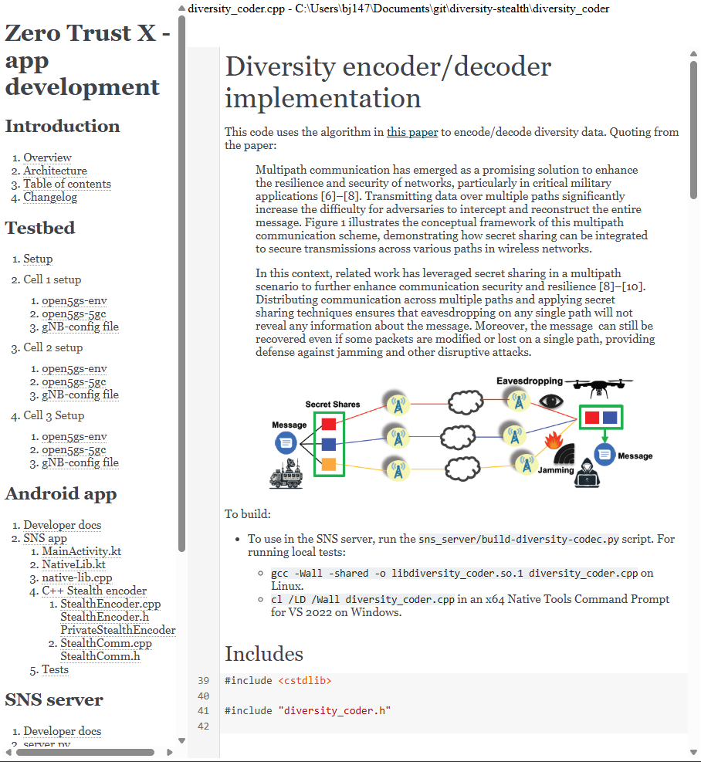
Literate programming
Managing LLMs means lots of writing: requirements, specs, data structures, …
Writing about code is easiest when you can place your writing within the code.

Slide 4
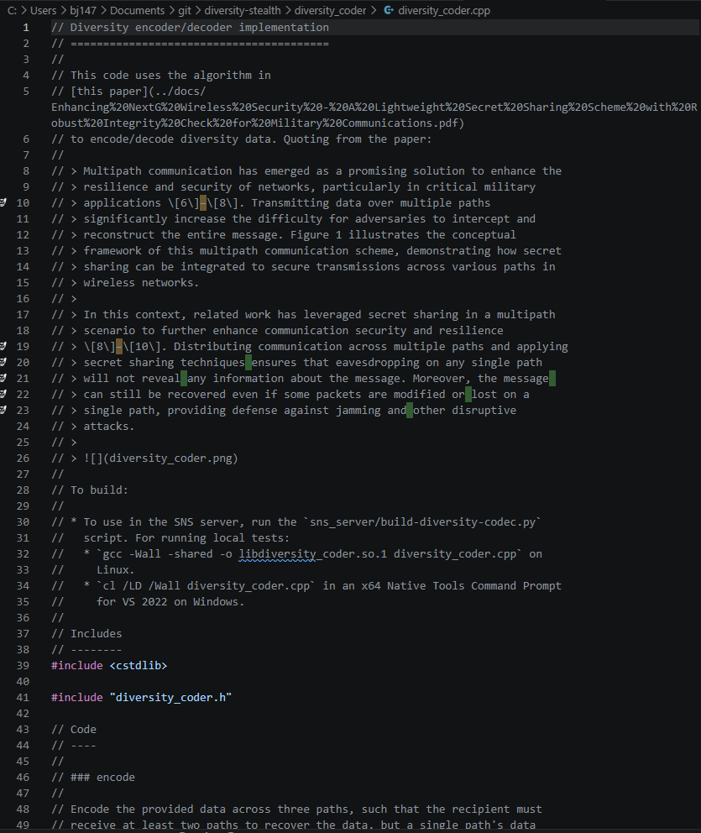
Literate programming
Managing LLMs means lots of writing: requirements, specs, data structures, …
Writing about code is easiest when you can place your writing within the code.

Slide 5
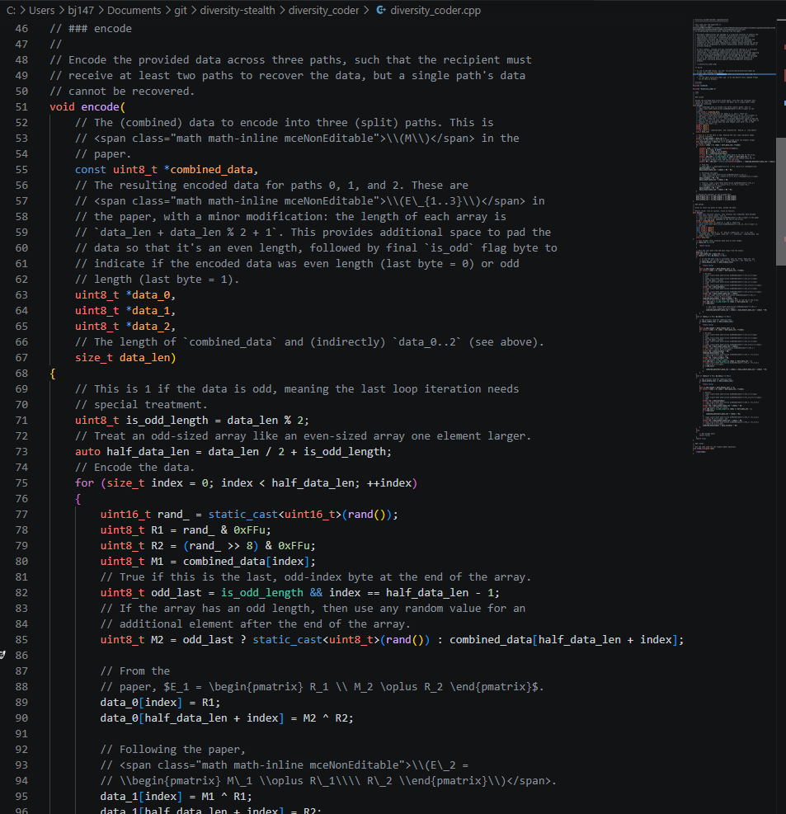
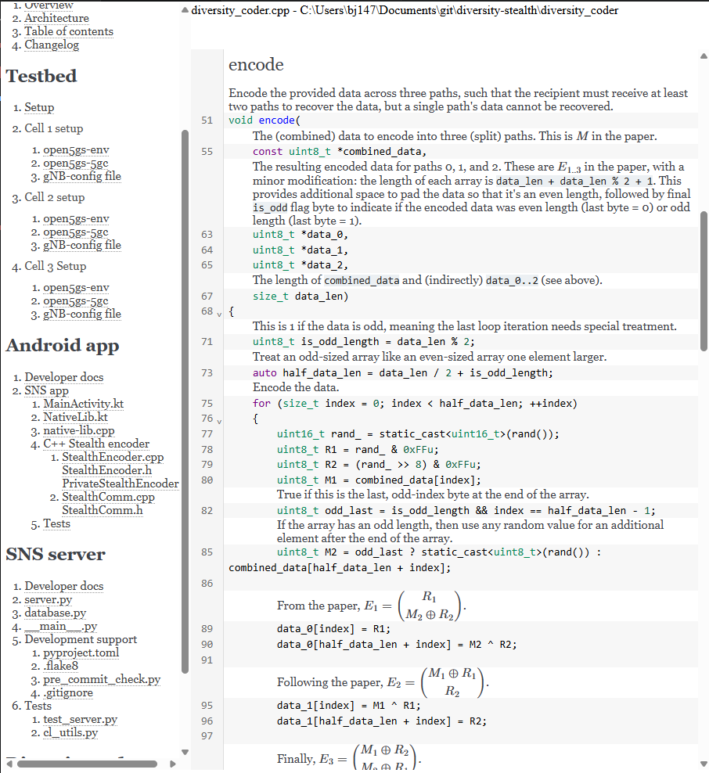
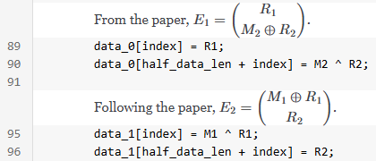

Slide 6
Approach
Cameras on!
I’ll share my experience. I don’t have all the answers.
I value your input, in-person and distance:
  In general, I’ll give in-person/synchronous students time to discuss. Async: use this to develop a response to the question.
  Each group, post your replies in the survey/chat; distance, post when you view the video.
What are your techniques for effective use of LLMs to generate code?

Slide 7
Class structure
Follow the link in the chat.

Slide 8

Introductions

Slide 9
Assignment
MS Teams:
  Introduction
  Installation (VSCode, the CodeChat Editor, book)

