Slide 1
ECE 4793/6793 and CSE 4353/6353
Applications of Literate Programming in Software Development

Slide 2
Goals
Grow you as a software developer.
Provide techniques for effective use of LLMs to generate code.
Your job (mainly) is to manage the code generation process, not to serve as the primary author of the code.
Provide a basic introduction to tools every developer needs:
Git
Testing
GitHub (social coding, project management)

Slide 3
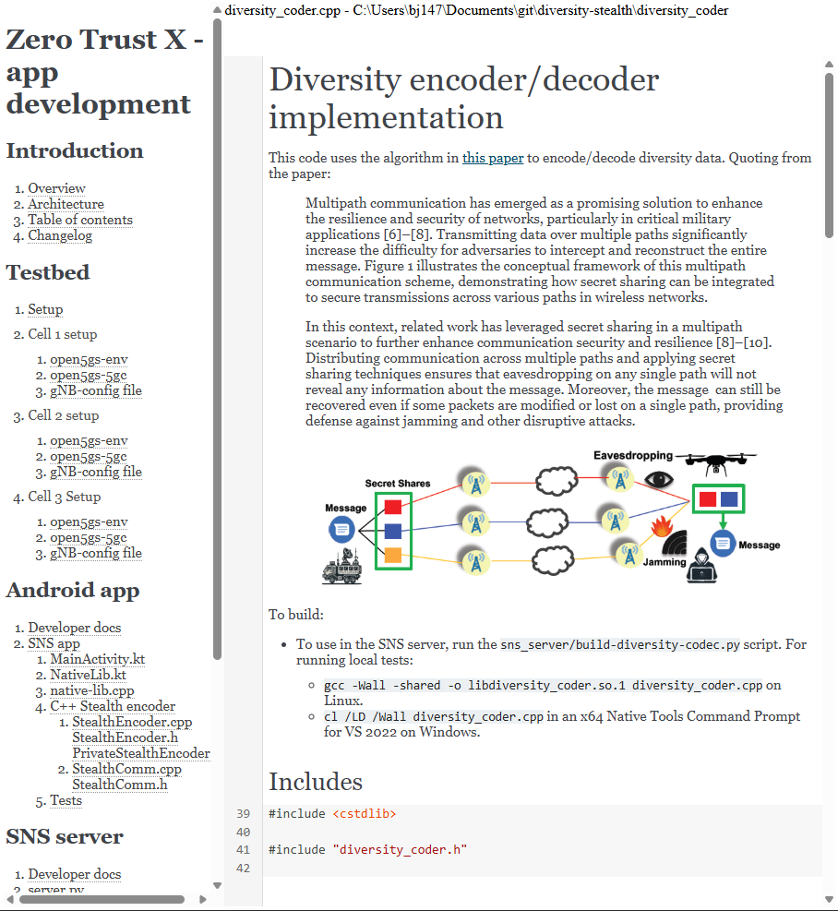
Literate programming
Managing LLMs means lots of writing: requirements, specs, data structures, …
Writing about code is easiest when you can place your writing within the code.

Slide 4
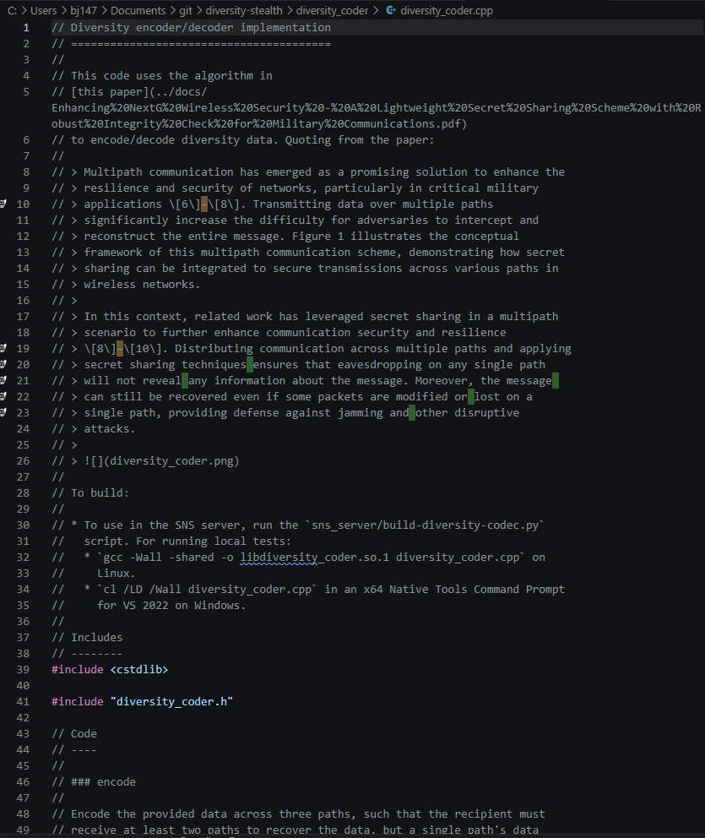
Literate programming
Managing LLMs means lots of writing: requirements, specs, data structures, …
Writing about code is easiest when you can place your writing within the code.

Slide 5
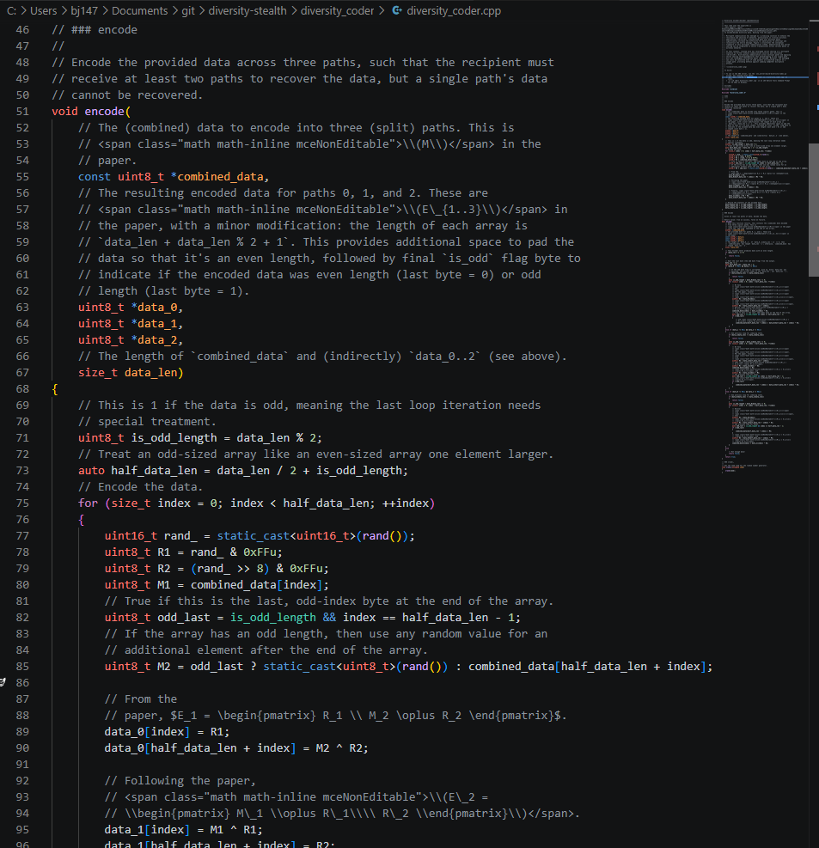
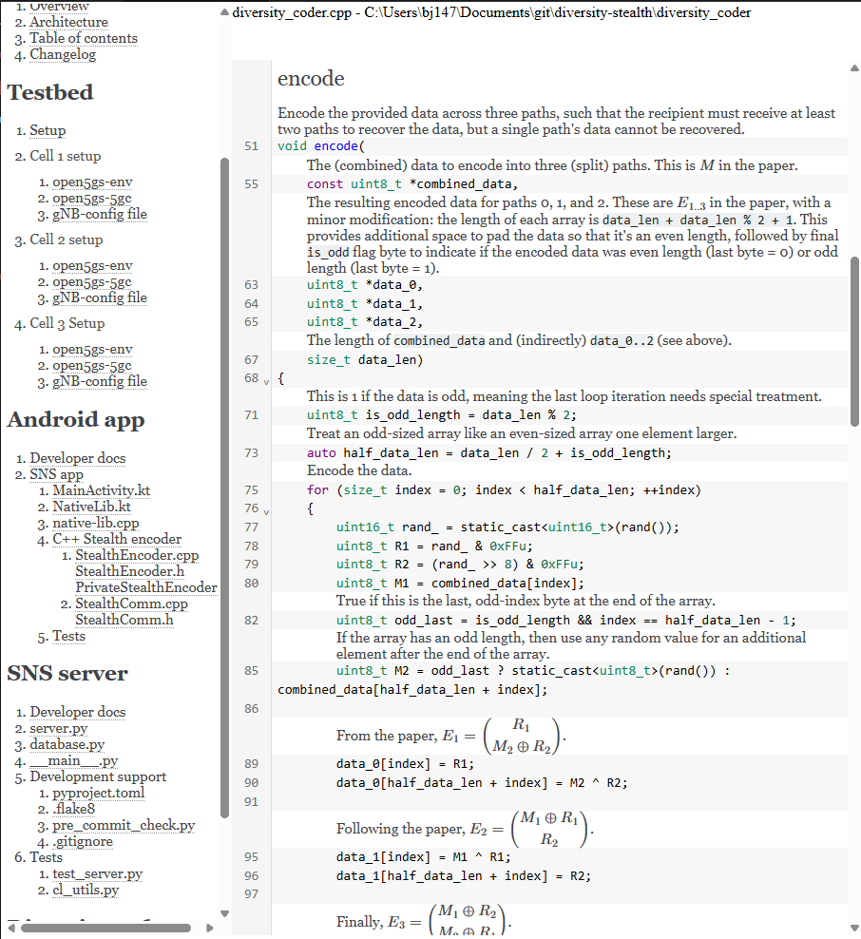
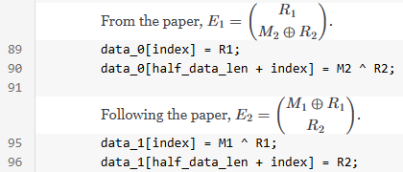

Slide 6
Approach
I’ll share my experience. I don’t have all the answers.
I value your input, in-person and distance:
In general, I’ll give in-person/synchronous students time to discuss. Async: use this to develop a response to the question.
Each group, post your replies in the survey/chat; distance, post when you view the video.
What are your techniques for effective use of LLMs to generate code?

Slide 7


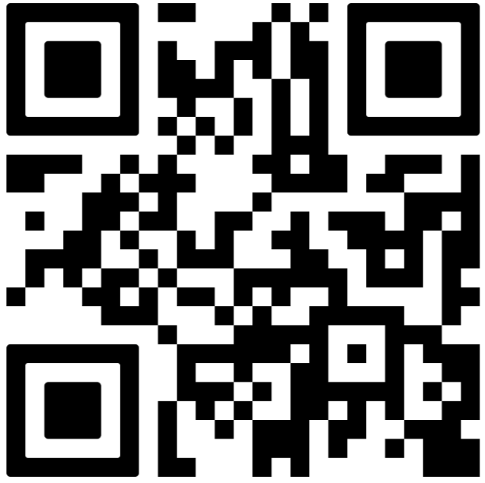

MSU Emergency Procedures:
Fire / Evacuation
Tornado Warning
Evacuate immediately when alarm sounds
Use nearest exit (no elevators)
Move away from building
Do not re-enter until cleared
Go to interior room on lowest floor
Stay away from windows
Avoid large open spaces
Cover head/neck and wait for all-clear
Evacuation Reunification Area:
North of building in front of Bowen Hall
Severe Weather Refuge Area:
Room 104 & under 1st floor stairwells
Notes:
“Before we get started with class, I want to take a minute to go over basic emergency procedures, so you know what to do if something happens.
If there is a fire alarm, you should treat it as real every time. Go ahead and evacuate the building immediately using the nearest exit—don’t use elevators. Once outside, move a safe distance away from the building so emergency responders can do their job. We will meet at the reunification point outside the building.”
(We have included a list of several classroom buildings along with their reunification areas and severe weather areas. Please share these locations with your class. This information and more are available in your Building Emergency Action Plan, or BEAP.)
“If we receive a tornado warning, take shelter right away. We’ll move to an interior hallway or room on the lowest floor, away from windows and doors. Stay safe and follow updates”
(We have included a list of several classroom buildings along with their reunification areas and severe weather areas. Please share these locations with your class. This information and more are available in your Building Emergency Action Plan, or BEAP.)

Slide 8

MSU Emergency Procedures:
Active Attacker
(Avoid, Deny, Defend)
Medical Emergency
Call 911
Provide location and details
Do not move injured unless necessary
Provide aid if trained
Send someone to guide responders to room
Avoid: Leave if safe
Deny: Lock, barricade, silence phones
Defend: Last resort to stop threat
Stay informed
Visit emergency.msstate.edu
Follow @MaroonAlert for updates
Follow faculty & emergency personnel instructions
Notes:
“I also want to briefly cover what to do in more serious situations.
In the event of an active attacker situation, follow instructions from Maroon Alert. We follow the Avoid, Deny, Defend model. First, avoid—Get to safety, if possible. If you can’t leave, then deny access—lock or barricade doors, turn off lights, stay quiet, and silence your phones. As a last resort, defend yourself by acting decisively to stop the threat if your life is in immediate danger.
For a medical emergency, call 911 right away. Be ready to tell them exactly where you are—building and room number—and what’s happening. Avoid moving the person unless it’s necessary. If you’re trained, you can provide first aid, CPR, or use an AED until help arrives. If possible, have someone go meet emergency responders and guide them to the location.
Lastly, stay informed.
Make sure you are registered for Maroon Alerts – the university’s official emergency notifications system. They will send out a test each semester.
To learn more, scan the QR code or visit emergency.msstate.edu for emergency response guides, videos, and Maroon Alert information. You can also follow @MaroonAlert on X to stay informed of updates. So stay safe and always be prepared to respond.

Slide 9
Class structure
Follow the link in the chat.

Slide 10

Introductions

Slide 11
Assignment
Canvas!
Introduction
Installation (VSCode, the CodeChat Editor, book)

