Slide 1
uC/PC data transfer
Bryan A. Jones

Slide 2
Typical uC approach
Write an embedded application
Create a simple menu interface
Notes:
Show example of reset.c

Slide 3
Typical uC approach
Write an embedded application
Create a simple menu interface
PC
Press 1 to turn on left motor
uC
1
Notes:
Show example of reset.c

Slide 4
Missing features
Transfer binary data between uC and PC
Provide basic debug support
PC
Press 1 to turn on left motor
uC
1

Slide 5
Missing features
Transfer binary data between uC and PC
Provide basic debug support
PC
Press 1 to turn on left motor
uC
1
PC
Distance sensor readings
uC
GUI
Drive commands

Slide 6
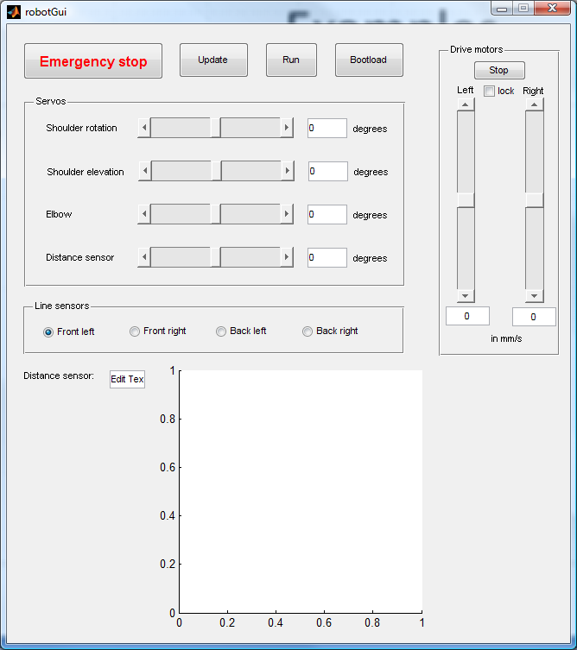
Missing features
Transfer binary data between uC and PC
Provide basic debug support
PC
Press 1 to turn on left motor
uC
1
+
PC
Distance sensor readings
uC
GUI
Drive commands

Slide 7
Missing features
Transfer binary data between uC and PC
Provide basic debug support
PC
Press 1 to turn on left motor
uC
1
PC
Distance sensor readings
uC
GUI
Drive commands
PC
i = 10, j = 11
uC
Vars
Change i to 11
Notes:
Show example

Slide 8
Missing features
Transfer binary data between uC and PC
Provide basic debug support
PC
Press 1 to turn on left motor
uC
1
+
PC
Distance sensor readings
uC
GUI
Drive commands
PC
i = 10, j = 11
uC
Vars
Change i to 11
Notes:
Show example

Slide 9
Incorporating dataXfer
Include
Initialize
Specify
Send/receive

Slide 10
Summary
Transfer binary data between uC and PC
Provide basic debug support
PC
Press 1 to turn on left motor
uC
1
+
PC
Distance sensor readings
uC
GUI
Drive commands
PC
i = 10, j = 11
uC
Vars
Change i to 11

