Slide 1
Population genomics for adaptation
Day 1 - Lecture 2

Slide 2
Analytical approaches
GWAS
Comparative genomics
Transcriptomics
Experimental evolution
QTL mapping
Epigenetics
Population genomics

Slide 3
Analytical approaches
GWAS
Comparative genomics
Transcriptomics
Experimental evolution
QTL mapping
Epigenetics
Population genomics

Slide 4
Population genomics
Population genetics studies the genetic differences within and between populations and the dynamics of how populations evolve.

Slide 5
Population genomics
Population genetics studies the genetic differences within and between populations and the dynamics of how populations evolve.
Population genomics studies these genetic differences using many markers to get a better sense of how evolutionary forces shape different parts of the genome.

Slide 6
Population genomics
Population genetics studies the genetic differences within and between populations and the dynamics of how populations evolve.
Population genomics studies these genetic differences using many markers to get a better sense of how evolutionary forces shape different parts of the genome.
By comparing differences in genetic diversity and differentiation within species we can study population structure, speciation and adaptation.

Slide 7
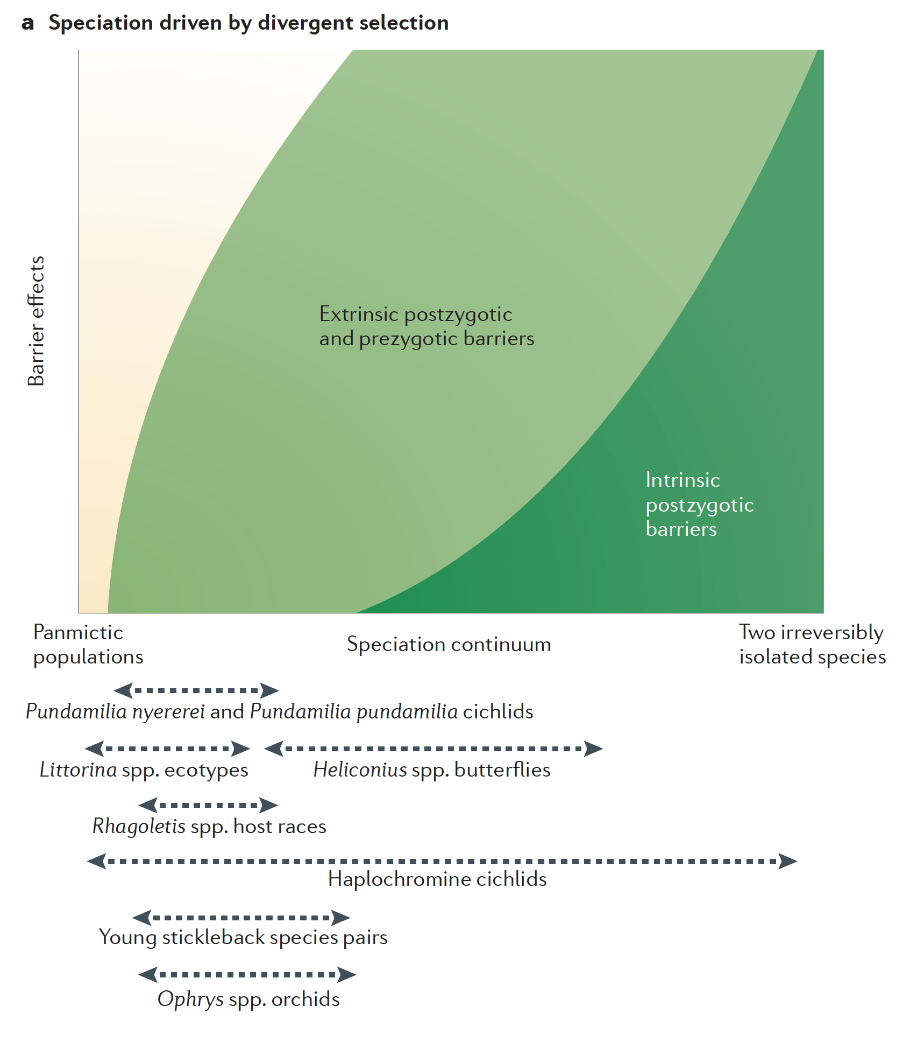

Population genomics for adaptation
Population genomics study populations early in the speciation continuum.
Seehausen et al. 2014, Nat. Gen. Rev.

Slide 8

Population genomics for adaptation
Population genomics study populations early in the speciation continuum.
Later on in the continuum, differentiation builds up and it becomes more and more difficult to distinguish whether genetic differentiation is due to ecological divergence and adaptation or to other factors.
Seehausen et al. 2014, Nat. Gen. Rev.

Slide 9
Population genomics with RADseq
$$$
Question
Study design
Samples
Depth
Coverage
Application
Why RADseq?
RADseq allows to genotype thousands of loci across many individuals at a reasonable cost and can be tuned to address many different questions

Slide 10
Why RADseq?
It doesn’t require extensive genomic resources: no need of a high-quality reference genome (though it helps)
It is customizable: through choice of restriction enzyme and sequencing volumes you can tune coverage of the genome and depth of sequencing
It samples random loci across the genome, both putative neutral and adaptive loci.
Notes:
It’s not an exaggeration to say that the improvement of sequencing technology has been a revolution in many fields, including evolutionary biology.
we now have higher resolution, we can also address questions that were intractable before, revisit old theory and develop new hypotheses. And these methods are becoming accessible to an increasing number of research groups we have a variety of tools to study the genomic basis of local adaptation. Until few years ago we were limited to genes that were identified and whose function was charcterized in model organisms. The so called candidate genes, that we can genotype in wild populations. With an Increased coverage of the genome we can identify loci under selection in wild populations directly. We can either adopt a reduced-represenation approach, such as rad-seq, to target up to hundreds of thousands of loci across the genome. Thanks to the recent reduction in sequencing costs sequencing whole genomes is now a reality. And with outlier analyses and genome-wide association studies for example we can detect loci under selection that underlie traits of adaptive importance.

Slide 11
Why RADseq?
It doesn’t require extensive genomic resources: no need of a high-quality reference genome (though it helps)
It is customizable: through choice of restriction enzyme and sequencing volumes you can tune coverage of the genome and depth of sequencing
It samples random loci across the genome, both putative neutral and adaptive loci.
For our adaptation genomics course
It provides a manageable amount of data that allows quick analyses.
It provides skills that are easily transferable for the analysis of other data type (targeted sequencing or WGS)
Notes:
It’s not an exaggeration to say that the improvement of sequencing technology has been a revolution in many fields, including evolutionary biology.
we now have higher resolution, we can also address questions that were intractable before, revisit old theory and develop new hypotheses. And these methods are becoming accessible to an increasing number of research groups we have a variety of tools to study the genomic basis of local adaptation. Until few years ago we were limited to genes that were identified and whose function was charcterized in model organisms. The so called candidate genes, that we can genotype in wild populations. With an Increased coverage of the genome we can identify loci under selection in wild populations directly. We can either adopt a reduced-represenation approach, such as rad-seq, to target up to hundreds of thousands of loci across the genome. Thanks to the recent reduction in sequencing costs sequencing whole genomes is now a reality. And with outlier analyses and genome-wide association studies for example we can detect loci under selection that underlie traits of adaptive importance.

Slide 12
Bioinformatic pipeline
Quality control
Adapter trimming
Read aligning
Variant calling

Slide 13
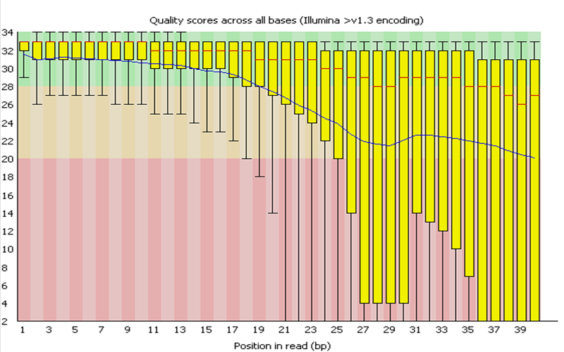
Bioinformatic pipelines
.fastq
.fastq
Quality control
Adapter trimming
Read aligning
Variant calling
FASTQC
file:///Users/anna/Dropbox/genomes%20analyses/murre_hunt/completedataset/fastqc_results/lane1.Tig1_R1_fastqc.html

Slide 14
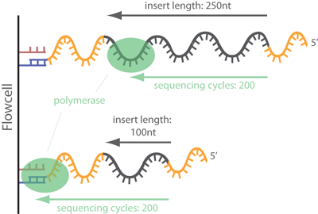
Bioinformatic pipeline
.fastq
.fastq
.fastq
Quality control
Adapter trimming
Read aligning
Variant calling
FASTQC
Trimmomatic
Cutadapt
Fastp

Slide 15
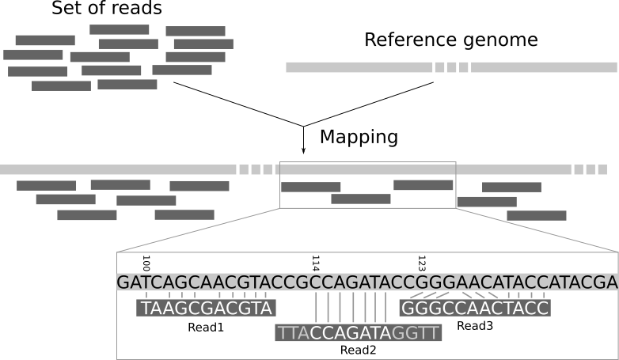
Bioinformatic pipeline
.fastq
.fastq
.fastq
.sam/.bam
Quality control
Adapter trimming
Read aligning
Variant calling
Bowtie2
BWA

Slide 16
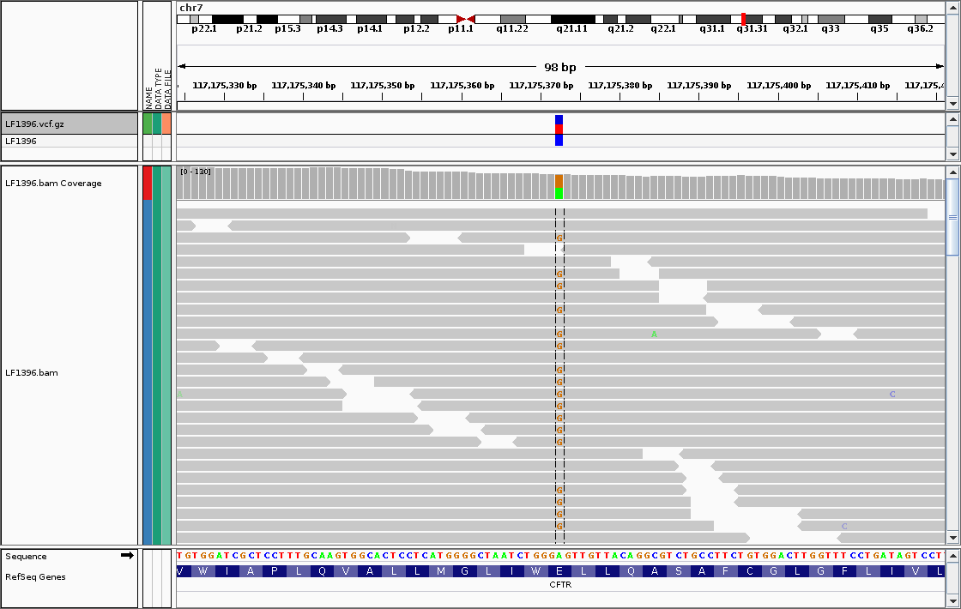
Bioinformatic pipeline
.fastq
.fastq
.fastq
.sam/.bam
.vcf
Quality control
Adapter trimming
Read aligning
Variant calling
STACKS
ANGSD
GATK
SAMtools
…

Slide 17
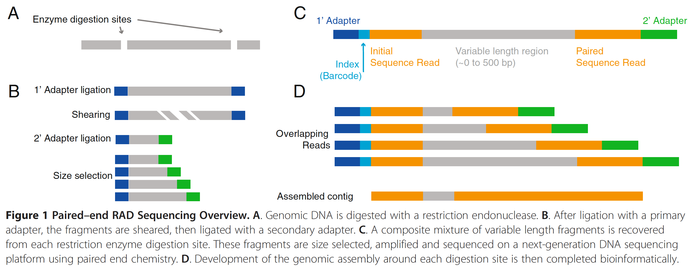

RADseq pipeline
Or double digestion

Slide 18
RADseq pipeline
Raw reads
READ 1
READ 2
Restriction site
Restriction site

Slide 19
RADseq pipeline
Raw reads
READ 1
READ 2
Restriction site
Restriction site
In addition to potential adapter contamination,
we need to demultiplex RADseq libraries

Slide 20
RADseq pipelines
STACKS (Catchen et al. 2013, Molecular Ecology)
dDocent (Puritz et al. 2014, PeerJ)
PyRAD (Eaton 2014, Bioinformatics)
AftrRAD (Sovic et al. 2015, Molecular Ecology Resources)
ANGSD (Korneliussen et al. 2014)
GATK (McKenna et al. 2010, Genome Research)

Slide 21
RADseq pipelines
STACKS (Catchen et al. 2013, Molecular Ecology)
dDocent (Puritz et al. 2014, PeerJ)
PyRAD (Eaton 2014, Bioinformatics)
AftrRAD (Sovic et al. 2015, Molecular Ecology Resources)
ANGSD (Korneliussen et al. 2014)
GATK (McKenna et al. 2010, Genome Research)

Slide 22
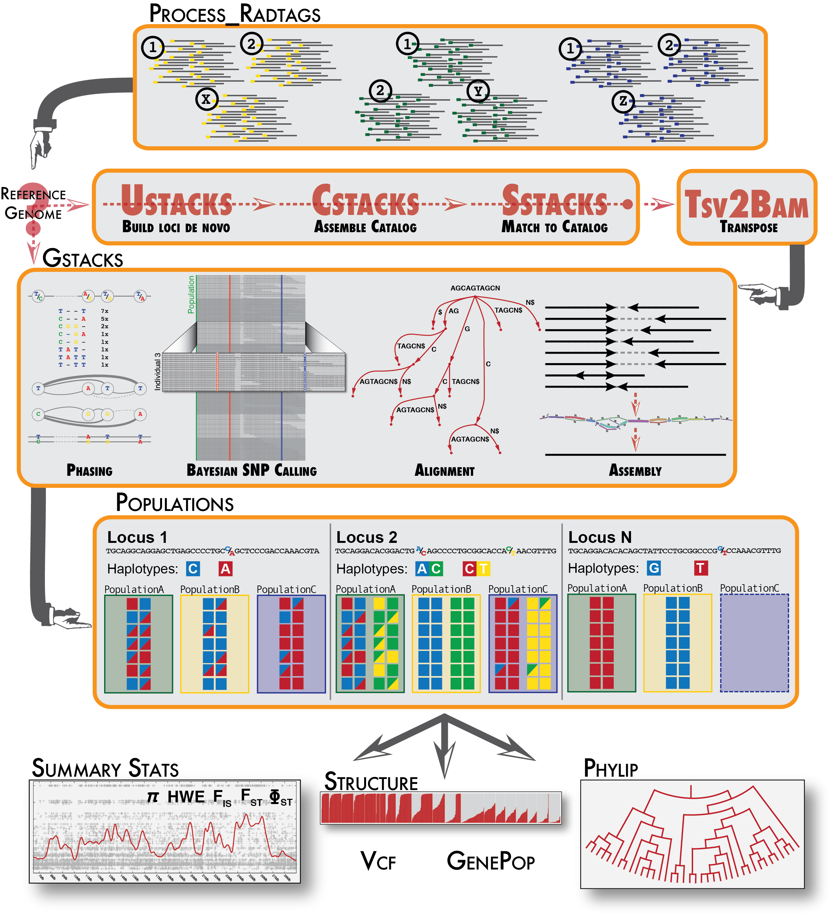
STACKS

Slide 23
To preprocess raw data
Demultiplexing
Adapter removal
Quality filtering
STACKS

Slide 24
Loci assembly without reference genome
STACKS

Slide 25
STACKS
If you have a reference genome, align RAD data with external software.
GSTACKS does different things according to data input but at end it calls variants from assembled loci.

Slide 26
STACKS

