Slide 1
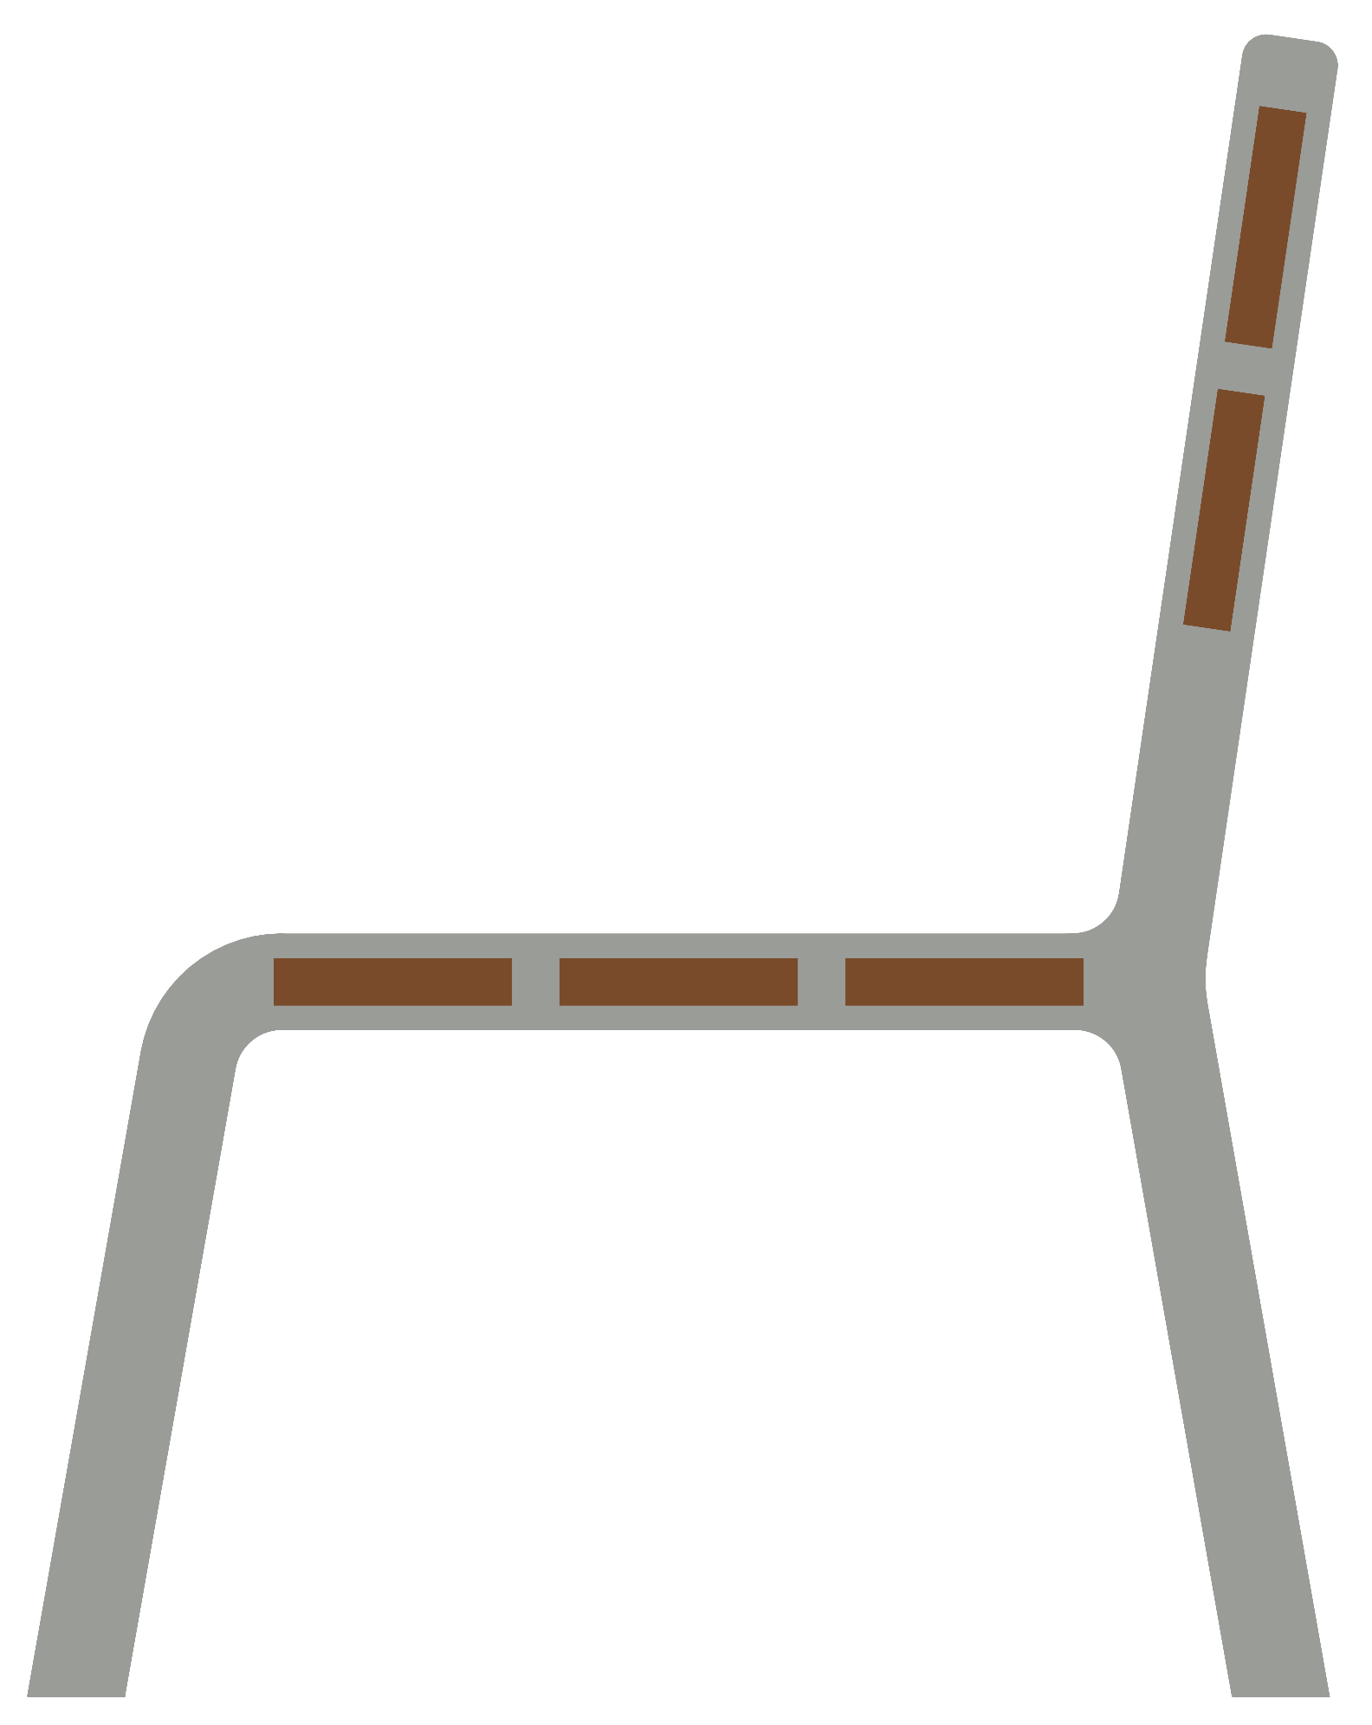

Configure it online, build it with a cobot
MMA4002 DESIGN FOR AUTOMATED MANUFACTURING
Bjørge Skjelbreid Djuve · John Isak Hammer
NTNU Ålesund · L167 · 9 November 2026
bjorgex.github.io/mma4002-h26-outdoor-furniture
Notes:
Suggested speaker: both introduce themselves, then John Isak.
We made an outdoor bench for public spaces and the robot cell that builds it. We start where the customer starts, on the website, then the product, the factory flow, and then the part we are proudest of: the simulation and the real robot.

Slide 2



The customer configures and orders online
Choose
See it in 3D
Order
Scan and configure your own bench
bjorgex.github.io/mma4002-h26-outdoor-furniture
Notes:
Suggested speaker: John Isak. Invite the board to scan the QR code and try it while you talk.
The paying customer is a municipality or a company. On our website they choose backrest or not and the mark on the top plank, see the bench in 3D, and send an order. The order tells production exactly which variant to build before anything is cut.

Slide 3
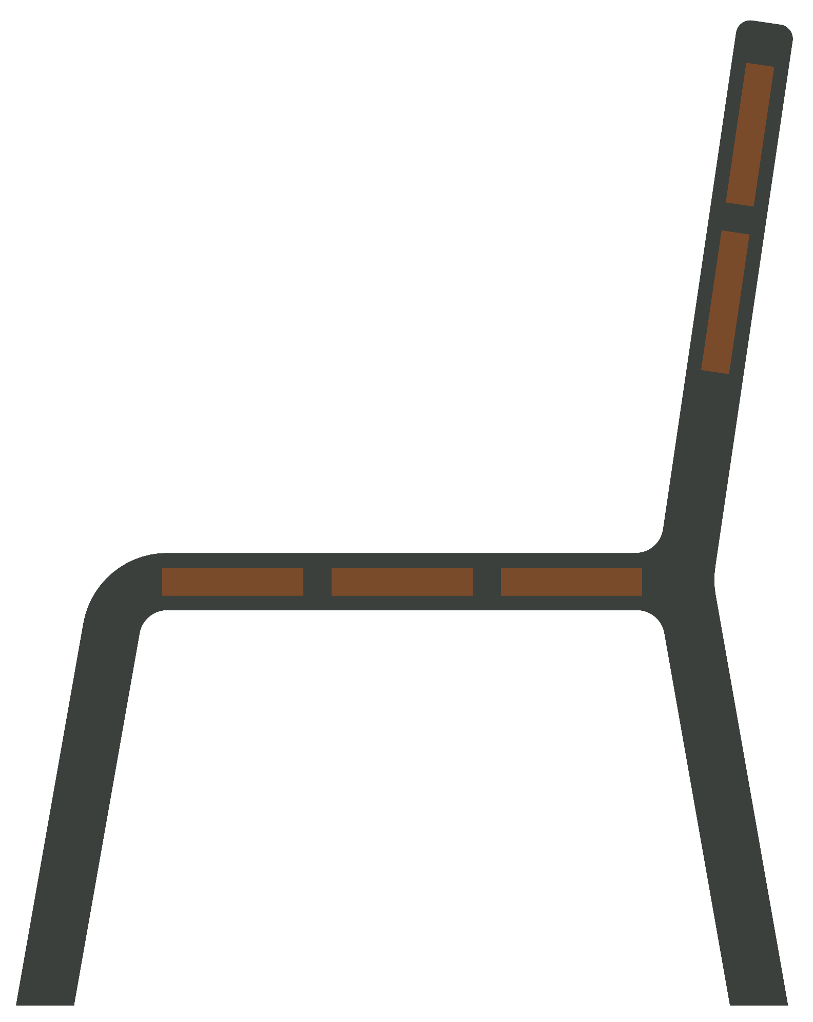
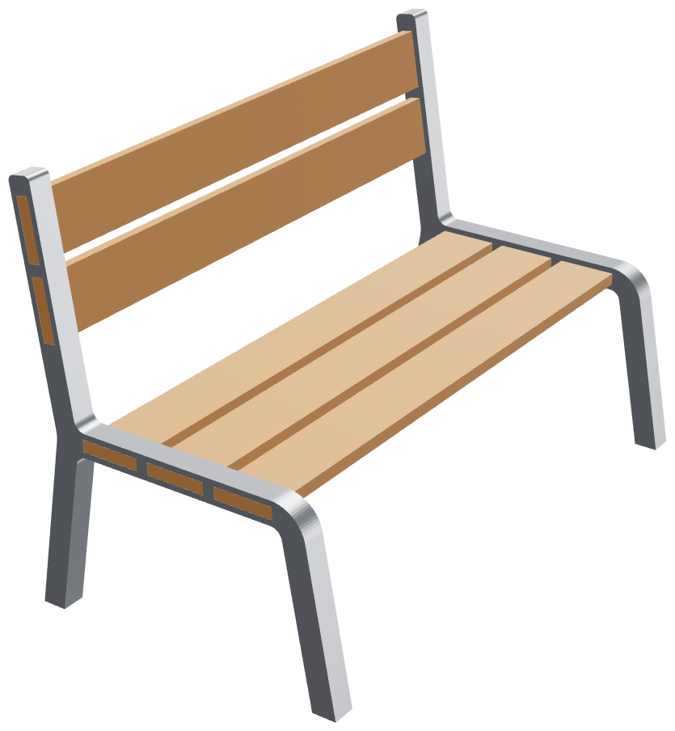
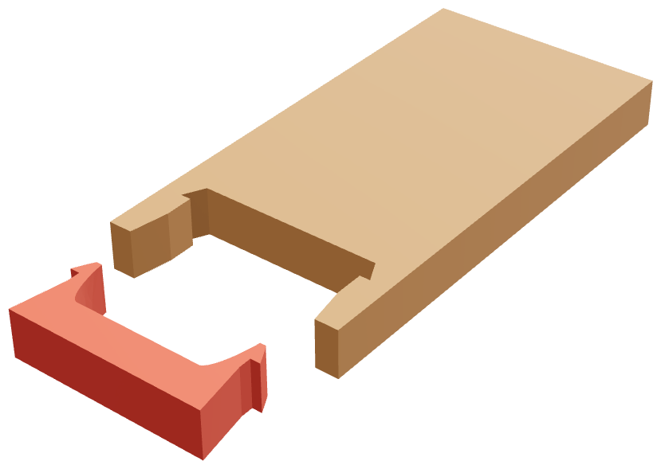
One bent bar, one plank, one interface
2
1
3
Side view, CAD V3 (1:7.5 demonstrator)
The whole bench in 3D, CAD V3
The interface: the clip on each plank end
1
Plank pockets
2
Backrest arm
3
No fasteners
Notes:
Suggested speaker: John Isak.
The product is one laser-cut flat bar, bent in a press brake, in two states: with or without the backrest arm. All planks share one section. The critical interface is the plank pocket: tight enough that the plank stands straight, but with chamfers so an offline-programmed robot still gets it in. The design was made for the robot, and the robot cell for the design.

Slide 4






From order to delivery
Order
Cut and bend
Kit
Cobot assembly
Mark and check
AMR delivery
FROM OUR LEAN ASSIGNMENT · ESTIMATES
3.65 h
≈ 18 min
≈ 8 %
≈ 6.5 min
takt time
work per bench
of the time used
cobot assembly (sim)
Notes:
Suggested speaker: John Isak, then hand over to Bjørge.
The flow from order to delivery. The green steps are robots: the cobot assembles, the mobile robot delivers. From our lean assignment, as estimates: 1000 benches in six months gives a takt of 3.65 hours, against about 18 minutes of work per bench, so one cell has plenty of capacity. Our simulation estimates the cobot assembly at about six and a half minutes; the real-robot time we measure now.

Slide 5
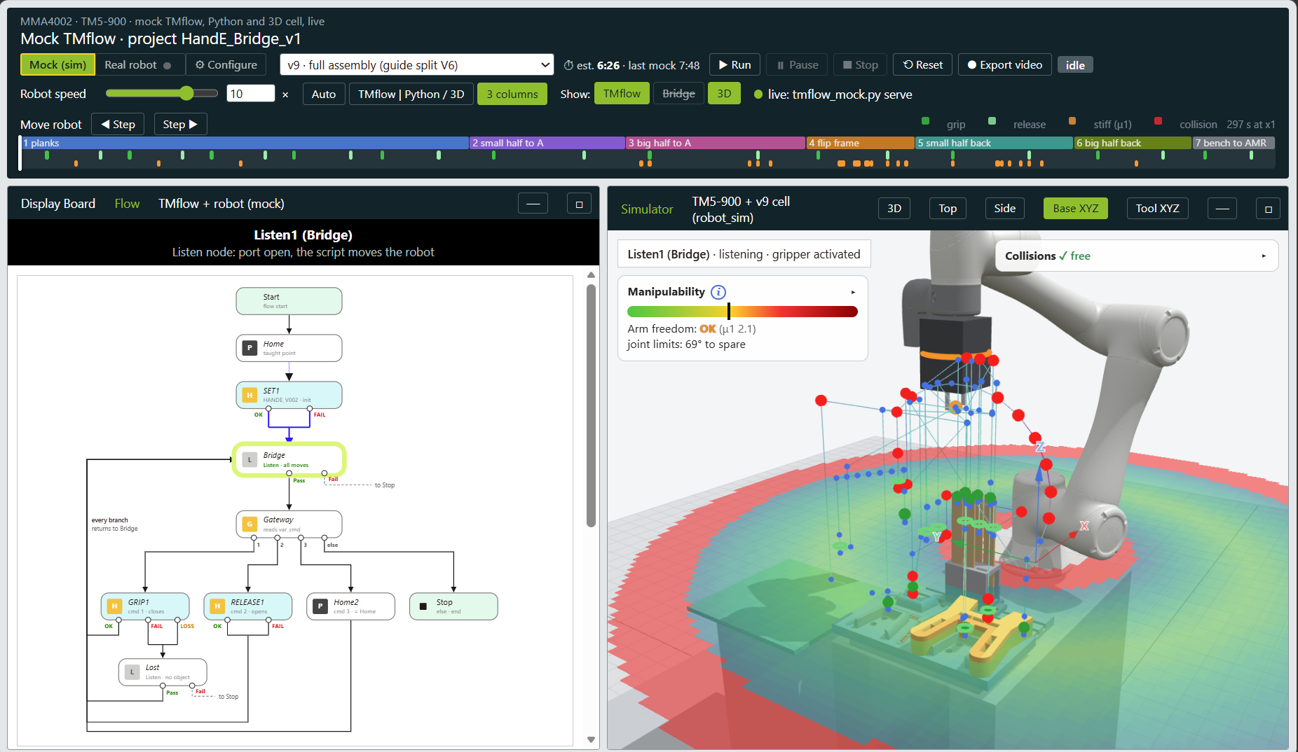


One loop from the simulator to the robot
THE LOOP
Simulator page
Python bridge
TMflow Listen node
TM5-900 + Hand-E
Notes:
Suggested speaker: Bjørge.
Our own simulator page. On the left is the TMflow project that runs on the robot: start, home, initialise the Hand-E, then the Listen node called Bridge, where our Python script takes over and sends every move. A gateway reads which gripper command comes next: grip, release, home or stop, and every branch comes back to the Bridge. We mocked that whole flow, so the robot's own logic is tested together with the motion, not only the path. On the right is the 3D cell.
The loop: the page drives our Python bridge, the bridge sends each move as a script to TMflow's Listen node, and the gripper runs as TMflow nodes. The same script runs against the mock or the real TM5. A step changed and saved on the page rebuilds the robot program.

Slide 6
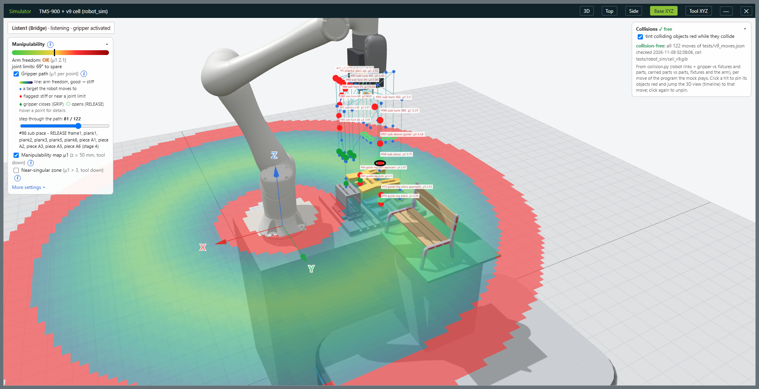


Before it runs: the whole program at a glance
Gripper path
Manipulability
Checked before the lab
Notes:
Suggested speaker: Bjørge.
Before we press play: the whole v9 program at once. The line is the gripper path; every point is a target the robot moves to, coloured by how free the arm is there. Red points are stiff or close to a joint limit, green rings are where the gripper closes and opens. The red and green volume is the manipulability: green is where the arm works well, red is close to a singularity or out of reach. The timeline at the top shows every stage, grip, release and any collision; this version is collision-free.

Slide 7
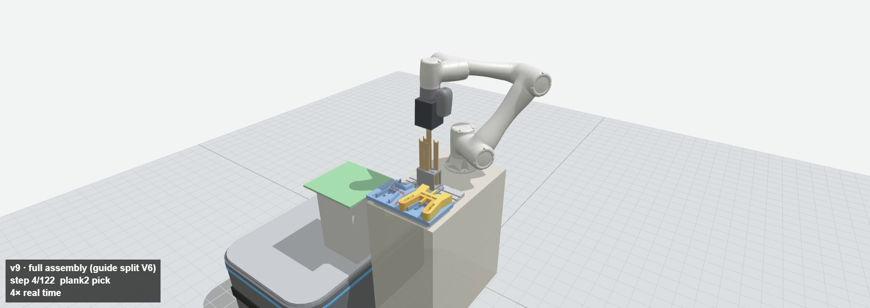
One bench assembled in our simulator
4× real time
Notes:
Suggested speaker: Bjørge. Click the video to play (about 38 s, 4x real time).
The assembly: five planks from the rack into frame 1, the plank guide on, frame 1 with the planks flipped into frame 2, the guide halves slide out of the finished bench, and the bench is turned onto its feet on the mobile robot. These are the exact moves we send to the real robot.

Slide 8


What we learned, and what comes next
Learned
Next
Design the product and the cell together
Full cycle on the real robot
Fail in software first
New guide split
Simulation and real robot from one program
Two benches stacked on the AMR
Notes:
Suggested speaker: both. John Isak takes 'learned', Bjørge 'next'.
Three lessons: design product and cell together; fail in software first, it is cheap; and keep the simulation and the robot on one program so tuning on the robot flows back into the model. Next: the full cycle on the real robot with a measured time, the new guide split so the guide comes out without force, and stacking two benches on the AMR.

Slide 9
Thank you. Questions?
Configure a bench yourself:
bjorgex.github.io/mma4002-h26-outdoor-furniture
Bjørge Skjelbreid Djuve · John Isak Hammer
MMA4002 · NTNU Ålesund
Notes:
Suggested speaker: both.
Open for questions. If there is time: the configurator live, or the simulator running a full bench.

