Slide 1
One bent bar, assembled by a cobot
MMA4002 DESIGN FOR AUTOMATED MANUFACTURING · INDUSTRIAL REVIEW BOARD
An outdoor bench whose product architecture, jig and robot cell were designed together and tested in our own simulation before the lab
Bjørge Skjelbreid Djuve · John Isak Hammer
NTNU Ålesund · L167 · 9 November 2026
Notes:
Suggested speaker: both (introduce yourselves), then John Isak.
We designed an outdoor bench for public spaces and the line that builds it. The drawing on the right is the real side frame, traced from our CAD: one laser-cut flat bar, bent in a press brake, with the timber planks sitting in pockets cut into the bar.
The talk has two halves: the product and its architecture, then the manufacturing cell, where our wow factor is the simulation: we built and broke every version of the robot cell in software before touching the lab robot.

Slide 2
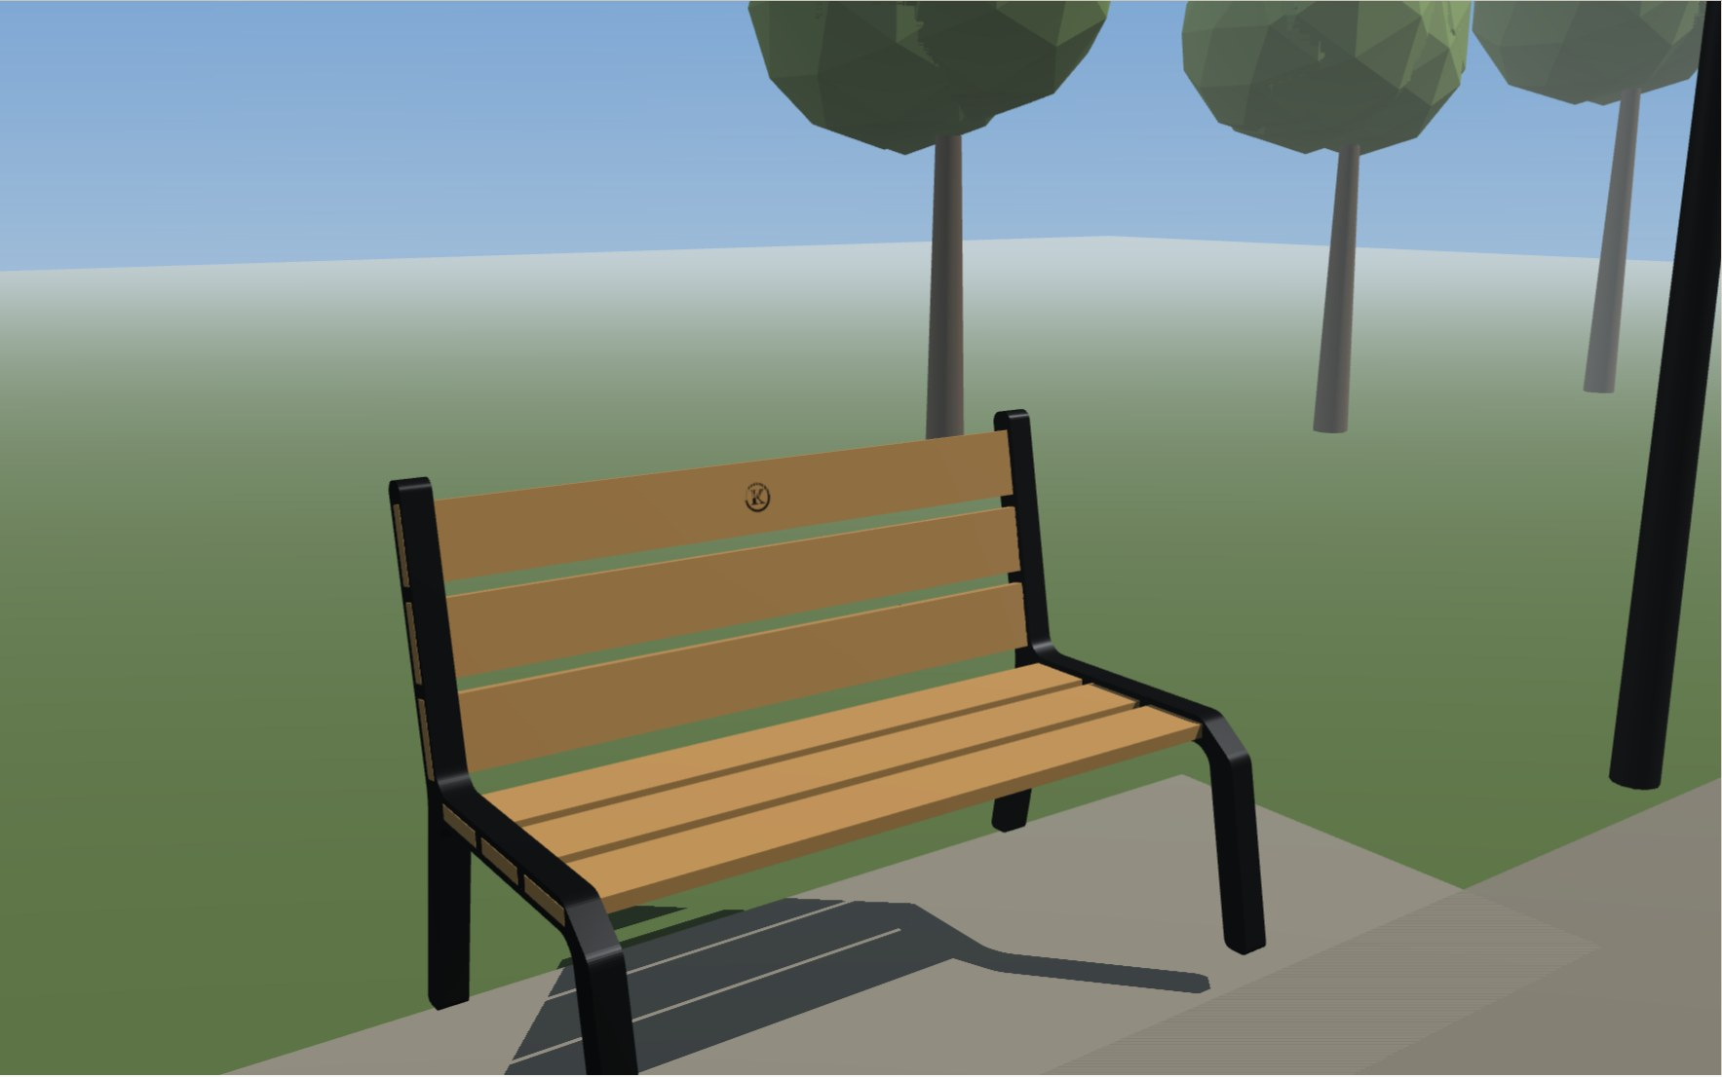


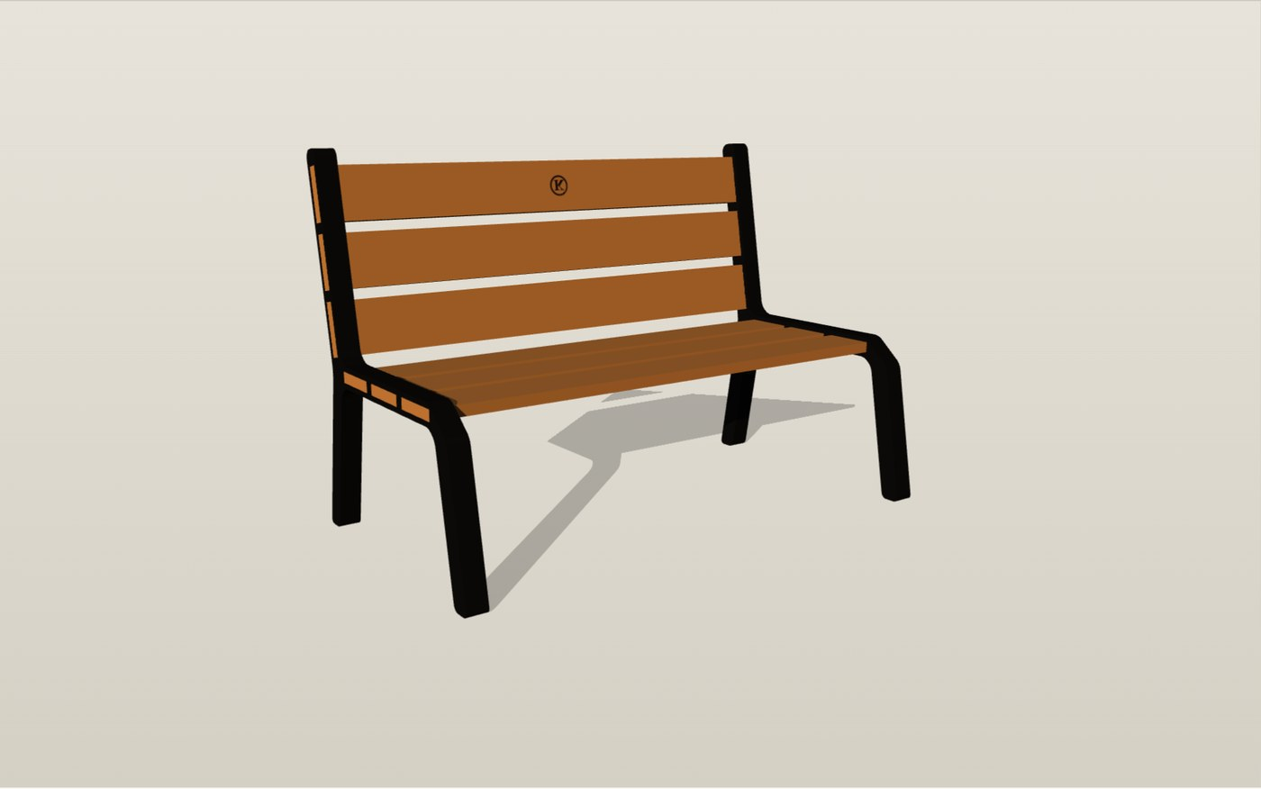

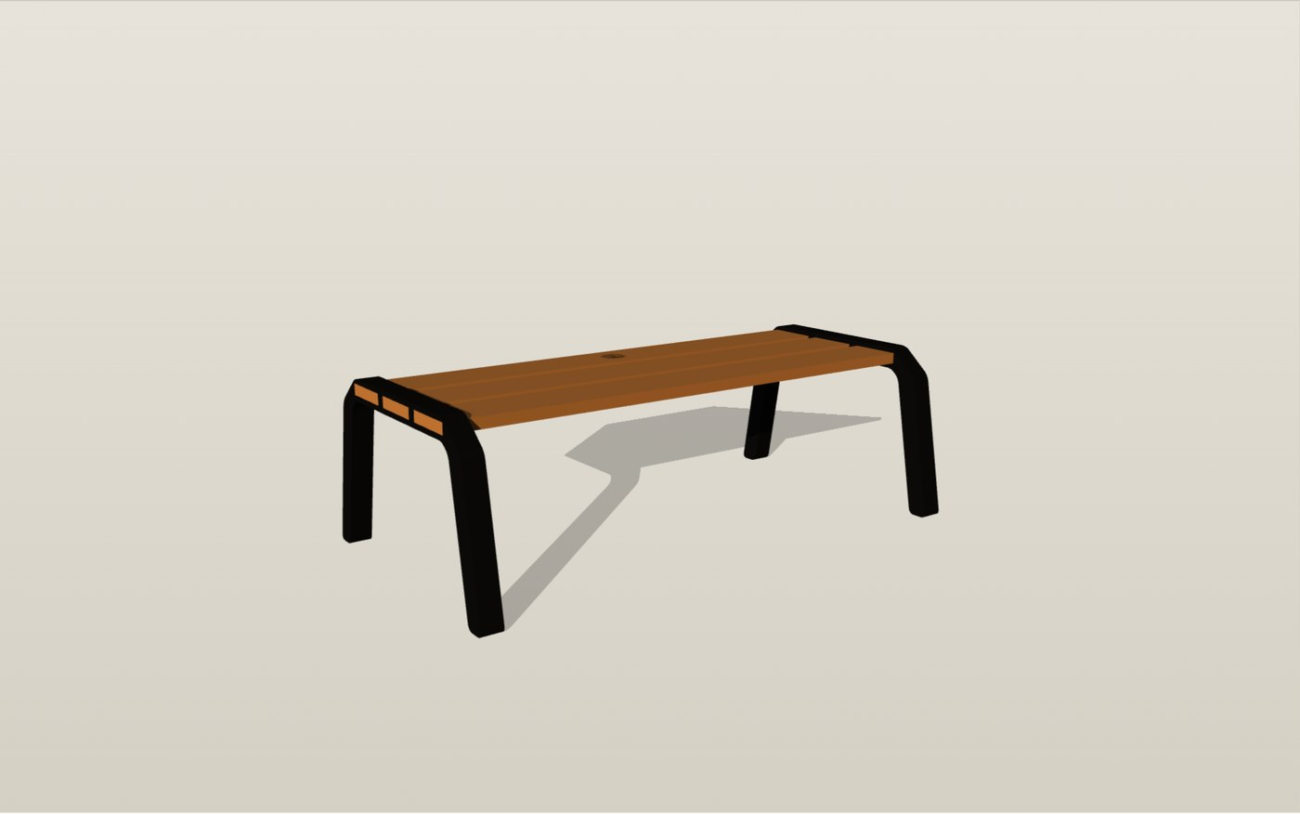

A public bench, configured per customer
Who buys it
Municipalities, cities and larger companies. They buy the message the furniture sends, not the lowest unit price.
What they choose
Backrest or not, and the mark on the top plank: a laser-cut crest or a logo shield. Everything else is standard.
How they order
A web configurator with live 3D, bill of material and a quote request, opened from a QR code.
Backrest · laser-cut mark
Backrest · logo shield
Bench seat only
Notes:
Suggested speaker: John Isak.
Customer view. The paying customer is a municipality or a company, not the person who sits on the bench. From assignment 1: they care about what the furniture says about the place, and studies show people prefer traditional over modern street furniture.
We deliberately limited the choices to what matters to that customer: backrest or not, and a personal mark on the top plank. The pictures are screenshots of our configurator, which generates the bench from the same frame profile as the CAD.

Slide 3
Architecture: variety moved out of the frame
ASSIGNMENT 1 · AS-IS
ASSIGNMENT 2 · TARGET, BUILT
Cast sides carry the style
One bar, standard planks, a mark
Ten traditional cast side designs, five lengths, three backrests
A pattern (tooling) for every side design
Boards slide in lengthwise along a machined channel
Style and structure in one part: an integral side
One laser-cut flat bar, press-brake bent; no casting tool
Two frame states: with or without the backrest arm
Every plank the same 25 × 5 section, dropped straight in
Customer variety only in the mark, added last
10 → 1
1
0
1
side design (in 2 states)
plank section, seat and back
fasteners in the frame
assembly direction: straight down
Notes:
Suggested speaker: John Isak.
Engineering view, before and after. In assignment 1 the style lived in cast-iron sides: ten designs, each needing its own pattern, with boards sliding in lengthwise. Style and structure were the same part, so every new look meant a new casting.
In assignment 2 we moved variety out of the frame. One flat bar, laser-cut and bent, in two states. All six planks share one section. The only customer-specific part is the mark on the top plank, and it is added last: late differentiation.
The numbers along the bottom are what the robot cares about: one frame family, one plank, no fasteners, everything goes in straight down.

Slide 4
Modules and the critical interface
1
Seat pockets
4
Three 25 × 5 planks in 25.4 × 5.4 windows: 0.2 mm per side. Chamfers of 1.5 and 1 mm widen the robot's capture range from ±0.2 to ±2.7 mm.
2
2
Backrest arm
The only frame variant: the same bar, bent further, with three more pockets for the same plank.
3
Legs
1
The bent bar reaches the ground itself: no separate foot, no fasteners, nothing to adjust.
3
4
Top plank mark
Laser-cut crest or logo shield. A cheap part on a standard interface carries the customer variety.
Side frame as modelled (1:7.5 demonstrator)
Notes:
Suggested speaker: John Isak.
This is the frame as modelled, drawn straight from the CAD coordinates. Three modules: the frame (in two states), the planks (one part, seat and back), and the mark.
The critical interface is the plank pocket. The window is only 0.2 mm larger than the plank per side, so the plank stands straight. That is too tight for an offline-programmed robot, which is 1 to 2 mm off before teaching. So we added lead-in chamfers on window and plank end: the capture range grows to about 2.7 mm. That is a design-for-assembly decision driven by the robot.

Slide 5





Manufacturing flow: order to delivery
Order
Cut and bend
Kit
Cobot assembly
Mark and check
AMR delivery
Web configurator: variant and mark
Laser + press brake; planks cut to length
Planks in the rack, frames in the jig
Omron TM5-900 in one jig
Crest or shield, then QC
Bench set on the AMR by the cobot
FROM OUR LEAN ANALYSIS (ASSIGNMENT 3, ESTIMATES)
3.65 h
≈ 18 min
≈ 8 %
≈ 5.5 min
takt time: 1000 benches in six months
mean cycle per bench, rework included
of available time used: room to grow
cobot assembly in our simulation (A3 assumed 5)
Notes:
Suggested speaker: John Isak, handing over to Bjørge at the end.
The flow from order to delivery. The order comes from the configurator, so production knows the variant and the mark before anything is cut. Frames are laser-cut and bent with no tooling per variant. The green steps are where the robots are: the cobot assembles in one jig, and the mobile robot delivers.
From our lean analysis: with 1000 benches over six months the takt time is 3.65 hours, against roughly 18 minutes of work per bench. So one cell is far from being the bottleneck. And the simulation gave us a real number for the robot step: about five and a half minutes, close to the five we had assumed in the value stream map.
Bjørge will now show how that number came about.

Slide 6
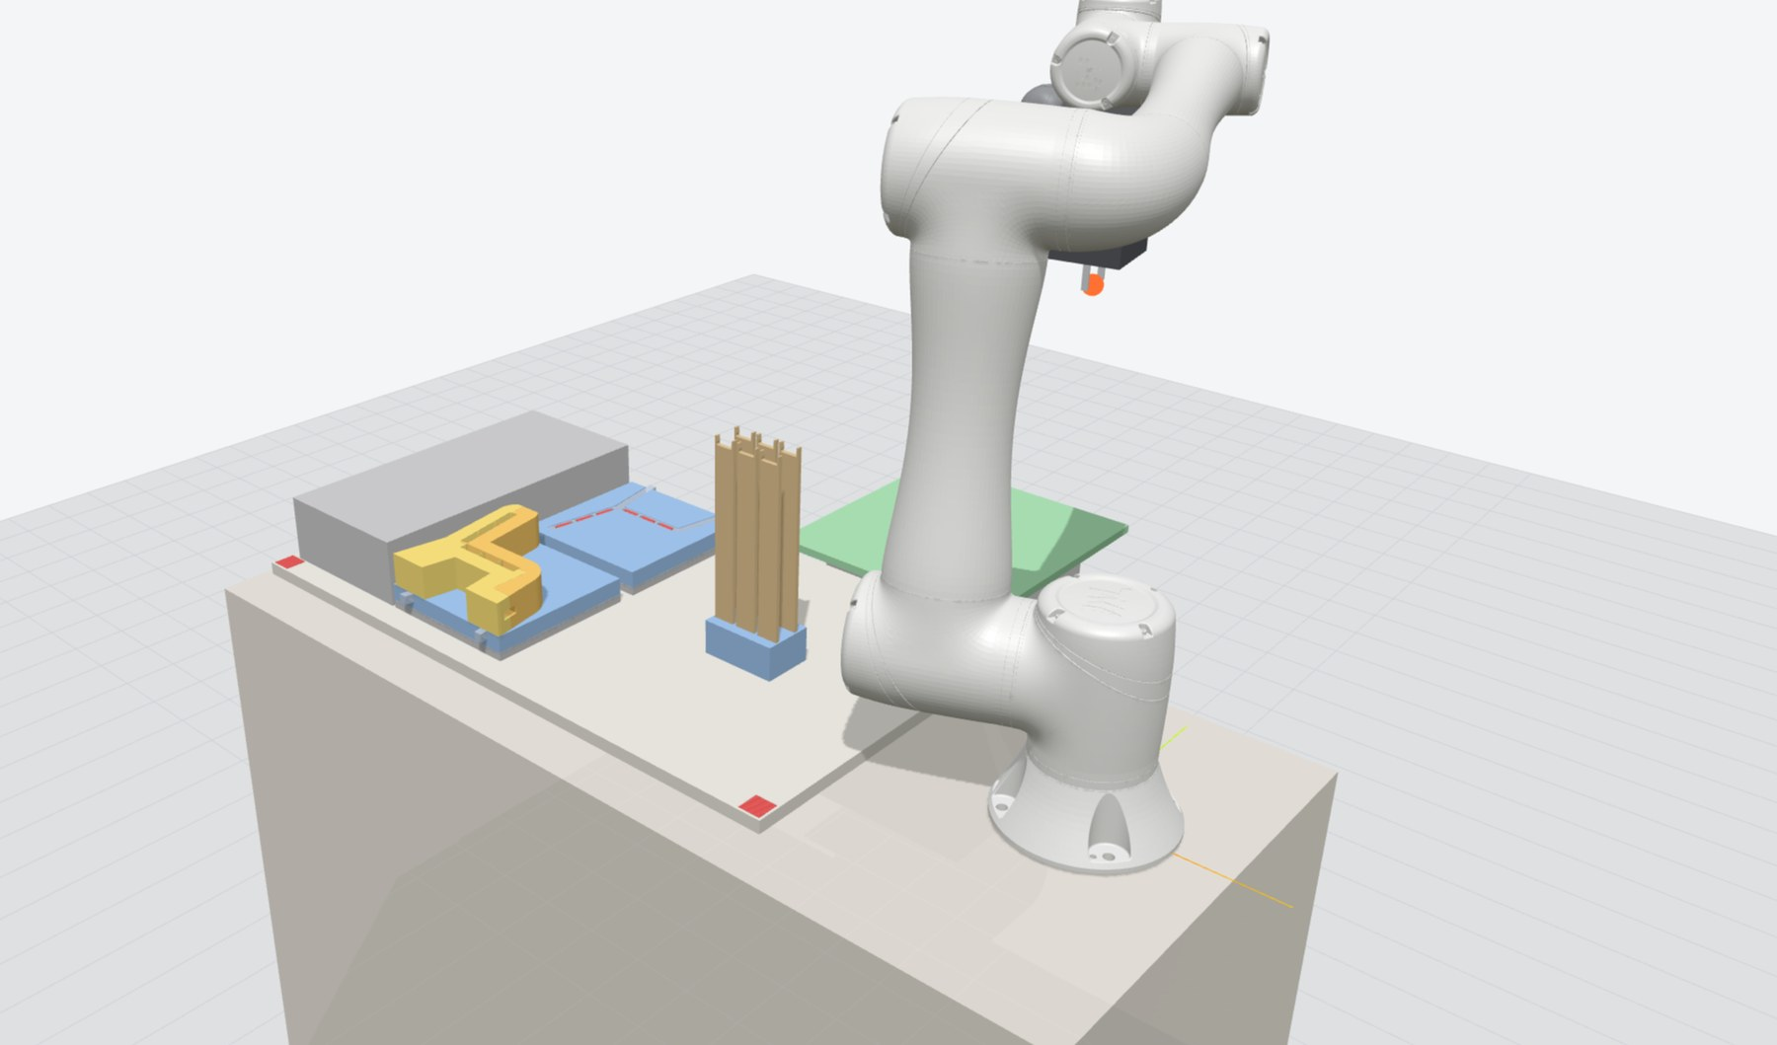
The cell runs in software before it runs in the lab
OUR WOW FACTOR
A digital twin of the TM5-900 cell, built by us: the same robot program and TMflow logic, with reach and collisions checked on every move
Notes:
Suggested speaker: Bjørge.
This is the part we are proudest of. We started in RoboDK, but its licence limits and the fact that it stops at the first collision slowed us down. So we wrote our own simulator: the robot's kinematics, a collision checker, the TMflow export, and a live 3D view in the browser. Every jig version you will see was tested here first.

Slide 7
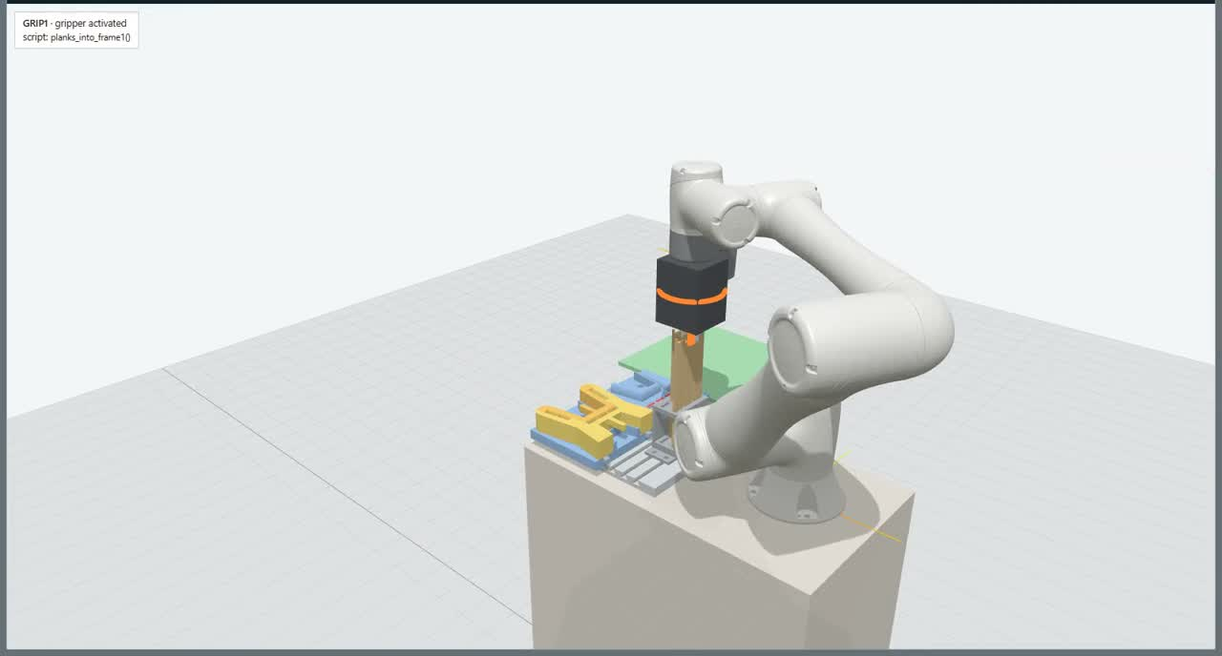
Video: one bench assembled in our simulator (2× speed)
Planks into frame 1 · guide halves onto base A · frame 1 and planks flipped into frame 2 · guide out
Notes:
Suggested speaker: Bjørge. Click the video to play (about 60 s).
What you see: the robot takes five planks from the rack and stands them in frame 1. The plank guide, in two halves, goes on top so the planks stay at the right pitch. Then the robot flips frame 1 with its planks into frame 2 on the other base. Finally the guide halves are pulled out of the finished bench, and the bench goes to the mobile robot.
Everything here is the real program: the same moves that are exported to TMflow.

Slide 8
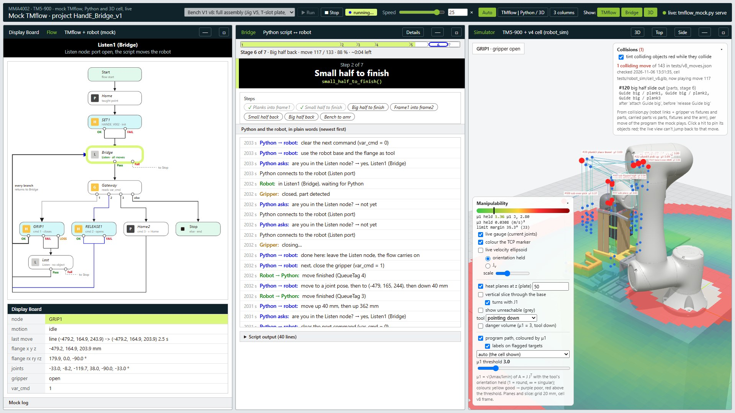
Our own digital twin of the cell
1
Mock TMflow project
1
2
4
The flow that runs on the robot: Listen node, gripper nodes, error exits.
2
Python bridge
Sends every move as a script over the Listen node, exactly as to the real TM.
3
3
3D cell
Techman's link meshes, our jig, planks and AMR plate; joints streamed live.
4
Checks on every move
Reach, collisions (arm, gripper and carried parts) and manipulability.
Live view during a v8 run, with the one remaining collision listed top right
Checked against RoboDK: kinematics within 0.005 mm, first collision at the same move.
Notes:
Suggested speaker: Bjørge.
Four parts. One: a mock of the TMflow project, the same flow that runs on the robot, so the logic is tested too, not just the path. Two: the Python bridge that streams each move over the Listen node, exactly as it does to the real robot. Three: the 3D cell. Four: the checks on every move: reach, collisions including the parts the robot carries, and manipulability, how far each pose is from a singularity.
We trust it because we checked it against RoboDK: forward kinematics agree within 0.005 mm, and on version 7 both tools found the first collision at the same move. Unlike RoboDK, ours lists every collision, not just the first, and runs on any laptop without a licence.

Slide 9
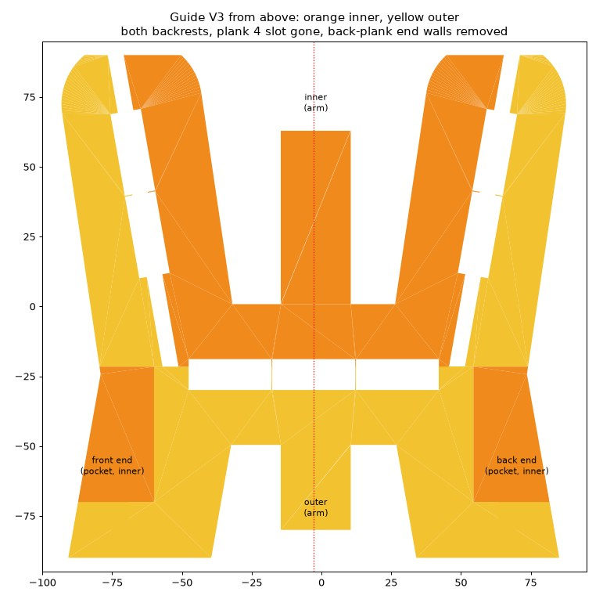
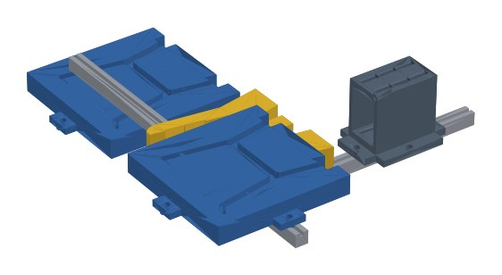
The simulation broke every jig before the lab did
v3
v4
v6
v7
v8
One double-sided guide
Guide split in two
No parking pad
Jig on the work plate
Feet face the robot
Found: the guide ends up trapped between the frames.
Each half slides out its own way; the bench goes onto the AMR.
The halves go straight back onto base A: the cell ends as it starts.
Found: wrist hits the plank rack while carrying the guide.
Guide out before the lift, big half parked on the AMR.
RULES WE TOOK AWAY
Risers of 120 mm: 60 and 30 mm fail at the flip
3-2-1 locating, push towards one datum
Lead-ins on every pocket
Guide split: inner half orange, outer yellow
Two frame jigs, guide and plank rack on T-slot profiles
Notes:
Suggested speaker: Bjørge.
Each circle is a version of the assembly method, and every one was found wanting in the simulation, not in the lab.
Version 3 used one double-sided guide. The simulation showed it ends up trapped between the two frames. So in version 4 we cut it in two along the plank rows: each half only touches the planks on sides it can slide away from. That is the orange and yellow drawing.
Version 7 moved the jig onto the robot's work plate, and the checker found the wrist hitting the plank rack. Version 8 turned the bases so the frame's feet face the robot, takes the guide out before the bench is lifted, and parks the big guide half on the AMR plate.
The rules on the right came out of it, for example: the risers must be 120 mm, because at 60 or 30 mm the flip does not clear.

Slide 10
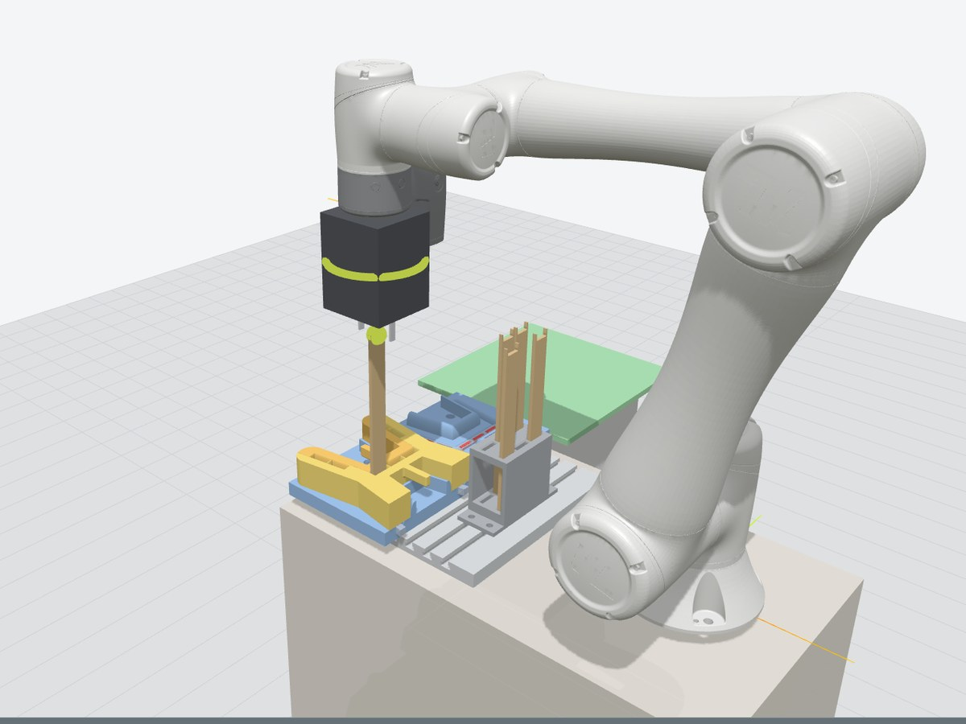
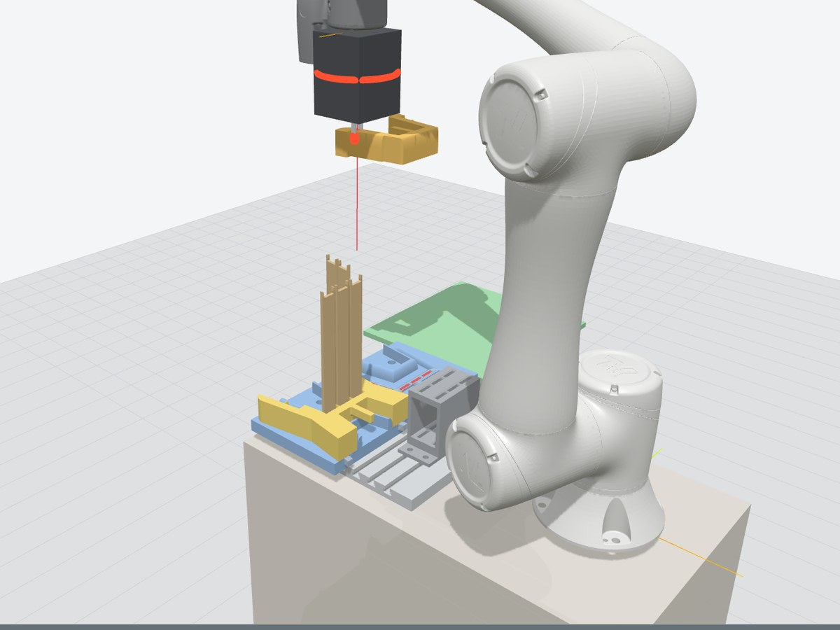
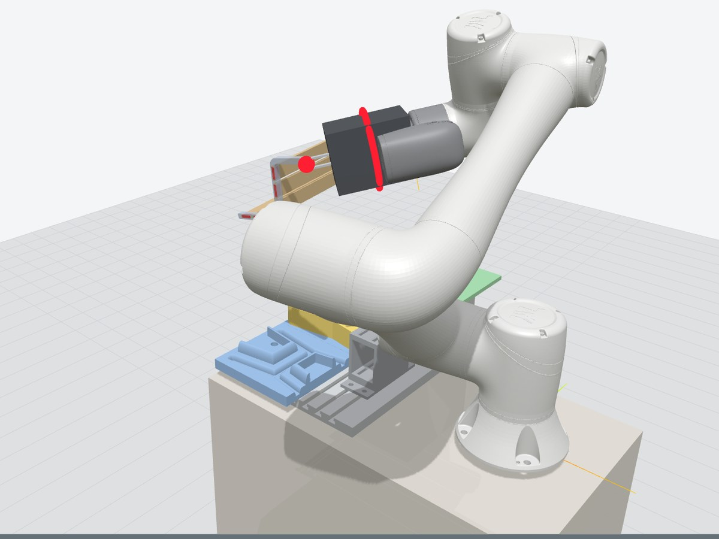
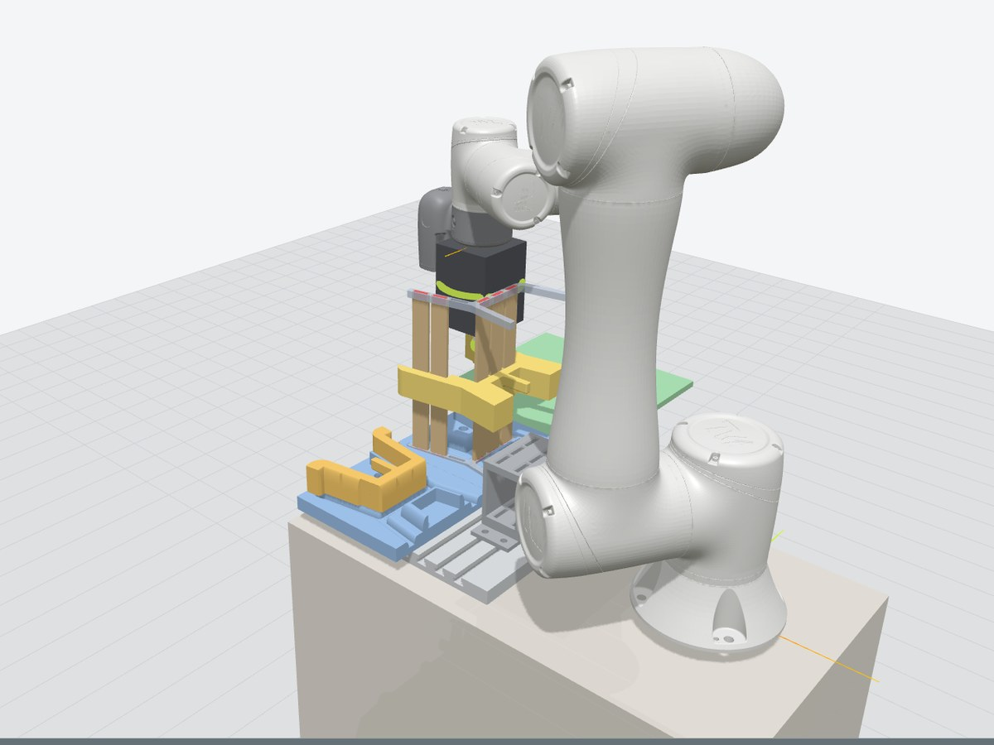
One bench: eight stages, about 333 seconds
1
2–3
Five planks: rack to frame 1
Guide halves onto base A
4
5–6
Splitting the guide cost about 100 s but removed a trapped part and a manual step.
The planks dominate: slow 20 mm/s moves near the parts.
Times at programmed speeds; the real robot's time comes from the lab.
Frame 1 and planks flipped into frame 2
Guide halves out of the bench
7–8: bench onto the AMR, big guide half back to base B
Notes:
Suggested speaker: Bjørge.
The eight stages of version 8. One: five planks from the rack into frame 1. Two and three: the guide halves onto base A. Four, the hardest move: frame 1 with all its planks is flipped into frame 2. Five and six: the guide comes out of the bench. Seven and eight: the bench goes to the AMR and the guide goes back for the next bench.
The chart is the cycle time for each version, calculated from the program at its programmed speeds. Version 3 was fastest, but its guide was trapped. Splitting the guide cost about a hundred seconds and removed a manual step. Version 8 is at about 333 seconds, five and a half minutes, far below the 3.65-hour takt. The planks take most of the time, because the robot moves slowly near the parts.
Data: cycle_times.csv (v3, v4, v6, v7; v5 was only an estimate and is left out). v8 = about 333 s from our own simulator (robot-cell/Next steps.md).

Slide 11
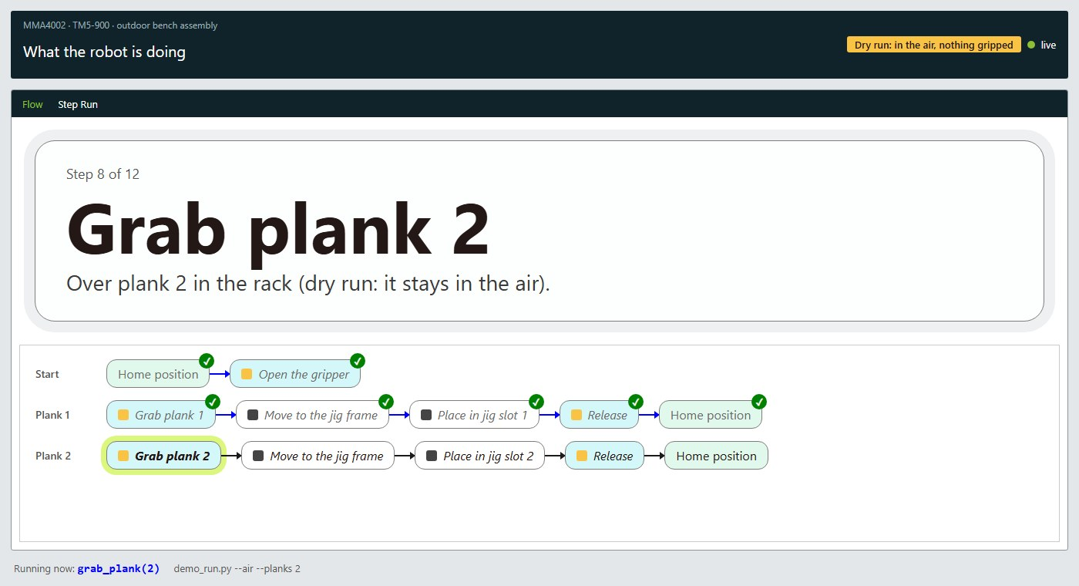


From simulation to the real TM5-900
VERIFIED ON THE LAB ROBOT
Live state at 100 Hz
Joints and flange pose over Ethernet Slave and Modbus.
Moves from Python
Line moves over the Listen node: 20 and 50 mm, exactly.
Gripper in the loop
Grip, release and an empty grip detected; hand-over in 6 s.
NEXT IN THE LAB
Audience view during a dry run on the lab robot: what the robot is doing, step by step
AMR delivery over ARCL
One program, two targets. The same move list drives the simulator and exports to a TMflow project. The export round-trips byte for byte on RoboDK's files; the import into TMflow is still to be tested.
"goto BenchCell", place the bench, "goto Delivery".
Vision base on the AMR plate
A TM Landmark corrects the AMR's few-cm stop error.
Notes:
Suggested speaker: Bjørge.
The simulator is not a toy: the bridge it tests is the one we use on the real robot. In the lab we verified that we can read the robot's state live, move it from Python over the Listen node with millimetre accuracy, and run the gripper in the loop, including detecting when it closes on nothing.
The screen on the right is the audience view from a dry run on the lab robot.
Next is the mobile robot. Omron's AMR takes text commands over the network, so the cell can send it to the bench and on to delivery. It only stops to within a few centimetres, so the cobot finds the plate with its wrist camera and a printed landmark.
Honest status: our own TMflow export matches RoboDK's files, but we have not yet imported it on the robot.

Slide 12


What we learned, and what we ask you
Lessons
Your feedback
Design product and cell together. One plank section and straight-down assembly made a one-jig cell possible.
Guide half locked in CAD. With the small half out, the big half cannot slide past the planks. More clearance, or a tooth less?
Fail in software first. Trapped guide, flip clearance, arm through the bench: all found before the lab.
Docking the AMR. Vision landmark or a mechanical docking guide: which holds up in a real plant?
Own tools pay off. No licence cap, every collision listed, runs on any laptop in the group.
Plank joint at full size. Slot fit works at 1:7.5. Would you press-fit, snap or screw planks in a real line?
Notes:
Suggested speaker: both. John Isak takes lessons, Bjørge the questions.
Three lessons. Designing the product and the cell together is what made it work: if the planks had different sections or went in from different directions, we would need several jigs or tool changes. Failing in software is cheap; failing in the lab costs a session. And building our own tools paid off.
Three questions for you. One: our last collision. In the CAD, the big guide half is locked between the planks once the small half is out; we want to know if you would add clearance or redesign the guide. Two: docking the AMR, vision or mechanics. Three: at full size, how would you join the planks to the frame in a real line?

Slide 13
Thank you. Questions?
Configure a bench yourself:
bjorgex.github.io/mma4002-assignment1
Bjørge Skjelbreid Djuve · John Isak Hammer
MMA4002 Design for Automated Manufacturing · NTNU Ålesund
Notes:
Suggested speaker: both.
Open for questions. If time allows, show the configurator live from the link or the simulator running v8.

