Slide 1
Machine Learning
Clustering

Slide 2
Subfields in machine learning
Supervised Learning - data and labels
Unsupervised Learning - data but no labels
Reinforcement Learning - agent generates data
Clustering is a field within unsupervised learning which tries to group data into clusters

Slide 3
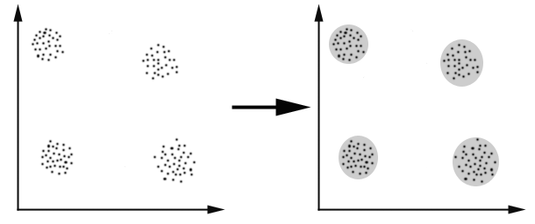
Example

Slide 4
Major clustering approaches
Partitioning
Density-based
Hierarchy algorithms

Slide 5

Partitioning Algorithms (K – means)
Goal : partition the n data into k clusters
How : minimize some objective function
$F=\sum_{i=0}^{k}{\sum_{\vec{X_{j}}∈C_{i}}{{\left\|\vec{X_{j}}− \vec{C_{i}}\right\|}^{2}}}$
$\vec{C_{i}}=\frac{1}{\left|C_{i}\right|}\sum_{\vec{X_{j}}∈C_{i}}{\vec{X_{j}}}$

Slide 6
K - means
Usually data is too large to try all possible combinations of clusters
Instead do the following:
1) Split the data into k clusters
2) Calculate the cluster centers (centroids)
3) Assign data to the cluster which it is closest to
4) Repeat 2 and 3 until converged

Slide 7
Pros and cons
Pros
Relatively fast O(tkn), t = #iterations, n = #objects and k = #clusters
Easy implementation
Cons
Need to specify the number of clusters in advance
Depends in initial partition → several restarts are required
Clusters are forced to have convex shapes

Slide 8
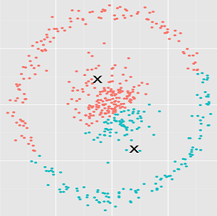
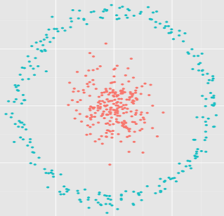
Convex example
K - means
Density-based

Slide 9
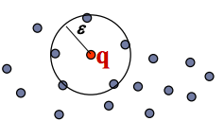
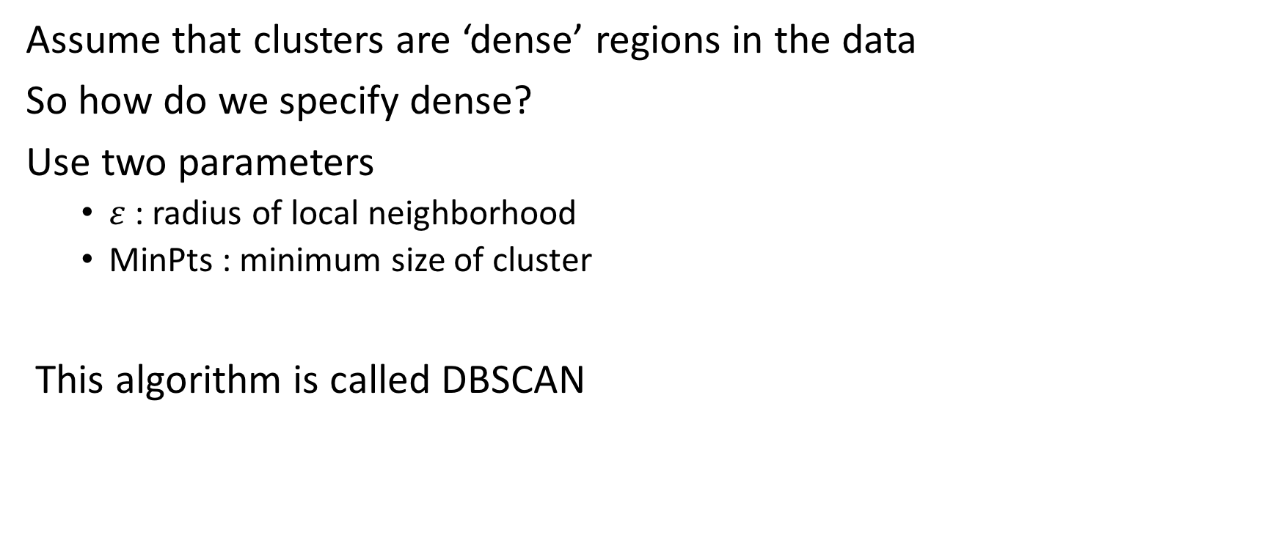
Density-based clustering
Assume that clusters are ‘dense’ regions in the data
So how do we specify dense?
Use two parameters
$ε$: radius of local neighborhood
MinPts : minimum size of cluster
This algorithm is called DBSCAN

Slide 10
DBSCAN
Pros
Arbitrary shapes possible
Can detect noise
No need to specify number of clusters
Cons
Can be difficult to determine parameters
Slower than k - means

Slide 11
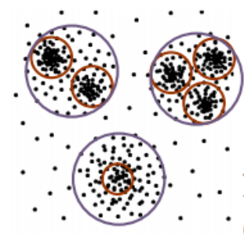
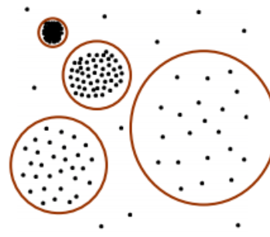
Parameter sensitivity

Slide 12
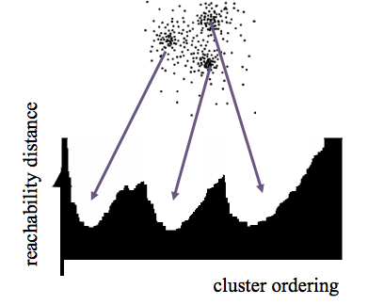
Hierarchical clustering - OPTICS
Ordering Points To Identify the Clustering Structure
Basic idea : always make the shortest jump

Slide 13
OPTICS
Pros
No need to specify number of clusters
Robust parameters
Complete hierarchy of clusters
Good visualization independent of dimension of data
Cons
Slower than other methods

Slide 14
Mathias S. Jørgensen, Michael N. Grooves,
Bjørk Hammer
J. Chem. Theory Comput., 2017, 13 (3)

Slide 15
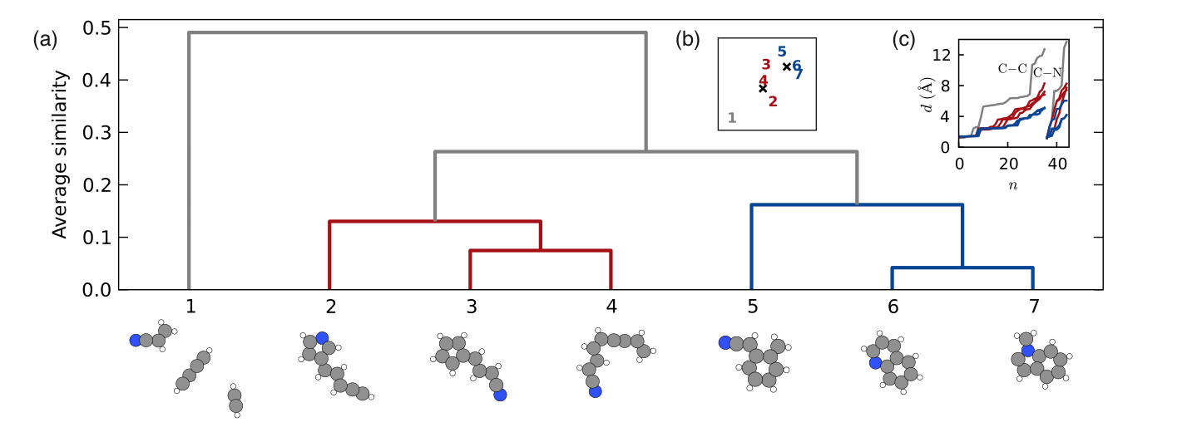
Feature vector : Bag-of-Bonds
Similarity : L1-norm
Mathias S. Jørgensen, Michael N. Grooves,
Bjørk Hammer
J. Chem. Theory Comput., 2017, 13 (3)

Slide 16
Dense,
explored region
Promising, unexplored region
Population
Offspring

Slide 17
Mathias S. Jørgensen, Michael N. Grooves,
Bjørk Hammer
J. Chem. Theory Comput., 2017, 13 (3)

Slide 19

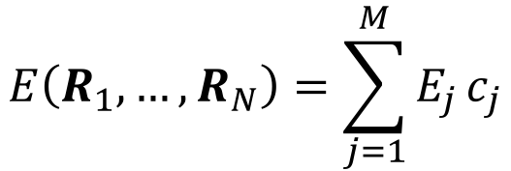
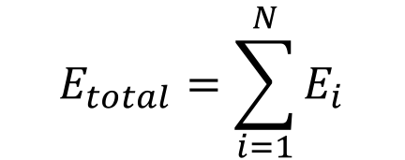
Machine Learning model
$$E_{total}=\sum_{i=1}^{N}{E_{i}}$$
# of atoms in cluster 1
Calculate local feature vectors
Cluster local feature vectors
For a given configuration count atoms in each cluster
Regression model to predict total energy as sum of local energies
$$F\left(f_{1}, …,f_{N}\right)=\left[c_{1}, …,c_{M}\right]$$
$$E\left(R_{1}, …, R_{N}\right)=\sum_{j=1}^{M}{E_{j}}c_{j}$$

