Slide 1
globalhealth
an e-health solution for everyone
Investment opportunity
Proprietary and Confidential
Health XCEL, Inc. 2008
Bjorn Harvold President and Founder bjorn@hxcel.com (917) 494 6357 | Ben Taylor CIO and Founder ben@hxcel.com (917) 208 6124 | Paul Fisher CTO and Founder paul@hxcel.com (973) 651 7393

Slide 2

Notes:
Health XCEL, Inc., a service company in the e-health market,
empowers institutional, professional and patient stakeholders
with the ability to share and review sensitive patient
information and communicate seamlessly and
securely through the Internet

Slide 3
Team
Bjorn Harvold
Paul Fisher
Ben Taylor
Notes:
Bjorn Harvold
10 years experience
Expertise: Technology vision, e-health sector expert
Founded Brezzy-Knight Intl.
Founded F-SSS
Founded WPS
Founded Xenotrope

Slide 4
Market Summary
Industry size (2006): $37.2 billion
Projected size (2013): $68.5 billion
Growth: 84%

Slide 5
Opportunities

Slide 6
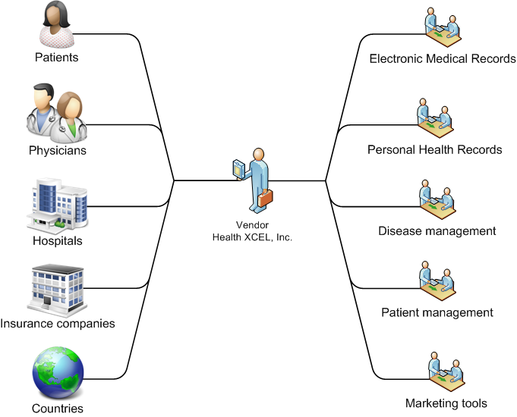
Overview
Notes:
Globalhealth empowers patients, physicians, hospitals, insurance companies and even countries with secure sharing of patient records, appointment scheduling, and alerts and notifications.

Slide 7
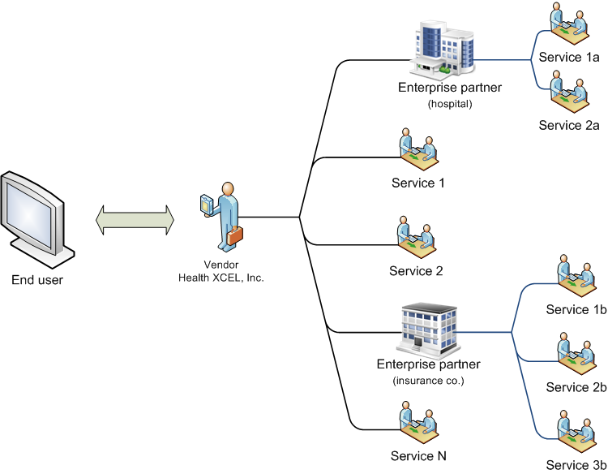
Enterprise interoperability
Notes:
The Globalhealth Platform leverages cutting edge technologies and medical standards. It gives us and 3rd party integrators the ability to create quality health care applications that can securely interoperate with each other and other external applications.

Slide 8
Competition

Slide 9
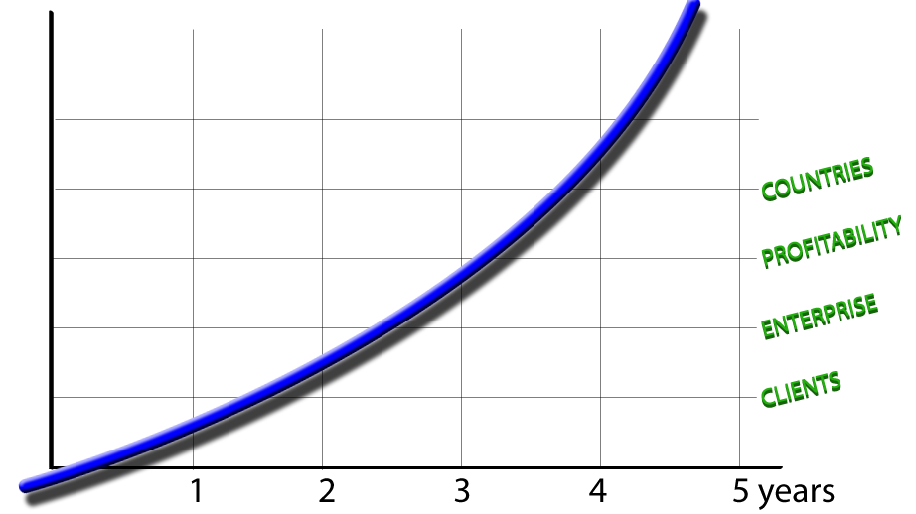
Goals

Slide 10
Financials

Slide 11
Questions?

Slide 12
What’s the problem anyway?
Healthcare cost
Countries cannot afford healthcare
Baby boomers growing old
Population growing
Citizens cannot afford healthcare
Insurance premiums / Denied coverage
Doctors cannot afford healthcare
Administrative overhead
Notes:
E.U. has already spent 500+ million Euro on e-health initiatives

Slide 13
What’s the problem anyway?
Medical records
Paper based
Non-centralized
Doctors control patient records
Lack of standardization

Slide 14
What’s the problem anyway?
Information Technology
Old / disparate technologies
Data sharing impossible [or very costly]
Costly to maintain aging systems
Not enough funds for major overhauls

Slide 15
Is there a solution? e-Health!
Centralized system
Secure storage / transmission
Standards based
ICD-10, ICPC-2, HL-7
SSL, AES-256 (encryption)
SOA for integration
Authentication & Access Control

Slide 16
Is there a solution? e-Health!
Client-centric, permission-based model
Patient controls / manages her electronic medical records (EMRs) created by doctor
Patient shares the records with other doctors
Patient facilitates record creation by keeping Personal Health Records (PHRs)
Patient manages her emergency records

Slide 17
Introducing Globalhealth
A social network for health care
Platform built on accepted standards
Security
Data exchange
Medical
Vertical 1-stop shop for health professionals

Slide 18
DATA SHARING
Journal creation
Diagnosis
ICPC-2, ICD-10…
Treatment
Media
Journal sharing
Patient shares journal w/ other doctors

Slide 19
DATA SHARING
PHR creation
Allergies
Conditions
Medications
etc …
PHR sharing
Emergency record set

Slide 20
DISEASE MGMT.
Alerts
Message creation
Voice recordings
Emails
Text messages (SMS)
Surveys
Conferencing

Slide 21
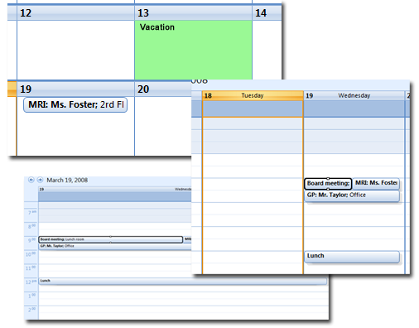
SCHEDULING
Appointments
Creation
Browsing
Synchronizing
Sharing
Supports
Multiple schedules
Vacation days
Single / group
Recurring
Cancellations
iCalendar standard

Slide 22
MARKETING
Ratings
Blog
Forum
Chat
Media

Slide 23
RATING
Patients with established relationships can rate their doctors
Rating: 1 – 5 stars + review

Slide 24
JOB BOARD
Job board
Referral network

Slide 25
E-COMMERCE
e-Store for professionals
B2B, B2C
Multi-lingual
Multi-currency

Slide 26
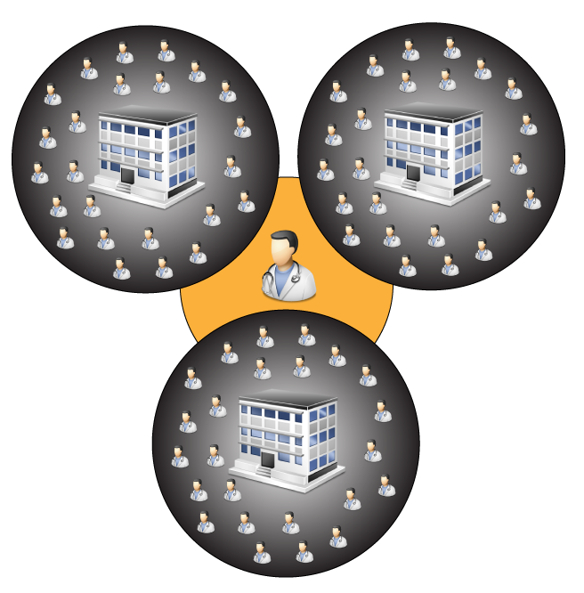
REVENUE SHARING
Revenue incentive for professionals
Kickback of monthly subscription fees
Lowered monthly subscriptions

Slide 27
SECURITY
SECURITY IS KEY!
Encrypted data (AES)
Public / Private key data sharing
Authentication
Permissions
Network encryption (SSL)
HIPAA standards
NATO Level-4 Restricted standards

Slide 28
LOCAL IS GLOBAL
Local initiatives on a global scale
Offer low cost health care to members (U.S.)
Support Red Cross / UNICEF
Support for local health initiatives

Slide 29
Milestones & Opportunities
Social network for health care
Organization level integration
Country level integration

Slide 30
Social network for health care
Globalhealth v1.0
Premium subscription packages
Partly ad-based revenue

Slide 31
Organization level integration
Enterprise social networks
Hospitals
Insurance companies
Non-profit

Slide 32
Questions?

Slide 33
For more information
www.hxcel.com

