Slide 1


Unified Communications
Convergence and Openness in Healthcare
Health XCEL, Inc.
Notes:
Good morning
Thank you for having us
My name is…. And this is my associate
We’re here to talk about how to build an HIE while leveraging RDF
We know we’re the only thing between you and lunch and we have a lot of stuff to cover so let’s get cranking

Slide 2

Agenda
Unified Communication is…
Convergence in Health
Semantic Web/Web 3.0/Future Tech
Questions
Health XCEL, Inc.
Notes:
- Quick introduction
We’ll cover the paradigm shift that is coming in healthcare
What it takes to build a successful HIE
RDF: One solution for data aggregation
Application / Platform demo
Q/A if we have time

Slide 3
What is Unified Communication?
Convergence.
Health XCEL, Inc.

Slide 4
What is Unified Communication?
Convergence of:
Services, Platforms, & Standards
  Social Networks (aka Facebook)
  EHR (Electronic Health Record)
  PHR (Personal Health Record)
  Telephone Networks (PSTN, VOIP, SIP)
  iPhone / PDA
  OpenID (authentication standard)
Media
  Patient / Doctor journals (aka medical data)
  Instant Messaging / SMS / e-mail
  Conference calls / Emergency calls
Health XCEL, Inc.

Slide 5
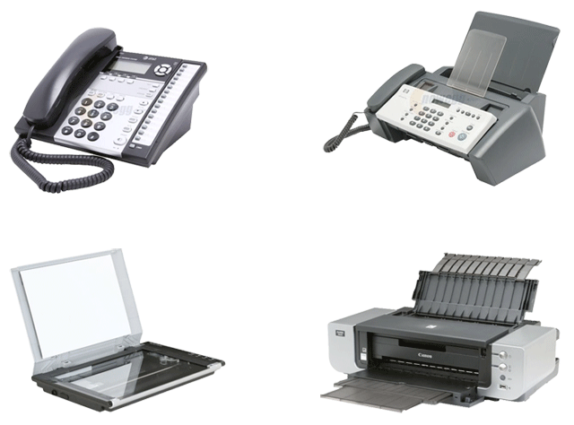
What is Unified Communication?
Health XCEL, Inc.

Slide 6
What is Unified Communication?
Health XCEL, Inc.

Slide 7
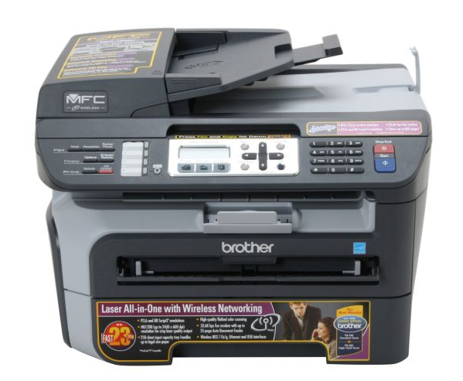
What is Unified Communication?
Health XCEL, Inc.
Notes:
Offering Phone, Fax, Scanner AND Printer capabilities. And for today only….. NEXT SLIDE

Slide 8
What is Unified Communication?
70% OFF
Health XCEL, Inc.
Notes:
Seriously though. The product is wrong in our case…. But the concept is right. The manufacturer has created a platform that supports services such as scanning, printing etc.
It might not understand what a Xerox printer is trying to tell it, even though they offer the same services, but that’s because they aren’t interoperable, and that’s beside the point for right now.

Slide 9
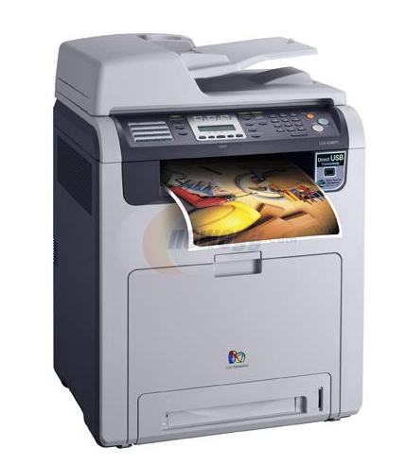
What is Unified Communication?
Health XCEL, Inc.
Notes:
Offering Phone, Fax, Scanner AND Printer capabilities. And for today only….. NEXT SLIDE

Slide 10
What is Unified Communication?
Interoperability problem is not solved.
Health XCEL, Inc.
Notes:
Offering Phone, Fax, Scanner AND Printer capabilities. And for today only….. NEXT SLIDE

Slide 11
Why we need convergence
One of the problems with technology today is that there too many platforms; too many channels and tools through which to communicate.
Health XCEL, Inc.

Slide 12
Why we need convergence
This can often cause more problems than it solves.
Health XCEL, Inc.

Slide 13
Why we need convergence
Convergence helps to unify these various protocols and tools, enabling communication.
Health XCEL, Inc.

Slide 14
Convergence is about Synergy
Synergy is achieved when the sum of the parts is significantly greater than the individual parts themselves.
Health XCEL, Inc.

Slide 15
Convergence is about Synergy
True Convergence is made possible through interoperability.
Health XCEL, Inc.

Slide 16
Convergence is about Synergy
When disparate platforms / services are able to effectively communicate with each other.
Health XCEL, Inc.

Slide 17
Unified Communication is…
What about e-health convergence?
Health XCEL, Inc.

Slide 18
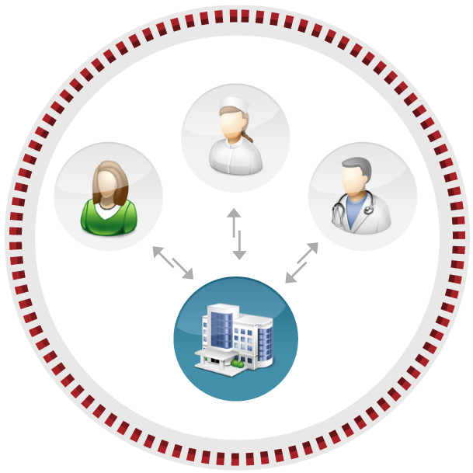
Old Business Paradigm
Health XCEL, Inc.
Notes:
INTERCOMMUNICATION
Created a silo for Patients and Physicians to share information
Assumed everyone would enter in data into our silo ONLY
Contributed to the existing problem of silos not being able to communicate.
2 ways of getting information into the system
1. Patients and Physicians could enter the data in manually
2. Data migration from existing systems
Features:
- An online service to securely enter and exchange medical data. E.g. PHR and HER
Challenges:
- critical info not in electronic form
- when it is in electronic form it is difficult to exchange between systems (technical and regulatory issues)
- tying into external systems for insurance, hospital records
While it does take things a step in the right direction where data exchange is possible, it doesn’t solve the problem

Slide 19
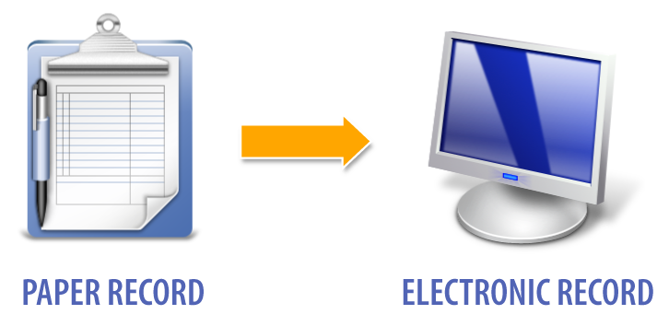
Medical Data Management Evolution
Stage 1
Health XCEL, Inc.
Notes:
How to get paper into the computer

Slide 20
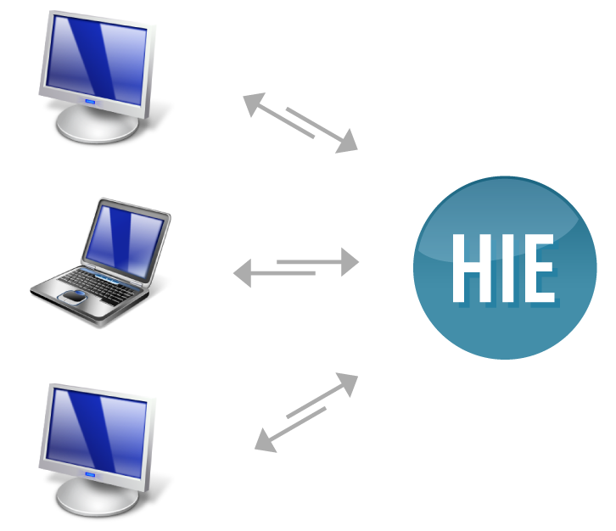
Medical Data Management Evolution
Stage 2
PHYSICIAN
INSURANCE
PATIENT
Health XCEL, Inc.
Notes:
Show ilustration of how the data will move from hospitals and doctors to HIEs
Data now resides completely with the HIE and external entities are leveraging the services of the HIE to conduct their daily work

Slide 21
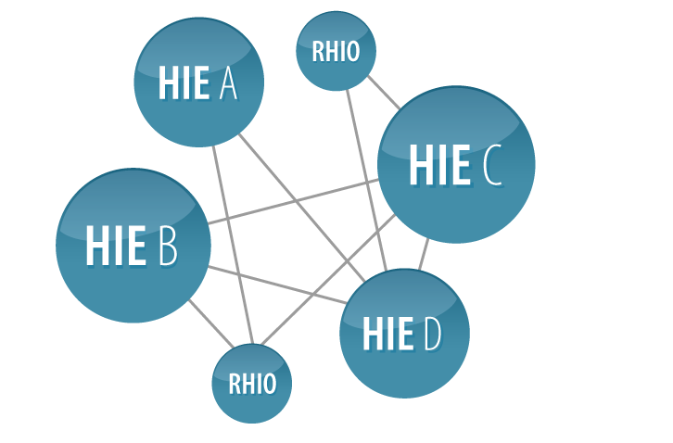
Medical Data Management Evolution
Stage 3
Health XCEL, Inc.
Notes:
Data is hosted across a network of HIE
One HIE might offer superior services for large data mining
Another service hosts the best Personal Health Record
The location of the data or service doesn’t matter as long as we know where to go get the data
Federated security
These systems will require new regulations AND deregulation

Slide 22
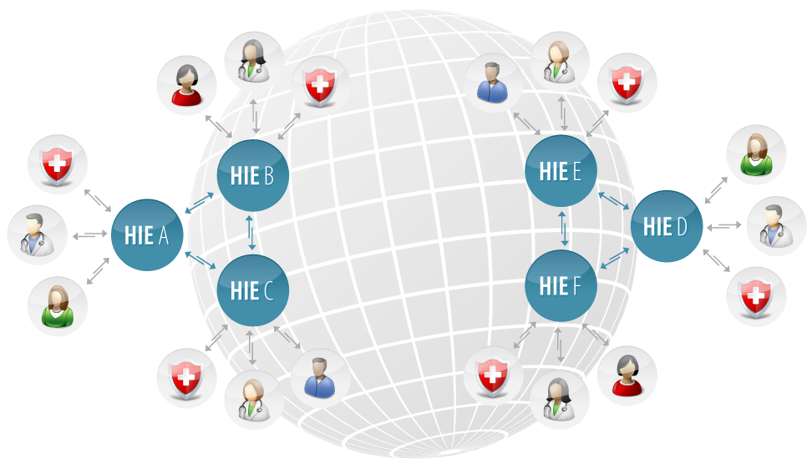
New Business Paradigm
Health XCEL, Inc.
Notes:
Hospitals and Physicians will no longer need to install anything or store sensitive data. Instead, they will shop for the local RHIO that offer their services and sign up for a monthly subscription.
Let the professionals take care of data storage and securing that data.
Hospitals will save millions in outsourced IT
INTEROPERABILITY
How to open up the silos and have them speak to each other using a common language
E.g. AOL vs Internet

Slide 23
Convergence in Practice
Real-time access to Health Records from any device
Health XCEL, Inc.

Slide 24
Convergence in Practice
Real-time access to Health Records from any device
Automatic Event notification to physicians, family members, or other systems
Health XCEL, Inc.

Slide 25
Convergence in Practice
Real-time access to Health Records from any device
Automatic Event notification to physicians, family members, or other systems
Real-time conferences, integrating disparate media and platforms
Health XCEL, Inc.

Slide 26
Convergence in Practice
The core point is that convergence enables the creation of a new breed of services through open standards and interoperability.
Health XCEL, Inc.

Slide 27
New Paradigm Barriers
Regulations
Technology adoption
Lack of interoperability
Standards
Health XCEL, Inc.

Slide 28
Health Information Exchange
Quick Overview of HIE.
Health XCEL, Inc.

Slide 29

Health Information Exchange
HIE System
Communication
Interoperation
Health XCEL, Inc.

Slide 30
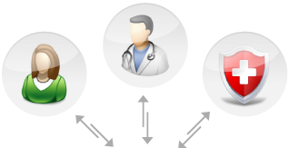
Health Information Exchange
HIE System
Communication
Interoperation
Health XCEL, Inc.
Notes:
Patients, insurance companies and physicians sharing information.

Slide 31
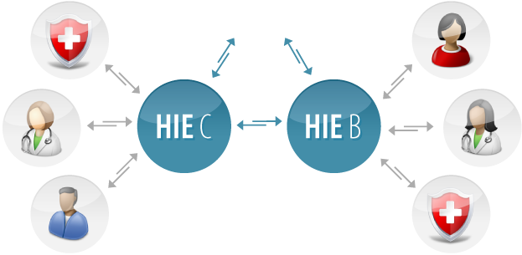
Health Information Exchange
HIE System
Communication
Interoperation
Health XCEL, Inc.
Notes:
HIEs interoperating
Doctors have access to patient info from external HIEs

Slide 32
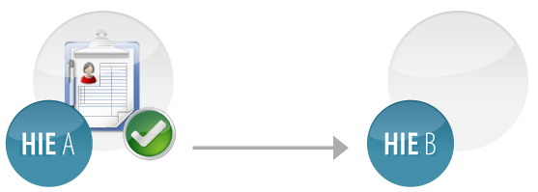

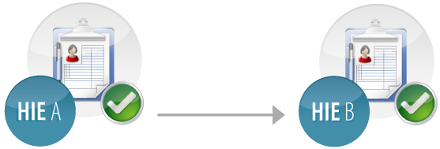
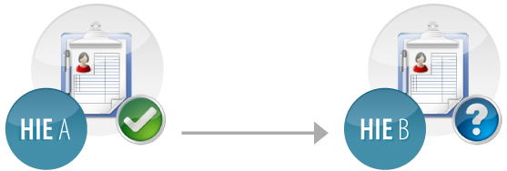
HIE Key Ingredients
The Portable User
Health XCEL, Inc.
Notes:
- We need to be able to distinguish the patient across HIEs

Slide 33

HIE Key Ingredients
Break-the-Glass Access
Health XCEL, Inc.

Slide 34
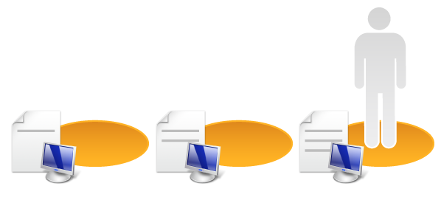

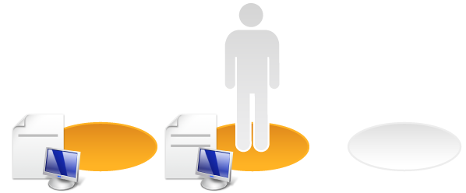
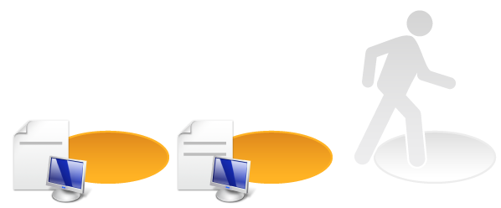

HIE Key Ingredients
Audit Trail
Health XCEL, Inc.
Notes:
CCHIT HIE conformance

Slide 35
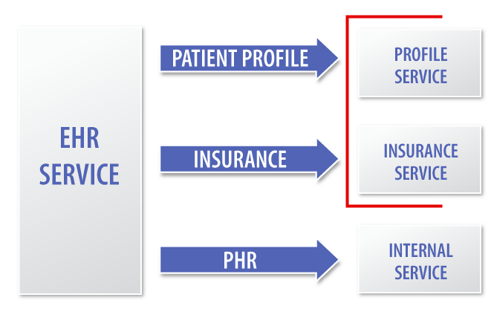
Building an HIE Platform
Service Oriented Architecture
Health XCEL, Inc.

Slide 36
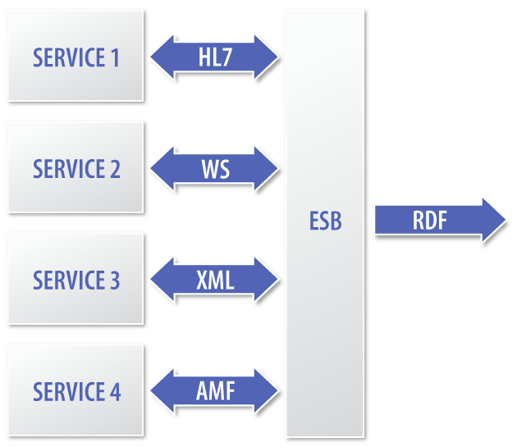
Building an HIE Platform
Enterprise Service Bus
Health XCEL, Inc.
Notes:
- mirthproject.org
Messaging
RDF XML, HL7 RIM, Web Services, AMF ++
➔ Enterprise Service Bus
Data structure
Standards, Standards, Standards
Domain Vocabularies / Ontologies
RDF???, HL7 EHR-S, PHR ++
Bringing the buzzwords together
RDF, XML, HL7, RIA,
ESB, SOA, WS, AMF, i18N

Slide 37
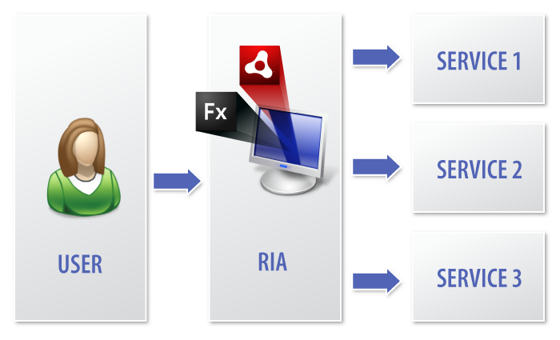
Building an HIE Platform
Rich Internet Application
Health XCEL, Inc.
Notes:
Adobe Flex / AIR
Modular, component-based and portable
Supports communicating via AMF. XML and Web Services
Stateful

Slide 38

Building an HIE Platform
Interrelated Component Architecture
Health XCEL, Inc.
Notes:
The result is a component based architecture with a growing number of modular services and applications.
Interrelated services such as a calendar depending on an alert service
What you saw was a system overview of what comprises a platform
Now I would like to talk about how you can make disparate data come together.

Slide 39
A Brave New World
Imagine. . . being able to do analyses and case studies — not on small samples, but on THE WHOLE POPULATION
Notes:
According to Dr. Jonathan Borden, MD, the semantic web could provide easy answers to questions like:
“Of all the patients I operated on for brain tumors between 1996-2000, matching severity of pathology and matching clinical status and who have the “P53” mutation, did PCV chemotherapy improve the cure rate at five years?”

Slide 40
A Pragmatic Solution
Proprietary solutions wont disappear. BUT, they need a common language that disparate systems can speak, so that data can be effectively shared
Enter Resource Description Framework

Slide 41
Core Concepts
RDF is based upon the concept of resources
  Resources are typically identified by a unique URL
  A resource can represent anything:
    A Patient
    A Hospital
    A Disease
Notes:
A Resource can be an abstract concept, linking an identifier to an entity in the real world.
For instance, if a resource represents a patient, the patient can change over time
As long as the resource linking remains constant, we can build inferences and assumptions
BELOW: NOT IMPORTANT
A collection of properties associated with a specific resource is called a description
RDF enables the ability to describe resources in a standard way
These concepts can be used to build a model that can be parsed by machines and humans to make powerful inferences
Resources in RDF contain properties which are identified by property-types.
Property-types have corresponding values
Property-types describe the relationship between a resource and its values
A value can be a literal or even another resource (with its own properties and values)

Slide 42

RDF Concepts
RDF statements are comprised of triples
Notes:
RDF statements are comprised of triples (or tuples) containing a:
Subject
Predicate
Object
The subject is the resource we are describing
The predicate defines the property
And the object represents the value of the attribute

Slide 43
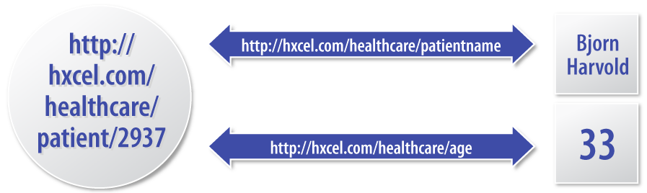
RDF Concepts
Notes:
A subject is represented by a URL resource, allowing multiple, disparate systems to define properties about an entity
For instance, if a patient is represented by the URL: http://hxcel.com/patients/2937 we can make inferences about this patient by aggregating data where this URL is defined as a subject of an RDF statement
Notice that both the subject and the predicate are represented by URL resources.
Representing a predicate with a URL allows us to define shareable, absolute vocabularies.
In other words, if we define a property of:
http://hxcel.com/healthcare/patient/name
We can use this property in other applications and statements to indicate the same concept: a patient’s name
This is the building block for defining vocabularies about a particular subject or domain

Slide 44
RDF Examples
Imagine these statements:
  Bjorn is the patient of Dr. Taylor
  The patient of Dr. Taylor is Bjorn
The above statements means the same thing
But to a computer, they are very different — the inferred meaning is the same
Notes:
RDF allows machines to understand and make inferences about resources, their properties and their relationships to other resources
The ability to describe resources in an “open-fashion” is the key benefit of RDF
The goal of RDF and the semantic web is that systems can aggregate data from disparate RDF models across the Internet

Slide 45
Contrasting RDF: DB Approach
Patient Table
  PersonId FirstName LastName
Doctor Table
  DoctorId FirstName LastName
Condition Table
  ConditionId ConditionName ConditionDetails
Notes:
Imagine a typical Database-driven application for healthcare:
We might want to define a model that tracks patients, their doctors, and their conditions

Slide 46
Contrasting RDF: DB Approach
Patient_Doctor Table
  PatientId DoctorId
Condition_Patient Table
  PatientId ConditionId
Notes:
Link Tables must be employed to associate a row from one table with a row from another table:
But what if we want to build upon this model and want to define concepts such as symptoms, diagnoses, results?
With our Database-driven approach, we must define new tables and possibly alter the database schema of our existing application
In healthcare today, the database example accurately portrays the way patient data is currently managed and saved
Disparate, proprietary, closed systems manage patient data
Redundant systems exist which maintain information about the same patients and/or the same diseases, symptoms, etc.

Slide 47
Contrasting RDF: DB Approach
With closed systems, data is not easily shared
RDF is an ideal solution to bridge the gap and make sharing, aggregating and mashing data feasible
With RDF, all data is broken down into the “lowest common denominator” of tuples and resources.
Allows data from disparate sources to be mashed together
Notes:
This is both flexible and extensible, allowing for both new resources and new concepts to be defined and integrated into our application

Slide 48
RDF Approaches
So what does RDF/XML look like?
<?xml version="1.0"?>
<rdf:RDF xmlns:rdf=http://www.w3.org/1999/02/22-rdf-syntax-ns# xmlns:hxl=http://hxcel.com/hxl/elements/1.1/ xmlns:exterms="http://www.example.org/terms/">
<rdf:Description rdf:about=”http://hxcel.com/healthcare/patient/2937">
<hxl:patientname>Bjorn Harvold</hxl:patientname>
</rdf:Description>
<rdf:Description rdf:about=“http://hxcel.com/healthcare/patient/2937”>
<hxl:age>33</hxl:age>
</rdf:Description>
</rdf:RDF>
Notes:
The core RDF statement is:
<rdf:Description rdf:about=”http://hxcel.com/healthcare/patient/2937">
This statement uses the rdf namespace, and indicates that we are describing a particular resources (via the rdf:about attribute).
============================================================
The predicate and object are defined with the rdf:description block:
<hxl:patientname>Bjorn Harvold</hxl:patientname>
This specifies that the property hxl:patientname has the literal value: Bjorn Harvold
============================================================
In the previous example, the property hxl:patientname is using a namespace prefix as a shortcut
As far as RDF is concerned, the actual resource representing this property is the full extended URL represented by the hxl prefix, followed by #patientname
=============================================================
It is important to remember that the object of a subject – predicate – object statement may be a literal or a resource itself.
For instance, we could define a resource type called patientRecord that could be represented directly by a URL resource
We could then attach properties to this resource, rather than a patient directly
This could give us greater flexibility, for instance, allowing patients to have multiple records, etc

Slide 49
Ontologies
Roll your own:
Data types
Class hierarchies
Notes:
RDF also allows for the description of data types and class hierarchies
This provides a construct similar to Java and object-oriented language
For instance, you can represent the hierarchy and relationship between diseases, symptoms, treatments
These concepts can then provide clues from which applications can make inferences
Ontologies provide a means for defining a hierarchical model, along with a vocabulary of concepts
Defined ontologies can then be applied to resources to provide better “clues” as to how resources are related, and “what” they actually are.
These concepts enable object-oriented concepts to RDF resources, allowing models to be defined with more specificity

Slide 50
Ontologies
<rdfs:Class rdf:ID=”Symptom"/>
<rdfs:Class rdf:ID=”Nausea"> <rdfs:subClassOf rdf:resource="#Symptom"/>
</rdfs:Class>
Notes:
The above statement introduces a base class called Symptom
We then define a class called Nausea, indicating that it is a subclass of Symptom

Slide 51

Going Full-Cycle
Cradle-2-Grave medical management
Health XCEL, Inc.
Notes:
RDF facilitates a cradle-2-grave philosophy where medical data about a person is aggregated throughout the person’s lifetime from many different sources and available from anywhere

Slide 52
Demonstration
Topics
Flex/AIR highlights
Portable user
Hosted services
  versioning
  hot swappable
Hosted applications
  versioning
  hot swappable
  licensable
Customizable by country
  Configurable at runtime
  Internationalization at runtime
  Customizable by licensee
Health XCEL, Inc.

Slide 53
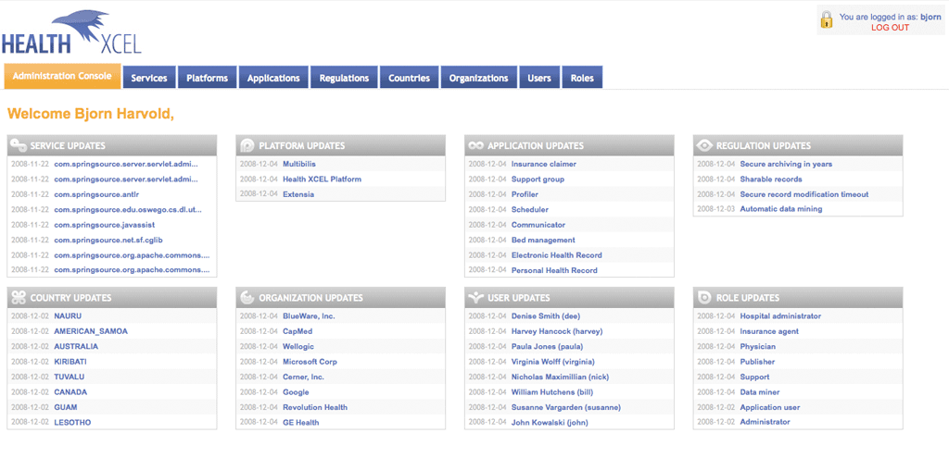
Demonstration
Health XCEL, Inc.

Slide 54
Conclusion
Unified Communication is a platform that can offer interoperable services to its global subscriber base
  E.g. Electronic Heath Record service
Building these services using open source technologies allows for
  higher quality software – lower cost,
  faster to market,
  larger developer base and
  greater transparency
    (not to be mistaken with less security)
Health XCEL, Inc.

Slide 55
Conclusion
Founded 2004, New York City
Health XCEL is an e-health vendor
  HIE Platform
  Interoperable applications
    EHR
    PHR
    RX
    Billing
    Scheduling
    Communications suite
Health XCEL, Inc.
Notes:
Founded in 2004 and based out of NYC.
We’ve built an interoperable, modular, patient centric (where the patient is in control of her own data), HIE platform that can service small and large health care providers, their patients, insurance companies and countries.
Applications:
Services include automated billing, online prescription refills, personal health record, electronic health record, client scheduler and a communication suite for conference calls, appointment alerts via sms, email and phone reminders and phone surveys.
We’ve leveraged only recognized medical and technology standards, and open source frameworks for messaging, security, data ontologies and storage.
E.g. Java, RDF, Web Services, Adobe Flex/AIR, HL 7 RIM v2/3, ICPC-2, ICD-10, conforming to HIPAA etc
Turn it over to Ben who will provide a business context for why our apps and services were created

Slide 56
Questions?
Health XCEL, Inc.

Slide 57
Thank you for your attention
info@hxcel.com
www.hxcel.com
Bjorn Harvold | Ben Taylor
Health XCEL, Inc.

