Slide 1
Functional purity as a code quality metric in multi-paradigm languages
20-07-2022
Bjorn Jacobs

Slide 2
Introduction
Notes:
Mention the context of c#
Mention the origin of this study. E.g. previous studiesj

Slide 3
What are metrics?
Process | Product
Features done | Lines of source code
Hours spend programming | Cyclomatic complexity
Story points done | Comment count
Etc. | Etc.

Slide 4
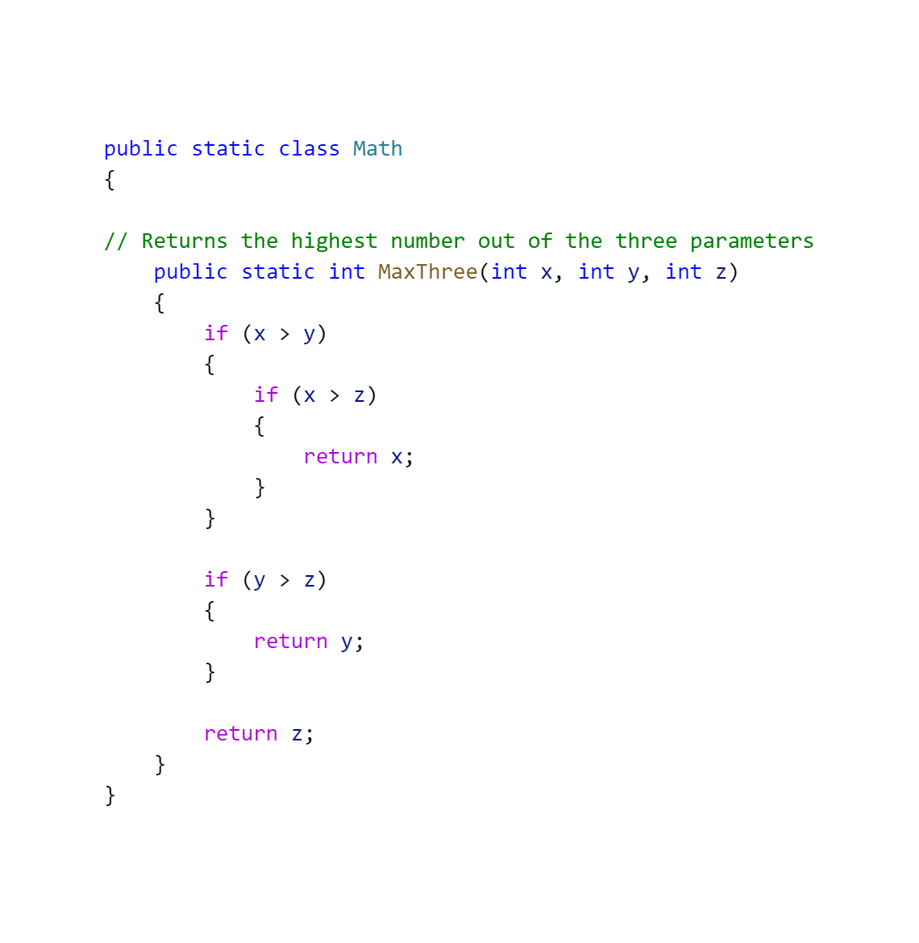
What metric do we focus on?
Lines of source code | 20
Number of comments | 1
Cyclomatic Complexity (MaxThree) | 4
Notes:
Talk about metrics on screen
Some metrics are just counting and some are more complex

Slide 5
Functional features of c#
Local functions
Lambda functions
LINQ
Higher order functions
Tuples
Records (Immutable types)
Pattern matching
Notes:
Mention LINQ
Records
Pattern matching
In order of c# version

Slide 6
What is functional purity
The function does not have any side effects
1.1 No writing to fields
1.2 No writing to IO
1.3 No outputting to the screen
The function is deterministic
2.1 No reading from IO
2.2 No using random number
2.3 No user input

Slide 7
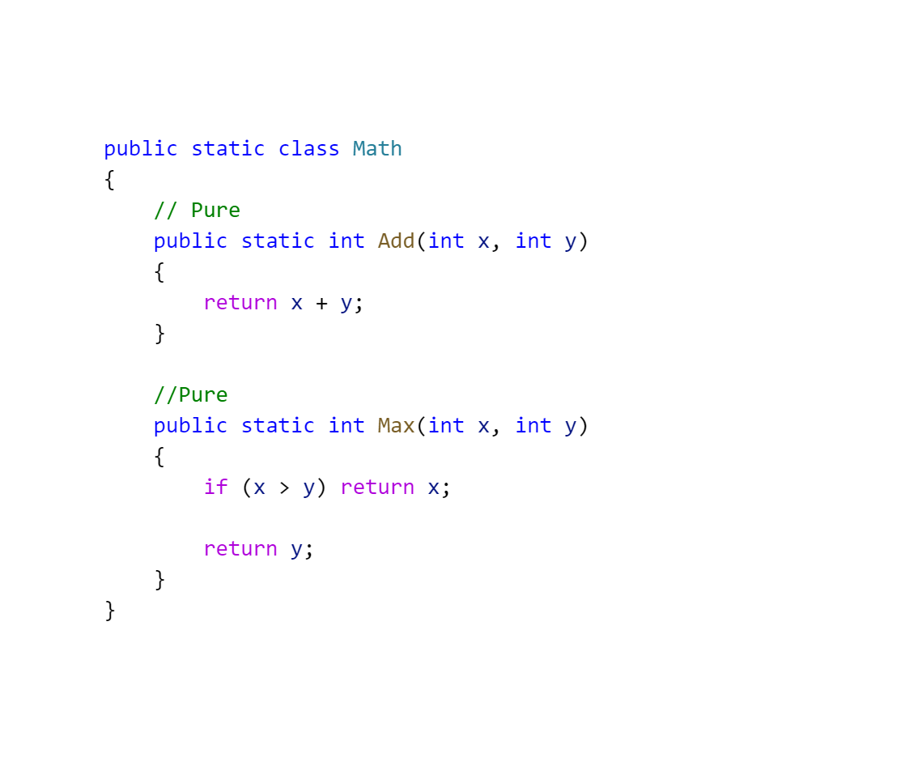
Pure functions in c#

Slide 8
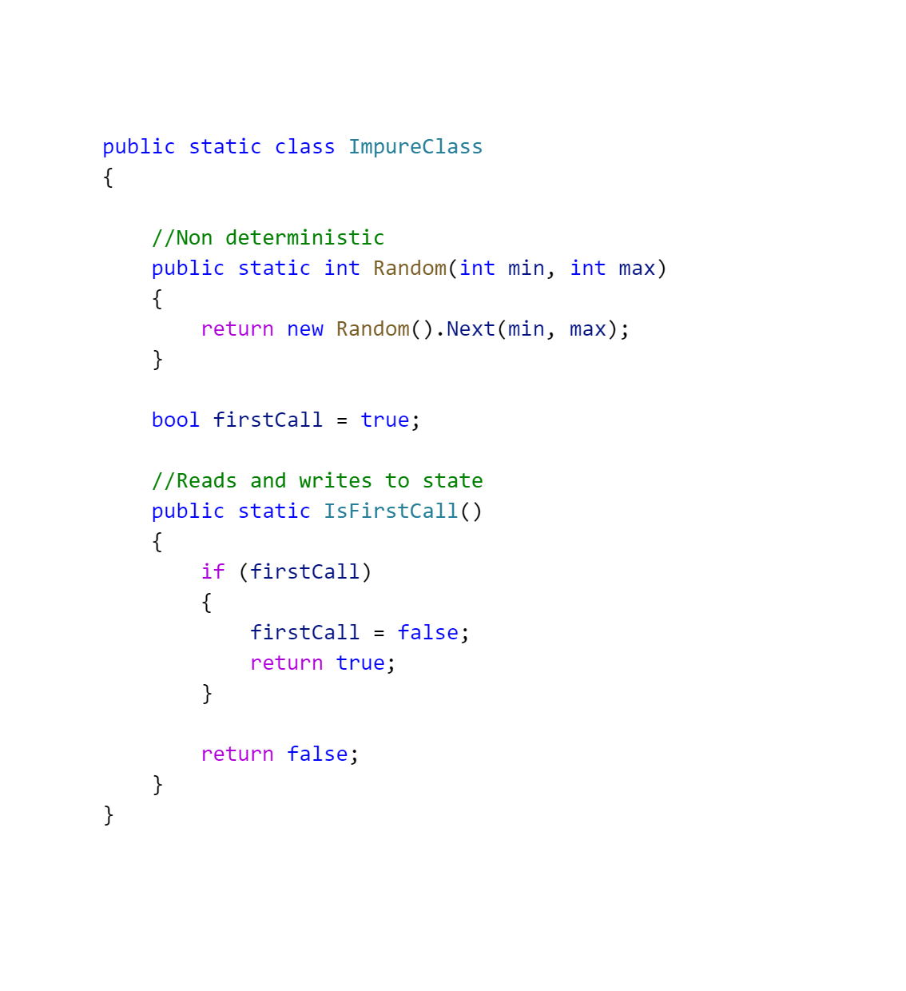
Impure functions in c#

Slide 9
Research question
RQ: To what extent can functional purity be used as a code quality metric in an object-oriented language like csharp
RQ1: How can the concept of functional purity be used as a software quality metric in an object-oriented language?
RQ2: How well do the purity metrics predict error-proneness?
RQ3: How well does the purity metric perform in the different types of functions in csharp?
RQ4: To what extent does combining existing metrics with the purity metric improve the error-proneness prediction?
Notes:
Research question and the intent of the questions

Slide 10
Functional Purity in an object-oriented language
Challenges
- Object-oriented design philosophy results in impure functions.
-
Notes:
How do we measure functional purity in an object-oriented language and what challenges we encountered in doing so

Slide 11
Starting point – Österberg (Cspurity)
Different purity levels
Pure
Impure throws exception
Parametrically impure
Locally impure
Impure
Unknown
Purity levels propagate thru the dependency graph
Notes:
Describe the key concepts

Slide 12
Purity violations
Violations
Reads local state
Writes local state
Reads global state
Writes global state
Modifies parameters
Modifies non-fresh

Slide 13
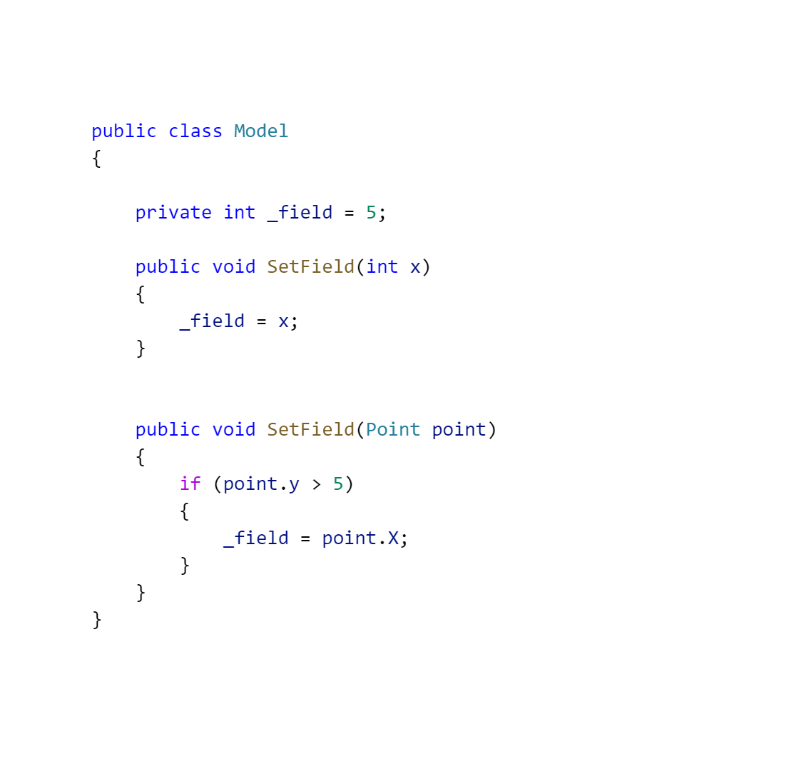
Identifier analysis
Find all identifiers
Filter out non top-level identifiers
For each identifier
Find out if it written or read from
Find out the scoping information
Local field
Global
Parameter
Local variable
Assign the correct violations
Notes:
Mention how violation (except fresh) are calculated
Give code example
Show what identiefiers are used
Give an example of read, write, local, global and parameters

Slide 14
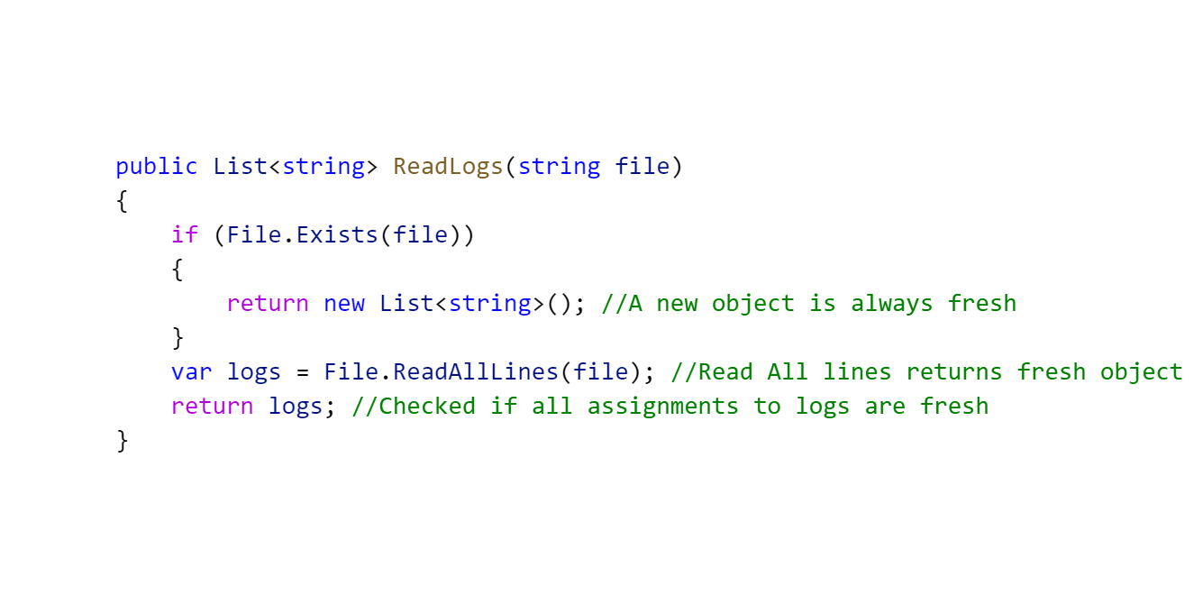
(non) fresh objects
Find all return statements
Check the expression
A primitive type? Ignore
A reference type? Check all assignments to that variable with step 2.
A function? Add to the list of fresh dependencies
Notes:
Why are non fresh diffeclut to calculate
Give example of borrower in rust

Slide 15
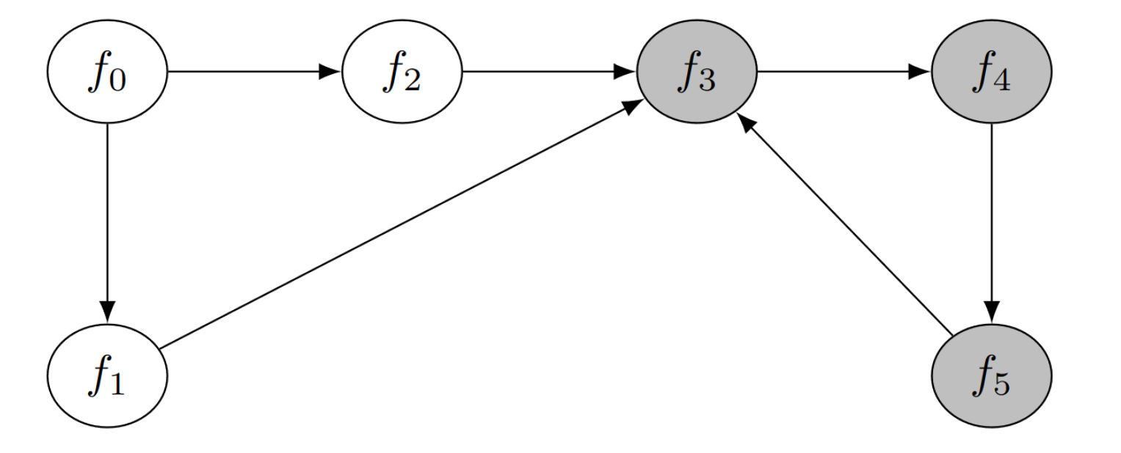
Indirect violations
Save function calls for each function
Use Tarjan’s algorithm to fin out all strongly connected components
Process each function in order
Add all
Notes:
Give example of indirecit violations
Why is this a challenge
Recusrsion is solved
What is the result

Slide 16
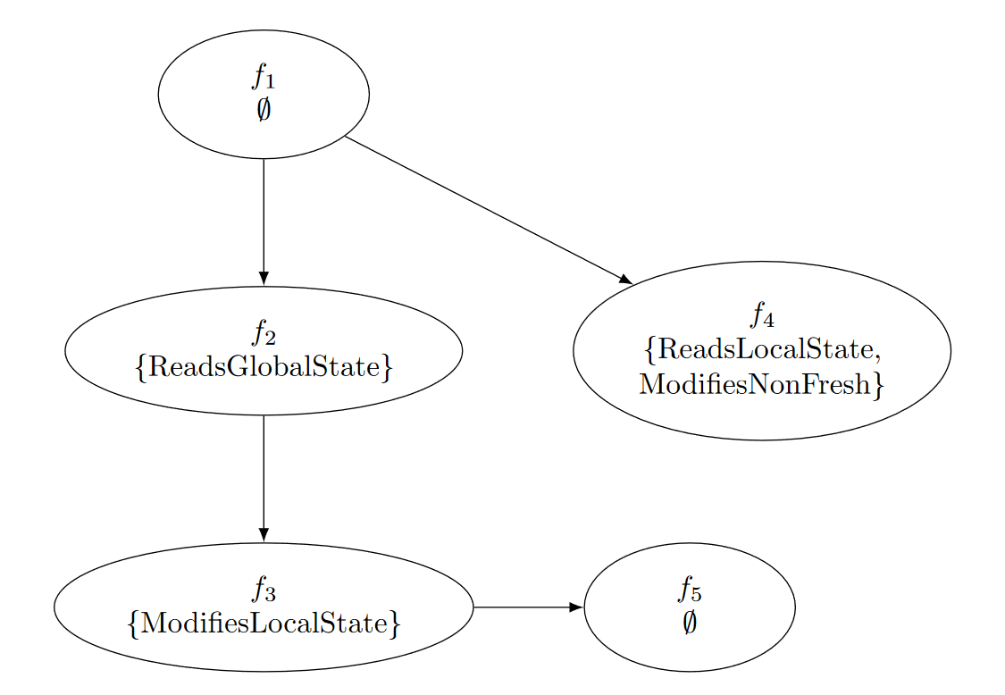
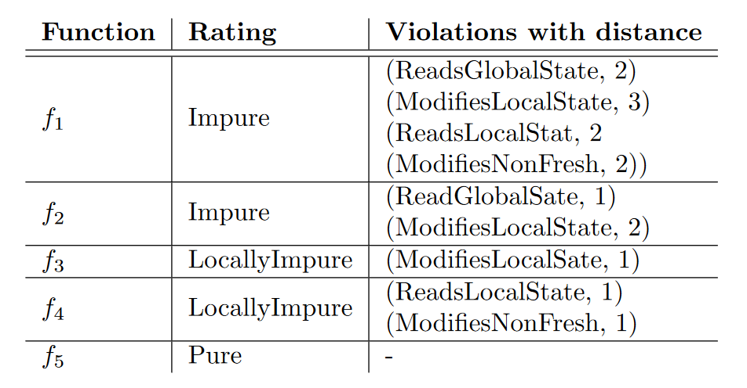
Violations example

Slide 17
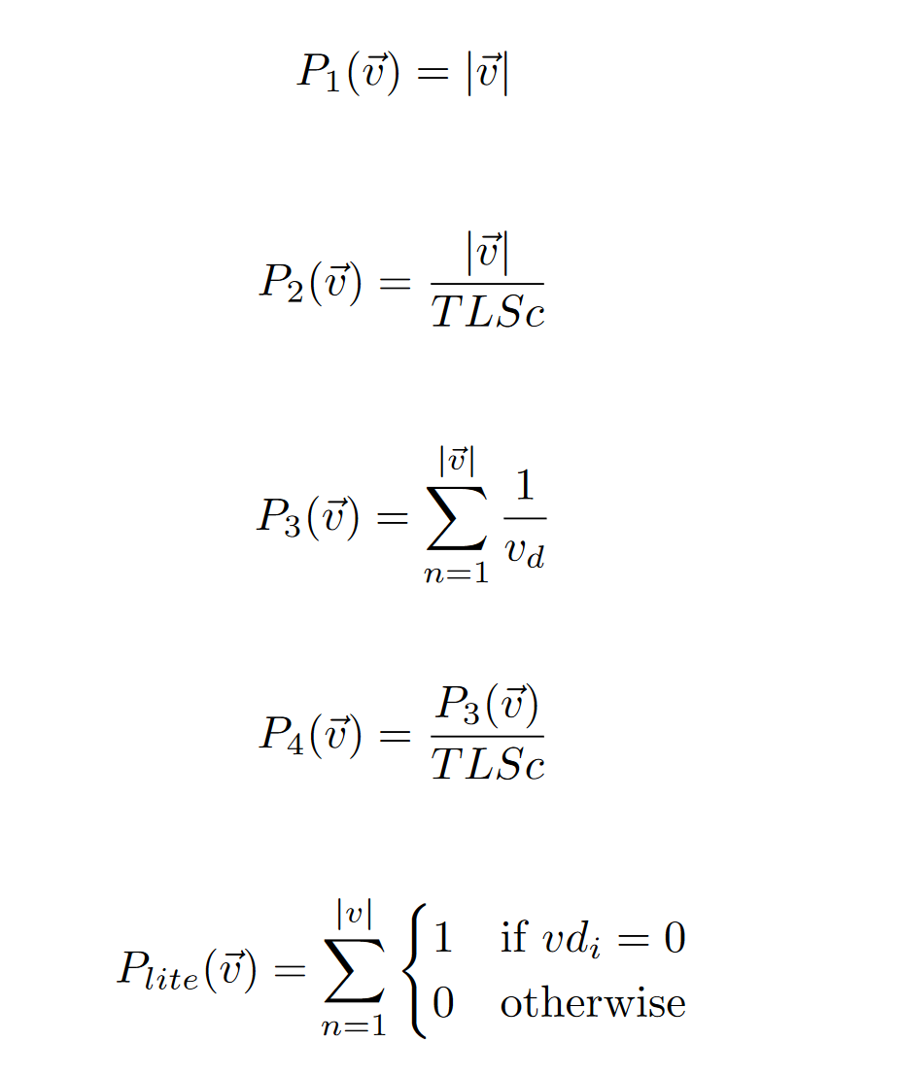
Purity metric
Notes:
How are we going to use these violations
P1 t/m pLite

Slide 18
Conclusion – rq1
How can the concept of functional purity be used as a software quality metric in an object-oriented language?

Slide 19
Validating
We have
The ability to capture the purity of a function into a vector of integers
We Want
To know how well this vector of integers predicts the error-proneness of a function.
Notes:
Mention what we need to validate this data

Slide 20
Landkroon’s methodlogy
Find out what code is error-prone
Calculate code metrics for this code
Notes:
What is the goal of using landkroons methodology

Slide 21
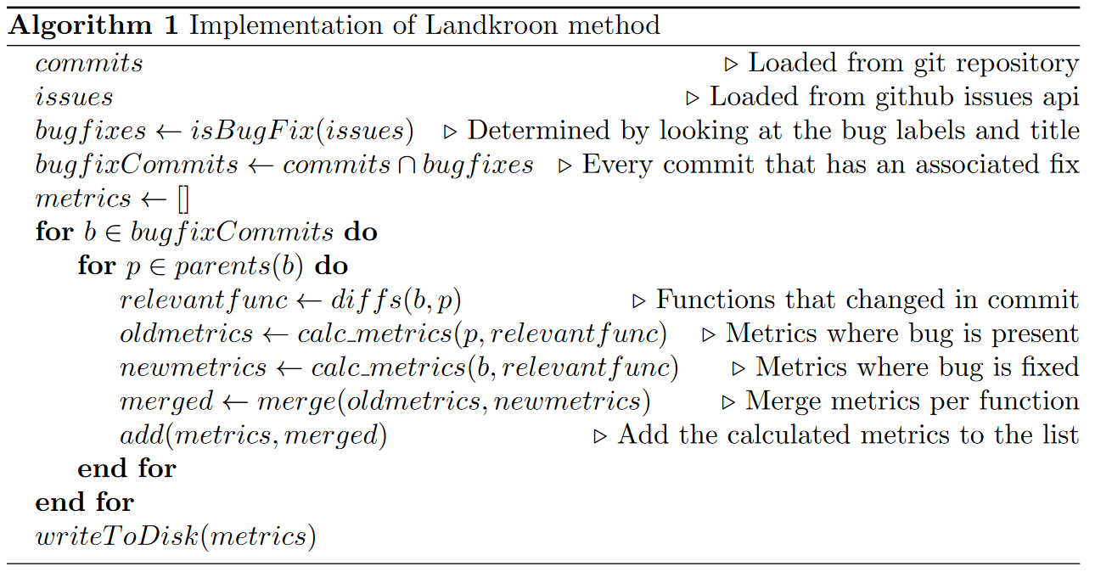
Landkroon’s methodology - Implementation
Notes:
How do we use git to implement this

Slide 22
dataset
Name | Type
Function name | string
Commit hash | string
Method type | Enum (method, local, lambda)
Dependency count | int
Total lines of source code | Int
Metrics | Dictionary<Measure, Int>
Violations | List<(Violation, Distance)
Notes:
What does the dataset look like

Slide 23
models
Purity (or) | Object-Oriented (and) | Functional (and)
P1 | Weighted methods per class | Lambda score
P2 | Cyclomatic complexity | Number of lambda functions used
P3 | Depth of inheritance tree | Source lines of lambda
P4 | Lack of cohesion of methods | Lambda local variable usage
Plite | Response for class | Number of lambda functions using mutable field variables
 | Comment density
Notes:
What models do we have?

Slide 24
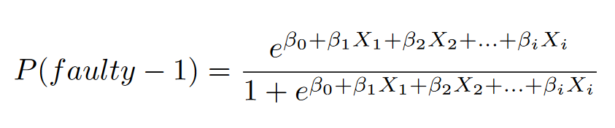
Regression
Find the link between a vector of numbers (metrics in the model) and the prediction label (error-proneness)
Notes:
How are the models translated to regression data
What did we use for regression

Slide 25
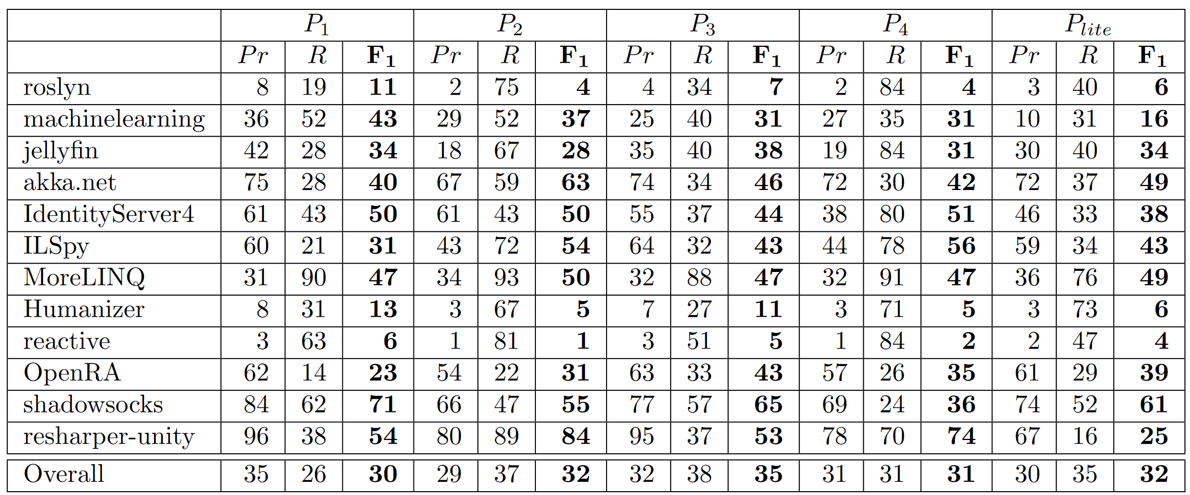
Results – error proneness purity metrics

Slide 26
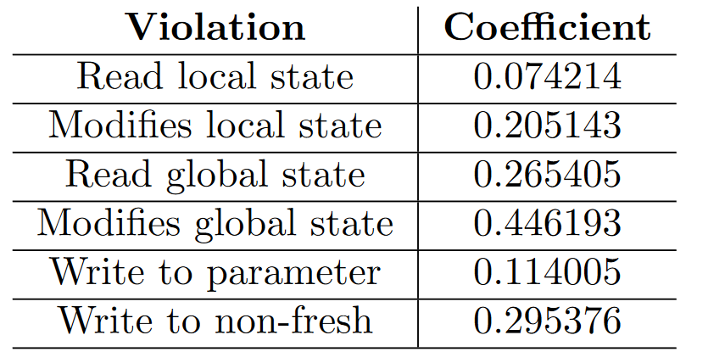
Results – error proneness purity metrics

Slide 27
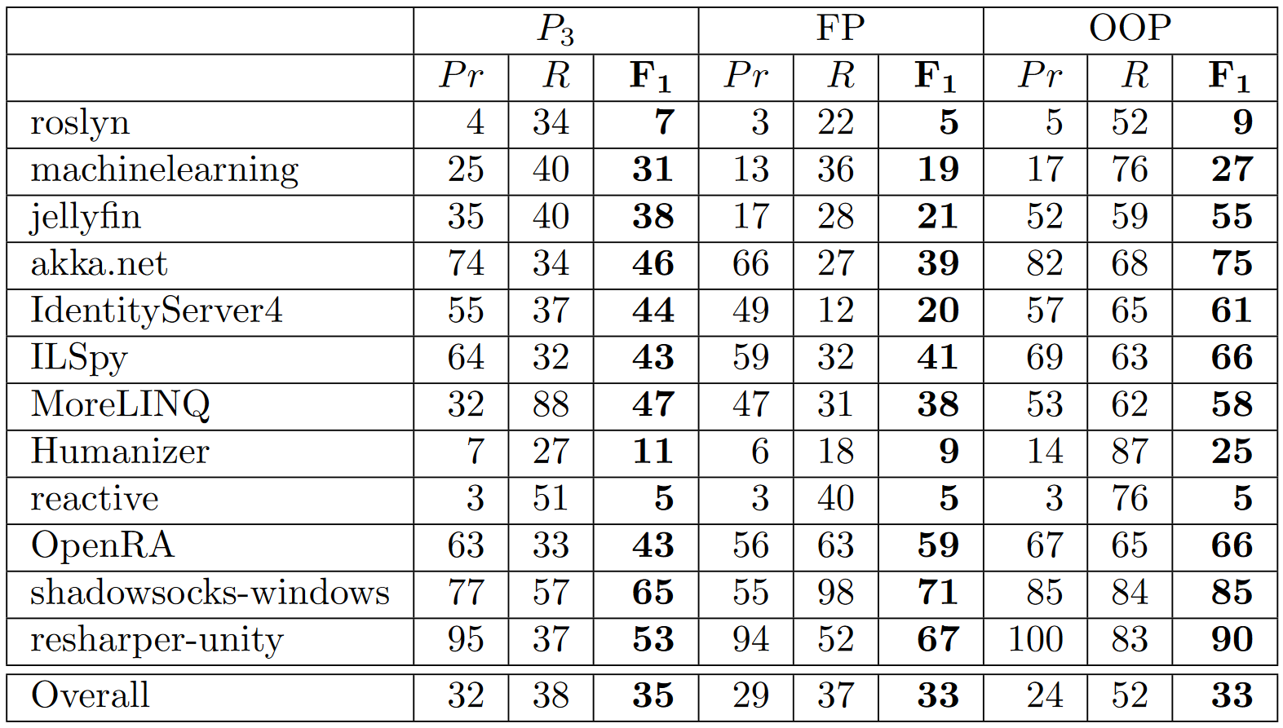
Results – error proneness prediction per model

Slide 28
Conclusion – rq2
How well do the purity metrics predict error-proneness?

Slide 29
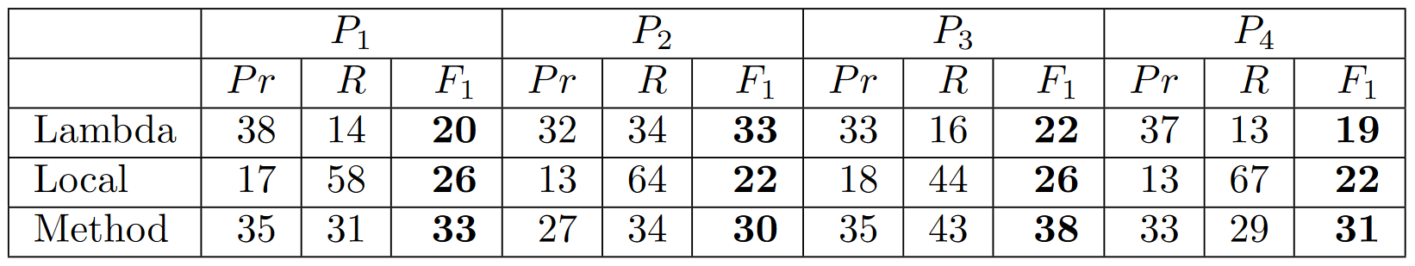
Results – Method type

Slide 30
Conclusion – rq3
How well does the purity metric perform in the different types of functions in csharp?

Slide 31
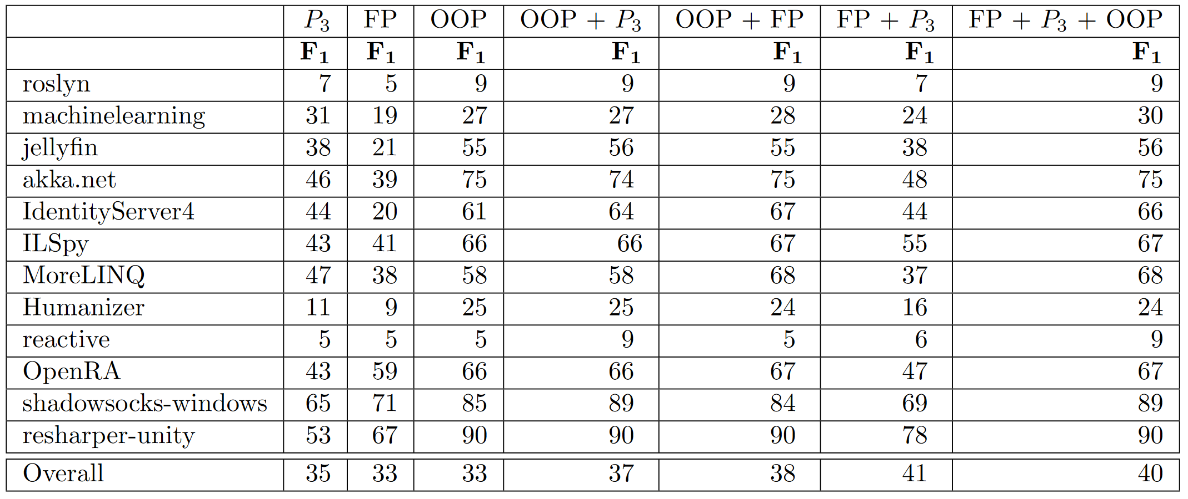
Results – Model combinations

Slide 32
Conclusion – rq4

Slide 33
Conclusion

Slide 34
Discussion

Slide 35
Questions?

