Slide 1
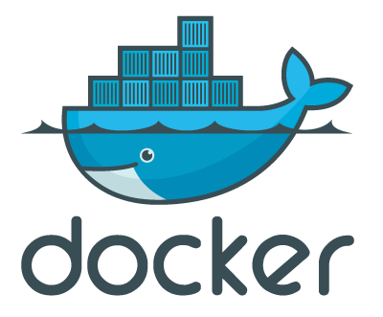
Build and share infrastructure as easily as code
Bjørn Nordlund
https://github.com/bjornno/dockerdemo
Notes:
I will present some of the basic building blocks of todays cloud services, or Plattform As A service frameworks.
I will present a tool called docker, that is an open source implementation, it’s similar to other tools used by
For example cloud foundry or heroku.
----
CF use warden

Slide 2
Notes:
Here I have a small webapp that runs in a PaaS
Actually in cloud foundry that is currently hosted on my laptop
I can deploy my app with a single push command, it will get access to all services available from the plattform, right now my app consists of a load balancer, and an appnode.
If I want to change the infrastructure I can do it easily. I can for example add databases, message queues, or scale up by adding more memory,
or scale out adding more app nodes like this (cf scale –i 5).
Wow, I added 50 nodes
And it all happens in seconds or fraction of a second.
How do they do this?
----------------
cf services

Slide 3
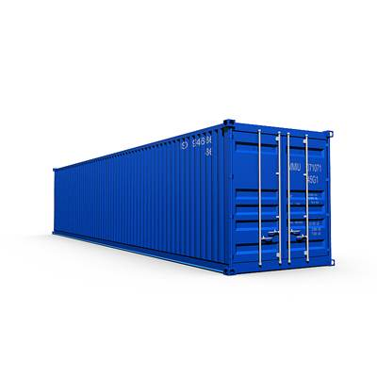
Notes:
They all use what we call containers –
It is similar to a virtual machine, but without all the friction and overhead of a virtual machine.

Slide 4

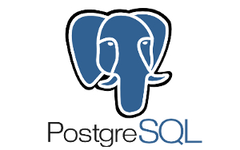



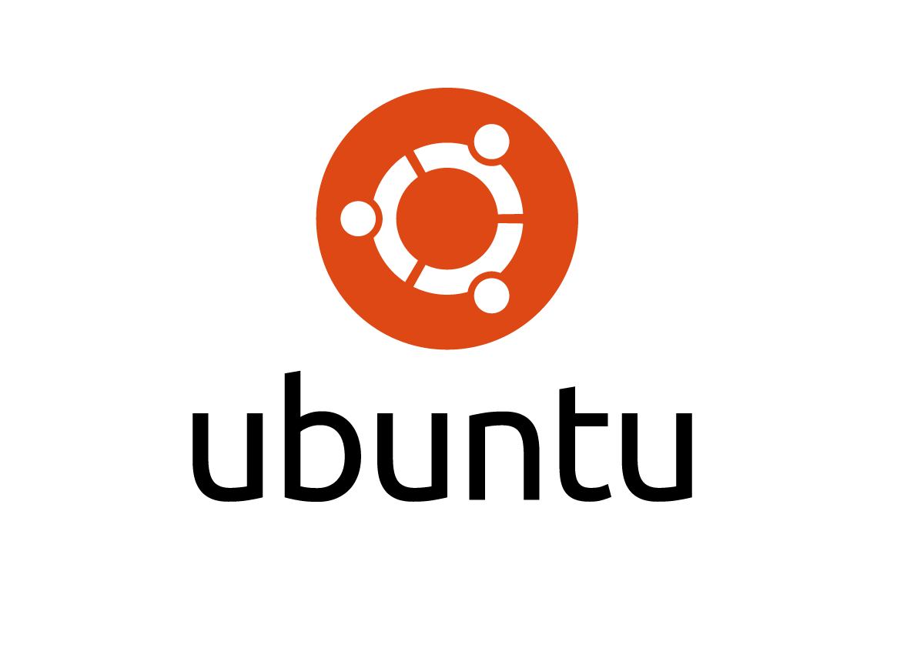

appserver
webserver
database
cache
files
OS
meldingskø
Notes:
The idea is the same as cargo containers. You can put whatever you like into them, but seen from the outside it’s the same, its one unit.
And that one unit can be shipped with trains, ships, cars or whatever. And stacked on top of eachother.
You could put a OS, some files, a database, an appserver, anything into it.. And ship it.

Slide 5

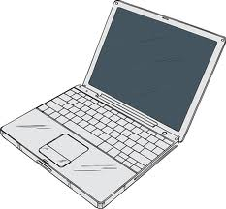


laptop
cloud
CI server
On prem customer
Notes:
You can then run it on your local machine, a integration test server, deploy it to a customer or to a public cloud provider. Without changing anything.
You will always have the exact same environment

Slide 6
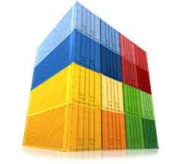
Notes:
you can stack multiple containers together on the same servers.
The containers could for example be multiple instances of the same application but for different customers running completely isolated from each other, providing multi tenancy
Or it could be different applications

Slide 7
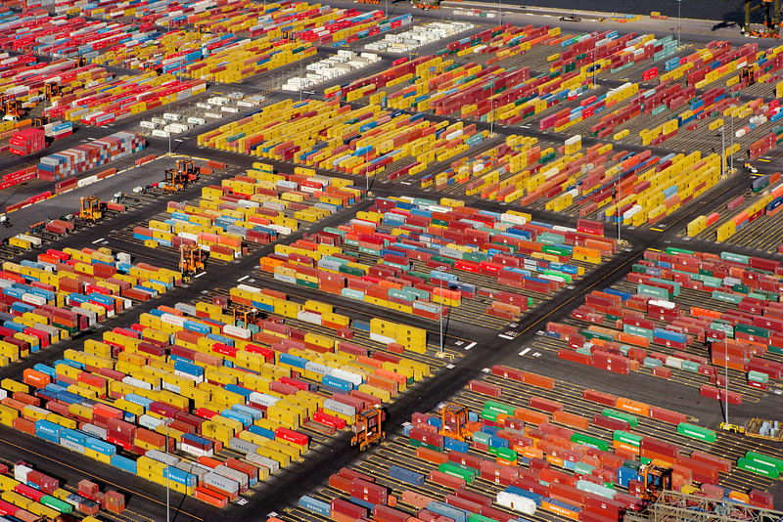
Notes:
Or you can scale your app out by deploying multiple containers running on multiple servers
utilizing amazon ec2 instances and automatically scale your app when load increases

Slide 8
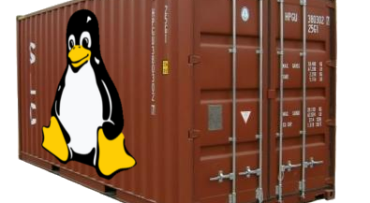
Linux Containers (LXC)
http://www.linuxadvocates.com/2013/04/linux-containers-and-why-they-matter.html
Notes:
So one implementation of such a container is the linux container or LXC,
That lets you run multiple linux system within one linux system
-----
Fast: ~97% of bare metal
start/stop in miliseconds
Agile: container can be moved seamlessly between local, vm, bare metal with a click of a button, or scripted
Flexible: containerize a whole system with os, db, etc or just an application. Freedom
Leightweight:
On a typical physical server, with average compute resources, you can easily run:
● 10-100 virtual machines
● 100-1000 containers
Cloudy: support from various cloud management framworks, like open stack
Is becoming the new “unit of deployment”
Changing how we develop, package, deploy and manage apps at all scales (test/dev to production)
Removes the friction of using virtual machines
Simplify workflow and provides performance benefits. It’s the basis of most paas solutions like heroku, cloudfoundry etc

Slide 9
LXC
Kernel namespaces
cgroups
chroot
…
Notes:
A linux container uses features from the linux kernel to create isolated environments on the same machine. Seen from the inside of such an environment It looks like a virtual machine
but from the outside, the host os, it looks like a process.
But since LXC is pretty hard to work with directly
-----
like control groups for resource isolation (cpu, memory, I/O, network etc), and kernel namespaces to isolate an applications
view of the surrounding operating system, like processes, users, network, filesystems etc. And chroot to change the root directory to the container.
In effect you get an isolated environment where you can install your own linux os, and your own applications without the cost of creating a virtual machine.
---------
Namespaces:
Processes, network interfaces, filesystem, hostname, users
eg you can have multiple processes with pid=42 in different environments
Control groups: cgroups
kernel feature to limit and isolate resource usage (cpu memory disk I/O etc)
Chroot:
Change the root to a directory on the filesystem for a single process, the process can not normally access files on the outside of this directory
Aufs:
Writable single-s

Slide 10
Docker
CLI
REST
Repository
Create, list, delete, inspect, start, stop, commit, history….
LXC
AUFS
Kernel namespaces
cgroups
chroot
…
Notes:
We use docker,
which is a tool that adds a user friendly layer to work with linux containers.
You get a command line interface and a rest interface.
You can create new images, commit their state, push/pull to a repository,
You get version history, automated build scripts and a bunch of other usefull features.
----------
“A docker is the person that works on the dock loading and unloading ships”
Docker has a command line interface with git like commands for pulling down images, pushing new versions, diff, history etc.
And it heavily uses aufs, which is a ……….stackable unification file system wich unifies several directories and provides a single directory.
It is a layered filesystem where many containers can have their own filesystems, but all common files are shared or copied.
I will not go into detail how this work, but the effect is that you only need to change the diffs between two containers using mostly the same files.
With docker and linux containers you have the building blocks to create the containers that can run in the cloud.
Open stack and many cloud providers has native support for docker containers.
But it could also be the building blocks to create your own cloud or even your own paas.
Giving you more flexibility and control, and the possibility to tailor the infrastructire exactly to your need.
So I will finish up by demonstrating some of the basics of docker and how you can use the basics to implement more advanced use cases..

Slide 11
 | Ship | Boot | #instances on one physical server
Bare Metal | days | minutes | 1
VM’s | minutes | seconds | 10-100
Containers | seconds | milliseconds | 100-1000
Notes:
And the benefit of working with containers is many.
As you already have seen in the first demo, where I ran more than 50 containers on my laptop.
It is really fast, adds marginally overhead to memory, processing and size.
They share the same kernel as the host, and only the differences to the file systems are stored, all equal files is stored just once.
-----------
And it is Fast: ~97% of bare metal
start/stop in miliseconds
Leightweight:
On a typical physical server, with average compute resources, you can easily run:
● 10-100 virtual machines
● 100-1000 containers
They use marginally more resources than the applications you run, as it shares most with the surrounding OS and other containers.

Slide 12
demo
Notes:
So lets finish with some hands on with docker
docker run -i -t -p 80:9292 bjornno/ubuntu /bin/bash
git clone https://github.com/bjornno/dockerdemo.git
cd dockerdemo
bundle
rackup
http://localhost:8000
diff
Commit
History
Share

Slide 13
Dockerfile
FROM bjornno/ubuntu
RUN git clone https://github.com/bjornno/dockerdemo.git
WORKDIR /dockerdemo
RUN bundle
CMD ["rackup"]
Notes:
Normally you would not create the images interactively like this, but instead have a Dockerfile (think of it as a makefile for building a container), that is checked in with your application source code.
You always start with a image and adds stuff to it. Here I start with a ruby image which is an ubuntu with ruby tools pre installed.
docker build –t bjornno/app .
docker run -p 80:9292 bjornno/app

Slide 14
Learn more on http://docker.io
Use Case | Examples | Link
Build your own PaaS | Dokku - Docker powered mini-Heroku. The smallest PaaS implementation you’ve ever seen | http://bit.ly/191Tgsx
Web Based Environment for Instruction | JiffyLab – web based environment for the instruction, or lightweight use of, Python and UNIX shell | http://bit.ly/12oaj2K
Easy Application Deployment | Deploy Java Apps With Docker = Awesome | http://bit.ly/11BCvvu
Running Drupal on Docker | http://bit.ly/15MJS6B
Installing Redis on Docker | http://bit.ly/16EWOKh
Create Secure Sandboxes | Docker makes creating secure sandboxes easier than ever | http://bit.ly/13mZGJH
Create your own SaaS | Memcached as a Service | http://bit.ly/11nL8vh
Continuous Integration and Deployment | Next Generation Continuous Integration & Deployment with dotCloud’s Docker and Strider | http://bit.ly/ZwTfoy
Lightweight Desktop Virtualization | Docker Desktop: Your Desktop Over SSH Running Inside Of A Docker Container | http://bit.ly/14RYL6x
https://github.com/bjornno/dockerdemo
Notes:
So that was a very short intro to docker.
I hope you’ve seen that it could be a useful tool on its own to run multiple environments really cheap on your pc,
Always have a clean ubuntu at your hands.
Or you can package a ready application image from your source code that you can share out.
Or it could be used for automated integration testing.
And that you have some ideas how PaaS solutions works internally, or even how to build your own PaaS.
I guess you will be better of by using for example cloud foundry or other hosted paas solutions as it is a lot more going on to actually run such an environment.
Check out dockers homepage for more resources.
Thank you..

