Slide 1
Medication Support Course Review
Bjorn Pederson

Slide 2
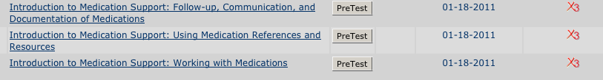
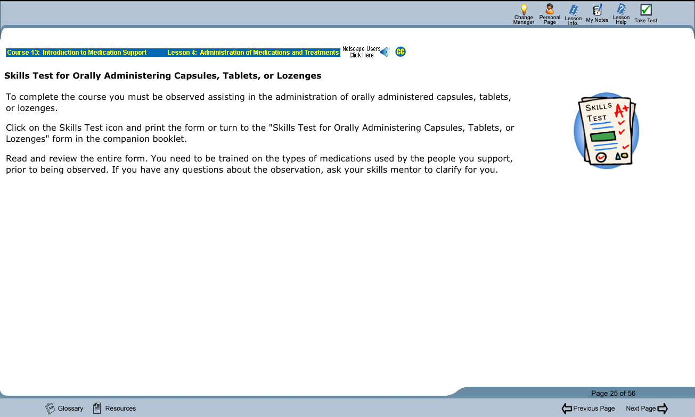
Current State of Medication Supports

Slide 4
Problem-Based Learning Model
Taking the learning a little further…

Slide 6
Constructivism
“Knowledge is formulated by learners as they attempt to make sense of their experience.”
(Driscoll, 2005) in (Molenda, 2008)

Slide 7
Problem-Based Learning
“[When we] solve the many problems we face every day, learning occurs.”
(Barrows & Tamblyn, 1980) in (Hung, Jonassen & Liu, 2008)

Slide 8
PBL Characteristics
Focused problem, ill-structured in an authentic situation.
Learner centered
Self-directed
Self-reflective, learners monitor their own understanding
Support for learning and usage.

Slide 9
The Environment
Http://134.84.0.85/NABpresentation

Slide 10
The Two Environments
 | Limited Version | Full Version
Problem | X | X
Learner Centered | X | X
Self-Directed | X | X
Reflection | X | X
Support |  | (Not Complete)

Slide 11
Moving forward
Continued development of the environment support.
Solution and reflection sharing.
Development of the learner profile (My Info)
time spent within areas
Environment to-do list
Save states.

Slide 12
Questions
What worked well about this format?
What did not work well for you?
What would you change?

Slide 13
In conclusion…

