Slide 1


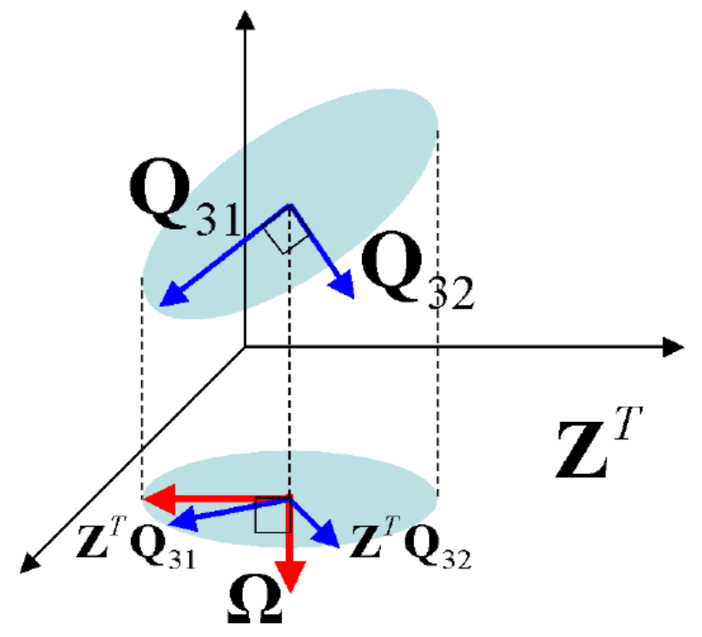
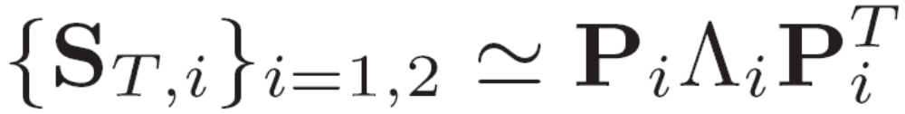
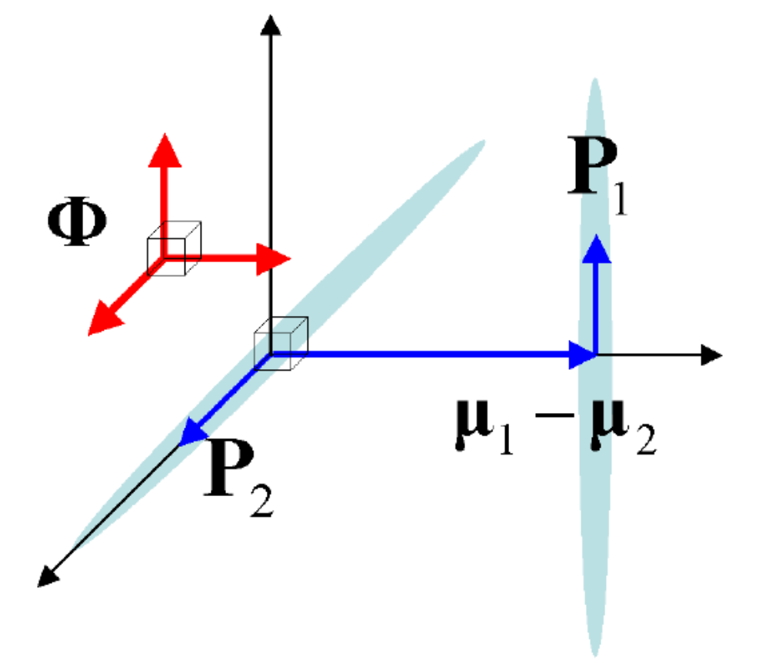



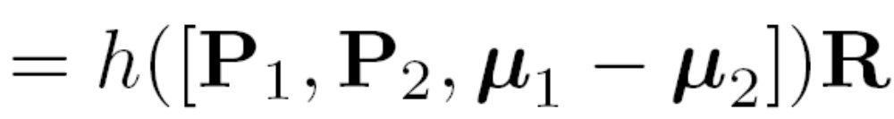
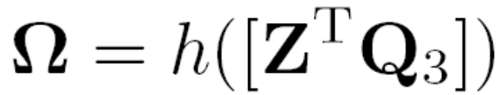

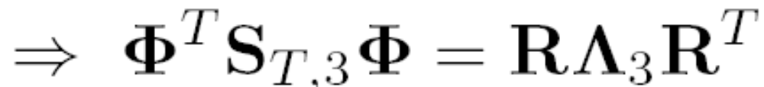

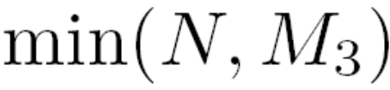

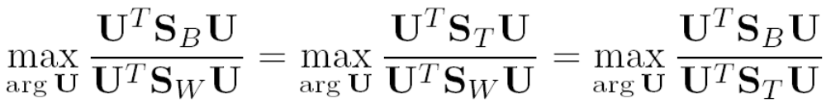
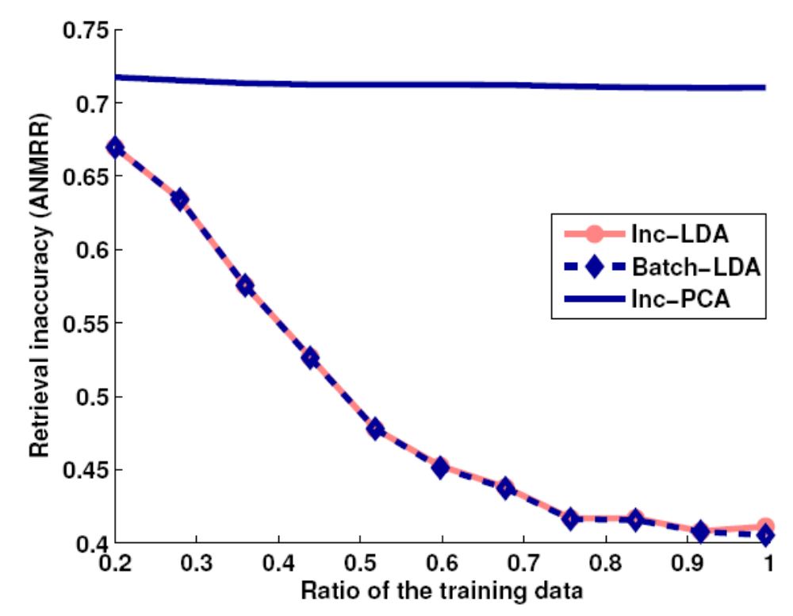
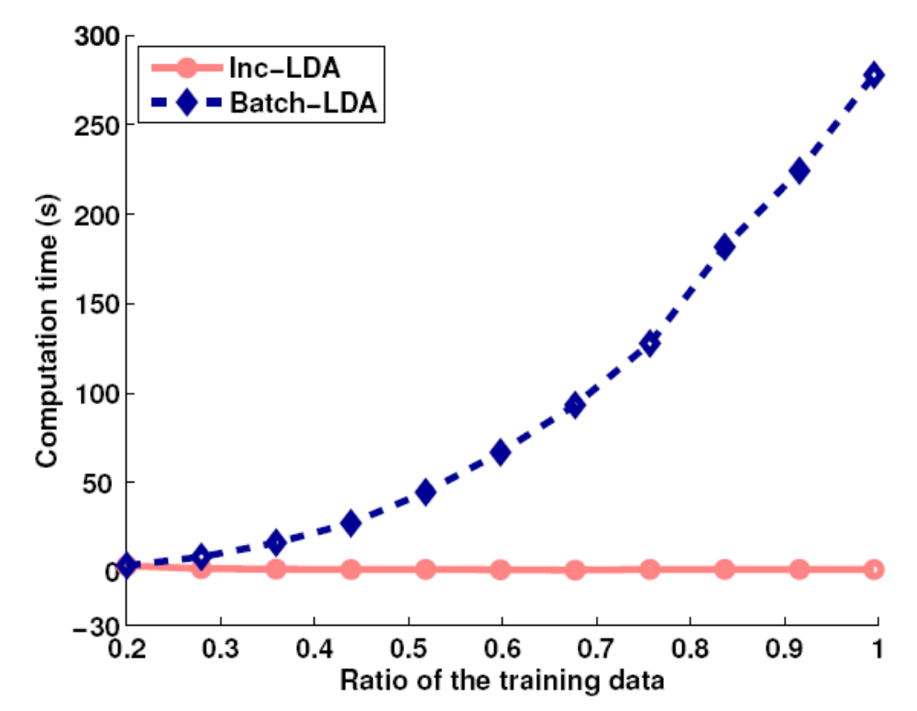
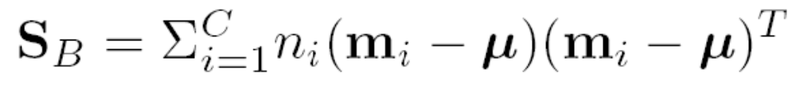

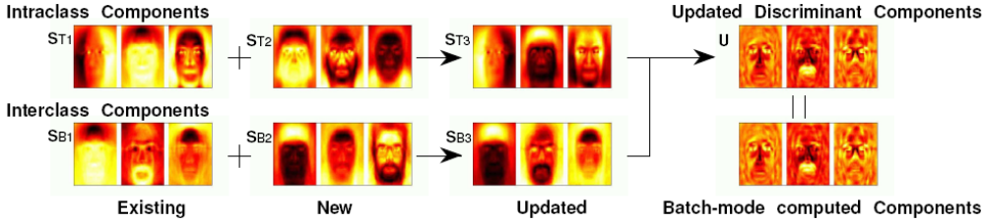


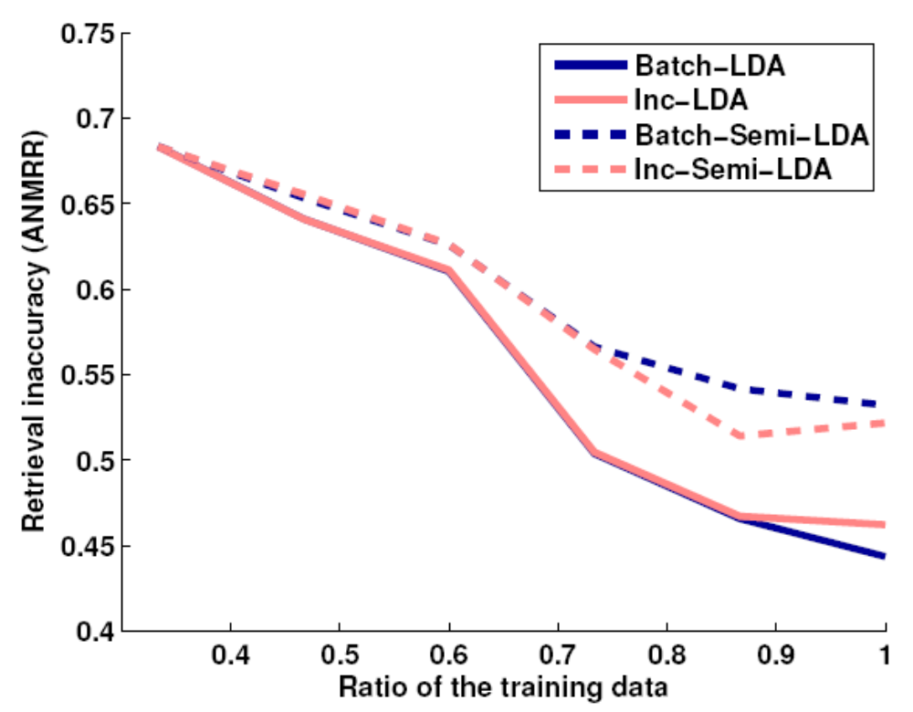
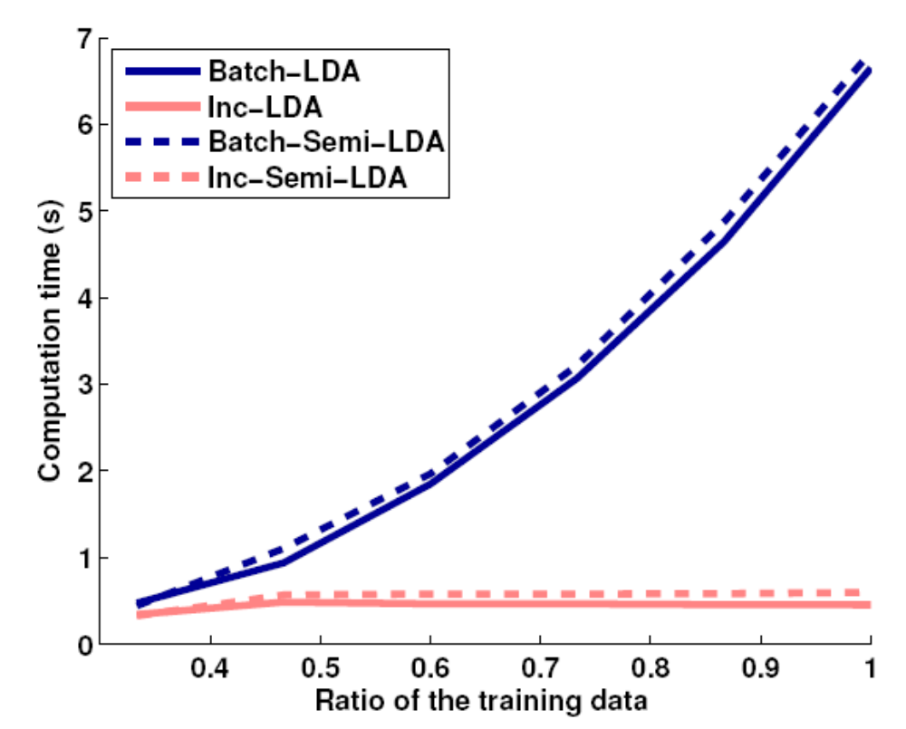




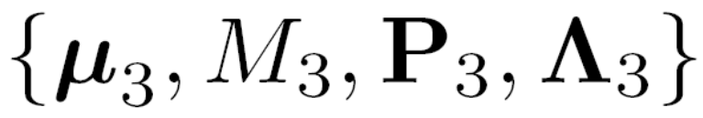
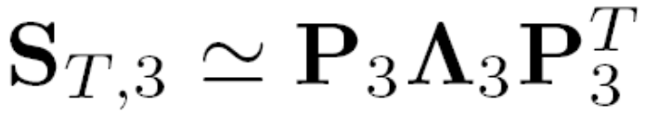

Incremental Linear Discriminant Analysis Using Sufficient Spanning Set Approximations
Tae-Kyun Kim¹, Shu-Fai Wong¹, Björn Stenger², Josef Kittler³, Roberto Cipolla¹
¹ University of Cambridge
² Toshiba Research Europe
³ CVSSP, University of Surrey
Motivation
  where
Using Sufficient Spanning Set,
The economical eigen-computation is
where the sufficient spanning set is
The final updated LDA component is given by
It is beneficial to learn the LDA basis from large training sets, which may not
be available initially.
This motivates techniques for incrementally updating the discriminant components when more data becomes available.
Our Contribution
We propose a new solution for incremental LDA, which is accurate as well as efficient in both time and memory.
The benefit over other LDA update algorithms lies in its ability to efficiently handle large data sets with many classes (e.g. for merging large databases).
The result obtained with the incremental algorithm closely agrees with the batch LDA solution, whereas previous studies have shown discrepancy.
S_{B,3} : between-class scatter of the combined set, d_{B,3} : subspace dimension of S_{B,3} , R : rotation matrix,
Q₃ : eigenvector of between-class scatter of the combined set
Experiments
Incremental LDA
See the paper for
  an analytic comparison of time and space complexity,
  semi-supervised incremental learning with EM,
  which boosts accuracy without the class labels of new training data, while being as time-efficient as incremental LDA with given labels.
Fisher’s Criteria:
Updating Between-class Scatter Matrix
S_{B} : between-class scatter
S_{w} : within-class scatter
S_{T} : total scatter
C : number of classes
n_{i} : number of samples of i-th class
m_{i} : i-th class mean
μ : global mean
Similarly, compute the eigen-model of the combined set given the eigen-models of the existing and new set by
This update involves both incremental and decremental learning as
where
,
μ_{i} : global mean of i-th set
M_{i} : total sample number of i-th set
Q_{i} : eigenvector matrix of i-th set
Δ_{i} : eigenvalue matrix of i-th set
n_{ij} : sample number of j-th class in
i-th set
α_{ij} : coefficient vectors of j-th class
mean in i-th set
m_{ij} : j-th class mean in i-th set
S_{B,,i}: between-class scatter of i-th
set
s : indices of common class of both
sets
By sufficient spanning sets
Database (MPEG-7 standard set) merging experiments for face image retrieval
On-line update of an LDA basis
Updating Total Scatter Matrix
The subsequent process can be similarly done with the sufficient spanning set as
Input : Eigen-models of the existing and new set,
Output : Eigen-model of the combined set,
where
μ_{i} : global mean of i-th set
M_{i} : total sample number of i-th set
P_{i} : eigenvector matrix of i-th set
Λ_{i} : eigenvalue matrix of i-th set
S_{T,i}: total scatter of i-th set
R : rotation matrix
N : vector dimension
d_{T,i} : subspace dimension of i-th set
Updating Discriminant Components
P₃ : eigenvector matrix of total scatter of the combined set
Λ₃ : eigenvalue matrix of total scatter of the combined set
Semi-supervised incremental LDA
This is done by first projecting the data by
Matlab code of ILDA is now available at http://mi.eng.cam.ac.uk/~tkk22.

