Slide 1

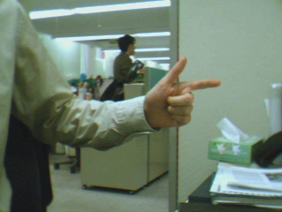
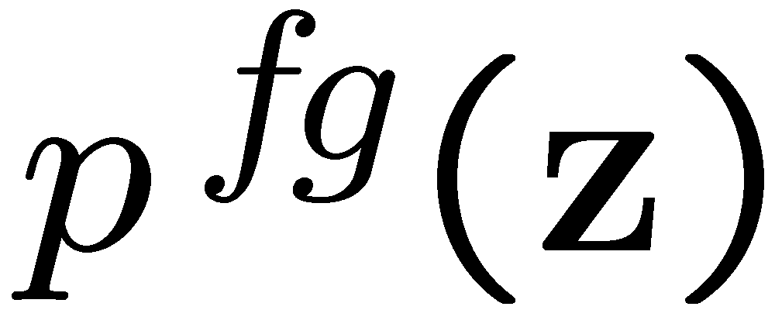
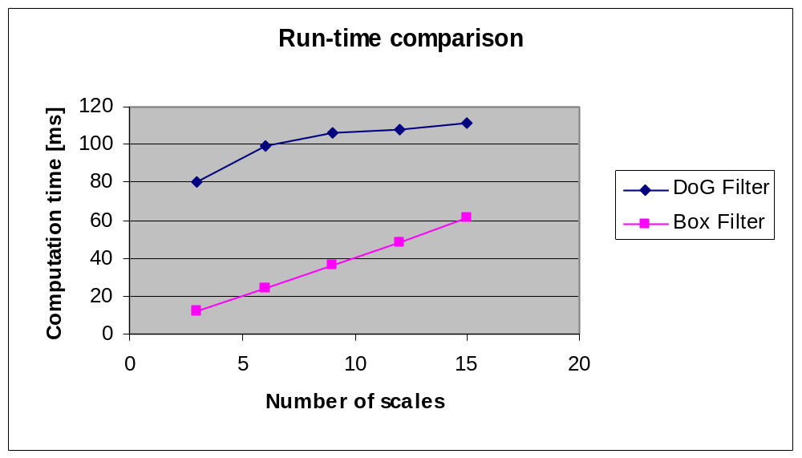
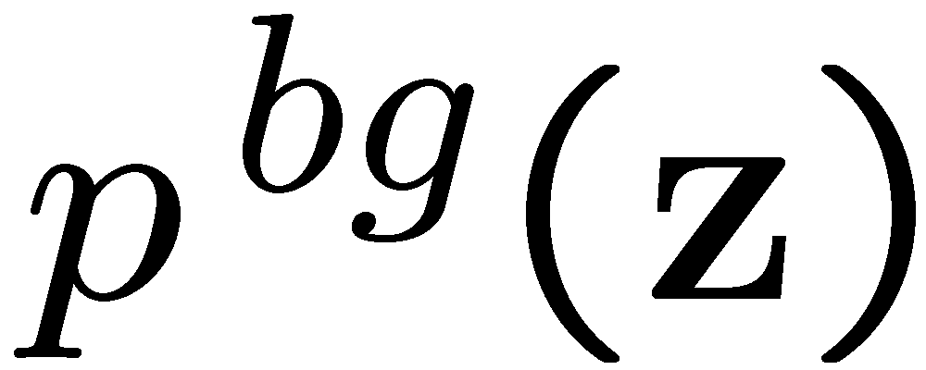

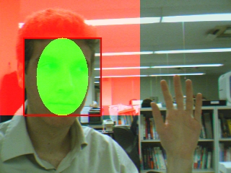
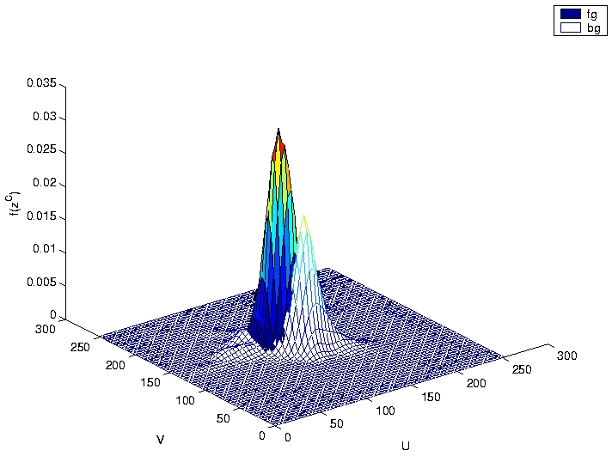
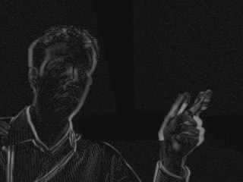
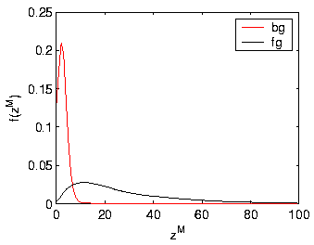
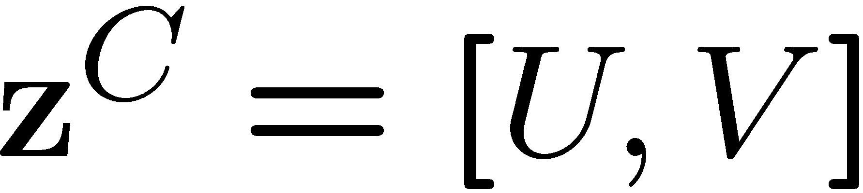
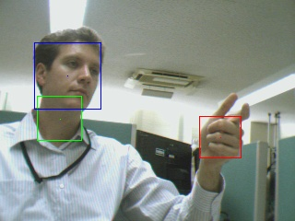
















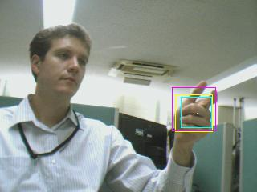


























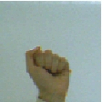
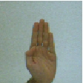
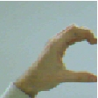
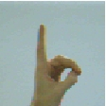
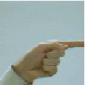
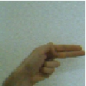
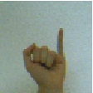
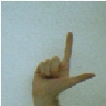
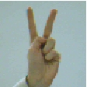
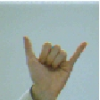
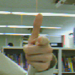
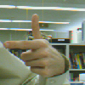
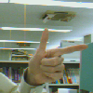

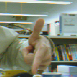
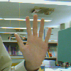
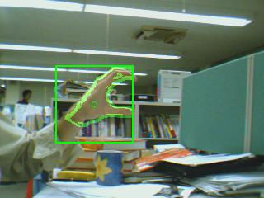
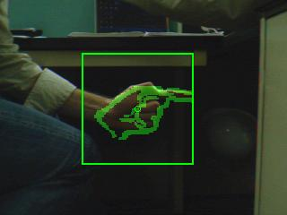
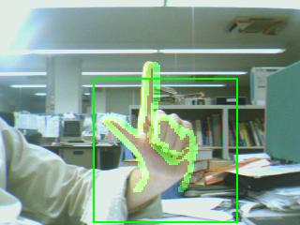
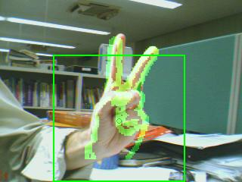
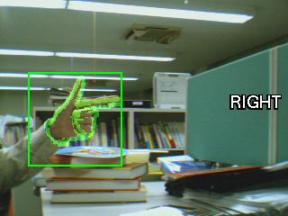
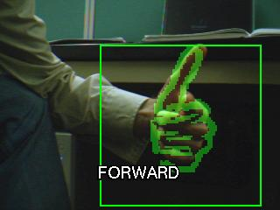
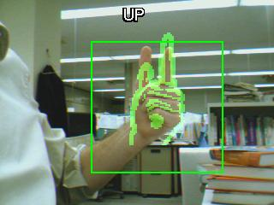
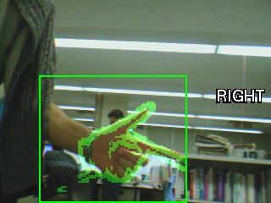
Template-Based Hand Pose Recognition Using Multiple Cues
Björn Stenger
Multimedia Laboratory, Corporate Research & Development Center
Hand Pose Recognition
System Overview
Summary
Practical system for hand pose recognition in cluttered scenes
First hypothesize regions based on colour and motion, independently
Then use normalized template matching (colour and edges) and nearest neighbour classifier for pose estimation
5 fps (3GHz P4) for 6 poses (300 templates per pose)
No fixed hand-camera distance, no background subtraction, no binary colour segmentation, no tracking
Input image
Motion model
Region
hypotheses
Face detector
Colour model
Exemplar-based
shape model
Pose classification
Hypothesize Image Subwindows
  Search for maxima in scale-space of feature likelihoods
  Local maxima suppression
  Hypothesize for colour and motion likelihood independently
  Efficient “box filters” instead of difference of Gaussian filter
Colour Model
Motion Model
Advantages
good localization
discriminative (fg/bg)
Disadvantages
not illumination invariant
other skin coloured regions
Advantages
user independent
illumination invariant
no initialization required
Disadvantages
other moving regions
localization less accurate
Normalized Template Matching
Subwindow hypotheses
Normalization
Feature extraction
colour gradient
orientation layers
training set
normalized size, neutral background
colour
colour likelihood
motion
intensity gradient
weighted
gradient
orientation layers
Results
Pose classification
10 poses, 100 examples per pose
single user
4 sequences, each 3000 frames
Navigation by pointing
6 poses, 300 templates per pose
4 different users
4 sequences, each 1000 frames
forward left right up down stop
 | motion hypotheses |  | colour hypotheses
consecutive frames | edge template | colour template | edge template | colour template
1 | 0.29 | 0.33 | 0.67 | 0.85
2 | 0.42 | 0.50 | 0.78 | 0.91
3 | 0.51 | 0.63 | 0.84 | 0.94
4 | 0.59 | 0.73 | 0.87 | 0.95
5 | 0.66 | 0.79 | 0.88 | 0.96
 | motion hypotheses |  | colour hypotheses
consecutive frames | edge template | colour template | edge template | colour template
1 | 0.35 | 0.61 | 0.57 | 0.73
2 | 0.42 | 0.65 | 0.69 | 0.81
3 | 0.49 | 0.73 | 0.74 | 0.84
4 | 0.53 | 0.79 | 0.80 | 0.86
5 | 0.54 | 0.83 | 0.84 | 0.88

