Slide 1


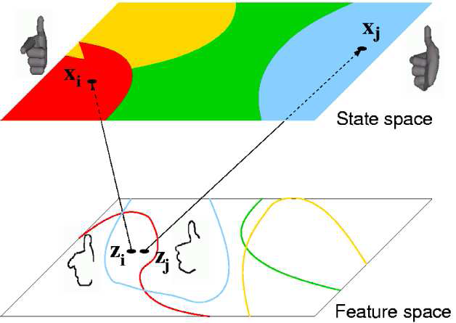
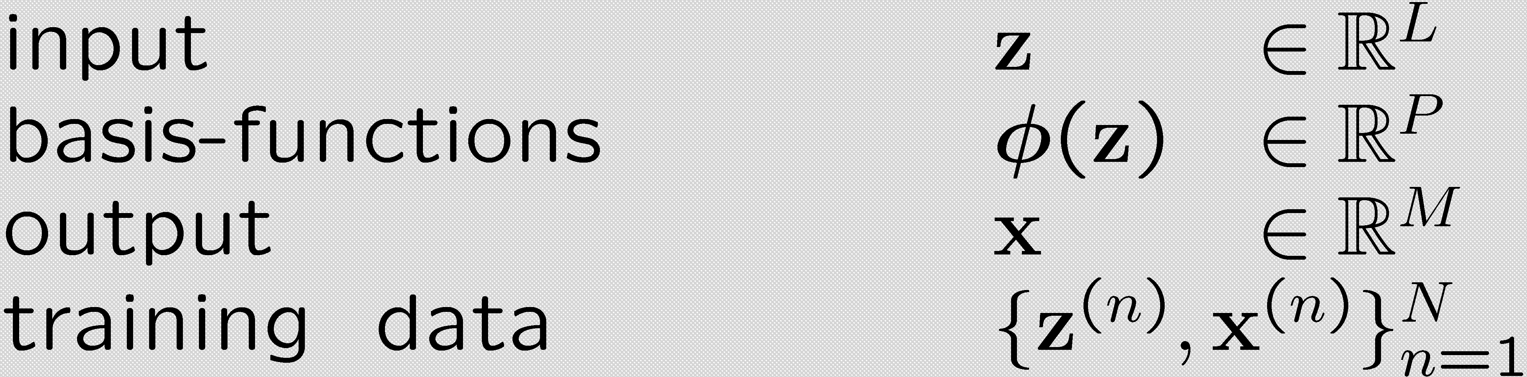
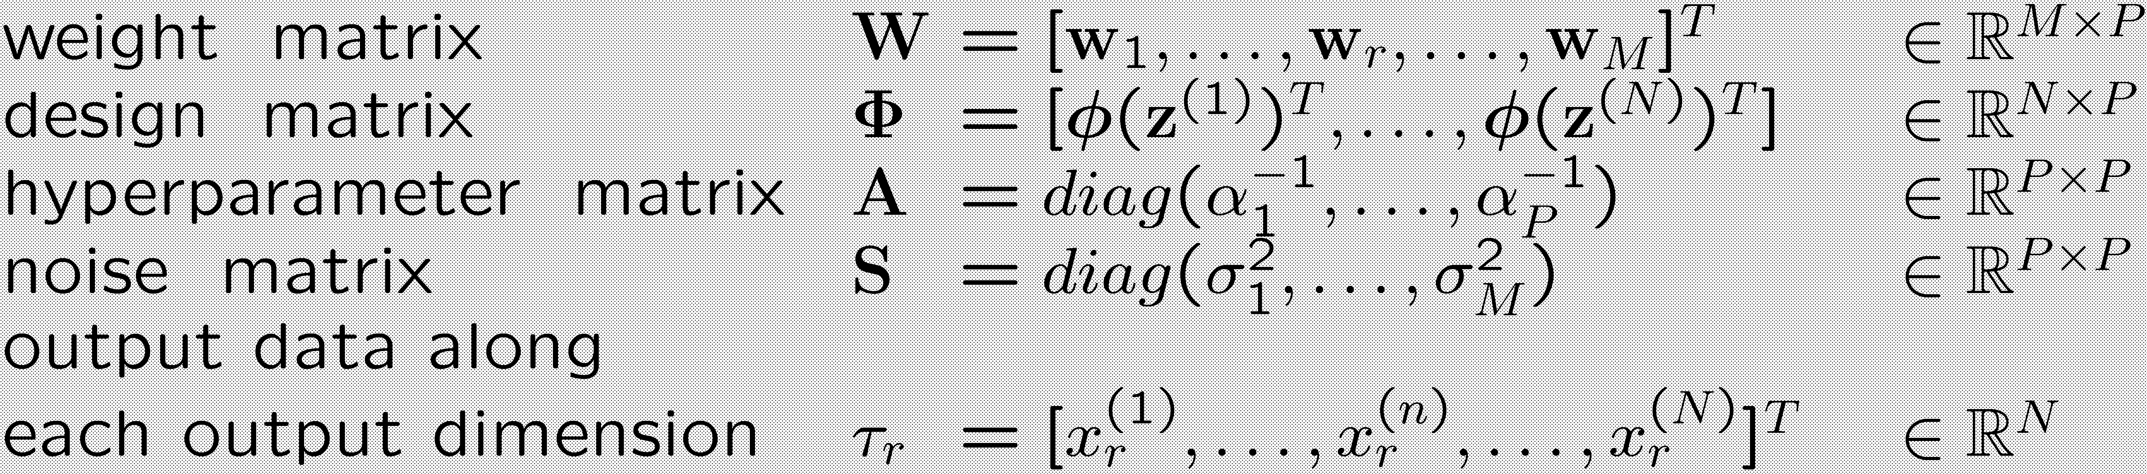
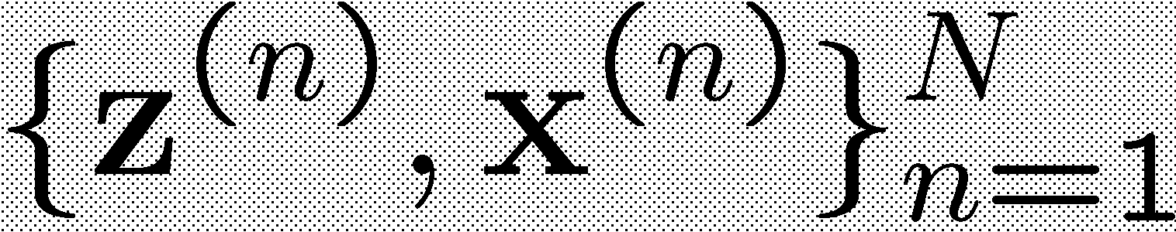
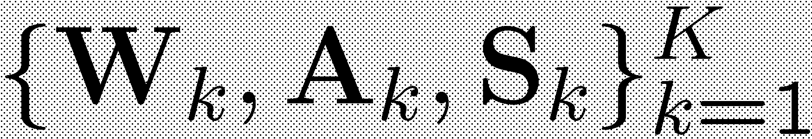
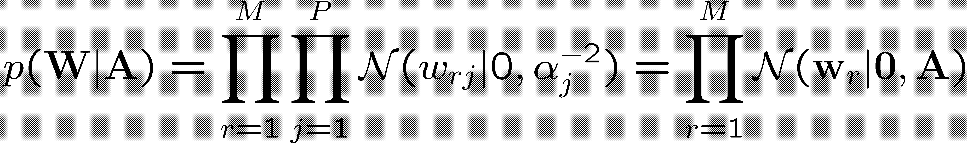
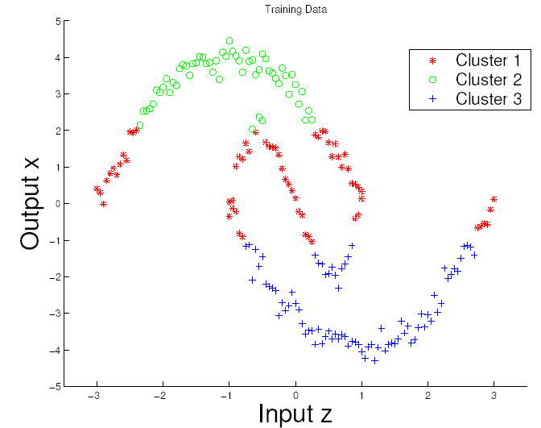
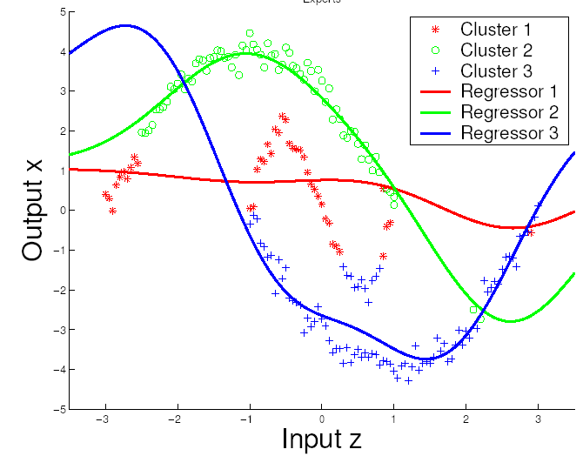
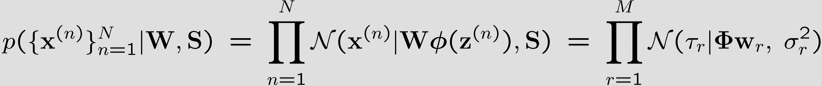
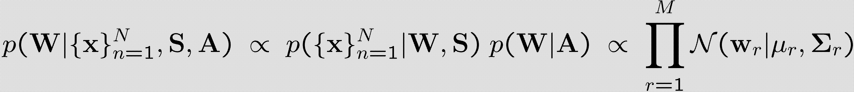
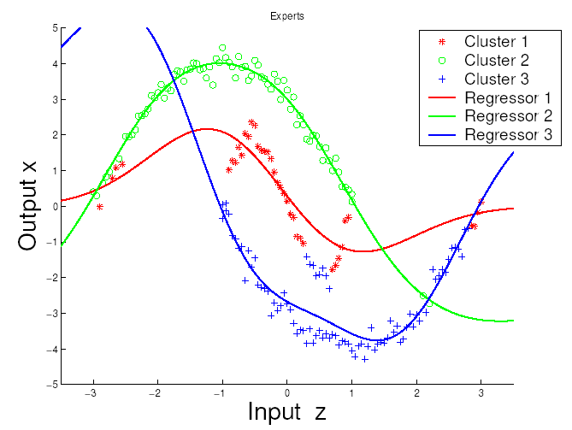
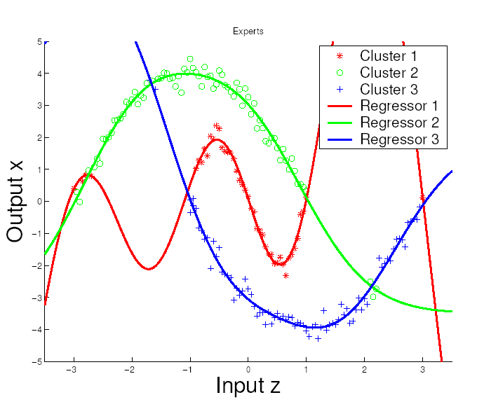
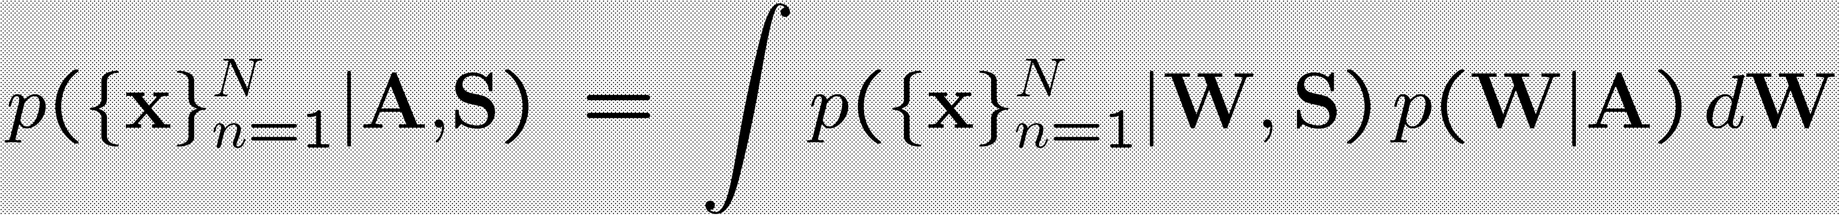
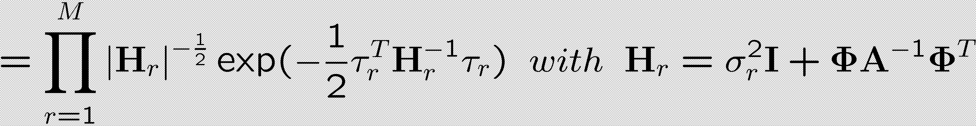
UNIVERSITY OF
CAMBRIDGE
Multivariate Relevance Vector Machines For Tracking
A. Thayananthan, R. Navaratnam, B. Stenger, P. H. S. Torr and R. Cipolla
Graz, Austria
Contributions
Learning a Sparse One-to-Many Mapping
An extension of the RVM algorithm to multivariate outputs (MVRVM)
An EM type algorithm for learning a sparse one-to-many mapping
Application to the pose estimation problem
Mapping from image features to state space is one-to-many.
Mutually exclusive regions in state space can correspond to overlapping regions in feature space.
Learn several mapping functions from feature space to different state space regions.
MVRVM
Original RVM algorithm is limited to 1D outputs
MVRVM: principled extension of RVM to multivariate output (code available!)
Assumption: independent Gaussian noise, independent weights
EM for learning K MVRVMs
Input:
Output:
E-step: Estimate parameters using MVRVM training
M-step: Estimate assignment probabilities of samples to each MVRVM
Model :
Prior :
grouping weights along output dimensions
Likelihood :
Data
1st Iteration
error for each sample
grouping weights along output dimensions
Posterior :
4th Iteration
10th Iteration
Marginal Likelihood :

Slide 2
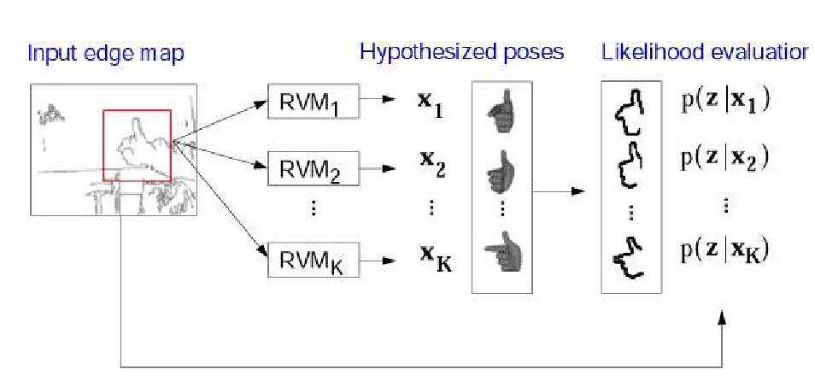
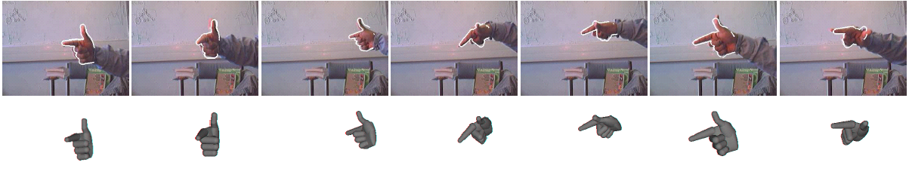
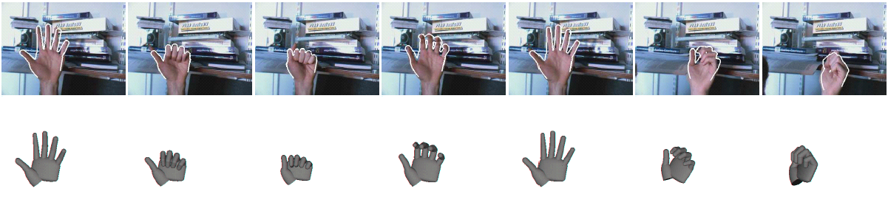
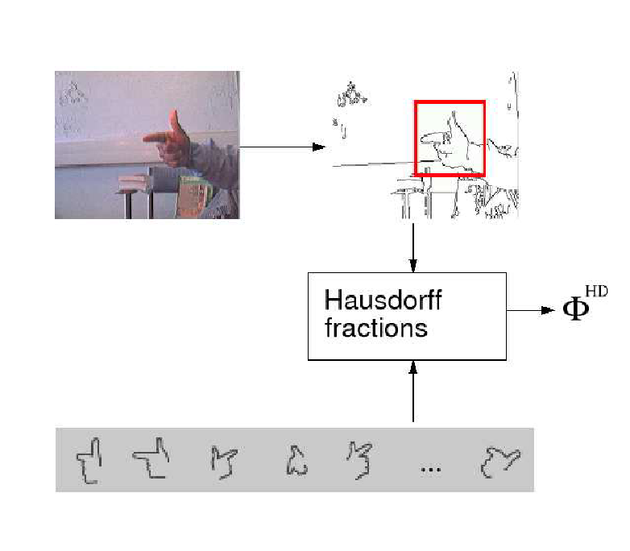
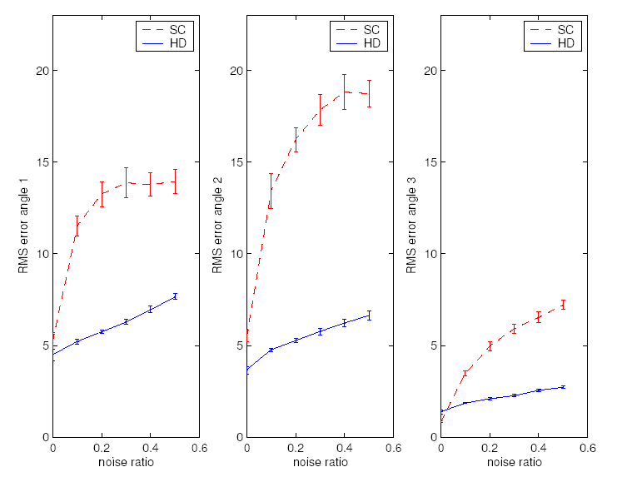
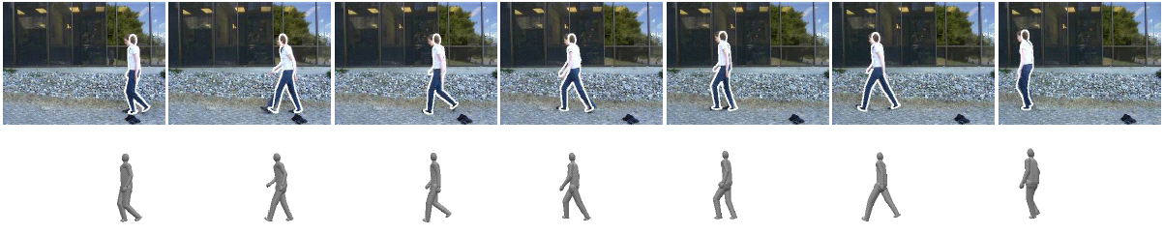
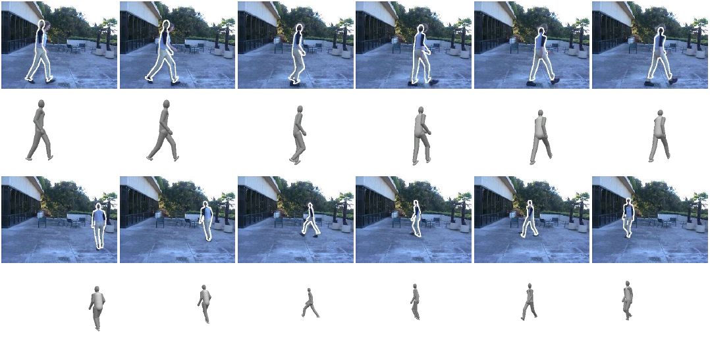
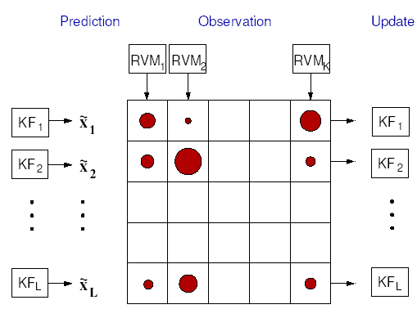
UNIVERSITY OF
CAMBRIDGE
Multivariate Relevance Vector Machines For Tracking (2)
Graz, Austria
Application to Pose Estimation
Results
MVRVM functions predict poses
Predicted poses are used to project 3D model
Likelihoods are calculated for predicted poses
State space: 4D Training samples: 5 000 MVRVMs: 10 Relevant Vectors:389
Robust Representation of Image Features
Basis functions
Hausdorff vs Shape Context
State space: 8D Training samples: 10 000 MVRVMs: 10 Relevant Vectors: 455
Basis function vector is obtained by matching templates with edges.
Error for different features: Hausdorff fractions and shape context histograms
State space: 8D Training samples:13 000 MVRVMs: 4 Relevant Vectors: 118
Tracking Framework
Posterior: piecewise Gaussian with L components
Predict each of the L components
Perform RVM regression to obtain K hypotheses
Evaluate likelihood computation for each hypothesis
Compute the posterior distribution for each of LxK components
Select L components to propagate to next time step by selecting from different modes
State space: 9D Training samples: 50 000 MVRVMs: 50 Relevant Vectors: 984

