Slide 1
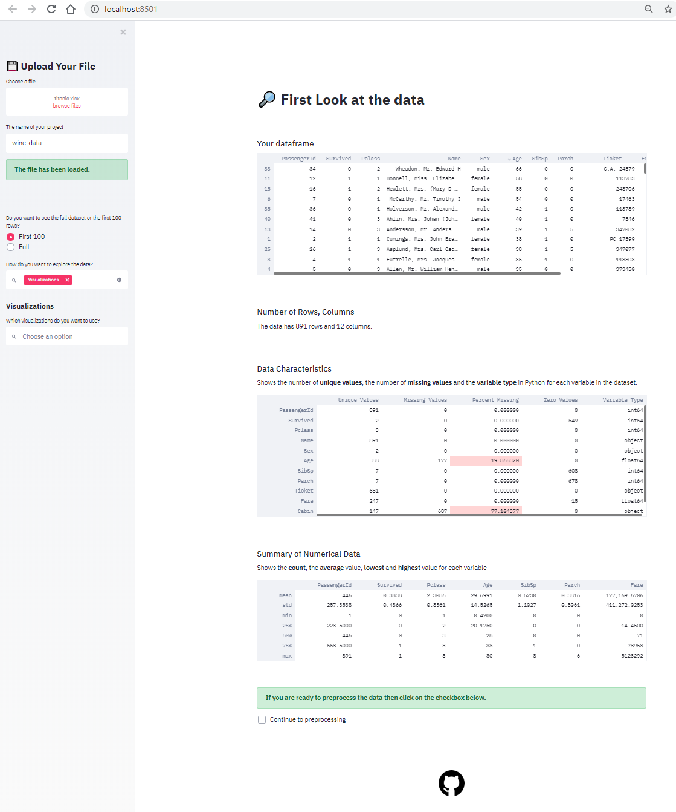

Innovation Initiative: Data Checker
A tool that provides an overview of data characteristics for any dataset
Why are we doing this?
What are the next steps & what support do we need?
Visualizing data and checking a dataset for characteristics like missing values, unique values and extreme outliers is always the first step when doing any type of data analysis. Standardizing this step ensures that this first check is done properly and efficiently, saving valuable hours on client projects and providing the same data quality check each and every time.
Finish the application for CSV/Excel files
Add extra quality checks and visualization options
Support needed
Python developers
A code reviewer
Advice on the deployment of the application
How are we going to achieve this?
By building a web application that can load any type of dataset. The dataset will be analyzed and the relevant data characteristics will be displayed. The user will have the option to visualize the data using built-in visualization options. Interactive messages will be shown to make preprocessing recommendations about for example the number of missing values.
What are the first results?
Shows data characteristics (missing values, unique values, outliers)
Built-in visualization options (boxplots, scatterplots)
Some recommendations based on data quality checks (what to do with the missing values?)
A deployable web application with a nice UI
What are the benefits?
Less time spent on data quality checks means more time spent on generating useful business insights. Furthermore, this tool with result in a consistent and complete data quality check when first receiving client data. Deloitte can quickly go back to the client with questions on the data, and even go through the data characteristics with them together.
Who to contact for more information?
Björn van Dijkman

