Slide 1
June 11th , 2020
Innovation Project – Analytics Roadmap
A&C

Slide 2

Welcome!
Objectives
Introduction to Streamlit
Björn van Dijkman
Analyst, Analytics & Cognitive
Previous Projects
Future possibilities
You?
Analytics & Cognitive

Slide 3
Pre-Streamlit
Developing data science applications required a thorough understanding of both front-end and back-end technologies
Python The language to actually build the functionalities of the tool. Also the language that most data scientists love and use.
HTML/CSS The building blocks of the web. Used to display and style the front-end of your application
Javascript (Frameworks) Used to introduce interactivity into the tool
Flask Acts as the bridge between the front-end and the back-end.

Slide 4
Post-Streamlit
Now its just Python
Python The language to actually build the functionalities of the tool. Also the language that most data scientists love and use.

Slide 5
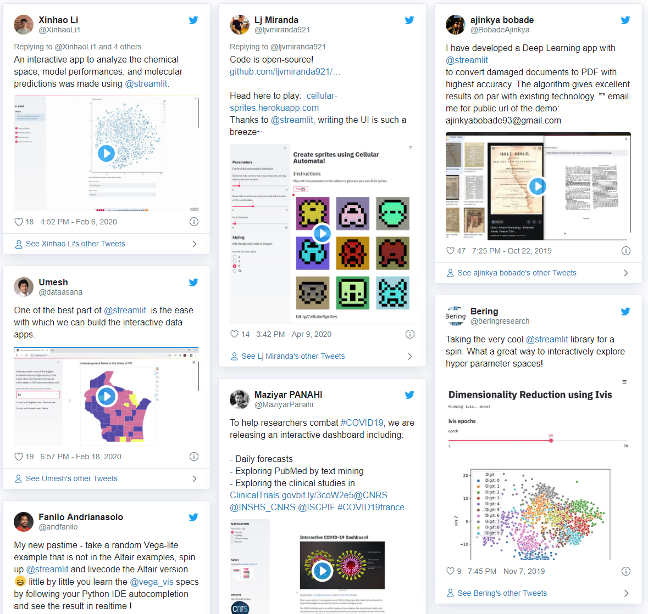
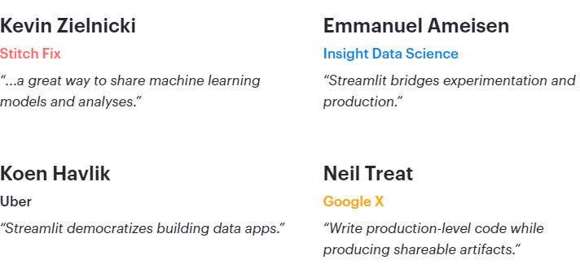
The possibilities are endless!

Slide 6
Previous projects

Slide 7
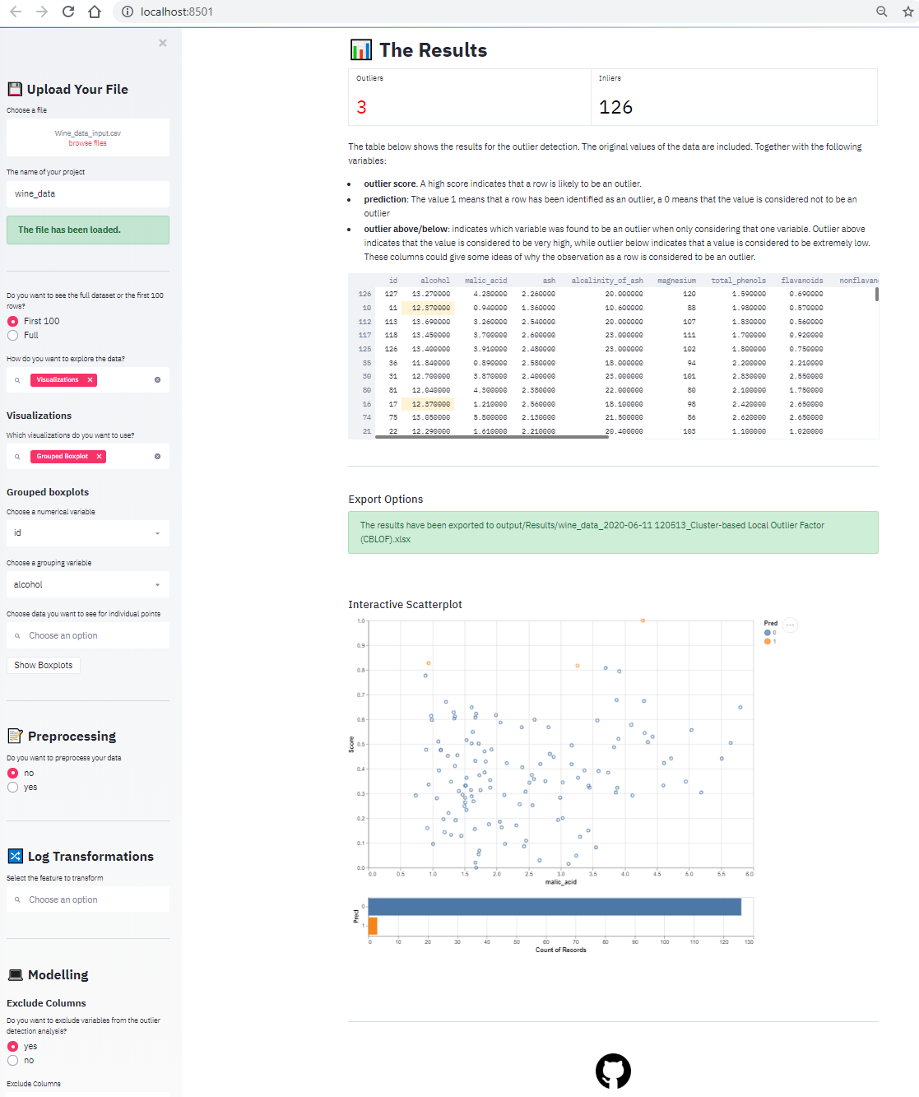
Outlier Detection Tool
Find the outliers in your dataset using machine learning.
Works with all csv/excel datasets
Shows summary statistics
Data visualization possibilities
Interactive information on dealing with missing values. Various imputation options are implemented
Logarithmically transform variables
Use any of 5 algorithms or a combination of them to identify the outliers in your dataset
Give interpretations based on univariate analysis
Demo

Slide 8
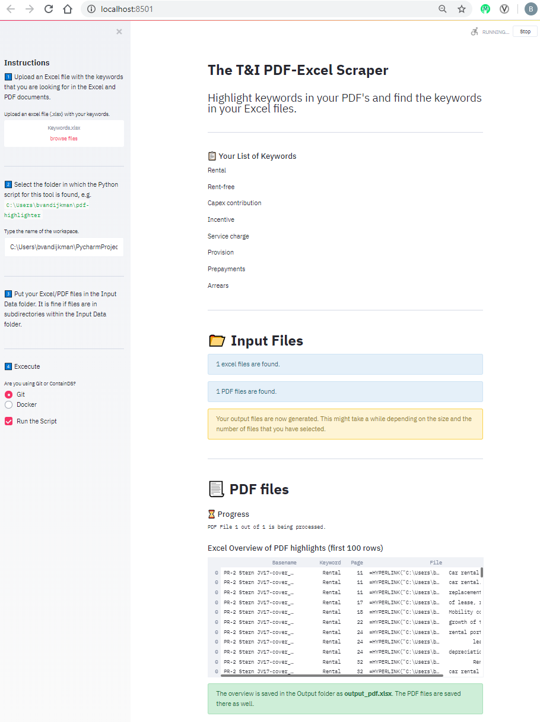
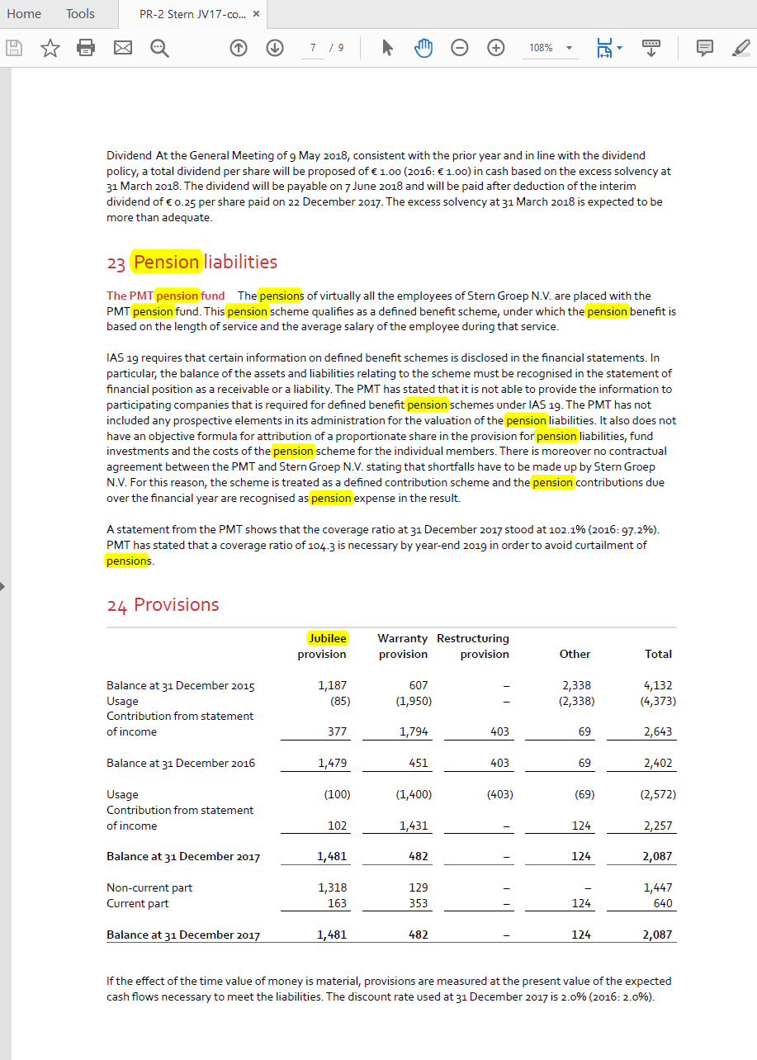
PDF-Excel scraper
Look through your PDF and Excel files for certain keywords
Upload a list of keywords
Return highlighted PDF documents, only include pages in which a keyword was found
Return an excel sheet with hyperlinks to keywords that were found in excel files

Slide 9
Analytics Roadmap – Innovation Project

Slide 10
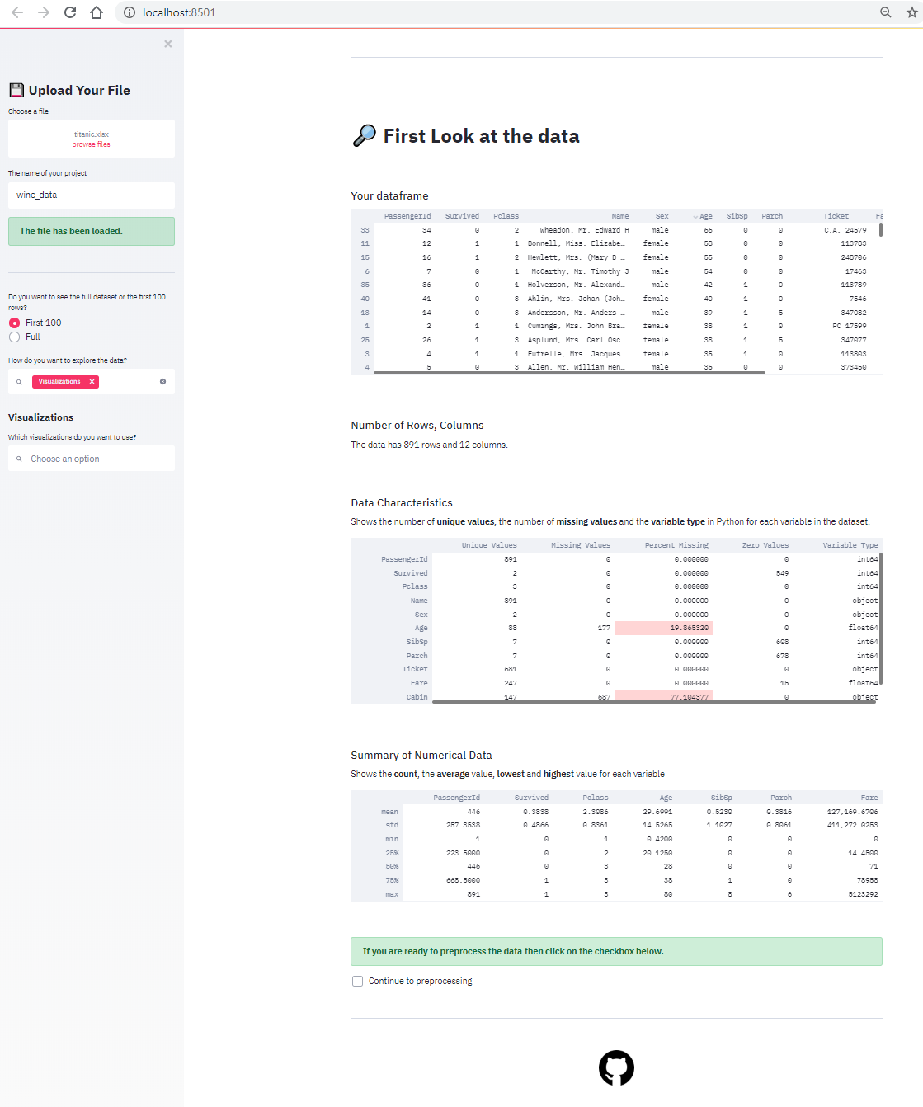
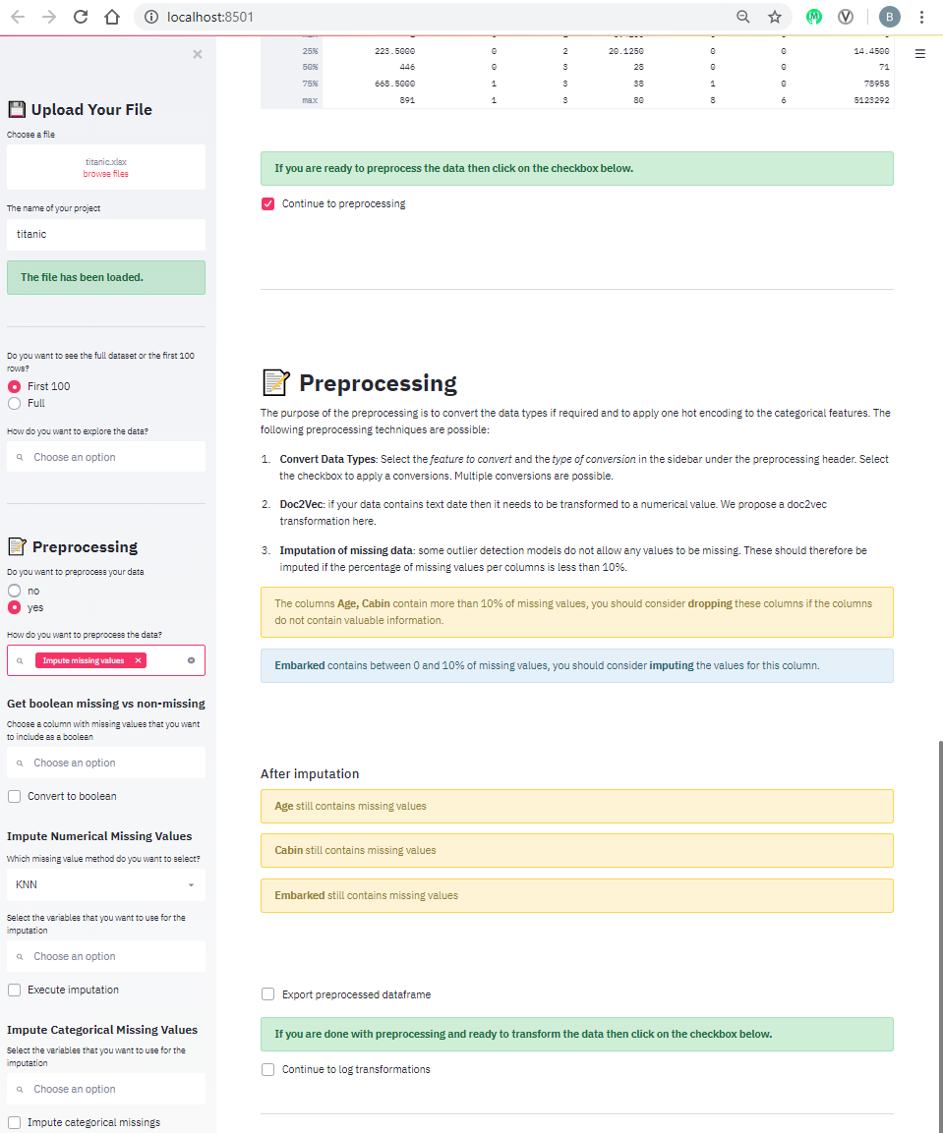
Analytics-Roadmap
Expand on the outlier detection tool and create an elaborate version of this flowchart
Explore the Data
Include visualizations (boxplots, barplots, line charts etc.)
Include suggestions for dealing with missing values,
how to deal with extreme outliers
Dealing with duplicates
when to logarithmically transform variables
when to use which algorithm.
include links to articles or Deloitte training material.

Slide 11
Project Requirements
For this project to be successful, it should …
01
04
Fill a gap It should replace a process with is done over and over again in projects.
Have commercial value Can we offer it to the client after a period of internal testing and development?
A tool like this could give the client an indication what Deloitte can do in terms of advanced analytics.
02
Be easily accessible be easily accessible for people in Deloitte. Maybe on cognitive Deloitte?
03
05
Be secure
But is cognitive Deloitte secure enough for client data?
Scalable
Be able to handle large amounts of data.

Slide 12
Where do I need help?
Deployment
Code reviewer
Python developers
Statistics guru’s
How to deploy the application within Deloitte?
Is a SQl backend necessary for scaling?
Is the code efficient?
Is it DRY?
Are Devops practices correctly implemented?
What other functionalities could we implement?
Which features are interesting for projects?
Which features would be interesting for clients?
When to treat missing values?
When to apply certain transformations?
What are good resources to point the users to?

Slide 13
Thank you

Slide 14
Questions: 1. What do you think would be useful for yourself when looking back at your projects? 2. What would have the most value for clients? 3. Do you want to help be involved?

